Slide 1
CPIT-252 Software Design Patterns
Java Collections and Generics
Last updated: 20/03/2022

Slide 2
Introduction
We often store our data in variables and create instances (objects) of our classes.
We may use simple data structures such as arrays to store our values.
We may also arrange elements in slightly more complex data structures such as multi-dimensional arrays to represent elements in rows and columns.
We may work with various type of data where these options are not appropriate solutions to our problems.

Slide 3
Introduction (cont.)
A program that looks like this may be a start, but we often deal with various types of data that need to be stored in a collection with efficient flexible operations on large amounts of data.
String username = "ali990";
Student s = new Student(2200990, "Ali", 3.90);
String[] courseTaken = new String[42];
// 2-d array initialized with values
int[][] courseYear = { { 252, 2022 }, { 405, 2022 }, { 305, 2021 } };

Slide 4
Array
An Array is a sequence of elements or values of the same type.
Each element is stored at a zero-based location called index.
The number of elements in an array is called length.
Index
0
1
2
3
4
5
Value
45
67
48
23
67
97
Length = 6
int[] arr = {45, 67, 48, 23, 67, 97};
System.out.println(arr.length);
System.out.println("Second item: " + arr[1]);
6
Second item: 67

Slide 5
Multidimensional Array
A multidimensional arrays is a collection of elements or values of the same type.
In two-dimensional arrays, elements are laid out in a rectangular grid with rows and columns.
Column
0
1
2
3
4
5
45
67
48
23
67
97
Row 0
Row 1
17
9
28
0
11
32
int[][] arr = { { 45, 67, 48, 23, 67, 97 }, { 17, 9, 28, 0, 11, 32 } };
int[][] arr2 = new int[2][6]; // 2 rows 6 columns initialized with zeros.
System.out.println(arr[0][0]); // row 0, column 0 => 45
System.out.println(arr[0][1]); // row 0, column 1 => 67

Slide 6
Limitations of arrays
The use of arrays will inevitably lead into problems due to their inherent limitations:
Arrays are fixed in size.
Arrays can not store data of various data types.
No easy duplicate removal
No default and optimized search and sort feature
As our program continues to grow and the amount of data increases, we will need bigger, more efficient and flexible data structures.
Data structure is a way to organize data in a cohesive unit that enables efficient access and modification.

Slide 7
The Java Collection Framework
The Java Collection API was introduced to solve the problem of storing various types of data inside container data structures with an efficient and flexible access.
We will look at the available data structures in the Java collection framework: Set, List, Queue, Deque, and Map. Finally, we will see how generics make collections powerful.

Slide 8
Collections
Collections are fundamental data structures for storing and accessing data.
A collection is an object that represent and manipulate a group of objects called elements.
Some collections allow duplicate elements and others do not. Some are ordered and others are unordered.
Learning how to use collections will help improve the efficiency and performance of your program as well as increase your productivity since you do not need to implement these powerful data structures and reinvent the wheel.

Slide 9
The Java Collection Framework
The Java Collection Framework is a unified library of classes and interfaces for working with collection objects.
It provides methods for adding, removing and searching for a particular element within a collection of elements.
The collection framework defines a handful of interfaces in the java.util package.
These interfaces are divided into two groups:
java.util.Collection: used for containers that hold elements.
java.util.Map: used for key/value pairs.

Slide 10
Part 1: java.util.Collection interface
The Collection interface is used for containers that hold elements.

Slide 11
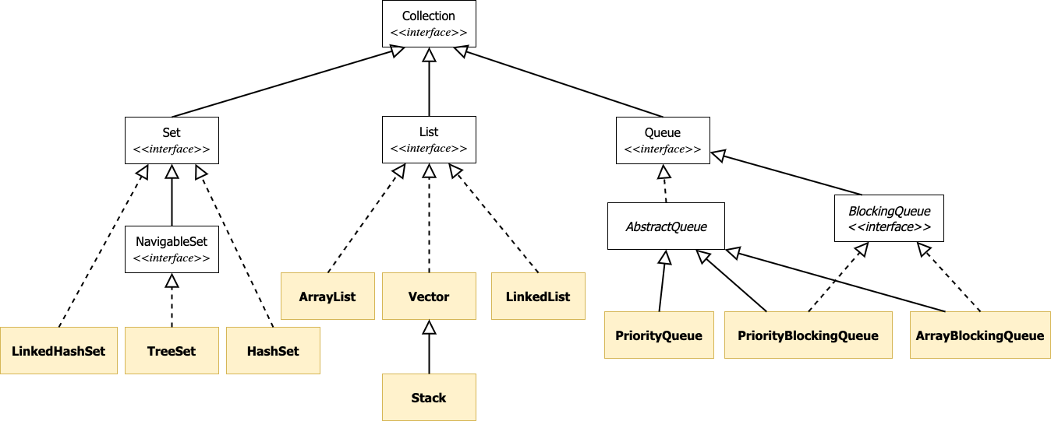
The Collection interface* (I)
* Not the complete list of classes and interfaces.

Slide 12
The Collection interface (II)
The Java collection framework uses three main interfaces: Set, List, and Queue.
Each interface is implemented by concrete classes in multiple ways:
HashSet, TreeSet and LinkedHashSet implement Set
ArrayList and LinkedList implement List
LinkedList , ArrayDeque implement Queue

Slide 13
The Collection interface (III)
It defines common operations to all collections and describes what it does but not how it does it. Examples:
Add an element to the collection:
public boolean add(element)
Remove an element from a collection:
public boolean remove(element)
Check if an element is in the collection:
public boolean contains(element)
Iterate or loop through all elements using an Iterator object
public Iterator iterator()
Get the size of the collection:
public int size()

Slide 14
Constructing a Collection (I)
Interface<Type> name = new Class<Type>();
The type of the collection’s elements is specified between < and >.
The type must be a class type (e.g., Integer, String, etc.) and can’t be a primitive data type (e.g. int, boolean, etc.)
This is called a Generic class, which allows a collection to store elements of different types. Examples:
Set<String> mySet = new HashSet<String>();
List<Integer> myList = new ArrayList<Integer>();
Queue<Student> myQueue = new LinkedList<Student>();

Slide 15
Constructing a Collection (II)
The Java Collections framework makes heavy use of interfaces to describe abstract data types:
Set, List, Queue, Deque and Map
We declare variables using interface types with elements of object data types.
Why interfaces? Because we can use a different implementation later without requiring significant changes to existing code. This means that we can add, change and remove elements in the same way.
List<Integer> myList = new ArrayList<Integer>();
myList = new LinkedList<Integer>();

Slide 16
Autoboxing and Unboxing
Unlike arrays, collections can not store primitives directly and only store objects.
The Java compiler will convert primitives into their corresponding objects through auto-boxing and back to primitives through unboxing.
List<Integer> myList = new ArrayList<Integer>();
myList.add(23); // autoboxing (int -> Integer)
int a = myList.get(0); // unboxing (Integer -> int)

Slide 17
Collections
We will look at the following data structures in the Java collection framework:
Set:
HashSet
TreeSet
LinkedHashSet
List:
ArrayList
LinkedList
Vector
Stack
Queue
Deque

Slide 18
Set (I)
A Set contains an unordered collection of unique elements.
It models the mathematical set model where duplicate elements are not allowed.
A Set has no notion of position of stored elements within the collection.
If you try to add an element that already exists in a Set, the add() method will return false.

Slide 19
Set (II)
The Set interface has three concrete implementations:
The HashSet class implements the Set interface and stores elements in a hash table.
Best for performance but order of elements is not guaranteed.
The TreeSet class implements the Set interface and stores an ordered set of elements in a TreeMap data structure.
Slower than a HashSet but it orders its elements based on their values and can find the closest match for a target, greater than or lesser than a given search target.
The LinkedHashSet class implements the Set interface and stores elements in a hash table with a linked list running through it
It orders its elements based on the insertion-order.

Slide 20
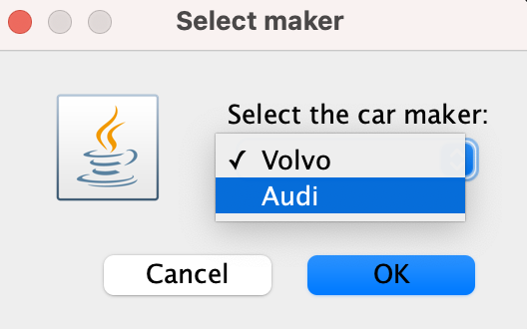
Set Example:
public static void main(String[] args) {
Set<String> mySet = new HashSet<>();
mySet.add("Audi");
mySet.add("Volvo");
mySet.add("Audi");
System.out.println(mySet);
// show the set in a dropdown menu
JOptionPane.showInputDialog(null,
"Select the car maker:","Select maker",
JOptionPane.QUESTION_MESSAGE,null,
mySet.toArray(), null);
}
Output:
[Volvo, Audi]
Demo

Slide 21
List (I)
A List is an ordered sequence of elements.
Unlike a Set, a List may contain duplicate elements.
It is like an array but with a variable length and methods for manipulating the position of elements in the list.
Unlike arrays, a list is a collection, so we can not store primitives directly and only store objects.
The Java compiler will convert primitives into their corresponding objects through auto-boxing.

Slide 22
List (II)
In Java, the List interface has a handful concrete implementations:
ArrayList class implements the List interface using a resizable/growable array.
It’s often faster for adding/removing at the end and better-performing implementation in most scenarios.
LinkedList class implements the List interface using a doubly LinkedList.
It’s often faster for adding/removing at the beginning and middle and has better-performing implementation in certain scenarios.

Slide 23
List (III)
Vector class implements the List interface using a resizable or growable array.
Both the Vector class and the ArrayList class are almost equivalent. The main difference is that access to a Vector is synchronized (thread-safe) whereas it is not synchronized for an ArrayList.
If a thread-safe implementation is not needed, it is recommended to use ArrayList in place of Vector.
You may also use the Collections.synchronizedList function with an ArrayList to create a synchronized list and get the equivalent of a Vector.

Slide 24
More on List Implementations: ArrayList
ArrayList is built using an internal uninitialized array and a size field to keep track of its capacity.
If an element is added, it first verifies whether it has enough capacity in the array to store new element or not. If there’s enough capacity, the array is increased by 50% to create a larger array and copy the original array into it.
The initial capacity can be defined upon creating the ArrayList:
List<Student> myList = new ArrayList<Student>(20);
Index
0
1
2
3
4
5
Value
obj1
obj2
0
0
0
0
Size = 2

Slide 25
More on List Implementations: LinkedList
LinkedList is built using a doubly LinkedList where small node objects keep links to the next and previous node objects.
These node objects form a chain with pointers to the next and previous node elements.
next
next
next
element
element
element
element
null
null
prev
prev
prev
Size = 4
0
1
2
3

Slide 26
More on List Implementations: Vector
Vector is quite similar to the ArrayList’s implementation, which implements a growable array of objects with a size field to keep track of its capacity, but with additional thread-safety and synchronized implementation.
If there’s enough capacity, the array is increased by 100% to create a larger array and copy the original array into it.
Vector is a legacy class since JDK 1.0 and is considered slower due to synchronization.
The initial capacity can be optionally set upon creating the Vector:
List<String> myList = new Vector<String>(20);
Index
0
1
2
3
4
5
Value
obj1
obj2
0
0
0
0
Size = 2

Slide 27
List Methods
Method
public boolean add(E element) | Adds the specified element to the end of the list
public void add(int index, E element) | Adds the specified element at the given position.
public void remove(int index ) | Removes the element at the specified position
public E get(int index) | Returns the element at the given position
public E set(int index , E element) | Changes the element at the given position
public void clear() | Removes all elements from the list.
public Iterator<E> iterator() | Returns an object used to iterate through the elements of the list.
// Note: E is the parameterized element type that is specified when creating the List. For example, below are examples where E is of a String class type and an Integer class type:
List<String> myStringList = new ArrayList<String>();
List<Integer> myIntegerList = new ArrayList<Integer>();

Slide 28
List Example: ArrayList implementation
List<String> myList = new ArrayList<String>();
myList.add("Ahmed");
myList.add("Ali");
myList.add("Abdullah");
System.out.println(String.format("Content: %s, Size: %d", myList, myList.size()));
myList.add(1,"Khalid");
System.out.println(String.format("Content: %s, Size: %d", myList, myList.size()));
Content: [Ahmed, Ali, Abdullah], Size: 3
Content: [Ahmed, Khalid, Ali, Abdullah], Size: 4
Demo

Slide 29
List Example: LinkedList implementation
List<String> myList = new LinkedList<>();
myList.add("Ahmed");
myList.add("Ali");
myList.add("Abdullah");
System.out.println(String.format("Content: %s, Size: %d", myList, myList.size()));
myList.add(1,"Khalid");
myList.remove("Abdullah");
System.out.println(String.format("Content: %s, Size: %d", myList, myList.size()));
Content: [Ahmed, Ali, Abdullah], Size: 3
Content: [Ahmed, Khalid, Ali], Size: 3
Demo

Slide 30
List Example: Vector implementation
List<String> myList = new Vector<>();
myList.add("Ahmed");
myList.add("Ali");
myList.add("Abdullah");
System.out.println(String.format("Content: %s, Size: %d", myList, myList.size()));
myList.add(1,"Khalid");
myList.remove("Abdullah");
System.out.println(String.format("Content: %s, Size: %d", myList, myList.size()));
Content: [Ahmed, Ali, Abdullah], Size: 3
Content: [Ahmed, Khalid, Ali], Size: 3
Demo

Slide 31
Stack (I)
The Stack class extends the Vector class to represent a last-in-first-out (LIFO) stack of objects with five operations: push(E item), pop(), peek(), search(Object o) and empty().
It retrieves elements in the reverse order they were added in.
The Stack class does not provide a complete and consistent set of LIFO stack operations.
It’s a less powerful as a collection implementation but is optimized to perform LIFO operations very quickly.
Stacks are often implemented using an array
The Deque interface and its implementations are preferred over the Stack class (seen later).

Slide 32
Stack Example (I)
Recall that the Java compiler will convert primitives into their corresponding objects through auto-boxing and back to primitives through unboxing.
Stack<Integer> myStack = new Stack<Integer>();
myStack.push(20); // autoboxing (int -> Integer)
myStack.push(40);
myStack.push(60);
int a = myStack.pop(); // unboxing (Integer -> int)
System.out.println(a);
System.out.println(myStack);
60
[20, 40]
Demo

Slide 33
More Stack Applications
Push
Pop
Examples of First-In-First-Out (FILO) applications:
The “Undo” operation in a text editor.
The “Back” button to return to previous browsing history.
First-In-Last-Out
Last-In-First-Out
"https://www.apple.com/watch/"
"https://www.apple.com/mac/"
"https://www.apple.com/ipad/"
"https://www.apple.com/iphone/"
"https://apple.com"

Slide 34
Stack Example: Browsing History
Stack<String> history = new Stack<String>();
history.push("https://apple.com");
history.push("https://www.apple.com/iphone/");
history.push("https://www.apple.com/ipad/");
history.push("https://www.apple.com/mac/");
history.push("https://www.apple.com/watch/");
while(!history.empty()){
System.out.println(history.pop());
}
https://www.apple.com/watch/
https://www.apple.com/mac/
https://www.apple.com/ipad/
https://www.apple.com/iphone/
https://apple.com
Demo

Slide 35
Queue
A Queue typically, but not always, retrieves elements in a FIFO (first-in-first-out) order.
There are special queue implementations such as a priority queue where elements are ordered according to their natural ordering or a Comparator method.
A queue may be bounded or unbounded.
A bounded queue implementation uses a fixed-sized array to hold the elements, where capacity can’t be changed.
There are many concrete implementations of the Queue interface:
LinkedList
PriorityQueue
SynchronousQueue
ArrayBlockingQueue
ConcurrentLinkedQueue
DelayQueue

Slide 36
Queue Example
Queue<Integer> ordersQueue = new LinkedList();
ordersQueue.add(3);
ordersQueue.add(1);
ordersQueue.add(5);
while(!ordersQueue.isEmpty()){
System.out.println(ordersQueue.remove());
}
3
1
5
Demo

Slide 37
Deque
A Deque is a queue that supports element insertion and removal at both ends.
The name deque is short for "double ended queue" and is pronounced "deck".
Most Deque implementations, but not always, are unbounded with no fixed limits on the number of elements they may contain
There are many concrete implementations of the Queue interface:
ArrayDeque
LinkedList
LinkedBlockingDeque
ConcurrentLinkedDeque

Slide 38
Deque Example
Deque<Integer> ordersDeque = new ArrayDeque();
ordersDeque.add(3);
ordersDeque.add(1);
ordersDeque.add(5);
ordersDeque.addFirst(0);
ordersDeque.addLast(7);
while(!ordersDeque.isEmpty()){
System.out.println(ordersDeque.remove());
}
0
3
1
5
7
Demo

Slide 39
Part 2: java.util.Map interface
The Map interface is used for storing key/value pairs.

Slide 40
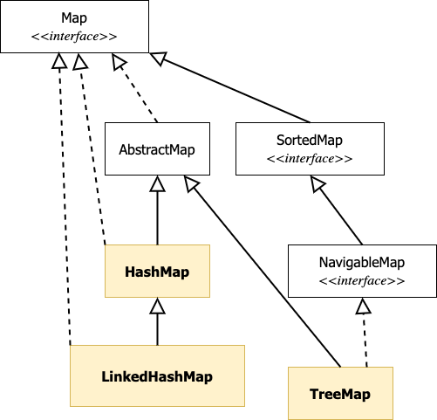
The Map interface*
* Not the complete list of classes and interfaces.

Slide 41
Map (I)
A Map can be thought of as an array with an index that does not have to be an int. It’s also known as “dictionary” or “associative array.”
A Map stores key-value pairs acting like a cache or a minimalist database.
Maps cannot contain duplicate keys; each key is unique and maps to a single value.
“Huda”
“Ali”
“Badr”
“Sarah”
4.3
3.4
4.1
4.6
Key
Huda
Ali
Sarah
Badr
4.1
3.4
4.6
4.3
Value
Size = 4
Keys
Values

Slide 42
Map (II)
With generics, a Map type is parameterized with two types: one for the keys and one for the values.
A Map has the following basic operations:
put(key, value): Creates a mapping from the key to the specified value.
get(key): Returns the value by the given key.
remove(key): Removes the mapping for the given key.
Map<String, Date> m = new HashMap<String, Date>();
m.put("request-2345-ghy", new Date());

Slide 43
Map (III)
The Map interface has three concrete class implementations (analogous to the Set Interface):
HashMap stores an unordered set of key-value pairs in a hash table.
HashMap does not maintain order but is considered faster and with O(1) for the basic get() and put() operations.
TreeMap stores an ordered set of key-value pairs (according to the natural ordering of its keys) in a TreeMap data structure.
LinkedHashMap stores an ordered set of key-value pairs (according the insertion order) in a hash table with a doubly-linked list running through it.

Slide 44
Map Methods
Method
public <V> put(K key, V value) | Adds a mapping from the given key to the given value.
public <V> get(Object key) | Returns the value mapped to the given key or null if not found.
public boolean containsKey(K key) | Returns true if there's a mapping for the specified key.
public <V> remove(Object key) | Removes the mapping for a key if it exists
Set<K> keySet() | Returns the unique set of keys in the map.
Collection<V> values() | Returns the values contained in the map.
public void clear() | Removes all key/value pairs from the map.
// Note: K and V are the parameterized element type that are specified when creating the Map. For example, below are examples where K is of a String class type and V is an Integer class type:
Map<String, Integer> myMap = new HashMap<String, Integer>();

Slide 45
Map Example
Map<String, Integer> vehicles = new HashMap<String, Integer> ();
vehicles.put("BMW", 5);
vehicles.put("Audi", 4);
vehicles.put("Ford", 10);
for(String v: vehicles.keySet()){
System.out.println(String.format("We have %d %s vehicles", vehicles.get(v), v));
}
We have 4 Audi vehicles
We have 10 Ford vehicles
We have 5 BMW vehicles
Demo

Slide 46
One more thing on Maps: Maps vs. Sets
A Set contains a unique elements of values and it is more like a map from elements to boolean values (true). While a Map, is a map from unique set of keys to values.
Set: Is “Toyota” in the set? (true or false)
Map: How many “Toyota” cars do we have? (mapping a key to a key)
Toyota
BMW
Ford
Honda
Size = 4
Key
Toyota
BMW
Ford
Honda
26
7
19
13
Value
Size = 4

Slide 47
Part 3: Generics
Work with a general data type

Slide 48
Let’s answer the following questions:
How do we store data without casting
Any takers?

Slide 49
Generics: Introduction (I)
In OOP, polymorphism means that objects can take many forms and are mostly interchangeable.
Polymorphism occurs when a parent class reference is used to refer to a child class object.
Example: If Truck is a subtype of Vehicle, then we can use an object of type Truck anywhere that we expect something of type Vehicle.
public interface Vehicle{}
public class Truck extends Vehicle{}
Vehicle v = new Truck();

Slide 50
Generics: Introduction (II)
Generics enable creating classes and methods that work with any object data types.
Generics are also known as “parameterized types” or “templates”.
With Generics, we can write a function that handles parameters of different data types without depending on their actual data types.
Such a function is called generic function, or it takes a generic data type.
Generics allow us to write general or flexible code without sacrificing the static type safety.
Generics are heavily used in Java Collections.
Java Collections and Maps can hold just about any object type without the need to do data type casting to convert one type into another.

Slide 51
Problems without Generics?
In Java, an object is a child of the general type java.lang.Object.
If the ArrayList takes a java.lang.Object, it can accept any object, which is error-prone, and the return value must be casted/converted, which can also lead to run-time errors and unexpected behavior.
ArrayList myList = new ArrayList();
myList.add("BMW");
myList.add(90); // This is bad, but compiler will allow it (with a warning)!
myList.add("Audi");
String bmw = (String) myList.get(0); // We must cast from Object to String
int quantity = (Integer) myList.get(1); // We must cast from Object to Integer
System.out.println(bmw); // prints BMW
System.out.println(quantity); //prints 90

Slide 52
Can we do better without Generics? (I)
Is there a way to make an ArrayList that only accepts String into the list? Can we get rid of the casting? Can we do better?
What if we override the add() method in a subclass that only accept String objects?
Unfortunately, doing so will not override anything!! Instead, it will create another overloaded method. We can add any non-String data type to our list.
public void add( Object o ) { ... } // still here
public void add( String s ) { ... } // overloaded method

Slide 53
Can we do better without Generics? (II)
What if we take a bigger approach and write our own StringList class that does not extend ArrayList but delegates to it.
Unfortunately, doing so will make our new StringList class not a List, so it will not work with any Java Collection methods (e.g., sort(), addAll())
class StringList{
ArrayList l;
public StringList(ArrayList l){
this.l = l;
}
public boolean add(String item){
return l.add(item);
}
}

Slide 54
Generics in Action
The class java.util.List is a generic class and is declared as:
The identifier E between the angle brackets (<>) is a type parameter.
It indicates the class List is generic and requires a data type as an argument.
The letter E is chosen as a naming convention, but it can be anything else.
Example: Declaring a variable using the generic type List with a type parameter of String:
class List<E>{
public void add(E element){ //TODO: Add to the list }
public E get(int i) { //TODO: Get from the list }
}
List<String> myList;

Slide 55
How do generics solve these problems?
If the ArrayList was made generics, then it would take only the parameterized element type and threw a compile time error in any other case (type-safety) and no need for casting (flexibility).
ArrayList<String> myList = new ArrayList<String>();
myList.add("BMW");
// myList.add(90); This is wrong and will result in compiler time error
myList.add("Audi");
String bmw = myList.get(0); // Casting is not needed
System.out.println(bmw); // prints BMW

Slide 56
Generics: Conclusion
Generics enable classes and interfaces to be used as parameter types when defining classes, interfaces and methods.
Type parameters allow us to re-use the same classes with different data types.
Generics allow stronger type-safety at compile time.
Recall that fixing compile-time errors is much easier than fixing runtime errors.
Generics eliminate the need for casting/type conversion.
Generics enable us to work on collections of different types.

Slide 57
Wrapping up
Collections and generics are powerful abstractions in the Java programming language.
Collections allow for flexible and efficient containers that hold other objects.
The java.util.Collection interface has three main child interfaces:
Set: A collection of unique elements
List: A collection of elements with a specific order.
Queue: A collection of elements retrieved in specific fashion (e.g., first-in-first-out or based a specific priority value).
The java.util.Stack interface A collection of elements retrieved in specific manner (first-in-last-out).
The java.util.Map interface represents a collection of key/value pairs.

