Slide 1
Creational Design Patterns
Software Design Patterns
CPIT-251

Slide 2
Creational Design Patterns
Deals with objects creation mechanisms
Depends on object composition than class inheritance
Encapsulate concrete classes the system uses
Hide how instances of these classes are created and combined
System knows about the interfaces
Flexibility in what gets created, who creates it, how it gets created, and when

Slide 3
Creational Design Patterns
Singleton
Prototype
Builder
Factory Method
Abstract Factory

Slide 4
Singleton Design Pattern
Intent
Ensure a class has only one instance
It provides a global point to access it
Motivation
Some classes must have one instance: printer spooler (manages jobs that send to the printer), accounting system server for one company
Classes can be responsible for tracking the number of instances it created

Slide 5
Singleton Design Pattern
Singleton
-instance: Singleton
-Singleton()
+getInstance(): Singleton

Slide 6
Singleton Design Pattern
public class Singleton {
private static Singleton instance = null;
private Singleton() { }
public static Singleton getInstance()
{
if(instance == null)
{
instance = new Singleton();
}
return instance;
}
}
To keep track if instance was created
Created to keep users from instantiation
Only Singleton will be able to instantiate this class
The only way to create instance by calling this method
Lazy instantiation
Static Variable: assigned the same value for all created instances (object) of this class
Static method: belonged to the class and can be called without create instance of the class

Slide 7
Singleton Design Pattern
public class SingletonTest {
public static void main(String[] args) {
Singleton newInstance = Singleton.getInstance();
newInstance.MethodName();
}
}
How you create a new instance of Singleton

Slide 8
Prototype Design Pattern
Intent
Create new objects by copying/Cloning other objects called prototype.

Slide 9
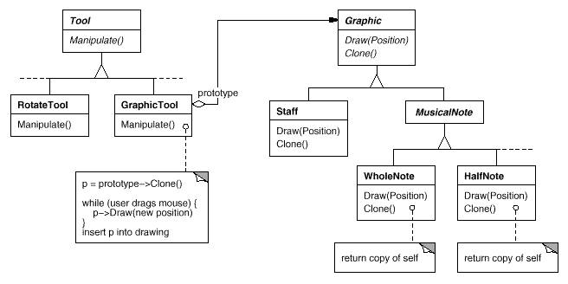
Prototype Design Pattern
Motivation

Slide 10
Prototype Design Pattern
Applicability
When the system should be independent of how its products created
When classes to instantiate are specified at run-time
Avoid building a class hierarchy that is parallel to an existing one

Slide 11
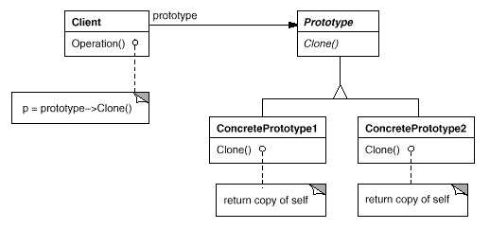
Prototype Design Pattern

Slide 12
Prototype Design Pattern
Animal is the Prototype class in previous slide
<<interface>> Animal
Client
Operation()
makeCopy()
Sheep
Cow
makeCopy()
makeClone()

Slide 13
Prototype Design Pattern
getClone() -> makeCopy()
Client
CloneFactory
Operation()
getClone()
Animal is equivalent to Prototype class in previous slide
<<interface>> Animal
makeCopy()
Sheep
Cow
makeCopy()
makeClone()

Slide 14
Prototype Design Pattern
Create a Cloneable interface
To tell Java compiler it is okay to copy instance of this class
public interface Animal extends Cloneable{
public Animal makeCopy();
}
Animal class serves as a prototype class

Slide 15
Prototype Design Pattern
Concrete Class
public class Sheep implements Animal {
public Sheep() {
System.out.println("Sheep is Made”); }
@Override
public Animal makeCopy() {
System.out.println("Sheep is Being Made");
Sheep sheepObject = null;
try {
sheepObject = (Sheep) super.clone();
} catch (CloneNotSupportedException e) {
e.printStackTrace();
}
return sheepObject;}
public String toString(){
return "Dolly is my Hero, Baaaaa”;}
}
Constructor
Override makeCopy() method
Call clone() from the super class Animal and cast it to Sheep type
Add catch-block in case animal was not cloneable

Slide 16
Prototype Design Pattern
- Receives any Animal, or Animal subclass and
- Makes a copy of it and stores it in its own location in memory
- CloneFactory has no idea what these objects are except that they are subclasses of Animal
public class CloneFactory {
public Animal getClone(Animal animalSample) {
return animalSample.makeCopy();
}
}
- Because of Polymorphism , the animalSample makeCopy()
is called here instead of Animals
- If animalSample is Sheep, then makeCopy() of Sheep is called

Slide 17
Prototype Design Pattern
public class Client {
public static void main(String[] args) {
CloneFactory animalMaker = new CloneFactory()
Sheep sally= new Sheep();
Sheep clonedSheep = (Sheep) animalMaker.getClone(sally);
System.out.println(sally);
System.out.println(clonedSheep);
System.out.println(”Sally HashCode: " +
System.identityHashCode(System.identityHashCode(sheep1)));
System.out.println("Cloneed Sheep HashCode: " +
System.identityHashCode(System.identityHashCode(clonedSheep1)));
}
}
Creates a clone of sheep1 and stores it in its own location

Slide 18
Prototype Design Pattern
Consequences
Hide the concrete classes from the client
Reduce subclassing
Adding and removing products at run-time by allowing the clients to instantiate a new instance
Adding new objects by instantiate existing classes and register these instances as prototypes of client objects
It can be used to structure complex objects created by simple objects (parts). Parts can be prototypes that can be cloned to create the complex object

Slide 19
Builder Design Pattern
Intent
Create objects by combing other objects
Separate the construction of complex object from its representation
Creation of object independent for other objects

Slide 20
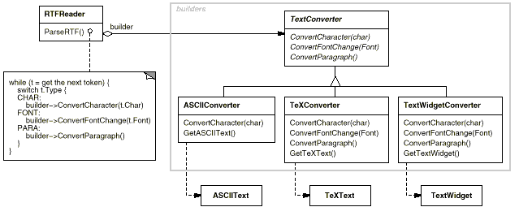
Builder Design Pattern
Motivation

Slide 21
Builder Design Pattern
Applicability
When you want the creation of parts object to be independent of the main object
The construction process must allow different representation for the objects that’s constructed

Slide 22
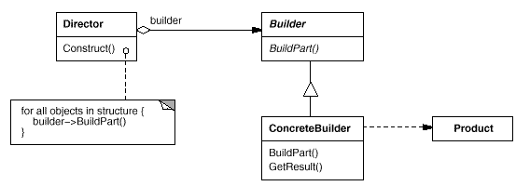
Builder Design Pattern

Slide 23
Builder Design Pattern
Client has a reference to RobotEngineer using object of RobotBuilder or one of its subclasses
makeRobot() -> buidlRobot()
Client
RobotEngineer
Director
Operation()
makeRobot()
Call makeRobot()
<<interface>> RobotBuilder
buildRobot()
Robot
OldStypeRobot
NewStyleRobot
setRobot()
buildRobot()
buildRobot()
buildRobot() -> setRobot()

Slide 24
public class Robot {
private String robotHead;
private String robotTorso;
private String robotArms;
private String robotLegs;
public Robot() { }
public void setRobotHead(String head) { robotHead = head;}
public void setRobotTorso(String torso) {robotTorso = torso;}
public void setRobotArms(String arms) {robotArms = arms;}
public void setRobotLegs(String legs) { robotLegs = legs; }
public String getRobortHead() {return robotHead;}
public String getRobortTorso() {return robotTorso;}
public String getRobortArms() {return robotArms;}
public String getRobortLegs() {return robotLegs;}
}
This is the create the product (Robot)

Slide 25
Builder Design Pattern
Defines the methods needed for creating/building robot parts
public interface RobotBuilder {
public void buildRobotHead();
public void buildRobotTorso();
public void buildRobotArms();
public void buildRobotLegs();
public Robot getRobot();
}

Slide 26
public class OldRobotBuilder implements RobotBuilder {
private Robot robot;
public OldRobotBuilder() {this.robot = new Robot(); };
@Override
public void buildRobotHead() {robot.setRobotHead("Tin Head");}
@Override
public void buildRobotTorso() {robot.setRobotTorso("Tin Torso");}
@Override
public void buildRobotArms() {robot.setRobotArms("Blowtorch Arms");}
@Override
public void buildRobotLegs() {robot.setRobotLegs("Rollar Skates");}
@Override
public Robot getRobot() {return this.robot;}
}
The concrete class that implement the builder interface that assembles the parts
of the finished Robot objects

Slide 27
The director / engineer class creates a Robot using the builder interface that is defined (OldRobotBuilder)
public class RobotEngineer {
private RobotBuilder robotmaker ;
public RobotEngineer(RobotBuilder robotmaker){
this.robotmaker = robotmaker;
}
public Robot getRobot()
{
return this.robotmaker.getRobot();
}
public void makeRobot()
{
this.robotmaker.buildRobotArms();
this.robotmaker.buildRobotHead();
this.robotmaker.buildRobotLegs();
this.robotmaker.buildRobotTorso();
}
}
Reference to RobotBuilder
Return robot created by the Builder
Create Robot using the builder

Slide 28
public class Client {
public static void main(String[ ] args) {
RobotBuilder oldStyle = new OldRobotBuilder();
RobotEngineer robotEng = new RobotEngineer(oldStyle);
robotEng.makeRobot();
Robot firstRobot = robotEng.getRobot();
System.out.println("Robot Built");
System.out.println("Robot Head Type: " + firstRobot.getRobortHead());
System.out.println("Robot Torso Type: " + firstRobot.getRobortTorso());
System.out.println("Robot Arm Type: " + firstRobot.getRobortArms());
System.out.println("Robot Leg Type: " + firstRobot.getRobortLegs());
}
}
Reference to builder concrete class
Reference to RobotEngineer using the builder concrete class (OldRobotBuilder)
makeRebot of an OldRobotBuilder

Slide 29
Builder Design Pattern
Consequences
Builder object provides an interfaces for construction the products, thus hide the representation and internal structure of the product
Builder improved modularity by encapsulating the way the complex object is constructed.
Easily extended by adding more builder subclasses
Builder patterns create products step by step, thus builder interface reflects the process of constructing the product more than any other creational patterns

Slide 30
Factory Method Design Pattern
Intent
Define an interface for creating an object, but let subclasses decide which class to instantiate
Factory Method lets a class defer instantiation to subclasses

Slide 31
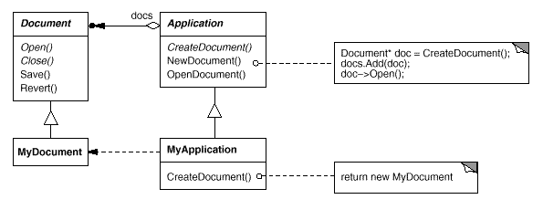
Factory Method Design Pattern
Motivation

Slide 32
Factory Method Design Pattern
Applicability
A class can't anticipate the class of objects it must create
A class wants its subclasses to specify the objects it creates.
L

Slide 33
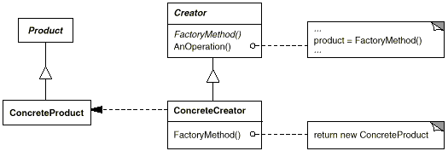
Factory Method Design Pattern
Structure

Slide 34
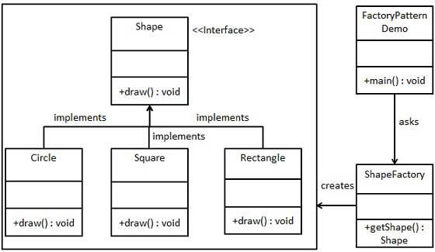
Factory Method Design Pattern

Slide 35
Factory Method Design Pattern
public interface Shape {
void draw();
}
public class Rectangle implements Shape {
@Override
public void draw() {
System.out.println("Inside Rectangle::draw() method.");
}
}

Slide 36
Factory Method Design Pattern
public class Square implements Shape {
@Override
public void draw() {
System.out.println("Inside Square::draw() method.");
}
}
public class Circle implements Shape {
@Override
public void draw() {
System.out.println("Inside Circle::draw() method.");
}
}

Slide 37
Factory Method Design Pattern
public class ShapeFactory {
public Shape getShape(String shapeType){
if(shapeType == null){
return null; }
if(shapeType.equalsIgnoreCase("CIRCLE")){
return new Circle();
} else if(shapeType.equalsIgnoreCase("RECTANGLE")){
return new Rectangle();
} else if(shapeType.equalsIgnoreCase("SQUARE")){
return new Square();
}
return null;
}
}
use getShape method to get object of type shape

Slide 38
Factory Method Design Pattern
public class FactoryPatternDemo {
public static void main(String[] args) {
ShapeFactory shapeFactory = new ShapeFactory();
Shape shape1 = shapeFactory.getShape("CIRCLE");
shape1.draw();
Shape shape2 = shapeFactory.getShape("RECTANGLE");
shape2.draw();
Shape shape3 = shapeFactory.getShape("SQUARE");
shape3.draw();
}
}
get an object of Circle and call its draw method.

Slide 39
Factory Method Design Pattern
Consequences
Provides hooks for subclasses. Creating objects inside a class with a factory method is always more flexible than creating an object directly.

Slide 40
Abstract Factory Design Pattern
Intent
Provide an interface for creating families of related or dependent objects without specifying their concrete classes
Factory of factories

Slide 41
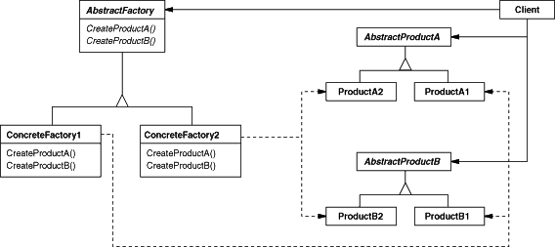
Abstract Factory Design Pattern
Structure

Slide 42
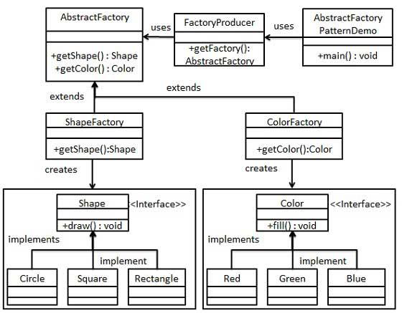

Slide 43
Abstract Factory Design Pattern
public interface Color {
void fill();
}
public class Red implements Color {
@Override
public void fill() {
System.out.println("Inside Red::fill() method.");
}
}

Slide 44
Abstract Factory Design Pattern
public class Green implements Color {
@Override
public void fill() {
System.out.println("Inside Green::fill() method.");
}
}
public class Red implements Color {
@Override
public void fill() {
System.out.println("Inside Red::fill() method.");
}
}

Slide 45
public class Blue implements Color {
@Override
public void fill() {
System.out.println("Inside Blue::fill() method.");
}
}

Slide 46
Abstract Factory Design Pattern
public abstract class AbstractFactory {
abstract Color getColor(String color);
abstract Shape getShape(String shape) ;
}

Slide 47
public class ShapeFactory extends AbstractFactory {
@Override
public Shape getShape(String shapeType){
if(shapeType == null){
return null; }
if(shapeType.equalsIgnoreCase("CIRCLE")){
return new Circle();
} else if(shapeType.equalsIgnoreCase("RECTANGLE")){
return new Rectangle();
} else if(shapeType.equalsIgnoreCase("SQUARE")){
return new Square();
}
return null;
}
@Override
Color getColor(String color) {
return null;
}
}

Slide 48
public class ColorFactory extends AbstractFactory {
@Override
public Shape getShape(String shapeType){
return null; }
@Override
public Color getColor(String color) {
if(color == null){
return null;
}
if(color.equalsIgnoreCase("RED")){
return new Red();
} else if(color.equalsIgnoreCase("GREEN")){
return new Green();
} else if(color.equalsIgnoreCase("BLUE")){
return new Blue();
}
return null;
}
}

Slide 49
public class FactoryProducer {
public static AbstractFactory getFactory(String choice){
if(choice.equalsIgnoreCase("SHAPE")){
return new ShapeFactory();
} else if(choice.equalsIgnoreCase("COLOR")){ return new ColorFactory();
}
return null;
}
}

Slide 50
public class AbstractFactoryPatternDemo {
public static void main(String[] args) {
AbstractFactory shapeFactory = FactoryProducer.getFactory("SHAPE");
Shape shape1 = shapeFactory.getShape("CIRCLE");
shape1.draw();
AbstractFactory colorFactory = FactoryProducer.getFactory("COLOR");
Color color1 = colorFactory.getColor("RED");
color1.fill();
}
}
get shape factory
get an object of Shape Circle
call draw method of Shape Circle
get color factory
get an object of Color Red
call fill method of Red

Slide 51
Abstract Factory Design Pattern
Consequences
+ It isolates concrete classes: Clients manipulate instances through their abstract interfaces. Product class names are isolated in the implementation of the concrete factory; they do not appear in client code
It promotes consistency among products: When product objects in a family are designed to work together, it's important that an application use objects from only one family at a time. AbstractFactory makes this easy to enforce.
- Supporting new kinds of products is difficult: Supporting new kinds of products requires extending the factory interface, which involves changing the AbstractFactory class and all of its subclasses.

