Slide 1
Chapter 1 Introduction to Design Patterns
Software Design Patterns
CPIT-251

Slide 2



What is a Design?
Formulate the maximum alternative solutions of the problem and select the best one
Software Design is the process of implementing a software solutions to do one or more set of problems

Slide 3






Why We Need A Design?
Provides an overall picture of the system
An understandable design is the best hope to construct a program that works
Provide facilitate reuse (NOT code reuse)
Design uses abstraction to create views that are comprehensible (understandable)

Slide 4






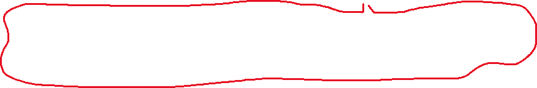








Design and Quality
Explicit requirements = clearly stated, written requirements
Implicit requirements = unstated but expected (performance, usability, security)
The design must implement all of the explicit (clear) requirements contained in the analysis model, and it must accommodate all of the implicit (hidden) requirements desired by the customer
The design must be readable, understandable guide for those who generate code and for those who test and subsequently support the software
The design should provide a complete picture of the software, addressing the data, functional, and behavioral domains from an implementation perspective
NOT ONLY UNDERSTANDBLE FOR YOU

Slide 5








Design Techniques
Structured/functional Design: data flow diagram (DFD), entity relation diagram (ERD), and Hierarchical Charts
Object Oriented Design: UML, Use Cases and Class Diagrams
Examples of Design Tools
Rational Rose, Star UML, Together Soft, and Microsoft Visio

Slide 6








Object Oriented Design Techniques
Basic components
Classes, which include objects
Functions
Component relationships
One class uses other classes to fulfill its responsibilities
Methods from one class call methods in the other classes
Inheritance
Classes grouped into packages/subsystems

Slide 7

Object Oriented Design Techniques
Identify basic objects/concepts in application domain, and use these as foundation classes
Add additional classes for desired functionality
Abstract out super classes to facilitate understanding and possible re-use
Refactor as necessary

Slide 8



Definitions
A pattern is a recurring solution to a standard problem, in a context
Pattern is a structure or template that is designed to provide solution of a specific problem
“A pattern describes a problem which occurs over and over again in our environment, and then describes the core of the solution to that problem, in such a way that you can use this solution a million times over, without ever doing it the same way twice”

Slide 9





Main Types of Patterns
Architectural Patterns
Design Patterns
Idiom Patterns
Our main focus is : Design Patterns

Slide 10









Design Pattern
The design patterns in this book are descriptions of communicating objects and classes that are customized to solve a general design problem in a particular context
A design pattern identifies the key aspects of a common design structure that can be used to create a reusable object-oriented design
The design pattern identifies the participating classes and instances, their roles and collaborations, and the distribution of responsibilities
Each design pattern focuses on a particular object-oriented design problem

Slide 11



Benefits of Design Patterns
Design patterns enable large-scale reuse of software architectures and also help document systems
Design patterns explicitly capture expert knowledge and design tradeoffs and make it more widely available
Design patterns help improve developer communication

Slide 12













Design Pattern Elements
Design patterns have 4 essential elements:
Pattern name
Describes a design problem and its solutions
Increases vocabulary of designers
Problem
Describes when to use the pattern
Solution
Describes the elements that make up the design, their relationships, responsibilities and collaboration
UML-like structure, abstract code
Consequences
The results and tradeoffs of applying them

Slide 13









Model View Controller (MVC)
MVC is a design pattern used in software engineering to separates the application logic (model) from business logic (view)
MVC consists of
The model, which is the application object
The view, which is the screen representation
Controller, which defines the way user interface acts to the user input

Slide 14
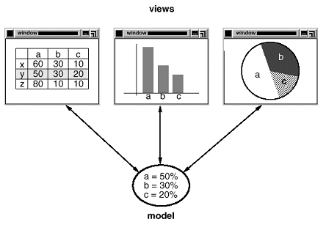
MVC

Slide 15




How MVC Works?
The user interacts with the user interface in some way
e.g., user presses a button
A controller handles the input event from the user interface, often via a registered handler or callback
The controller accesses the model, possibly updating it in a way appropriate to the user's action
e.g., controller updates user's shopping cart

Slide 16



How MVC Works?
A view uses the model to generate an appropriate user interface
e.g., view produces a screen listing the shopping cart contents
The view gets its own data from the model. The model has no direct knowledge of the view.
However, the observer pattern can be used to allow the model to indirectly notify interested parties – potentially including views of a change

Slide 17
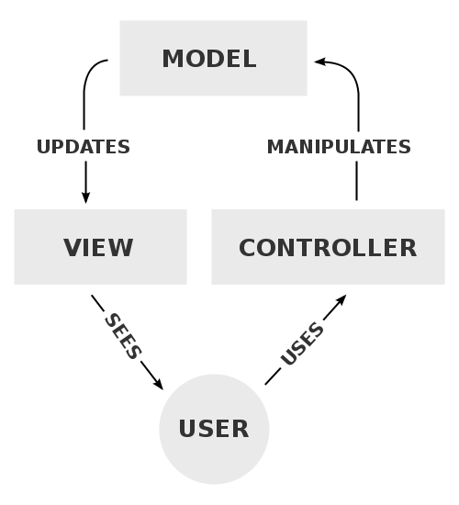







MVC with Controller

Slide 18









Describing Design Patterns
Pattern Name and Classification: A descriptive and unique name that helps to identify and refer to the pattern
Intent: A description of the goal behind the pattern and the reason for using it
Also Know As: other well known name for the pattern
Motivation: A scenario illustrates a design problem and how the pattern solve the problem
Applicability: Situations in which this pattern can be applied, and example of poor designs that pattern can address

Slide 19












Describing Design Patterns
Structure: A graphical representation of the classes in the pattern
Class diagrams and Interaction diagrams may be used for this purpose
Participants: The classes and/or objects used in the pattern and their roles in the design
Collaboration: A description of how classes and objects interact with each other
Consequences: A description of the results, side effects, and tradeoffs caused by using the pattern

Slide 20







Describing Design Patterns
Implementation: A description of an implementation of the pattern
Sample Code: An illustration of how the pattern can be implemented using a programming language
Known Uses: Examples of patterns found in real systems
Related Patterns: Other design patterns are closely related to this one and discussion of the differences between the patterns

Slide 21














Design Patterns Classifications
Purpose
Which reflects what a pattern does
Patterns can have either creational, structural, or behavioral purpose
Creational patterns concern the process of object creation (5 design patterns)
Structural patterns deal with the composition of classes or objects (7 design patterns)
Behavioral patterns characterize the ways in which classes or objects interact and distribute responsibility (11 design patterns)
Creational design patterns use to create objects efficiently
Structural design patterns: used to ease the design by identifying a simple way to realize relationships between entities
Behavioral design patterns: identify common communication patterns between objects and realize these patterns to increase the flexibility in carrying the communication
Notes:
Creational design patterns use to create objects efficiently. Such as create objet for an initial state and copy it or clone it everything a new game started.
Structural design patterns: used to ease the design by identifying a simple way to realize relationships between entities such as identifying how objects are composed using inheritance relationships, or how one object represents in another object.
Behavioral design patterns: identify common communication patterns between objects and realize these patterns to increase the flexibility in carrying the communication. Such as chain of responsibiliy pattern which passes messages from object to another until it reached the object that is cabaple of handeling the request which in response reduce the coupling between the sender on the recivever that will handel the request.

Slide 22






Design Patterns Classifications
Scope
Specifies whether the pattern applies primarily to classes or to objects
Class patterns (4 design patterns)
Deal with relationships between classes and their subclasses
These relationships are established through inheritance, so they are static—fixed at compile-time
Object patterns (20 design patterns)
Deal with object relationships
It can be changed at run-time and are more dynamic

Slide 23
How Design Pattern Solve Design Problems
Finding Appropriate Objects
Determining Object Granularity
Specifying Object Interfaces
Specifying Object Implementations
Putting Reuse Mechanisms to Work
Relating Run-Time and Compile

Slide 24









1. Finding Appropriate Objects
Object-Oriented design made up of objects
Operations are the only way to change an object’s internal data
Object internal state is encapsulation
Object-Oriented design is decomposed into objects
Encapsulation, granularity, dependency, flexibility, performance, evolution, reusability, and so on
Notes:
Encapsulation: is the concept of bind data and function together to prevent it from outside interference

Slide 25



1. Finding Appropriate Objects
Many objects in a design come from the design model
Many classes have no match in real world
Strict modeling of the real world leads to a systems that reflect today’s need but not flexible to to be used in the future
Design patterns help to make a flexible design
Composite pattern helps to identify objects that does not have a physical match in real world at uniform level of abstraction
Algorithms are not part of nature but a crucial part of a flexible system. Strategy pattern describes how to implement interchangeable families of algorithms

Slide 26






2. Determining Object Granularity
How to decide what should be an object?
Design patterns describes how decompose an object into smaller objects
Abstract Factory and Builder patterns produce objects who’s responsible for creating another objects
Visitor and Command patterns produce objects who’s only responsible to implement request on another object or group of objects
Notes:
Granularity is the level of details

Slide 27






3. Specifying Object Interfaces
Object interface is the set of all operation signatures defined by object’s operations
The run-time association between an object and one of its operations is called a dynamic binding
Design patterns help to identify interfaces and the relationship between them
Memento design patterns describes how to encapsulate and save the internal state of an object

Slide 28






4. Specifying Objects Implementations
Programming to an interface, not an implementation
Inheritance is a mechanism to extend application functionality by reusing parent classes
Inheritance defined families of objects with identical interfaces: inherit from abstract class
Subclasses add or override operations: all subclasses are subtype of the interface
Notes:
Reduce the implementation dependencies between subsystems since it tights objects to interfaces not to implementaion

Slide 29



4. Specifying Objects Implementations
Programming to an interface, not an implementation
+ Clients remain unaware of the specific type of objects they use
+ Clients remain unaware of the classes that implements the objects
+ Reduce the implementation dependencies between subsystems
Notes:
Reduce the implementation dependencies between subsystems since it tights objects to interfaces not to implementaion

Slide 30








4. Specifying Objects Implementations
Design patterns, such as creational patterns, ensure that your system is written in terms of interfaces, not implementations
Guide you to instantiate concrete classes
Give you different ways to associate an interfaces with its implementation
// ممكن:
p = new PayPalPayment();
// أو:
p = new VisaPayment();
// أو:
p = factory.createPayment(type);

Slide 31




5. Putting Reuse Mechanism to Work
Class inheritance vs. Object composition
Class inheritance
+ Class inheritance defined statically at compile-time
+ It is easy to modify the implementation through overridden
- You cannot change the implementation inherited from the supper class at run-time
- Inheritance breaks encapsulation
Any change to parent’s implementation will force the subclass to change (implementation dependencies)
Limits system flexibility and reusability
Notes:
Example of coffee and cofferCup in word document

Slide 32






5. Putting Reuse Mechanism to Work
Object Composition
Object composition is a way to combine simple objects to create complex one
Example: Coffee and CoffeeCup (Coffee can be referenced in CoffeeCup)
+ Object composition defined dynamically at run-time
Through object referencing other objects
+ Object composition are accessed through interfaces, thus don’t break encapsulation
+ Fewer implementation dependencies

Slide 33

5. Putting Reuse Mechanism to Work
Favor object composition over class inheritance
Design with object composition will have more objects and fewer classes
The system behavior depends on more interrelationships instead of being defined in one class
Every object comes from a class ✔️ No object without a class
👉 But you can have:
Few classes
Many objects

Slide 34

5. Putting Reuse Mechanism to Work
Delegation
Two objects involved to handle a request
Window
Rectangle
rectangle
Height
width
Area()
Area()
Return rectangle -> Area()
Return height*width

Slide 35




5. Putting Reuse Mechanism to Work
Delegation: is a way to make composition powerful
+ Delegation makes it easy to compose behaviors at run-time
- Makes software flexible through objects composition
- Dynamic software is harder to understand than static software
- Run-time inefficiencies
Many design patterns used delegation
State, strategy, visitor, mediator
Notes:
Window can became circular at rum-time by replacing Rectangle instance with a Circle instance, assuming Rectangle and Circle have the same type

Slide 36
5. Putting Reuse Mechanism to Work
Inheritance vs. parameterized types
Parameterized types, also called genetics or templates
It lets you define a type without specifying all the other types. The unspecified types are supplied as parameters
E.g., List<Integers> = new ArrayList<Integer>();
+ A way to compose behavior in OO system
+ It lets you change the type the class can uses
- Cannot be changed at run-time

Slide 37
5. Relating Run-time and Compile-time Structures
Software structure can be forced by the designer
The relationship between objects and their types must be design with great care
They determine how good or bad is the run-time structure
Some design patterns are useful for building complex run-time structures
Composite, decorator, observer

Slide 38
5. Designing for Change
Consider how the system might need to change over lifetime
Might need to redesign the whole system in the future
Design patterns help to ensure system can change over time by making the system robust of particular type of change
Tight coupling between classes: change in one class required changes to other classes (Abstract Factory, Bridge, Command)
Extending functionality by subclassing: define subclass requires understanding to the parent class. Use object composition is another way for combing behaviors but will make software hard to understand (Bridge, Chain of Responsibility, Composite)

Slide 39
Common Design Mistakes
Not enough time has been spent to understand the underlying problem and its context, and as a consequence, you select a pattern that looks right, but is inappropriate for the solution required.
Once the wrong pattern is selected, you refuse to see your error and force fit the pattern
It will result a poor or wrong fit.
Sometimes a pattern is applied too exactly and the required adaptations for your problem space are not implemented.

