Slide 1
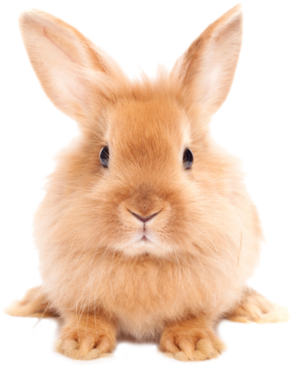
What do you know about bitmap images?
Talk about:
Pixels
Colours

Slide 2
Today’s lesson
Look at how data is stored in a computer
Understand how image data is stored using a bitmap file

Slide 3
How is data stored in a computer
Everything is binary
Zeros and ones (one bit)
Eights bits in one byte

Slide 4
Everything is binary
So what is this?
01000001
Depends on the type

Slide 5
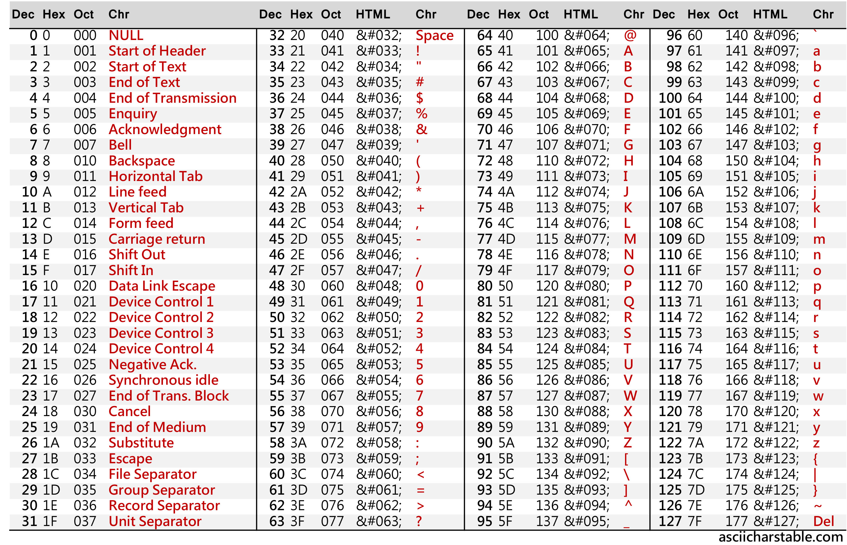

Slide 6
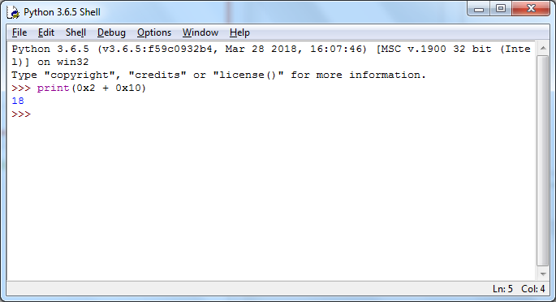
Do you know hexadecimal?
What would we see if I ran this Python code?

Slide 7
Do you know hexadecimal?
What would we see if I ran this Python code?

Slide 8
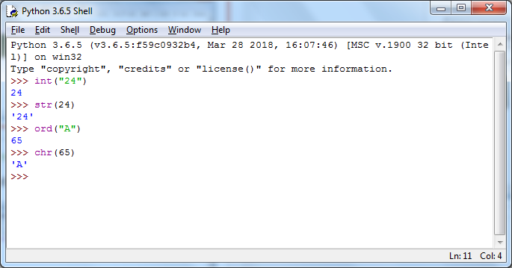
Python functions for data types

Slide 9
Quiz

Slide 10
Today’s lesson
Look at how data is stored in a computer
Understand how image data is stored using a bitmap file

Slide 11
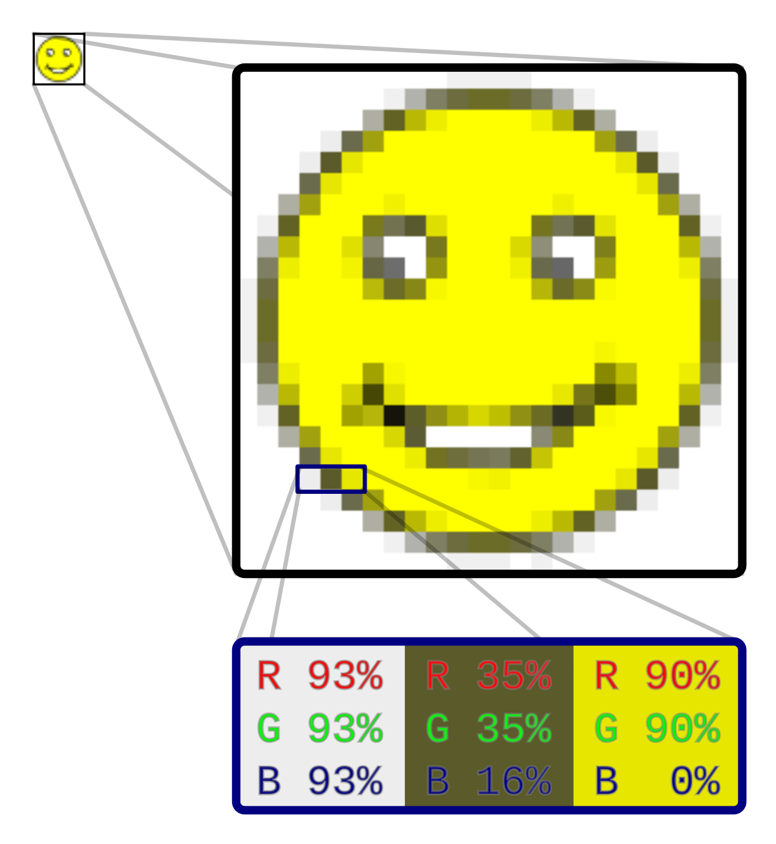
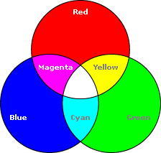
RGB

Slide 12
Each pixel: 3 colours, 3 bytes
11111100
11111100
00000000

Slide 13
Task
Use paint to open bunny.bmp from the Unit 1 folder
Zoom to see the pixels
Click on different pixels to see the colour values

