Slide 1
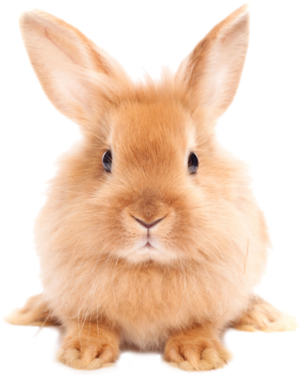
What do you know about bitmap images?
Talk about:
Pixels
Colours

Slide 2
Today’s lesson
Look at how data is stored in a computer
Understand how image data is stored using a bitmap file

Slide 3
How is data stored in a computer
Everything is binary
Zeros and ones (one bit)
Eights bits is one byte

Slide 4


Everything is binary
So what is this?
65
A
01000001
Depends on the encoding

Slide 5
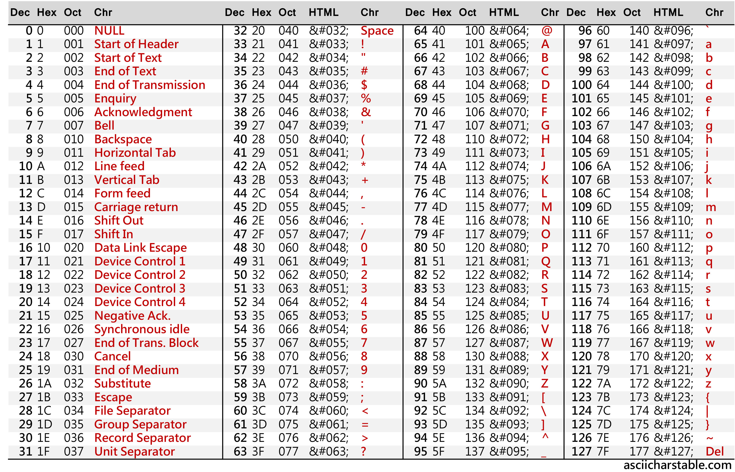

Slide 6
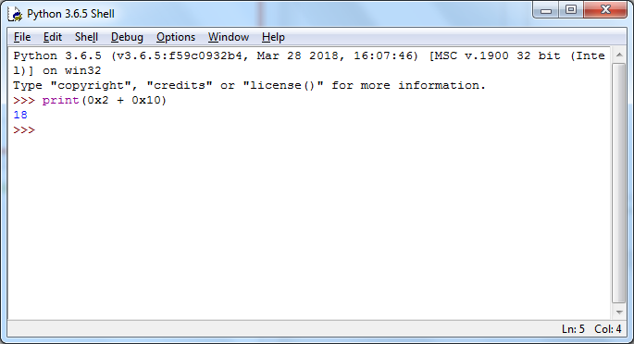
Do you know hexadecimal?
What would we see if I ran this Python code?

Slide 7
Do you know hexadecimal?
What would we see if I ran this Python code?

Slide 8
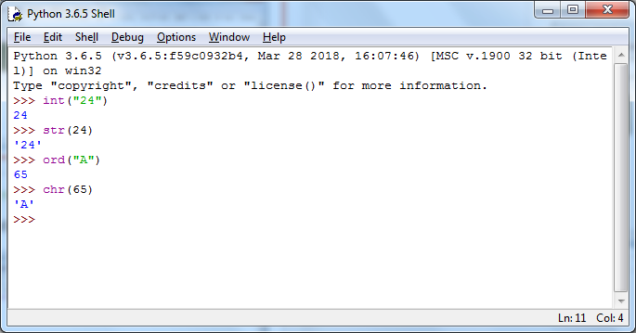
Python functions to know

Slide 9
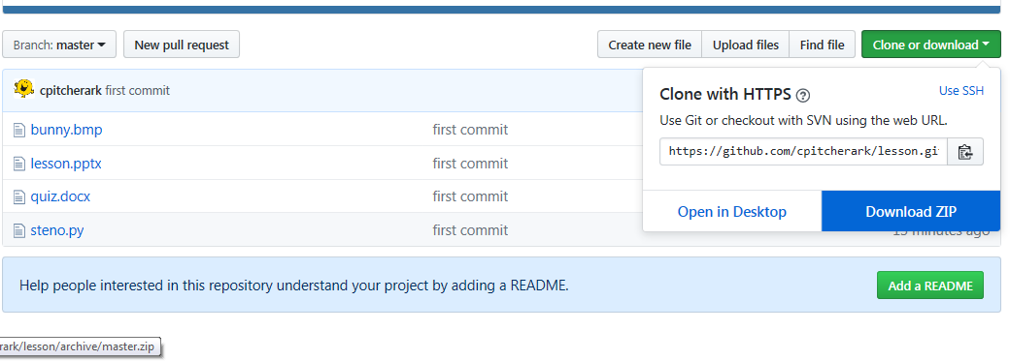
Task
Go to https://github.com/cpitcherark/lesson
Download as zip and extract somewhere

Slide 10
Quiz!

Slide 11
Today’s lesson
Look at how data is stored in a computer
Understand how image data is stored using a bitmap file

Slide 12
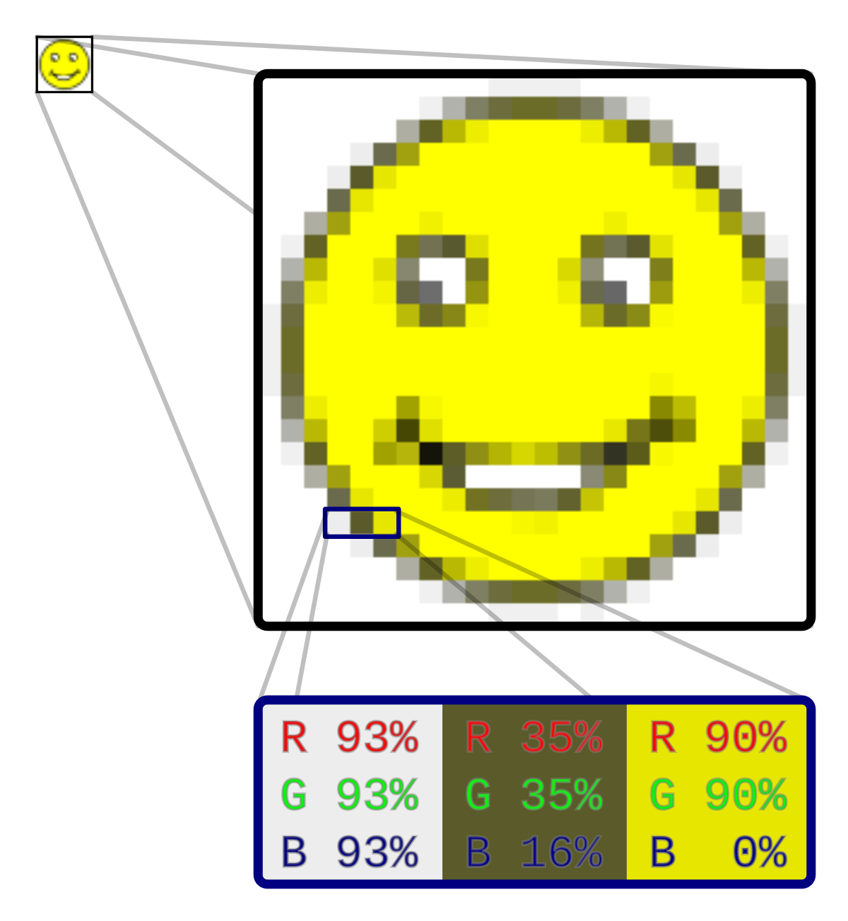
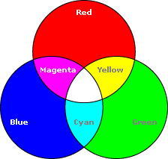
RGB encoding

Slide 13
Each pixel: 3 colours, 3 bytes
11111100
11111100
00000000

Slide 14
Task
Go to www.onlinehexeditor.com
Open bunny.bmp
What do you see?

Slide 15
Things about bitmaps
Pixels are tiny so you cannot see them
Means storing lots of pixels, so lots of data
A lot of this data is redundant
this means data can be compressed
it also means we can do something a bit funky…

Slide 16
Task 2
Have a look at steno.py – what is it going to do?
Run it
Look at newbunny.bmp file – what do you see?
Go back to onlinehexeditor.com and open up newbunny.bmp – what do you see?

Slide 17
Task 3
Improve steno.py by allowing the user to input their own message

Slide 18
Summary
All data is binary
What the data means depends on the encoding
Image data can be stored as a bitmap of pixels each with an RGB value => 3 bytes
Bitmap images have redundant data
We can use redundant data to hide secret messages in files

