Slide 1
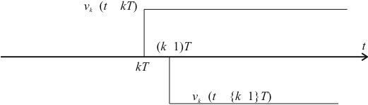
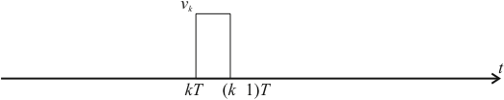


∇
∇
∇
−
∇
−
−
∇
ε
−
−
ε
−
−
−

Slide 2
∇
U(s)
Y(s)
U(z)
Y(z)
D(z)
u(t)
Area under whole curve is
t

Slide 3
u(t)
u(nT)
u(nT-T)
Shaded region is
nT-T
nT
t

Slide 4
Forward Rectangular
u(t)
u(nT)
u(nT-T)
Area of rectangle
nT-T
nT
t

Slide 5
Backward Rectangular
u(t)
u(nT)
u(nT-T)
Area of rectangle
nT-T
nT
t

Slide 6
Trapezoidal (Tustin)
u(t)
u(nT)
u(nT-T)
Area of trapezium
nT-T
nT
t

Slide 7
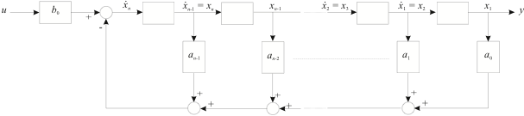

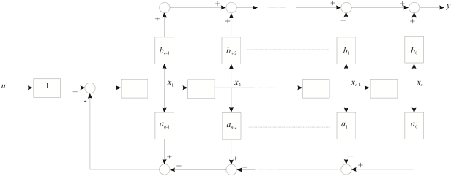

Slide 8
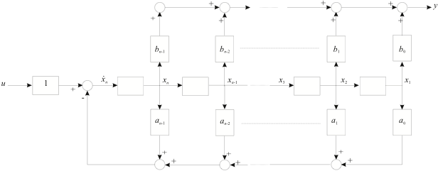

Slide 9
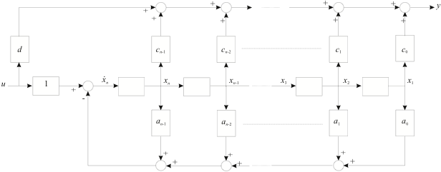

Slide 10
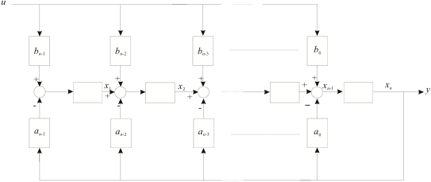

Slide 11
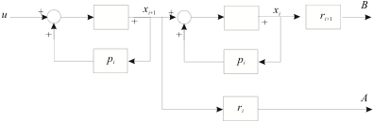
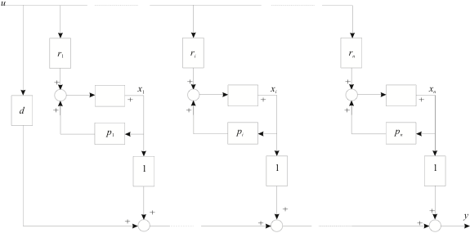

Slide 12


