Slide 1
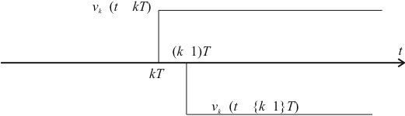
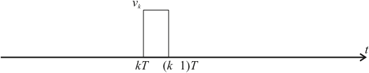


∇
∇
∇
−
∇
−
−
∇
ε
−
+
ε
−
+
+

Slide 2
∇
U(s)
Y(s)
U(z)
Y(z)
D(z)
u(t)
Area under whole curve is
t

Slide 3
r(kT)
Digital compensator
e(kT)
u(kT)
u(t)
actuator
plant
c(t)
ADC
CPU
DAC
clock
e(t)
analogue
pre-filter
sensor

Slide 4
r(t)
e(t)
D(s)
u(t)
G(s)
r(t)
+
−
e(t)
e(kT)
D(z)
ZOH
u(t)

Slide 5
r(t)
e(t)
D(s)
u(t)
c(t)
+
−
X
X
O
X

Slide 6
R(z)
E(z)
D(z)
U(z)
G(z)
C(z)
+
−
R(z)
E(s)
E(z)
D(z)
U(z)
ZOH
U(s)
G(s)
C(z)
+
−

Slide 7
s-plane
z-plane
X
X
X
O
X

Slide 8
u(t)
u(nT)
u(nT-T)
Shaded region is
nT-T
nT
t

Slide 9
Forward Rectangular
u(t)
u(nT)
u(nT-T)
Area of rectangle
nT-T
nT
t

Slide 10
Backward Rectangular
u(t)
u(nT)
u(nT-T)
Area of rectangle
nT-T
nT
t

Slide 11
Trapezoidal (Tustin)
u(t)
u(nT)
u(nT-T)
Area of trapezium
nT-T
nT
t

Slide 12
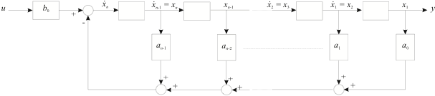

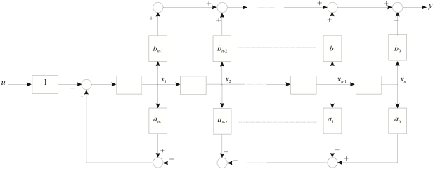

Slide 13
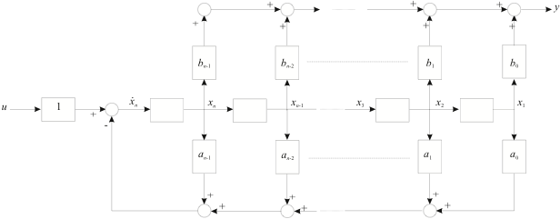

Slide 14
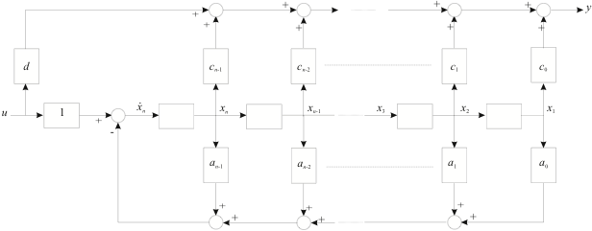

Slide 15
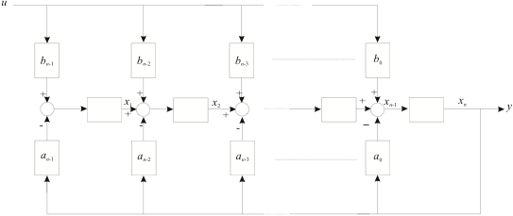

Slide 16
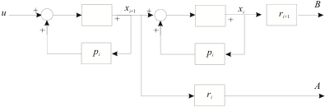
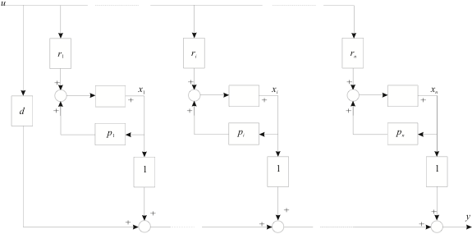

Slide 17


Slide 18
(a)
(b)

Slide 19
S₁
S₂
y
u
S₂
y
S₃
S₃
S₄
S₄
output
plant i/p
u
output
Plant
y
x
−
ref. i/p
Observer
+
r
measured
states

Slide 20
R(s)
+
Y(s)
−
+
+
+
y
u
+
p

Slide 21
u
System with
state x
y
+
L
−
Observer with
state
C
u
System with
state x
y
Observer with
state

Slide 22
y
+
−
356
25
+
+
u
7
+
+
+
+
-44
-15

