Slide 1
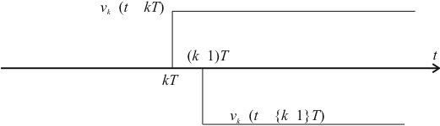
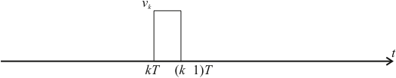


∇
∇
∇
−
∇
−
−
∇
ε
−
−
ε
−
−
−

Slide 2
∇
U(s)
Y(s)
U(z)
Y(z)
D(z)
u(t)
Area under whole curve is
t

Slide 3
r(kT)
Digital compensator
e(kT)
u(kT)
u(t)
actuator
plant
c(t)
ADC
CPU
DAC
clock
e(t)
analogue
pre-filter
sensor

Slide 4
r(t)
e(t)
D(s)
u(t)
G(s)
r(t)
+
−
e(t)
e(kT)
D(z)
ZOH
u(t)

Slide 5
r(t)
e(t)
D(s)
u(t)
r(t)
+
−
X
X
O
X

Slide 6
u(t)
u(nT)
u(nT-T)
Shaded region is
nT-T
nT
t

Slide 7
Forward Rectangular
u(t)
u(nT)
u(nT-T)
Area of rectangle
nT-T
nT
t

Slide 8
Backward Rectangular
u(t)
u(nT)
u(nT-T)
Area of rectangle
nT-T
nT
t

Slide 9
Trapezoidal (Tustin)
u(t)
u(nT)
u(nT-T)
Area of trapezium
nT-T
nT
t

Slide 10
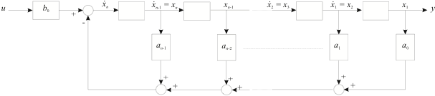

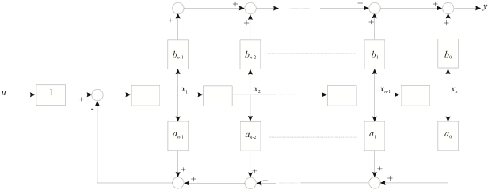

Slide 11
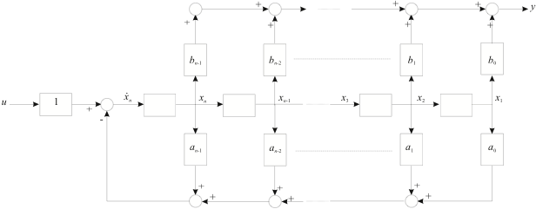

Slide 12
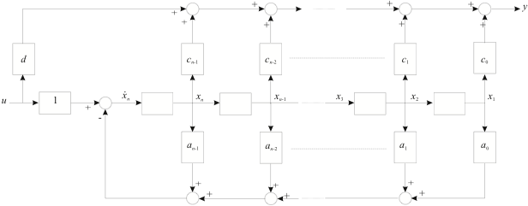

Slide 13
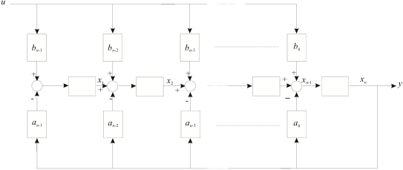

Slide 14
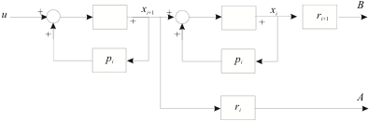
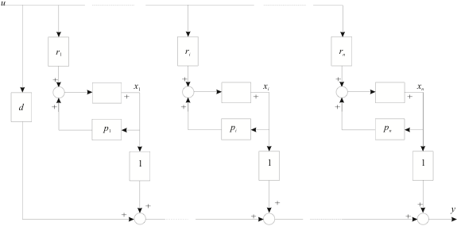

Slide 15


