Slide 1


Paul Boag
Creative Director { headscape.co.uk }
Podcaster & blogger { boagworld.com }

Slide 2
Is this presentation for you?

Slide 3
It is if you care about…
return on investment

Slide 4
It is if you care about…
staying ahead of the competition

Slide 5
It is if you care about…
ensuring consistent online branding

Slide 6
It is if you care about…
responding to your customers

Slide 7
It is if you care about…
reaching the widest possible audience

Slide 8
It is if you care about…
meeting your legal obligations

Slide 9
It is if you care about…
preparing for the future

Slide 10
Don’t be put off by the jargon!
XHTML, CSS, DOM scripting, Semantics,
tableless design, validation, graceful degradation, progressive enhancement, unobtrusive javascript, WAI, W3C

Slide 11
standards provide real business benefits

Slide 12
Lets take a trip back in time
In the beginning God created the world

Slide 13
Or more correctly…
In the 1991 Tim Berners-Lee created the internet

Slide 14
HTML was born
HTML was a very simple computer language that allowed people to describe the content of their written documents in a way the computer could understand.

Slide 15
<h1>HTML was born</h1>
<p>HTML was a <strong>very simple</strong> computer language that allowed people to describe the content of their written documents in a way the computer could understand.</p>

Slide 16
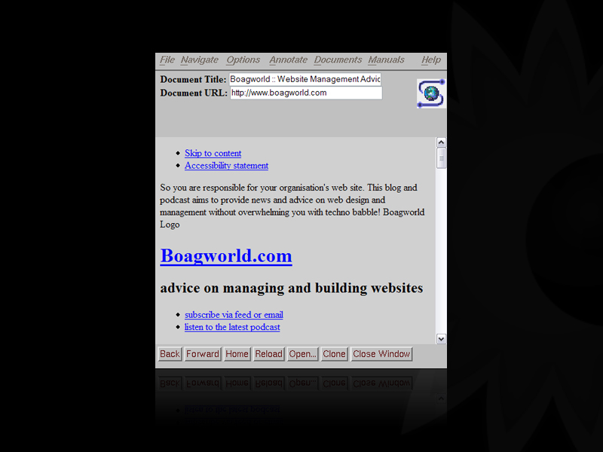

Slide 17
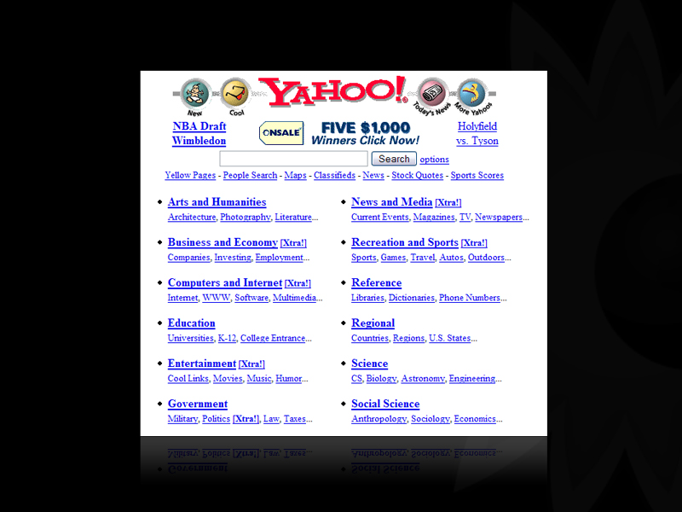

Slide 18
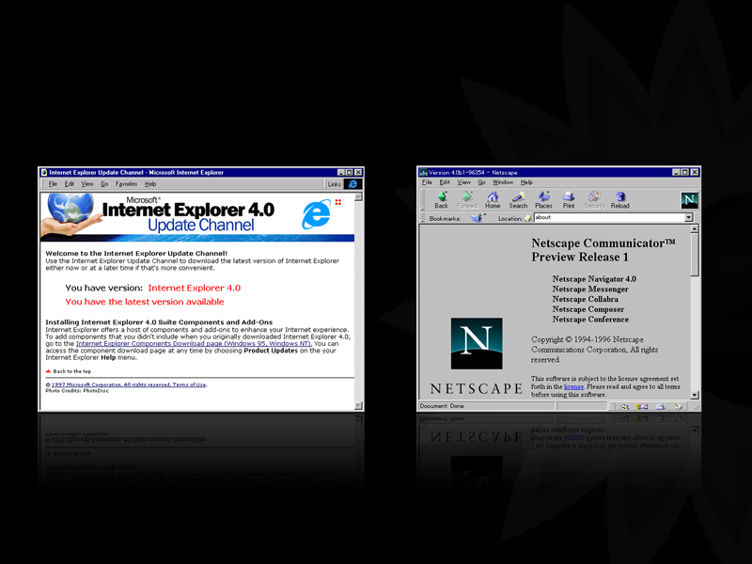
And then there was war!

Slide 19
The carnage was terrifying
<table border="0" cellspacing="0" cellpadding="0" align="center"><tr valign="bottom"> <td align="center" height="33"><a href="/gp/xs/sharethepi.html/ref=bd_gw/102-8084626-4815355"></a>&nbsp;</td> <td> <table border="0" cellspacing="0" cellpadding="0" align="center" class="tabs"> <tr id="twotabtop"> <td class="lefton" height="33"><div align="center"><a href="/ref=topnav_gw_gw/102-8084626-4815355"><img src="http://ec1.images-amazon.com/images/G/01/nav2/images/skins/teal/logo-on.gif" width="109" alt="Amazon.com" height="25" border="0" /></a></div></td><td class="middleoffonleft" height="33"><div align="center"><a href="/gp/yourstore/home/ref=topnav_ys_gw/102-8084626-4815355"><span style="text-transform: none;">Your<br />Amazon.com</span></a></div></td><td class="middleoff" height="33"><div align="center"><a href="/exec/obidos/subst/home/all-stores.html/ref=topnav_dir_gw/102-8084626-4815355" name="two-tabs|he|all-categories">See all 35<br/>Product&nbsp;Categories</a></div></td><td class="rightoff" width="15" height="33"><img src="http://ec1.images-amazon.com/images/G/01/x-locale/common/transparent-pixel.gif" width="15" alt="" height="8" border="0" /></td> <td class="tools" nowrap="nowrap" height="33" align="right">&nbsp;&nbsp;<a href="/gp/css/homepage.html/ref=topnav_ya_gw/102-8084626-4815355" >Your Account</a> <span class="navspacer"><span class="light">&#124;</span></span> <a href="/gp/cart/view.html/ref=topnav_cart_gw/102-8084626-4815355" ><img src="http://ec1.images-amazon.com/images/G/01/x-locale/common/icons/topnav-cart.gif" width="19" alt="Cart" height="16" border="0" /> Cart</a> <span class="navspacer"><span class="light">&#124;</span></span> <a href="/gp/lists/homepage.html/ref=topnav_lists_gw/102-8084626-4815355" id="lolPop_1" name="lolPop|he|listoflists_data">Your Lists</a> <span class="navspacer"><span class="light">&#124;</span></span> <a href="/exec/obidos/tg/browse/-/508510/ref=topnav_help_gw/102-8084626-4815355" >Help</a> <span class="navspacer"><span class="light">&#124;</span></span> <script language="javascript1.2"> n2RunThisWhen('onload', function () { goGoldboxPop = new N2SimplePopover(); goN2Events.registerFeature('goldboxPop', 'goGoldboxPop', 'n2MouseOverHotspot', 'n2MouseOutHotspot'); goGoldboxPop.initialize('goldboxPopDiv', 'goGoldboxPop'); }, 'init popover' ); </script> <div style="display: none"> <div id="goldboxPopDiv_1"> </td> </tr> </table> </td></tr></table> </td><td>&nbsp;</td></tr></table>

Slide 20
Our websites have become business critical and yet…

Slide 21
Our websites have become business critical and yet…
they are expensive to redesign

Slide 22
Our websites have become business critical and yet…
they quickly go out of date

Slide 23
Our websites have become business critical and yet…
your web team has become a bottleneck

Slide 24
Our websites have become business critical and yet…
editors wreck your
brand identity

Slide 25
Our websites have become business critical and yet…
you can’t respond quickly to the competition

Slide 26
Our websites have become business critical and yet…
they fail to print the entire pag

Slide 27
Our websites have become business critical and yet…
! the following bullet is only available to users with Internet explorer running at 1024 x 768 !

Slide 28
Our websites have become business critical and yet…
its expensive to user test different designs

Slide 29
Our websites have become business critical and yet…
they fail to meet their legal obligations

Slide 30
Our websites have become business critical and yet…
they
become
unreadable
on
devices
with a small
screen

Slide 31
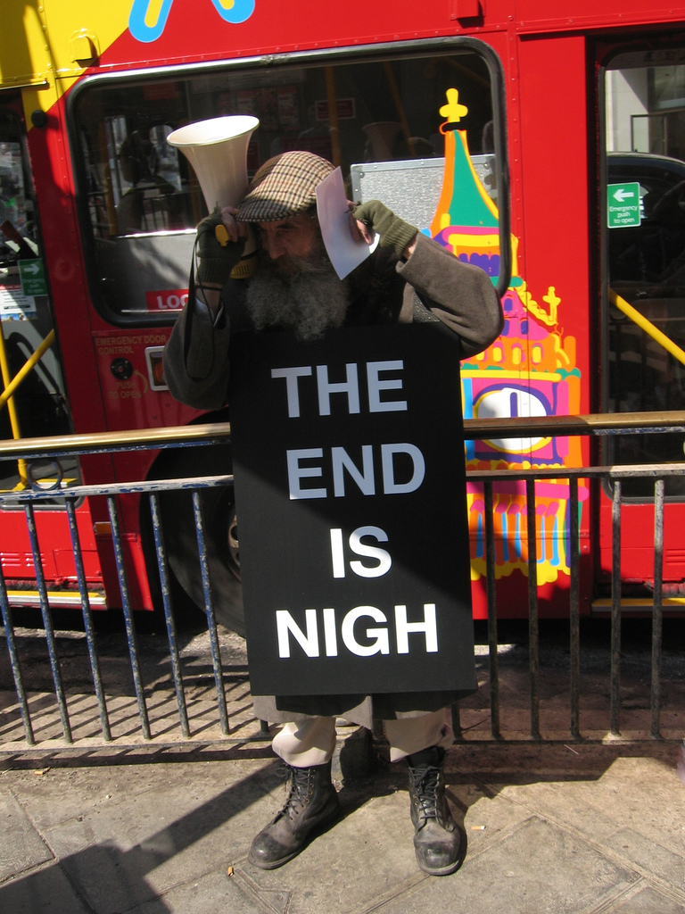


Slide 32

Salvation is at hand
thanks to the W3C

Slide 33
The trinity of web standards
HTML | CSS | DOM Scripting

Slide 34
The trinity of web standards
Content | Design | Behaviour

Slide 35
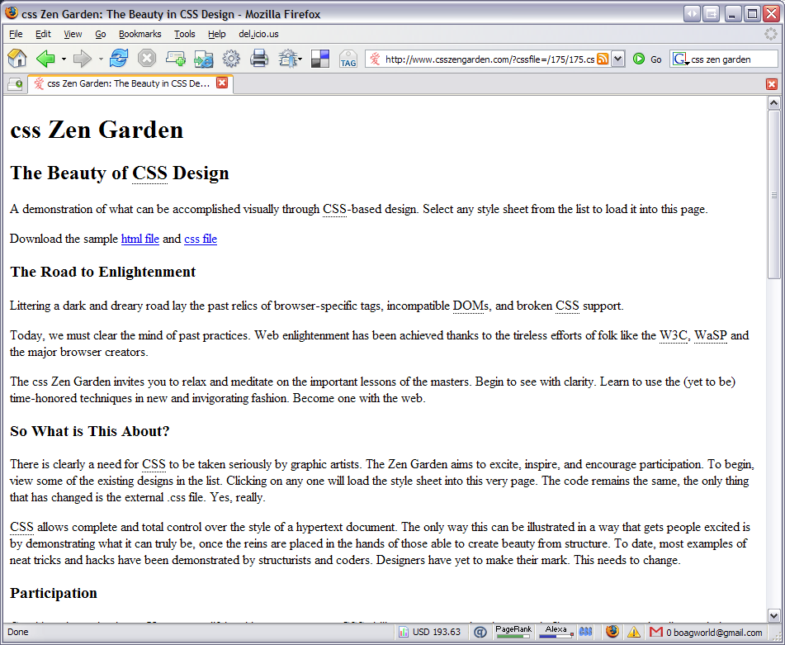

Slide 36
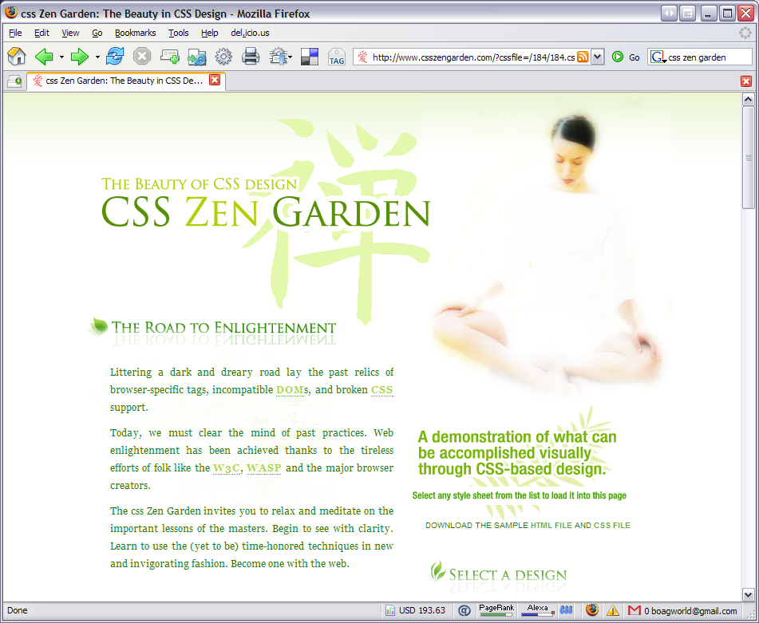

Slide 37
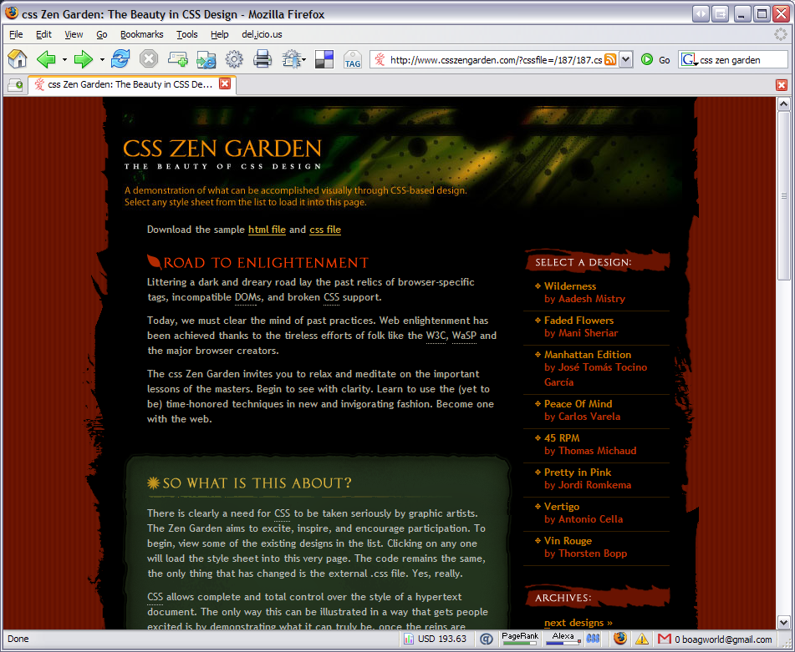

Slide 38
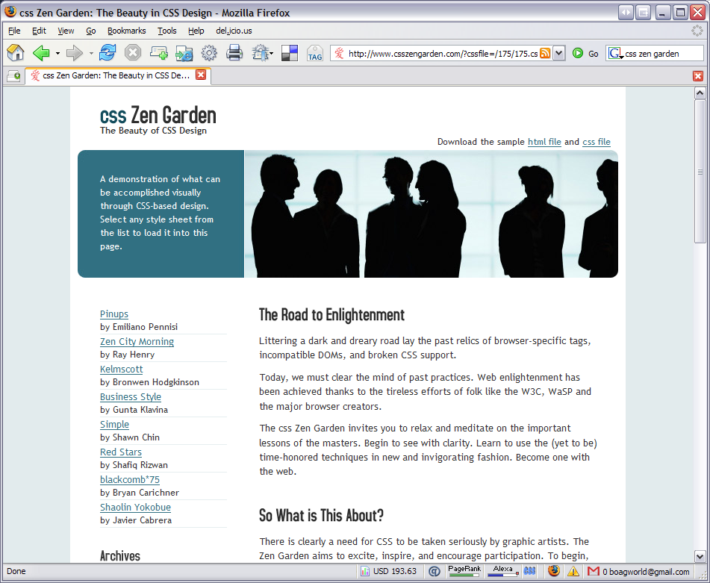

Slide 39
The business benefits

Slide 40
Total control over design
Quick and inexpensive to change

Slide 41
Total control over design
Total control over print

Slide 42
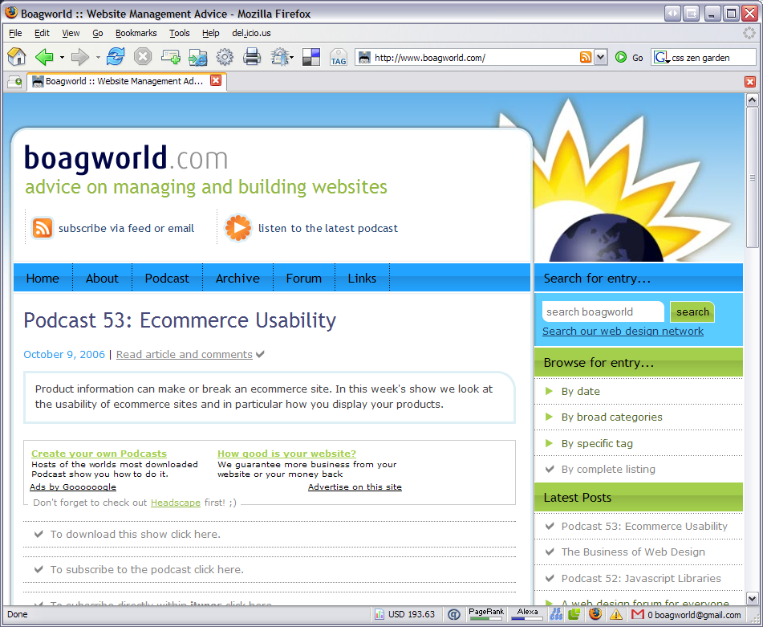

Slide 43
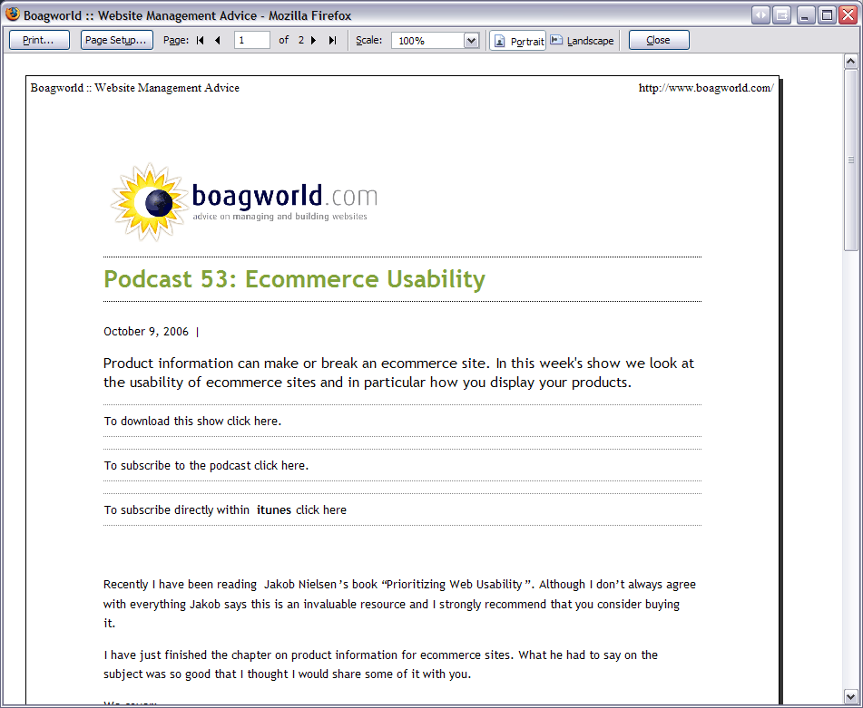

Slide 44
Avoids web team bottlenecks
More compatible with content management systems

Slide 45
Avoids web team bottlenecks
Non designers can create great looking pages

Slide 46
Avoids web team bottlenecks
Easier for anybody to update

Slide 47
More responsive
Easier to experiment

Slide 48
More responsive
Design & populate simultaneously

Slide 49
Never turn away a customer
Works with older browsers

Slide 51
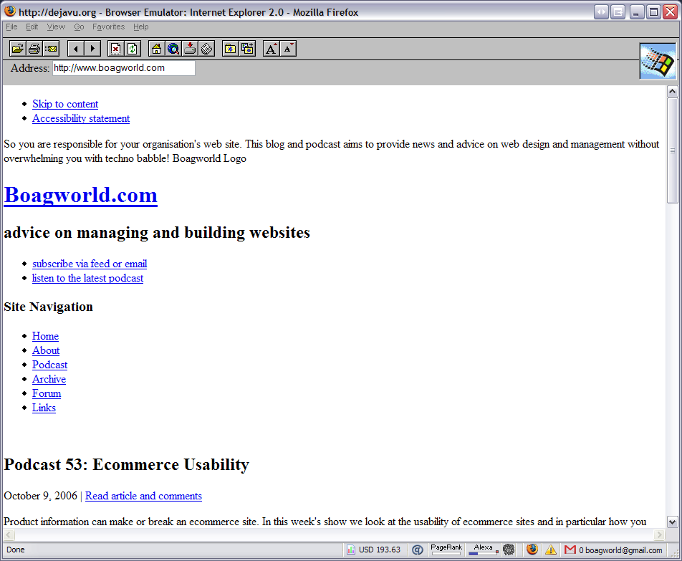

Slide 52
Never turn away a customer
Faster to download

Slide 53
Never turn away a customer
Works with alternative devices

Slide 54
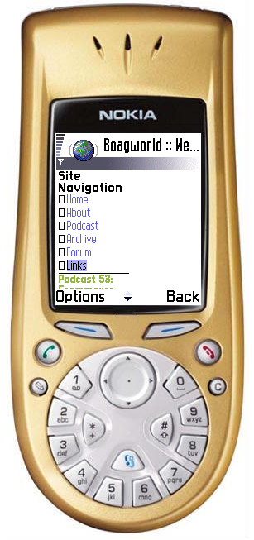

Slide 55
Never turn away a customer
Disabled and older users

Slide 56
Help meet legal requirements

Slide 57
Increase your exposure

Slide 58
Future proof your site
Upcoming browsers

Slide 59
Where from here?
Transition takes time
  Training of staff
  Migration of legacy content
Further reading: “Designing with Web Standards” by Jeffrey Zeldman
www.hotdesign.com/seybold/

Slide 60
http://standards.boagworld.com
Distributed under a creative commons license
Feel free to share

