Slide 1
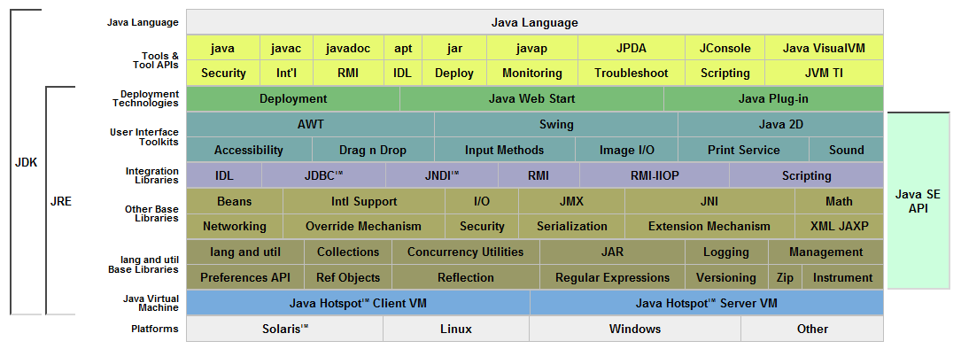
GDK
Java Platform APIs
Present on all clients and all servers

Slide 2
GDK
Java Virtual Machine (JVM)

Slide 3
Java Platform APIs
Present on all clients and all servers
Java Virtual Machine (JVM)

Slide 4
Other Languages:
JRuby, Jython, Scala, Clojure,
JavaFX, JavaScript, …
Java Language
Java Platform APIs
Present on all clients and all servers
Java Virtual Machine (JVM)

Slide 5
Java EE
Java Enterprise Edition
Java Platform
(Java SE)
Third party APIs and
frameworks
(many open source)
Java ME

Slide 6
GDK
Groovy
Other Languages:
JRuby, Jython, Scala, Clojure,
JavaFX, JavaScript, …
Java Language
Java Platform APIs
Present on all clients and all servers
Java Virtual Machine (JVM)

Slide 7
GDK
Groovy
Other Languages:
JRuby, Jython, Scala, Clojure,
JavaFX, JavaScript, …
Java Language
Java Platform APIs
Present on all clients and all servers
Java Virtual Machine (JVM)

