Slide 1
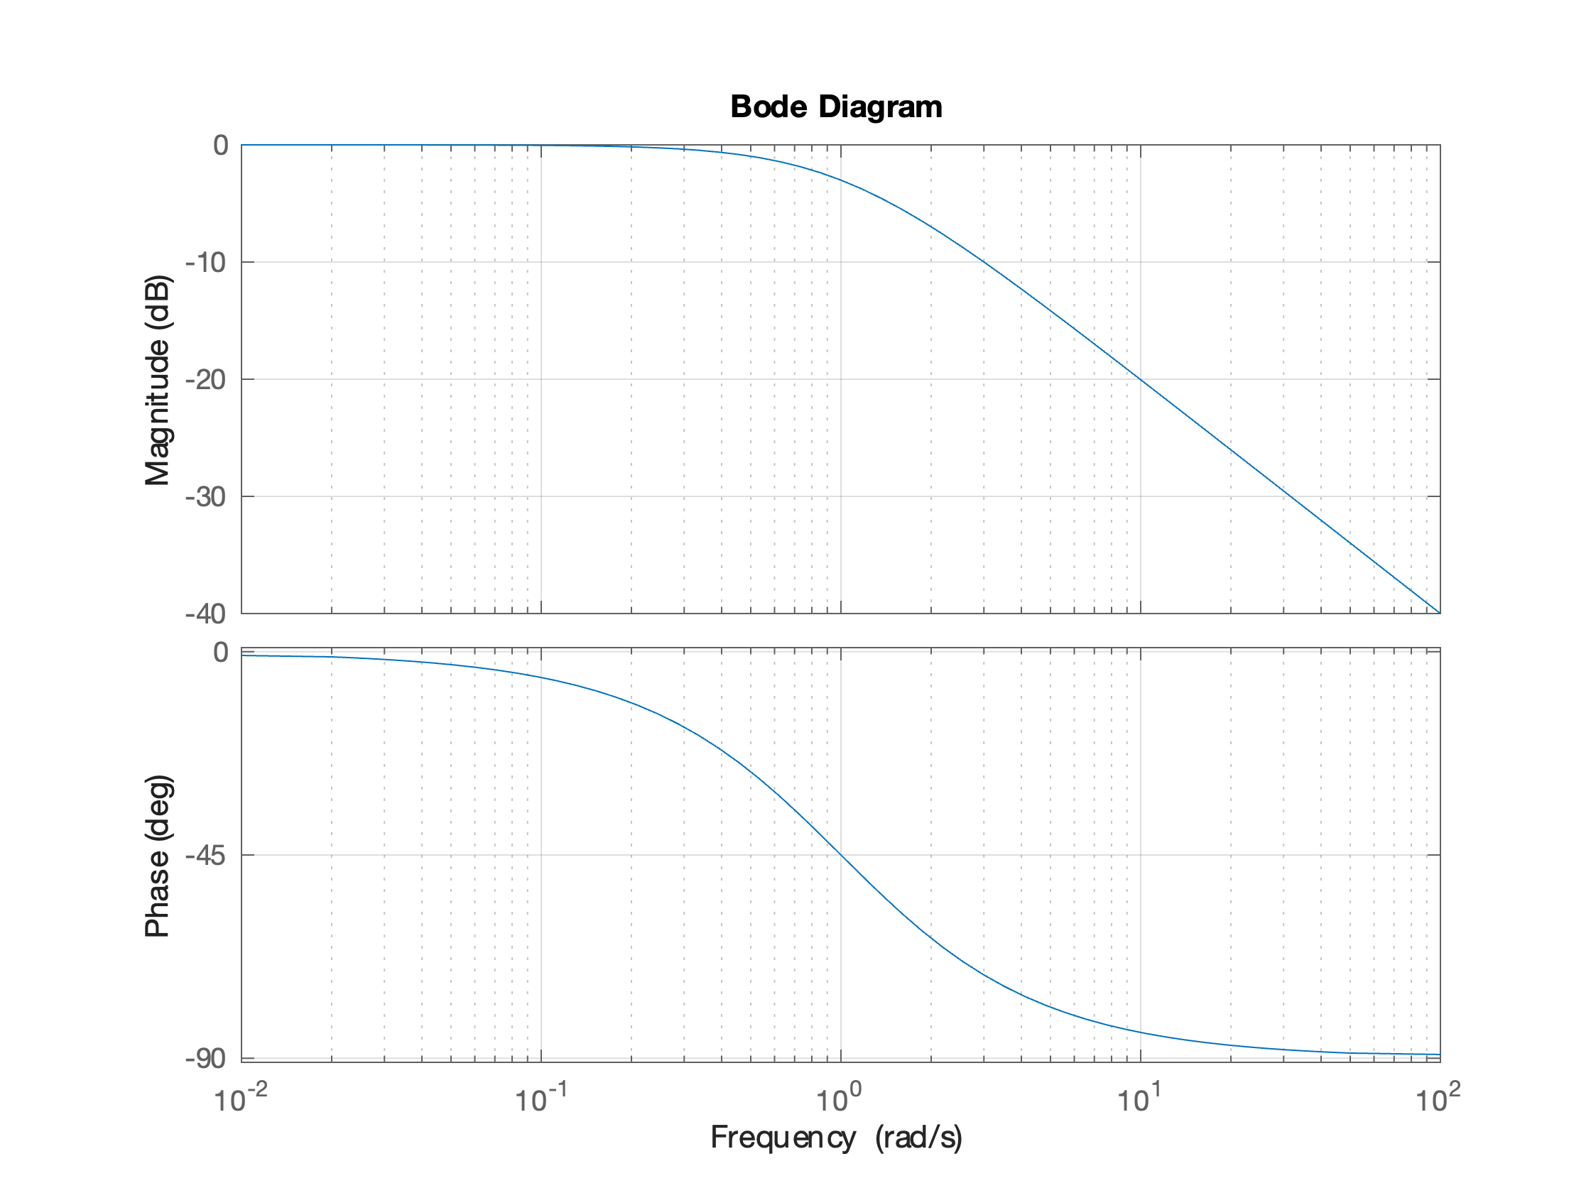



-3 dB
$$\frac{1}{τ}$$
$$\frac{1}{10τ}$$
$$\frac{10}{τ}$$

Slide 2
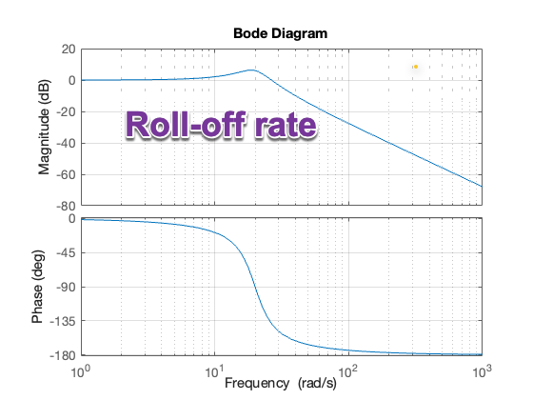

Slide 3
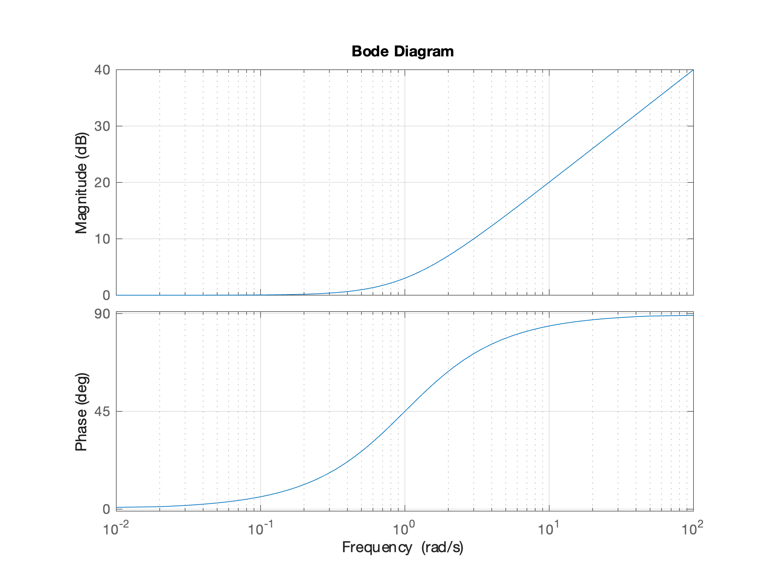

$$\frac{1}{τ}$$
+3 dB
$$\frac{1}{10τ}$$
$$\frac{10}{τ}$$

Slide 4
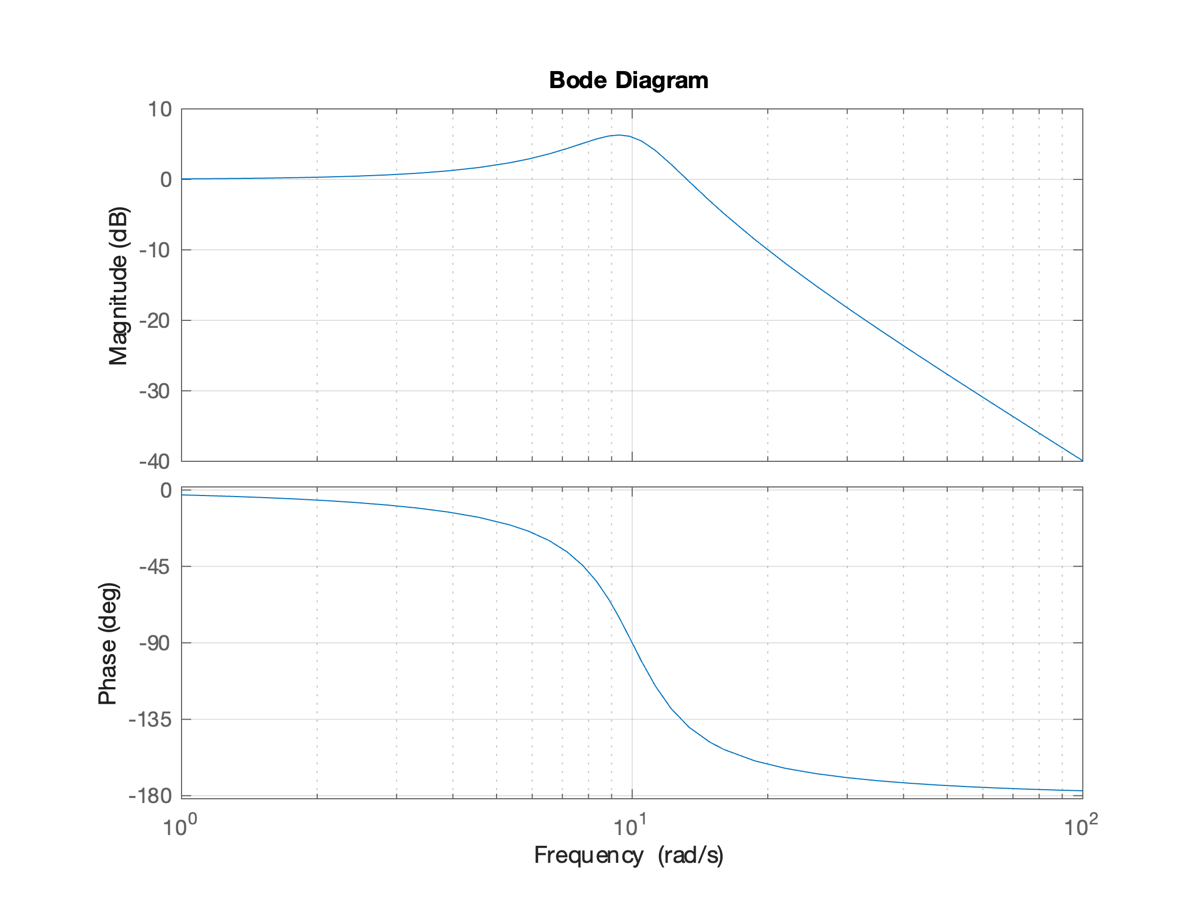


$${\left|\frac{1}{2ζ}\right|}_{\text{dB}}$$
-40 db/decade
$$ω_{n}$$

