Slide 1
EG151 – lab session 1
2014/2015

Slide 2
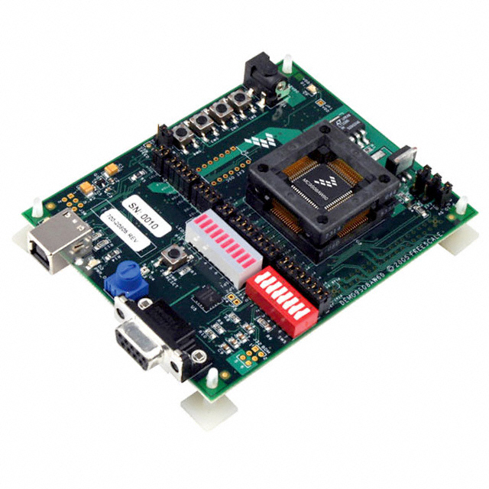
HCS08AW60 Demo board
Optional power supply
4 push-button user switches
4 MHz oscillator
USB-BDM for power and communication
MCU
Light sensor
I/O connectors
Potentiometer connected to ADC
LED light bar with 8 connected to I/O port
Master reset switch
8 rocker switch connected to I/O port
RS 232 serial port
Accelerometer

Slide 3
Starting CodeWarrior
CodeWarrior is an integrated development environment (IDE)
– Free version from Freescale, Inc
– Allows editing, simulation, interfacing to target hardware, debugging programs
– Assembly and C compiler

Slide 4
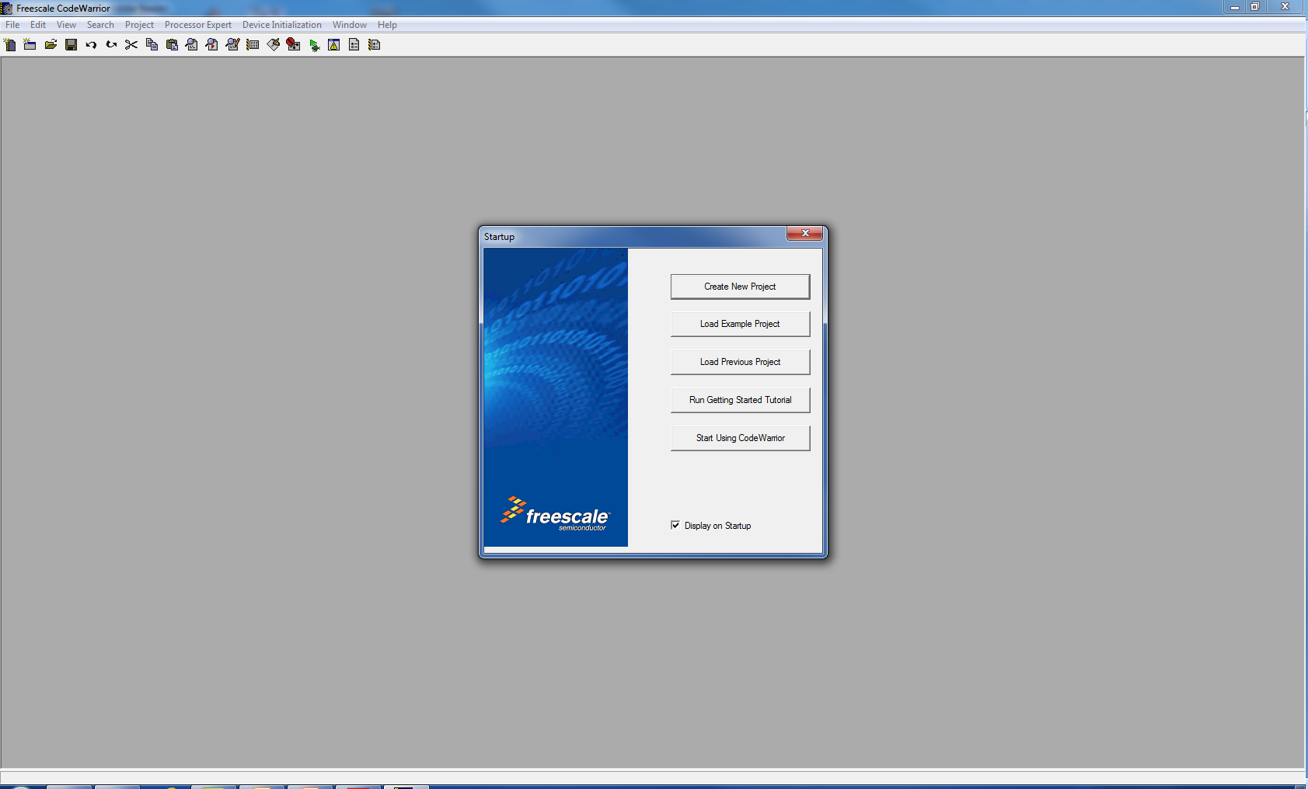
Start Codewarrior, on startup screen, choose “Create New Project”

Slide 5
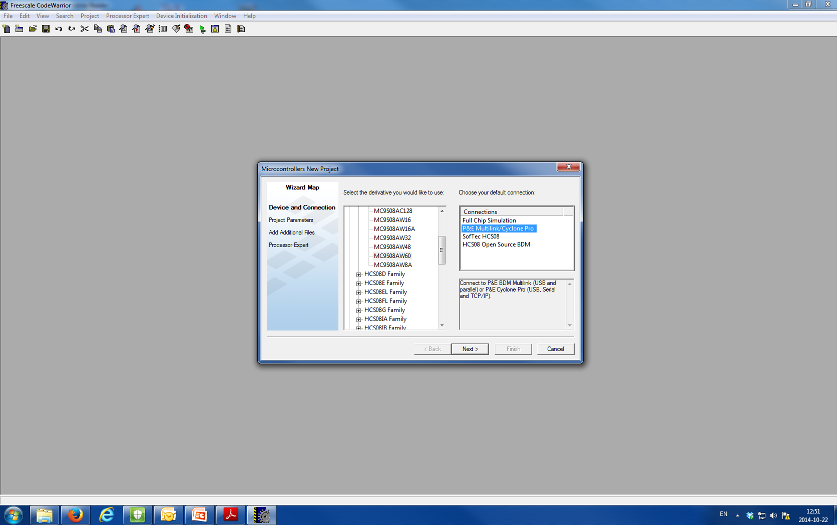
On next screen, select HCS08 -> HCS08A Family -> MC9S08AW60 select “P&E Multilink/Cyclone Pro” (Connect the Demo to computer through USB-BDM cable), then press ‘Next’
2
1
3

Slide 6
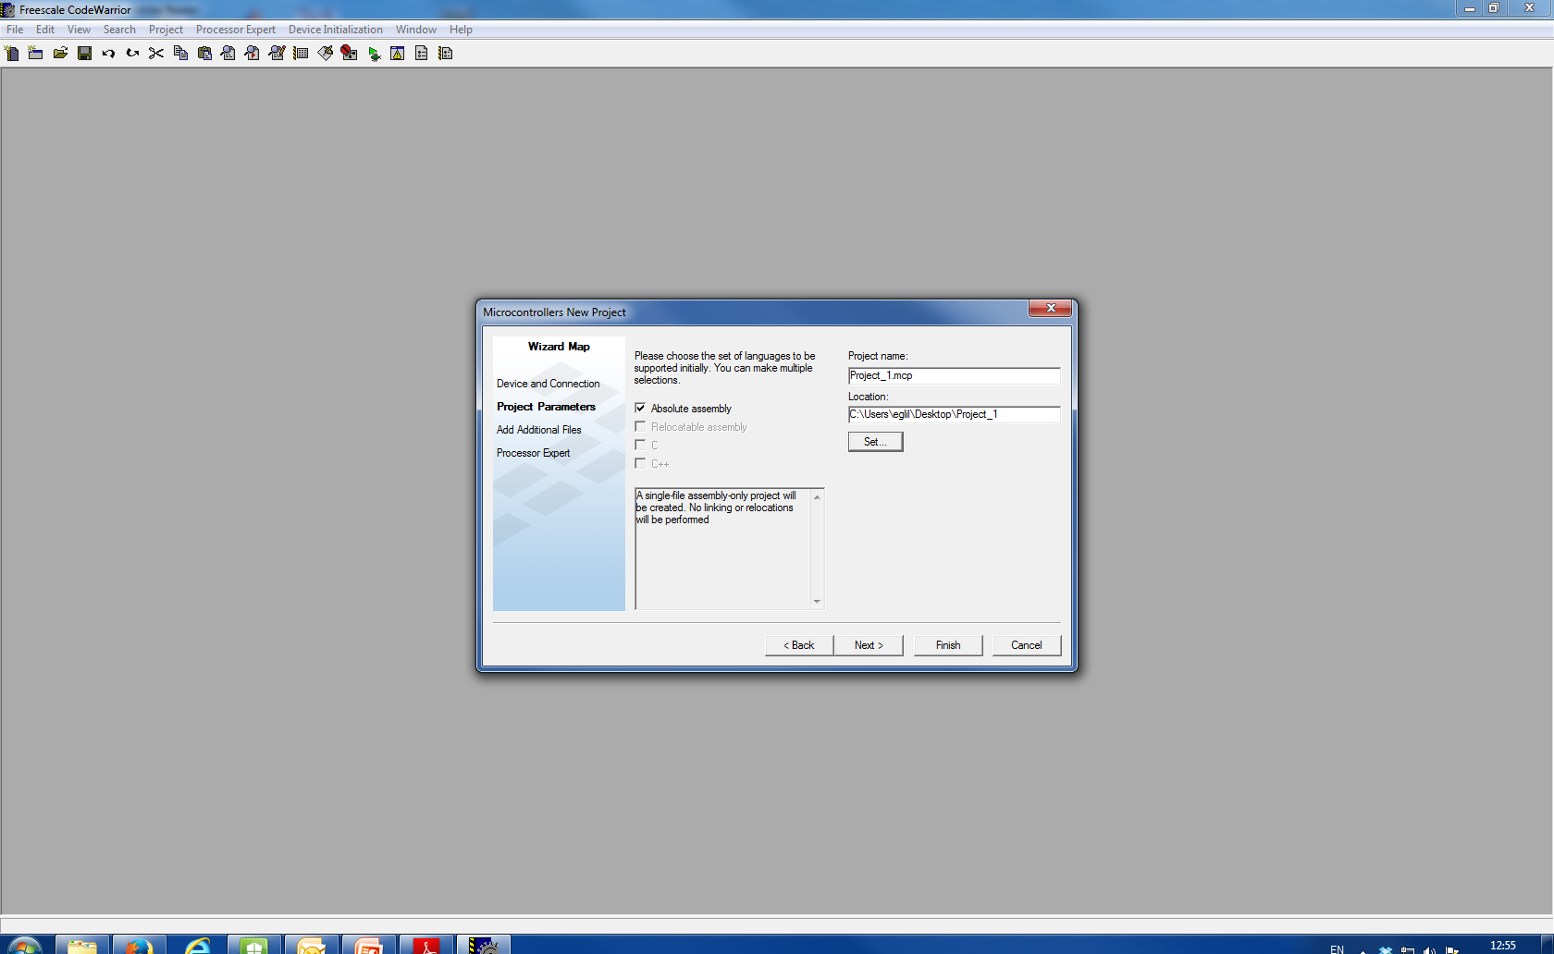
On next screen – Uncheck C, check “Absolute assembly” – Enter (or browse to) the new directory location for the project – Enter project name (you can leave it as “Project.mcp”) – Hit Finish

Slide 7
CodeWarrior automatically creates a sample “main.asm” file – we don’t use it – close Codewarrier – download and copy ‘prog1.asm’ from blackboard, and paste it into the project folder. – Delete the sample file, rename the ‘prog1.asm’ to ‘main.asm’ – Re-open the Codewarrier, now the main.asm should be ‘prog1.asm’. The first file PROG1.ASM has no code in it at all! It sets up the names and values of constants and variables used in the programme.

Slide 8
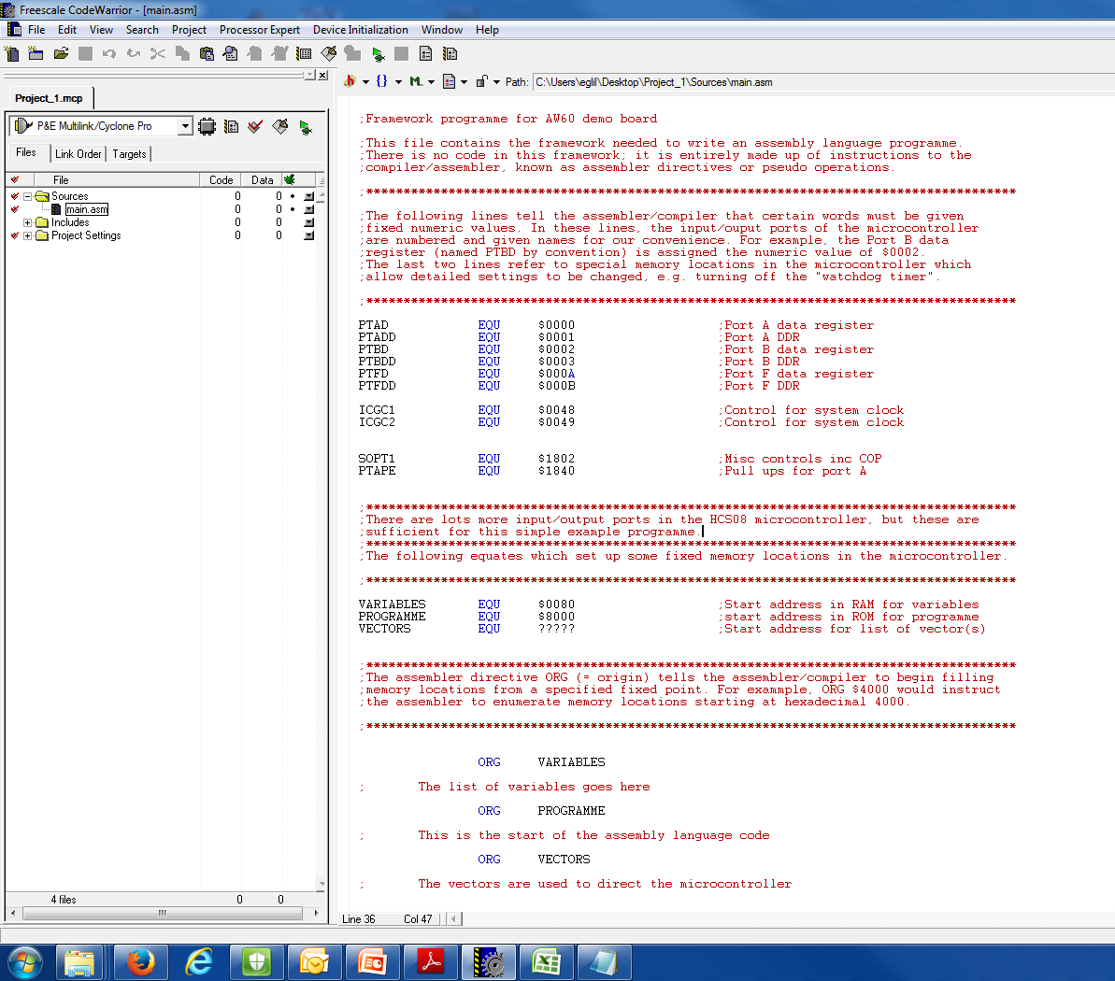
Header comments
Directives for assembler only

Slide 9
– close Codewarrier
– download and copy ‘prog2.asm’ from blackboard and paste it into the project folder.
– Delete the ‘main.asm’ file, rename the ‘prog2.asm’ to ‘main.asm’
– Re-open the Codewarrier, now the main.asm should be ‘prog2.asm’.
The second file PROG2.ASM contains some code, however
its function is to set up internal registers of the
microcontroller and to define the reset vector.

Slide 10
– close Codewarrier
– download and copy ‘prog3.asm’ from blackboard, and paste it into the project folder.
– Delete the ‘main.asm’ file, rename the ‘prog3.asm’ to ‘main.asm’
– Re-open the Codewarrier, now the main.asm should be ‘prog3.asm’.
The third file PROG3.ASM is a working programme which
increments an 8-bit binary number displayed on LEDs.

Slide 11
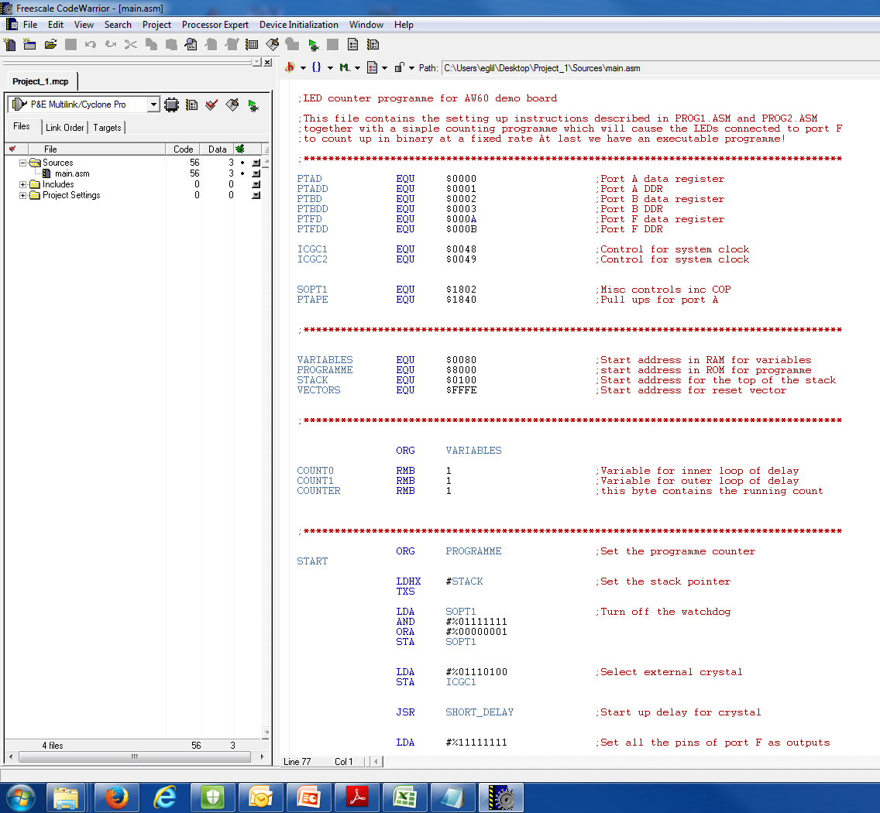
Compile and debug a program
Debug button

Slide 12
Do this in the Simulator

Slide 13
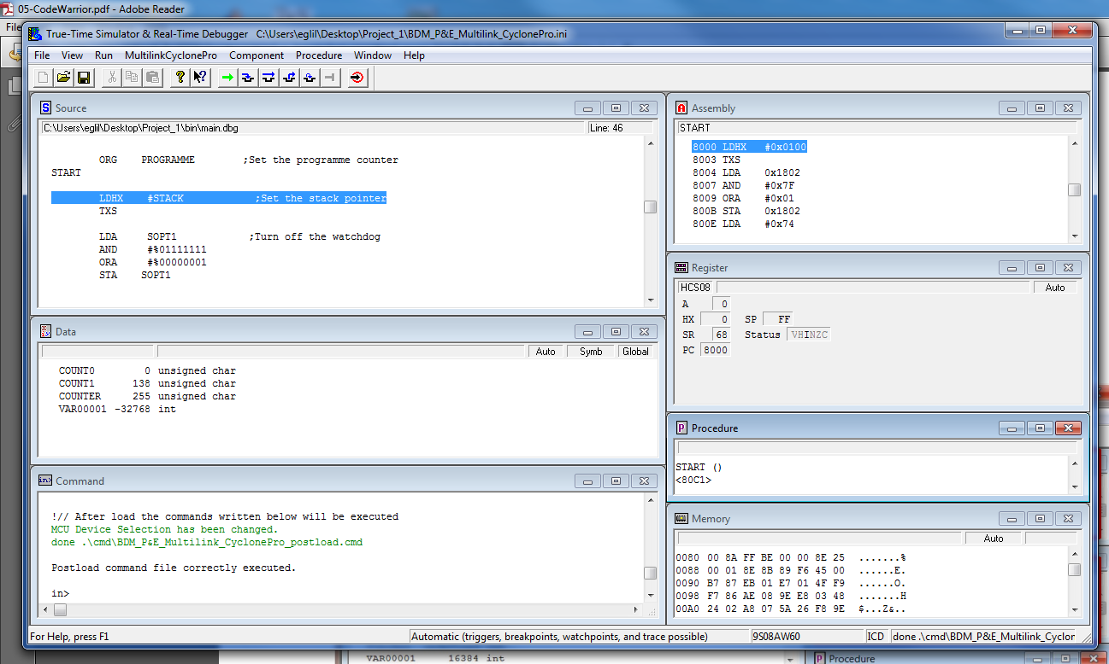
Debugger window
Show assembly code with addresses
Source code
CPU registers
Contents of memory

Slide 14
Put a break point step through

Slide 15
Run the program
Press ‘Start’ to run the program on the hardware

Slide 16
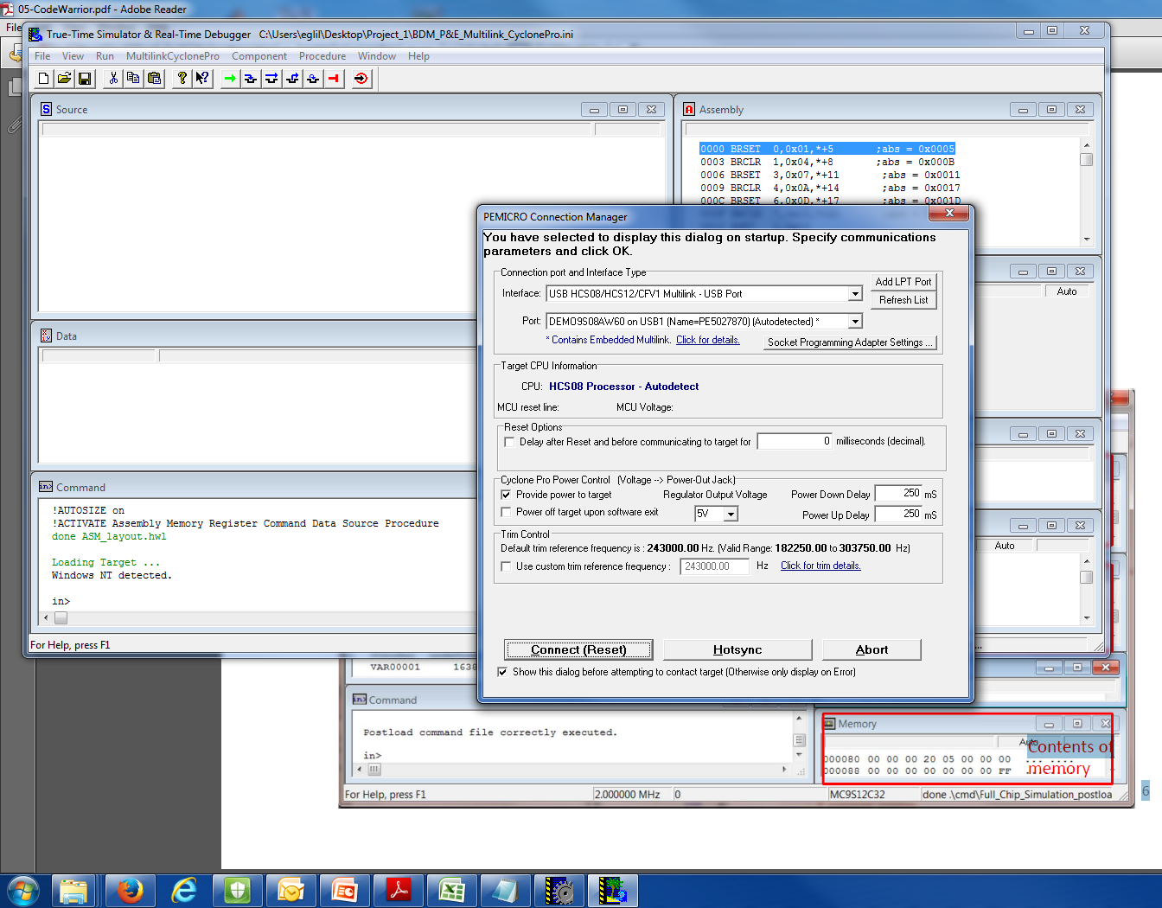
Build the connection between MCU and software
Connect the MCU

Slide 17

Results of prog3 is executed.

Slide 18
The fourth file PROG4.ASM develops PROG3 by including a button to control up or down counting on the LEDs.
Your activity today:
Take the file PROG4 and copy into the directory project name/sources. Rename the file as MAIN.ASM and answer "yes" when asked if the old file is to be over written.
Run Code Warrior and select "previous project" from the list. Click on the name of your project. The main edit screen will appear. Click on "main.asm" to open the file. Click on "make" to assemble the file.
If the file assembles correctly, click "debug" and follow the series of questions that follow. Some steps will take several seconds, so be patient!
Finally click on the "run" icon to run the programme.
Please consult a demonstrator for any question.

Slide 19
To add
Demonstrate the simulator
Show how code relates to code in memory
Put a break point in the second loop
Step through
Show what happens to the registers
Put a break in the main program
Answer a bunch of questions
Then do the link to hardware

