Slide 1
f_{p}(t)
f_{L}(t)
A
1
t
t
a
1
2

Slide 2
f_{T}(t)
1
t
1
2

Slide 3
f_{R}(t)
A
t
a
2a
3a
-A

Slide 4
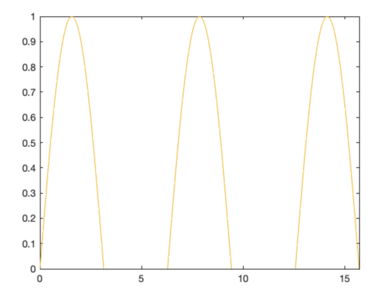





f_{HW}(t)
$$π$$
$$2π$$
$$3π$$
$$4π$$
$$5π$$

