Slide 1

Homework: Linux. Basic monitoring. Memory. LA
1 Depending on the configuration of your system, write what is the optimal LA value for your system
6, my system has six-core CPU, 12 threads
2 Using the stress utility, load the systems by 50%, assess the state of the system according to top
VirtualBox VM, 6 CPU are allocated:
[testvmadmin@testvm ~]$ stress -c 3
stress: info: [1852] dispatching hogs: 3 cpu, 0 io, 0 vm, 0 hdd
top - 19:24:55 up 47 min, 2 users, load average: 3.01, 2.20, 1.03

Slide 2
3 Use the ps utility to find the processes that are using the maximum memory / CPU on Linux.
CPU:
[testvmadmin@testvm ~]$ ps aux --sort=-pcpu | head -n 6
USER PID %CPU %MEM VSZ RSS TTY STAT START TIME COMMAND
testvma+ 1853 99.3 0.0 7976 96 pts/0 R+ 19:21 6:47 stress -c 3
testvma+ 1854 99.3 0.0 7976 96 pts/0 R+ 19:21 6:47 stress -c 3
testvma+ 1855 99.2 0.0 7976 96 pts/0 R+ 19:21 6:47 stress -c 3
root 1 0.0 1.3 240516 13316 ? Ss 18:37 0:01 /usr/lib/systemd/systemd --switched-root --system --deserialize 18
root 2 0.0 0.0 0 0 ? S 18:37 0:00 [kthreadd]
RAM:
[testvmadmin@testvm ~]$ sudo ps -A --sort -rss -o pid,pmem:40,cmd:500 | head -n 6 | tr -s " " ";z"
;PID;%MEM;CMD
;845;4.3;/usr/libexec/platform-python;-s;/usr/sbin/firewalld;--nofork;--nopid
;847;4.0;/usr/libexec/sssd/sssd_nss;--uid;0;--gid;0;--logger=files
;873;3.2;/usr/libexec/platform-python;-Es;/usr/sbin/tuned;-l;-P
;825;2.5;/usr/lib/polkit-1/polkitd;--no-debug
;858;1.8;/usr/sbin/NetworkManager;--no-daemon

Slide 3
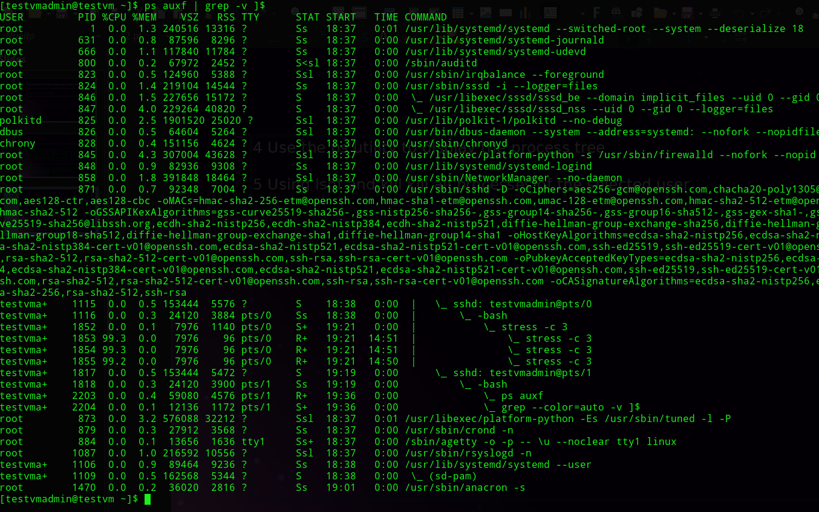
4 Use ps utility to display process tree

Slide 4
5 Using lsof and kill kill all processes of the selected user
Assuming username is «newuser», we can:
sudo kill -9 $(sudo lsof | grep newuser | awk '{ print $2 }' | xargs)

