Slide 1
Capstone Project-III HireHub
CSS
Team 100
Jainil Nayi
Yash Patel
Mihir Patel
A Job Finder Website

Slide 2
Table of contents
01
02
04
03
Overview
Demo Screenshots
Tech Stack
05
Working
Challenges & Future Works

Slide 3
Overview
HireHub offers an all-in-one solution for job seekers and companies to connect, apply, and hire efficiently. With advanced job search, personalized job recommendations, and interactive application guides, users can navigate the job market and recruitment process effortlessly.

Slide 4
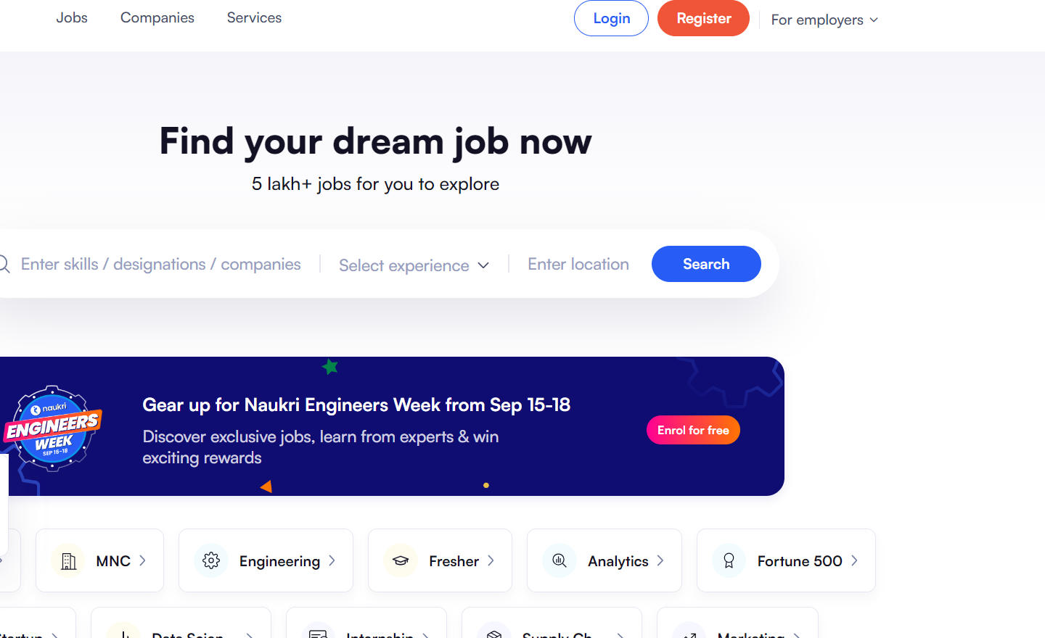
Computer mockup

Slide 5
Demo Screenshots

Slide 6
Demo Screenshots

Slide 7
Demo Screenshots

Slide 8
Demo Screenshots

Slide 9
Demo Screenshots

Slide 10
Tech Stack
Frontend
HTML
CSS
JavaScript
Database
MySQL
Backend
Node.js with Express.js

Slide 11
Working
Our web application seamlessly integrates the EDAMAM DB API, offering users a streamlined recipe discovery experience. Through intuitive search options, individuals can effortlessly explore recipes by name, ingredient, country, or season.
This user-centric approach ensures a personalized culinary journey, where users can tailor their exploration to their unique preferences. By providing a comprehensive array of search criteria, our platform empowers users to uncover new and exciting recipes, making meal planning an enjoyable and efficient process.

Slide 12
Challenges & Future Works
Challenges
Authentication Services Selection
API Selection and Integration
Responsive Web Design Implementation
Frontend API Integration
Deployment Challenges
Working with Database
Future Works
Plan to include job planning.
Partner with MNCS, Freelancers
Commitment to empowering users for successful, fulfilling careers through seamless job connections.

Slide 13
Thanks!

