Slide 1
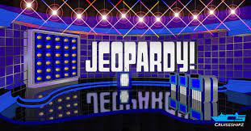
THIS IS:
How to study 35 years of Jeopardy Questions

Slide 2
As a fan of Jeopardy, how would one prepare to go on the show?
Jeopardy is a long running and popular trivia show, known for its high degree of difficulty and that you give answers in the form of a question, i.e. ‘Who is George Washington?’
I found a dataset on Kaggle with 35 years of jeopardy questions and answers.
This includes close to 350,000 different questions, a lot to study!
Is it possible to form a condensed study guide?
Knowing that many answers repeat, what if we built a model to construct a set of keywords (Pavlov clues), for the most frequently occurring answers for the most frequently occurring categories?
Data scientists have done this before: Colin Davy, a data scientist from San Francisco, won a Jeopardy game in October 2020 by taking a similar approach and creating word cloud flashcards.
His blog - https://colindavy.medium.com/how-i-won-jeopardy-with-data-science-c2e9b52a1958

Slide 3
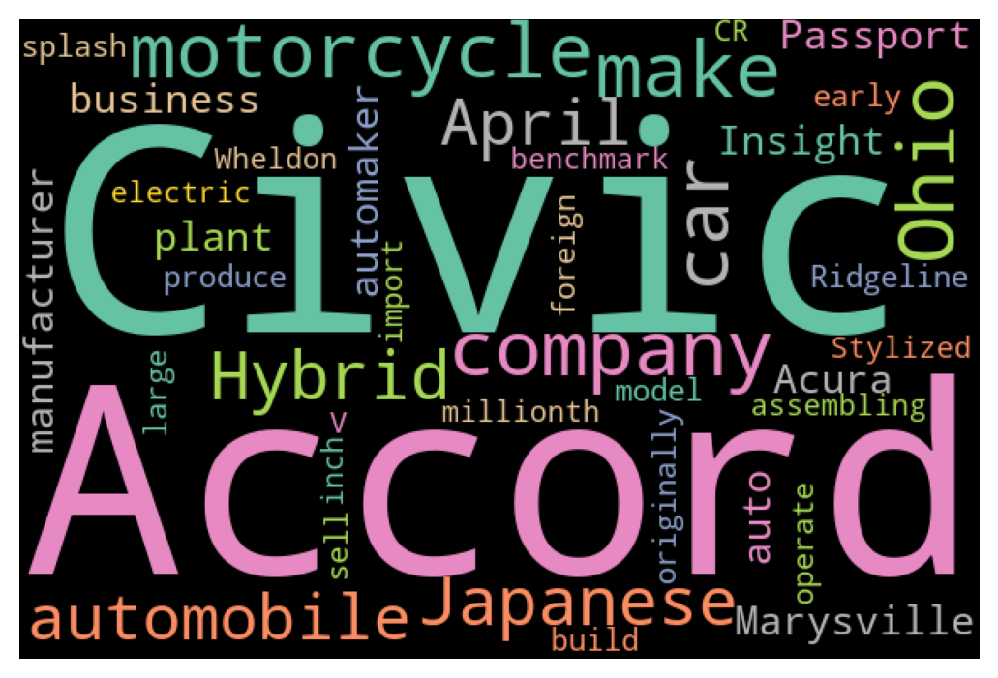
Sample Output What Answer Do You Think This Is?

Slide 4
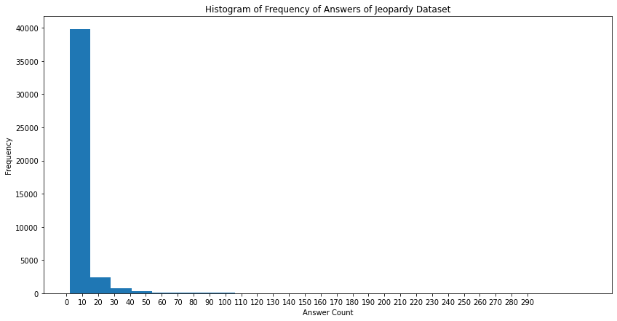
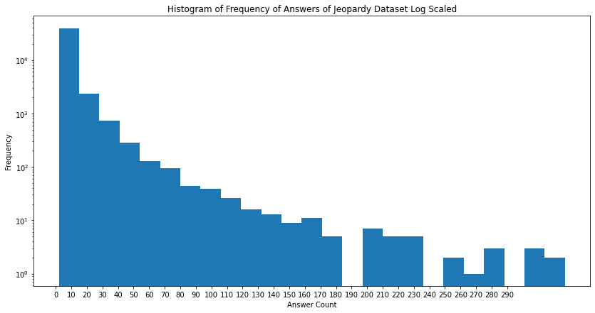
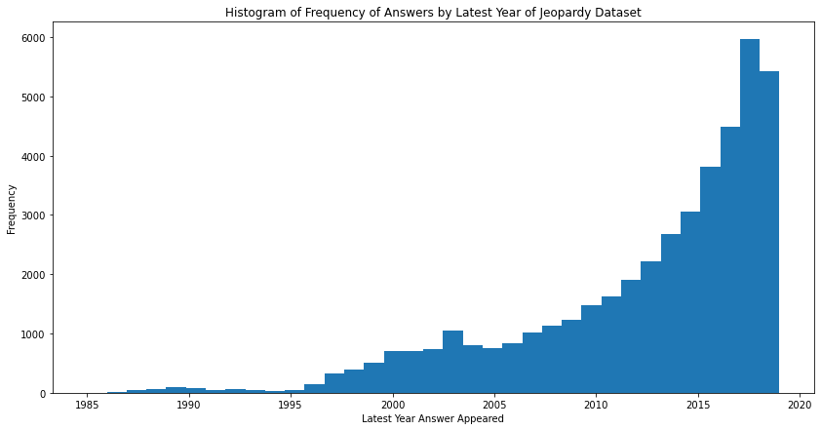
How Often Do the Same Answers Occur?
Looking at answers occurring more than once, we found around 43,000 different ones
Most seem to occur from 2 to 12 times, and most seem to have appeared in the last 5 years

Slide 5
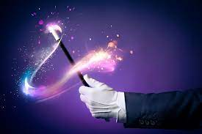
We use some Data Science Magic to Narrow Down Our Answers
We could produce 43,000 flashcards at this point, but this is still a lot to study.
These 43,000 answers we started with account for 285,000 questions,
82% of the total data.
Looking at only those answers that appear 12 or times, there are around 5100 unique answers, which is only 12% of what we started with.
These 5100 answers still account for around 140,000 total questions, about half of the we started with.
By concentrating on only 5100 of the top occurring answers, we still cover 40% of the entire Jeopardy dataset and we ignore answers that rarely occur.
5100 flashcards is doable from a study standpoint.

Slide 6
Can we break down our answers by Category?
A commonsense approach to studying Jeopardy is to focus on categories. After all, questions are presented by category.
This is valid as some categories such as Opera or Grammy Awards, that I generally struggle with while watching the show.
However, our 5100 answers appear in over 33,000 distinct categories. This is problematic.
It appears the same answer often appears in multiple categories.
What if we ignored grouping by category and pulled the keywords from combining the text of the questions and their categories?

Slide 7
Sample of ‘George Washington’ Multiple Categories
Category | Question
Presidential trivia | For the presidential portraits, Gilbert Stuart stuffed his sunken cheeks with cotton
Presidential firsts | 1st president to refuse a 3rd term
American revolution | General Howe faced him in Brandywine, Germantown, & Long Island battles
U.S. Marshalls | The oldest federal law-enforcement agency, the U.S. Marshals were established when this man signed the 1789 Judiciary Act
Dental problems | At age 57 in 1789 he had only one tooth remaining & wore dentures of hippo ivory made by John Greenwood
18th century nicknames | This president was "The American Cincinnatus", after a Roman who answered the call to leadership but preferred farming
American history | In 1976, more than 175 years after his death, this man was promoted by Congress to general of the armies of the United States
London | A replica of Houdon's famous statue of this American president stands outside the National Gallery
Religion | He told Newport, R.I. Jews, U.S. govt. "Gives to bigotry no sanction, to persecution no assistance"

Slide 8
Keyword Extraction
Keyword extraction is a very much an open and unsolved data science problem and active area of research, as well as Natural Language Processing in general (think about over 1 billion websites).
The most common traditional approach is Naïve Bay’s methods, which rely on bag of words and conditional probabilities. Although effective, a major drawback is you need to train your data or use a pre-trained corpus(dictionary).
For this problem, I also looked at some newer types of models which are unsupervised, that is are plug and play and do not require any training datasets.
In the end, I chose to dive into a model called YAKE (yet another keyword extraction model), very recently developed in 2018.
YAKE FEATURES AND METHODS
Corpus, domain, and language independent. Relies on statistical features of text only.
Built in pre-processing (i.e., removing stopwords), de-duplication, and scaling.
Returns keywords along with an individual score and ranking.
Key features of words used for scoring – Casing, Word Position (in relation to the document), Word Frequency, Word Relatedness to Context(number of different terms that occur before and after), and Word DifSentence(frequency of occurrences in different sentences).
In consideration of how the model works – I preserved casing and sentence structure when preparing my text.
I did lemmatize my words in consideration of the model and output.
Example: runs, running, ran > run

Slide 9
Initial Test Results Example – Alaska
We see overlap of keywords between different answers. How do we know what we returned is unique to our answer?
We will conduct a hypothesis test in the form of a 2-sample t-test to test statistical differences between the mean of the scores between ‘True Answers’ and ‘False Answers’. Our null hypothesis is that there is no difference.
category | question | answer | score
South park | National parks in the south of this state include Sitka and Glacier Bay | Alaska | 3028
Historic America | A fine collection of Haida & Tlingit totem poles was toted to Sitka National Historic Park in this state | Alaska | 2990
Visit a national park | Denali Park & Preserve has 6 million acres of wild land & a 20,000' peak in this state | Alaska | 2961
National Parks | The USA's largest national park in area is Wrangell-St. Elias in this state | Alaska | 2959
category | question | answer | score
National park place | Olympic National Park in this northwest state offers mountains, glaciers & the occasional elk | Washington | 2935
Red states | If you're visiting Glacier National Park in this state, be sure to check out Red Mountain & Red Eagle Mountain | Montana | 2935
State the national park | North Cascades National Park | Washington | 2932
North American geography | Joshua Tree National Monument near Palm Springs in this state was made a national park in 1994 | California | 2932

Slide 10
YAKE Model Results – Random Sample of 100
De-Dup Value | Max Words | Avg P-value (Below .05) | Percentage Below .05 | Avg Words Returned
0.3 | 20 | 6.2e-9 | 99 | 20
0.3 | 30 | 1.1e-10 | 100 | 29
0.3 | 40 | 7.3e-12 | 100 | 34
0.5 | 20 | 1.1e-8 | 99 | 20
0.5 | 30 | 2.2e-6 | 100 | 30
0.5 | 40 | 4.3e-12 | 100 | 40
Final Model : YAKE at .5 de-dup threshold and 40 words.
The P-values prove statistically that the keywords for a
answer are unique as compared to any other answer.
Let's Look at the results: https://share.streamlit.io/cpklackey/jeopardy-dashboard/main/Jeopardy_Flash_Cards.py

Slide 11
Conclusions and Recommendations
We built a model using YAKE to extract keywords for frequently occurring Jeopardy answers and can confidently say that with the model we chose, given a set of keywords we extracted for an answer, that set of keywords will be unique to our answer.
We also built an online dashboard that displays the keywords as word clouds which can be used a study guide.
It is possible to keep the dashboard updated as it is possible to web scrape data for all shows from the Jeopardy Archives website.
We found the Jeopardy dataset to be a rich and robust set of data with much more that could be explored.
We also learned the value of keyword extraction techniques and natural language processing in general and why these are so important and relevant to Data Science today.

