Slide 1
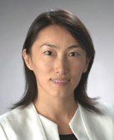
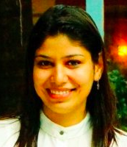

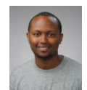

IST 659 - Data Administration Concepts and Database Management
Ankita Dhawan
Nata Barbosa
Alain Shema
Qunfang Wu
Yun Huang
Prof. Yun Huang <yhuang@syr.edu>
Monday
M002(9:30am to 12:15pm) Hinds Hall 027
M001(2:15PM – 5:05PM) Hinds Hall 013
Office hours – Monday (1pm to 2pm) Hinds Hall 226.
TA: Ankita Dhawan andhawan@syr.edu
Three Ph.D. students: serving as mentors for student presentations

Slide 2
Our First Lecture
Why to take this class?
What is this course about? What is it NOT about?
What is our learning goal? How to achieve it?
A roadmap of the semester with a timeline
The textbook
Class structure and assessments
How to use our blackboard
Knowing each other and your group member
Today’s action items
Review Syllabus
Offline reading
Project proposal

Slide 3
Some background on me:
Assistant professor at iSchool
My education background and work experience
Having designed, built and deployed many application systems using different database systems
Co-director of SALT (Social Computing Systems) lab http://salt.ischool.syr.edu
We are hiring student researchers.
If you are interested in, please send me your resume.
Notes:
We design and build systems. We apply various technologies to understand how people use different systems. We then provide better system design to improve system utilities and user experience.

Slide 4
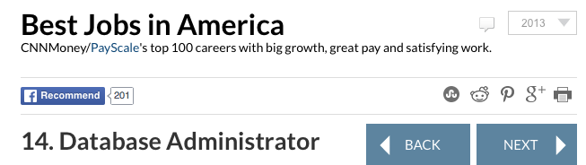
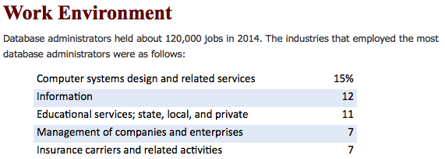
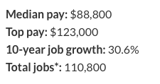
Why do we learn database management?
Notes:
Knowledge about DBMS and relevant skills are essential to succeed in IT related career.

Slide 5
Sample Stories
My previous TAs
A Chinese student, who had no prior work experience, now is working at Bloomberg.
An Indian student who had no prior work experience, graduated within 1.5 years and now works at Nasdaq. He used my database class materials to prepare for his interviews.
An Indian student who had some work experience, landed a full time position during her summer internship at Bank of America.
My students
A girl, who had no prior work experience, finished a 14-round job interview and received the job offer by showing the ERD diagram of my system.
A boy, who did not know database before, received an internship position at BoA for database security right after he took my class.
My students were from different majors. If they can make it, you can!

Slide 6
Basic Concepts
What is Database Management System (DBMS)?
A software application that interacts with its database, applications (web, mobile, etc.) and users to collect, represent and analyze data.
The essential activities involved in creating a database app:
Determining what data is involved
Identifying the relationships among different data
Creating a database for storing the data
Implementing user interfaces for collecting data
Realizing business intelligence by analyzing the data
Maintaining the data
Notes:
Write business requirements (functional / non-function requirements) of a database application
Model the relationship of the data that the app will capture
Create a database that stores the data
Implement effective user interfaces for collecting data
Realize business functions
Maintain the database

Slide 7

A Case Study
Use one of my research projects to explain the steps
How can transit agencies (i.e., the bus service providers) collect riders’ reports to improve transit services?

Slide 8
In order to answer “what” data is involved
Talk to the “subject matter experts” or “stakeholders” to understand what they do now
from the riders’ perspective:
Have paper schedule, but not real-time schedule
➔ challenge 1 : how to get real time bus information? (uncertainty)
from the drivers’ perspective:
If the bus is full, the bus driver can skip some stops
If the bus does not have space, wheelchair users cannot get on the bus
If we send many buses, we may waste money on running empty buses
➔ challenge 2 : How to collect bus load information?

Slide 9
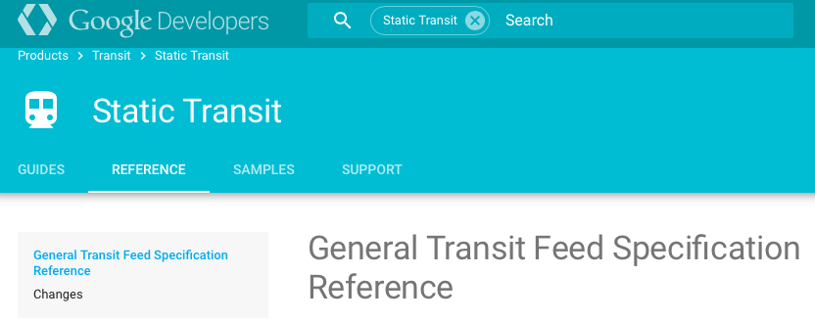
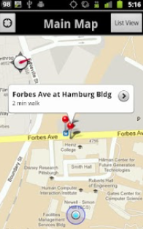
1. Writing Business Rules
The focus:
What data needs to be collected?
How different people would use the data coming through the system?
How to present the data?
Privacy issues? Who can see what?
Clarify the functional requirements by either describing the final deliverables or providing mockup designs
The final project website http://www.tiramisutransit.com
The app view https://play.google.com/store/apps/details?id=edu.cmu.dv1.androidprod

Slide 10
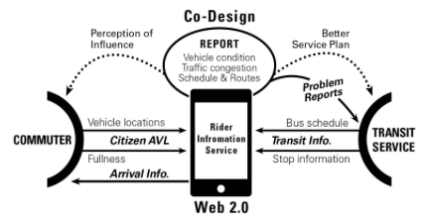
2. Modeling and Designing Database
The focus:
What attributes are involved in the data?
What’s the relationships among different data?
The deliverables:
Data Model and Database Schema
i.e. The number of data entities to be create and relationships of the entities

Slide 11


3. Creating a Database (Relational Tables)
The focus:
Select appropriate data types for storing the data
How to uniquely identify the data?
The deliverable:
A database with a set of tables that do not have much redundancy

Slide 12
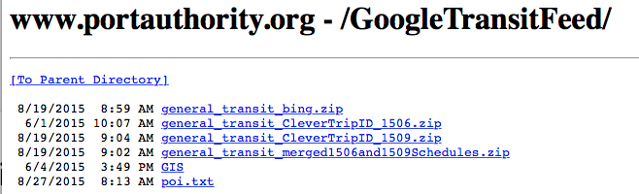
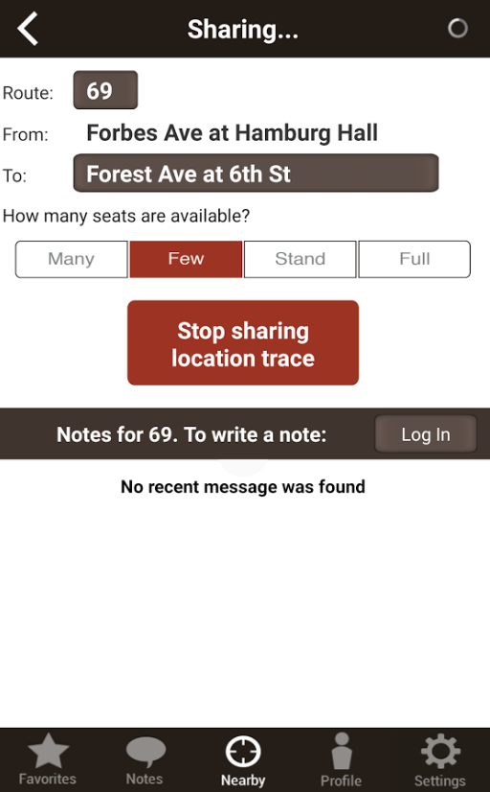
4. Collecting Data
The focus:
How to collect the data?
How the data are represented prior to analysis and presentation?
The deliverable
Scripts to load the static bus schedules
Mobile interface to collect user traces for generating real-time bus arrival information
Interface for riders to report issues about a trip
Additional tables or data attributes may need to be created for storing the data

Slide 13

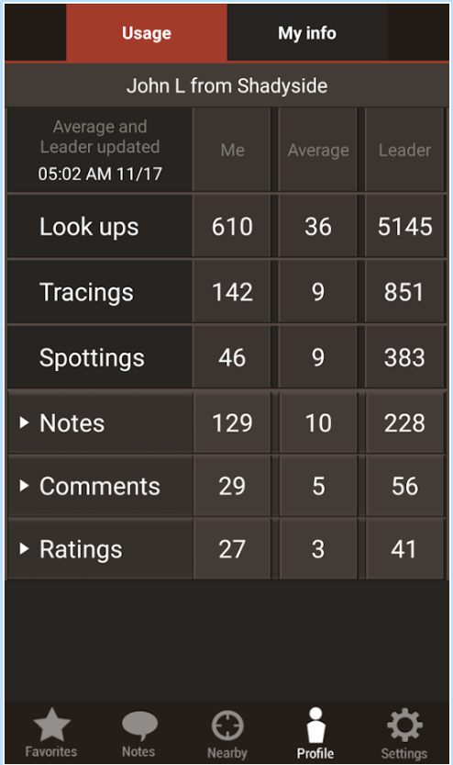
5. Analyzing Data (Generating Reports)
The focus:
Summarizing data
Cleaning data, identifying bad data
Many times involving technical, mathematical and statistical aspects to these activities.
The deliverables
Database functions created for
removing poor user traces that can not create accurate real-time predictions
Creating user reports

Slide 14
6. Database Maintenance
The focus:
Archiving collected data
What to keep and what to discard?
E.g. Every some months, there would be new bus schedules released
How to handle the old data?
Predict future use of the data
The deliverables
Script to index important data
Script to remove data that is not important for future use
Storage1
Storage2

Slide 15
The Pyramid
Business opportunities at certain communities, e.g., advertisements on certain bus trips
Wisdom
Route planning
Intelligence
Historical schedule estimation
Value
Service quality
Knowledge
Real-time bus arrival prediction
Bus fullness information
Information
Rider’s traces
Data
Paper Bus schedule

Slide 16
Scope of This Course
Focus on relational database – everything is a table
understanding the concepts and applying the concepts in your practices through different activities
Writing business plan -> design -> implementation -> demo
This class is NOT about a particular software, e.g., MS ACCESS, Visio or advanced SQL functions/procedures
Textbook: Hoffer, Jeffery B, Prescott, Mary B, and McFadden, Fred, Modern Database Management, (9th and 10th editions acceptable)
A roadmap
Please keep it available for your reference throughout the semester.
Update will be posted on Blackboard

Slide 17
A Roadmap of IST 659
User Interface
(MS Access)
10/31
9/26
10/10
Create a database app for a business including user interfaces for perspective users
8/29
Unary &
Relationship Attributes
Physical Design
(SQL)
DBMS
Concepts
TOPICS
5
Business rules, Data Modeling
9/19
Binary
Ternary
Query
11/14
10/03
C9
Transaction
10/17
Normalization
Modification
11/07
9/12
Function
Procedure
Trigger
10/10
Entity
Creation
(3.2) Demos
1
2
3
4
C2
C3
C4
C6
C7
C8
C10
C11
C12
C13
C1
C5
12/05
12/12
DUES
Student Videos of Advance Presentations are due BEFORE the class!
Lab3
Lab6
Lab 8
Lab4
Lab1
Lab2
Lab5
Lab 7
(3.1) Demo Slides
(4) Final Report
(1) Project Proposal
(2) Design report
Notes:
Knowledge wise, At the end of the semester, students are expected to understand:
Essential concepts and characteristics of relational databases
Key elements in business rules
Different Entity Relationship Diagrams?
The process of mapping the ER models to relational database tables
Normalizations and functional dependencies
Key constraints in database tables
Client server architecture
At the end of the course, students are expected to learn and practice the following skills.
Write business rules in a professional manner
Create ER diagram given certain business rules
Normalize tables to reduce data redundancy (to the 3rd Normal Form)
Create, populate and query tables using SQL languages
Write store procedures, functions, triggers or transactions to optimize database operations
Build an client/server database app to demonstrate the key features of a database system

Slide 18
Advanced Topic Presentations
Ph.D. Mentors
Each presentation will be co-presented by 2 students.
If there is no one to pair, then you will give it by yourself.
The presentation could be about 6 to 8 minutes.
Speakers:
Before the presentation:
submit your presentation video before the class.
If you have a group of two students, only one video is good.
Audiences:
Watch the video and use the tool to interact with the video.
Need help to pre-evaluate your presentations?
Each group will be assigned with one ph.d. student
Contact your ph.d. mentor for feedback
Nata Barbosa
Alain Shema
Qunfang Wu

Slide 19
4 Check Points of the Class Project
Project Proposal – 2 page
Find a topic that you are really interested in
feel free to email me and TA your project topics if you have questions
Design report – ERD
Data and relationships
Project demo
students are separated into two groups
The two groups will demo their projects in the last two lectures separately
Every student should submit the demo presentation slides on the same day (before the first demo)
Every student will demo at their own desks
Each student needs to review at least 8 students’ projects
Final report
Include screenshots and SQL scripts

Slide 20
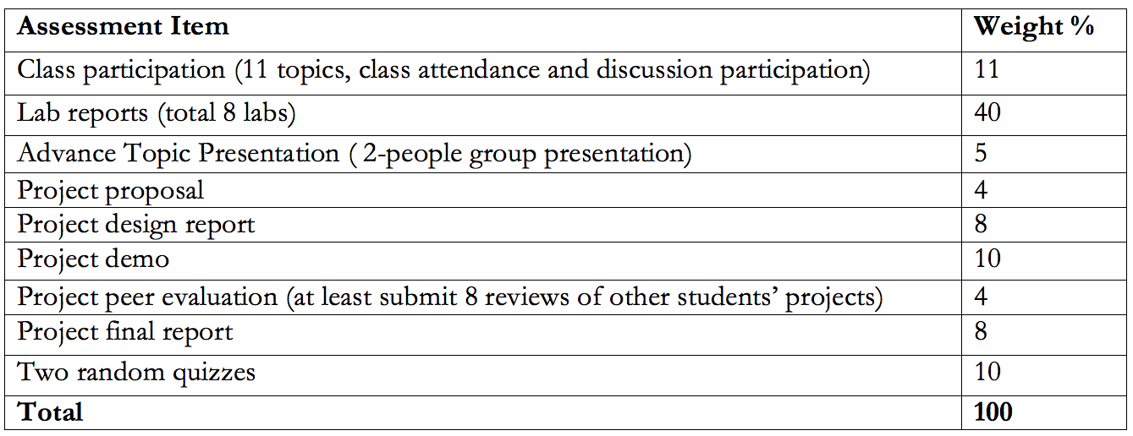
Assessment

Slide 21

Grading Policy and The Cut
Grades should not be negotiable. If you find any error, please send your request to the TA and CC me for re-evaluation within one week after the grade is sent out; grades cannot be changed thereafter.
Grades of the following items will be available after the last lecture to accommodate all the students’ schedules:
advanced topics, project demos, participations, lab 8, and final reports

Slide 22
How to Use Blackboard
Find your group
consult with the syllabus to identify the time of your presentation.
Each lecture
Before the class, upload your presentation video if you are scheduled for that Monday.
During the class
Watch student video together
Lecture, in-class exercises
review questions regarding lab or project assignments
Over this semester, there will be two quizzes
Each week, there is a TA hour
Let us decide a day and a time for the weekly TA hours from the following options now!
Tuesday, Wednesday any time ?

Slide 23
Breaking the Ice
Please
complete the profile form
leave the form on the table for me to pick it up
Take a few minutes to move around and introduce yourself to at least 4 students whom you do not know before.
Find your group member
Take a break!

Slide 24
DBMS concepts – for additional readings
** open the Class-1-Slides-for-Offline-Reading.ppt
Compare
Data, Metadata, Information
DBMS environment (page 10)
Components
Advantages
Disadvantages
Notes:
Coming back from the break

Slide 25
Revisit today’s lecture
Why to take this class?
What is this course about? What is it NOT about?
What is our learning goal? How to achieve it?
A roadmap of the semester with a timeline
The textbook
Class structure and assessments
How to use our blackboard

Slide 26
Your action items for now
Go through the syllabus
ask questions
Plan for your project proposal
Read the project instruction documents
Read the sample design report
Brainstorm and discuss the topic of your class project with your peers, the TA and me

Slide 27
Your action items for the following two weeks
Finish the offline reading
Finalize advanced topic presentation by next Monday
email your topic to the TA.
Plan for your project proposal
Find a topic that you will be very interested in.
The size of the project can’t be too small or too large, better not be too simple or to complicated either.
Pre-read the textbook for the next lecture
The first presentation group uploads your video!!

Slide 28
Project Topics Relevant to My Research
If you take any of the topics, my research team members and I will meet you and discuss the project scope with you in details.
The following topics are available:
Google Indoor Map Project - A variety of databases for SU indoor map apps
Each of the following can be one project.
International center office
Hinds Hall
Student Center
Administration Office
Gym
If you are not from iSchool, then an indoor map database for your department building?
It is possible many of the buildings will use a similar database structure eventually, but there must be some difference you can discover
Your final product will be incorporated into my Google Research Project. Thus your class project can be also claimed as part of a research project sponsored by Google.
Public Safety project – Showing and search crime information at different locations
Social Media project – Showing the public’s discussion topics and sentiment to police department agencies
Database for an online learning system – Encourage communication between instructors and students using online videos.

Slide 29
Additional Information (I) - Key Elements in Your Advanced Topic Presentation
Introduction of the concept
What is it
Why it is important or an interesting one?
What is the current state of art?
How is it used?
Better give an example
Is there any other important aspects that we should know?

Slide 30
Additional Information (II) To Give A Good Presentation
Before the presentation
Make sure you practice with your co-presenter
Appropriate font sizes and colors
Avoid small texts
Avoid too much texts
Avoid color combinations that are difficult for color blind people
Please self-evaluate your presentation using the following criteria http://www.english.wisc.edu/rfyoung/333/Presentation_Evaluation_Form.pdf
The above criteria will be used for grading as well.
During the presentation:
Keep track of your time

Slide 31
Feedback
Please write down
Which part of this lecture you like the most or think the most helpful? (optional why)
Which part of today’s lecture is confusing or needs more time to understand? (optional why)
Any other comments or questions? (optional)
How to find me
Please email me your questions or requests for appointments beforehand. Office: Hinds 226
If you call my office 315-443-5299, please leave a voicemail. It will show up in my email.

