Slide 1
Normalization
IST 659 – Class 5
Courtesy of book materials and previous lecture notes. No dissemination or sale of any part of this work (including on the WWW).

Slide 2
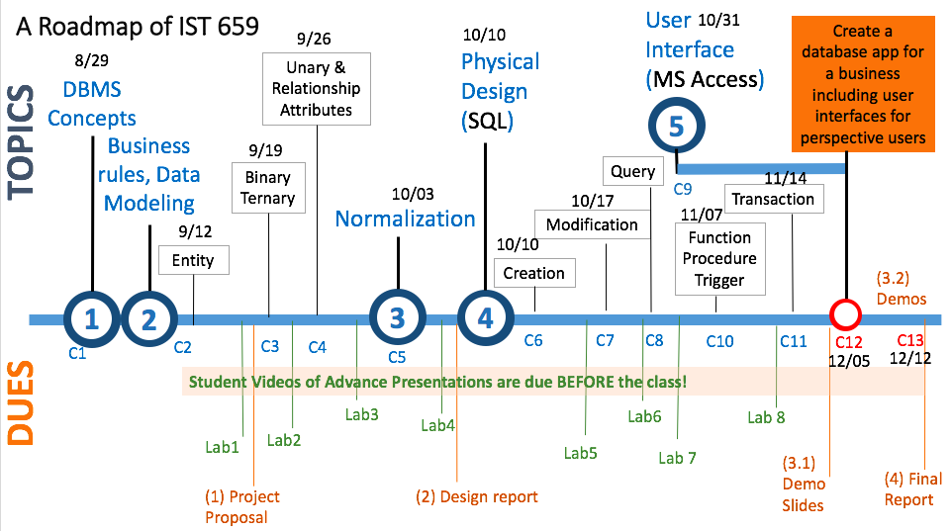
We are here today.

Slide 3
Today’s Goal
Concept
  Normalization
    The process of decomposing relations with redundancies to produce smaller, well-structured relations.
    Integrity constraint
    Anomaly
    Functional Dependencies
Skills
  Being able to convert a relation to 3rd Normal Form

Slide 4
Relation
A relation is a named, two-dimensional table of data.
A table consists of rows (records) and columns (attribute or field).
Requirements for a table to qualify as a relation:
  The table must have a unique name.
  Every attribute value must be atomic (not multivalued, not composite).
  Primary Key: Every row must be unique (can’t have two rows with exactly the same values for all their fields).
  Attributes (columns) in tables must have unique names.
  The order of the columns must be irrelevant.
  The order of the rows must be irrelevant.
Notes:
Keys are special fields that serve two main purposes:
Primary keys are unique identifiers of the relation. Examples include employee numbers, social security numbers, etc. This guarantees that all rows are unique.
Foreign keys are identifiers that enable a dependent relation (on the many side of a relationship) to refer to its parent relation (on the one side of the relationship).

Slide 5
Open the Access Table
Make a copy of the existing “normalization” table
  Look at the schema, what is the PK?
  Look at the values
Try
  Creating a new product
  Updating one product price
  Deleting an order
Notes:
– we can’t do it without having an orderID
– we create inconsistent prices, unless we update all the prices of the same product.
– we lose the customer information

Slide 6
Three integrity constraints
To facilitate maintaining the accuracy and integrity of data in the database
  Entity integrity
  Domain integrity
  Referential integrity

Slide 7
Entity Integrity (about PK)
  Every entity has a primary key (PK)
  PK can NOT be NULL
SID
100001
100002
100003
100004
Fname | Lname | Birthdate
Jim | Gray | 07/17/1970
Richard | Lancaster | 07/17/1970
Jenny | White | 06/08/1975
Jim | Gray | 07/17/1970
You can’t have two identical rows.
Notes:
By enforcing entity integrity constraint (primary key) we make sure same data won’t be entered twice, reduce data redundancy.

Slide 8
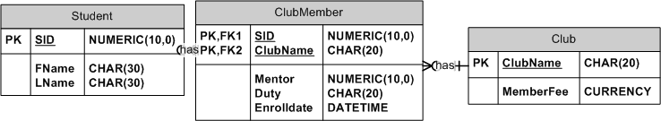
Domain Integrity (about Data Type)
  Every column has a data type
  The allowable value for an attribute has to conform to the data type.
    For example, if it is a number you can’t put in a text string)
  A foreign key in one entity must have the same data type as its corresponding primary key in another entity does
Notes:
By enforcing domain integrity constraint we make sure each entered values satisfy our data type requirements.

Slide 9
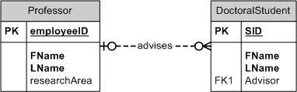
Referential Integrity (about FK)
  Foreign key (FK)
    is primary key in another table
  The value of a foreign key must either match a primary key value in the parent table, or NULL
eID | FName | LName | researchArea
01 | Yang | Wang | Privacy
03 | Yun | Huang | Mobile
SID | FName | LName | Advisor
1 | Jing | Zhu | 02
2 | David | Liu | null
Notes:
By enforcing referential integrity constraint we make sure the data across tables are consistent.

Slide 10
Well-structured Relations
Complying to all the integrity constraints may not be sufficient to create well-structured relations.
  You also want to minimize redundancy in your relations, such that when users insert, modify and delete the rows in a table, there are no anomalies (i.e. errors or inconsistencies).

Slide 11
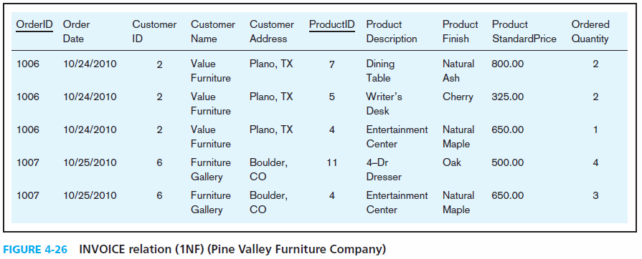
Data Redundancy
Suppose you create a big relation for the following data from an excel file, and you identify OrderID and productID as the PK.
Redundancy: the same data appeared in multiple rows unnecessarily.

Slide 12
Data Redundancy
Results in Errors or Inconsistencies
Insertion: If the furniture company produces a new table, but the product information cannot be entered, until someone places an order on it.
Update: changing the price of product ID 4 requires update in multiple records
Deletion: if we delete the order of 1007, we lose this customer information.

Slide 13
Anomaly
Anomaly:
  An error or inconsistency generated when changing the table records
Three types of anomalies
  Insertion Anomaly– occurs when certain attributes cannot be inserted into the database without the presence of other attributes.
  Update Anomaly–changing data in a row forces changes to other rows because of duplication, otherwise the data will be inconsistent.
  Deletion Anomaly– when certain attributes are lost because of the deletion of other attributes

Slide 14
The Root Cause: Multiple Entities in One Relation
PK | OrderID
PK | ProductID
 | Order Date
 | CustomerID
 | CustomerName
 | CustomerAddress
 | ProductDescription
 | ProdcutFinish
 | ProductStandardPrice
 | OrderedQuantity
  Customer and product information is depended on the order
General rule of thumb: A table should not pertain to more than one entity type.

Slide 15
Normalization

Slide 16
DATA NORMALIZATION
Data normalization
  the process of decomposing relations with anomalies to produce smaller, well-structured relations, removing data redundancy
Goal is to avoid the three anomalies

Slide 17
Concepts
Normalization can be achieved in stages, each stage corresponds to a normal form.
Normal form: requires that certain rules regarding relationships between attributes (or functional dependencies) are satisfied.

Slide 18
1st Normal Form (1NF)
A relation is a named, two-dimensional table of data which satisfies the following requirements:
  Every column must have a unique name
  Every row must be unique (primary key exists)
  Every value is atomic
All relations are in 1NF
  E.g. All tables that you created in Access are relations (1NF)
Notes:
composite attribute vs. multi-value attribute

Slide 19

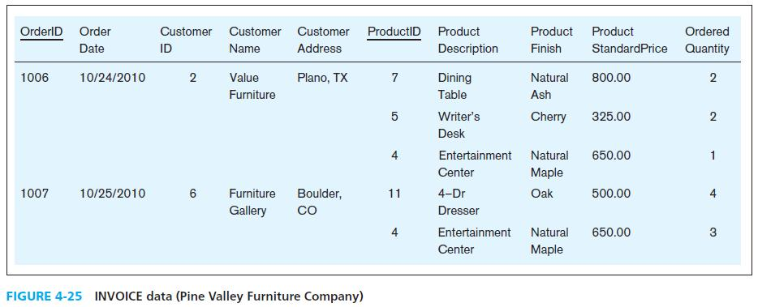
PK can’t be null
There is no unique PK for each row, so this is not a relation.

Slide 20
1st normal form (1NF)
Table with no multivalued attributes and unique rows

Slide 21
Review the Access Table
Anything remains to be done?

Slide 22
1st normal form (1NF)
Table with no multivalued attributes or composite attributes
Note: This is a relation, but has redundancy.

Slide 23
2nd NORMAL FORM (2NF)
  The relation has been converted to 1NF
  Every non-key attribute must be defined by the entire PK, not by only part of the PK
  Goal: remove partial functional dependencies

Slide 24
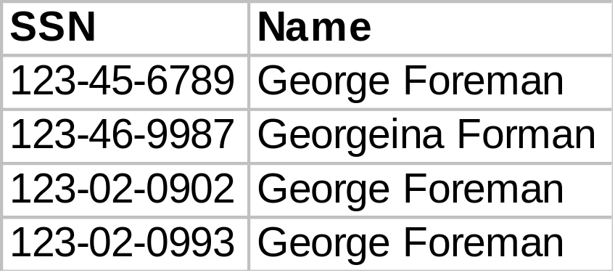
Functional Dependence
For attributes A and B,
  Written: A → B ,
  Read as A determines B, or B is the determinant
  each value in column A determines one and only one value in column B
  E.g., SSN → Name
  (Name is functionally
  dependent on SSN)
  .
Notes:
One A can’t have two Bs.

Slide 25
Partial Functional Dependency
Partial Functional Dependency:
  Part (but not all) of the PK can determine one or more non-key attributes.
  PK has to be a composite key in this case

Slide 26
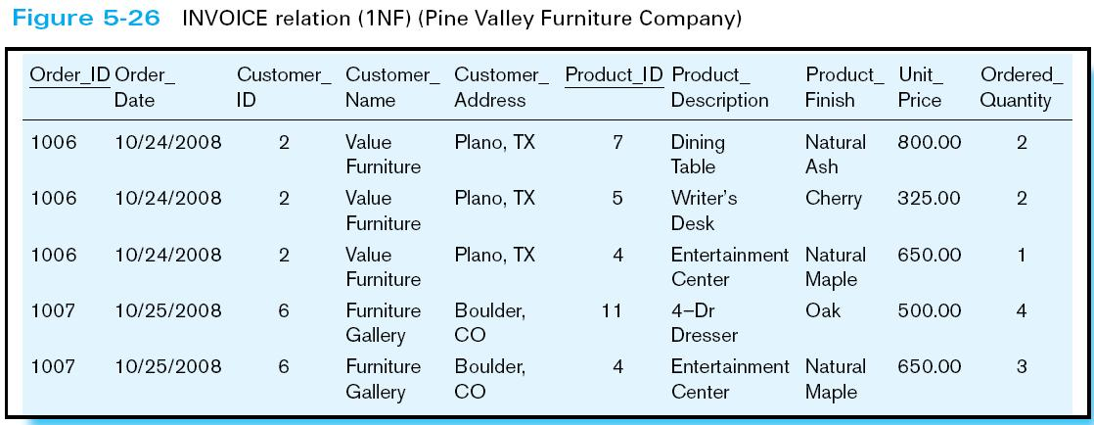
Step 1: Identifying partial dependencies by examining part of the PK
Composite PK : order_ID, product_ID
Order_ID ➔ Order_Date, Customer_ID, Customer_Name, Customer_Address

Slide 27
Step 1: Identifying partial dependencies by examining part of the PK
Composite PK : order_ID, product_ID
Product_ID ➔ Product_Description, Product_Finish, Unit_Price

Slide 28
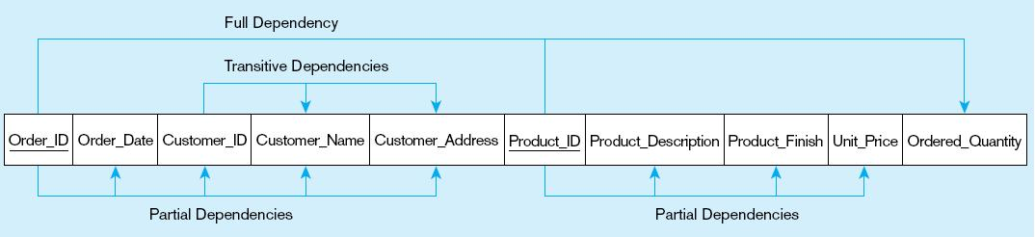
Identifying all the partial dependencies
Total 2 partial dependencies are identified.
Order_ID ➔ Order_Date, Customer_ID, Customer_Name, Customer_Address
Product_ID ➔ Product_Description, Product_Finish, Unit_Price
Notes:
Create a new table for each partial dependency, here we create the product table and order table. Now one big table is decomposed to three smaller tables.

Slide 29
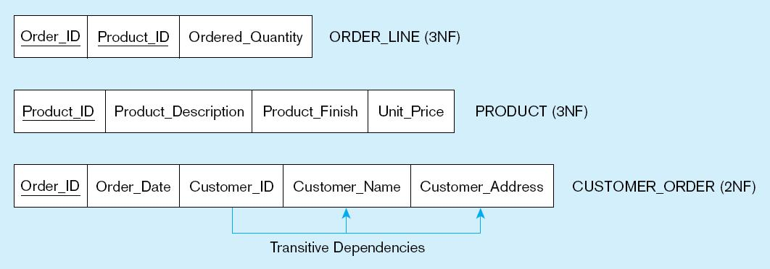
Step 2: Removing partial dependencies: 1NF-> 2NF
Create one table for each partial dependency
  Each new key stays as both PK and FK in the old table
Keep the non-key attributes that are determined by the entire PK un-touched.

Slide 30
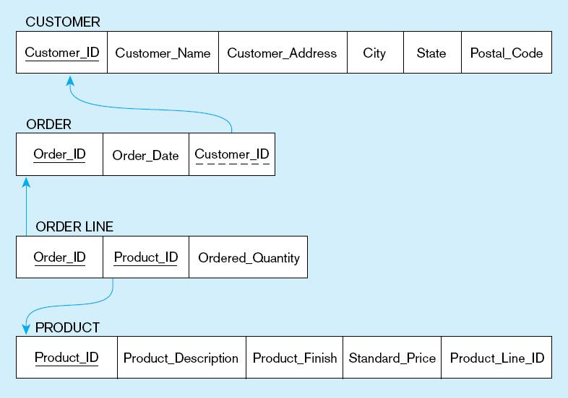
1NF
Removing partial dependencies
2NF
Order_ID ➔ Order_Date, Customer_ID, Customer_Name, Customer_Address
Product_ID ➔ Product_Description, Product_Finish, Unit_Price
Notes:
Create a new table for each partial dependency, here we create the product table and order table. Now one big table is decomposed to three smaller tables.

Slide 31
Review the Access Table
Change it to the 2nd normal form.

Slide 32
How many partial dependencies to look up?
When the PK is a composite Key with two attributes, A and B:
  You have to check A and B separately
When the PK is a composite key with three attributes, A, B and C:
  You have to check
    A, B, C separately
    Then,
      A, B-> ?
      B, C-> ?
      A, C->?

Slide 33
3NF (the 3rd Normal Form)
To remove transitive dependencies from 2NF, such that each attribute must be dependent on the entire PK ONLY
Transitive Dependency:
  Some non-key attribute(s) determines some other nonkey attribute.

Slide 34
Step 1: Identifying transitive dependencies
Customer_ID ➔ Customer_Name, Customer_Address

Slide 35
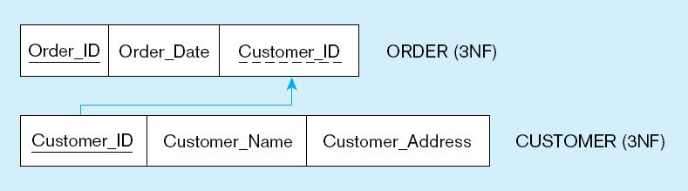
Step 2: Removing transitive dependencies: 2NF->3NF
Create one table for each transitive dependency
  non-key determinant becomes primary key in the new table and stays as foreign key in the old table
Keep the non-key attributes that are determined by the entire PK un-touched.
Notes:
We further create new table for each transitive dependency, here we create the customer table. Four tables in total now.

Slide 36

1NF
Removing partial dependencies
2NF
3NF
Removing transitive dependencies
Foreign key constraints are drawn via arrows from dependent to parent table
Notes:
Create a new table for each partial dependency, here we create the product table and order table. Now one big table is decomposed to three smaller tables.

Slide 37
Review the Access Table
Change it to the 3rd normal form.

Slide 38
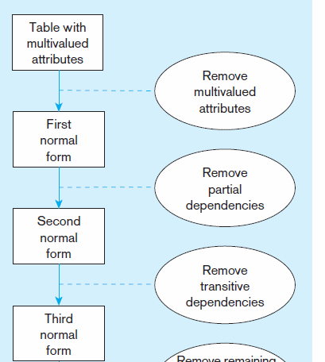
Data Normalization Process to 3rd Normal Form (3NF)
  PK is not null
  Each row is unique
  No composite values
  No multi-values
  If composite PK, there is no partial dependencies
  No transitive dependencies
3rd normal form is generally considered sufficient
  Each attribute must be dependent on the whole key ONLY
Notes:
Check if each entity is 1NF, if not convert it to 1NF
Check the functional dependencies of each entity to find redundant data groups
Remove partial dependencies to convert 1NF to 2NF
Remove transitive dependencies to convert 2NF to 3NF

Slide 39
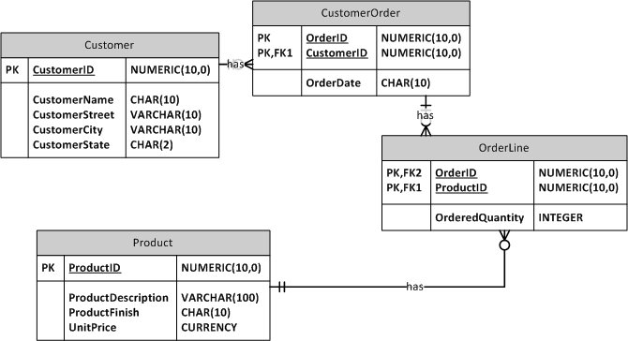
Each attribute must be dependent on the key, the whole key, and nothing but the key!

Slide 40
In Class Exercise
Table
(A, B, C, D, E, F)
B, C -> D
E -> F
How to normalize this table?
Notes:
\

Slide 41
Review Today’s Goal
Concept
  Integrity constraint
    Limiting acceptable values and actions, so as to maintain the accuracy and integrity of data
  Anomaly
    An error or inconsistency that may result when trying to modify a relation that has redundant data.
  Normalization
    The process of decomposing relations with anomalies to produce smaller, well-structured relations.
  Functional Dependencies
    Relationships between attributes
Skills
  Being able to convert a relation to 3rd Normal Form

Slide 42
More Class Exercise: Student club database
A student can join many clubs and serve one duty in each club. A student may have a mentor in each club. A student can be a mentor for many other new students.
SID | Student Name | Mentor | Duty | Club | MemberFee | Enroll date
001 | White | B. Gray | accountant | Fencing | 20 | 08/31/2010
003 | C. Black | D. Red | outreach | Chess | 30 | 09/01/2010
002 | B. Gray |  | president | Marathon | 15 | 08/31/2008
004 | E. Blue |  | president | Swim | 40 | 08/30/2008
001 | White | H. Purple | outreach | dance | 50 | 09/25/2010

