Slide 1
Introduction to SQL –DDL, DML & AGGREGATE FUNCTIONS
IST 659 – Lecture 6

Slide 2
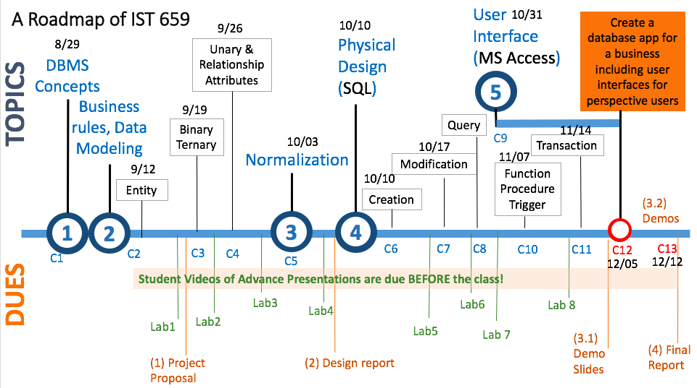
We are here today.

Slide 3
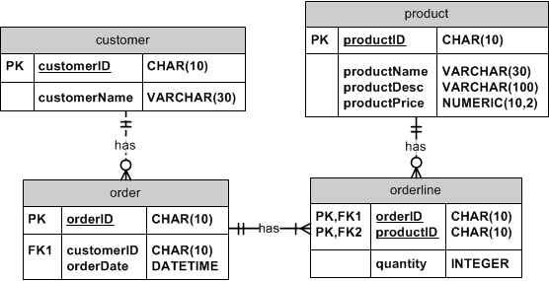
The Order of Creating Tables
Referential integrity check
Create entities without FKs first
E.g. Customer and Product tables
They don’t have foreign keys
Then create entities with FKs
Order and then Orderline
Any table that has foreign key referenced to another table cannot be created until the other table has been created

Slide 4

When Creating One Table
Define Table name
Identify data types for attributes
Identify columns that can and cannot be null
Identify columns that must be unique (candidate keys)
Identify primary key–foreign key mates
Determine default values
Identify constraints on columns (domain specifications)
Create the table and associated indexes

Slide 5
Today’s Goal
Concept
SQL SELECT statement on one table
After each step of your SQL script, an intermediate results table is produced and will be used for the next step. Users only see the table for the final results. Some times, it is only one row.
Skills
Can write SELECT queries with various conditions
Can use different operators in the WHERE clause

Slide 6
What can we achieve by querying one table?
Present individual row values of selected columns from one table
Filter each row based on some condition
One condition
multiple conditions
Call aggregation functions to summarize values of selected records
Categorize records to some groups based on the values of some columns and show values of the groups
After grouping, we can only select some groups
The final results can be sorted in some order

Slide 7
Today’s Focus: SELECT statement for One Table
Used for queries on single or multiple tables
Clauses of the SELECT statement:
SELECT
List the columns (and expressions) that should be returned from the query
FROM
Indicate the table(s) or view(s) from which data will be obtained
WHERE
Indicate the conditions under which a row will be included in the result
GROUP BY
Indicate categorization of results
HAVING
Indicate the conditions under which a category (group) will be included
ORDER BY
Sorts the result according to specified criteria, default is in ascending order.
Only FROM and SELECT are mandatory
Notes:
Group by divides a table into subsets (by groups); then an aggregate function can be used to provide summary information for each grup.
Order by: Use DESC as a keyword, placed after the column used to sort.

Slide 8
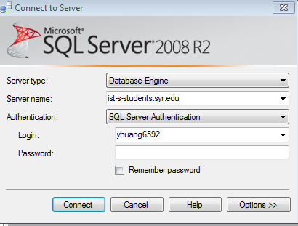
Let’s start with SQL Server…
Server name: ist-s-students.syr.edu

Slide 9
Creation and Population of Data – using SQL Statements (CREATE and INSERT)
Open IST659-Class-7-Query.sql
Read the script
Drop all the existing tables in your current database
Create tables and insert values
Create tables in order
IDENTITY type in SQL Server (AUTONUMBER in Access)
No need to input values for columns with identity data type
Check all the tables for the current values

Slide 10
What can we achieve by querying one table?
Present individual row values of selected columns from one table
Filter each row based on some condition
One condition

Slide 11
SELECT example
Query: find products with standard price less than $275 (script line #84)
Notes:
Write an empty query
Select
From
Where
Group by
Having
Order by

Slide 12
FROM clause
Query: find products with standard price less than $275
Where are the prices? In the product table!
Product_id | Product_name | Product_finish | Standard_price
1 | End Table | Cherry | $175
2 | Coffee Table | Natural Ash | $400
3 | Computer Desk | Natural Ash | $175
4 | Dining Table | Natural Ash | $800
5 | Computer Desk | Walnut | $250
FROM product

Slide 13
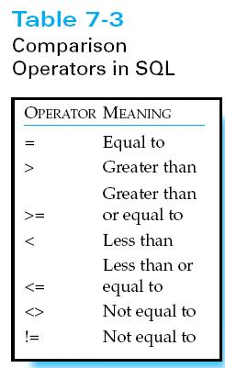
WHERE clause
Query: find products with standard price less than $275
Which rows to select? standardPrice<275
Product_id | Product_name | Product_finish | Standard_price | Product_line_id
1 | End Table | Cherry | $175 | 1
2 | Coffee Table | Natural Ash | $400 | 2
3 | Computer Desk | Natural Ash | $175 | 2
4 | Dining Table | Natural Ash | $800 | 3
5 | Computer Desk | Walnut | $250 | 1
FROM product
WHERE standardPrice < 275

Slide 14
SELECT all columns
Query: find products with standard price less than $275 (script line #84)
* means return all the columns!
SELECT *
FROM product
WHERE standardPrice < 275;
productID | productDesc | productFinish | standardPrice
1 | End Table | Cherry | $175
3 | Computer Desk | Natural Ash | $175
5 | Computer Desk | Walnut | $250

Slide 15
SELECT some columns
Query: find products with standard price less than $275
Just need product description?
SELECT productDesc
FROM product
WHERE standardPrice < 275;
productDesc
End Table
Computer Desk
Computer Desk
How to remove duplicate descriptions?

Slide 16
DISTINCT
Query: find products with standard price less than $275
Use DISTINCT to return unique values
SELECT DISTINCT productDesc
FROM product
WHERE standardPrice< 275;
productDesc
End Table
Computer Desk

Slide 17
String Match Operators
Show all the table products? Namely, we need to return products whose description ended with “table”.
SELECT productDesc
FROM product
WHERE productDesc LIKE ‘%Table’;
-- Matches any string of zero or more characters.
-- This wildcard character can be used as either a prefix or a suffix.
-- Besides being a Prefix and a Suffix, it can be used as an Infix.
Wildcard - Percent Character “%”
productDesc
Coffee Table
Dining Table

Slide 18
Matching one character using “_”
Show customer names whose last name has 4 characters in front of a Y character.
SELECT customerFName, customerLName
FROM customer
WHERE customerLName LIKE '____y';
There are four “_”s.
customerFName | customerLName
Abe | Kelly

Slide 19
What can we achieve by querying one table?
Present individual row values of selected columns from one table
Filter each row based on some condition
One condition
multiple conditions

Slide 20
BOOLEAN operators
Boolean operators are used to combine multiple conditions in the “where” clause
Show table and desk products
SELECT productDesc, productFinish, standardPrice
FROM product
WHERE productDesc LIKE ‘%Desk’ OR productDesc LIKE ‘%Table’;
productID | productDesc | productFinish | standardPrice
1 | End Table | Cherry | $175
2 | Coffee Table | Natural Ash | $400
3 | Computer Desk | Natural Ash | $175
4 | Dining Table | Natural Ash | $800
5 | Computer Desk | Walnut | $250

Slide 21
Order of Boolean Operations
Boolean operators
AND, (when all conditions are true, this result is true)
OR, (when any conditions are true)
NOT (negates an expression)
Order of Boolean operations
“NOT” first, “AND” second, “OR” has the lowest priority
Analogy to arithmetic operators -, *, and +
NOT is like “negative”, e.g. -7, AND is like multiplication “*”, OR is like addition “+”
1+2*3=7, x OR y AND z
(1+2)*3=9, (x OR y) AND z

Slide 22
One more example on Boolean Operator
Show table and desks products whose prices are higher than 200
SELECT productDesc, productFinish, standardPrice
FROM product
WHERE (productDesc LIKE ‘%Desk’
OR productDesc LIKE ‘%Table’)
AND standardPrice > 200;
productDesc | productFinish | standardPrice
Coffee Table | Natural Ash | $400
Dining Table | Natural Ash | $800
Computer Desk | Walnut | $250

Slide 23
BETWEEN operator
Show table and desks products whose prices are between 200 and 500
SELECT *
FROM product
WHERE standardPrice BETWEEN 200 AND 500;
productID | productDesc | productFinish | standardPrice
2 | Coffee Table | Natural Ash | $400
5 | Computer Desk | Walnut | $250

Slide 24
IN operator
Find the customers who are from FL, TX, CA and HI.
SELECT customerID, customerFName, customerLName, customerState
FROM customer
WHERE customerState IN (‘FL’, ‘TX’, ‘CA’, ‘HI’);

Slide 25
NOT IN
SELECT customerID, customerFName, customerLName, customerState
FROM customer
WHERE customerState NOT IN (‘FL’, ‘TX’, ‘CA’, ‘HI’);

Slide 26
Summary - “WHERE” clause
Number comparison operators
>, >=, <, <=, =,<> (not equal to, you can also write !=)
String match operators
% (to represent any collection of characters)
_ (to represent exactly one character)
Set operators (match a list of values)
IN, NOT IN
Range operator
BETWEEN
Boolean operators are used to combine multiple conditions in the “where” clause
AND, (when all conditions are true, this result is true)
OR, (when any conditions are true)
NOT (negates an expression)

Slide 27
What can we achieve by querying one table?
Present individual row values of selected columns from one table
Filter each row based on some condition
One condition
multiple conditions
Call aggregation functions to summarize values of selected records

Slide 28
Aggregation functions
COUNT
SUM
MIN
MAX
AVG

Slide 29
COUNT
Data question: how many customers are from California?
Select count(customerID) from customer where customerState = ‘CA’;

Slide 30
COUNT exercise
Data question: how many types of products were ordered in Order#1004?
orderID | productID | quantity
1001 | 1 | 2
1001 | 2 | 2
1001 | 4 | 1
1002 | 3 | 5
1003 | 3 | 3
1004 | 5 | 2
1004 | 4 | 2
1005 | 4 | 4

Slide 31
COUNT exercise
Data question: how many types of products were ordered in Order#1004?
Order_ID | Product_ID | quantity
1001 | 1 | 2
1001 | 2 | 2
1001 | 4 | 1
1002 | 3 | 5
1003 | 3 | 3
1004 | 5 | 2
1004 | 4 | 2
1005 | 4 | 4
SELECT COUNT(productID) as totals
FROM orderline
WHERE orderID=1004;
COUNT(*)
2

Slide 32
MIN, MAX, and AVG
Data question: what is the lowest price?
SELECT MIN(standardPrice)
FROM product;

Slide 33
MIN, MAX, and AVG
Data question: what is the highest price?
SELECT MAX(standardPrice)
FROM product;

Slide 34
MIN, MAX, and AVG
Data question: what is the average price?
SELECT AVG(standardPrice)
FROM product;

Slide 35
SUM
Data question: how many products ordered in total in order#1004?
Order_ID | Product_ID | quantity
1001 | 1 | 2
1001 | 2 | 2
1001 | 4 | 1
1002 | 3 | 5
1003 | 3 | 3
1004 | 5 | 2
1004 | 4 | 2
1005 | 4 | 4
SELECT SUM(quantity)
FROM orderline
WHERE orderID=1004
SUM(quantity)
4

Slide 36
More on aggregation
Aggregate functions ignore null values
Aggregate functions can be combined with distinct values
/* Compare these two statements*/
SELECT COUNT(DISTINCT customerID)
FROM customerOrder;
SELECT COUNT( customerID)
FROM customerOrder;
Notes:
alter table customer alter COLUMN customerGender CHAR(1) null;
UPDATE customer SET customerGender=null WHERE customerID='1000000007'
select * from customer;
SELECT customerState, count(customerGender) 'total customers'
FROM customer
GROUP BY customerState;
It will not count the null values.
But if type in this command, there will be three values returned.
SELECT distinct customerGender from customer;

Slide 37
What can we achieve by querying one table?
Present individual row values of selected columns from one table
Filter each row based on some condition
One condition
multiple conditions
Call aggregation functions to summarize values of selected records
Categorize records to some groups based on the values of some columns and show values of the groups

Slide 38
GROUP BY: data categorization
Goal: generate a report to list the number of customers in each state
Process:
find all customer records in the customer table
Categorize them into groups by customerState
Count the number of customers in each group
Output the result for better readability
SELECT customerState, count(customerID) 'total number of customers'
FROM customer
GROUP BY customerState;

Slide 39
You can GROUP BY based on multiple columns
E.g. show the number of customers based on their state and gender information
SELECT customerState, customerGender, count(customerID) 'total number of customers'
FROM customer
GROUP BY customerState, customerGener;

Slide 40
What can we achieve by querying one table?
Present individual row values of selected columns from one table
Filter each row based on some condition
One condition
multiple conditions
Call aggregation functions to summarize values of selected records
Categorize records to some groups based on the values of some columns and show values of the groups
After grouping, we can only select some groups

Slide 41
HAVING: selecting groups
/* find all states with more than 1 customer, output the customer count */
Customer table has the needed information
Check each State group
Count the total number of customers and select the group that has more than 1 customer
Output the customer count with state information
SELECT customerState, count(customerID) 'total customers'
FROM customer
GROUP BY customerState
HAVING COUNT (customerID)>1;

Slide 42
HAVING exercise
/* find all states with warm weather, output the customer count */
select customerState, count(customerID) 'total number of customers'
from customer
group by customerState
having customerState IN ('CA', 'TX');

Slide 43
Sorting results
Sort customers by their states and lastnames
SELECT customerFName, customerLName, customerState
FROM customer
WHERE customerState IN (‘FL’, ‘TX’, ‘CA’, ‘HI’)
ORDER BY customerState, customerLName;
SELECT column_name, column_name FROM table_name ORDER BY column_name ASC|DESC, column_name ASC|DESC;

Slide 44
HAVING is used to check conditions after the aggregation takes place.
WHERE is used before the aggregation takes place.
select City, CNT=Count(1)
From Address
Where State = 'MA'
Group By City
Gives you a count of all the cities in MA.
select City, CNT=Count(1)
From Address
Where State = 'MA'
Group By City
Having Count(1)>5
Gives you the count of all the cities in MA that occur 6 or more times.

Slide 45
WHERE clause can be used in UPDATE and DELETE
Double prices for tables
Delete the customer whose first name is Elaine

Slide 46
TOP
/* find the top seller productID */
Orderline table has information on the quantity ordered for each product
In order to find out the total quantities ordered for each productID, we need to calculate each productID group
Summing up the quantity, and sort the results in descending order
Take the top first, which has the largest quantity value
SELECT TOP 1 productID, sum(quantity) 'total quantity sold'
FROM orderline
GROUP BY productID
ORDER BY SUM(quantity) DESC;
(script line #196-200)

Slide 47
More on TOP
When TOP is used in conjunction with the ORDER BY clause, the result set is limited to the first N number of ordered rows; otherwise, it returns the first N number of rows in an undefined order.

Slide 48
Submit your SQL scripts to blackboard the discussion forum

Slide 49
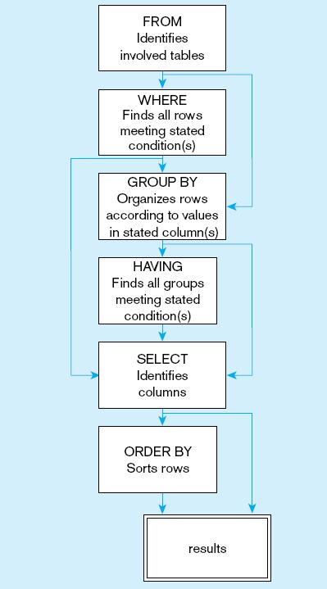
Review Today’s Goal
Concept
The sequence of writing your SQL statement
FROM: which table or tables have the requested information?
WHERE: is there any condition applied to individual record?
GROUP BY: do we need to group the records?
HAVING: should we only select some of the groups?
SELECT: which columns or aggregated values should we return?
ORDER BY: do we want the results to be sorted or do we only select some of the TOP ones?
An intermediate results table is produced after each step and will be used for the next clause.
Users only see the final results table, which can be one row
Skills
Can write SELECT queries with various conditions
Can use different operators in the WHERE clause

