Slide 1
IST 659 SQL - JOIN
Class 8

Slide 2
What have we achieved last week?
Present individual row values of selected columns from one table
Filter each row based on some condition
One condition
multiple conditions
Call aggregation functions to summarize values of selected records
Categorize records to some groups based on the values of some columns and show values of the groups
After grouping, we can only select some groups
The final results can be sorted in some order

Slide 3
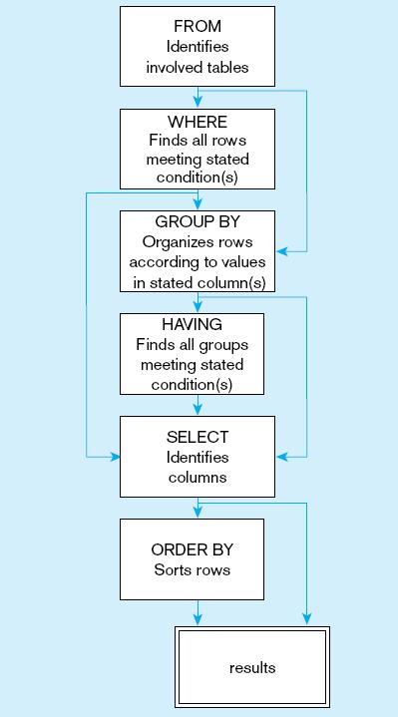
Last Lecture – Query on one Table
Concept
The sequence of writing your SQL statement
FROM: which table or tables have the requested information?
WHERE: is there any condition applied to individual record?
GROUP BY: do we need to group the records?
HAVING: should we only select some of the groups?
SELECT: which columns or aggregated values should we return?
ORDER BY: do we want the results to be sorted or do we only select some of the TOP ones?
An intermediate results table is produced after each step and will be used for the next clause.
Users only see the final results table, which can be one row

Slide 4
Today’s Goal
Concept
Using alias
JOIN
Subquery
Skills
Query multiple tables using WHERE clause
Write different JOIN queries
Write subqueries
Can use UNION to combine different results

Slide 5
What to achieve today
Connect multiple tables.
Return all the rows that have matching records from many tables using WHERE
Return matching rows from both tables use INNER JOIN
Return all rows from the left table, with the matching rows in the right table using LEFT JOIN
Return all rows from the right table, with the matching rows in the left table use RIGHT JOIN
Combine results of both LEFT and RIGHT OUTER JOIN using FULL OUTER JOIN
Leverage the NULL values to return the records unique in one table
Subquery
Union

Slide 6
SQL
- WHERE clause (on two or more tables)

Slide 7
What to achieve today
Connect multiple tables.
Many times, we compare FK and PK values
Attention: when two tables have columns with the same name, we need to define alias names, and use alias names in front of the column names to differentiate them

Slide 8
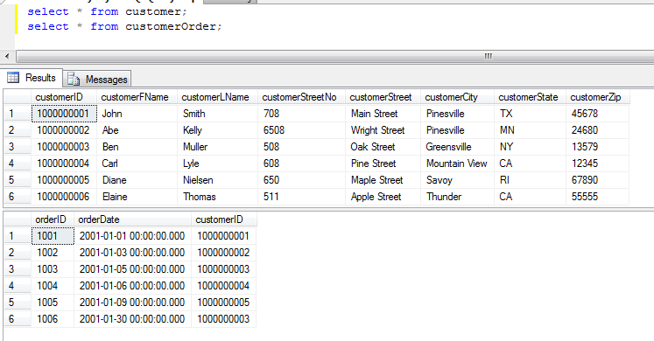
Two Tables Created in the Last Class
Notes:
How many rows in the new joined table?

Slide 9
Queries on More Tables
Data question:
Find all customers who placed orders. Show orderID, customerID, customerFName, and customerLName
Notes:
Where do the data come from? Tables customer and customerOrder

Slide 10
WHERE clause for multiple tables
Because the data needed to answer the data question come from TWO tables, thus we list the two tables in the FROM clause
FROM customer, customerOrder
Where customerID = customerID
Problem 1: How to connect these two tables so that the database know the record in customer table can be mapped to a row in the customerOrder table?
Problem 2: Which tables these two customerIDs are pointing to?
Remember we have the foreign key defined

Slide 11
WHERE (using Aliases)
Use Alias to solve the ambiguity
Define the Aliases at FROM clause
FROM customer AS c, customerOrder AS co
Where c.customerID = co.customerID
Use the Alias in the WHERE clause

Slide 12
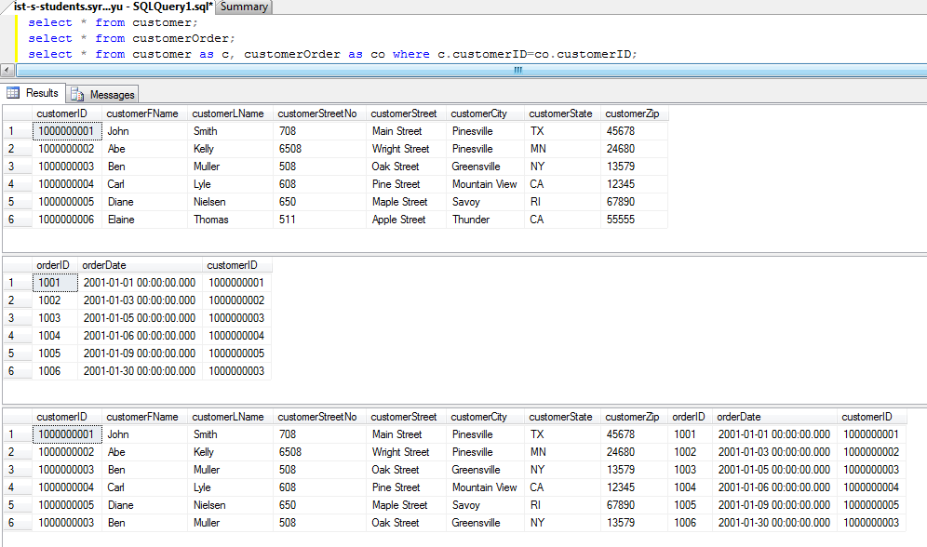
Both customerID columns are displayed. How to remove dupilcated columns?

Slide 13
What to achieve today
Connect multiple tables.
Return all the rows that have matching records from many tables using WHERE

Slide 14
Selecting matching rows from multiple tables
Alias needs to be used in the SELECT clause to address ambiguity as well.
Which customerID you want to return? When there is an ambiguity, the system will give you an error message.
c.
SELECT orderID, customerID, customerFName, customerLName
FROM customer AS c, customerOrder AS co
WHERE c.customerID=co.customerID;

Slide 15
Exercise
Find all products that have been ordered. Show orderID, productID, productDesc, and the quantity ordered

Slide 16
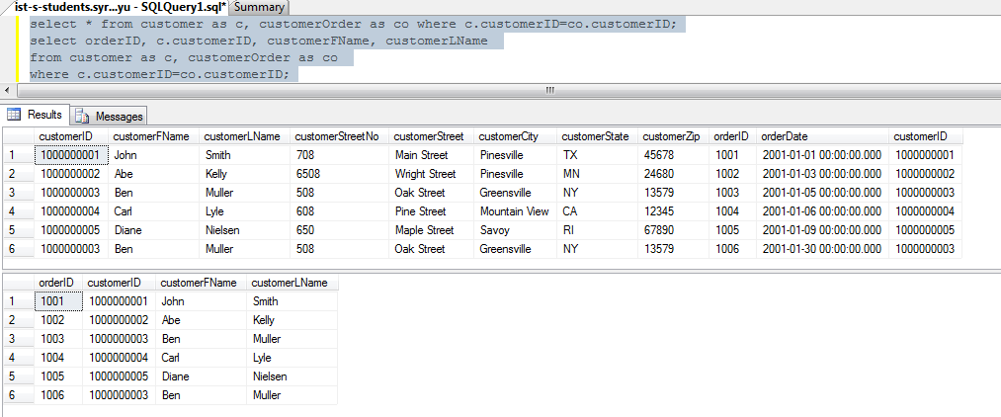
Remove duplicated columns

Slide 17
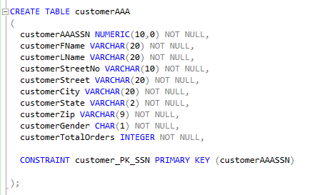
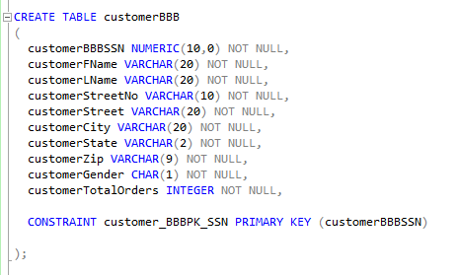
More Exercises
Say we have customer tables for two companies AAA and BBB
drop your existing customer and customerOrder tables,
recreate tables using the attached class8-Create&Insert.sql

Slide 18
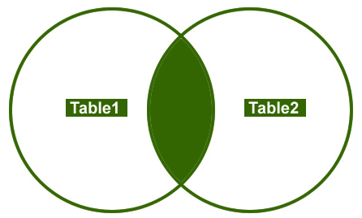
Illustration of the two customer tables
The values are SSN numbers in the two customer tables.
1
AAA
4
BBB
2
5
3
6
7
SSNs exist only in AAA table
SSNs exist only in BBB table
SSNs exist in both tables

Slide 19
What to achieve today
Connect multiple tables.
Return all the rows that have matching records from many tables using WHERE
Return matching rows from both tables use INNER JOIN

Slide 20
INNER JOIN
Inner join of two tables allows to select the rows from both tables as long as there is a match between the columns specified in the Inner Join condition.

Slide 21
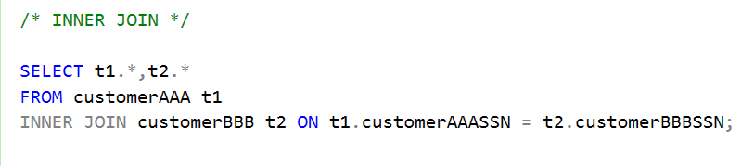
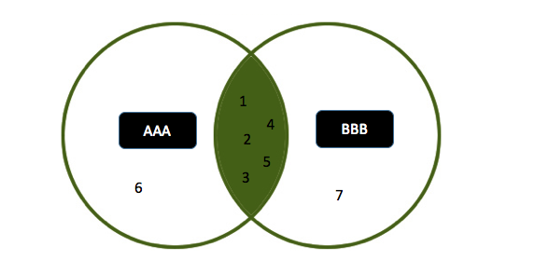
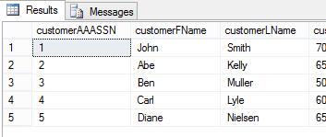
INNER JOIN
Who are the two companies’ common customers?
Put one table in the FROM clause
INNER JOIN the second table
Then specify the matching condition in the ON clause. In this case, we compare the customer’s SSN numbers.
More columns

Slide 22
What to achieve today
Connect multiple tables.
Return all the rows that have matching records from many tables using WHERE
Return matching rows from both tables use INNER JOIN
Return all rows from the left table, with the matching rows in the right table using LEFT JOIN (NULL values in the right side when there is no match).

Slide 23
LEFT JOIN
Left outer join of two tables allows to select all the rows from the left table, with the matching rows in the right table. If there is no match, the values in the right side will be NULL.

Slide 24
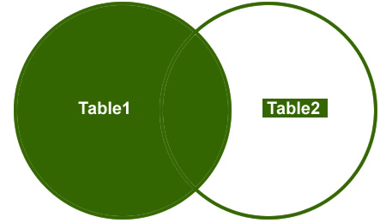
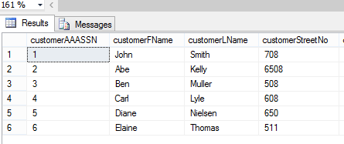

LEFT JOIN
show all AAA customer’s totalorder. If customerAAA also made orders in BBB, show their totalorder with BBB as well, otherwise show null value.
1
AAA
4
BBB
2
5
3
6
7
Put the left table in the FROM clause.
LEFT JOIN the right table

Slide 25
Join table: outer join
Data question 2:
Find all AAA customers, show orderID, customerID, customerFName. For customerAAAs who haven’t placed order, the orderID should show as null.

Slide 26
What to achieve today
Connect multiple tables.
Return all the rows that have matching records from many tables using WHERE
Return matching rows from both tables use INNER JOIN
Return all rows from the left table, with the matching rows in the right table using LEFT JOIN (NULL values in the right side when there is no match).
Return all rows from the right table, with the matching rows in the left table use RIGHT JOIN (NULL values in the left side when there is no match).

Slide 27
RIGHT JOIN
Right outer join of two tables allows to select all the rows from the right table, with the matching rows in the left table. If there is no match, the values in the left side will be NULL.

Slide 28
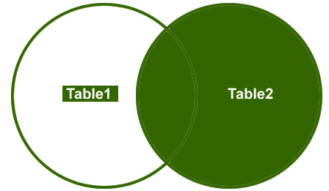

RIGHT JOIN
show all BBBcustomer’s totalorder. If customerBBB also made order with AAA, show their totalorder as well, otherwise, show null value.
1
AAA
4
BBB
2
5
3
6
7
Put the left table in the FROM clause.
RIGHT JOIN the right table

Slide 29
Exercise
Find all products no matter if they have been ordered or not. If a product has been ordered, show the orderID(s). If not, show “null” in the orderID column.

Slide 30
What to achieve today
Connect multiple tables.
Return all the rows that have matching records from many tables using WHERE
Return matching rows from both tables use INNER JOIN
Return all rows from the left table, with the matching rows in the right table using LEFT JOIN (NULL values in the right side when there is no match).
Return all rows from the right table, with the matching rows in the left table use RIGHT JOIN (NULL values in the left side when there is no match).
Combine results of both LEFT and RIGHT OUTER JOIN using FULL OUTER JOIN

Slide 31
FULL OUTER JOIN
Full OUTER JOIN of two tables combines the results of both LEFT and RIGHT OUTER JOIN.

Slide 32
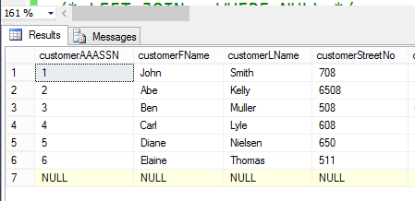
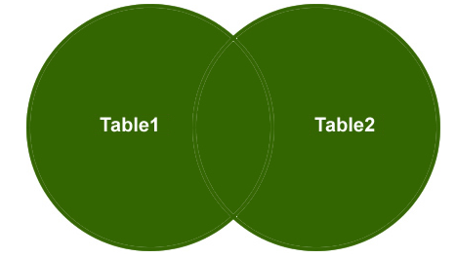

FULL OUTER JOIN
show both AAA and BBB customers’ total number of orders.
1
AAA
4
BBB
2
5
3
6
7
When FULL OUTER JOIN, either one of the table can be put in the FROM clause

Slide 33
What to achieve today
Connect multiple tables.
Return all the rows that have matching records from many tables using WHERE
Return matching rows from both tables use INNER JOIN
Return all rows from the left table, with the matching rows in the right table using LEFT JOIN (NULL values in the right side when there is no match).
Return all rows from the right table, with the matching rows in the left table use RIGHT JOIN (NULL values in the left side when there is no match).
Combine results of both LEFT and RIGHT OUTER JOIN using FULL OUTER JOIN
Leverage the NULL values to return the records unique in one table

Slide 34

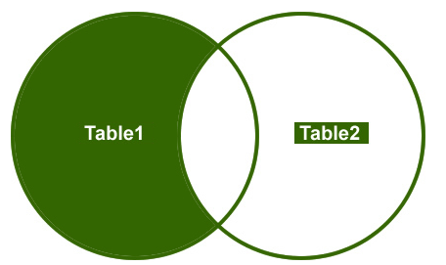


LEFT JOIN – WHERE NULL
Show information of AAA customers who are not BBB’s customers
1
AAA
4
BBB
2
5
3
6
7

Slide 35

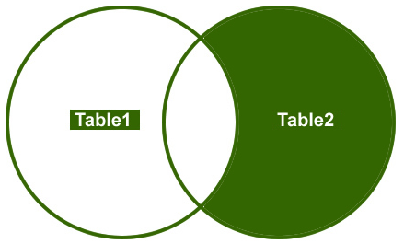


RIGHT JOIN – WHERE NULL
Show information of BBB customers who are not AAA’s customers
1
AAA
4
BBB
2
5
3
6
7

Slide 36

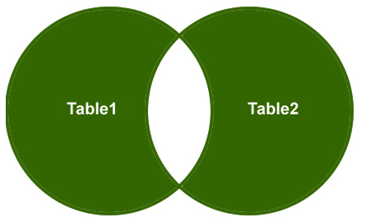

FULL OUTER JOIN = NOT INNER JOIN
Show each company’s unique customers
1
AAA
4
BBB
2
5
3
6
7

Slide 37
SUMMARY – JOIN
INNER JOIN: to find out common records of all the tables
LEFT JOIN (or RIGHT JOIN): to focus on one table’s records but still want relevant records’ values from the other table.
FULL OUTER JOIN: to find out records’ values from all the tables
LEFT JOIN (or RIGHT JOIN) + WHERE NULL: to find out the records that only show in one table
FULL OUTER JOIN + WHERE NULL : to find out unique records in all the tables

Slide 38
WHERE clause can achieve some JOIN function
SELECT c.customerID, co.orderID
FROM customer AS c, customerOrder AS co
WHERE c.customerID=co.customerID;
When executing WHERE clause, database checks the condition by taking all the table’s values.

Slide 39
When joining multiple tables
SELECT *
FROM table1, table2, table3, table4
WHERE table1.pk = table2.col1
AND table2.pk = table3.col1
AND table3.pk = table4.col1;
Different coding styles.
Some database applies ON before JOIN, which saves some memory, but many databases use the same methods to implement them.
SELECT *
FROM table1
INNER JOIN table2 ON table1.pk = table2.col1
INNER JOIN table3 ON table2.pk = table3.col1
INNER JOIN table4 ON table3.pk = table4.col1;

Slide 40
What to achieve today
Connect multiple tables.
Return all the rows that have matching records from many tables using WHERE
Return matching rows from both tables use INNER JOIN
Return all rows from the left table, with the matching rows in the right table using LEFT JOIN (NULL values in the right side when there is no match).
Return all rows from the right table, with the matching rows in the left table use RIGHT JOIN (NULL values in the left side when there is no match).
Combine results of both LEFT and RIGHT OUTER JOIN using FULL OUTER JOIN
Leverage the NULL values to return the records unique in one table
Subquery

Slide 41
Subquery
Subquery is one query that is embedded in another one.
Subquery can be used in WHERE or FROM clauses

Slide 42
SubQuery in WHERE clause
Which customerAAA has not placed order? Show customerID, customerFName, and customerLName
Step 1: find all customerAAAs, get result#1
Step 2: find all customerAAAs who have placed order, get result #2
Step 3: remove result#2 from result#1
SELECT customerAAASSN, customerFName, customerLName
FROM customerAAA
WHERE customerAAASSN NOT IN
SELECT DISTINCT customerSSN
FROM customerOrder ;
Subquery in WHERE clause
(
Make sure you enclose the subquery using ()
)

Slide 43
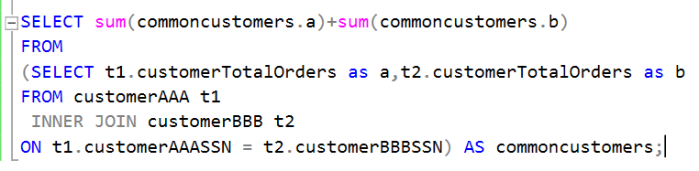
Subquery in FROM clause
What is the total number of orders made by the customers of both AAA and BBB.
Subquery in FROM clause
Make sure you enclose the subquery using ()

Slide 44
Exercise 3
Find all products that have not been ordered

Slide 45
What to achieve today
Connect multiple tables.
Return all the rows that have matching records from many tables using WHERE
Return matching rows from both tables use INNER JOIN
Return all rows from the left table, with the matching rows in the right table using LEFT JOIN (NULL values in the right side when there is no match).
Return all rows from the right table, with the matching rows in the left table use RIGHT JOIN (NULL values in the left side when there is no match).
Combine results of both LEFT and RIGHT OUTER JOIN using FULL OUTER JOIN
Leverage the NULL values to return the records unique in one table
Subquery
Union – the number of columns should be the same and have the same type

Slide 46
UNION query
find the most expensive and the least expensive product
SELECT * FROM product
WHERE standardPrice=(select max(standardPrice) from product)
UNION
SELECT * FROM product
WHERE standardPrice=(select min(standardPrice) from product);

Slide 47
Review Today’s Goal
Concept
Using alias
JOIN
Subquery
Skills
Query multiple tables using WHERE clause
Write different JOIN queries
Write subqueries
Can use UNION to join different results

Slide 48
Blackboard Discussion Form - Exercises
Work with your neighbor
Using the provided customerAAA, customerBBB, product, customerOrder, orderline tables, please propose 3 data questions that can be answered by using the following types of script respectively
LEFT JOIN
LEFT JOIN and WHERE NULL
Subquery
Submit your queries to the blackboard
E.g. Show the number of unique orders that all the AAA and BBB customers have made
(customerSSN, uniqueNumberofProducts)

Slide 49
Summaries of today’s queries.
Who are the two companies’ common customers?
show all AAA customer’s totalorder, if customerAAA also made order with BBB, show the totalorder as well, otherwise, show null value.
Show both AAA and BBB customers’ totalorder together.
Show those AAA’s customers who did not make order with BBB.
Show unique customers of AAA and BBB, i.e., those who did not make orders from both two companies.
JOIN Statement can help us answer the above questions easily.

