Slide 1
Modeling Data in the Organization
IST 659 – Lecture 4
Courtesy of book materials and previous lecture notes. No dissemination or sale of any part of this work (including on the WWW).

Slide 2
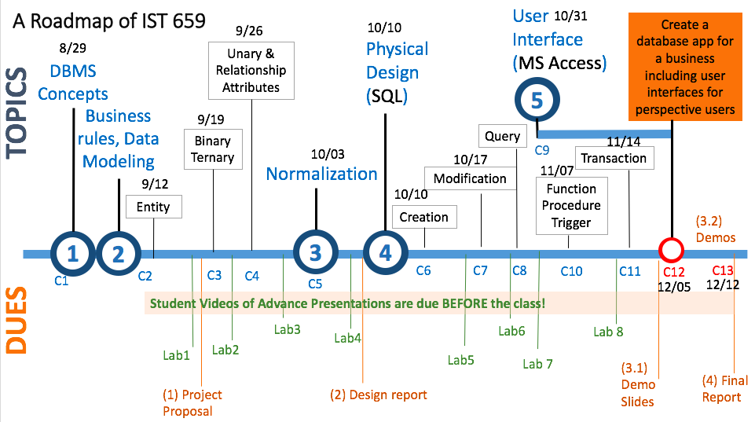
We are here today.

Slide 3
Today’s Goals
Concept
  Identifying and non-identifying relationships
  Relational tables modeling unary relationship
  Relationship with attributes
Skills
  Define foreign keys for unary relationship
  Create an associative entity for relationship with attribute
  Create ACCESS tables according to the ER diagrams

Slide 4
Identifying Relationship
v.s.
Non-identifying relationship

Slide 5
Identifying Relationship
The child table can’t uniquely identifying its records without the parent table.
  E.g., Each state has many cities.

Slide 6
Identifying Relationship
State table has stateName column as PK.
City table has cityName column, but it can’t be PK, because many cities from different states share some common names.
PK CityName
Little Rock
Washington
Atlanta
Washington
Chicago
Washington
PK StateName
Arkansas
Georgia
Illinois
Indiana

Slide 7
Identifying Relationship
PK StateName
Arkansas
Georgia
Illinois
Indiana
PK CityName | PK, FK StateName
Little Rock | Arkansas
Washington | Arkansas
Atlanta | Georgia
Washington | Georgia
Chicago | Illinois
Washington | Indiana

Slide 8
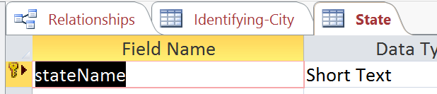
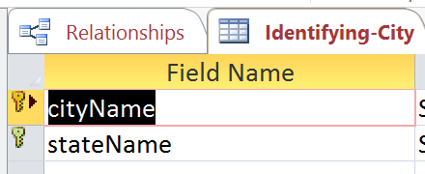
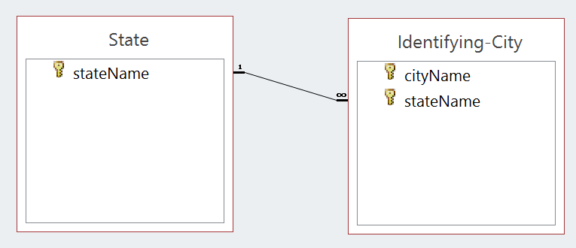
Creating Identifying Relationships in Access
Create a composite PK with multiple columns
stateName in the city table can’t be null, thus each city relies on the existence of a state

Slide 9
Non-identifying Relationship
The city table uses a serial number auto generated for PK.
  Each city record can be uniquely identified by the serial number.
  Then the city and state pairs can be duplicated.
We can test it using the Access table.

Slide 10
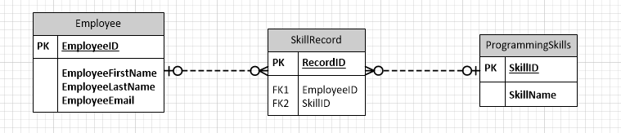
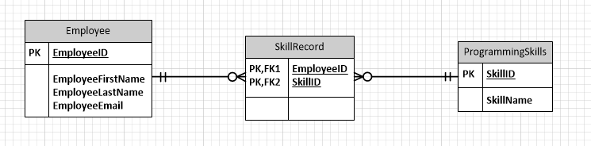
Non-identifying relationship: because skillrecords can have null employeeID or null skillID.
  dashed line
identifying relationship: because skillrecords cannot have null employeeID or null skillID.
Strong Entity
Weak Entity
Strong Entity
  2. FK is part of the PK
  1. solid line

Slide 11
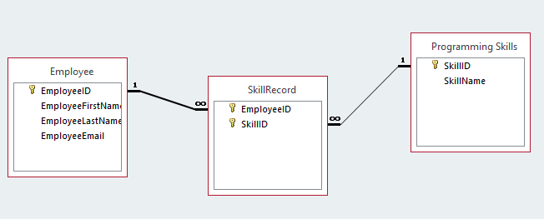
Composite PK in Access

Slide 12
Composite Key V.S. Surrogate Key
 | Concept | Pros | Cons
Composite Key | Borrow parent table’s primary key as part of the child’s primary key | Identify the identifying relationship with explicit dependency Consistent update | A long key (if there are many parents, or one parent has a long composite key) Change in any parent key has to be updated (e.g. using another attribute as parent’s primary key)
Surrogate Key | Serial number auto generated for the child table | Simple implementation Changes in parent’s key won’t affect the child | the corresponding parent field in the child table may not be implemented as a foreign key, then there could be bad parent value in the child table Even with the foreign key constraint implemented, there could be duplicate pairs (parent, child) that are against the identifying relationship

Slide 13
ER Model:
Unary Relationship

Slide 14
Unary Relationship
Unary relationship is a special kind of binary relationship in which the two associated entities are the same.
Three cardinalities
  1:1
  1:M
  M:N

Slide 15
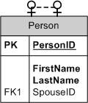
1:1 (symmetric)
Person
Is married to

Slide 16
Completed unary relationship (1:1)
Marriage relationship
Person
Is married to
Because the marriage relationship is optional, so the spouseID FK attribute is an optional field.

Slide 17
Open the people-demo Access Table
Create one column spouseID column in the person table
Connect the spouseID as a foreign key with the ID in the person table.
Enter sample data

Slide 18
1:M (asymmetric)
Employee
Manages

Slide 19
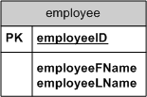
Modeling unary relationship in ERD (1:M, asymmetric)
Employee manages other employee(s)

Slide 20
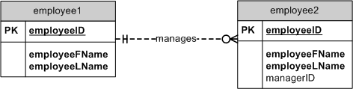
Modeling unary relationship in ERD (1:M, asymmetric)
Employee manages other employee(s)
FK

Slide 21
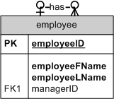
Modeling unary relationship in ERD (1:M)
Employee manages other employee(s)

Slide 22
Modeling unary relationship in ERD (1:M)
Employee manages other employee(s)
eID | Fname | Lname | managerID
8 | Arthur | Smith | 4
4 | Terry | Wind | 2
2 | Kelly | Hill | 1
1 | John | Weiss
Because the cardinality constraint on the many side is optional, the foreign key value can be empty.

Slide 23
Modeling unary relationship in ERD (M:N)
A course has other course(s) as prerequisites, and one course can be many courses’ prerequisites.
  e.g. courses 311, 322, 411, 511,422,522
  311 is prereq for 411,422
  311 and 322 are prereqs for 422

Slide 24

Modeling unary relationship in ERD (M:N)
Course requires other course(s)
requires

Slide 25
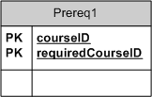
Modeling unary relationship in ERD (M:N)
Course requires other course(s)
prereqRecord
RequiredCourse

Slide 26
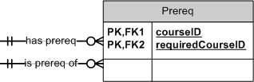
Modeling unary relationship in ERD (M:N)
Course requires other course(s)
prereqRecord

Slide 27
Relationship has attributes

Slide 28
Unary relationship
Person
Is married to
What if we want to record when and where they got married?

Slide 29
Associative Entity of unary relationships
Marriage Certificate
Person
Person
Person
PersonID
FirstName
LastName
MarriageCertificate
PK CertificateID
FK HusbandID
FK WifeID
IssueOffice
IssueDate
Person
PersonID
FirstName
LastName

Slide 30
Additional attributes on unary relationships
MarriageCertificate
PK CertificateID
FK HusbandID
FK WifeID
IssueOffice
IssueDate
Marriage Certificate
Person
What if one person married many times?

Slide 31
Attributes on Unary relationships
1:M
MarriageCertificate
PK CertificateID
FK HusbandID
FK WifeID
IssueOffice
IssueDate
Marriage Certificate
Person
An associate entity can also enable representing different cardinality constraints.

Slide 32
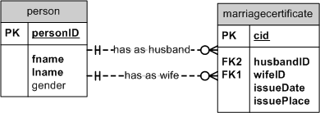
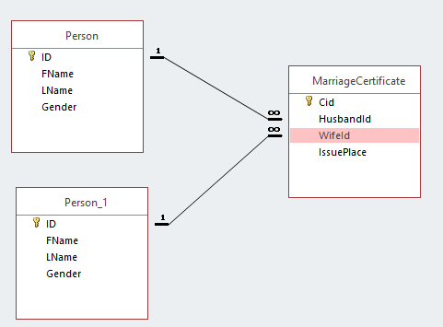
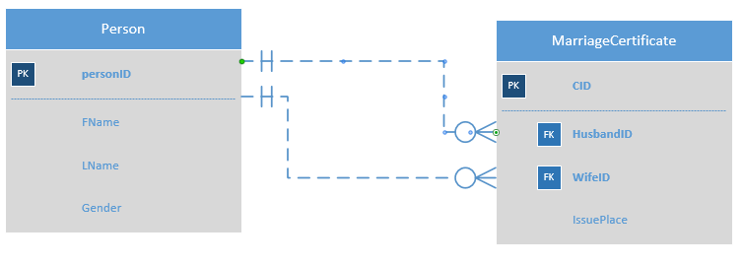
Attributes on unary relationship

Slide 33
Review Today’s Goals
Concept
  Identifying and non-identifying relationships
  Relational tables modeling unary relationship
  Relationship with attributes
Skills
  Define foreign keys for unary relationship
  Create an associative entity for relationship with attribute
  Create ACCESS tables according to the ER diagrams

Slide 34

Any questions with Lab 2?

Slide 35
Quiz Time
The quiz is available at the “lab assignments”.
  Quiz-1

Slide 36
After the Quiz
If we have more time in the class, please create Access tables for this ER diagram
Read the super/sub type slides
Next lecture, we will talk about normalization

