Slide 1
THE DATABASE ENVIRONMENT AND DEVELOPMENT PROCESS
IST 659 - Week 1
Yun Huang
Courtesy of book materials and previous lecture notes. No dissemination or sale of any part of this work (including on the WWW).

Slide 2
OBJECTIVES
Data, Metadata & Information
The Database Approach
  advantages of databases
  costs and risks of databases
  components of database environment
  categories of database applications
  database system development life cycle
  Classification of DBMS
  Relational DBMSs
    Five Key technologies
  Key concepts in Enterprise Relational DBMSs

Slide 3
The Database Approach

Slide 4
DEFINITIONS
Data: stored representations of meaningful objects and events
  Structured: numbers, text, dates
  Unstructured: images, video, documents
Metadata: data that describes the properties and context of user data
Information: data processed to increase knowledge in the person using the data

Slide 5
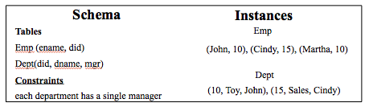
An Example
What is data?
Meta data (or schema)?
What is information?

Slide 6
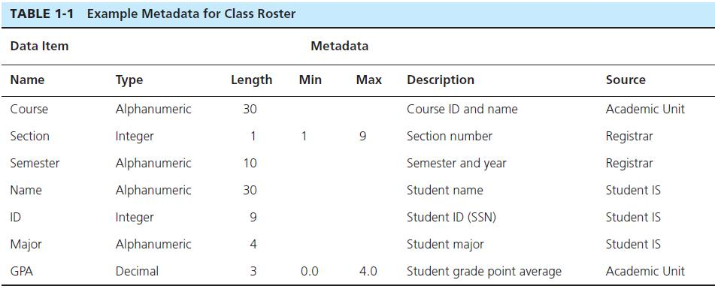
Descriptions of the properties or characteristics of the data, including data types, field sizes, allowable values, and data context

Slide 7

Figure 1-1b Summarized data
Graphical displays turn data into useful information that managers can use for decision making and interpretation

Slide 8
SOLUTION: THE DATABASE APPROACH
Database: organized collection of logically related data
  Central repository of shared data
  Data is managed by a controlling agent
  Stored in a standardized, convenient form
Requires a Database Management System (DBMS)

Slide 9
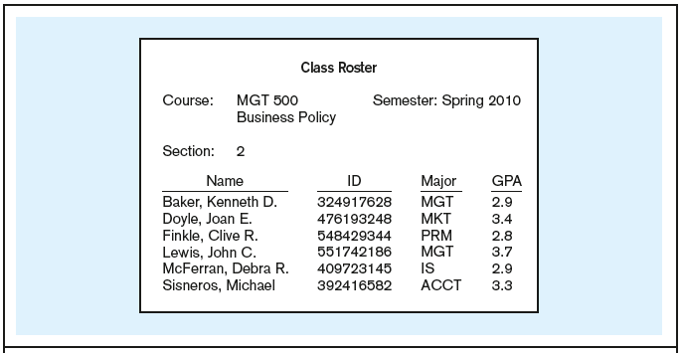
How does a database system handle such information?
Context helps users understand data

Slide 10
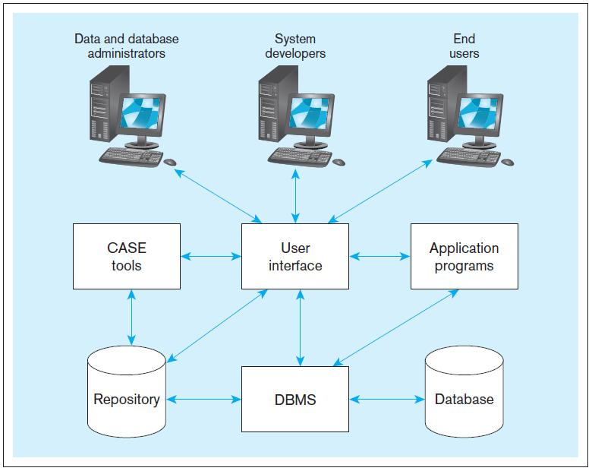
Figure 1-5 Components of the Database Environment
CASE (Computer-aided Software Engineering)
Repository contains metadata information

Slide 11
THE DATABASE ENVIRONMENT
Database–storehouse of the data
CASE Tools–computer-aided software engineering
Repository–centralized storehouse of metadata
Database Management System (DBMS) –software for managing the database
Application Programs–software using the data
User Interface–text and graphical displays to users
Data/Database Administrators–personnel responsible for maintaining the database
System Developers–personnel responsible for designing databases and software
End Users–people who use the applications and databases

Slide 12
ADVANTAGES OF THE DATABASE APPROACH
Program-data independence
Planned data redundancy
Improved data consistency
Improved data sharing
Increased application development productivity
Enforcement of standards
Improved data quality
Improved data accessibility and responsiveness
Reduced program maintenance
Improved decision support
Notes:
Different programs can be built upon the same database.
Central repository – reduce data redundancy, …

Slide 13
COSTS AND RISKS OF THE DATABASE APPROACH
New, specialized personnel
Installation and management cost and complexity
Conversion costs
Need for explicit backup and recovery
Organizational conflict
Notes:
Database on the cloud save you a lot of this cost.

Slide 14
EVOLUTION OF DATABASE SYSTEMS
Driven by four main objectives:
    Need for program-data independence ➔ reduced maintenance
    Desire to manage more complex data types and structures
    Ease of data access for less technical personnel
    Need for more powerful decision support platforms

Slide 15
Relational DBMS

Slide 16
Classification of DBMS
Relational DBMS:
  Modeling concept: tables and constraints on tables
  Query Language: SQL
  Applications: suited for traditional business processing
Object-Oriented DBMS
  Modeling concepts: objects, classes, inheritance
  Query Language: object oriented OQL
  Applications: suited for CAD databases
Object-Relational DBMS:
  Incorporate OO concepts into relational model
  Similar functionality as OO-DBMS, but different implementations
  Language: extended to process objects.
XML DBMS
  XML-document: Self-describing nature of the data format
  Query language: XQuery
  Applications: data interchange

Slide 17

Sample Relational Database
Note 01

Slide 18
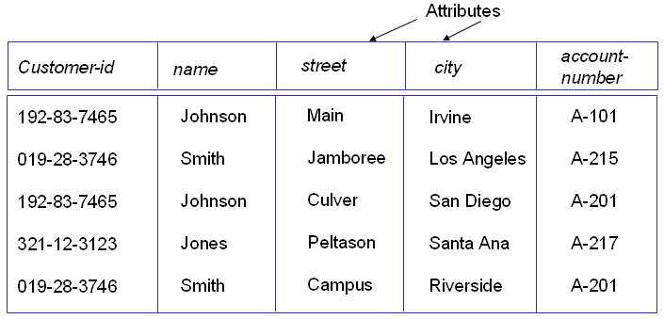
Relational Model
Data represented as tables
  Attributes: column names
  Relation: table
  Tuple: a row in the table
An example relation

Slide 19
SQL (Structured Query Language)
Widely-used nonprocedural language
  “Find the id of the customer whose name is Smith.”
  SELECT customer-id
  FROM customer
  WHERE customer-name = ‘Smith’;
Basic SQL has limited expressive power:
  Some functions cannot be implemented
Application programs access DB through one of
  Procedural language extensions to allow embedded SQL
  Application program interface (e.g. ODBC/JDBC) that allow SQL queries to be sent to a database

Slide 20
Key Concepts in Enterprise DBMS

Slide 21
ENTERPRISE DATABASE APPLICATIONS
Enterprise Resource Planning (ERP)
  Integrate all enterprise functions (manufacturing, finance, sales, marketing, inventory, accounting, human resources)
Data Warehouse
  Integrated decision support system derived from various operational databases

Slide 22
MANAGING PROJECTS
Project–a planned undertaking of related activities to reach an objective that has a beginning and an end
Initiated and planned in planning stage of SDLC
Executed during analysis, design, and implementation
Closed at the end of implementation

Slide 23
MANAGING PROJECTS:
PEOPLE INVOLVED
Business analysts
Systems analysts
Database analysts and data modelers
Users
Programmers
Database architects
Data administrators
Project managers
Other technical experts

Slide 24
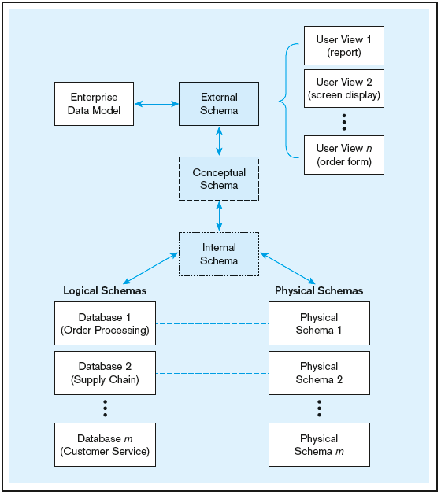
Figure 1-9 Three-schema architecture
Different people have different views of the database…these are the external schema
The internal schema is the underlying design and implementation

Slide 25
ENTERPRISE DATA MODEL
First step in the database development process
Specifies scope and general content
  Enterprise Data Model–high-level entities and relationships for the organization
  Project Data Model–more detailed view, matching data structure in database or data warehouse
Overall picture of organizational data at high level of abstraction
Entity-relationship diagram
Descriptions of entity types
Relationships between entities
Business rules

Slide 26
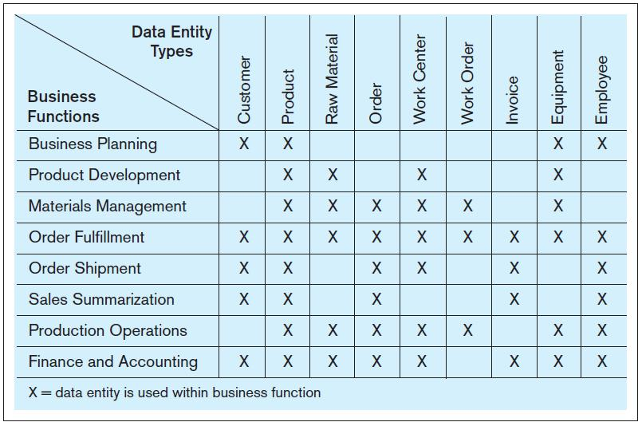
FIGURE 1-6 Example business function-to-data entity matrix

Slide 27
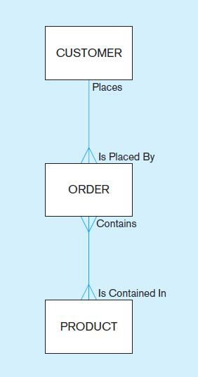
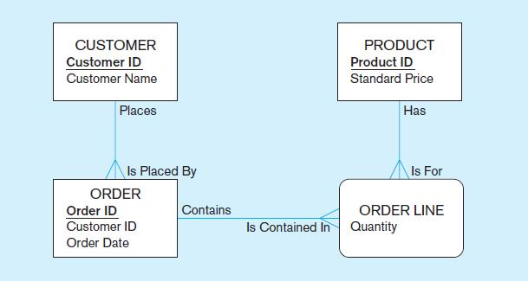
Figure 1-3 Comparison of enterprise and project level data models
Segment of an enterprise data model
Segment of a project-level data model

Slide 28
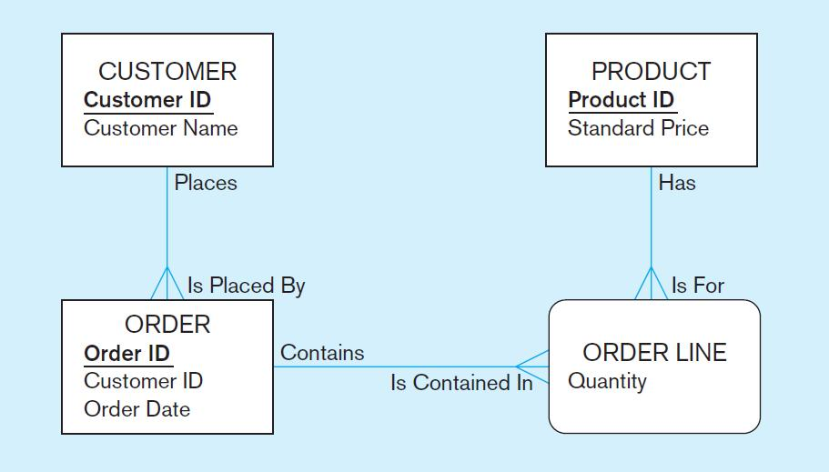
One customer may place many orders, but each order is placed by a single customer
→ One-to-many relationship

Slide 29
One order has many order lines; each order line is associated with a single order
→ One-to-many relationship

Slide 30
One product can be in many order lines, each order line refers to a single product
→ One-to-many relationship

Slide 31
Therefore, one order involves many products and one product is involved in many orders
→ Many-to-many relationship

Slide 32
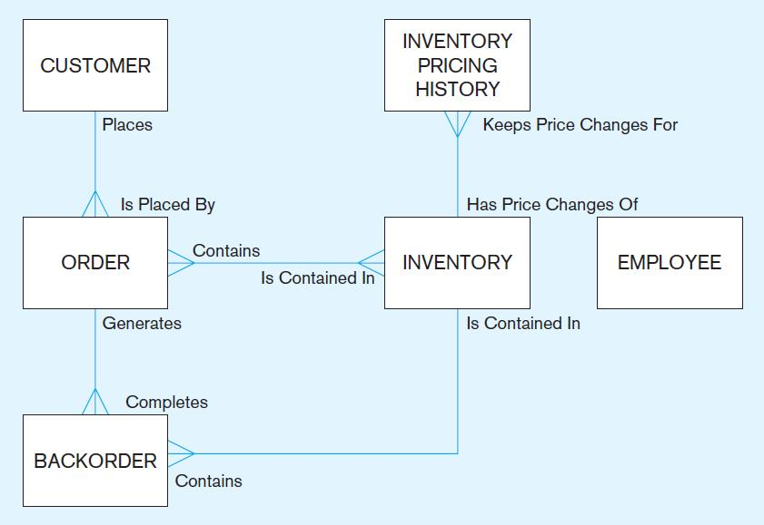


Slide 33
TWO APPROACHES TO DATABASE AND ITS DEVELOPMENT
SDLC
  System Development Life Cycle
  Detailed, well-planned development process
  Time-consuming, but comprehensive
  Long development cycle
Prototyping
  Rapid application development (RAD)
  Cursory attempt at conceptual data modeling
  Define database during development of initial prototype
  Repeat implementation and maintenance activities with new prototype versions

Slide 34
SYSTEMS DEVELOPMENT LIFE CYCLE
(SEE ALSO FIGURE 1-7)
Planning
Analysis
Logical Design
Physical Design
Implementation
Maintenance

Slide 35
SYSTEMS DEVELOPMENT LIFE CYCLE
(SEE ALSO FIGURE 1-7) (CONT.)
Planning
Purpose–preliminary understanding
Deliverable–request for study
Planning
Analysis
Logical Design
Physical Design
Database activity–
enterprise modeling and early conceptual data modeling
Implementation
Maintenance
Notes:
Energy efficiency program, who are the stakeholders

Slide 36
SYSTEMS DEVELOPMENT LIFE CYCLE
(SEE ALSO FIGURE 1-7) (CONT.)
Purpose–thorough requirements analysis and structuring
Deliverable–functional system specifications
Planning
Analysis
Analysis
Logical Design
Physical Design
Database activity–thorough and integrated conceptual data modeling
Implementation
Maintenance
Notes:
What kind of computations involved? Summary of the sells? Is it a weekly report or monthly one?
Keeping customer information?

Slide 37
SYSTEMS DEVELOPMENT LIFE CYCLE
(SEE ALSO FIGURE 1-7) (CONT.)
Purpose–information requirements elicitation and structure
Deliverable–detailed design specifications
Planning
Analysis
Logical Design
Logical Design
Physical Design
Database activity–
logical database design (transactions, forms, displays, views, data integrity and security)
Implementation
Maintenance
Notes:
Detailed transactions can’t be viewed by assistants. Everything can be looked up by the program manager.

Slide 38
SYSTEMS DEVELOPMENT LIFE CYCLE
(SEE ALSO FIGURE 1-7) (CONT.)
Purpose–develop technology and organizational specifications
Deliverable–program/data structures, technology purchases, organization redesigns
Planning
Analysis
Logical Design
Physical Design
Physical Design
Database activity–
physical database design (define database to DBMS, physical data organization, database processing programs)
Implementation
Maintenance
Notes:
Customer id is numeric or string? How long will the string be?

Slide 39
SYSTEMS DEVELOPMENT LIFE CYCLE
(SEE ALSO FIGURE 1-7) (CONT.)
Purpose–programming, testing, training, installation, documenting
Deliverable–operational programs, documentation, training materials
Planning
Analysis
Logical Design
Physical Design
Database activity–
database implementation, including coded programs, documentation, installation and conversion
Implementation
Implementation
Maintenance
Notes:
Use sql sever? How big the storage will need to be reserved?

Slide 40
SYSTEMS DEVELOPMENT LIFE CYCLE
(SEE ALSO FIGURE 1-7) (CONT.)
Planning
Purpose–monitor, repair, enhance
Deliverable–periodic audits
Analysis
Logical Design
Physical Design
Database activity–
database maintenance, performance analysis and tuning, error corrections
Implementation
Maintenance
Maintenance
Notes:
How frequent to back up the data?

Slide 41
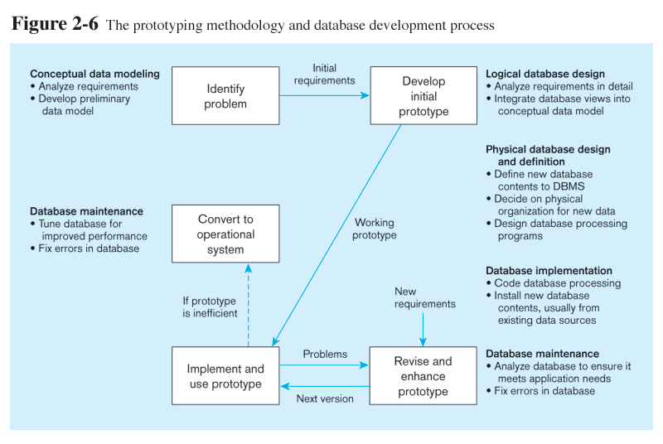
Prototyping Database Methodology
(Figure 1-8)

Slide 42
Prototyping Database Methodology
(Figure 1-8) (cont.)

Slide 43
Prototyping Database Methodology
(Figure 1-8) (cont.)

Slide 44
Prototyping Database Methodology
(Figure 1-8) (cont.)

Slide 45
Prototyping Database Methodology
(Figure 1-8) (cont.)

Slide 46
DATABASE SCHEMA
External Schema
  User Views
  Subsets of Conceptual Schema
  Can be determined from business-function/data entity matrices
  DBA determines schema for different users
Conceptual Schema
  E-R models–covered in Chapters 2 and 3
Internal Schema
  Logical structures–covered in Chapter 4
  Physical structures–covered in Chapter 5

