Slide 1
Enhanced Entity-Relationship Model
- Supertype and Subtype Relationship

Slide 2
Example
There are two kinds of employees:
  Salaried employees who are paid by fixed annual salary amount.
  Hourly employees who are paid by hourly rate
The two kinds of employees share some common attributes, but each has their own unique attributes too.
“Employee” is a “supertype” which has two “subtypes”: “salaried” and “hourly”.

Slide 3
Supertype and Subtype Relationship
Subtype:
  A subgrouping of the entities in an entity type that is meaningful to the organization and that shares common attributes or relationships distinct from other subgroups.
Supertype:
  A generic entity type that has a relationship with one or more subtypes.

Slide 4
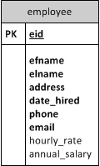
Approach 1 – All attributes in one entity
Any problems with this design?
Shared attributes, required
Unique attributes, optional

Slide 5
Everything in one table
eid | efname | elname | address | date_hired | phone | email | hourly_rate | annual_salary
101 | Ann | Wong | xxx | 1/11/15 | xxxx | xxx | 10
102 | Mary | Zhu | xxx | 2/11/15 | xxxx | xxx | 20
… | .. | … | .. | … | .. | … | ..
204 | Lin | Min | xxx | 1/21/14 | xxx | xxx |  | 100K
… | .. | … | .. | … | .. | … |  | 200K
505 | Linda | Zing | xxx | 1/21/14 | xxx | xxx |  | 150K

Slide 6
Problem of Approach 1
Approach 1: All possible attributes are lumped into one entity.
Problem: the payment related columns have to be set as optional, because each employee has to fill either “hourly_rate” or “annual_salary” but not both. It could happen that both attributes are empty for one employee without being detected by the DBMS.
Conclusion: not good to maintain data integrity

Slide 7
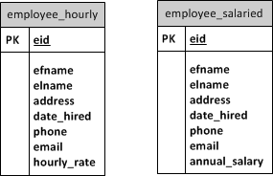
Approach 2 - use two entities, each stores one type
Shared attributes, required
Unique attributes, required
Any problems with this design?

Slide 8
One Entity (table) for Each Category
eid | efname | elname | address | date_hired | phone | email | hourly_rate
101 | Ann | Wong | xxx | 1/11/15 | xxxx | xxx | 10
102 | Mary | Zhu | xxx | 2/11/15 | xxxx | xxx | 20
204 | Lin | Min | xxx | 1/21/14 | xxx | xxx | 30
… | .. | … | .. | … | .. | … | ..
eid | efname | elname | address | date_hired | phone | email | annual_salary
204 | Lin | Min | xxx | 1/21/14 | xxx | xxx | 100K
… | .. | … | .. | … | .. | … | 200K
505 | Linda | Zing | xxx | 1/21/14 | xxx | xxx | 150K

Slide 9
Problem of Approach 2
Approach: use two entities, each stores one type of employees
Problem: when users look up an employee (or to update or delete), they don’t know which table to look up unless they know the type of employee, or they have to look up two tables.
What if some employee has both fixed salary and some hourly rate working period?
Conclusion: not good for data search, update, and deletion

Slide 10
Extract the Common Features
eid | efname | elname | address | date_hired | phone | email
101 | Ann | Wong | xxx | 1/11/15 | xxxx | xxx
102 | Mary | Zhu | xxx | 2/11/15 | xxxx | xxx
… | .. | … | .. | … | .. | …
204 | Lin | Min | xxx | 1/21/14 | xxx | xxx
… | .. | … | .. | … | .. | …
505 | Linda | Zing | xxx | 1/21/14 | xxx | xxx
eid | hourly_rate
101 | 10
102 | 20
… | ..
eid | annual_salary
204 | 100K
… | 200K
505 | 150K

Slide 11
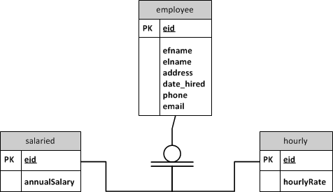
The solution – Specialization (a Top-down process for modeling Supertype/Subtype)
Specialization:
  Define supertype first, then subtypes, finally form supertype/subtype relationships.
Assuming: each employee has to be either salaried or hourly (“total/complete” Specialization)
Note: Not done yet!

Slide 12
Comparison
Notes:
Each approach has its own pros and cons
The one-entity solution is the simplest, but can’t maintain data integrity. Can use computer programs like stored procedure to control one of the two pay-related columns is not null
The two-entity solution is a bit clumsy for data search, update, and delete, but if these two types of employees are managed separately in a company, separating them in two entities is a reasonable solution. So it depends on how the data will be used.
The supertype/subtype solution is a “standard” solution that solves the problems in the above two solutions, but it’s a complex data model that includes three entities. Usually we want as few entities as possible.

Slide 13
Completeness Constraint of Specialization
Addresses the question of whether an instance of a supertype must also be a member of at least one subtype.
  Total(complete) specialization rule
  Partial(complete) specialization rule

Slide 14
Total specialization Rule
Each supertype entity instance has to be one of the subtype entities.
Question: How they are associated?
Note: Not done yet!

Slide 15
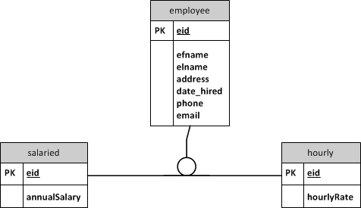
Partial Specialization Rule
What if some employees are neither salaried or hourly?
  Such supertype/subtype relationship is called “partial” because a record in the supertype may not belong to any subtype

Slide 16
Summary
“total”: each employee has to be either salaried or hourly
(double line)
“partial”: an employee can be neither salaried nor hourly
(single line)
Notes:
Important

Slide 17
Disjointness Constraints
Disjointness Constraint:
  Addresses whether an instance of a supertype may simultaneously be a member of two (or more) subtypes.
Can an employee be both salaried or hourly?
  No: “disjoint” rule
  Yes: “overlap” rule
Problem with Visio: you have to manually insert a textbox to indicate whether it’s disjoint or overlap, put a “d” or “o” in the circle

Slide 18
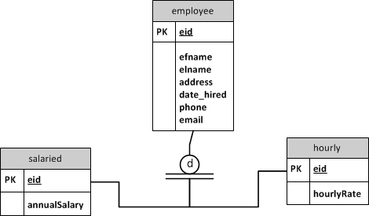

disjoint
overlap
Notes:
inportant

Slide 19
Subtype discriminator
Subtype Discriminator: An attribute of the supertype whose values determine the target subtype(s)
  E.g. add an attribute “payType” to the Employee entity. “payType” serves as the discriminator.
  If we need to create a new profile for a new employee, we create a record in the Employee table first, then if the “payType” value is “salaried”, we need to further create a record in the “salaried” table; if it is “hourly”, we need to create a record in the “hourly” table.

Slide 20
Extract the Common Features
eid | efname | elname | address | date_hired | phone | email | paytype
101 | Ann | Wong | xxx | 1/11/15 | xxxx | xxx | hourly
102 | Mary | Zhu | xxx | 2/11/15 | xxxx | xxx | hourly
… | .. | … | .. | … | .. | … | hourly
204 | Lin | Min | xxx | 1/21/14 | xxx | xxx | salaried
… | .. | … | .. | … | .. | … | salaried
505 | Linda | Zing | xxx | 1/21/14 | xxx | xxx | salaried
eid | hourly_rate
101 | 10
102 | 20
… | ..
eid | annual_salary
204 | 100K
… | 200K
505 | 150K

Slide 21
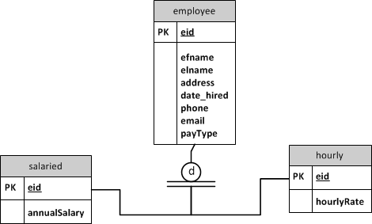
Note: Not done yet!

Slide 22
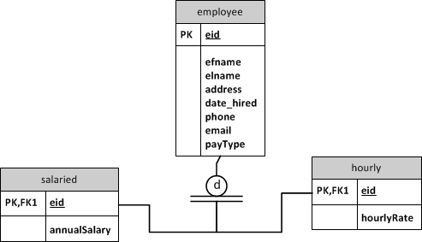
Associate the subtype entities to supertype entity with foreign keys
Note: Not done yet!

Slide 23
Disjointness Constraint Affects Subtype Discriminator Values(I)
Disjoint – a simple attribute with alternative values to indicate the possible subtypes

Slide 24
Discriminator in disjoint relationship
payType=‘S’ for salaried
payType=‘H’ for hourly
payType=‘S’
payType=‘H’
Now the supertype/subtype data model is done!

Slide 25
Disjointness Constraint Affects Subtype Discriminator Values(II)
Overlapping – a composite attribute whose subparts pertain to different subtypes. Each subpart contains a boolean value to indicate whether or not the instance belongs to the associated subtype

Slide 26

payType=
“11” if both salaried and hourly
“10” if salaried only
“01” if hourly only
“00” if neither salaried nor hourly (not possible in this “complete” supertype/subtype model
payType
First digit=‘1’
payType
second digit=‘1’
Now the supertype/subtype data model is done!

Slide 27
Review of a complete model
Supertype attributes
Disjointness constraint
Subtype discriminator with values
Subtype discriminator with values
Completeness constraint
payType=‘S’
payType=‘H’
Foreign keys in subtypes
Foreign keys in subtypes
Subtype attributes
Subtype attributes

Slide 28
When to model supertype/subtype relationships
Either (or both) of the following conditions are present
  There are attributes that apply to some (but not all) instances of an entity type. E.g. the employee example
  The instances of a subtype participate in a relationship unique to that subtype. (shown in the next slide)

Slide 29
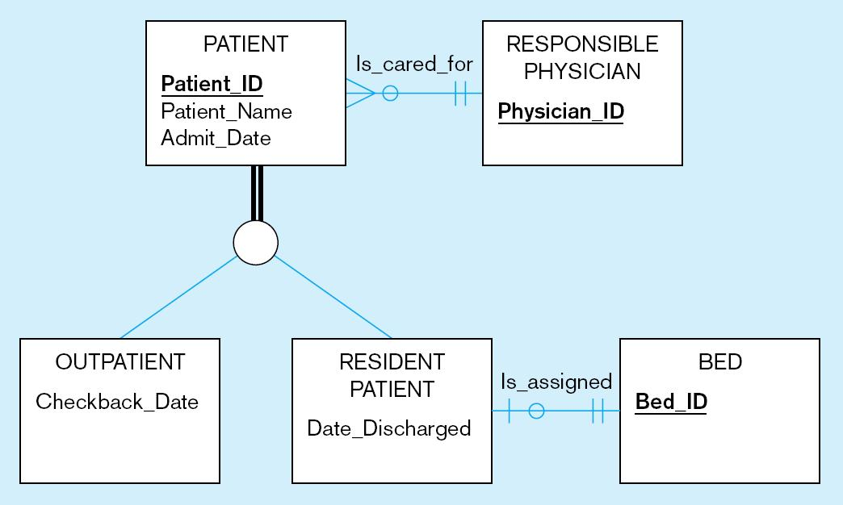
Specialization: Subtype has a unique relationship
Complete, disjoint
d

Slide 30
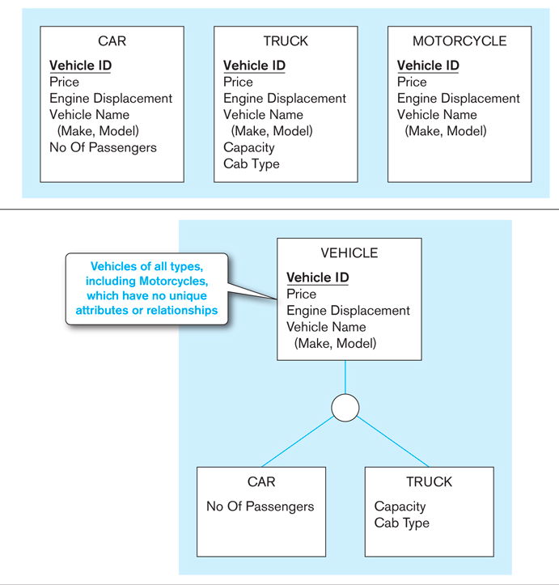
Generalization (A Bottom-up Process for modeling Supertype/subtype )
The process of defining a more general entity type from a set of more specialized entity types.

