Slide 1
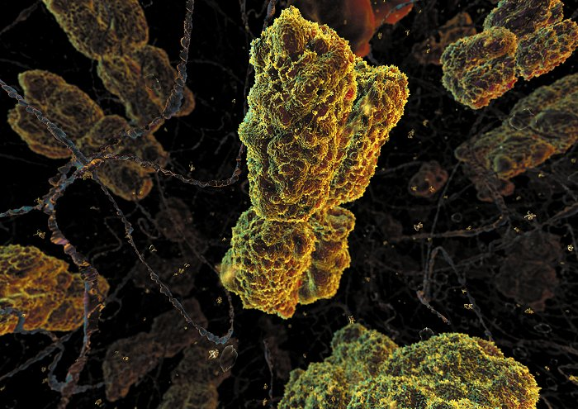
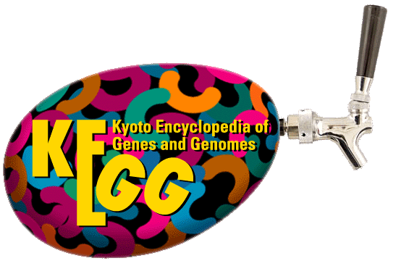
KEGGTap: Biologically solid data give biologically meaningful results
Chris Plaisier
Stats Club
08/19/2005

Slide 2
Annotation Databases
All annotation databases are based on published material
Annotation is very sensitive to noise
  i.e. human error, or published data that is incorrect
Two main types of annotation databases
  High Level Annotation Database:
    Hydrolase, Phosphatase, or Hypothetical Protein
  Low Level Annotation Database:
    Gene W + Gene X + Compound Y → Compound Z

Slide 3
High Level Annotation
GO Annotation (High Level Annotation)
  Used to give a basic overview of the function of the gene
  Based on published data
  Pros:
    Easy to use
    Annotates many genes
  Cons:
    Not very specific
    Can change

Slide 4
Low Level Annotation
KEGG (Low Level Annotation)
  Gives a very definite explanation of the function of the gene
  Based on biochemically proven reactions
  Pros:
    Very specific
    Annotations don’t change
  Cons:
    Not many genes annotated
    Slightly harder to use en masse

Slide 5
High Level vs. Low Level Annotation
High level annotation provides useful information about novel genes
However, if we want to see if there is anything interesting known about a group of genes high level annotation has too much noise
Low level annotation like KEGG allows us to use solid biochemical information to analyze a group of genes

Slide 6
Gene Enrichment
Not a Novel Idea
Gene enrichment is a very useful to ascertain function of a group of genes
Has been used a lot in large scale genomic approaches
Need tools to make it easier to look at the information pertaining to our specific aims

Slide 7
The Problem
Is there a way to ascertain the function of the modules using annotation?
Or more basically we have classified a dataset into groups and we want to assign functions to the different classes

Slide 8

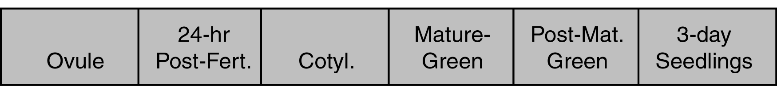
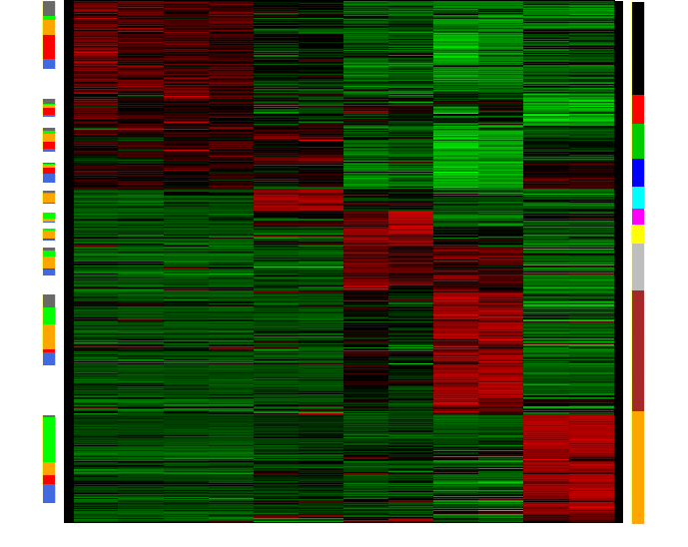
Beatutiful Co-expression Networks

Slide 9
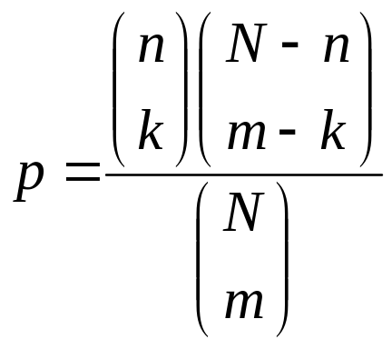
Enter the Hypergeometric Probaility Distribution Function
Hypergeometric PDF is described by this formula:
N = number of genes in dataset that are annotated
n = number of genes annotated as specific type
m = number of genes in class, or module in this case
k = number of genes in module that are of the specific type

Slide 10
Making a p-value from a probability (an easy hack :-)
What is a p-value?
  It is the sum of the probabilities of an event occurring and anything more extreme
  If I have a probability what is a simple way to calculate the p-value?
  Just add one to the k until k is equal to m or n
  Then sum all the probabilities and that is a one tailed p-value

Slide 11
What are the limits?
How large a dataset can the hypergeometric PDF in KEGGTap handle?
It was tested with N=22,000, m=1000, n=500, and an incremental k
To calculate p-values in this range took approximately 2-3 seconds
Therefore a run of every known genome is feasible

Slide 12
Running KEGGTap
Python command-line program
Uses command-line options
Multiplatform
  Which means it can run on Windows, Linux or Mac
  Going to produce executable binaries so that libraries for Python need not be installed
    i.e. KEGGTap.exe

Slide 13
What input is necessary to run KEGGTap?
KEGG Data
Input File
Output File
Three letter KEGG organism name
p-value Cutoff

Slide 14
Program Parameters
C:\Documents and Settings\cplaisier\My Documents\Work\cm260 Project\code\KEGGTap.2>KEGGTap.py
###############################################################
# #
# KEGGTap 2.0 developed by Chris Plaisier (plaisier@ucla.edu) #
# Licensed under the Academic Free License version 2.1 #
# #
###############################################################
usage: KEGGTap.py [options]
options:
-h, --help show this help message and exit
-o ORG, --org=ORG Three letter organism name from KEGG,
http://www.genome.jp/kegg/catalog/org_list.html
-d DATA, --data=DATA How to obtain the KEGG data; 0 = Cached, 1 = Download
XML Files, 2 = Get Directly From Kegg Database
-i INPUT, --input=INPUT
Name of input file, default is input.csv
-s OUTPUT, --output=OUTPUT
Name of output file, default is KEGGTapOutput.csv
-p PVALUE, --pvalue=PVALUE
p-value to use as threshold for calling a pathway
over-represented
C:\Documents and Settings\cplaisier\My Documents\Work\cm260 Project\code\KEGGTap.2>

Slide 15
KEGG Data Downloading
Two methods to download KEGG Data:
  Direct querying of the KEGG database
    Takes a really long time
    But more genes are annotated this way
    Only needs to be done once per organism, and can use cached file to do many analyses
  FTP XML Files and parse them
    Takes much less time
    Less genes are annotated
    Also only needs to be done once and then can use cached file
Cached files are written every time the program downloads KEGG data, they can save a lot of time

Slide 16
What does the input file look like?
Simple input file:
  <Gene Name>, <Classification>
    <Gene Name> = must be the identifier recognized by KEGG, for Mouse is the Locuslink ID
    <Classification> = an identifier for the class the gene belongs, module name works fine
      Can be a number or text
Input file can be exported from Excel as a CSV file

Slide 17
Sample Input File
Locuslink ID | Module Color
69339 | salmon
17776 | red
105377 | red
383154 | salmon
16826 | brown
216453 | blue
11637 | black
12534 | greenyellow
233400 | black
66614 | red
18813 | red
NA | brown
72682 | black
56356 | brown
… | …
Actual Input File:
69339,salmon
17776,red
105377,red
383154,salmon
16826,brown
216453,blue
11637,black
12534,greenyellow
233400,black
66614,red
18813,red
NA,brown
72682,black
56356,brown
…

Slide 18
KEGGTap Output
KEGGTap outputs a CSV file
  Classification
    module or other grouping
  KEGG pathway ID
  p-value:
    The enrichment of the pathway in the class
  k, m, n, N:
    Useful for looking at pathways
  KEGG Pathway URL:
    Has a link to the KEGG website where pathway can be viewed with genes in class highlighted
  Genes seperated by “|”

Slide 19
Example Output
Module | Pathway | p-Value | k | m | n | N | KEGG Pathway URL | Genes
blue | path:mmu04512 | 1.37E-09 | 16 | 119 | 19 | 600 | http://www.genome.jp/kegg-bin/mark_pathway_www?13405/mmu04512.args | mmu:16773|mmu:16775|mmu:19699|mmu:12826|mmu:12491|mmu:241226|mmu:12831|mmu:20750|mmu:22370|mmu:22371|mmu:53867|mmu:20971|mmu:12843|mmu:12842|mmu:16780|mmu:12827
blue | path:mmu04510 | 0.000407 | 19 | 119 | 46 | 600 | http://www.genome.jp/kegg-bin/mark_pathway_www?13437/mmu04510.args | mmu:16773|mmu:16775|mmu:19699|mmu:12826|mmu:241226|mmu:12831|mmu:20750|mmu:16476|mmu:22370|mmu:22371|mmu:53867|mmu:16542|mmu:12843|mmu:12842|mmu:16780|mmu:18590|mmu:18596|mmu:18595|mmu:12827
blue | path:mmu00950 | 0.039071 | 2 | 119 | 2 | 600 | http://www.genome.jp/kegg-bin/mark_pathway_www?13469/mmu00950.args | mmu:14718|mmu:234724
blue | path:mmu00401 | 0.039071 | 2 | 119 | 2 | 600 | http://www.genome.jp/kegg-bin/mark_pathway_www?13499/mmu00401.args | mmu:14718|mmu:234724

Slide 20
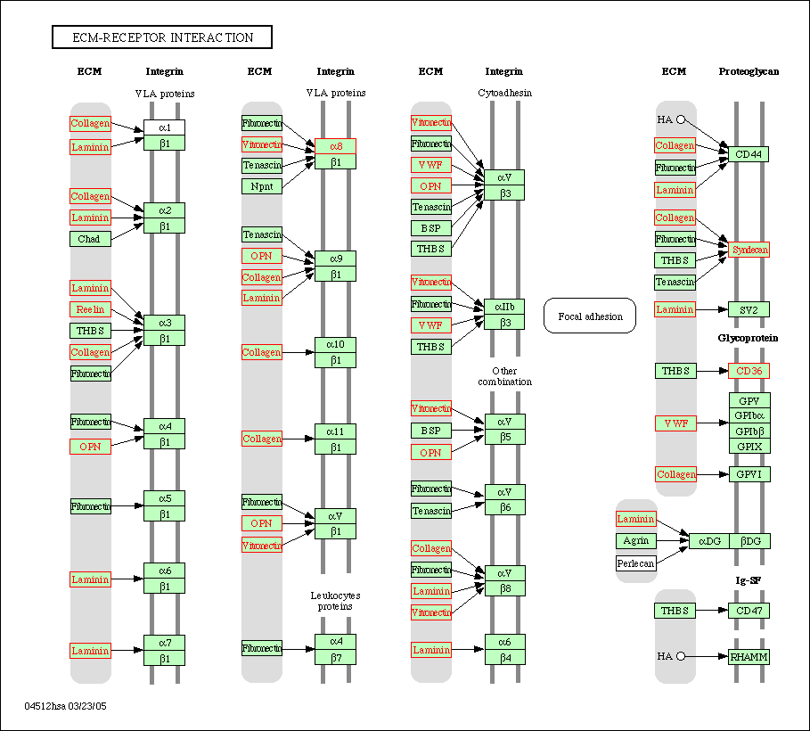
KEGG Pathway with Highlighted Genes from the Module
P-value = 1.37E-09
16 out of the 19 genes in the dataset are in this module.

Slide 21
Tested On Two Gene
Co-expression Networks
Arabidopsis thaliana seed developmental dataset
  Development of seeds is the variable in this dataset
Mouse dataset
  F2 intercross from Lusis Lab
  Mixing of two inbred populations is the variable in this dataset

Slide 22
Aradopsis thaliana Seed Developmental Co-expression Network

Slide 23
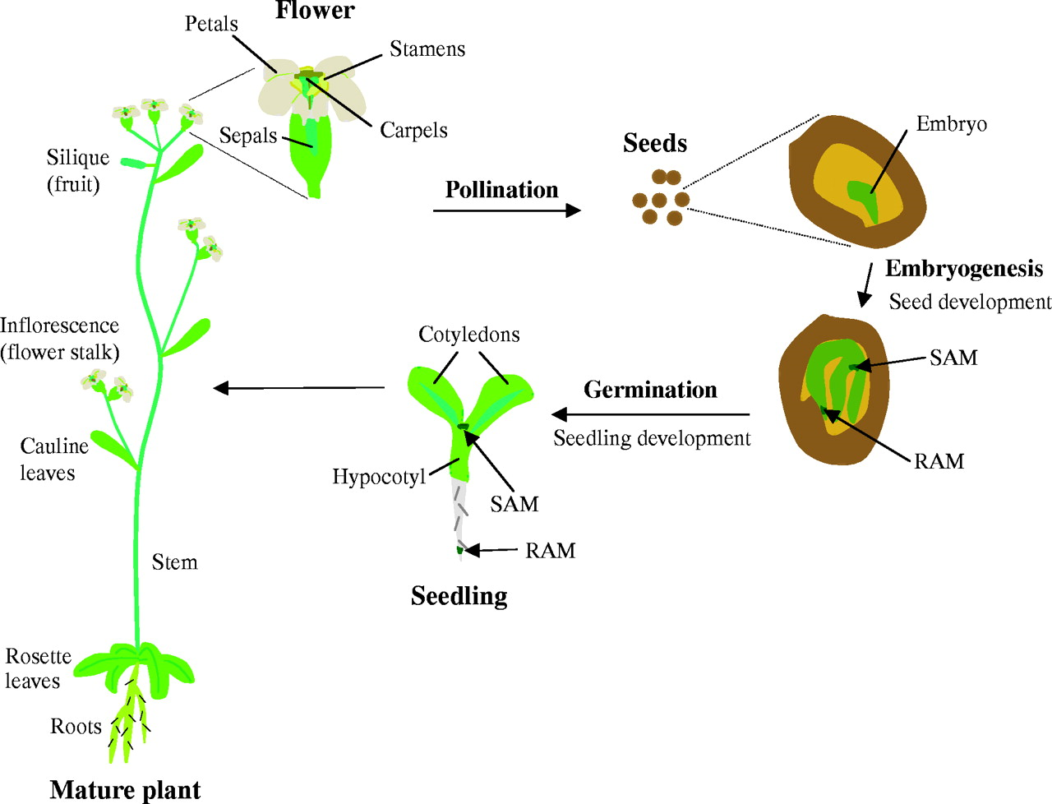
Seeds Make Fatty Acids for
Storage and Germination

Slide 24
Arabidopsis Module 6 KEGG Enriched Pathways
All the following pathways came from the same module
This is just one case where there is an obvious function for the module

Slide 25
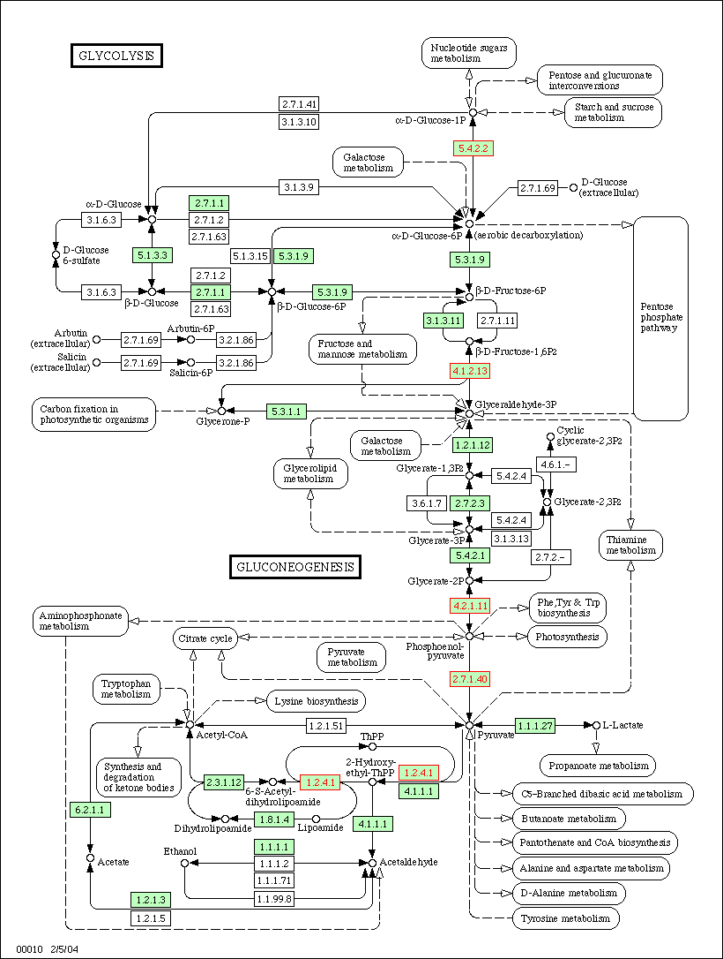

Slide 26
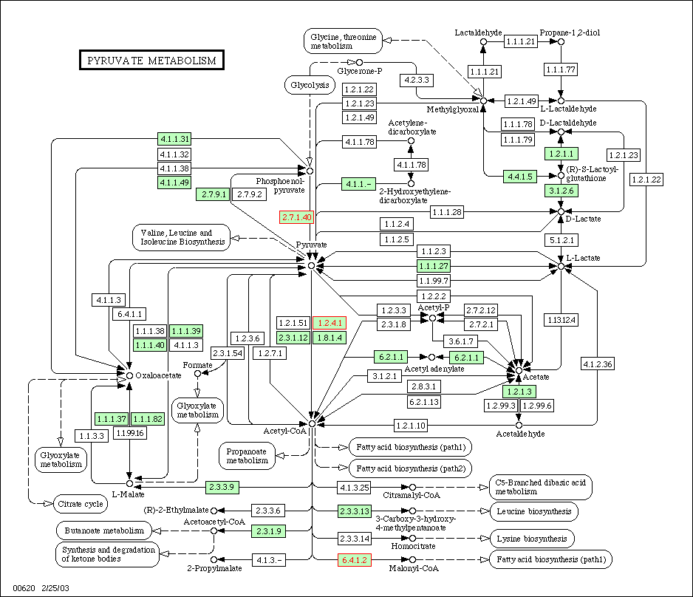

Slide 27
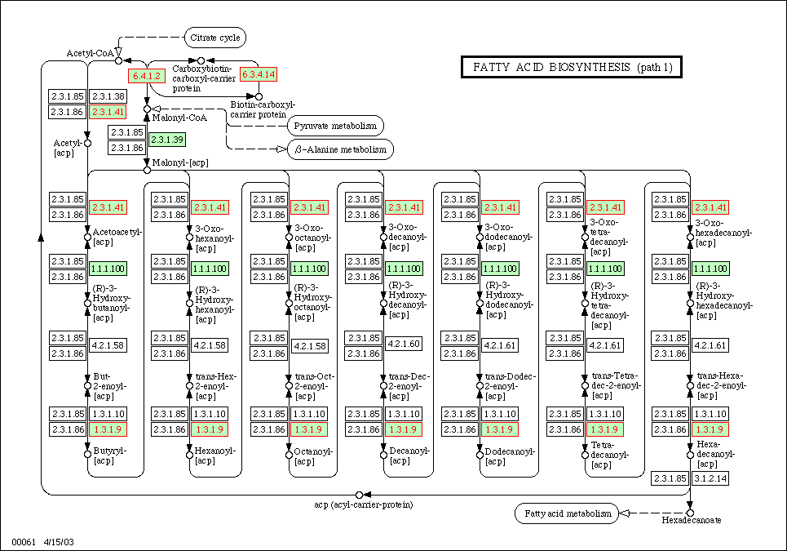

Slide 28
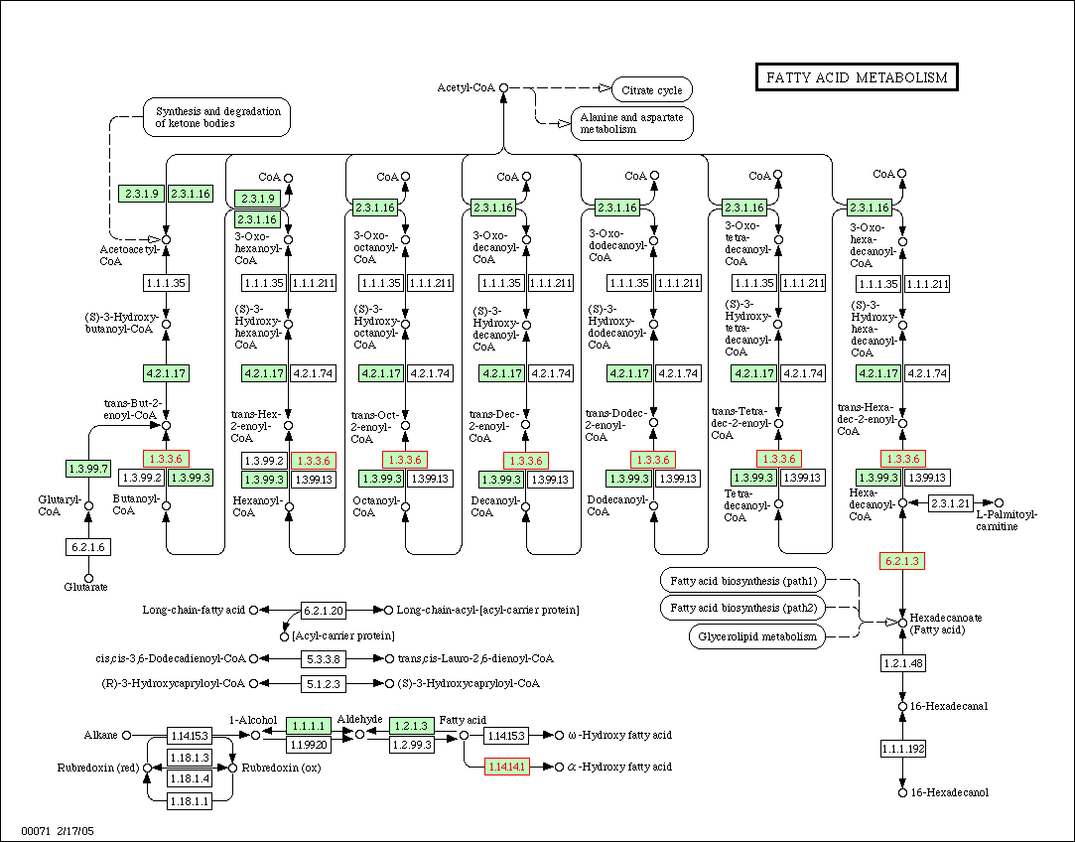

Slide 29
Summary of Arabidopsis Analyses
Only 516 genes of 2000 in the dataset were annotated to pathways in KEGG
Even so we found enriched pathways all but one module
Enriched pathways fit the biological events occurring in the organism during the developmental stage
It was also possible to pinpoint to the developmental stage when certain seed developmental events were occurring

Slide 30
Mouse Dataset
Dataset comes from Lusis Lab
Female mouse liver expression data for F2 crosses
Received already analyzed dataset, which had ~3400 genes and modules defined
Downloaded KEGG data from the database directly, 600 genes of the ~3400 genes were annotated by KEGG

Slide 31
Modules with Enriched Pathways
(p-value<=0.05)
Black = 6
Blue = 7
Brown = 14
Cyan = 4
Green = 7
GreenYellow = 4
Grey = 3
LightCyan = 6
LightYellow = 1
MidnightBlue = 10
Purple = 3
Red = 7
Salmon = 1

Slide 32
Blue Module Enriched Pathways
Blue is related to mouse weight (p-value = 7.7x10⁻⁵)
It is also related to abdominal fat pad mass (p-value = 0.009) and total mass of other fat depots (p-value = 0.02)

Slide 33
P-value = 1.37E-09

Slide 34
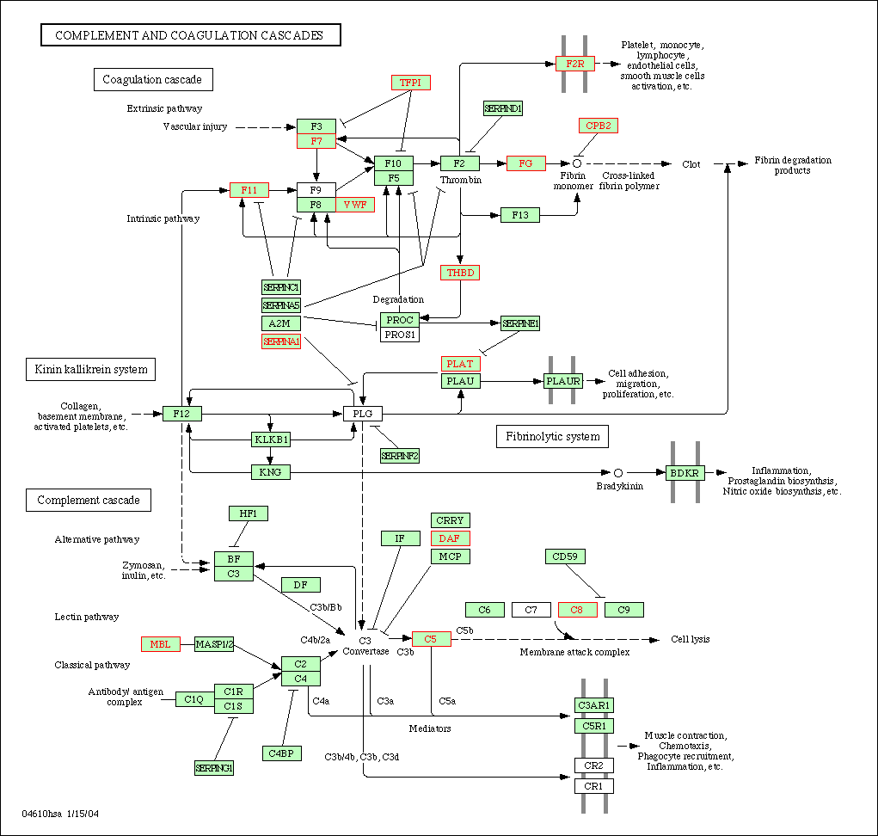
P-value = 6.52E-07

Slide 35
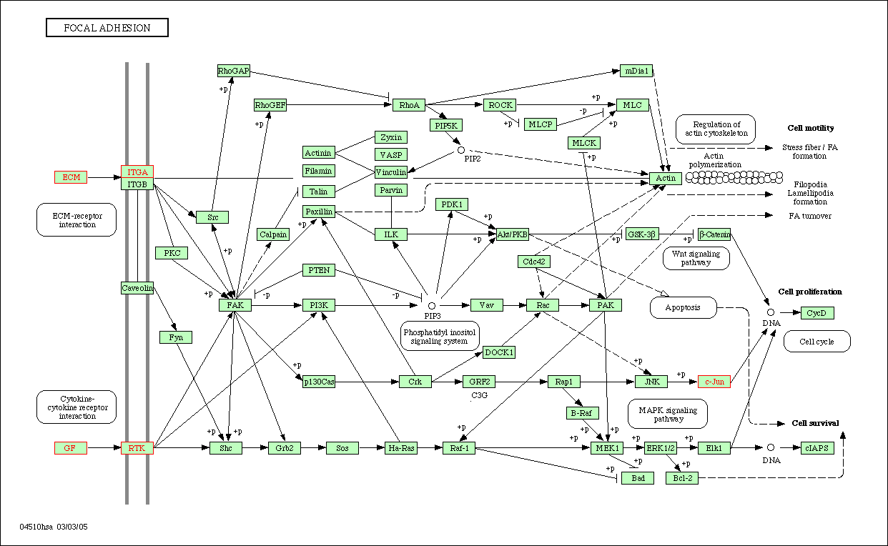
P-value = 0.00041

Slide 36
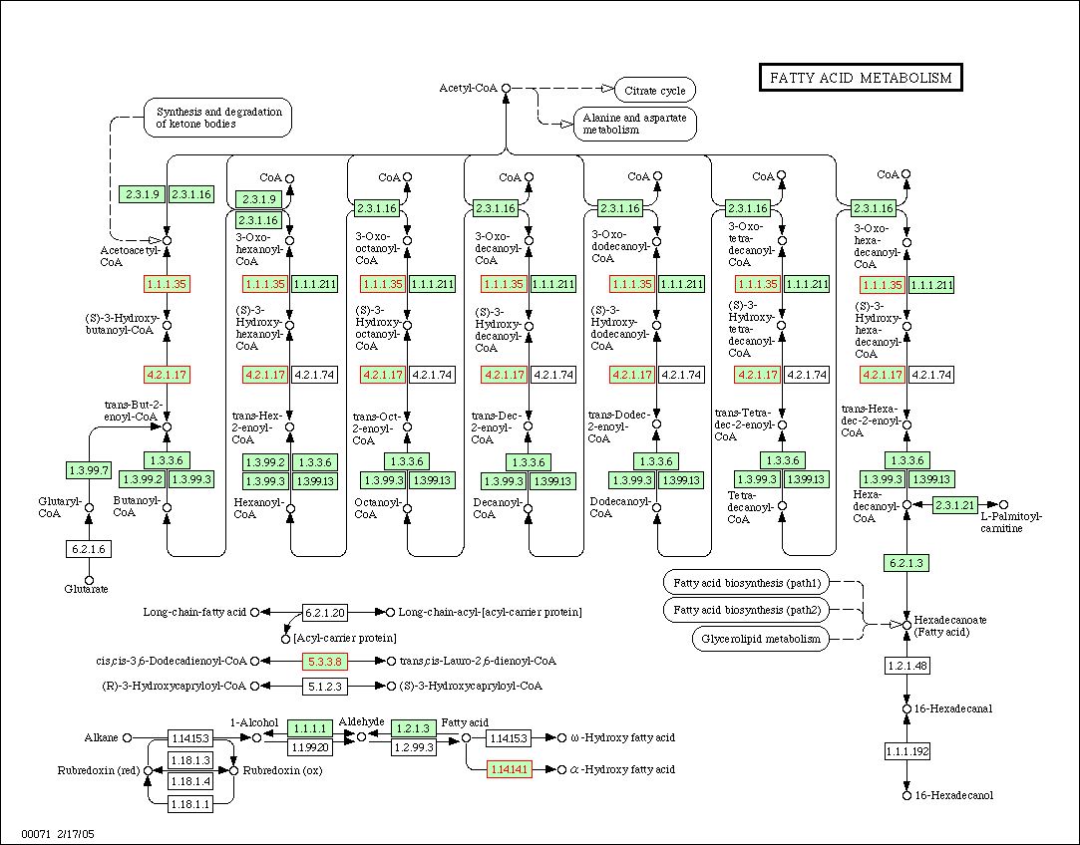
P-value = 0.018

Slide 37
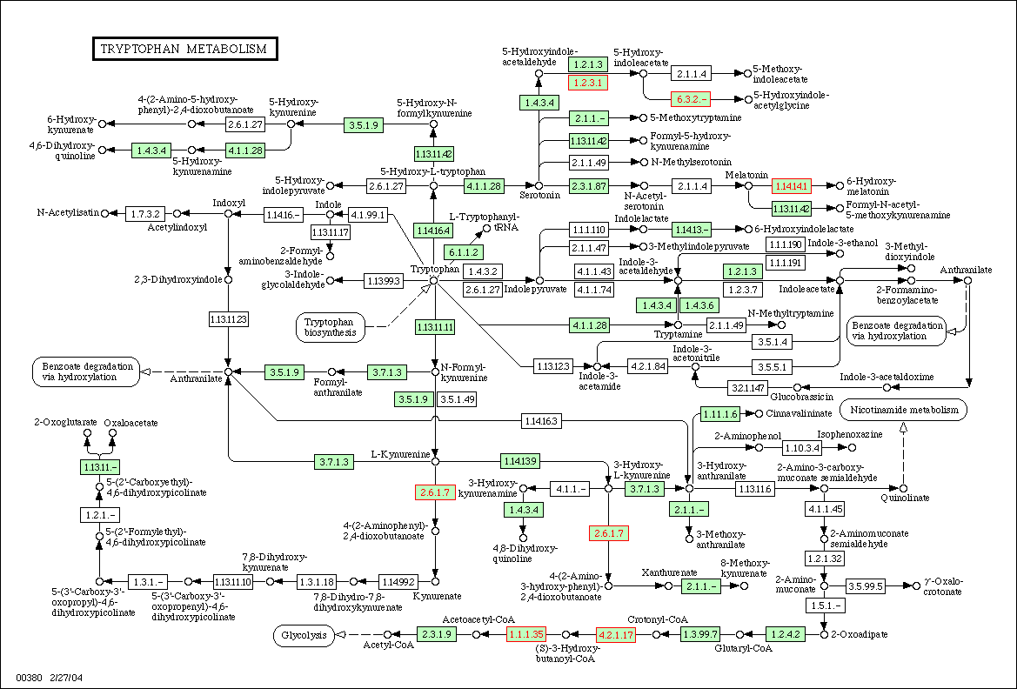
P-value = 0.020

Slide 38
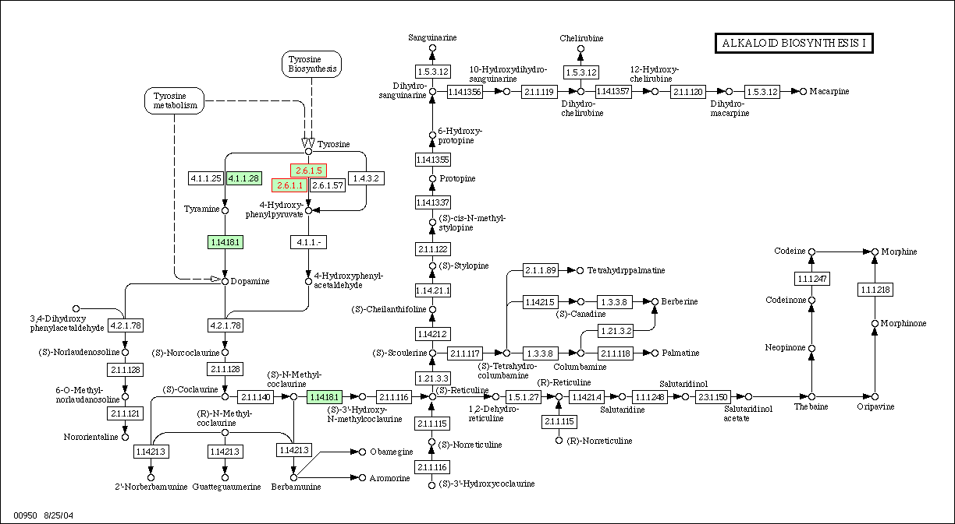
P-value = 0.039

Slide 39
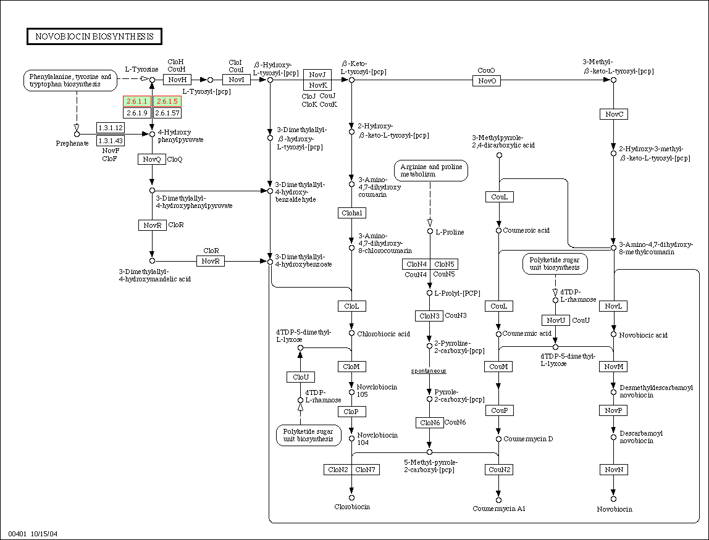
P-value = 0.039

Slide 40
Brown Module
Brown module is related to plasma glucose/insulin ratio (p-value = 0.004)
Also related to plasma insulin levels (p-value = 0.02)

Slide 41
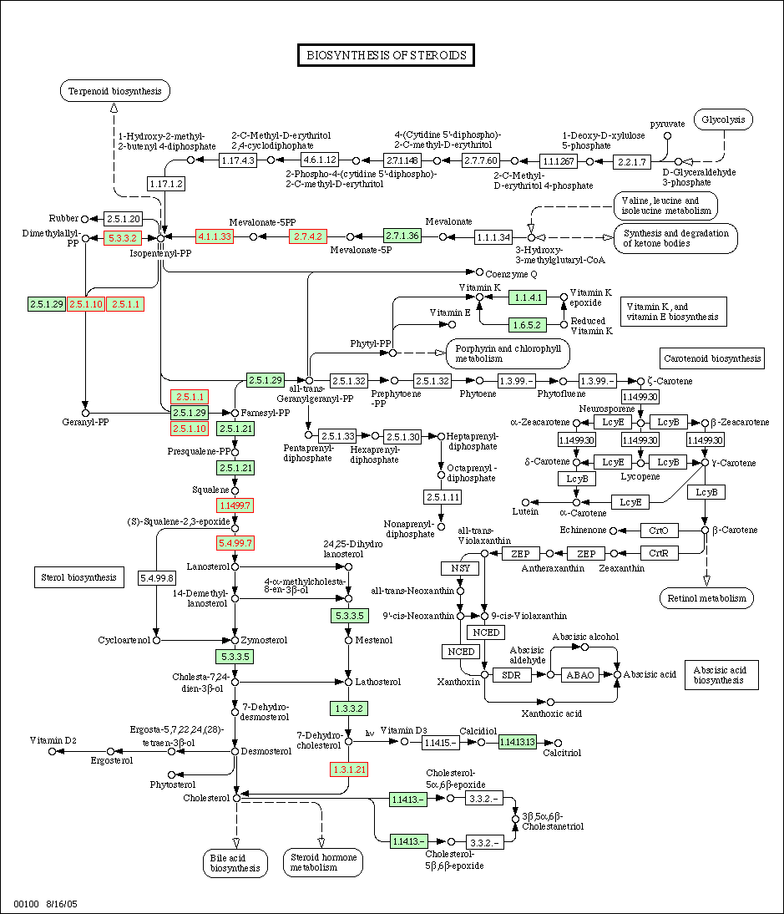
P-value = 1.8E-6

Slide 42
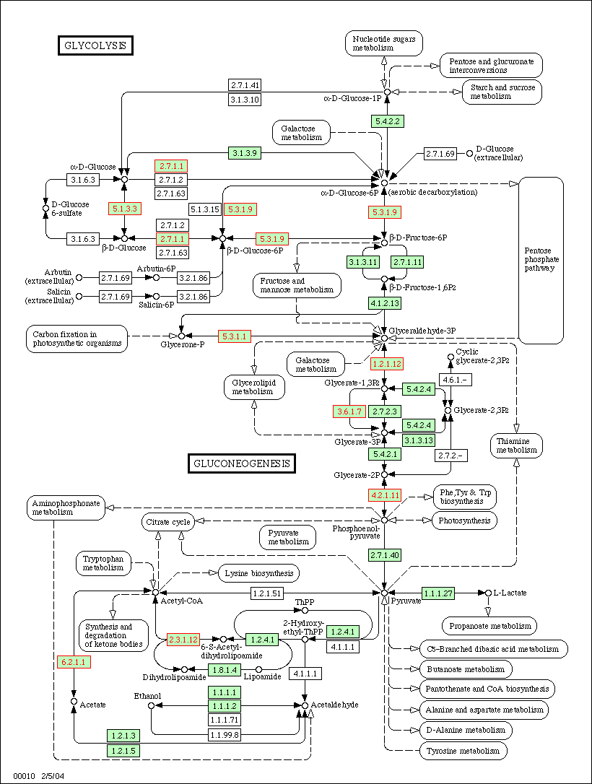
P-value = 3.55E-5

Slide 43
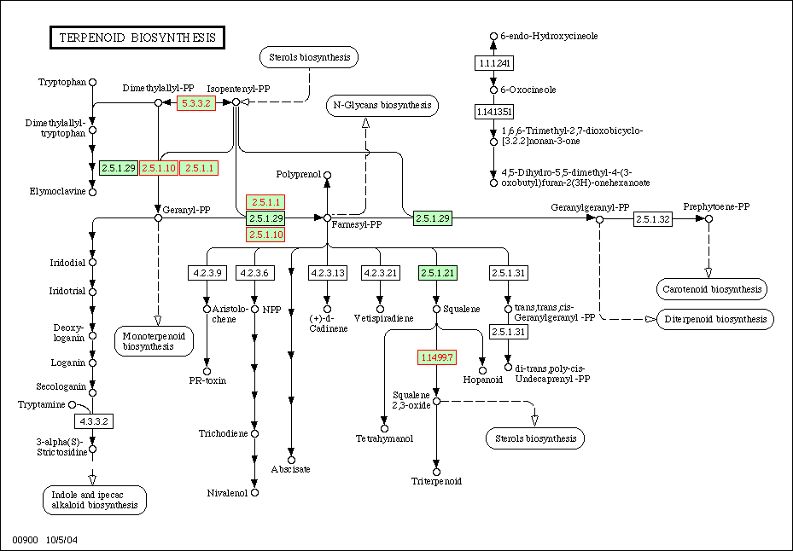
P-value = 0.016

Slide 44
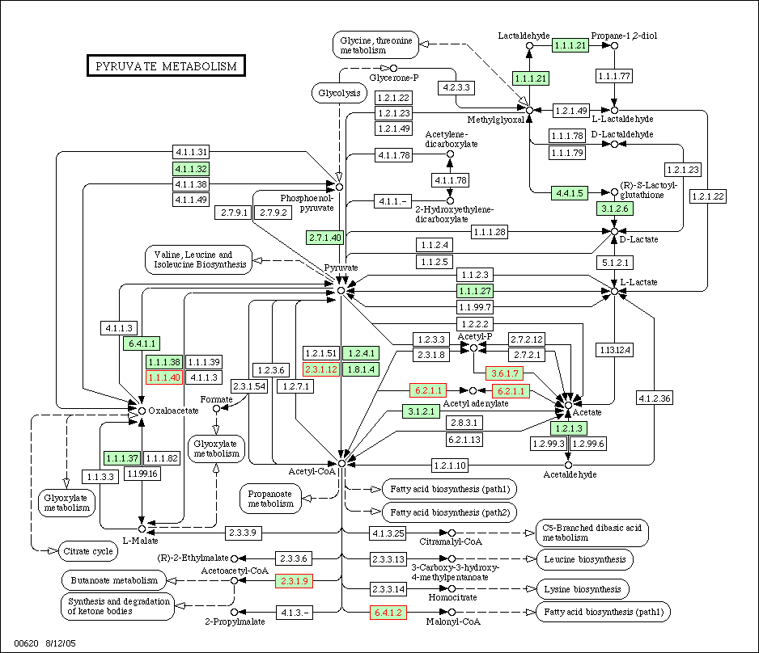
P-value = 0.002

Slide 45
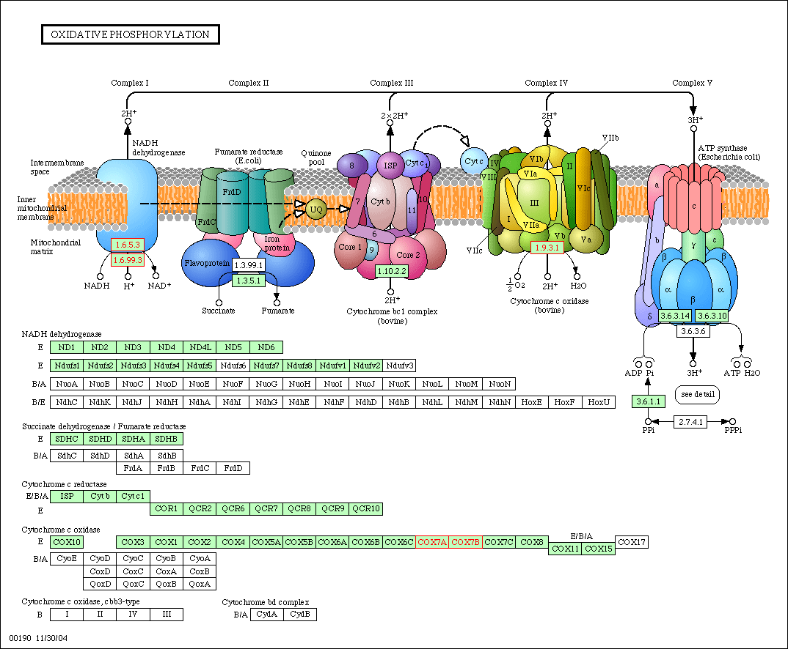
P-value = 0.0047

Slide 46
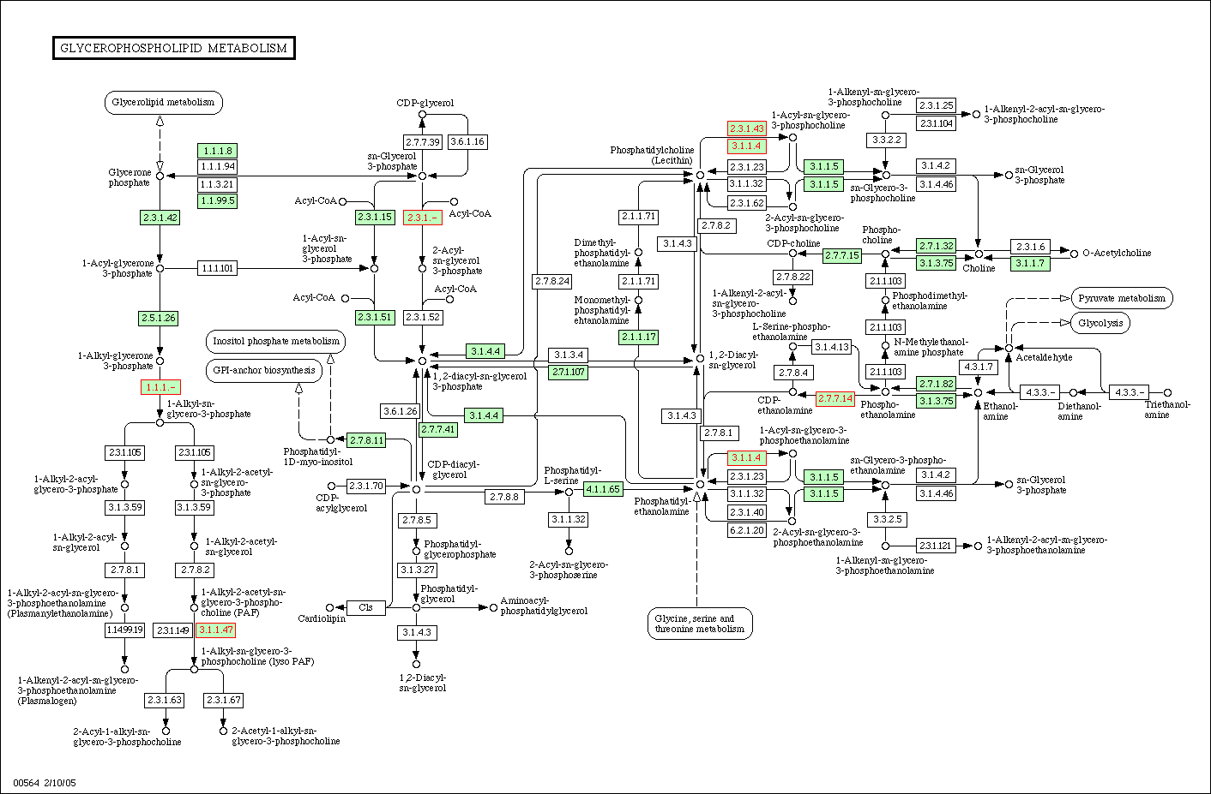
P-value = 0.013

Slide 47
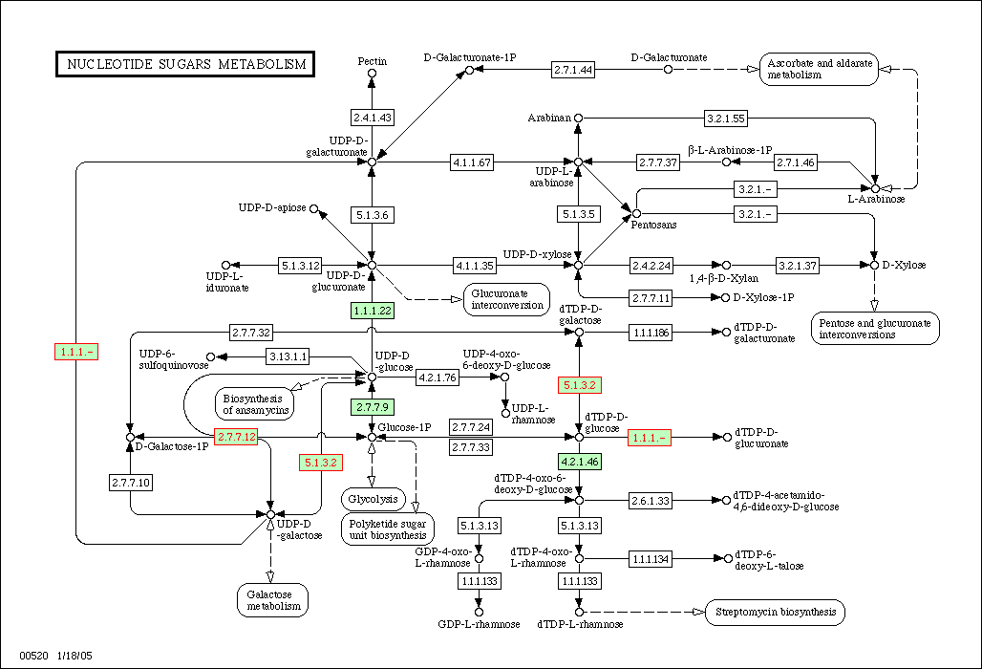
P-value = 0.013

Slide 48
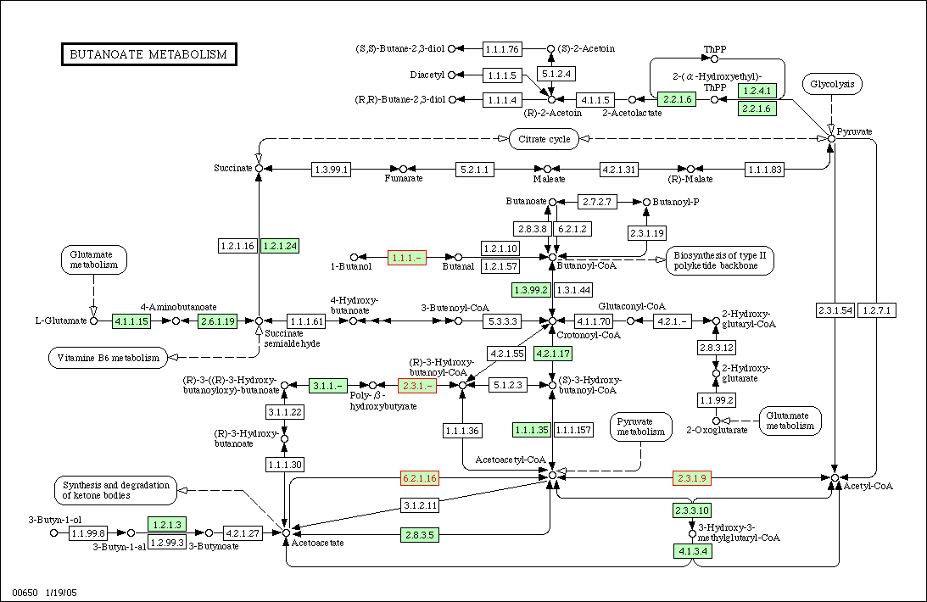
P-value = 0.014

Slide 49
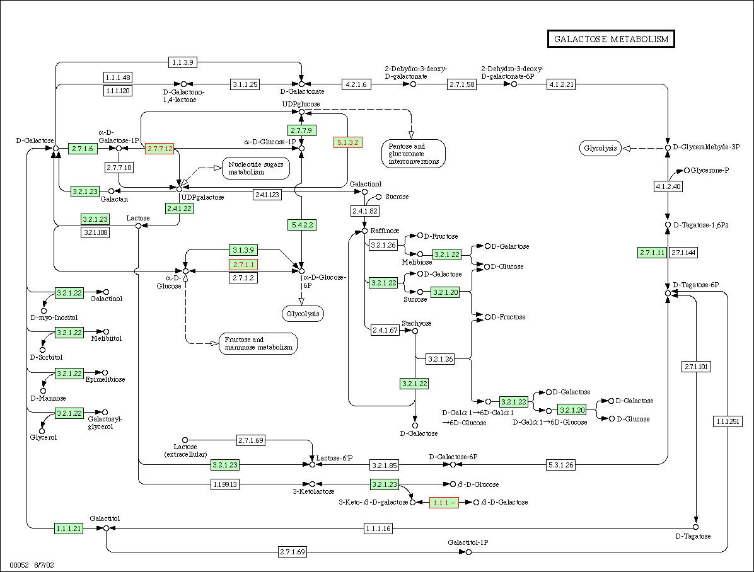
P-value = 0.031

Slide 50
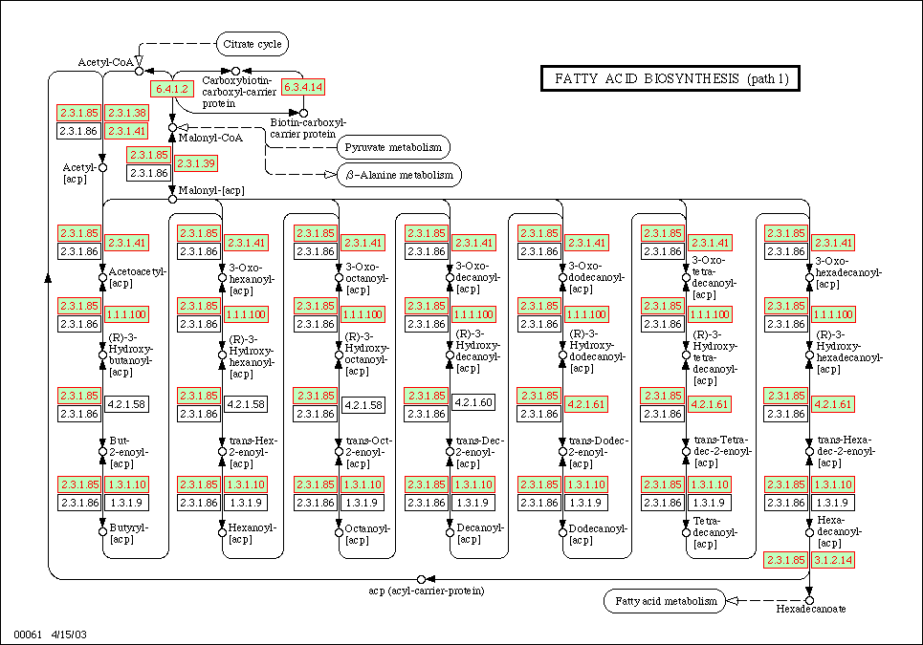
P-value = 0.038

Slide 51
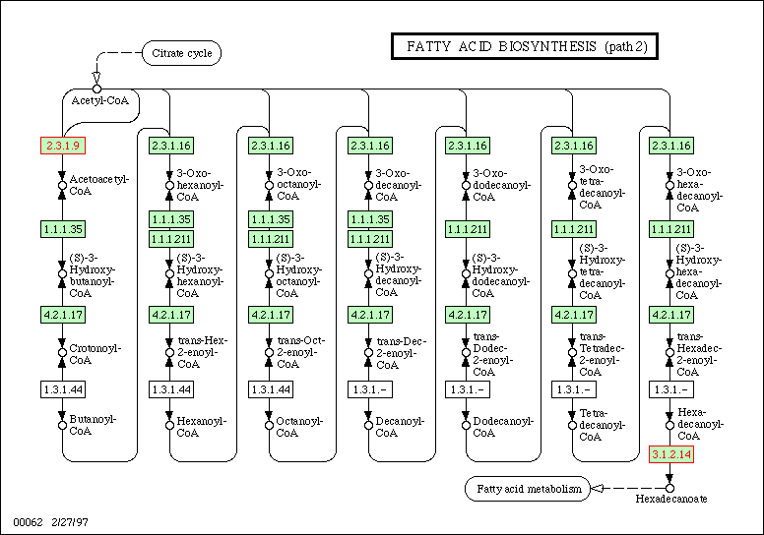
P-value = 0.038

Slide 52
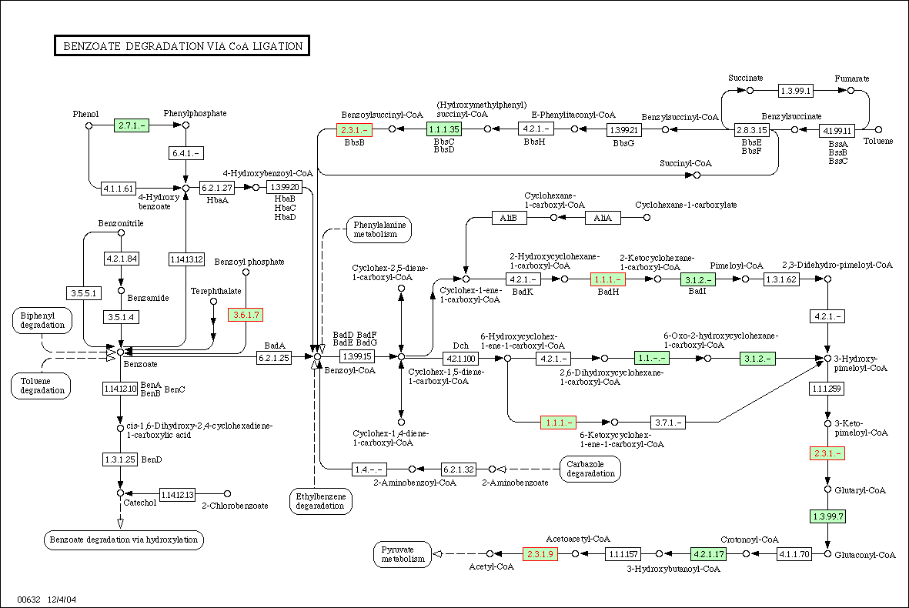
P-value = 0.043

Slide 53
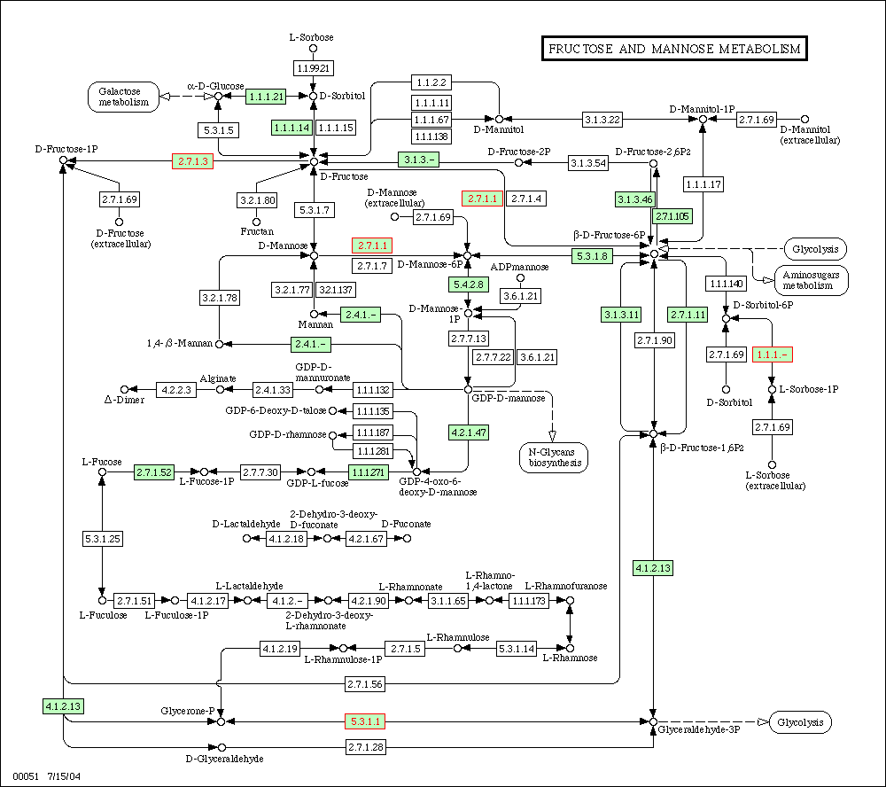
P-value = 0.043

Slide 54
Mouse Summary
That is only two modules worth of analyses
It is best to run all the modules at the same time, otherwise the hypergeometric PDF doesn’t have the same power
If p-value is set to 1, outputs all the results for every module and all pathways annotated in the dataset

Slide 55
Conclusions
KEGG annotation is useful when looking at a group of genes to understand the function
Although only a quarter of the genes are annotated the relationships are still meaningful
Please use KEGGTap to do your next analysis for function, it is free!!!

Slide 56
Future Directions
Use it on Human FCHL datasets
Download images of pathways directly instead of just getting a link
See if KEGG has a better set of XML files
Make accessible, and easily installed
Possibly fit a GUI to KEGGTap

Slide 57
Acknowledgements
CM260
Parag Mallick
Gene Co-expression Networking
Steve Horvath
Arabidopsis Dataset
Bob Goldberg
Brandon Lee
Mouse Data
Anatole Ghazalpour
Sudheer Doss
Bin Zhang
Susanna Wang
Eric E. Schadt
Thomas A. Drake
Aldons J. Lusis
My Current Lab
Paivi Pajukanta

