Slide 1
Differential Expression Analysis
Introduction to Systems Biology Course
Chris Plaisier
Institute for Systems Biology

Slide 2
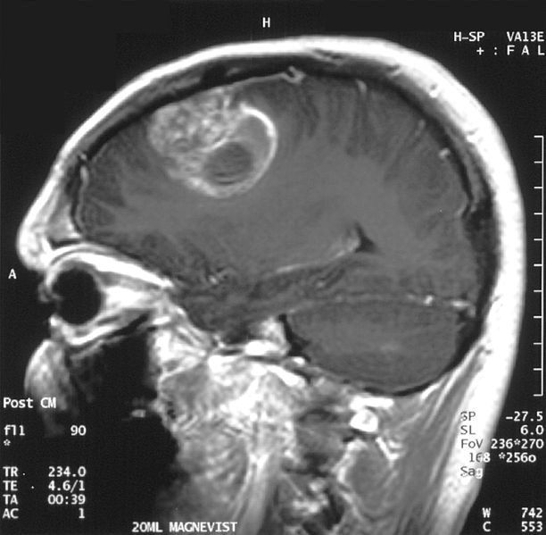
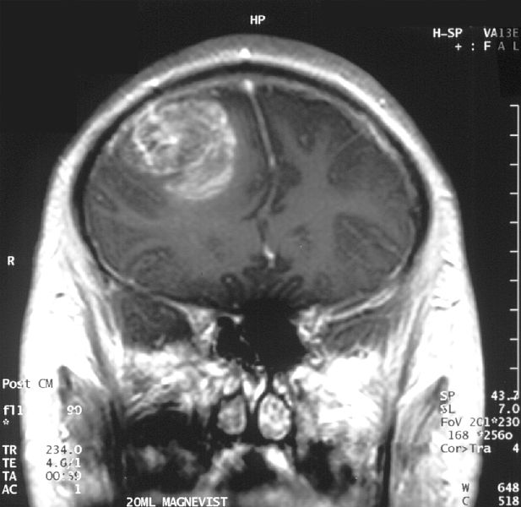
Glioma: A Deadly Brain Cancer
Wikimedia commons
Notes:
2

Slide 3
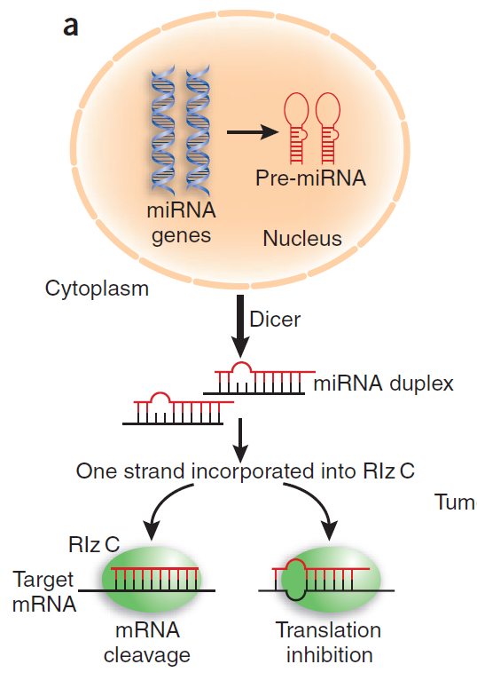
miRNAs in Cancer
RISC
Caldas et al., 2005

Slide 4
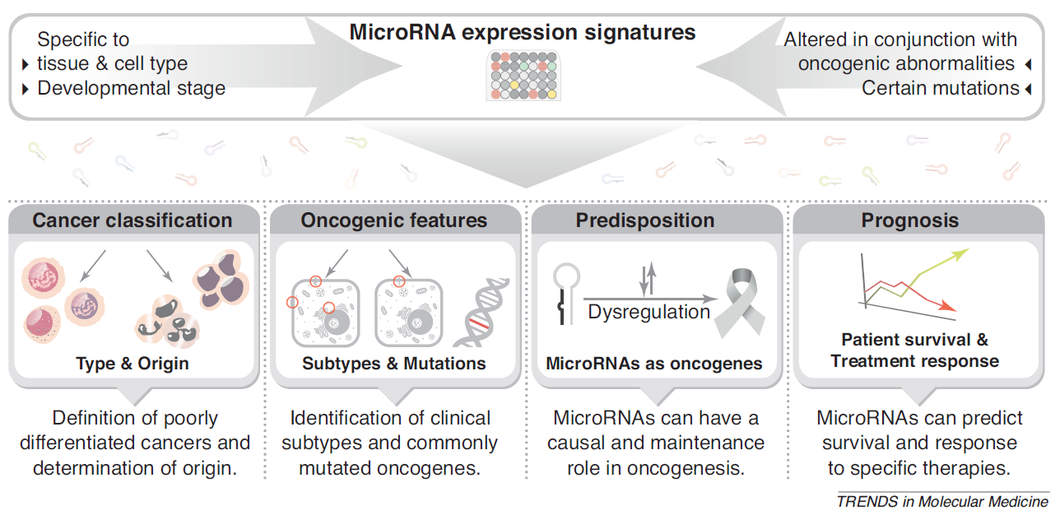
Utility of miRNAs in Cancer
Chan et al., 2011

Slide 5
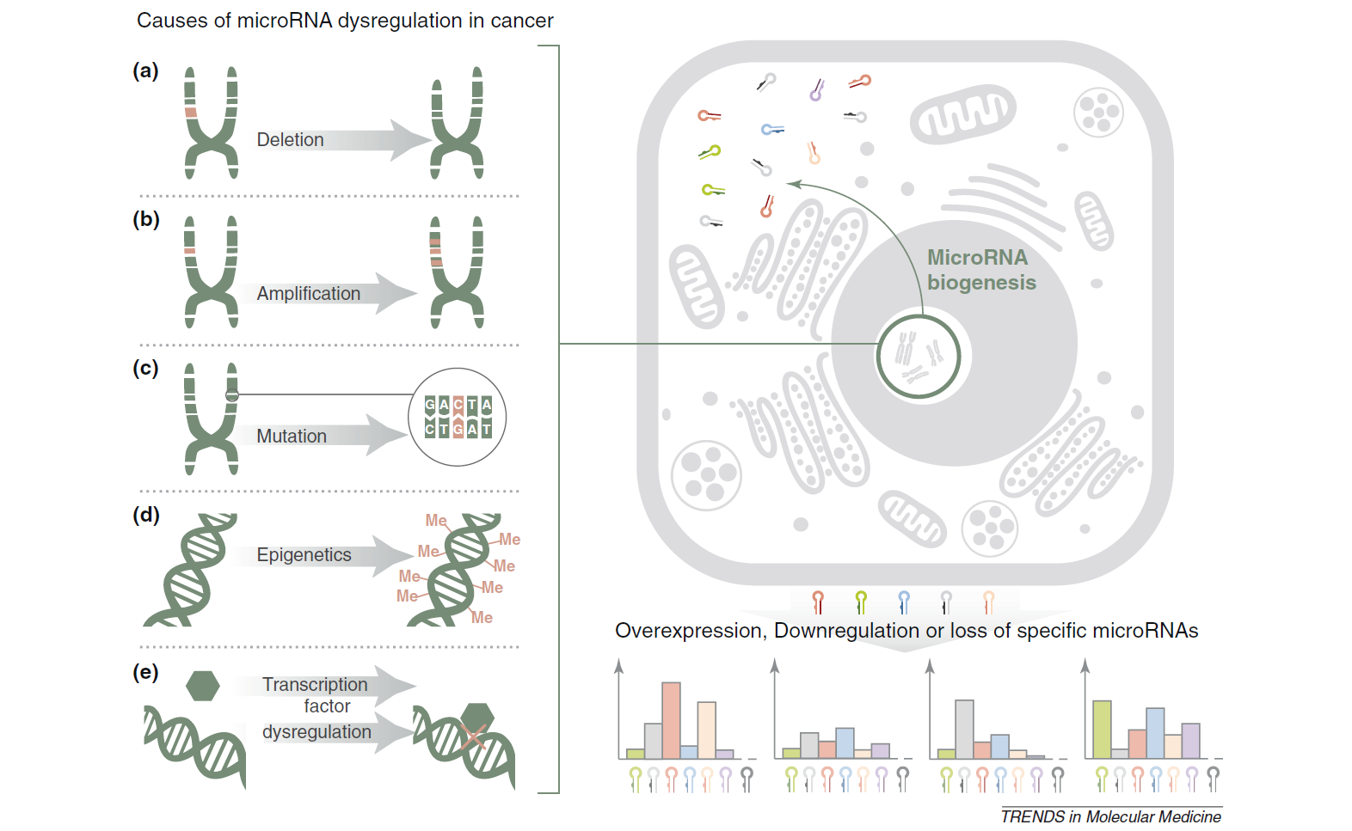
miRNAs are Dysregulated in Cancer
Chan et al., 2011

Slide 6
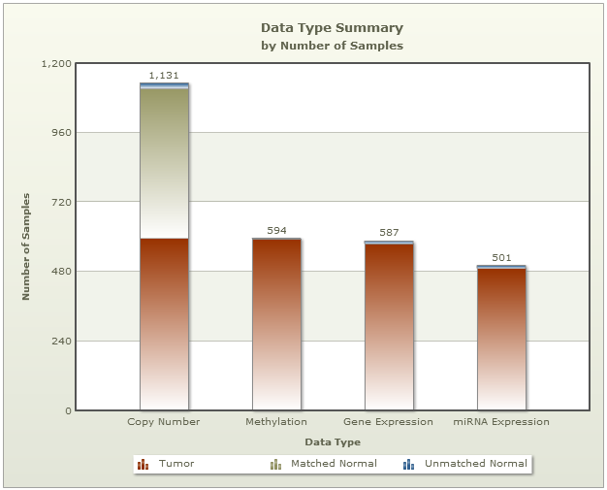
What data do we need?
TCGA

Slide 7
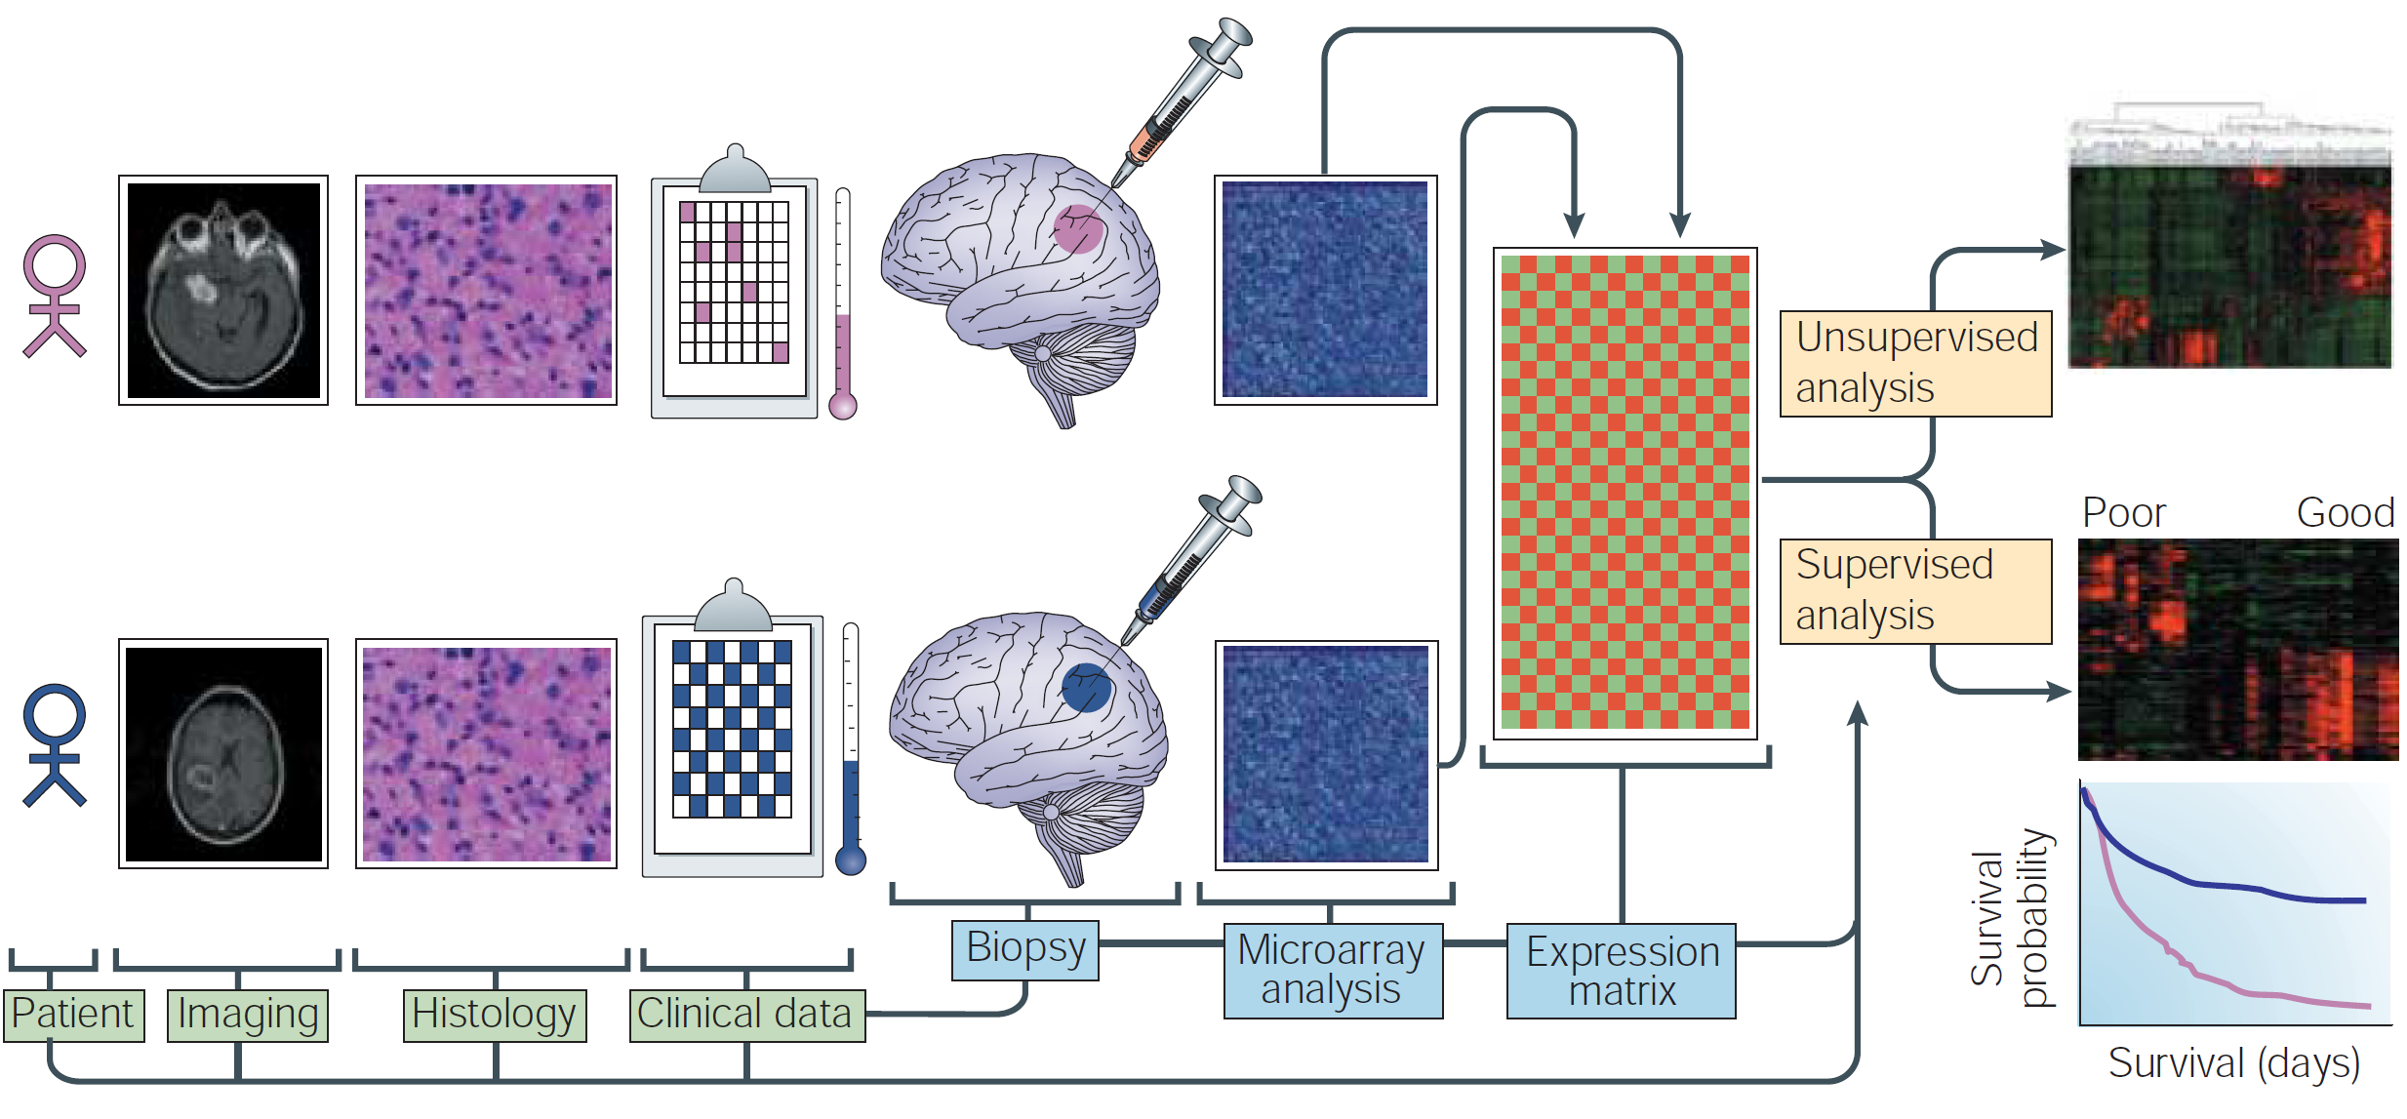
Analysis Method
Mischel et al, 2004

Slide 8
Utility of miRNAs in Cancer
Chan et al., 2011

Slide 9

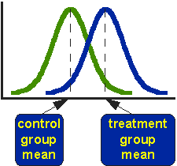
Student’s T-test
Notes:
9

Slide 10
Data for Analysis
Patient tumor miRNA expression levels
By identifying miRNAs whose expression is significantly different between glioma and normal
Could be drivers of cancer related processes

Slide 11
Loading the Data
Comma separated values file is a text file where each line is a row and the columns separated by a comma.
In R you can easily load these types of files using:
# Load up data for differential expression analysis
d1 = read.csv(
'http://baliga.systemsbiology.net/events/sysbio/sites/baliga.systemsbiology.net.events.sysbio/files/uploads/cnvData_miRNAExp.csv',
header=T,
row.names=1)
NOTE: CSV files can easily be imported or exported from Microsoft Excel.

Slide 12
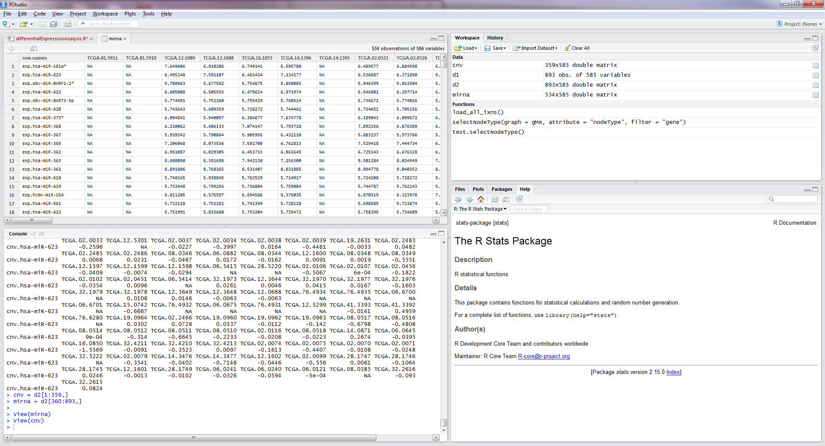
What does the data look like?

Slide 13
Subset Data Types
This file contains the case/control stats, CNVs and miRNA expression
We want to separate these out to make our analysis easier
# Case or control status (1 = case, 0 = control)
case_control = d1[1,]
# miRNA expression levels
mirna = d1[361:894,]
# Copy number variation
cnv = d1[2:360,]

Slide 14
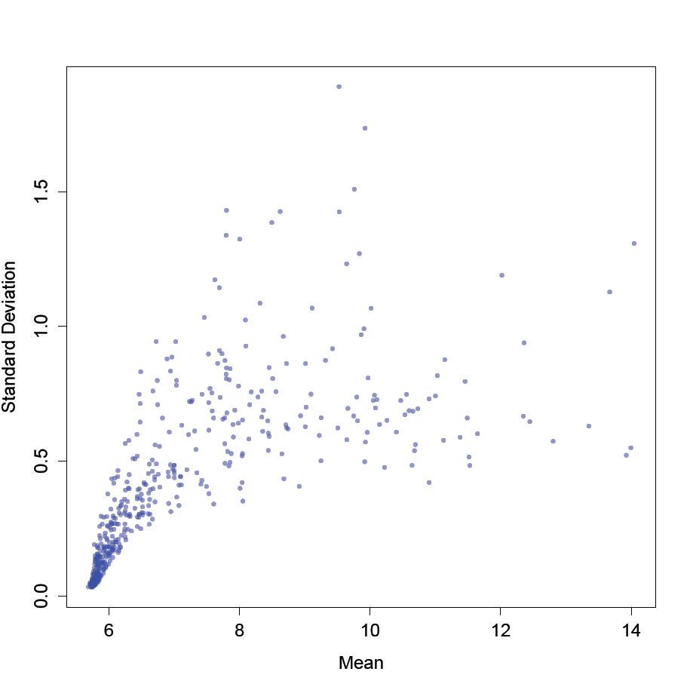
Plot the Data

Slide 15
Questions
What statistics should we compute?
What results should we save from the analysis?

Slide 16
Calculating T-test for all miRNAs
Use a Student's T-test to identify the differentially expressed miRNAs
from the study (compare experimental to controls).
Input: cnvData_miRNAExp.csv - matrix of miRNA expression profiles
Desired output:
t.test.fc.mirna.csv – a matrix of fold-changes, Student’s T-test statistics, Student's T-test p-values with Bonferroni and Benjamini-Hochberg correction in separate columns labeled by miRNA names (write them out sorted by Benjamini-Hochberg corrected p-values).
The number of miRNAs differentially expressed (α ≤ 0.05 and fold-change ± 2) for no multiple testing correction, Bonferroni and Benjamini-Hochberg correction (use whatever method you like: R or Excel)
volcanoPlotTCGAmiRNAs.pdf – Create a volcano plot of the –log₁₀(p-value) vs. log₂(fold-change)
Useful functions: read.csv, t.test, sapply, p.adjust, order, write.csv, print, pdf, plot, t, pdf, dev.off,
paste

Slide 17
Calculating Fold-Changes
Now lets calculate the fold-changes for each of the miRNAs, values are
log₂ transformed so need to reverse this before calculating fold-changes:
# Calculate fold-changes
fc = rep(NA, nrow(mirna))
for(i in 1:nrow(mirna)) {
fc[i] = median(2^as.numeric(mirna[i, which(case_control==1)]), na.rm = T) / median(2^as.numeric(mirna[i, which(case_control==0)]), na.rm = T)
}
or a faster version using an apply:
# Faster version using an sapply
fc.2 = sapply(1:nrow(mirna), function(i) { return(median(2^as.numeric(mirna[i, which(case_control==1)]), na.rm = T) / median(2^as.numeric(mirna[i, which(case_control==0)]), na.rm = T)) } )

Slide 18
Calculating T-Test for All miRNAs
Now lets calculate the significance of differential
expression for each of the miRNAs:
# Calculate Student's T-test p-values
t1.t = rep(NA, nrow(mirna))
t1.p = rep(NA, nrow(mirna))
for(i in 1:nrow(mirna)) {
t1 = t.test( mirna[ i, which(case_control==1) ],
mirna[ i, which(case_control==0) ] )
t1.t[ i ] = t1$statistic
t1.p[ i ] = t1$p.value
}

Slide 19
Multiple Testing Correction
When to use FDR vs. FWER for setting a threshold?
• Family Wise Error Rate (FWER) - e.g. Bonferroni
Extremely conservative only few miRNAs are called significant.
Is used when one needs to be certain that all called miRNAs are truly positive.
False Discovery Rate (FDR) - e.g. Benjamini-Hochberg
If the FWER is too stringent when one is more interested in having more true positives. The false positives can be sorted out in subsequent experiments (expensive).
By controlling the FDR one can choose how many of the subsequent experiments one is willing to be in vain.

Slide 20
Adjust for Multiple Testing
Next we will correct our p-values for multiple testing in two ways:
# Do Bonferroni multiple testing correction (FWER)
p.bonferroni = p.adjust(pValues, method='bonferroni')
# Do Benjamini-Hochberg multiple testing correction (FDR)
p.benjaminiHochberg = p.adjust(pValues, method='BH')
# How many miRNAs are considered significant
print(paste('Uncorrected = ',sum(pValues<=0.05),'; Bonferroni = ',sum(p.bonferroni<=0.05),'; Benjamini-Hochberg = ',sum(p.benjaminiHochberg<=0.05),sep=''))

Slide 21
Write Out Results to CSV
We will now write out the results of the T-test analysis to a CSV file:
# Create index ordered by Benjamini-Hochberg corrected p-values to sort each vector
o1 = order(p.benjaminiHochberg)
# Make a data.frame with the three columns
td1 = data.frame(fold.change = fc[o1],
t.stats = t1.t[o1],
t.p = t1.p[o1],
t.p.bonferroni = p.bonferroni[o1],
t.p.benjaminiHochberg = p.benjaminiHochberg[o1])
# Add miRNAs names as rownames
rownames(td1) = sub('exp.', '', rownames(mirna)[o1])
# Write out results file
write.csv(td1, file = 't.test.fc.mirna.csv')
This can now be opened in Excel for further analysis.

Slide 22
What are the DE miRNAs?
Typically genes / miRNAs are considered DE if adjusted p-value ≤ 0.05 and fold-change ± 2
Benjamini-Hochberg FDR ≤ 0.05 and FC ± 2 = 66 miRNA
How do we figure out which 66?
#The significant miRNAs
sub('exp.', '', rownames(mirna)[ which(p.benjaminiHochberg <= 0.05 & (fc <= 0.5 | fc >= 2)) ] )

Slide 23
Basic Code for a Volcano Plot
# Make a volcano plot
plot(log(fc,2), -log(t1.p, 10) , ylab = '-log10(p-value)', xlab = 'log2(Fold Change)', axes = F, col = rgb(0, 0, 1, 0.25), pch = 20, main = "TCGA miRNA Differential Expresion", xlim = c(-6, 5.5), ylim=c(0, 110))
p1 = par()
axis(1)
axis(2)

Slide 24
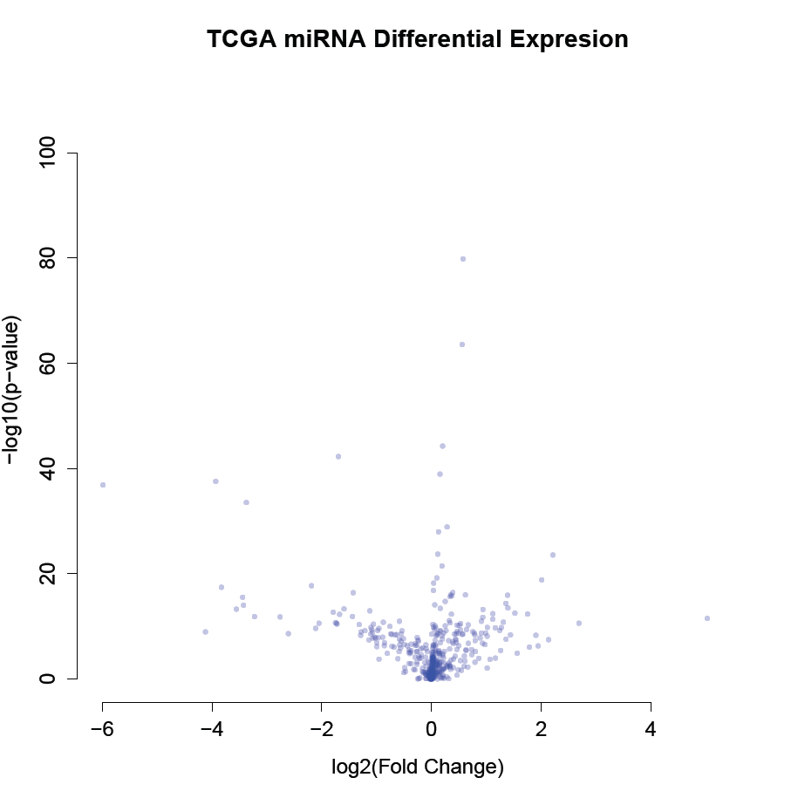
Volcano Plot

Slide 25
Adding Some Flair to the Volcano Plot
# Open a PDF output device to store the volcano plot
pdf('volcanoPlotTCGAmiRNAs.pdf')
# Make a volcao plot
plot(log(fc,2), -log(t1.p, 10) , ylab = '-log10(p-value)', xlab = 'log2(Fold Change)', axes = F, col = rgb(0, 0, 1, 0.25), pch = 20, main = "TCGA miRNA Differential Expresion", xlim = c(-6, 5.5), ylim=c(0, 110))
# Get some plotting information for later
p1 = par()
# Add the axes
axis(1)
axis(2)
## Label significant miRNAs on the plot
# Don’t make a new plot just write over top of the current plot
par(new=T)
# Choose the significant miRNAs
included = c(intersect(rownames(td1)[which(td1[, 't.p']<=(0.05/534))], rownames(td1)[which(td1[, 'fold.change']>=2)]), intersect(rownames(td1)[which(td1[, 't.p']<=(0.05/534))], rownames(td1)[which(td1[, 'fold.change']<=0.5)]))
# Plot the red highlighting circles
plot(log(td1[included, 'fold.change'], 2), -log(td1[included, 't.p'], 10), ylab = '-log10(p-value)', xlab = 'log2(Fold Change)', axes = F, col = rgb(1, 0, 0, 1), pch = 1, main = "TCGA miRNA Differential Expresion", cex = 1.5, xlim = c(-6, 5.5), ylim = c(0, 110))
# Add labels as text
text((log(td1[included, 'fold.change'], 2)), ((-log(td1[included, 't.p'], 10))+-3), included, cex = 0.4)
# Close PDF output device, closes PDF file
dev.off()

Slide 26
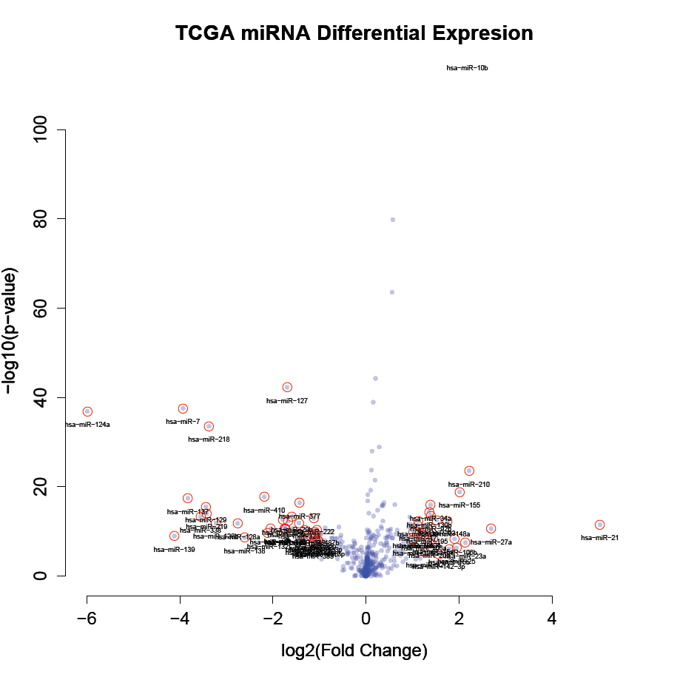
Making a Volcano Plot

Slide 27
Making a PDF
R has options that allow you to easily make PDFs of your plots
Nice because they can be loaded into Illustrator and modified
Can either be done at the command line or through the graphical interface

Slide 28
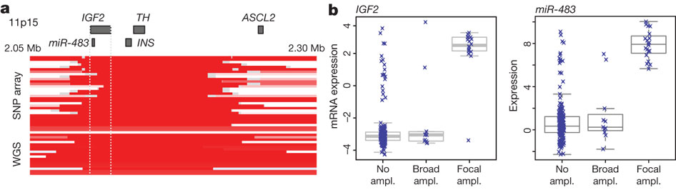
Integrating miRNA Expression and CNVs
Hypothesis:
If an miRNA was deleted or amplified it could affect its expression in a dose dependent manner
TCGA, Nature 2012

Slide 29
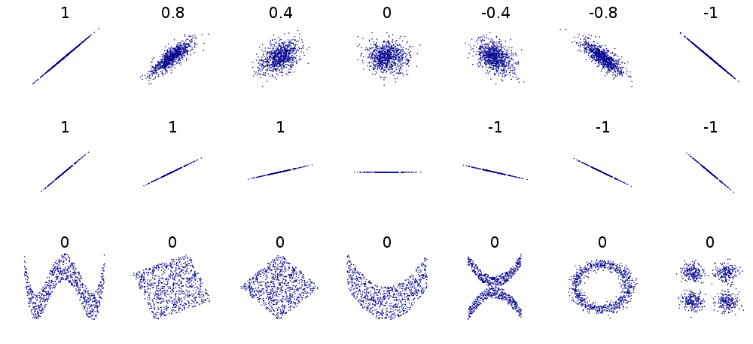
Correlation: Finding Linear Relationships

Slide 30
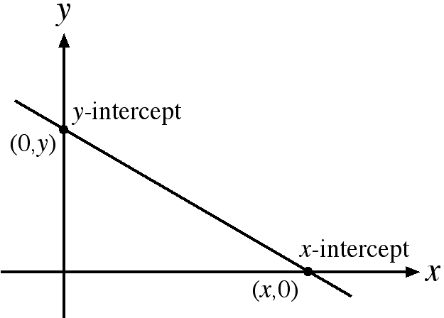
What is Linear? y = mx + b

Slide 31
Can CNV Levels Predict miRNA Expression Levels?

Slide 32

What kind of data do we need?

Slide 33
Does the TCGA have it?
Integrate
TCGA

Slide 34
Does the biology modify integration?
Should we correlate each CNV across genome with each miRNA?
Is there a way to reduce multiple testing?
Does it imply something about the causality of the association?

Slide 35
Tabulating miRNA CNVs
Collect miRNA genomic coordinates
Collect CNV levels across genome
Identify CNV levels for each miRNA
Correlate a expression and CNV levels for each miRNA

Slide 36
Calculating Correlation Between miRNA CNV and Expression
Use a correlation to identify the copy number variants that have a dose
dependent effect on miRNA expression:
Input: cnvData_miRNAExp.csv - matrix of miRNA expression profiles
Desired output:
corTestCnvExp_miRNA_gbm.csv - a matrix of correlation coefficients, correlation p-values, and Bonferroni and Benjamini-Hochberg correction in separate columns labeled by miRNA names (write them out sorted by Benjamini-Hochberg corrected p-values).
corTestCnvExp_miRNA_gbm.pdf – scatter plots of the top 15 miRNAs correlated with CNV variation.
Best two candidate miRNAs for follow-up studies.
Useful functions: read.csv, cor.test, sapply, p.adjust, order, write.csv, print, pdf, plot, t, pdf, dev.off,
paste

Slide 37
Formulae in R
Formulae in R are very handy:
response.variable ~ explanatory.variables
Formulae can be used in place of data vectors for many functions. In our case:
cor.test(.exp.miRNA ~ cnv.miRNA)

Slide 38
Calculating Correlation
Now lets calculate the fold-changes for each of the miRNAs, values are
log2 transformed so need to reverse this before calculating fold-changes:
# Make a matrix to hold the Copy Number Variation data for each miRNA
# Most miRNAs should have a corresponding CNV entry
cnv = d1[2:360,]
# Run the analysis for hsa-miR-10b
c1 = cor.test(as.numeric(cnv['cnv.hsa-miR-10b',]), as.numeric(mirna['exp.hsa-miR-10b',]), na.rm = T)
# Plot hsa-miR-10b expression vs. Copy Number levels
plot(as.numeric(mirna['exp.hsa-miR-10b',]) ~ as.numeric(cnv['cnv.hsa-miR-10b',]), col = rgb(0, 0, 1, 0.5), pch = 20, xlab = 'Copy Number', ylab = 'hsa-miR-10b Expression', main = 'hsa-miR-10b:\n Expression vs. Copy Number')
# Add a trend line to the plot
lm1 = lm(as.numeric(mirna['exp.hsa-miR-10b',]) ~ as.numeric(cnv['cnv.hsa-miR-10b',]))
abline(lm1, col='red', lty=1, lwd=1)

Slide 39
Plot Correlation
# Plot hsa-miR-10b expression vs. Copy Number levels
plot(as.numeric(mirna['exp.hsa-miR-10b',]) ~ as.numeric(cnv['cnv.hsa-miR-10b',]), col = rgb(0, 0, 1, 0.5), pch = 20, xlab = 'Copy Number', ylab = 'hsa-miR-10b Expression', main = 'hsa-miR-10b:\n Expression vs. Copy Number')
# Add a trend line to the plot
lm1 = lm(as.numeric(mirna['exp.hsa-miR-10b',]) ~ as.numeric(cnv['cnv.hsa-miR-10b',]))
abline(lm1, col='red', lty=1, lwd=1)

Slide 40
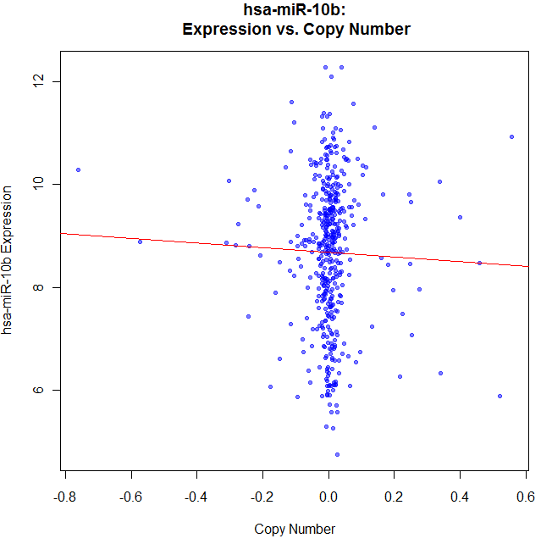
Not Associated with Copy Number
P-Value = 0.51
R = -0.03

Slide 41
Scaling it Up to Whole miRNAome
# Create a matrix to strore the output
m1 = matrix(nrow = 359, ncol = 2, dimnames = list(rownames(cnv), c('cor.r', 'cor.p')))
# Run the analysis
for(i in rownames(cnv)) {
# Try function catches errors caused by missing data
c1 = try(cor.test(as.numeric(cnv[i,]), as.numeric(mirna[sub('cnv','exp',i),]), na.rm = T), silent = T)\
# If there are no errors then adds values to matrix
m1[i, 'cor.r'] = ifelse(class(c1)=='try-error', 'NA', c1$estimate)
m1[i, 'cor.p'] = ifelse(class(c1)=='try-error', 'NA', c1$p.value)
}
# Adjust p-values and get rid of NA’s using na.omit
m2 = na.omit(cbind(m1, p.adjust(as.numeric(m1[,2]), method = 'BH')))

Slide 42
Write Out Results
Write out the resulting correlations and sort them by the correlation coefficient:
# Create index ordered by correlation coefficient to sort the entire matrix
o1 = order(m2[,1], decreasing = T)
# Write out results file
write.csv(m2[o1,], file = 'corTestCnvExp_miRNA_gbm.csv')

Slide 43
Plot Top 15 Correlations
# Get top 15 to plot based on correlation coefficient
top15 = sub('cnv.', '', rownames(head(m2[order(as.numeric(m2[,1]), decreasing = T),], n = 15)))
## Plot top 15 correlations
# Open a PDF device to output plots
pdf('corTestCnvExp_miRNA_gbm.pdf')
# Iterate through all the top 15 miRNAs
for(mi1 in top15) {
# Plot correlated miRNA expression vs. copy number variation
plot(as.numeric(mirna[paste('exp.', mi1, sep = ''),]) ~
as.numeric(cnv[paste('cnv.', mi1, sep = ''),]), col = rgb(0, 0, 1, 0.5),
pch = 20, xlab = 'Copy Number', ylab = 'Expression', main =
paste(mi1, '\n Expression vs. Copy Number'), sep = '')
# Make a trend line and plot it
lm1 = lm(as.numeric(mirna[paste('exp.', mi1, sep = ''),]) ~
as.numeric(cnv[paste('cnv.', mi1, sep = ''),]))
abline(lm1, col = 'red', lty = 1, lwd = 1)
}
# Close PDF device
dev.off()

Slide 44
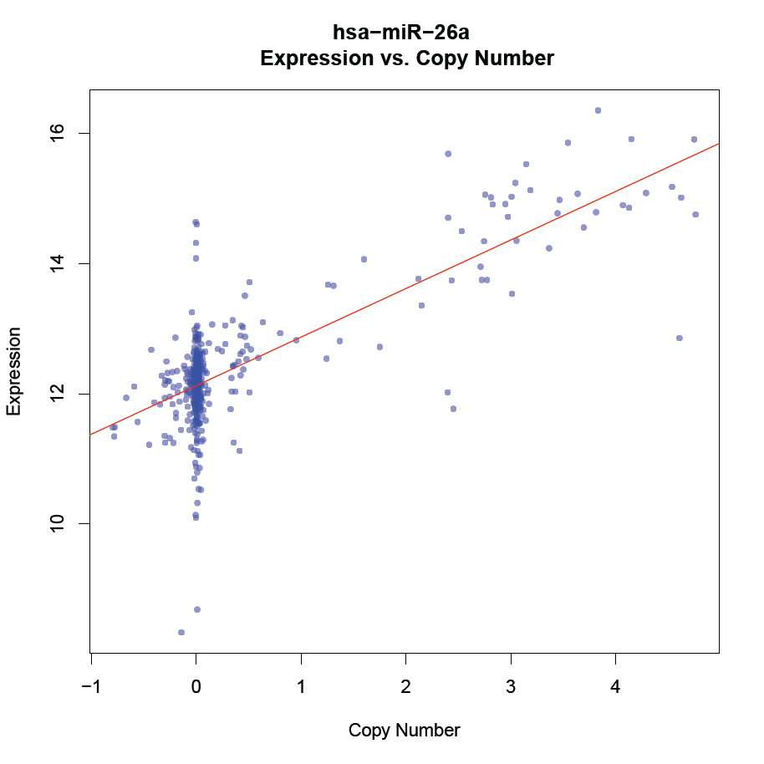
Amplification: Associated with Copy Number
Correlation
P-Value = < 2.2 x 10⁻¹⁶
R = 0.77
Differential Expression
Fold-change = 0.85
P-Value = 0.82

Slide 45
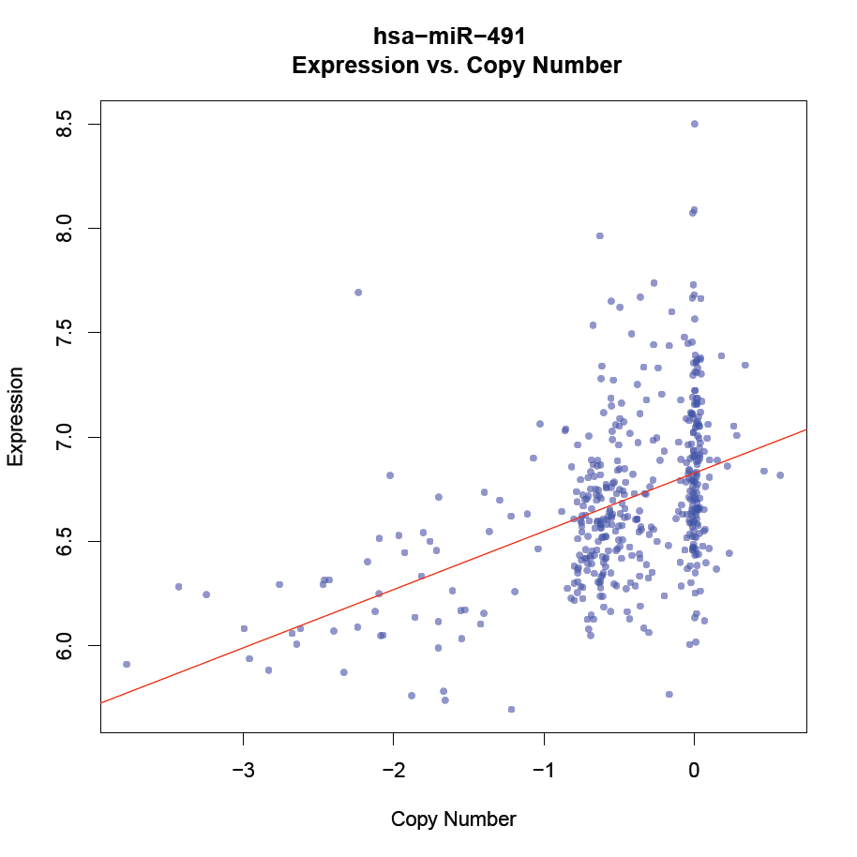
Deletion: Associated with Copy Number
Correlation
P-Value = < 2.2 x 10⁻¹⁶
R = 0.45
Differential Expression
Fold-change = -4.1
P-Value = 1.33 x 10⁻⁸

Slide 46
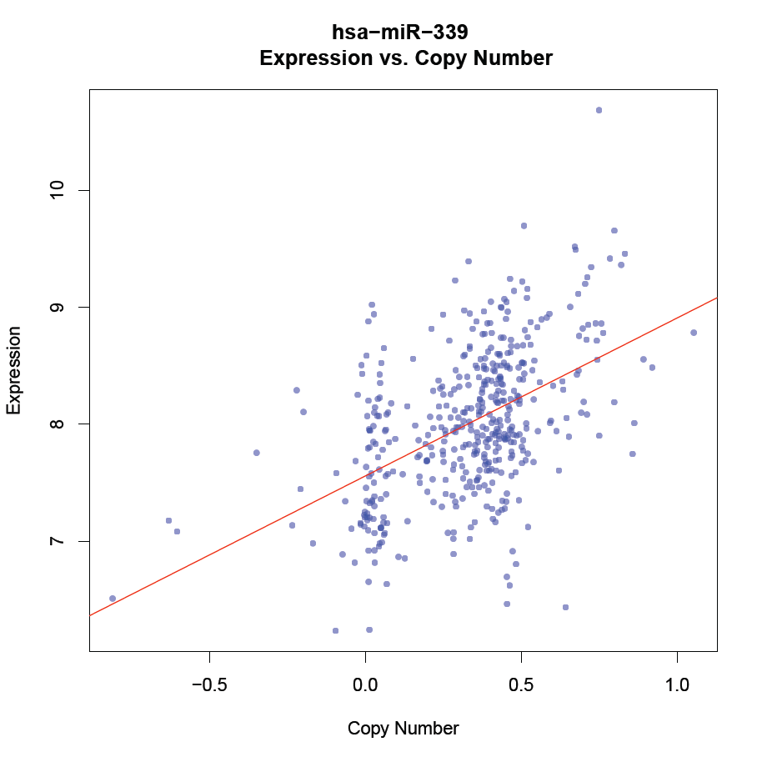
Sub-clonal Amplification: Associated with Copy Number
Correlation
P-Value = < 2.2 x 10⁻¹⁶
R = 0.50
Differential Expression
Fold-change = 2.2
P-Value = 2.0 x10⁻¹⁰

Slide 47
Top Two Candidates for Follow-Up?
What are your suggestions?
What other data would help to choose?
Can we overlap the miRNA DE and CNV correlation studies?
What if they don’t overlap?
What should we do for follow-up studies?

