Slide 1
Inferring Biologically Meaningful Relationships
Introduction to Systems Biology Course
Chris Plaisier
Institute for Systems Biology

Slide 2
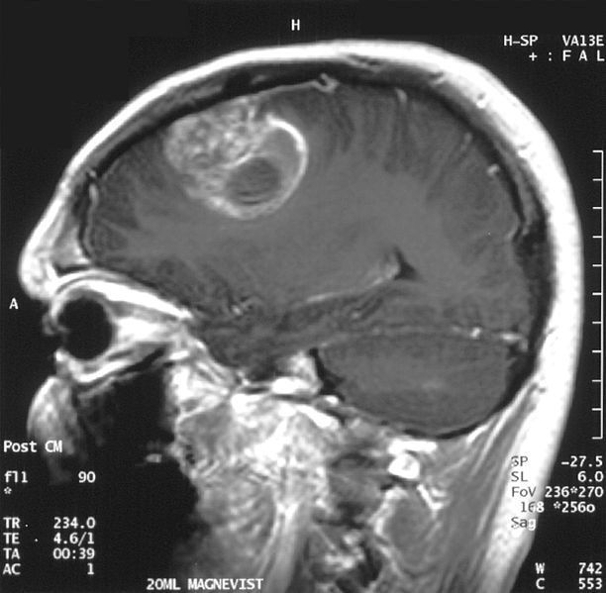
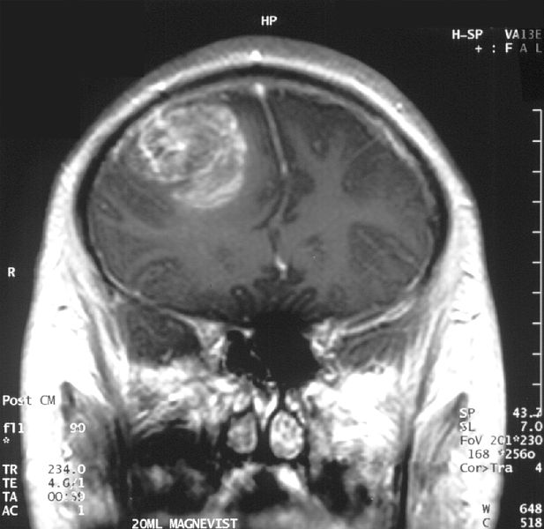
Glioma: A Deadly Brain Cancer
Wikimedia commons
Notes:
2

Slide 3
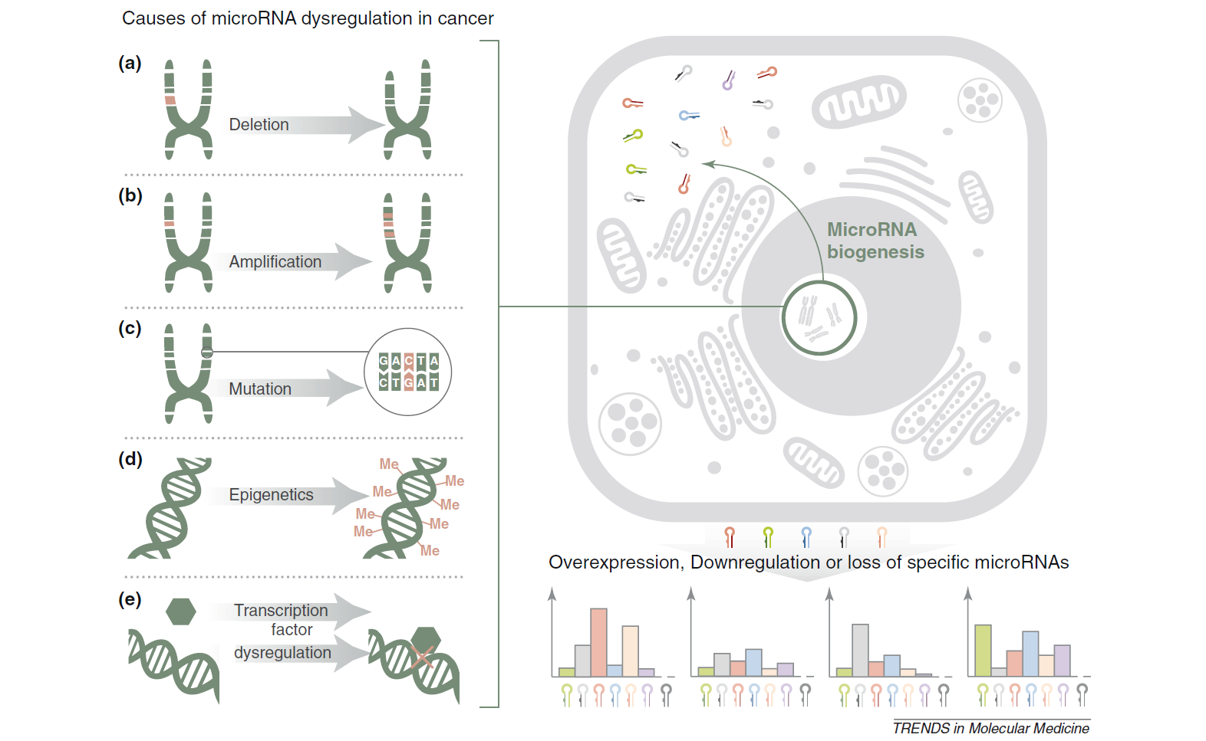
miRNAs are Dysregulated in Cancer
Chan et al., 2011

Slide 4
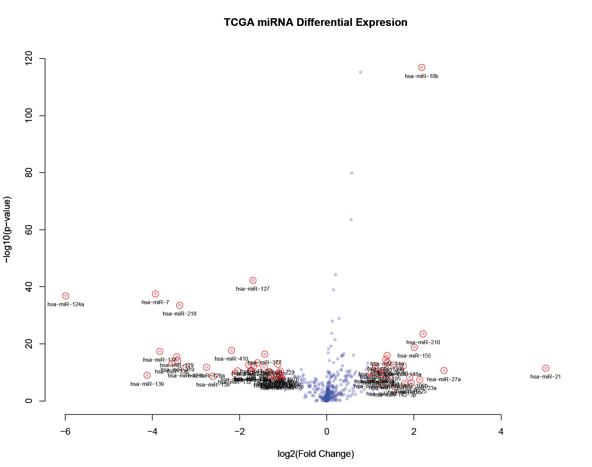

Slide 5
miRNAs are Dysregulated in Cancer
Chan et al., 2011

Slide 6
What happens if you amplify a miRNA?
If the DNA encoding an miRNA is amplified what happens?
Does it affect the expression of the miRNA?
We expect it might up-regulate it with respect to the normal controls
Can we detect this?

Slide 7

What kind of data do we need?

Slide 8
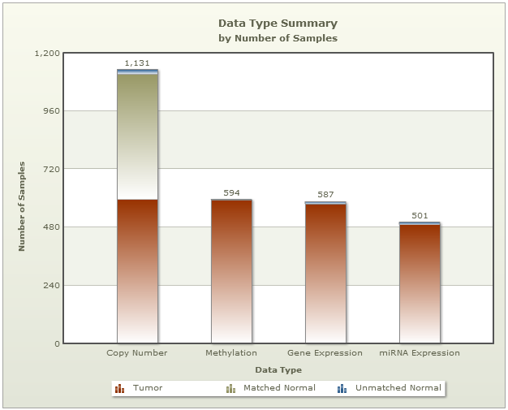
Biologically Motivated Integration
Integrate
TCGA

Slide 9
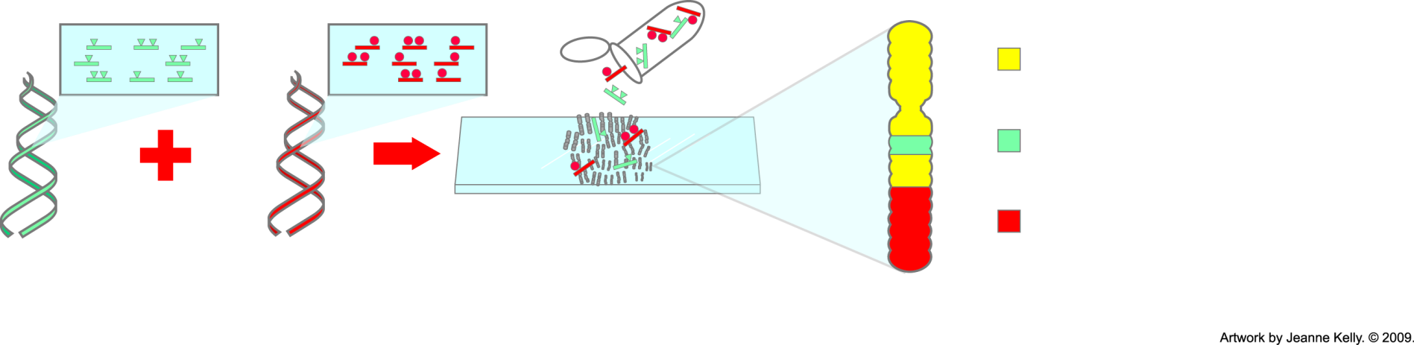
Genome-Wide Profiling:
Comparative Genomic Hybridization
= equal binding of labeled normal and tumor probes
= more binding of labeled tumor probes—gain of tumor DNA
= more binding of labeled normal probes—loss of tumor DNA
Label probes for all tumor DNA
Label probes for all normal DNA
Hybridize to normal metaphase chromosomes for 48—72 hours
Metaphase chromosome
Notes:
Comparative genomic hybridization (CGH) is a method that allows researchers to detect large-scale changes in chromosomes. They can visualize where extra genetic material (repeating copies) has been added or deleted. They can see where large portions of genetic material have been inserted into chromosomes. Many cancers exhibit these types of chromosomal abnormalities.

Slide 10
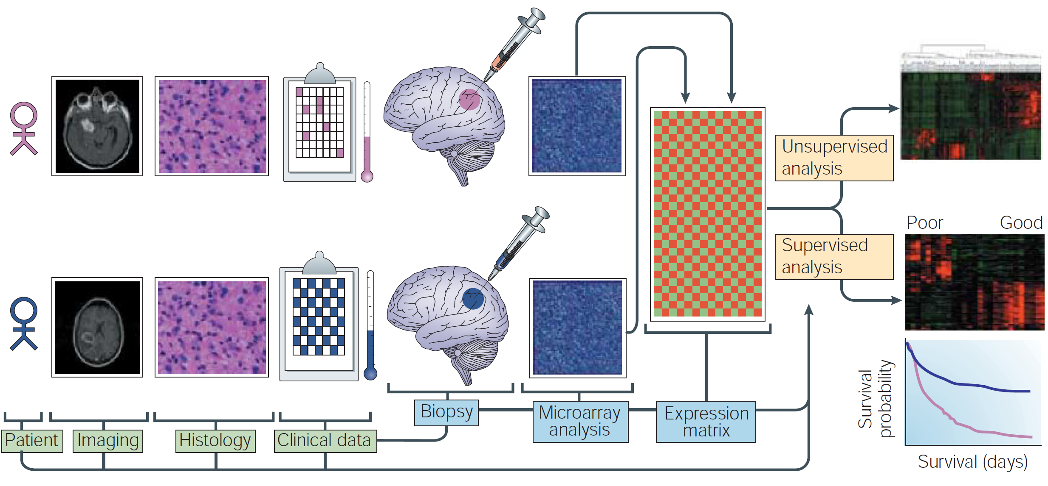
Stratification of Patients
Mischel et al, 2004

Slide 11
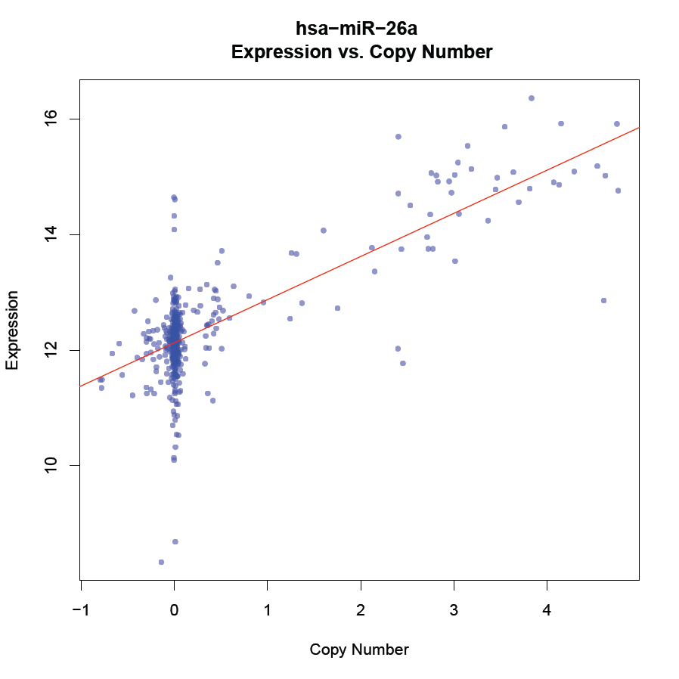
hsa-miR-26a Predicted by CNV

Slide 12
What are the next steps?
What are the most likely target genes of hsa-miR-26a in glioma?
Provides direct translation to wet-lab experiments
Can we infer the directionality of the associations we have identified?
Copy Number Variation
miRNA Expression
miRNA Target Gene Expression

Slide 13
Where We Left Off
We want to load up the data from earlier during the differential expression analysis:
## Load up image from earlier differential expresssion analysis
# Open url connection
con = url( 'http://baliga.systemsbiology.net/events/sysbio/sites/baliga.systemsbiology.net.events.sysbio/files/uploads/differentialExpressionAnalysis.RData‘)
# Load up the RData image
load(con)
# Close connection after loading
close(con)

Slide 14
Loading the Data
Comma separated values file is a text file where each line is a row and the columns separated by a comma.
In R you can easily load these types of files using:
# Load up data for differential expression analysis
d1 = read.csv(
'http://baliga.systemsbiology.net/events/sysbio/sites/baliga.systemsbiology.net.events.sysbio/files/uploads/cnvData_miRNAExp.csv',
header=T,
row.names=1)
NOTE: CSV files can easily be imported or exported from Microsoft Excel.

Slide 15
Which genes should we test?

Slide 16
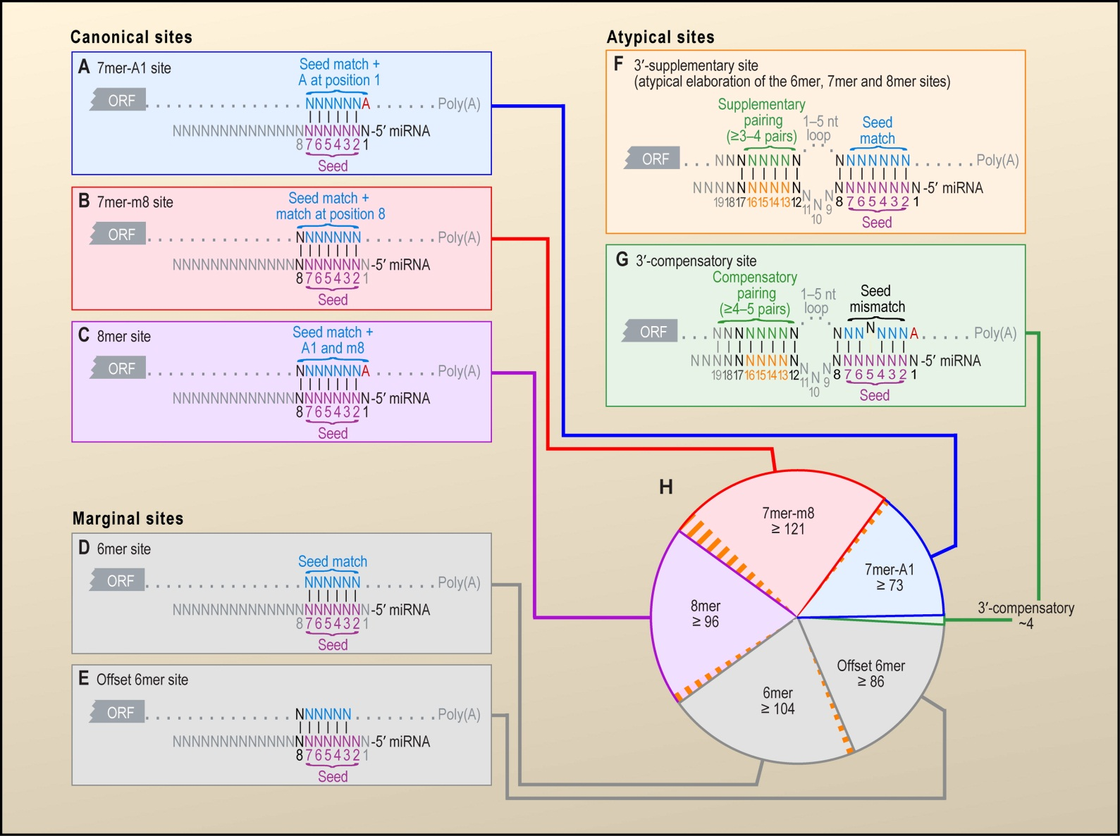
Correlation of miRNA Expression with miRNA Target Genes
Bartel, Cell 2009

Slide 17
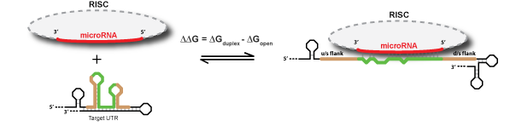
PITA Target Prediction Database
Takes into consideration miRNA complementarity
Cross-species conservation of site
Free energy of annealing
Free energy of local mRNA secondary structure
Kertesz, Nature Genetics 2007

Slide 18
Target Prediction Databases
Plaisier, Genome Research 2012

Slide 19
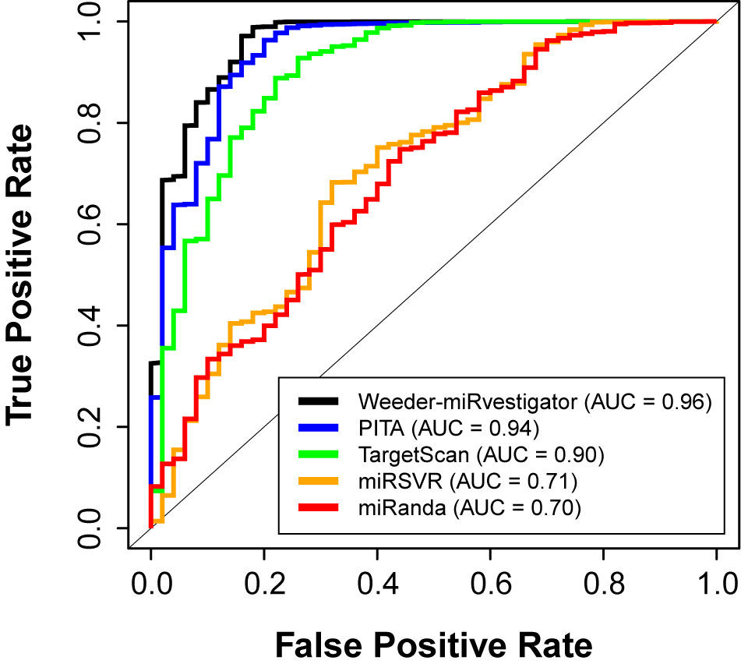
Comparison to Compendium
Plaisier, Genome Research 2012

Slide 20
Load Up Predictions for hsa-miR-26a
Extracted only the has-miR-26a predcited target genes from database file to a smaller file to make loading faster.
# First load up the hsa-miR-26a PITA predicted target genes
mir26a = read.csv('http://baliga.systemsbiology.net/events/sysbio/sites/baliga.systemsbiology.net.events.sysbio/files/uploads/hsa_miR_26a_PITA.csv', header = T)
http://genie.weizmann.ac.il/pubs/mir07/catalogs/PITA_targets_hg18_0_0_TOP.tab.gz

Slide 21
Subset Expression Matrix
Need to select out only those genes who are predicted to be regulated by hsa-miR-26a:
# Create data matrix for analysis
# sub removes ‘exp.’ from gene names
g2 = as.matrix(g1[sub('exp.', '', rownames(g1)) %in% mir26a[,2],])
# sapply is used to iterate through and coerce all colmuns into numeric format
g3 = as.matrix(sapply(1:ncol(g2), function(i) { as.numeric(g2[,i]) }))
# Add row (genes) and column (patient) names to the expression matrix
dimnames(g3) = dimnames(g2)
# Add the hsa-miR-26a expression as a row to the expression matrix
g3 = rbind(g3, 'exp.hsa-miR-26a' = as.numeric(d1['exp.hsa-miR-26a',]))

Slide 22
Calculate Correlation Between Genes and miRNA Expression
# Calculate correlations between PITA predicted genes and hsa-miR-26a
c1.r = 1:(nrow(g3)-1)
c1.p = 1:(nrow(g3)-1)
for(i in 1:(nrow(g3)-1)) {
c1 = cor.test(g3[i,], g3['exp.hsa-miR-26a',])
c1.r[i] = c1$estimate
c1.p[i] = c1$p.value
}
# Plot correlation coefficients
hist(c1.r, breaks = 15, main = 'Distribution of Correaltion Coefficients', xlab = 'Correlation Coefficient')

Slide 23
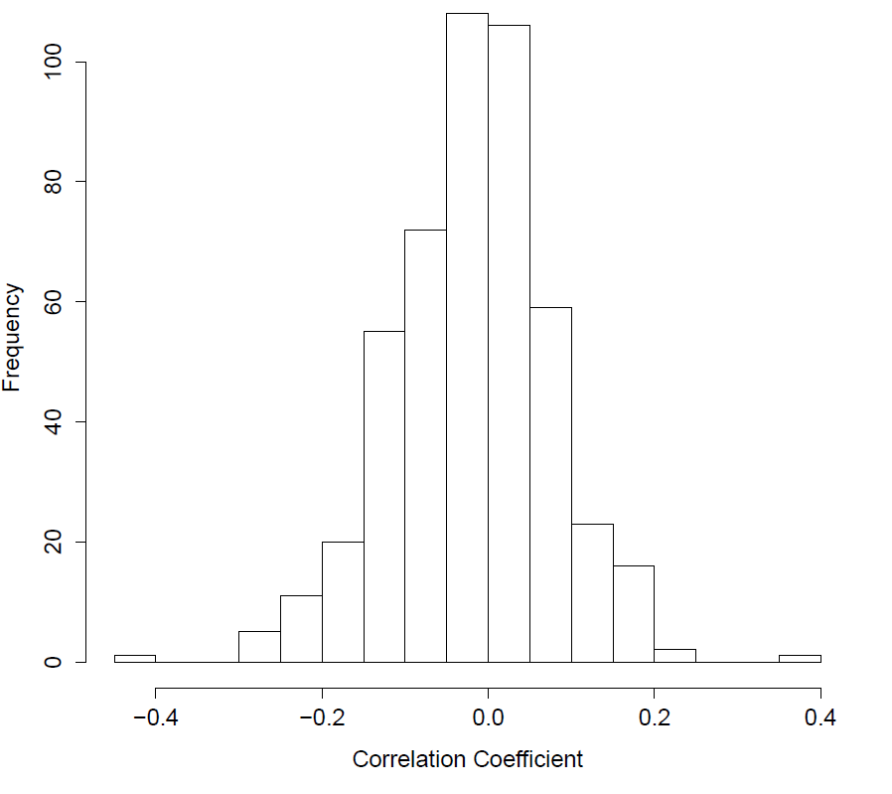
Distribution of Correlation Coefficients

Slide 24
Correcting for Multiple Testing
# Do testing correction
p.bonferroni = p.adjust(c1.p, method = 'bonferroni')
p.benjaminiHochberg = p.adjust(c1.p, method = 'BH')
# How many miRNA are considered significant via p-value only
print(paste('P-Value Only: Uncorrected = ', sum(c1.p<=0.05), '; Bonferroni = ', sum(p.bonferroni<=0.05), '; Benjamini-Hochberg = ', sum(p.benjaminiHochberg<=0.05), sep = ''))
# How many miRNAs are considered significant via both p-value and a negative correlation coefficient
print(paste('P-value and Rho: Uncorrected = ', sum(c1.p<=0.05 & c1.r<=-0.15), '; Bonferroni = ', sum(p.bonferroni<=0.05 & c1.r<=-0.15), '; Benjamini-Hochberg = ', sum(p.benjaminiHochberg<=0.05 & c1.r<=-0.15 ), sep = ''))

Slide 25
Significantly Correlated miRNAs
# The significantly negatively correlated genes
sub('exp.', '', rownames(g3)[which(p.benjaminiHochberg<=0.05 & c1.r<=-0.15)])
# Create index ordered by Benjamini-Hochberg corrected p-values to sort each vector
o1 = order(c1.r)
# Make a data.frame with the three columns
hsa_mir_26a_c1 = data.frame(rho = c1.r[o1], c.p = c1.p[o1], c.p.bonferroni = p.bonferroni[o1], c.p.benjaminiHochberg = p.benjaminiHochberg[o1])
# Add miRNA names as rownames
rownames(hsa_mir_26a_c1) = sub('exp.', '', rownames(g3)[-480][o1])
# Take a look at the top results
head(hsa_mir_26a_c1)

Slide 26
Plot Top Correlated miRNA Target Gene
Let’s do a spot check and make sure our inferences make sense. Visual inspection while crude can tell us a lot.
# Scatter plot of top correlated gene
plot(as.numeric(g3['exp.ALS2CR2',]) ~ as.numeric(g3['exp.hsa-miR-26a',]), col = rgb(0, 0, 1, 0.5), pch = 20, xlab = 'miRNA Expresion', ylab = 'Gene Expression', main = 'ALS2CR2 vs. hsa-miR-26a')
# Make a trend line and plot it
lm1 = lm(as.numeric(g3['exp.ALS2CR2',]) ~ as.numeric(g3['exp.hsa-miR-26a',]))
abline(lm1, col = 'red', lty = 1, lwd = 1)

Slide 27
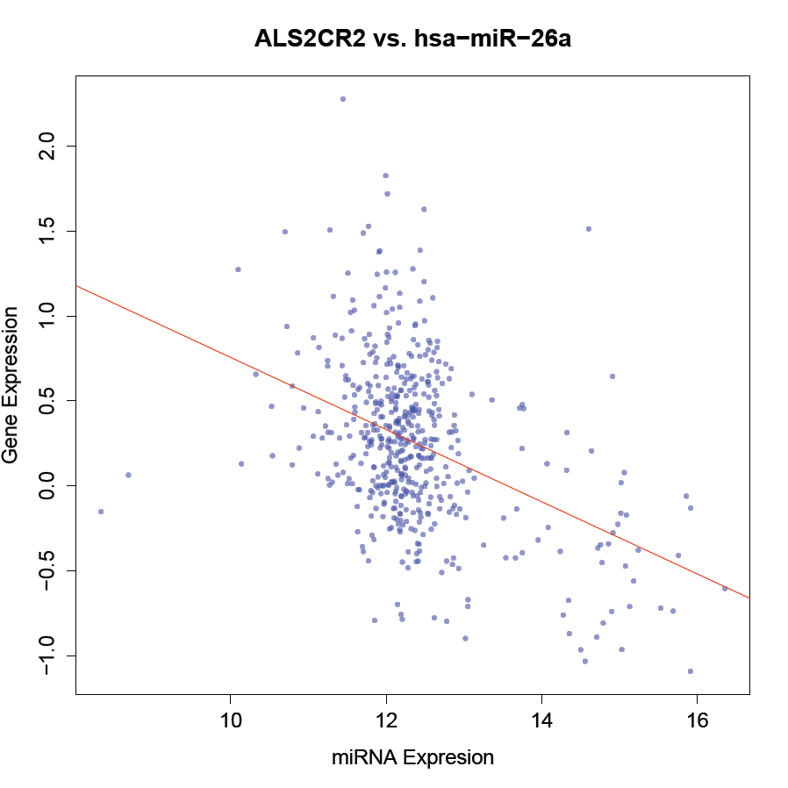
Top Correlated miRNA Target Gene

Slide 28
Scaling Up to Plot All Significantly Correlated Genes
# Select out significantly correlated genes
corGenes = rownames((g3[-480,])[o1,])[which(p.benjaminiHochberg[o1]<=0.05 & c1.r[o1]<=-0.15)]
## Plot all significantly correlated genes
# Open a PDF device to output plots
pdf('genesNegativelyCorrelatedWith_hsa_miR_26a_gbm.pdf')
# Iterate through all correlated genes
for(cg1 in corGenes) {
plot(as.numeric(g3[cg1,]) ~ as.numeric(g3['exp.hsa-miR-26a',]), col = rgb(0, 0,
1, 0.5), pch = 20, xlab = 'miRNA Expresion', ylab = 'Gene Expression', main =
paste(sub('exp.', '', cg1),' vs. hsa-miR-26a:\n R = ',
round(hsa_mir_26a_c1[sub('exp.','',cg1),1], 2), ', P-Value = ',
signif(hsa_mir_26a_c1[sub('exp.', '', cg1),4],2), sep = ''))
# Make a trend line and plot it
lm1 = lm(as.numeric(g3[cg1,]) ~ as.numeric(g3['exp.hsa-miR-26a',]))
abline(lm1, col = 'red', lty = 1, lwd = 1)
}
# Close PDF device
dev.off()

Slide 29
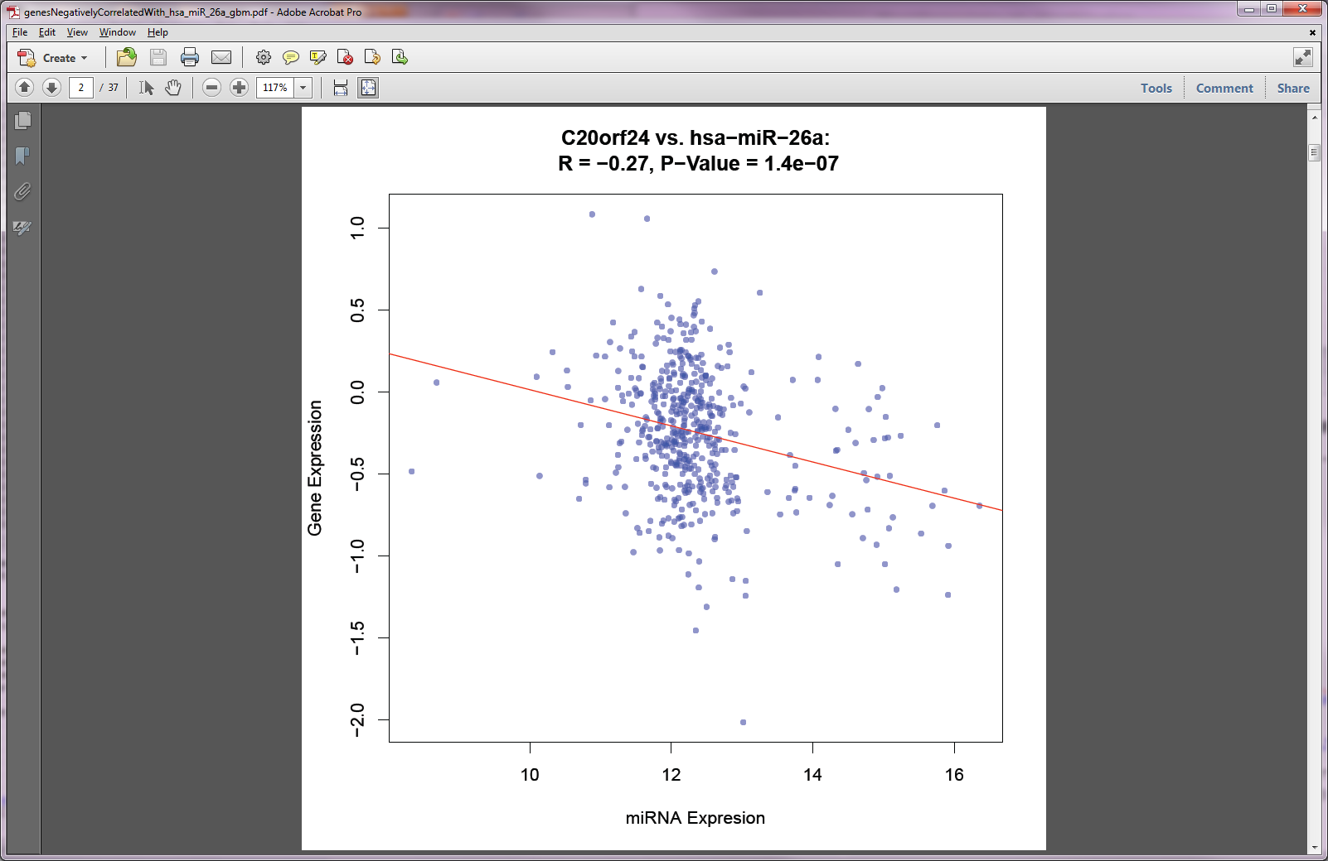
Open PDF

Slide 30
Write Out CSV File of Results
# Write out results file
write.csv(hsa_mir_26a_c1, file = 'hsa_mir_26a_correlated_target_genes_PITA.csv')

Slide 31
Correlation of CNV with miRNA Target Genes
Correlation between CNV and miRNA is not perfect
CNV explains ~58% of miRNA expression
Question: Does CNV also predict miRNA target gene expression?
Can pretty much directly use previous code

Slide 32
Add hsa-miR-26a Copy Number to Matrix
In order to conduct analysis we need to have copy number and gene expression in the same matrix.
# Create data matrix for analysis
g2 = as.matrix(g1[sub('exp.', '', rownames(g1)) %in% mir26a[,2],])
g3 = as.matrix(sapply(1:ncol(g2), function(i) { as.numeric(g2[,i]) }))
dimnames(g3) = dimnames(g2)
g3 = rbind(g3, 'cnv.hsa-miR-26a' = as.numeric(d1['cnv.hsa-miR-26a',]))

Slide 33
Calculate Correlations Between hsa-miR-26a CNV and Gene Expression
# Calculate correlations between PITA predicted genes and hsa-miR-26a
c1.r = 1:(nrow(g3)-1)
c1.p = 1:(nrow(g3)-1)
for(i in 1:(nrow(g3)-1)) {
c1 = cor.test(g3[i,], g3['cnv.hsa-miR-26a',])
c1.r[i] = c1$estimate
c1.p[i] = c1$p.value
}
# Plot correlation coefficients
hist(c1.r, breaks = 15, main = 'Distribution of Correaltion Coefficients', xlab = 'Correlation Coefficient')

Slide 34
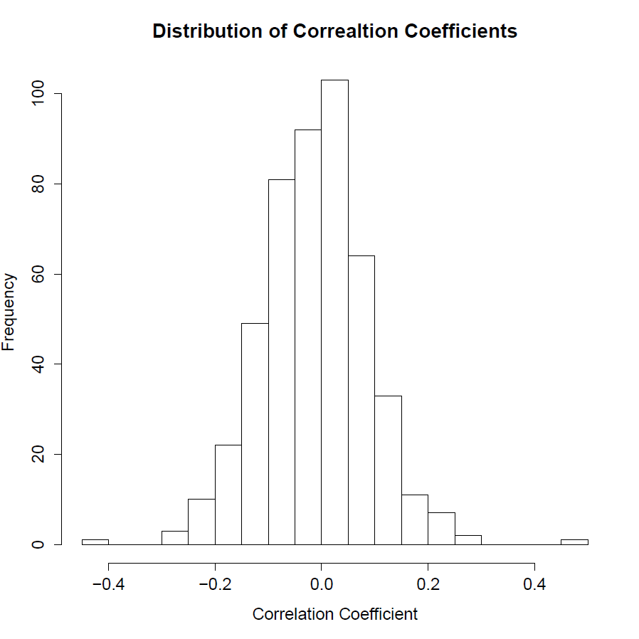
Distribution of Correlation Coefficients

Slide 35
Correcting for Multiple Testing
# Do testing correction
p.bonferroni = p.adjust(c1.p, method = 'bonferroni')
p.benjaminiHochberg = p.adjust(c1.p, method = 'BH')
# How many miRNA are considered significant via p-value only
print(paste('P-Value Only: Uncorrected = ', sum(c1.p<=0.05), '; Bonferroni = ', sum(p.bonferroni<=0.05), '; Benjamini-Hochberg = ', sum(p.benjaminiHochberg<=0.05), sep = ''))
# How many miRNAs are considered significant via both p-value and a negative correlation coefficient
print(paste('P-value and Rho: Uncorrected = ', sum(c1.p<=0.05 & c1.r<=-0.15), '; Bonferroni = ', sum(p.bonferroni<=0.05 & c1.r<=-0.15), '; Benjamini-Hochberg = ', sum(p.benjaminiHochberg<=0.05 & c1.r<=-0.15 ), sep = ''))

Slide 36
Significantly Correlated miRNAs
# The significantly negatively correlated genes
sub('exp.', '', rownames(g3)[which(p.benjaminiHochberg<=0.05 & c1.r<=-0.15)])
# Create index ordered by Benjamini-Hochberg corrected p-values to sort each vector
o1 = order(c1.r)
# Make a data.frame with the three columns
hsa_mir_26a_c1 = data.frame(rho = c1.r[o1], c.p = c1.p[o1], c.p.bonferroni = p.bonferroni[o1], c.p.benjaminiHochberg = p.benjaminiHochberg[o1])
# Add miRNA names as rownames
rownames(hsa_mir_26a_cnv1) = sub('exp.', '', rownames(g3)[-480][o1])
# Take a look at the top results
head(hsa_mir_26a_cnv1)

Slide 37
Plot Top Correlated miRNA Target Gene
Again, let’s do a spot check and make sure our inferences make sense.
# Plot top correlated gene
plot(as.numeric(g3['exp.ALS2CR2',]) ~ as.numeric(g3['cnv.hsa-miR-26a',]), col = rgb(0, 0, 1, 0.5), pch = 20, xlab = 'miRNA CNV', ylab = 'Gene Expression', main = 'ALS2CR2 vs. hsa-miR-26a CNV')
# Make a trend line and plot it
lm1 = lm(as.numeric(g3['exp.ALS2CR2',]) ~ as.numeric(g3['cnv.hsa-miR-26a',]))
abline(lm1, col = 'red', lty = 1, lwd = 1)

Slide 38
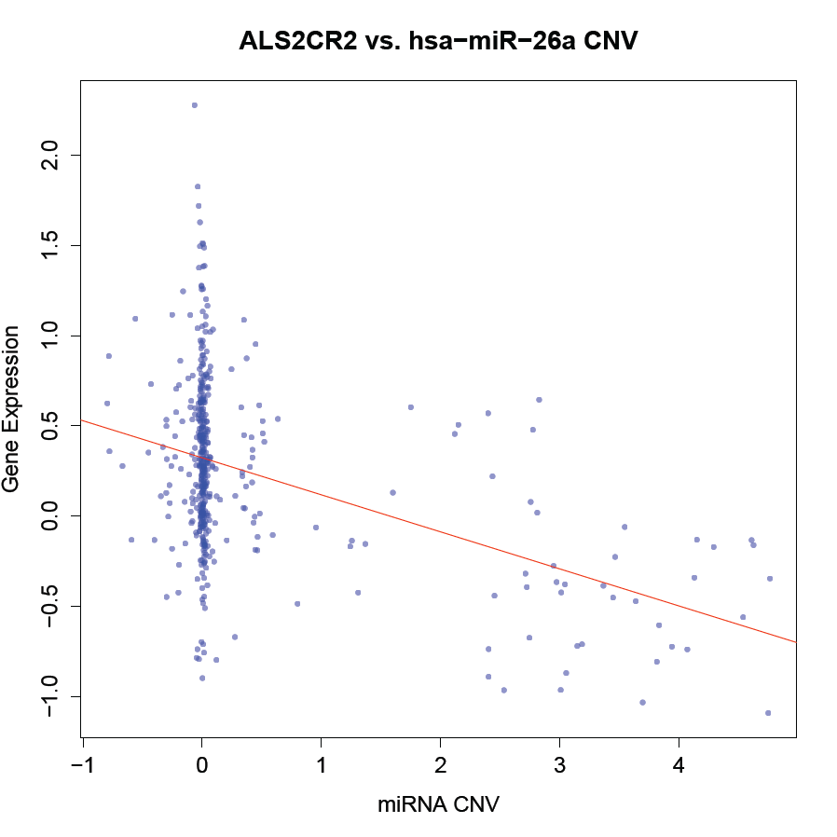
Top Correlated miRNA Target Gene

Slide 39
Scaling Up to Plot All Significantly Correlated Genes
# Select out significantly correlated genes
corGenes = rownames((g3[-480,])[o1,])[which(p.benjaminiHochberg[o1] <= 0.05 & c1.r[o1] <= -0.15)]
# Open a PDF device to output plots
pdf('genesNegativelyCorrelatedWith_CNV_hsa_miR_26a_gbm.pdf')
# Iterate through all correlated genes
for(cg1 in corGenes) {
plot(as.numeric(g3[cg1,]) ~ as.numeric(g3['cnv.hsa-miR-26a',]), col = rgb(0, 0, 1, 0.5), pch = 20, xlab =
'miRNA CNV', ylab = 'Gene Expression', main = paste(sub('exp.','',cg1), ' vs. hsa-miR-26a CNV:\n R = ',
round(hsa_mir_26a_cnv1[sub('exp.','',cg1),1],2), ', P-Value = ',
signif(hsa_mir_26a_cnv1[sub('exp.','',cg1),4],2),sep=''))
# Make a trend line and plot it
lm1 = lm(as.numeric(g3[cg1,]) ~ as.numeric(g3['cnv.hsa-miR-26a',]))
abline(lm1, col = 'red', lty = 1, lwd = 1)
}
# Close PDF device
dev.off()

Slide 40
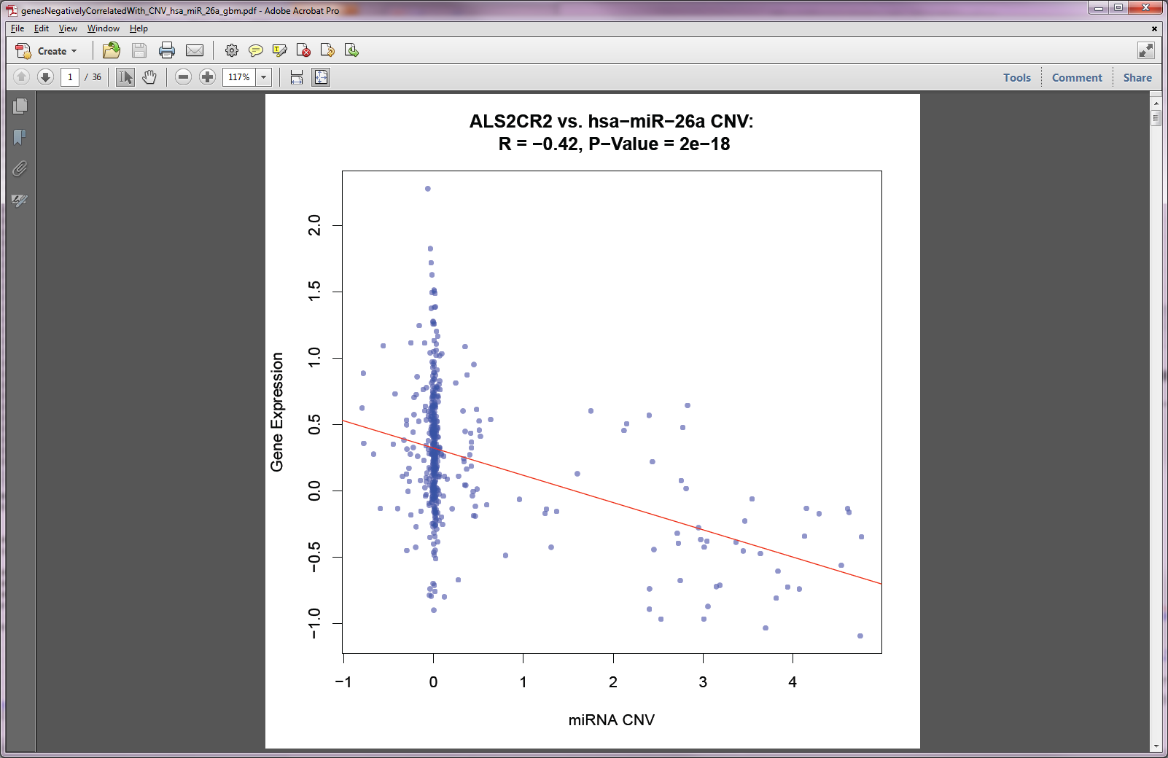
Open PDF

Slide 41
Write Out Results
# Write out results file
write.csv(hsa_mir_26a_cnv1, file = 'CNV_hsa_mir_26a_correlated_target_genes_PITA.csv')

Slide 42

Correlation doesn’t = Causation

Slide 43
Causality Analysis
Using a variety of approaches it is possible to determine the most likely flow of information through a genetically controlled system
e.g. http://www.genetics.ucla.edu/labs/horvath/aten/NEO
We won’t do this analysis here, but we can demonstrate at least that the trait variance explained by hsa-miR-26a CNV and expression are redundant to the effect on ALS2CR2

Slide 44
Make a Data Matrix for Analysis
### Causality of association ###
# Create data matrix for analysis
g2 = as.matrix(g1[sub('exp.','',rownames(g1)) %in% mir26a[,2],])
g3 = as.matrix(sapply(1:ncol(g2), function(i) {as.numeric(g2[,i])}))
dimnames(g3) = dimnames(g2)
g3 = rbind(g3, 'exp.hsa-miR-26a' = as.numeric(d1['exp.hsa-miR-26a',]), 'cnv.hsa-miR-26a' = as.numeric(d1['cnv.hsa-miR-26a',]))

Slide 45
Correlation Between CNV and miRNA
## Plot (1,1) - CNV vs. miRNA expression
# Calculate correlation between miRNA expression and miRNA copy number
c1 = cor.test(g3['cnv.hsa-miR-26a',], g3['exp.hsa-miR-26a',])
# Plot correlated miRNA expression vs. copy number variation
plot(g3['exp.hsa-miR-26a',] ~ g3['cnv.hsa-miR-26a',], col = rgb(0, 0, 1, 0.5), pch = 20, xlab = 'Copy Number', ylab = 'miRNA Expression', main = paste('miRNA Expression vs. miRNA Copy Number:\n R = ',round(c1$estimate,2),', P-Value = ',signif(c1$p.value,2),sep=''))
# Make a trend line and plot it
lm1 = lm(g3['exp.hsa-miR-26a',] ~ g3['cnv.hsa-miR-26a',])
abline(lm1, col = 'red', lty = 1, lwd = 1)

Slide 46
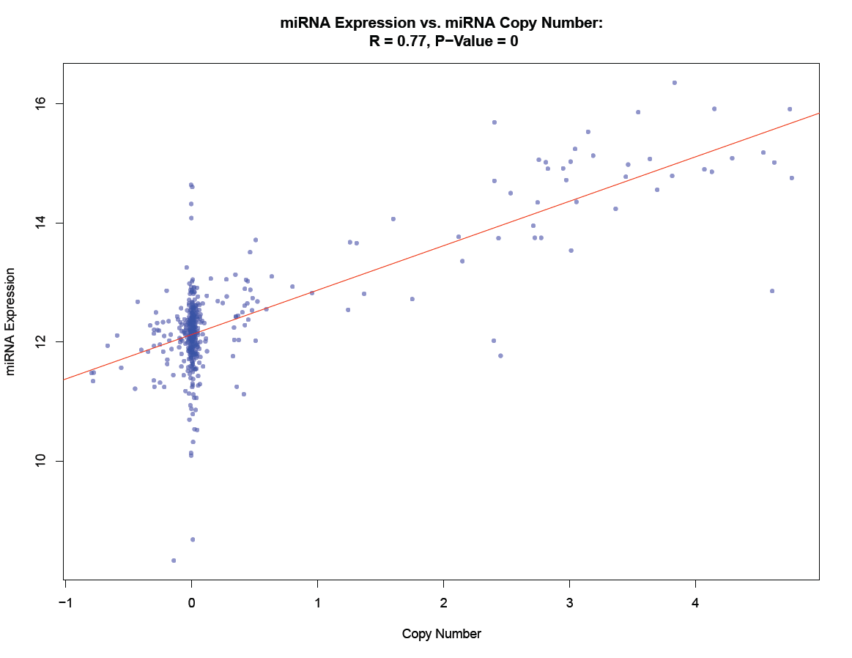
CNV Associated with miRNA

Slide 47
Correlation Between CNV and miRNA Target Gene
## Plot (1,2) - CNV vs. ALS2CR2 Expression
# Calculate correlation between miRNA target gene ALS2CR2 expression and miRNA copy number
c1 = cor.test(g3['cnv.hsa-miR-26a',], g3['exp.ALS2CR2',])
# Plot correlated miRNA target gene ALS2CR2 expression vs. copy number variation
plot(g3['exp.ALS2CR2',] ~ g3['cnv.hsa-miR-26a',], col = rgb(0, 0, 1, 0.5), pch = 20, xlab = 'Copy Number', ylab = 'Gene Expression', main = paste('ALS2CR2 Expression vs. miRNA Copy Number:\n R = ',round(c1$estimate,2),', P-Value = ',signif(c1$p.value,2),sep=''))
# Make a trend line and plot it
lm1 = lm(g3['exp.ALS2CR2',] ~ g3['cnv.hsa-miR-26a',])
abline(lm1, col = 'red', lty = 1, lwd = 1)

Slide 48
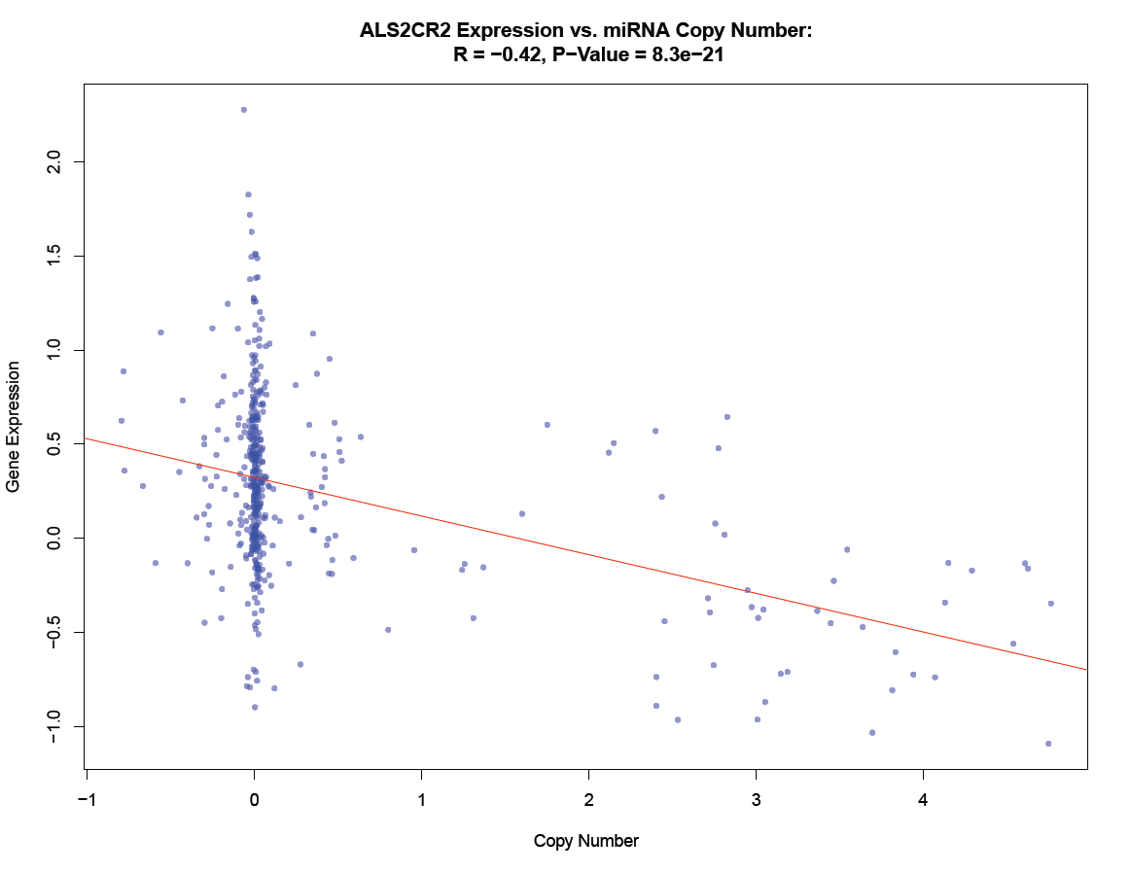
CNV Associated with miRNA Target Gene

Slide 49
Correlation Between miRNA and Target Gene
## Plot (2,1) - miRNA expression vs. CNV
# Calculate correlation between miRNA target gene ALS2CR2 expression and miRNA expression
c1 = cor.test(g3['exp.hsa-miR-26a',], g3['exp.ALS2CR2',])
# Plot correlated miRNA target gene ALS2CR2 expression vs. miRNA expression
plot(g3['exp.ALS2CR2',] ~ g3['exp.hsa-miR-26a',], col = rgb(0, 0, 1, 0.5), pch = 20, xlab = 'miRNA Expression', ylab = ' Gene Expression', main = paste('ALS2CR2 Expression vs. miRNA Expression:\n R = ',round(c1$estimate,2),', P-Value = ',signif(c1$p.value,2),sep=''))
# Make a trend line and plot it
lm1 = lm(g3['exp.ALS2CR2',] ~ g3['exp.hsa-miR-26a',])
abline(lm1, col = 'red', lty = 1, lwd = 1)

Slide 50
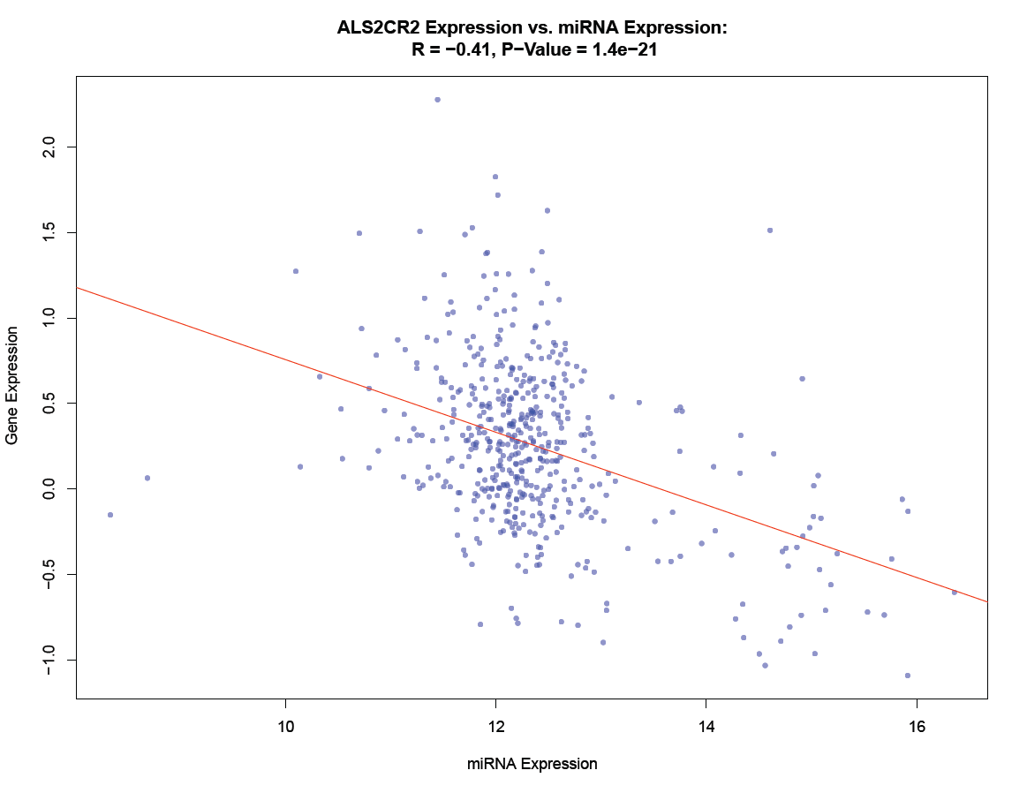
miRNA Associated with Target Gene

Slide 51
Condition miRNA Target Gene Expression on miRNA Expression
## Plot (2,2) - miRNA expression vs. CNV
# Get rid of NA's
g4 = t(na.omit(t(g3)))
# Calcualte regression model for miRNA target gene ALS2CR2 expression vs. miRNA expression
r1 = lm(g4['exp.ALS2CR2',] ~ g4['exp.hsa-miR-26a',])
# Calculate correlation between residual variation after conditioning miRNA target gene ALS2CR2 expression
# on miRNA expression against miRNA copy number
c1 = cor.test(g4['cnv.hsa-miR-26a',], r1$residuals)
# Plot correlated miRNA target gene expression vs. copy number variation
plot(r1$residuals ~ g4['cnv.hsa-miR-26a',], col = rgb(0, 0, 1, 0.5), pch = 20, xlab = 'Copy Number', ylab = 'Residual', main = paste('Residual vs. miRNA Copy Number:\n R = ',round(c1$estimate,2),', P-Value = ',signif(c1$p.value,2),sep=''))
# Make a trend line and plot it
lm1 = lm(r1$residual ~ g4['exp.hsa-miR-26a',])
abline(lm1, col = 'red', lty = 1, lwd = 1)

Slide 52
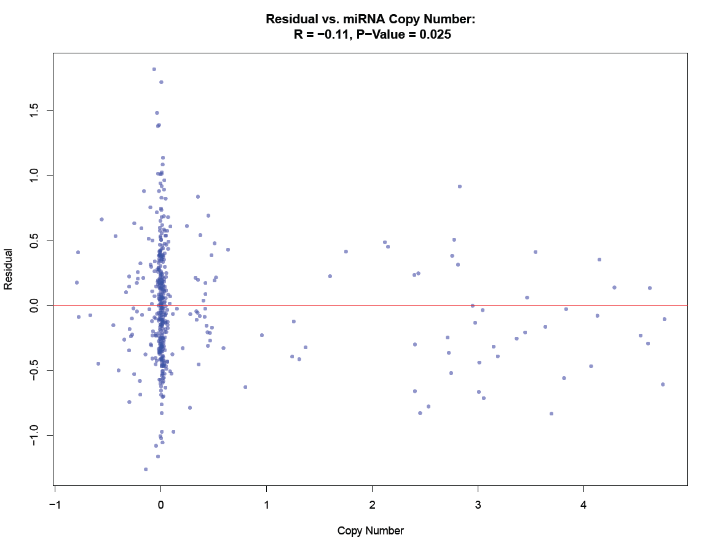
CNV Residual Association with miRNA Target Gene

Slide 53
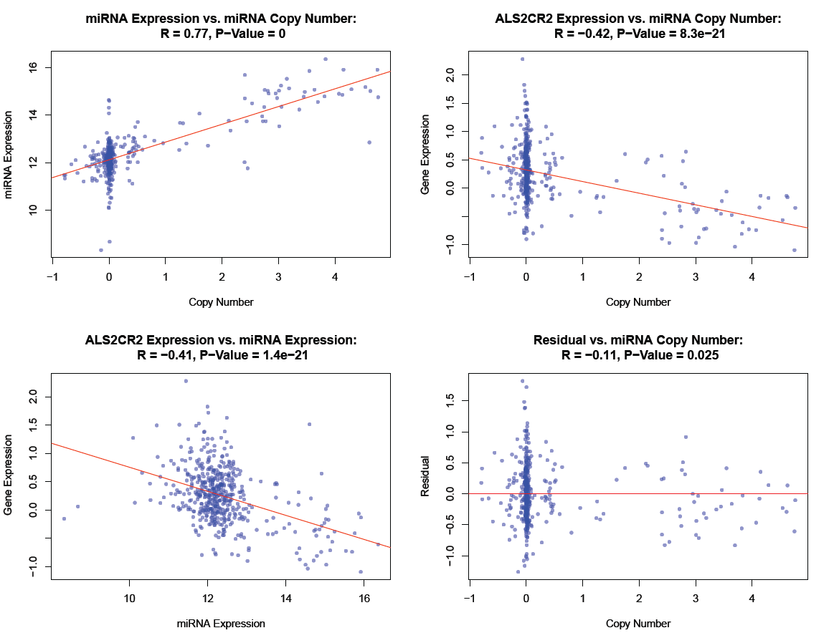
Biologically Meaningful Relationship

Slide 54
Summary
Can’t directly infer directionality of putative target gene without specialized analysis
However, given the underlying biology it is quite likely that the cause chain of events are:
Copy Number Variation
miRNA Expression
miRNA Target Gene Expression

