Slide 1
Introduction to R
Introduction to Systems Biology Course
Chris Plaisier
Institute for Systems Biology

Slide 2
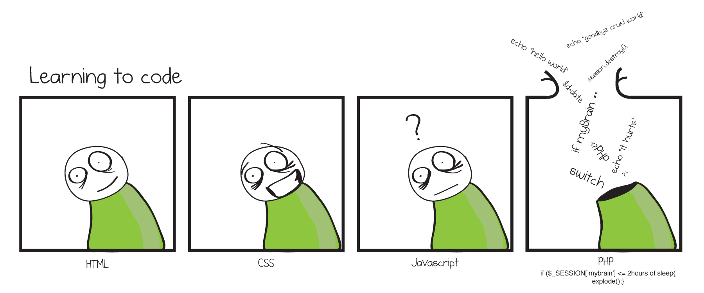
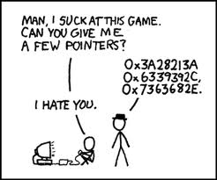
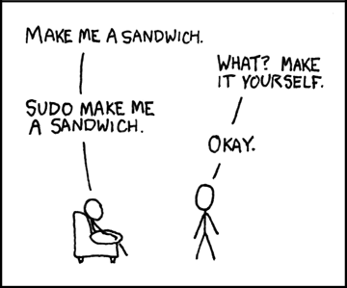
The beginner's perspective
Jason's Fix it up blog
Speaking the lingo
xkcd.com

Slide 3
Why use R?
R is FREE!!!
Many built-in functions and installable packages that will cover nearly every possible need
R is an interpreted language
Code doesn’t have to be compiled
Interactive console makes testing and debugging easy
Cons to using R
Slower than compiled languages
Can have runtime errors

Slide 4
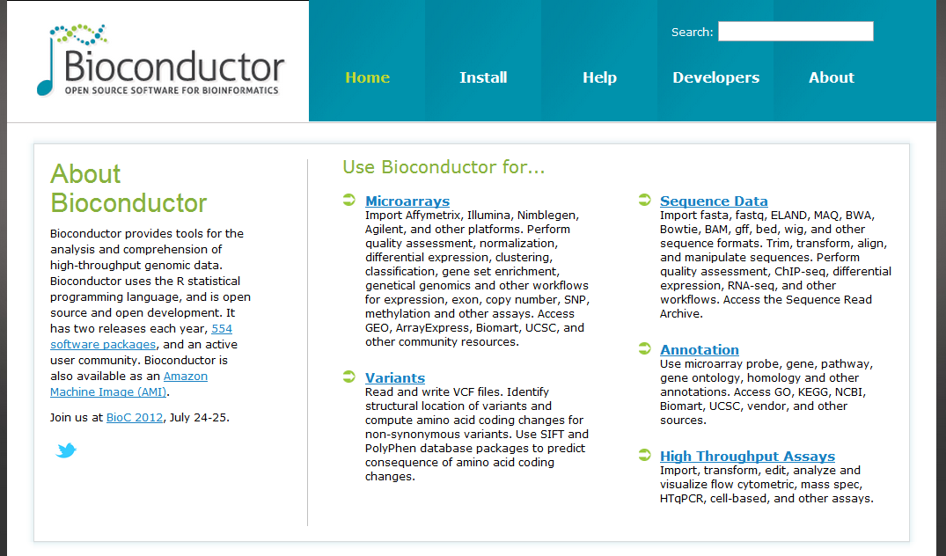
Bioconductor!

Slide 5
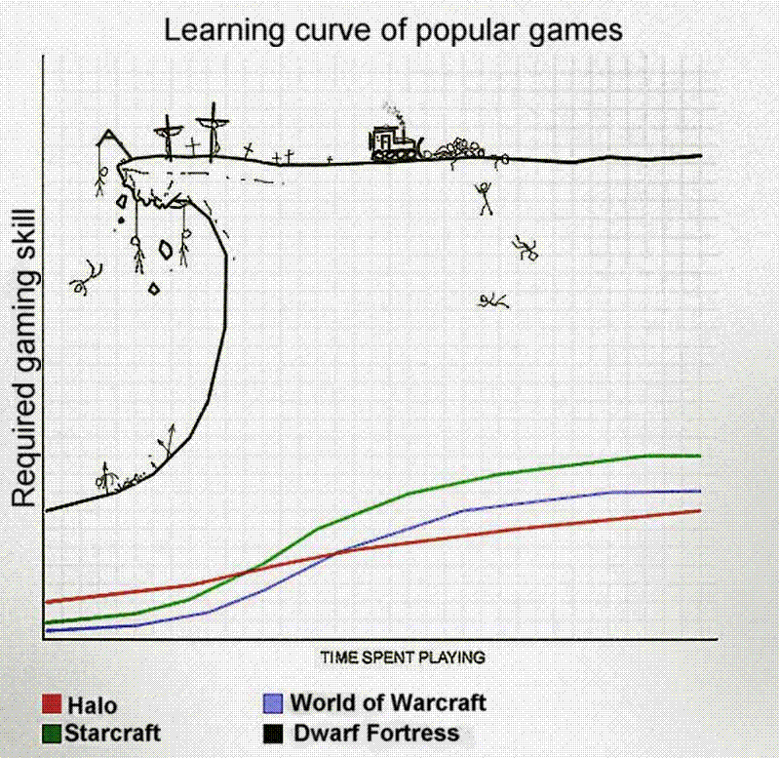
Why use R?
programming languages
R
Perl
Python
C/C++
http://www.vayapotra.es/wordpress/wp-content/uploads/2009/02/2rmqi6o.gif

Slide 6


Tools
R
www.r-project.org
The engine*
Rstudio
www.rstudio.org
The pretty face**
* Many alternatives exist. Smallest learning curve.
** A few alternatives exist. This happens to be the easiest at the moment.

Slide 7
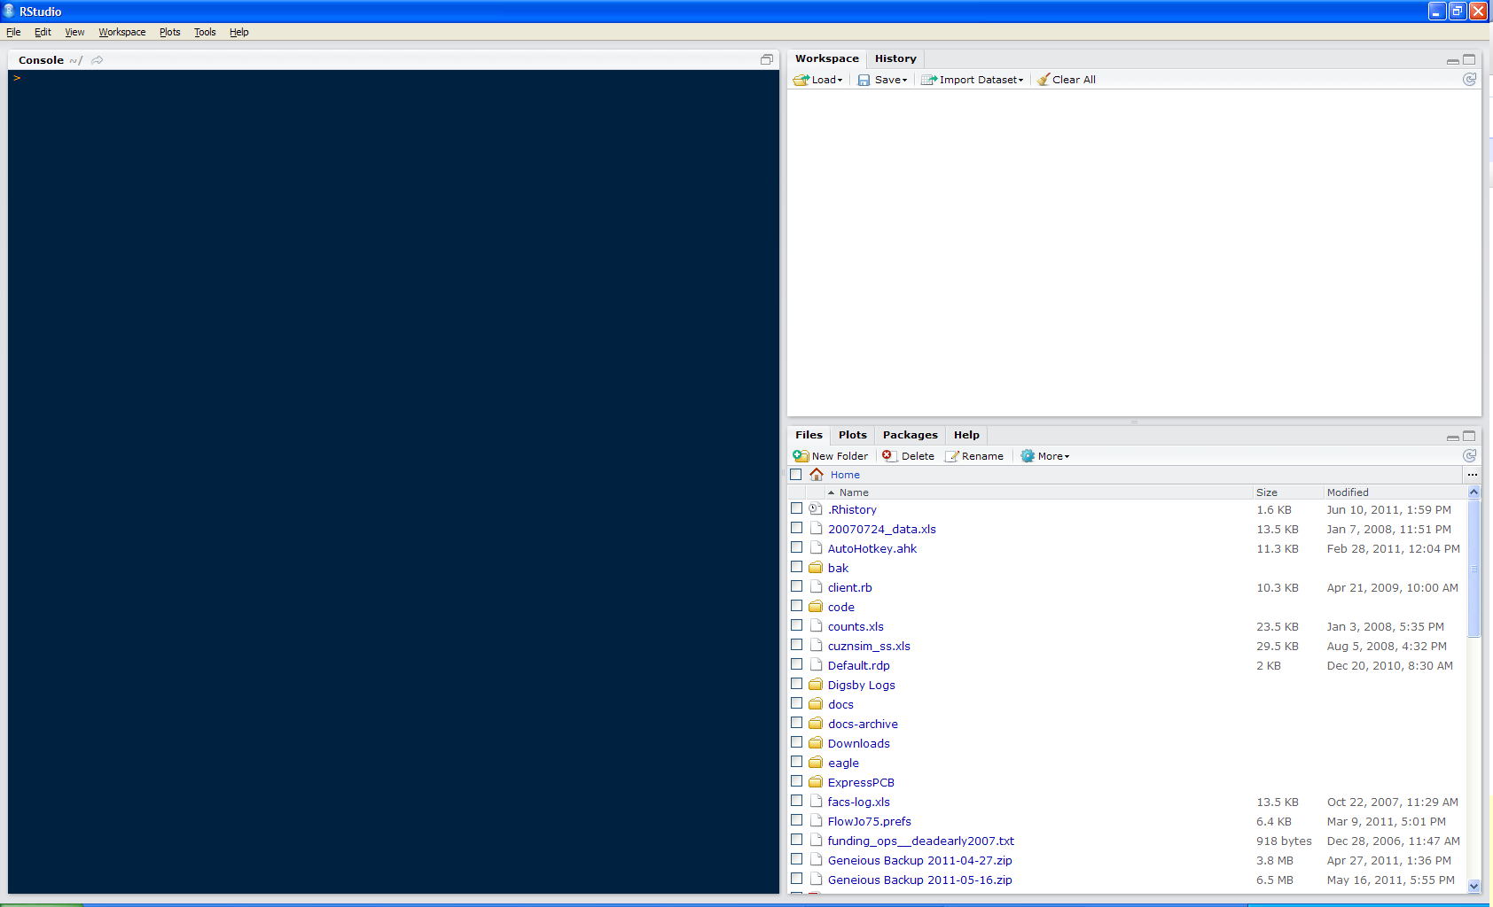
Introducing Rstudio
workspace: your variables
history: last command
console
(just like Rterm)
files
plots
packages
help

Slide 8
Rstudio Features
Code completion
Command history search
Command history to R script / file
Function extraction from Rscript
Sweave support

Slide 9
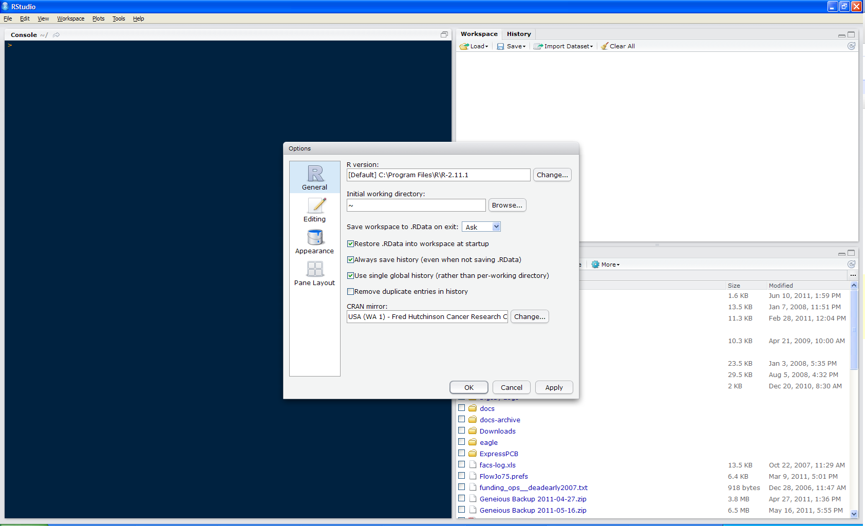

Configuring Rstudio

Slide 10
Choosing a CRAN Mirror
CRAN mirrors contain the R packages that can extend the functionality of R
Choose a mirror located close to you as that will most likely give you the fastest downloads

Slide 11
Choosing Repositories
Repositories host the packages
CRAN, CRANextra, BioCsoft, BioCann, BioCexp, BioCext, Omegahat, R-Forge and rforge.net
Use this code to set your repositories
setRepositories()

Slide 12
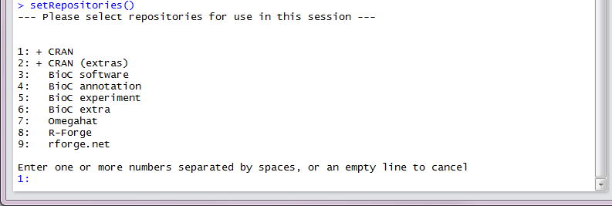
setRepositories()

Slide 13
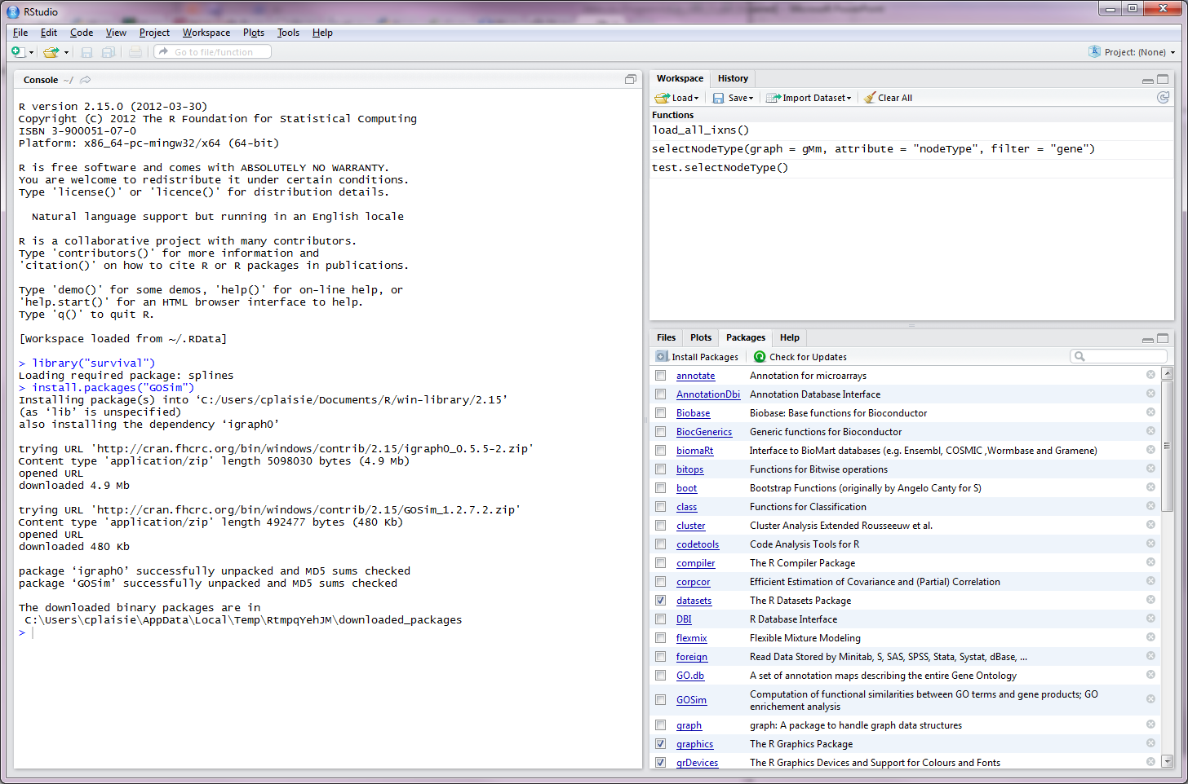
Packages Tab
Packages Tab

Slide 14
How do Packages Work?
Packages tab lets you see what packages are installed
A package must be loaded before you can use it
In Rstudio this is accomplished by clicking the checkbox next to the package name in the package tab
We will be using different packages throughout this tutorial

Slide 15
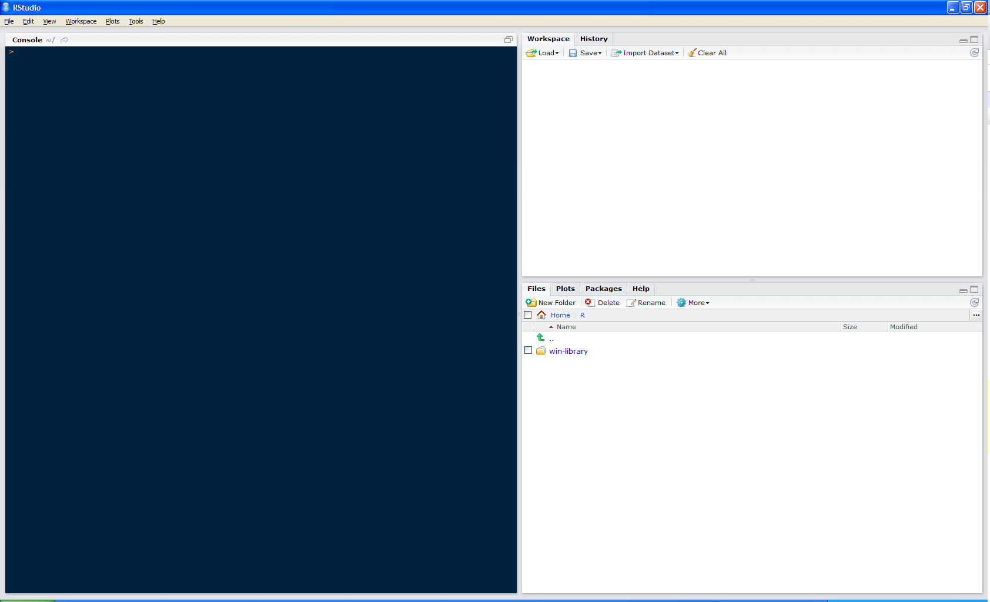

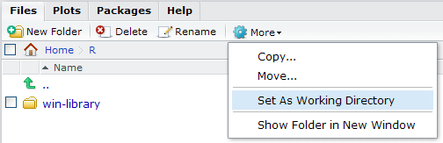
Working Directory
1
2

Slide 16
Ready to Code!
The working directory is where Rstudio will look first for scripts
Keeping everything in a self contained directory helps organize code and analyses
Check you current working directory with
getwd()

Slide 17
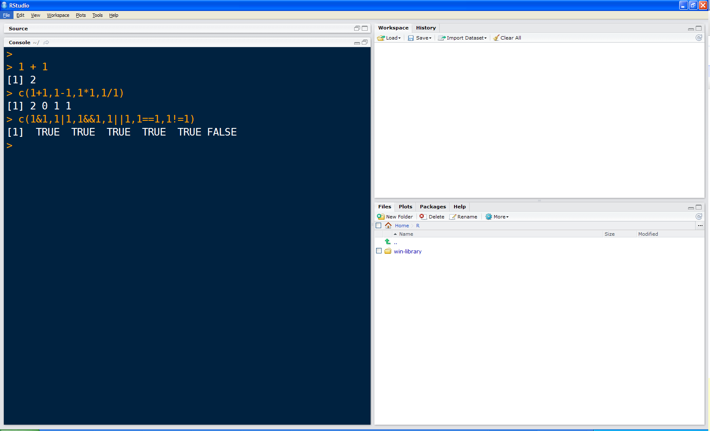
R as a Calculator

Slide 18
Basic Math / Basic Logic
+ addition
- subtraction
* multiplication
/ division
% modulus (remainder)
^ to the power
?Arithmetic
! NOT
& bitwise AND
| bitwise OR
&& shortcircuit AND
|| shortcircuit OR
== equality
!= NOT equality
?Logic
Also try ?Syntax, ?Comparison

Slide 19
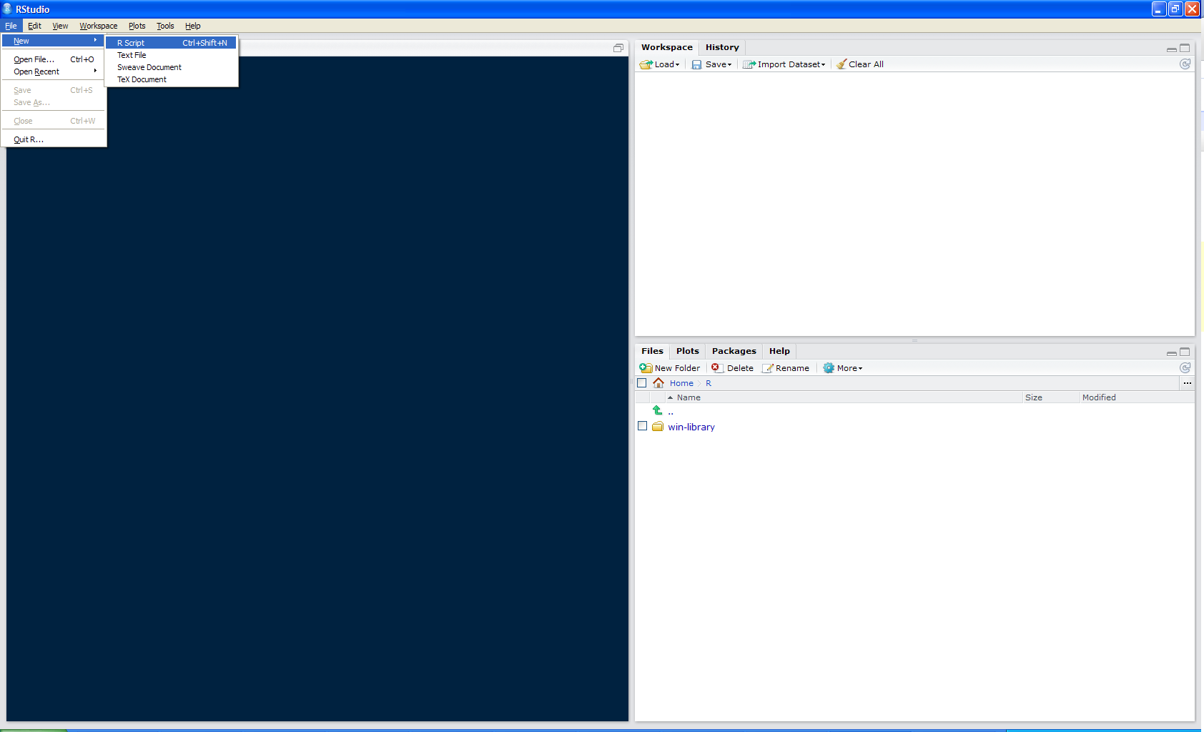
Make New R Script

Slide 20
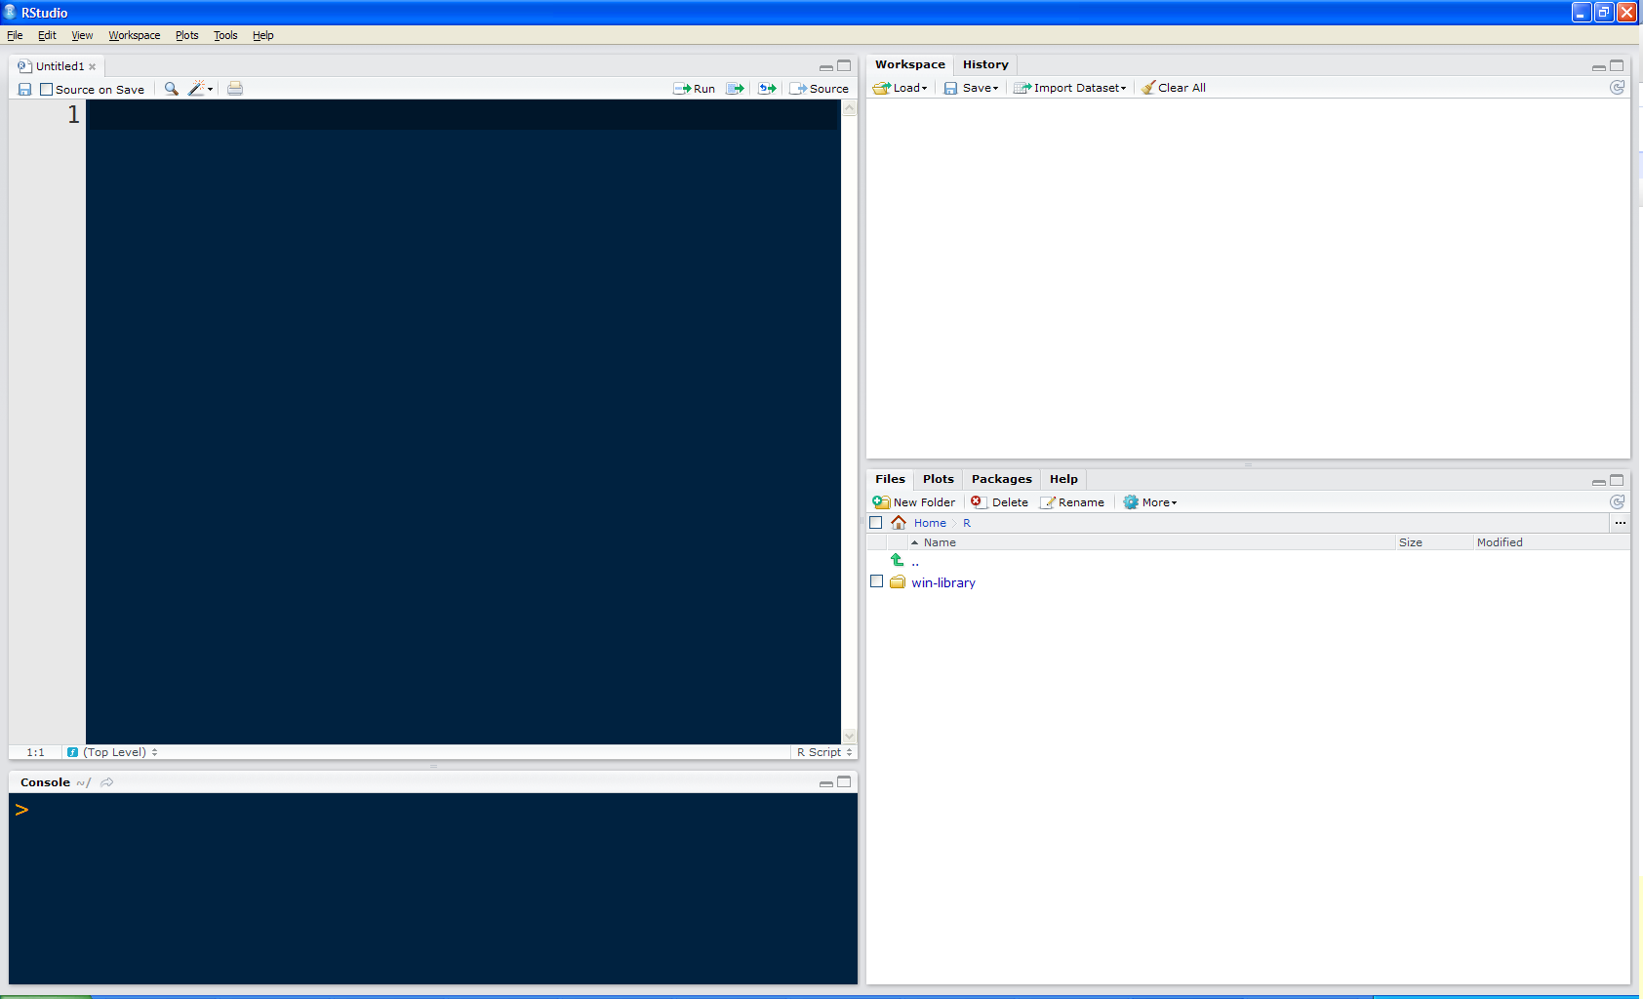
Make New R Script
script tab pane

Slide 21
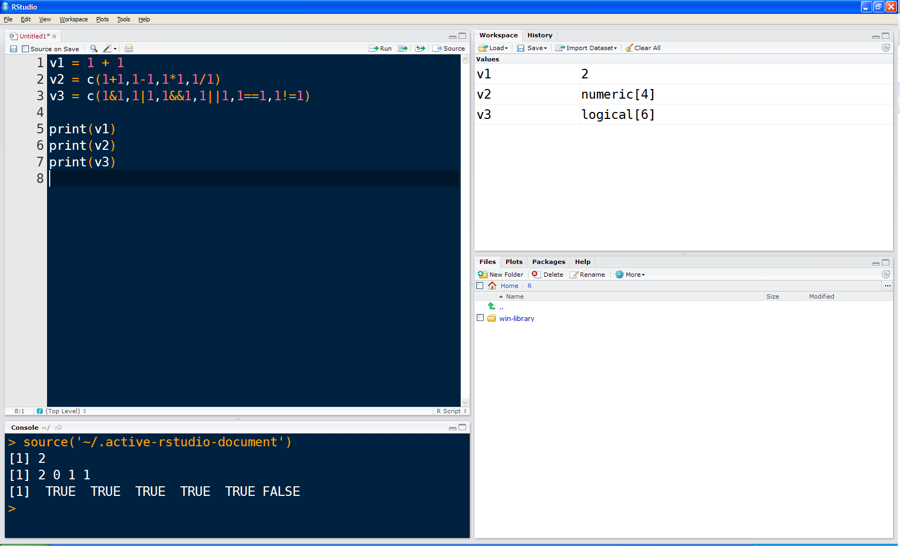

Run Script Loaded in Rstudio

Slide 22
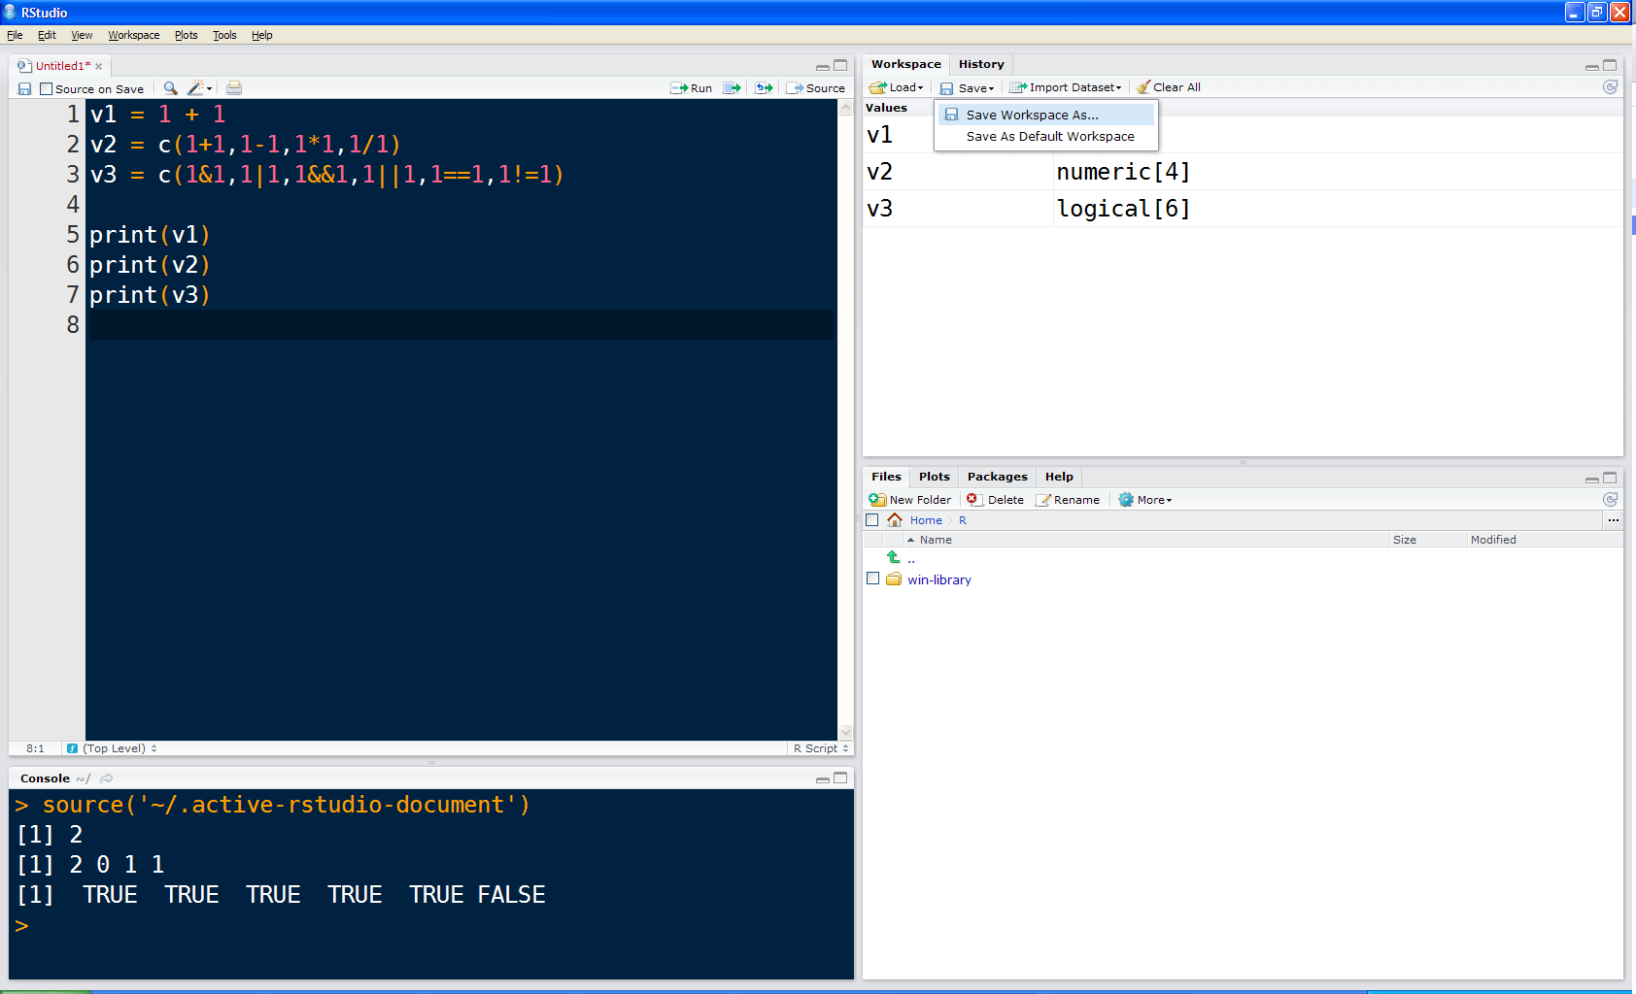

Slide 23
Saving Your Workspace
In R you can save your entire workspace, variables and all in its current state
Then you can reload this at a later time or can provie this to collaborators
Workspace data files are saved with the extension ‘.Rdata’

Slide 24
Getting Help
Inside of R
Simplify make a fake dataset
help(<function name>)
?<function name>
??<search term>
On the web
www.rseek.org and R only search engine
CRAN
Google topic with CRAN

Slide 25
Creating Variables
Named containers for data
Names can be anything you like except for 'special' words
Better if names describe what the stored data is Creating / Setting variables is a matter of equality:
var = somedata

Slide 26
Data Types in R
R's atomic data type is the vector
numeric
floating point
integer
logical
character
functions
lists
let you combine other data types
> a <- 101
> length(a)
[1] 1
> a[1]
[1] 101
> a[2]
[1] NA
> a[2] <- 202
> length(a)
[1] 2

Slide 27
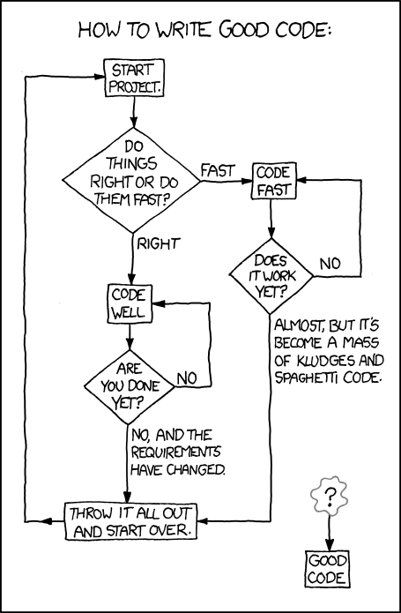
Coding
xkcd #844

Slide 28


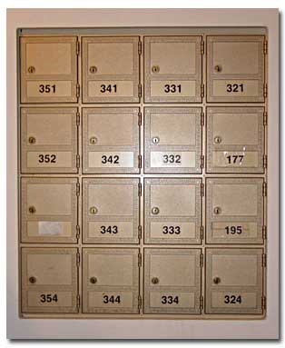
Arrays / Matrices
5x1 Ikea Expedit
"Vector"
4x4 Ikea Expedit
"Matrix"

Slide 29
Vignettes
Some packages have vignettes
A vignettes is an example of how to run the code and a lot of additional text explaining a lot more that you may want to know
List all available vignettes:
vignette()
Display the vignette as a pdf by executing
vignette(‘<topic>’)
To play with the vignette code
vig = vignette(‘<topic>’)
edit(vig)

Slide 30
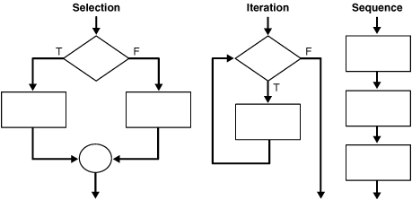
Programmatic Structure
for ...
while ...
if ... then ... else

Slide 31
For Loop
Repeats a line or lines (known as a block) of code until:
(for loop) a count limit is reached
for (i in 1:10) {
... code ...
}
the above loop runs 10 times
'{' and '}' enclose code looped
the variable i updated in the loop to values in the sequence 1:10

Slide 32
A Simple For Loop
# P-values from our analysis
p.values = c(0.1, 0.05, 0.003, 0.4, 0.9)
# A vector to store the negative log p-values
neglog10.p.values = 1:5
# Transform the p-values
for(p in 1:length(p.values)) {
neglog10.p.values[p] = -log10(p.values[p])
}
neglog10.p.values.2 = -log10(p.values)

Slide 33
While Loop
Repeats a line or lines (known as a block) of code until:
(while loop) a logical condition is reached
while (stop != TRUE) {
... code ...
}
the above loop runs until code sets
stop = TRUE
warning: if not properly written while loops can run infinitely

Slide 34
A Simple While Loop
# Numbers from our analysis
v1 = c(21, 22, 53, 74, 85, 96, 97, 58, 49, 30, 85)
# Iterator
i = 1
# Look for first instance of 85
while(v1[i] != 85) {
i = i + 1
}
# Print out where we found it
print(paste('v1[',i,'] = 85',sep=''))

Slide 35
Functions
Bits of code that do one thing and (preferrably) do it well
Functions break up your code into more manageable and reusable parts
Defining (e.g. in a script):
fun = function(arguments) {
... code ...
}
Calling:
party = fun(food,beer,folks)

Slide 36
A Simple Function
fn1 <- function(N) { for(i in as.numeric(1:N)) {
y <- i*i
} }
fn2 <- function(N) {
i = 1
while(i <= N) {
y <- i*i
i <- i + 1
}
}
system.time(fn1(60000))
system.time(fn2(60000))

Slide 37

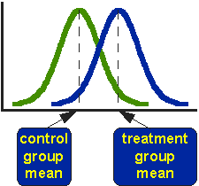
Student’s T-test
Notes:
37

Slide 38
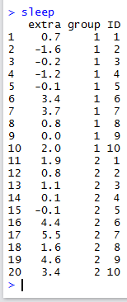
Comparing the Means of Two Groups
Sleep dataset in R is a comparison of two soporific drugs on students sleep habits

Slide 39
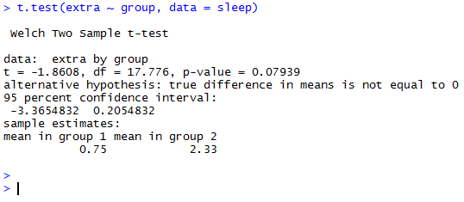
Doing a Student’s T-test
t.test(sleep[1:10,’extra’],sleep[11:20,’extra’])
or
t.test(extra ~ group, data = sleep)

Slide 40
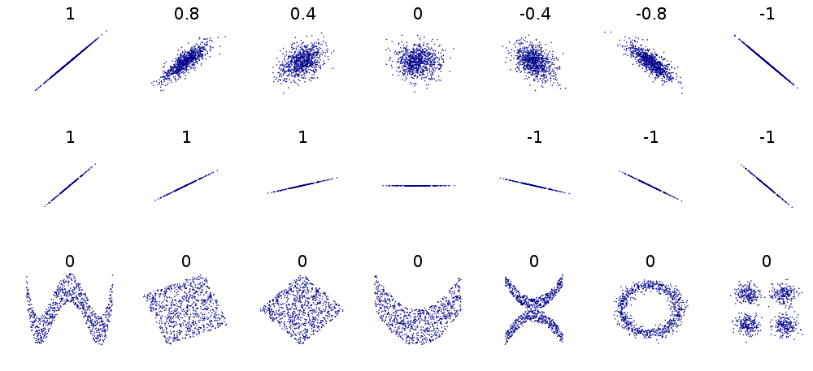
Correlation

Slide 41
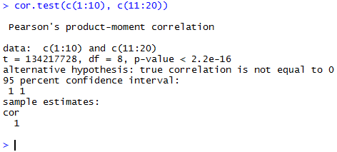
Testing for a Correlation
cor.test(c(1:10), c(11:20))

Slide 42
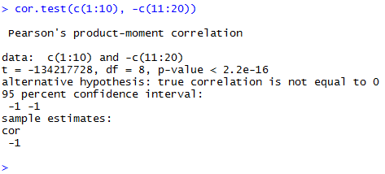
Testing for a Correlation
cor.test(c(1:10), -c(11:20))

Slide 43
What else is built-in?
library(help="stats")

Slide 44
Thanks
Lee Pang
Chris Bare
Baliga Lab

