Slide 1
Stitching the Tutorials Together
Introduction to Systems Biology Course
Chris Plaisier
Institute for Systems Biology

Slide 2
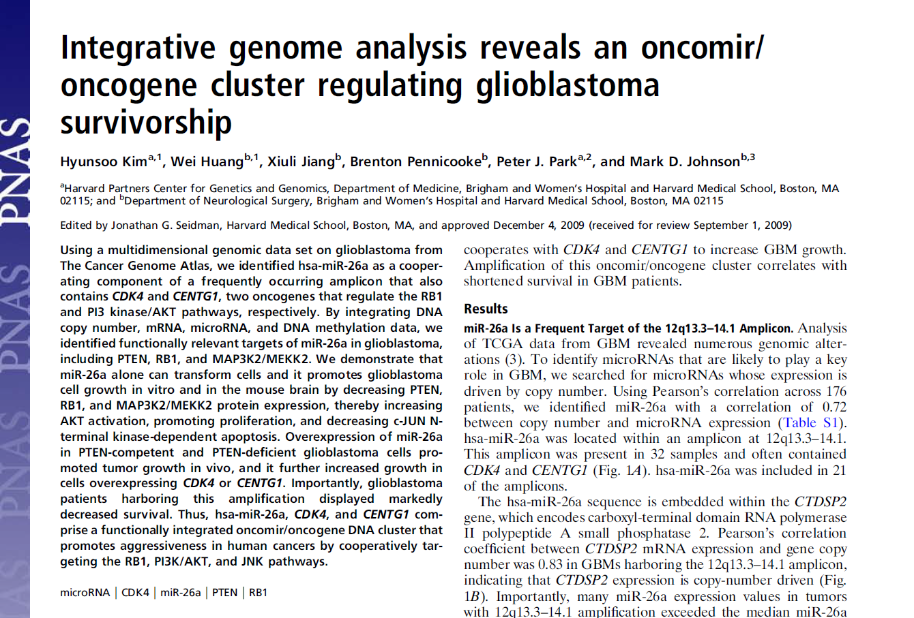
Impetus for Tutorial

Slide 3
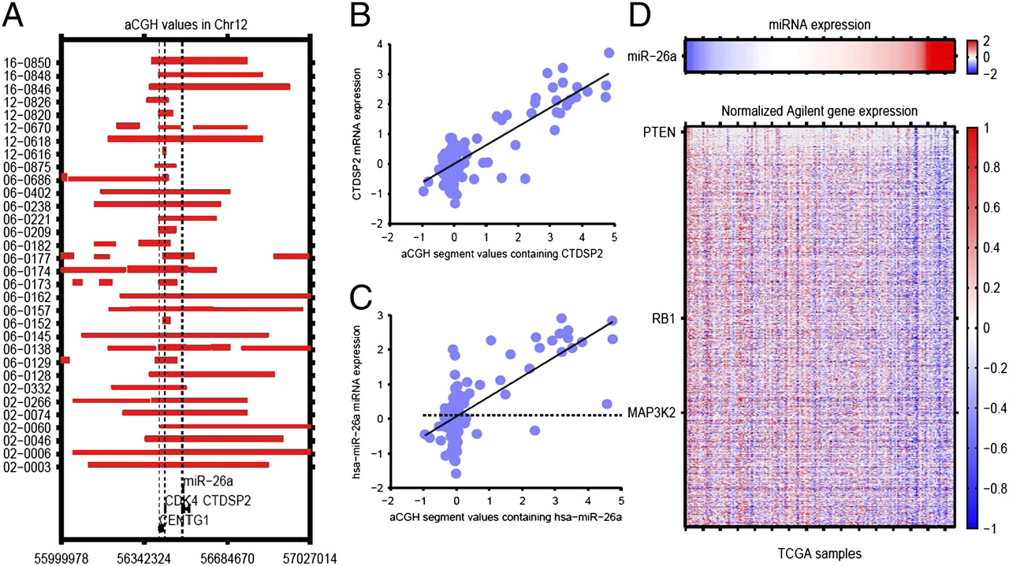
Searching for Amplified miRNAs
Region on chromosome 12 containing hsa-miR-26a is amplified in glioma
This region also contains a few other genes including the genes encapsulating hsa-miR-26a

Slide 4
Screen for miRNAs Correlated with CNV
Which miRNA’s expression is modified by CNVs?
hsa-miR-26a = Amplified
hsa-miR-491 = Deleted
hsa-miR-339 = Amplified and deleted in sub-clonal populations

Slide 5
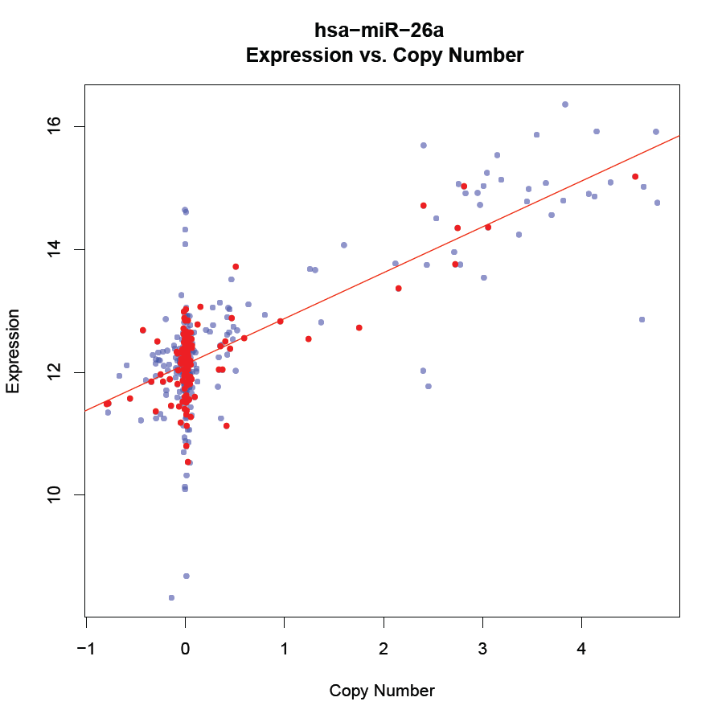
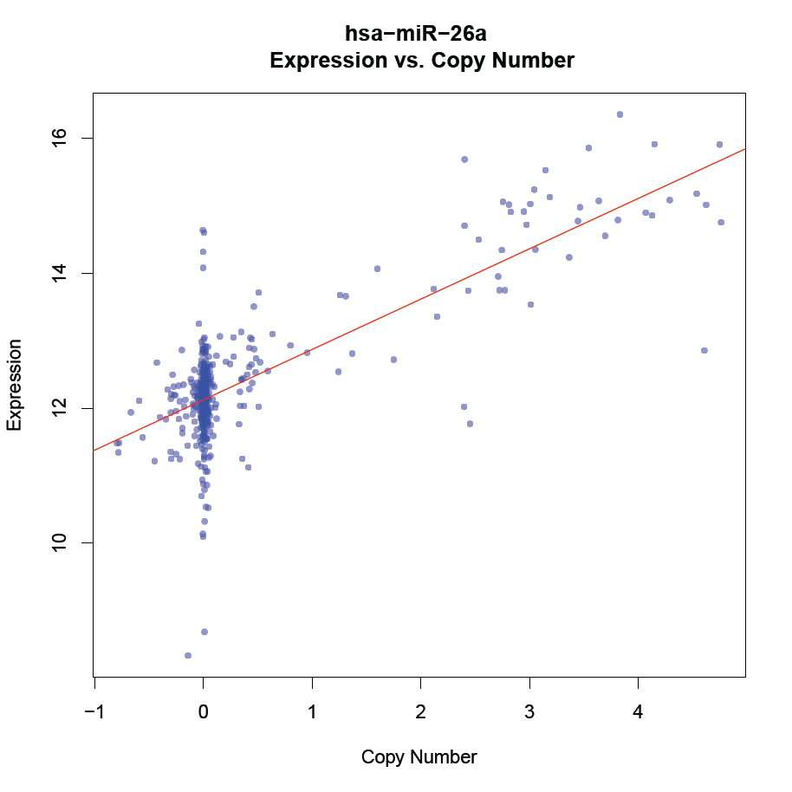
Correlation of miRNA Expression and Copy Number Variation

Slide 6
Comparison of Approaches
We identified other miRNA not reported by Kim, et al. 2010
Our screening approach yielded more putatively dysregulated miRNAs
Cherry picking can be useful
Typically need to follow rigorous statistical protocols for initial screen
After initial screen multiple paths to publication
Up to expertise of researcher

Slide 7
How could we make it better?
User linear regression and add covariates:
Sex
Age
...
Others?

Slide 8
Gene Affected by miRNA Perturbation
Applied biologically motivated filtering of putative genes targeted by miRNA to those predicted by PITA
Complementarity of miRNA to 3’ UTR
…
Tested for correlation between miRNA to putative target genes

Slide 9
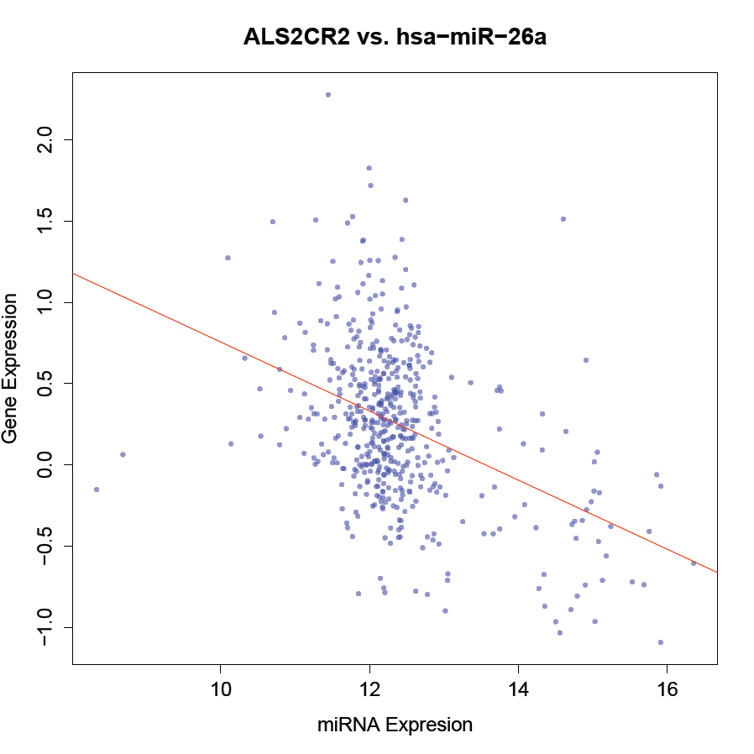
Correlation of miRNA Expression with Putative Target Genes

Slide 10
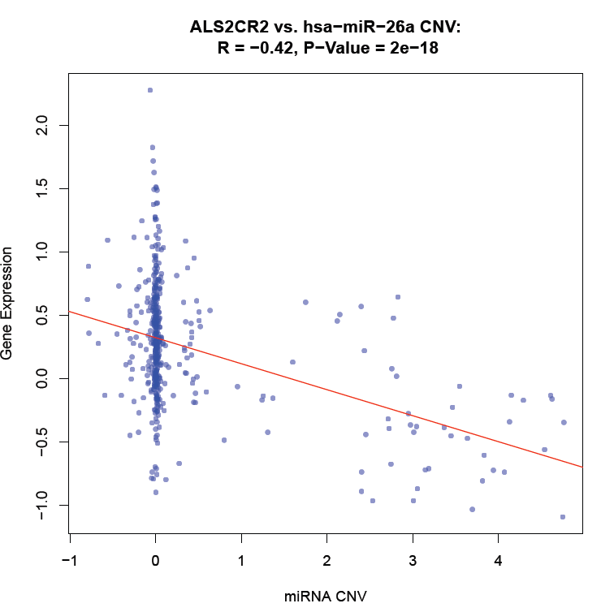
Correlation with CNV
We took it one step further and tested for a correlation between the CNV and miRNA target genes
Only one gene for hsa-miR-26a that was associated with the miRNA expression was not associated with hsa-miR-26a CNV

Slide 11
How could we make it better?
Use linear regression and integrate strength of PITA match
Others?

Slide 12
Causality?
Purpose of correlation with CNV is that we wanted to make sure the effect of the miRNA on the target genes was through the CNV
Can we really say for sure the direction of the association?
Can we imply causality?

Slide 13
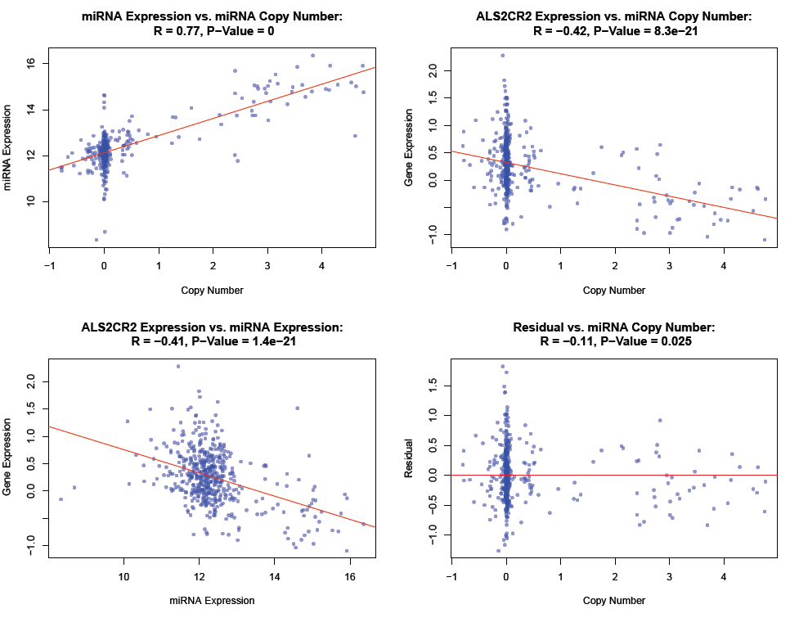

Slide 14
Consistent with Causality
While not a test for causality the fact that conditioning miRNA target gene expression on hsa-miR-26a expression significantly reduces the association is consistent with a causal model
There are ways we could model causal information flow
http://www.genetics.ucla.edu/labs/horvath/aten/NEO
http://www.nature.com/ng/journal/v37/n7/abs/ng1589.html

Slide 15
Integration with Clinical Phenotypes
Case / Control
Student’s T-Test
Correlation / Regression
Survival analysis
Need time to event and status at end of study

Slide 16
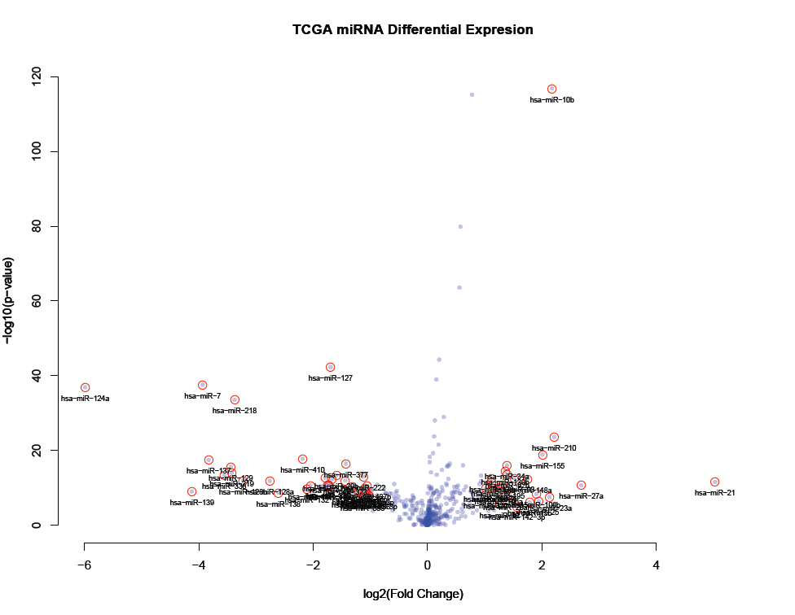
Glioma miRNAs Case/Control

Slide 17
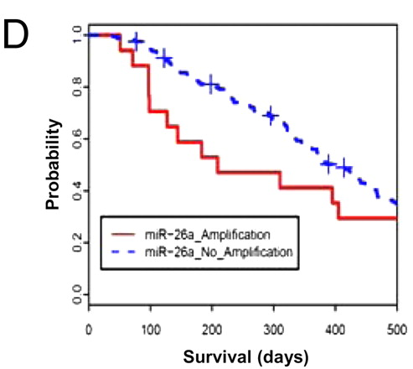
hsa-miR-26a Amplification Significantly Associated with Lower Survival

Slide 18
Summary
We repeated analysis done by Kim, et al.
You learned how to calculate a correlation and Student’s T-test in R
You learned how to correct for multiple testing
You learned how to go from a global study to specific hypotheses for testing

