Slide 1
Inferring Biologically Meaningful Relationships
Introduction to Systems Biology Course
Chris Plaisier
Institute for Systems Biology

Slide 2
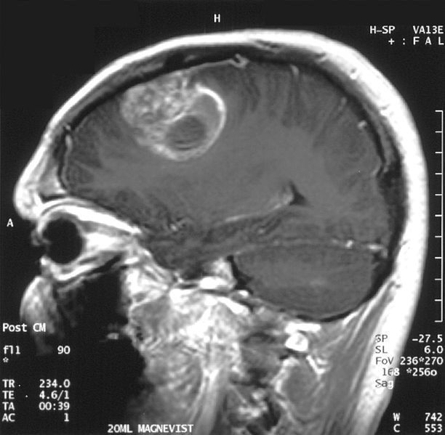
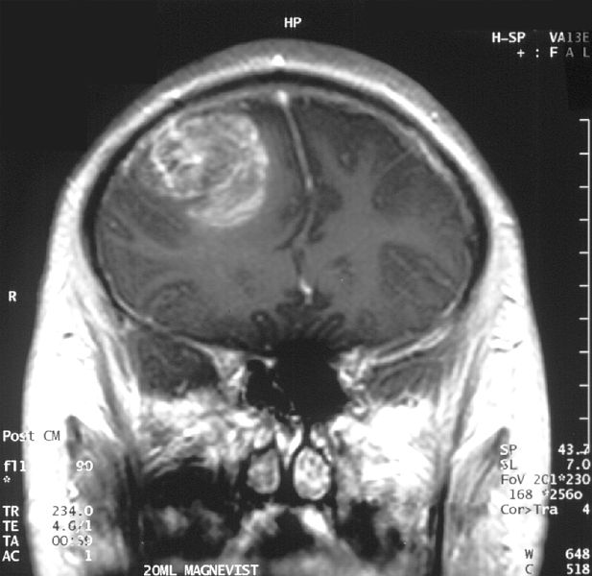
Glioma: A Deadly Brain Cancer
Wikimedia commons
Notes:
2

Slide 3
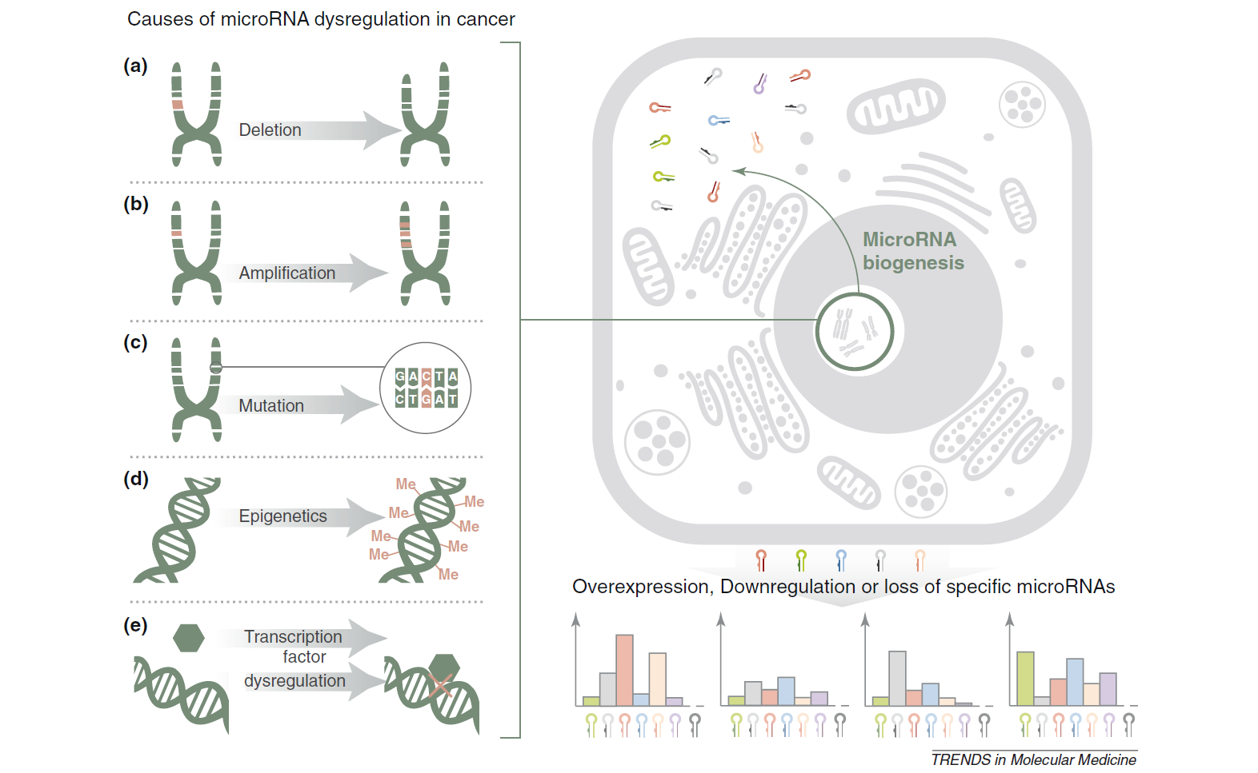
miRNAs are Dysregulated in Cancer
Chan et al., 2011

Slide 4
What happens if you amplify a miRNA?
If the DNA encoding an miRNA is amplified what happens?
Does it affect the expression of the miRNA?
We expect it might up-regulate it with respect to the normal controls
Can we detect this?

Slide 5
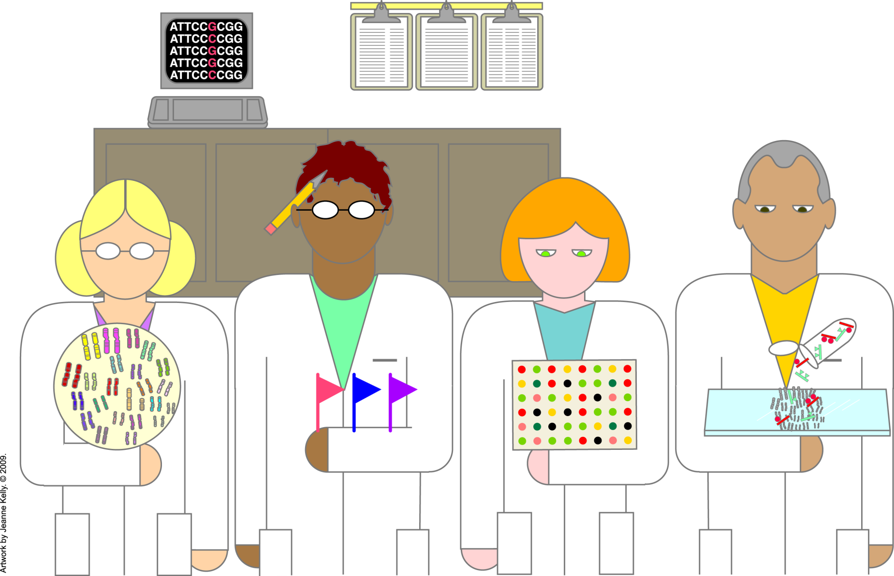
What kind of data do we need?

Slide 6
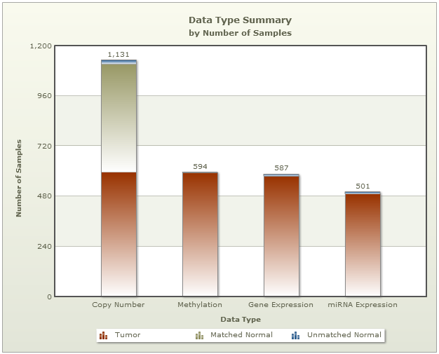
What data do we need?
Integrate
TCGA

Slide 7
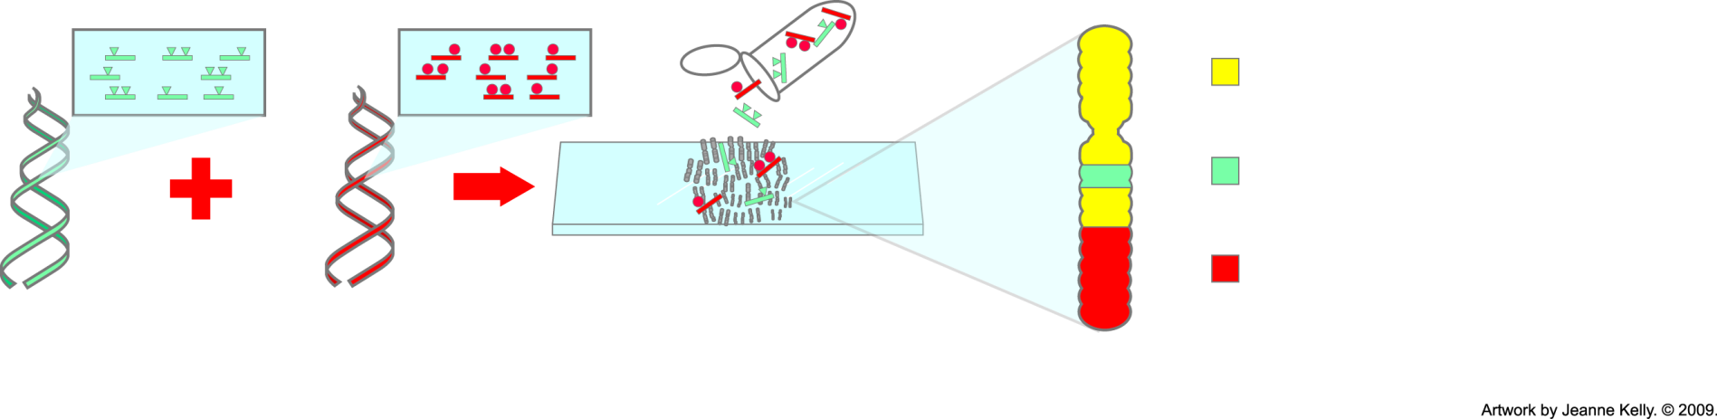
Genome-Wide Profiling:
Comparative Genomic Hybridization
= equal binding of labeled normal and tumor probes
= more binding of labeled tumor probes—gain of tumor DNA
= more binding of labeled normal probes—loss of tumor DNA
Label probes for all tumor DNA
Label probes for all normal DNA
Hybridize to normal metaphase chromosomes for 48—72 hours
Metaphase chromosome
Notes:
Comparative genomic hybridization (CGH) is a method that allows researchers to detect large-scale changes in chromosomes. They can visualize where extra genetic material (repeating copies) has been added or deleted. They can see where large portions of genetic material have been inserted into chromosomes. Many cancers exhibit these types of chromosomal abnormalities.

Slide 8
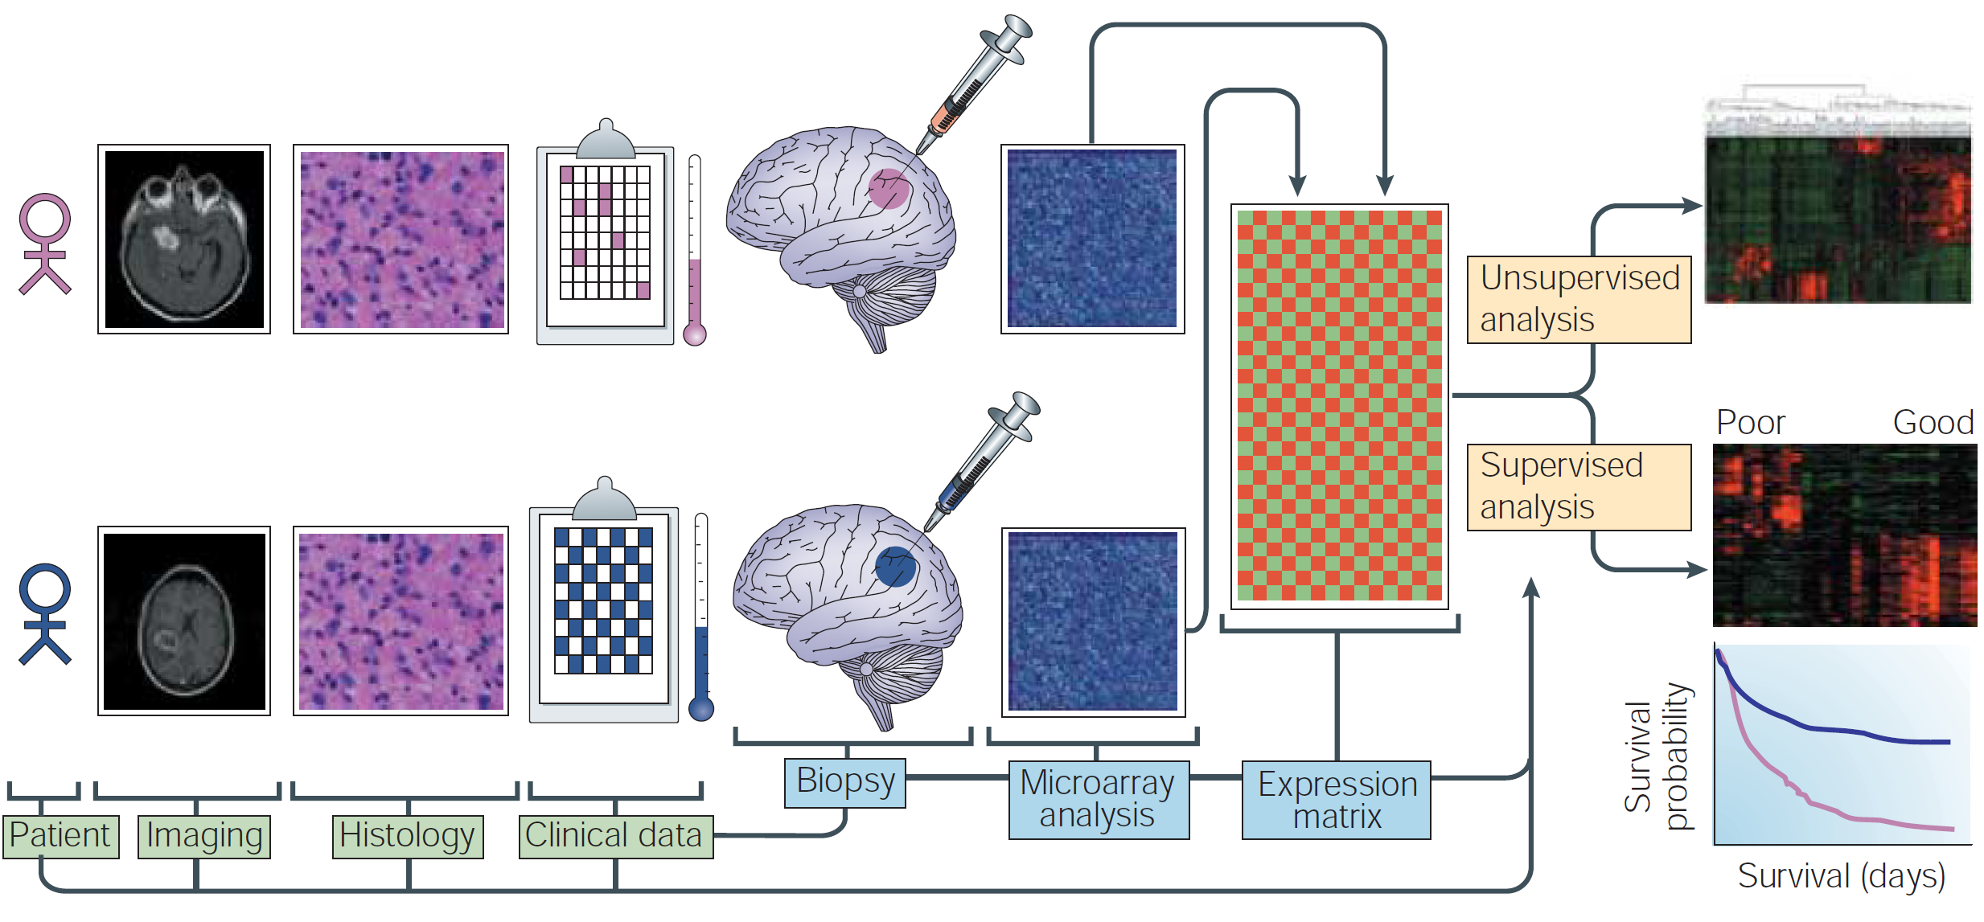
Stratification of Patients
Mischel et al, 2004

Slide 9
Data Integration
Patient tumor copy number levels
Patient tumor miRNA expression levels
By integrating these two we can identify miRNAs whose expression is predicted by the copy number variations (CNVs)

Slide 10
Integration Methods
Should we integrate all CNVs with each miRNA?
How can we use biology to come up with a good alternative that limits our test space?
Are there specific filters we ought to apply?

