Slide 1
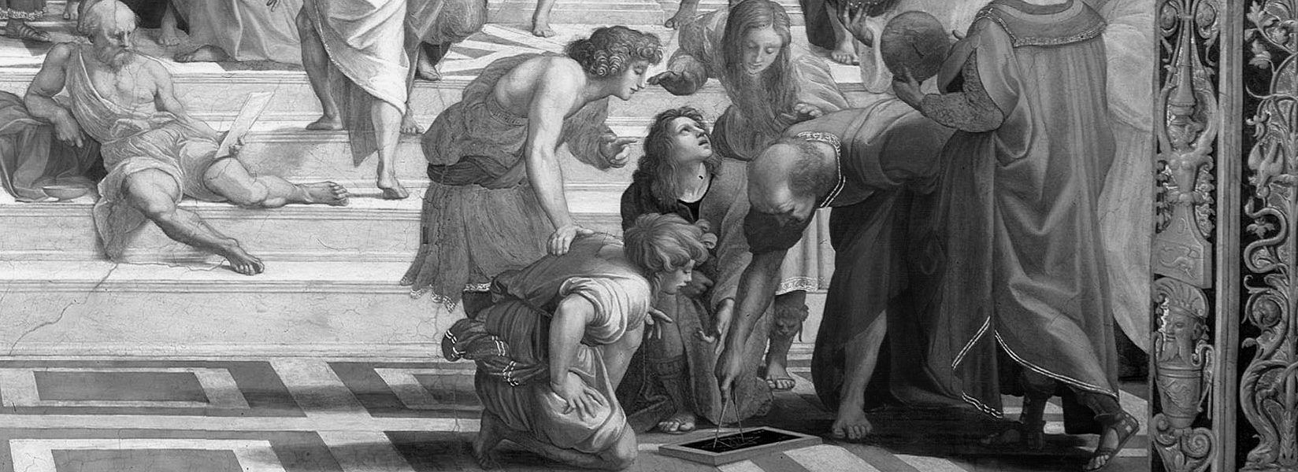
Metric geometry
Lecture 1
© Alexander & Michael Bronstein
tosca.cs.technion.ac.il/book
Numerical geometry of non-rigid shapes
Stanford University, Winter 2009

Slide 2
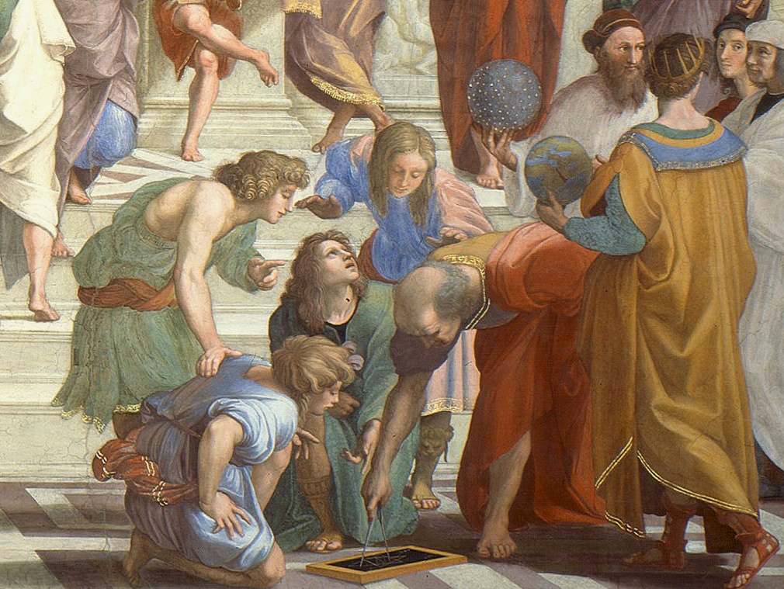
Raffaello Santi, School of Athens, Vatican

Slide 3
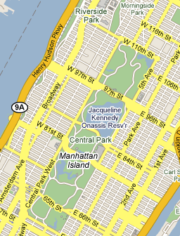

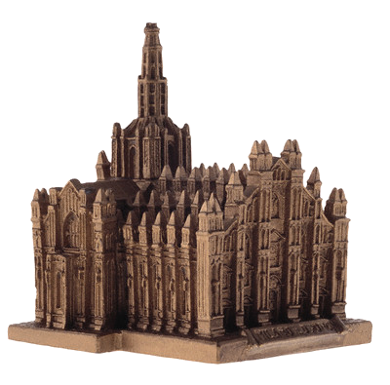
Distances
Euclidean
Manhattan
Geodesic

Slide 4
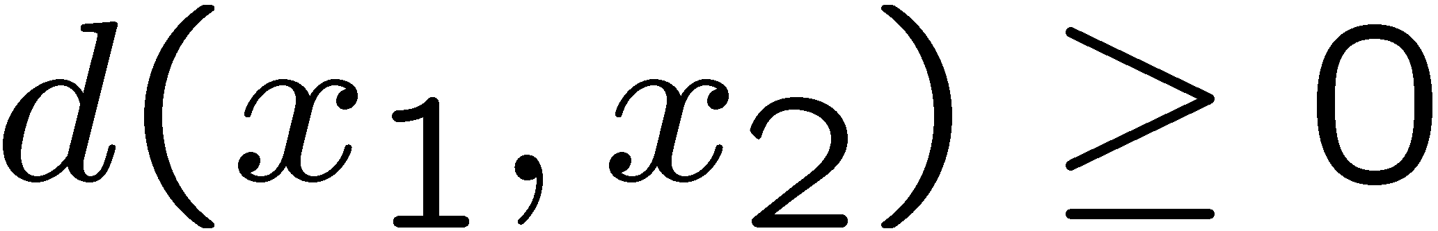
Metric
A function satisfying for all
Non-negativity:
Indiscernability: if and only if
Symmetry:
Triangle inequality:
B
is called a metric space
A
C
AB ≤ BC + AC

Slide 5
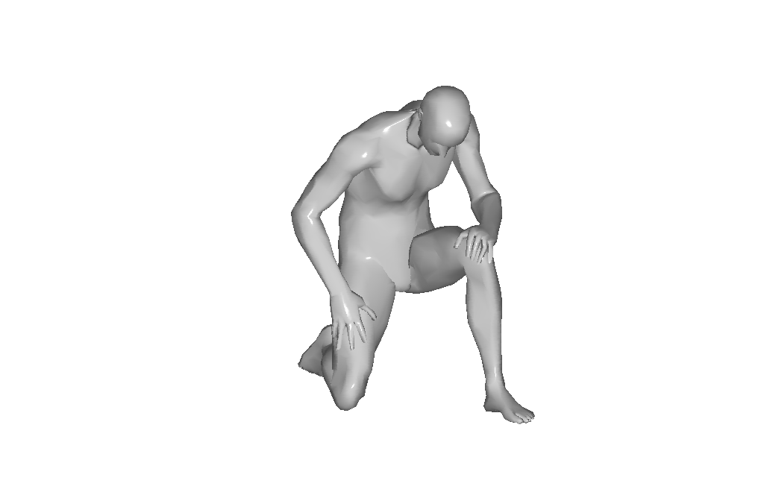
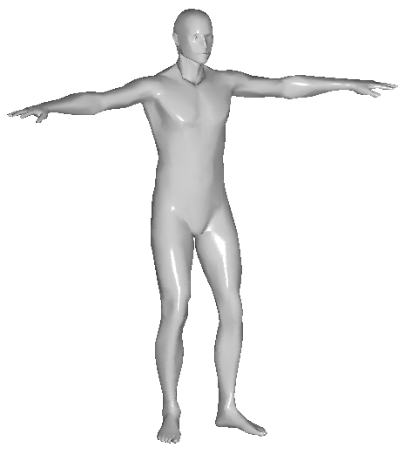
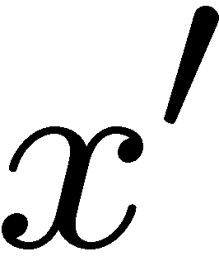

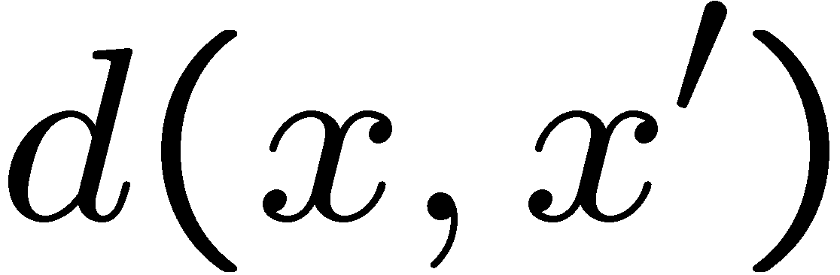
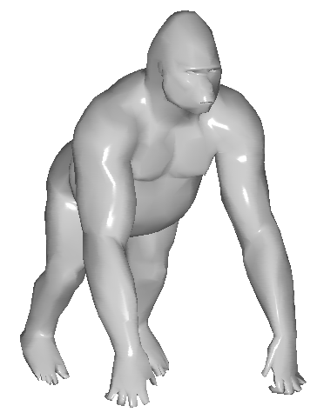
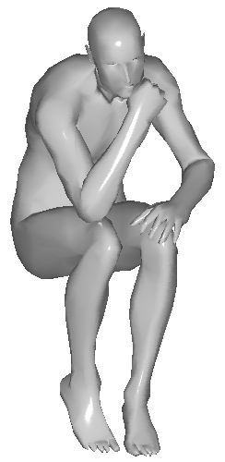
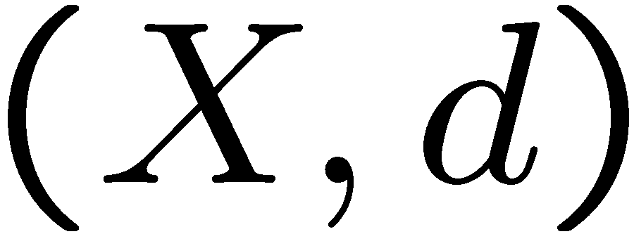
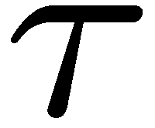
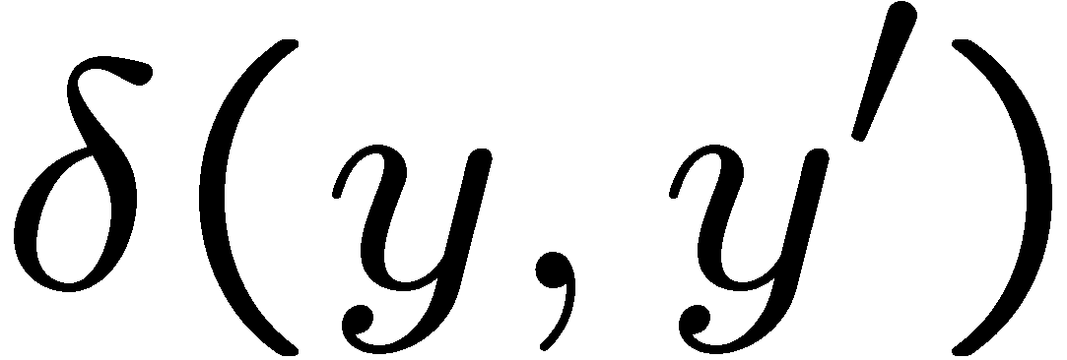
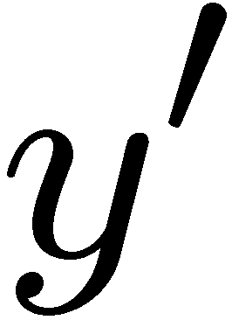

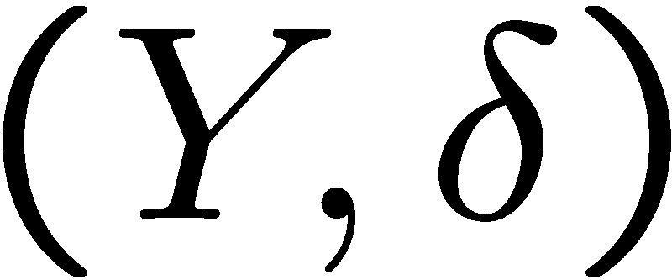
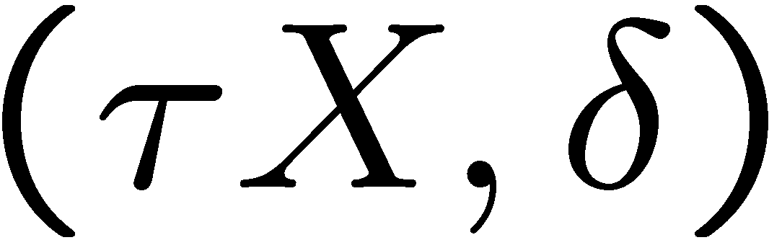
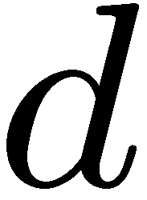
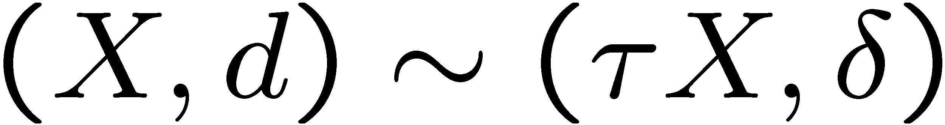
Shapes as metric spaces
≈
SHAPE
SIMILARITY
INVARIANCE
metric space
Distance between metric spaces and .
isometry w.r.t.

Slide 6
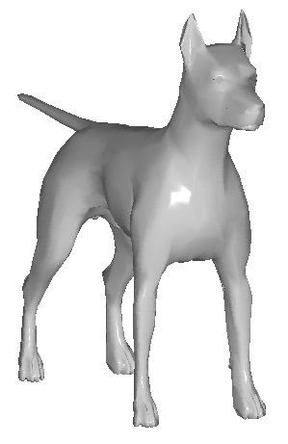
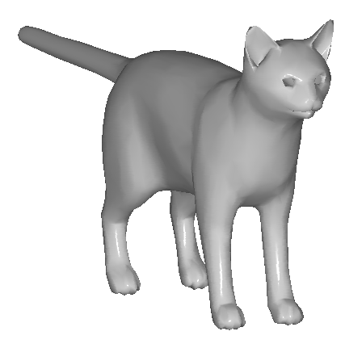
Similarity as metric
Two deformations of a human are equivalent
~
Human and monkey are ε-similar
Human is twice more similar to monkey than to dog
Shape space

Slide 7
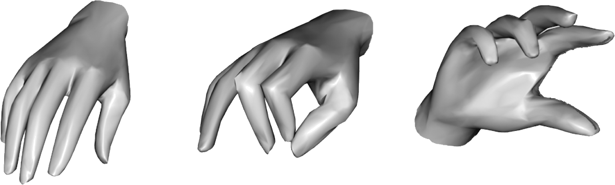
Examples of metrics
Euclidean
Path length

Slide 8
Length spaces
Path
Path length , e.g. measured as time it takes to travel along the path
Length metric
is called a length space

Slide 9
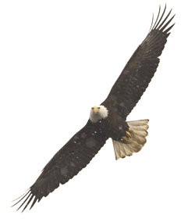
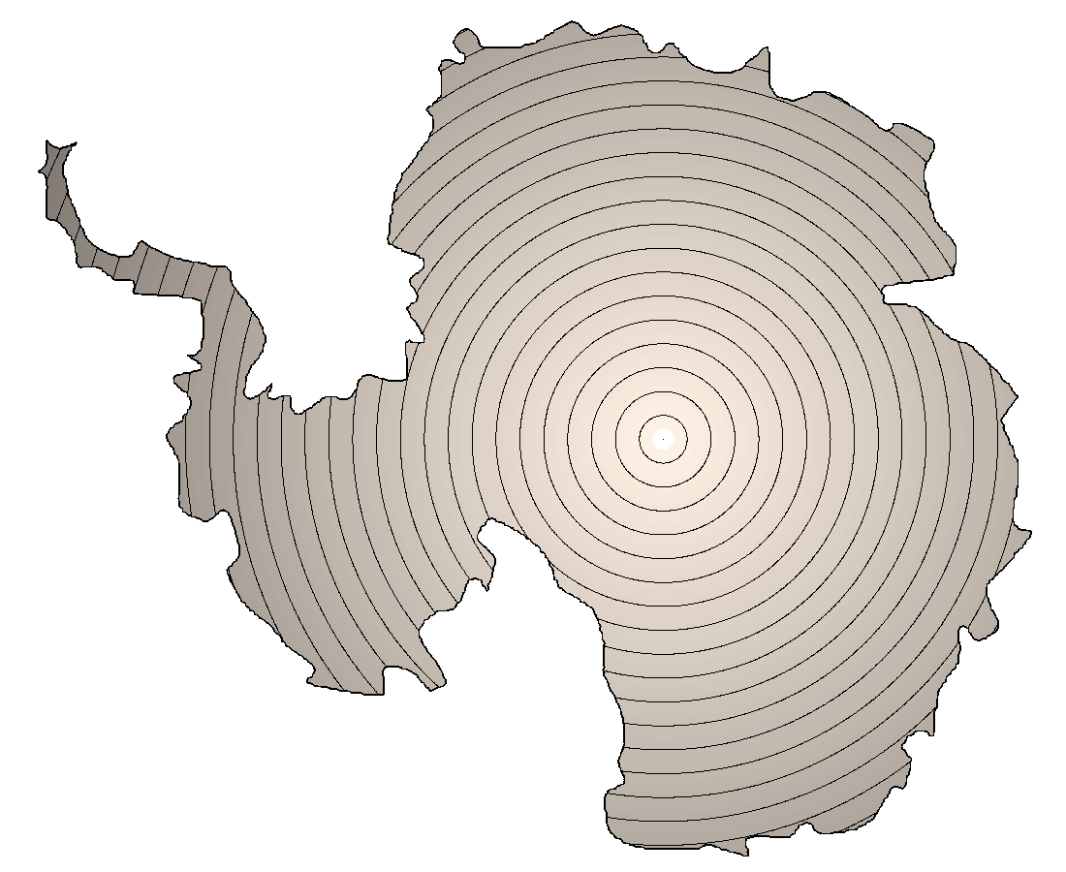
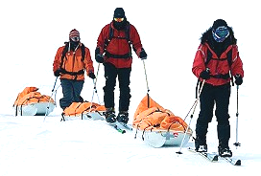
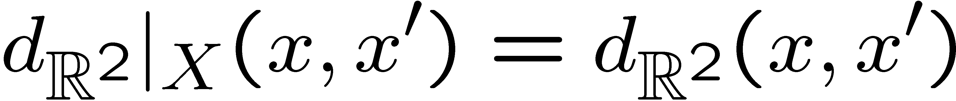
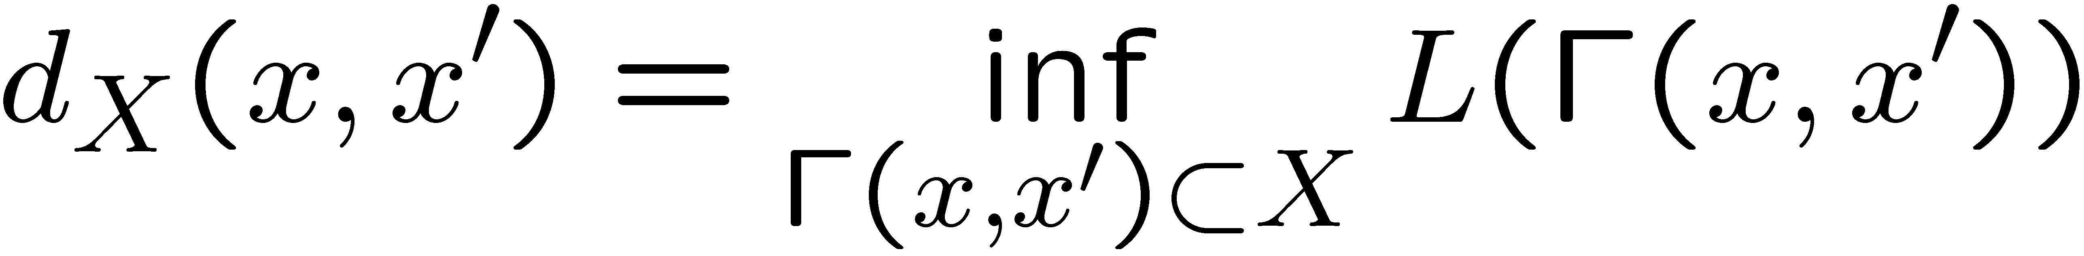
Restricted vs. intrinsic metric
Restricted metric
Intrinsic metric

Slide 10
Induced metric
Path length is approximated as sum of lengths of line segments
of which the path consists, measured using Euclidean metric
The Euclidean metric induces a length metric
Can induce another length metric?

Slide 11
Completeness
is called complete if between any there exists a path
such that
Complete
Incomplete
In a complete length space,
The shortest path realizing the length metric is called a geodesic and the corresponding length metric is called the geodesic metric

Slide 12
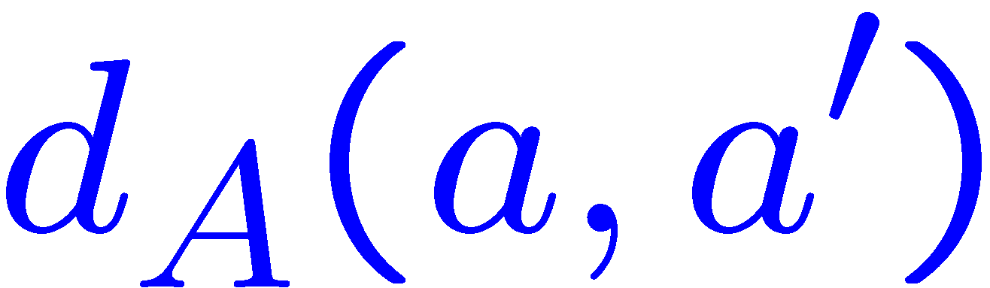
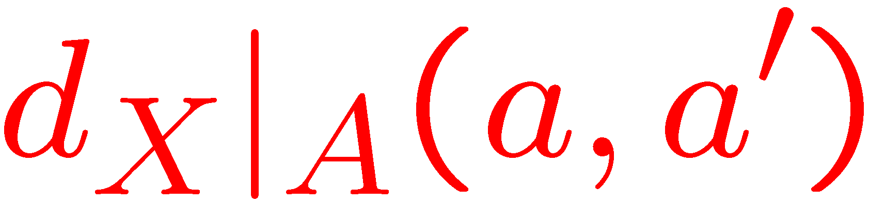
Convexity
A subset of a metric space is convex if the restricted and
the induced metrics coincide
Non-convex
Convex
A convex set contains all the geodesics

Slide 13
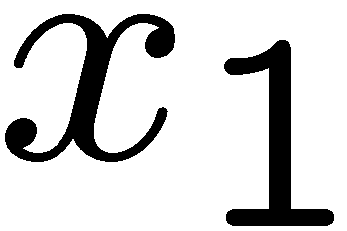
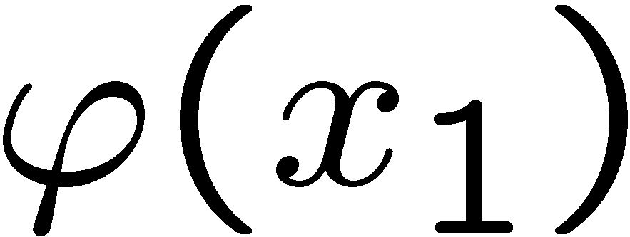
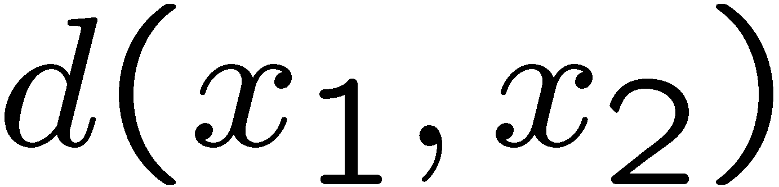

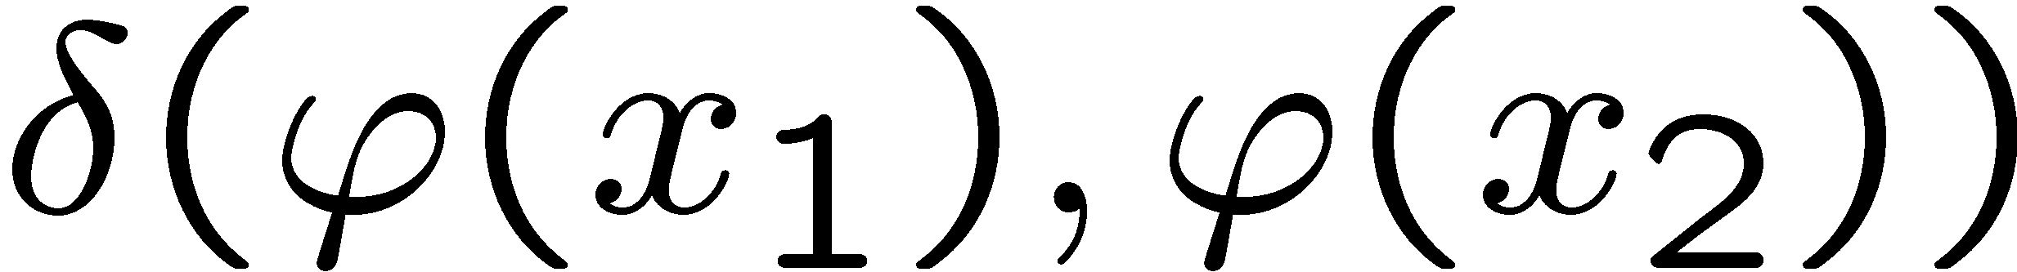
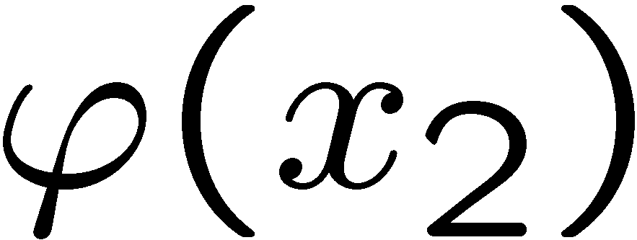
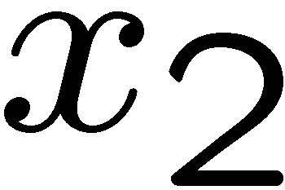
Isometries
Two metric spaces and are equivalent if there exists a
distance-preserving map (isometry) satisfying
Such and are called isometric, denoted
Isometries copy metric geometries – isometric spaces are equivalent
from the point of view of metric geometry

Slide 14
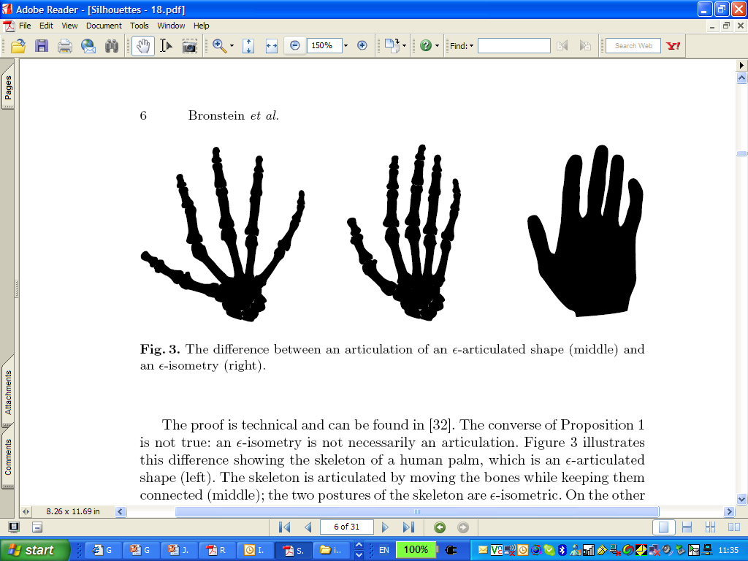
Euclidean isometries

Slide 15
Euclidean isometries
Rotation
Translation
Reflection

Slide 16
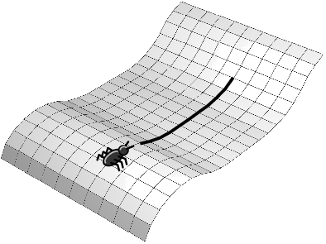
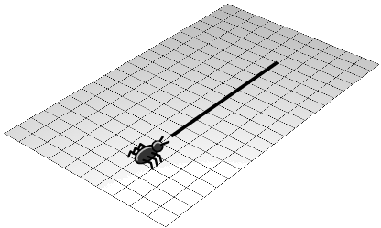
Geodesic isometries

Slide 17

Almost isometries
Almost isometry is a map satisfying
Distortion is the maximum absolute change of the metric
Almost isometry is not necessarily bijective

Slide 18
Almost isometries

Slide 19
ε-isometries
A function is an
Isometry
-isometry
Distance preserving
-distance preserving
Bijective (one-to-one and on)
-surjective
Continuous
Not necessarily continuous

