Slide 1
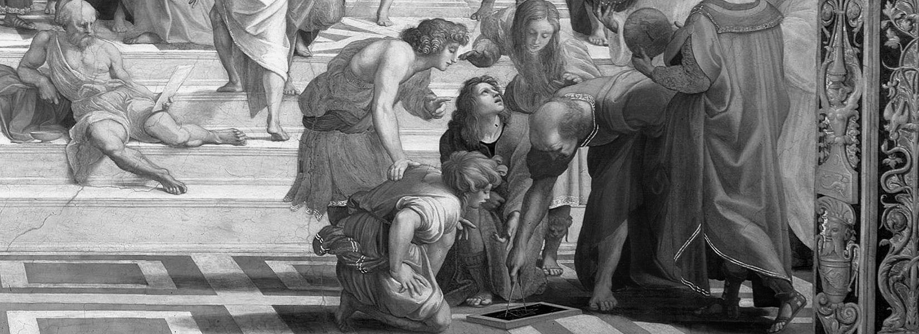
Differential geometry I
Lecture 1
© Alexander & Michael Bronstein
tosca.cs.technion.ac.il/book
Numerical geometry of non-rigid shapes
Stanford University, Winter 2009

Slide 2
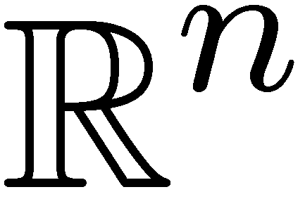
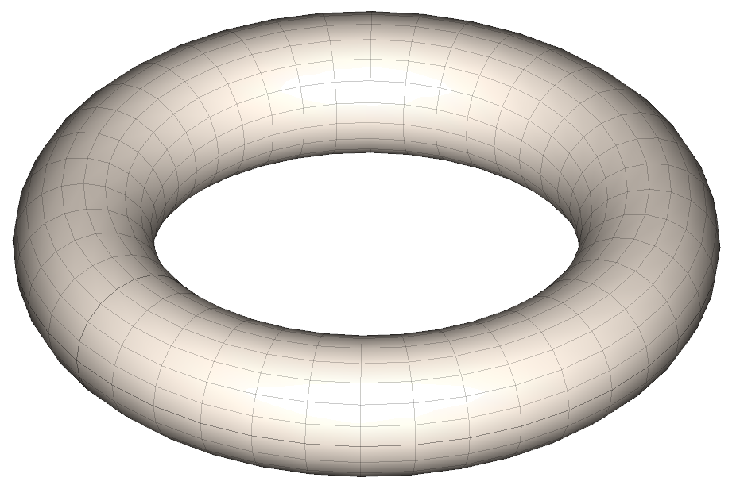
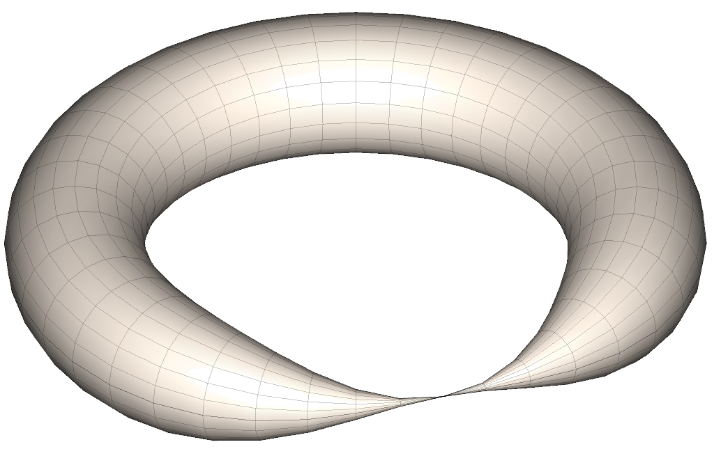
Manifolds
A topological space in which every point has a neighborhood homeomorphic to (topological disc) is called an n-dimensional (or n-) manifold
2-manifold
Not a manifold
Earth is an example of a 2-manifold

Slide 3
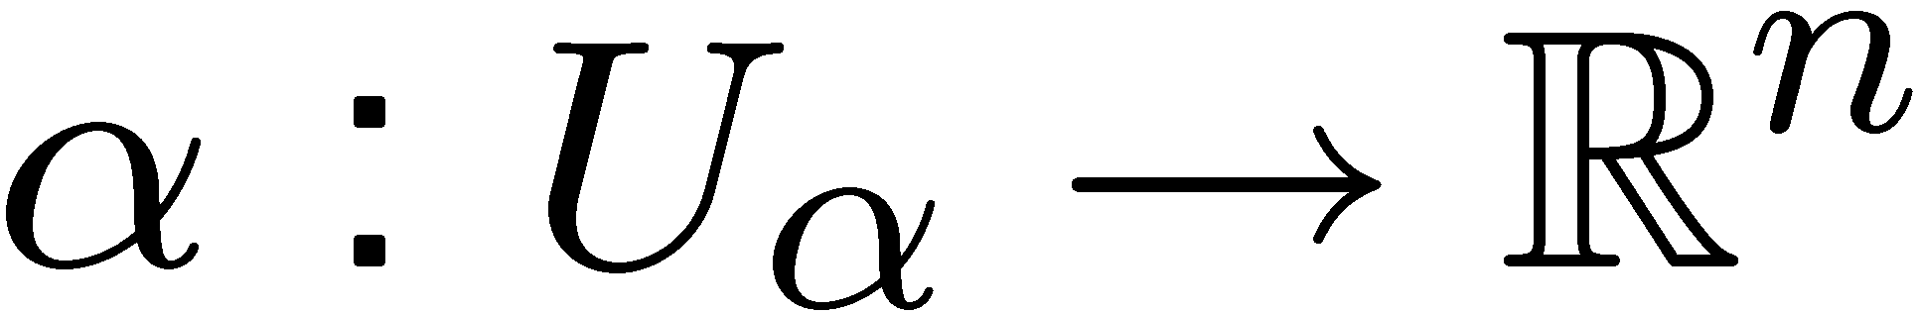
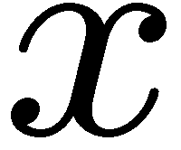
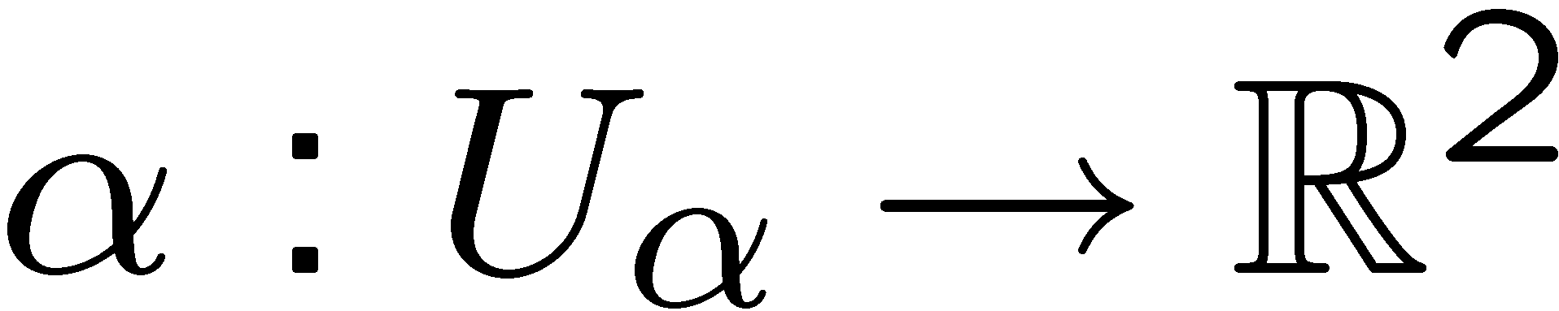
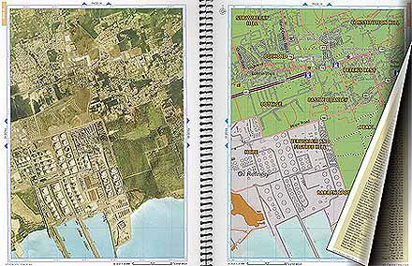
Charts and atlases
A homeomorphism
from a neighborhood of
to is called a chart
A collection of charts whose domains cover the manifold is called an atlas
Chart

Slide 4
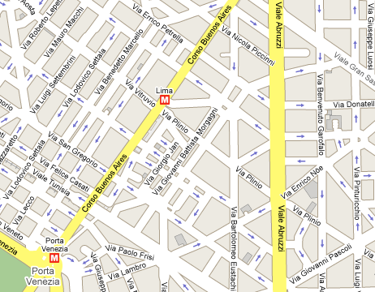
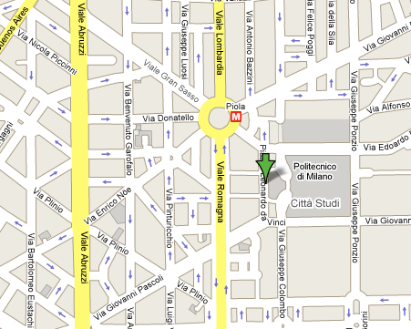
Charts and atlases

Slide 5
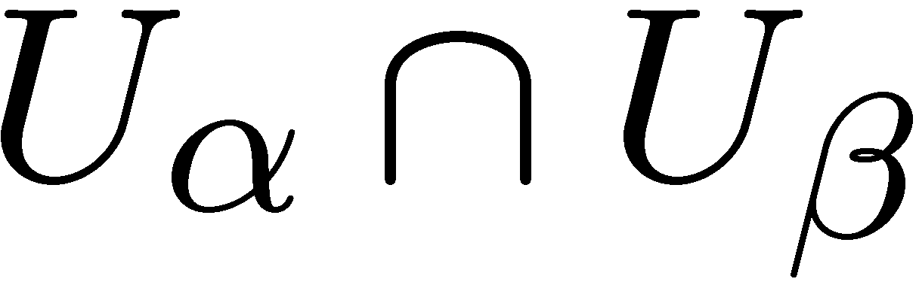
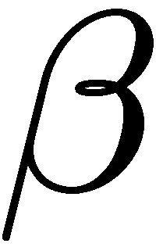
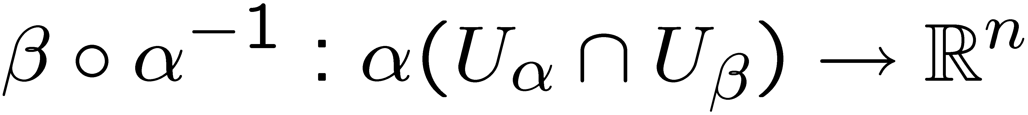

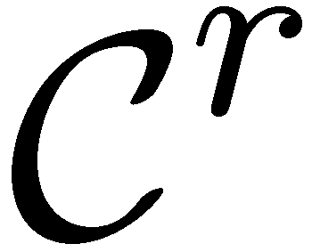
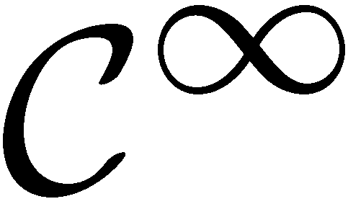
Smooth manifolds
Given two charts and
with overlapping domains change of coordinates is done by transition function
If all transition functions are , the manifold is said to be
A manifold is called smooth

Slide 6
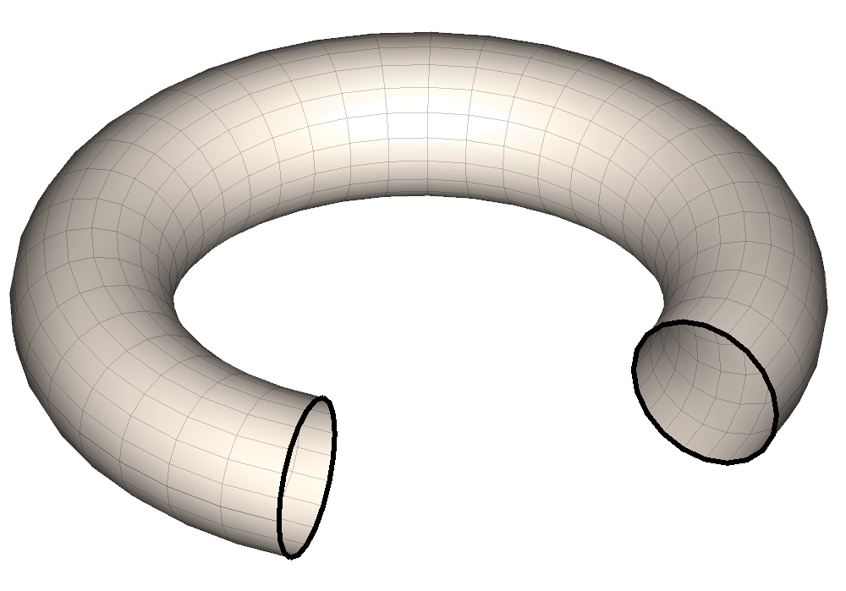
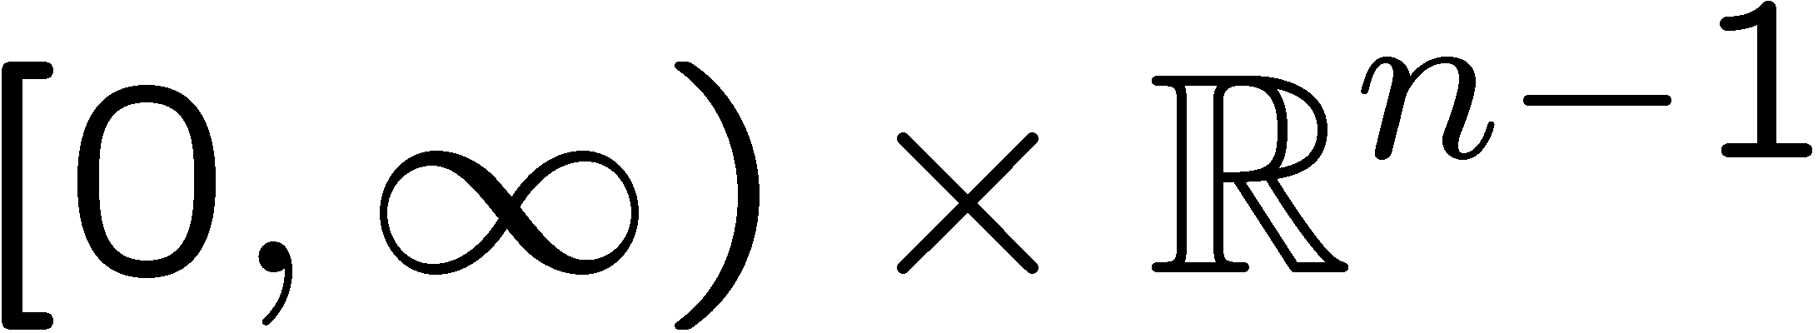
Manifolds with boundary
A topological space in which every point has an open neighborhood homeomorphic to either
topological disc ; or
topological half-disc
is called a manifold with boundary
Points with disc-like neighborhood are called interior, denoted by
Points with half-disc-like neighborhood are called boundary, denoted by

Slide 7
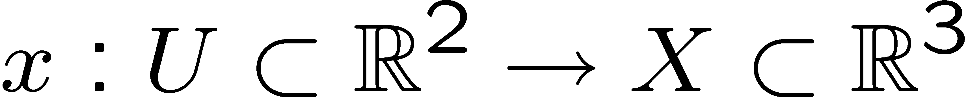
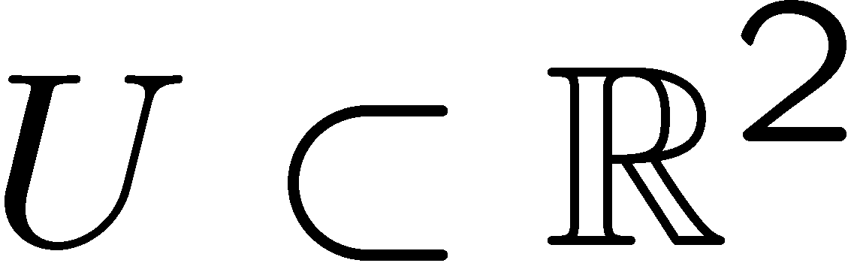
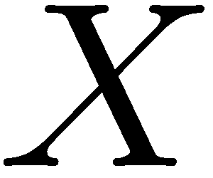
Embedded surfaces
Boundaries of tangible physical objects are two-dimensional manifolds.
They reside in (are embedded into, are subspaces of) the ambient
three-dimensional Euclidean space.
Such manifolds are called embedded surfaces (or simply surfaces).
Can often be described by the map
  is a parametrization domain.
  the map
  is a global parametrization (embedding) of .
Smooth global parametrization does not always exist or is easy to find.
Sometimes it is more convenient to work with multiple charts.

Slide 8
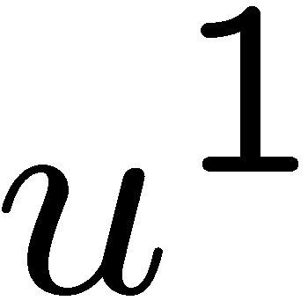

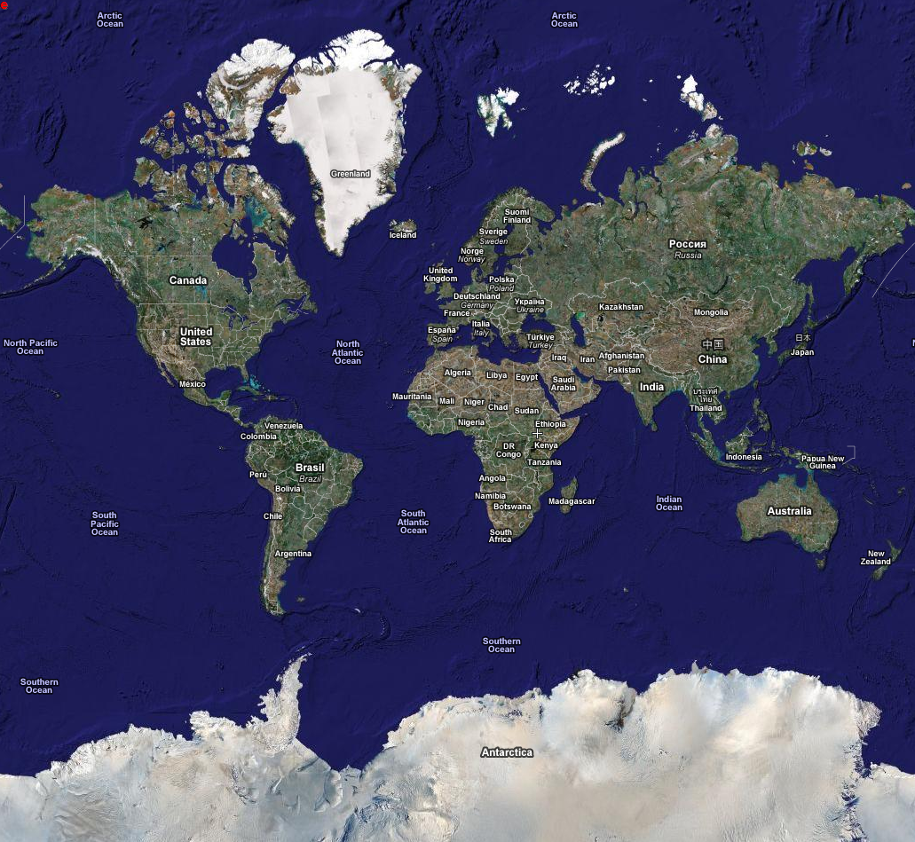

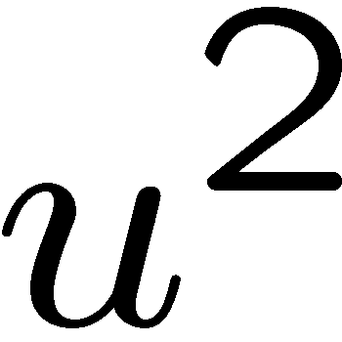
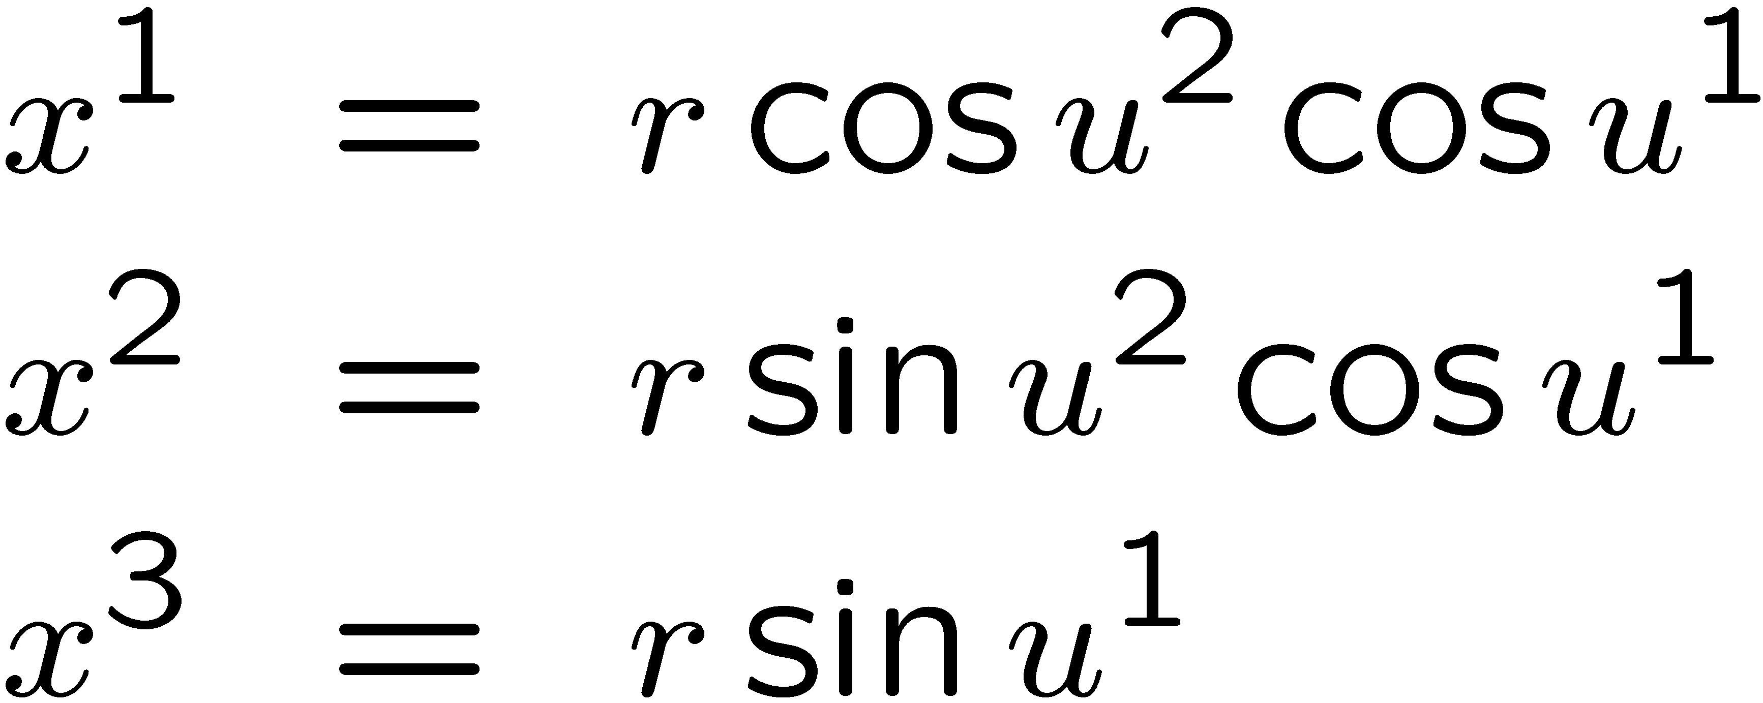
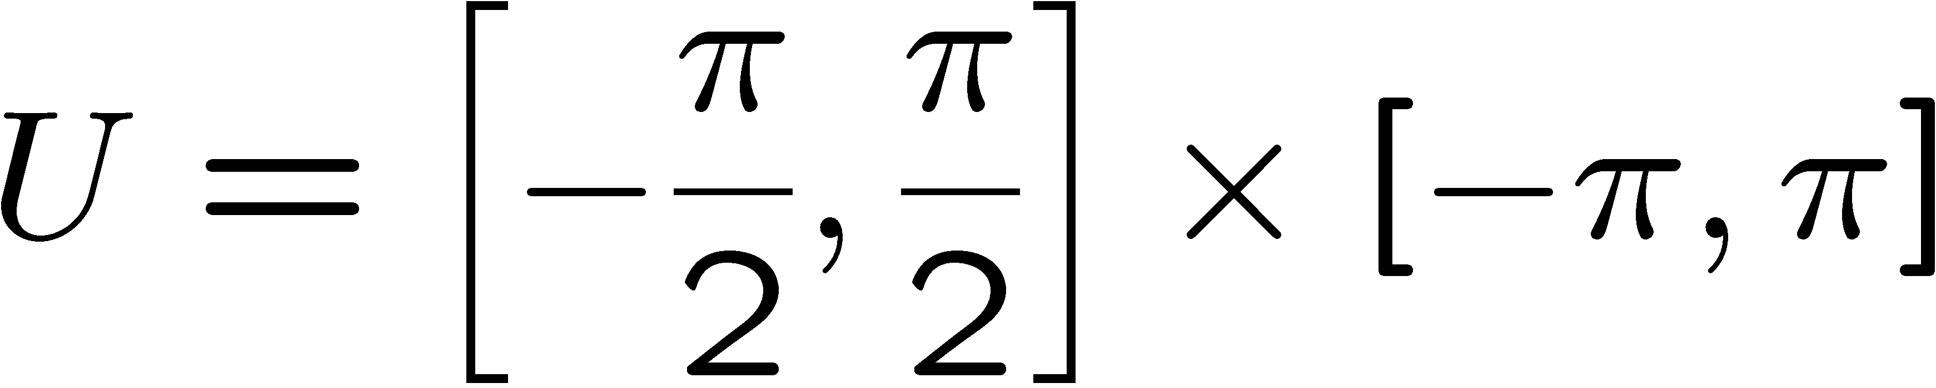
Parametrization of the Earth

Slide 9
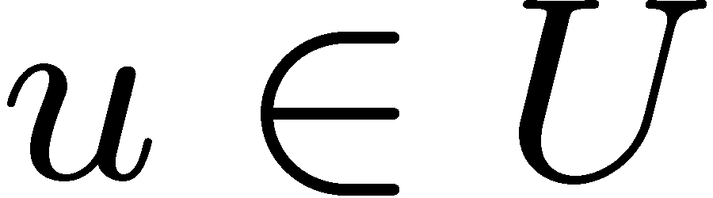

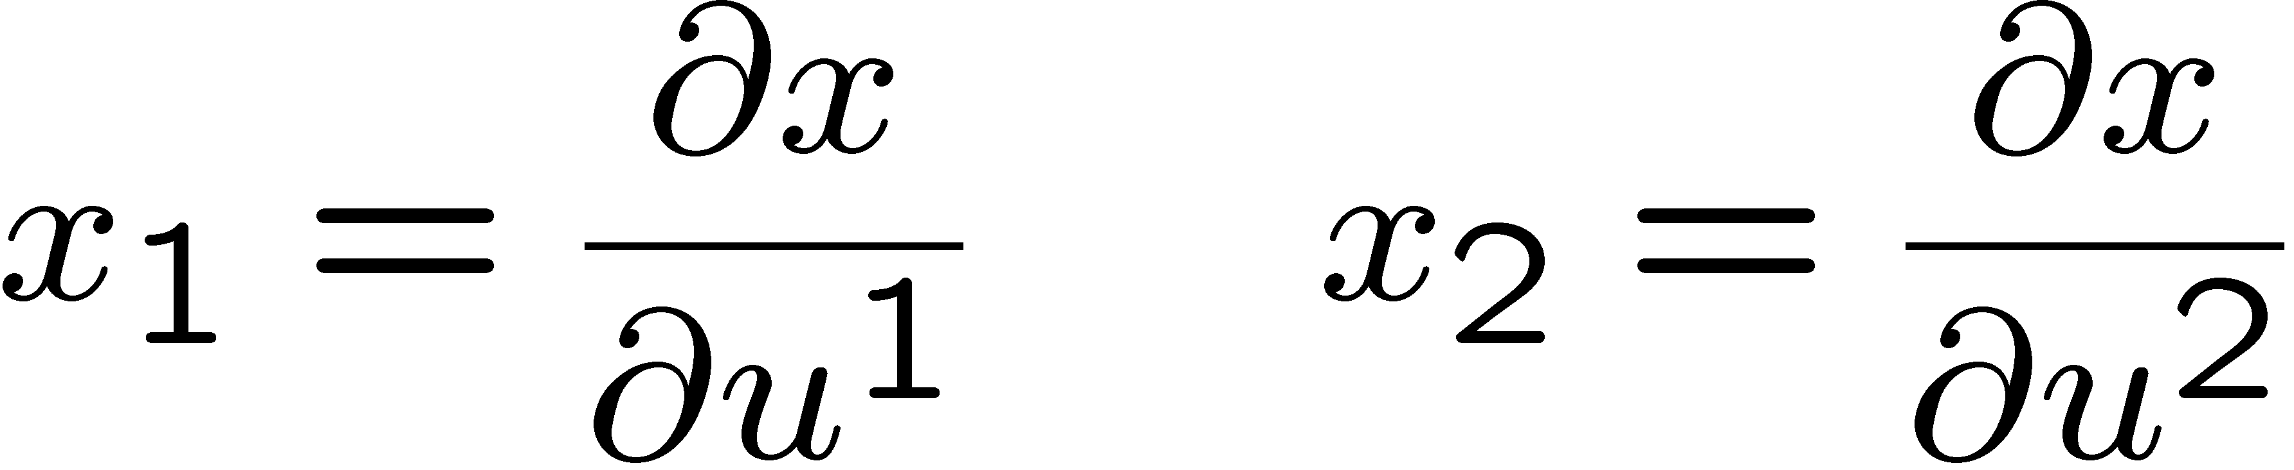

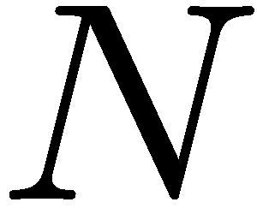
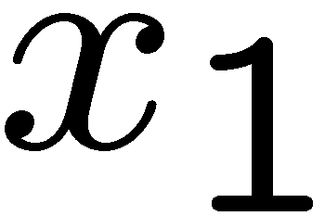
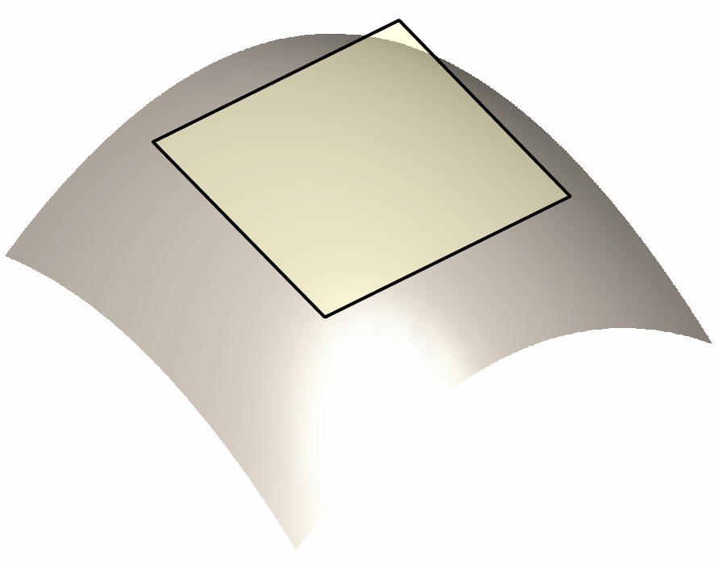
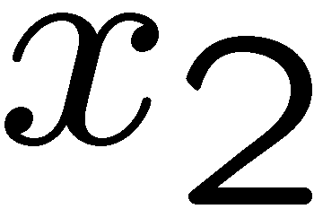
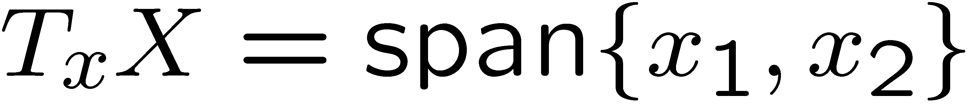
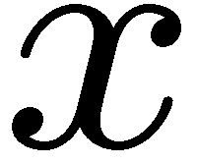
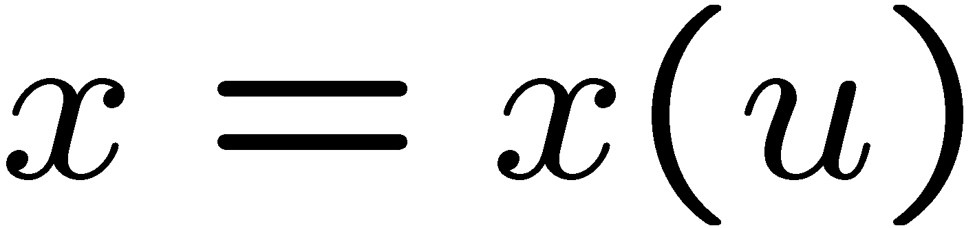
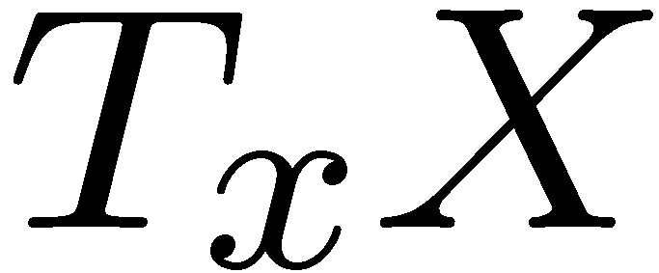
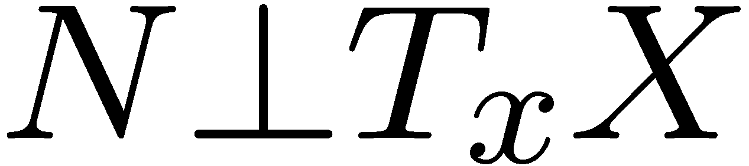
Tangent plane & normal
At each point , we define
local system of coordinates
A parametrization is regular if
and are linearly independent.
The plane
is tangent plane at .
Local Euclidean approximation
of the surface.
is the normal to surface.

Slide 10
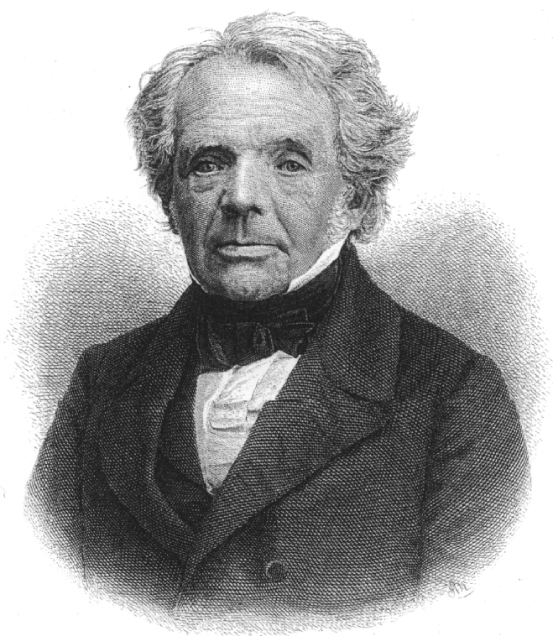
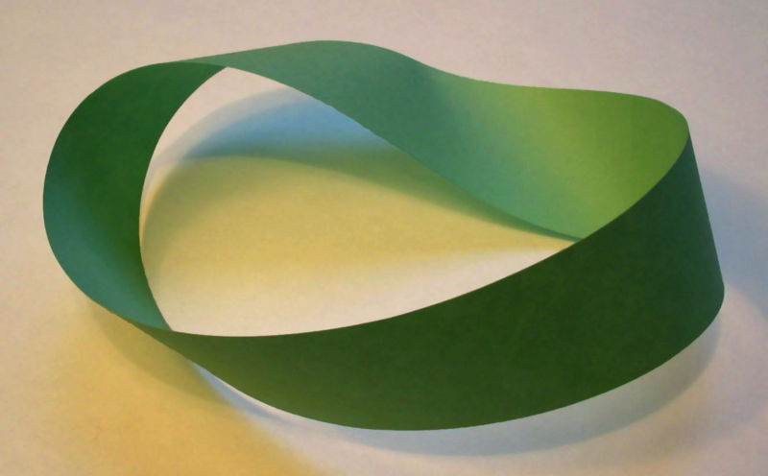
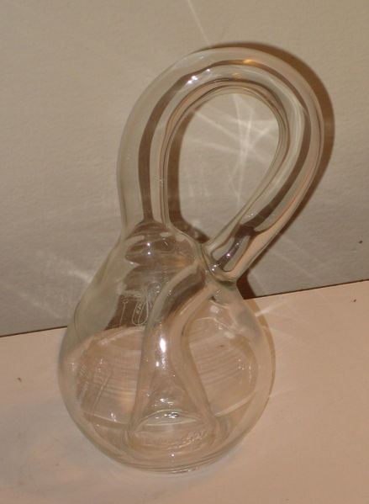
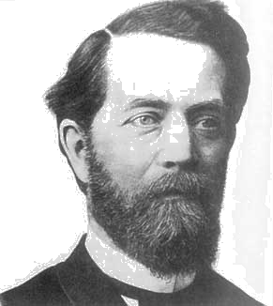
Orientability
Normal is defined up to a sign.
Partitions ambient space into inside
and outside.
A surface is orientable, if normal
depends smoothly on .
Möbius stripe
August Ferdinand Möbius
(1790-1868)
Felix Christian Klein
(1849-1925)
Klein bottle
(3D section)

Slide 11
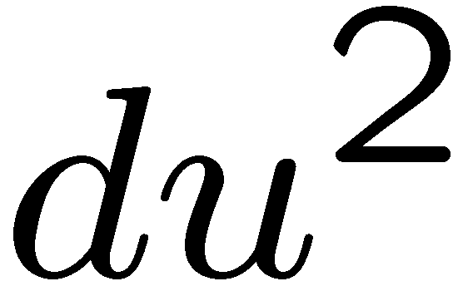
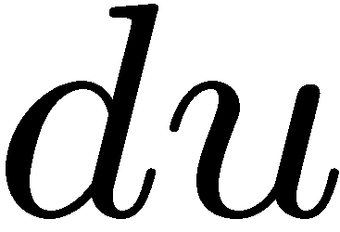
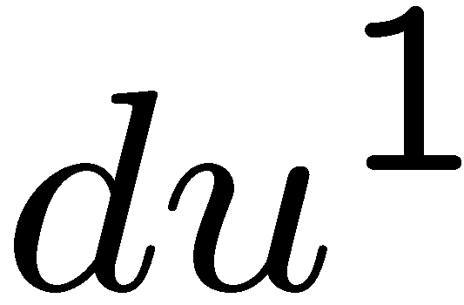
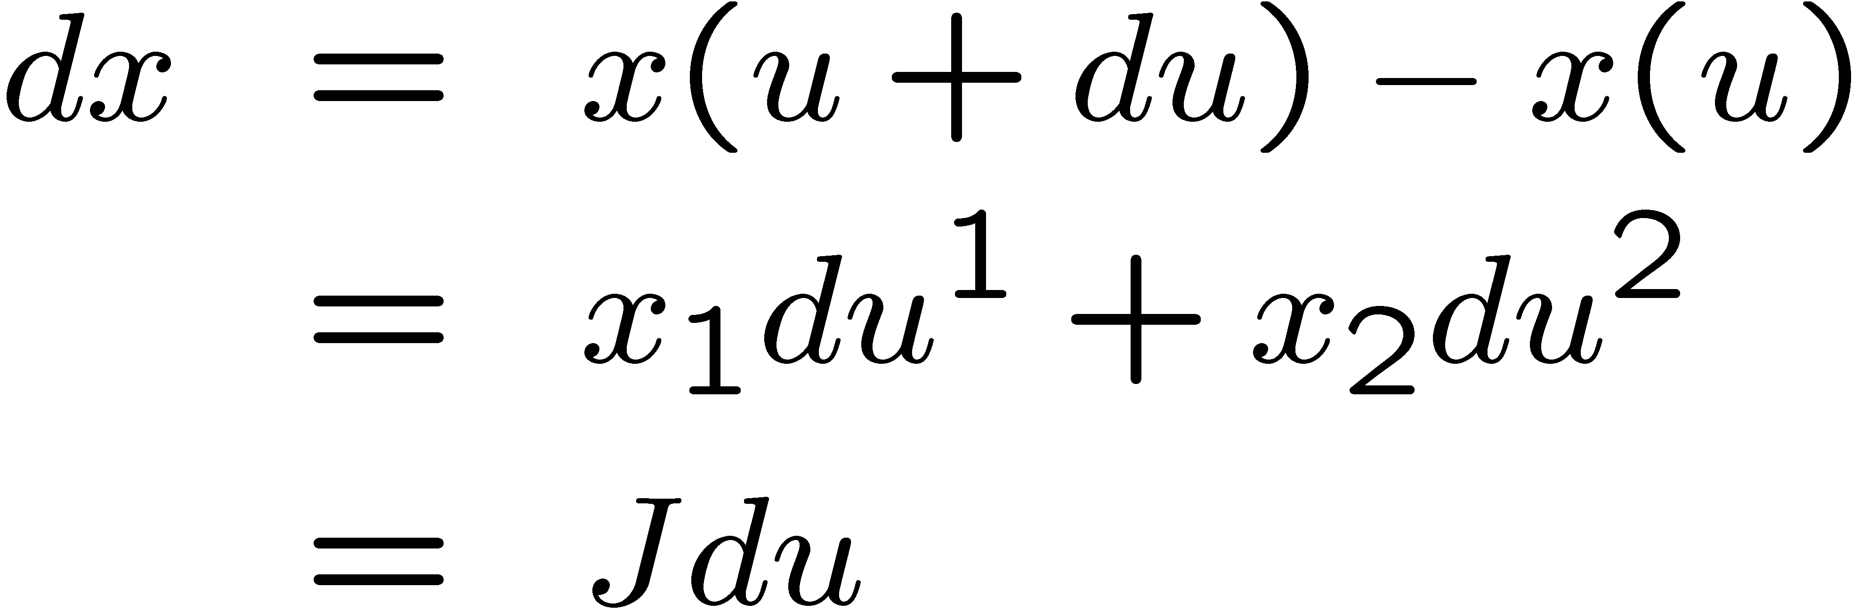
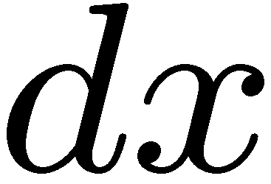
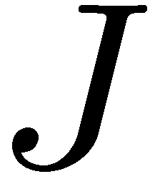
First fundamental form
Infinitesimal displacement on the
chart .
Displaces on the surface
by
is the Jacobain matrix, whose
columns are and .

Slide 12
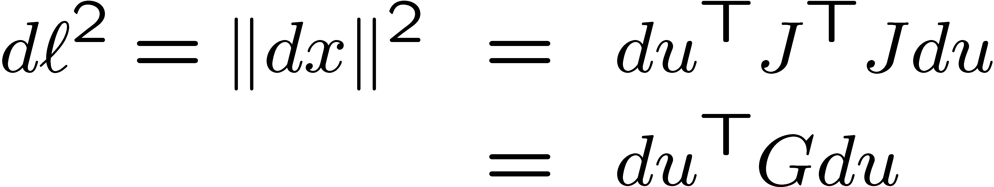

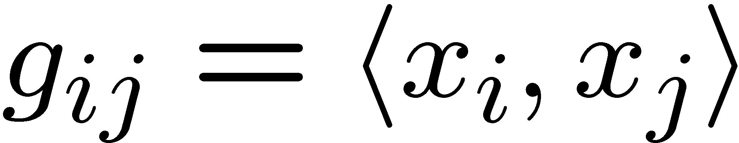
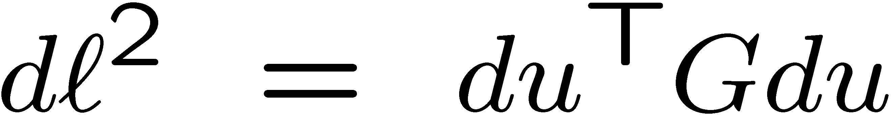
First fundamental form
Length of the displacement
is a symmetric positive
definite 2×2 matrix.
Elements of are inner products
Quadratic form
is the first fundamental form.

Slide 13
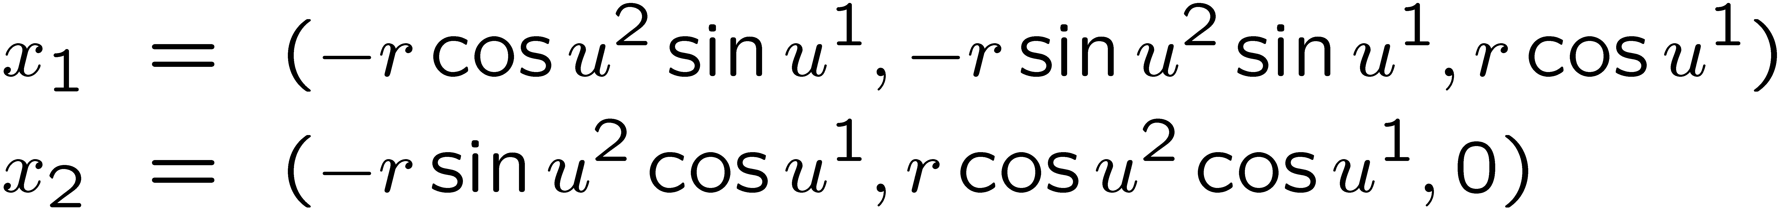

First fundamental form of the Earth
Parametrization
Jacobian
First fundamental form

Slide 14

First fundamental form of the Earth

Slide 15









First fundamental form
Smooth curve on the chart:
Its image on the surface:
Displacement on the curve:
Displacement in the chart:
Length of displacement on the
surface:

Slide 16


Intrinsic geometry
Length of the curve
First fundamental form induces a length metric (intrinsic metric)
Intrinsic geometry of the shape is completely described by the first
fundamental form.
First fundamental form is invariant to isometries.

Slide 17



Area
Differential area element on the
chart: rectangle
Copied by to a parallelogram
in tangent space.
Differential area element on the
surface:

Slide 18






Area
Area or a region charted as
Relative area
Probability of a point on picked at random (with uniform
distribution) to fall into .
Formally
are measures on .

Slide 19









Curvature in a plane
Let be a smooth curve parameterized by arclength
trajectory of a race car driving at constant velocity.
velocity vector (rate of change of position), tangent to path.
acceleration (curvature) vector, perpendicular to path.
curvature, measuring rate of rotation of velocity vector.

Slide 20







Curvature on surface
Now the car drives on terrain .
Trajectory described by .
Curvature vector decomposes into
  geodesic curvature vector.
  normal curvature vector.
Normal curvature
Curves passing in different directions
have different values of .
Said differently:
A point has multiple curvatures!

Slide 21






Principal curvatures
For each direction , a curve
passing through in the
direction may have
a different normal curvature .
Principal curvatures
Principal directions

Slide 22




Curvature
Sign of normal curvature = direction of rotation of normal to surface.
  a step in direction rotates in same direction.
  a step in direction rotates in opposite direction.

Slide 23


Curvature: a different view
A plane has a constant normal vector, e.g. .
We want to quantify how a curved surface is different from a plane.
Rate of change of i.e., how fast the normal rotates.
Directional derivative of at point in the direction
is an arbitrary smooth curve with
and .

Slide 24











Curvature
is a vector in measuring the
change in as we make differential steps
in the direction .
Differentiate w.r.t.
Hence or .
Shape operator (a.k.a. Weingarten map):
is the map defined by
Julius Weingarten
(1836-1910)

Slide 25






Shape operator
Can be expressed in parametrization coordinates as
is a 2×2 matrix satisfying
Multiply by
where

Slide 26


Second fundamental form
The matrix gives rise to the quadratic form
called the second fundamental form.
Related to shape operator and first fundamental form by identity

Slide 27








Principal curvatures encore
Let be a curve on the surface.
Since , .
Differentiate w.r.t. to
is the smallest eigenvalue of .
is the largest eigenvalue of .
are the corresponding eigenvectors.

Slide 28

Second fundamental form of the Earth
Parametrization
Normal
Second fundamental form

Slide 29


Shape operator of the Earth
Second fundamental form
First fundamental form
Shape operator
Constant at every point.
Is there connection between algebraic invariants of shape
operator (trace, determinant) with geometric invariants of the shape?

Slide 30





Mean and Gaussian curvatures
Mean curvature
Gaussian curvature
hyperbolic point
elliptic point

Slide 31


Extrinsic & intrinsic geometry
First fundamental form describes completely the intrinsic geometry.
Second fundamental form describes completely the extrinsic
geometry – the “layout” of the shape in ambient space.
First fundamental form is invariant to isometry.
Second fundamental form is invariant to rigid motion (congruence).
If and are congruent (i.e., ), then
they have identical intrinsic and extrinsic geometries.
Fundamental theorem: a map preserving the first and the second
fundamental forms is a congruence.
Said differently: an isometry preserving second fundamental form is a
restriction of Euclidean isometry.

