Slide 1
Hippocampal segmentation
Carlos Platero (ABE)

Slide 2
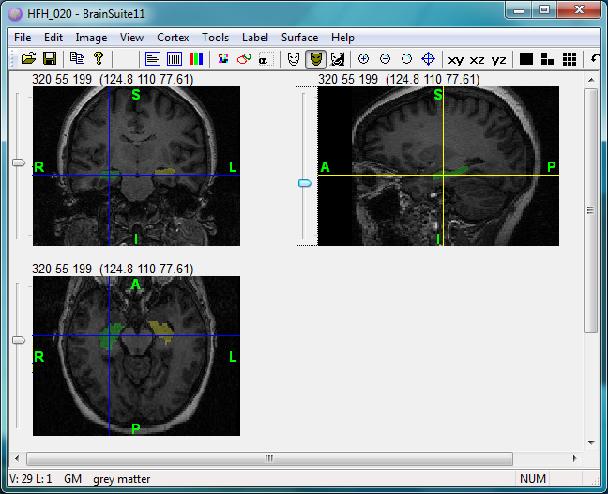
Target image

Slide 3
Target image (coronal)

Slide 4
Target image (sagital)

Slide 5
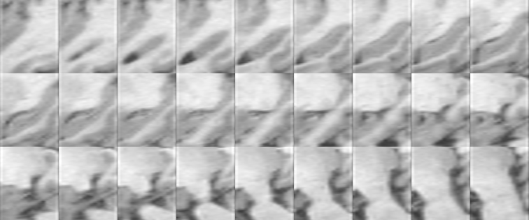
Target image (fusion-ROI)

Slide 6
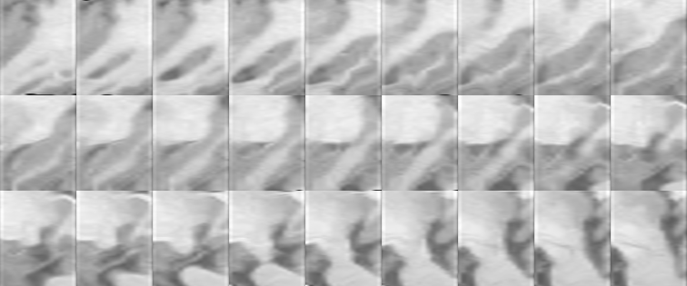
Example: the registration problem
Target nº 1
Registered atlas: 15 -> 1

Slide 7
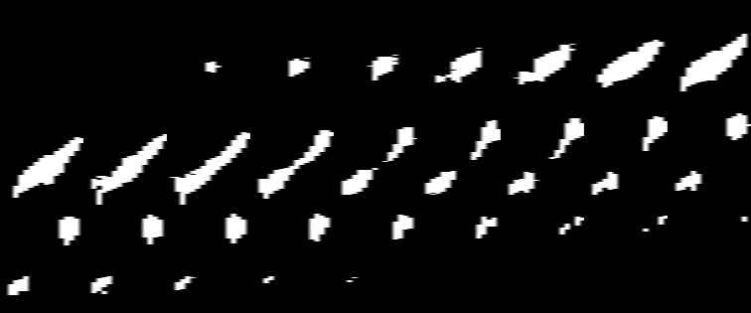
Example: the registration problem
Target nº 1
Registered atlas: 15 -> 1

Slide 8
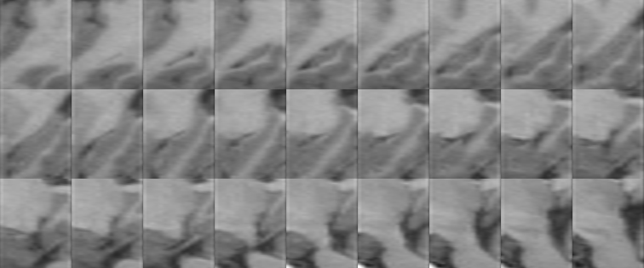
Example: the registration problem
Moving atlas: 15 -> 1
Registered atlas: 15 -> 1

Slide 9
Example
Moving atlas: 15 -> 1
Target nº 1

Slide 10
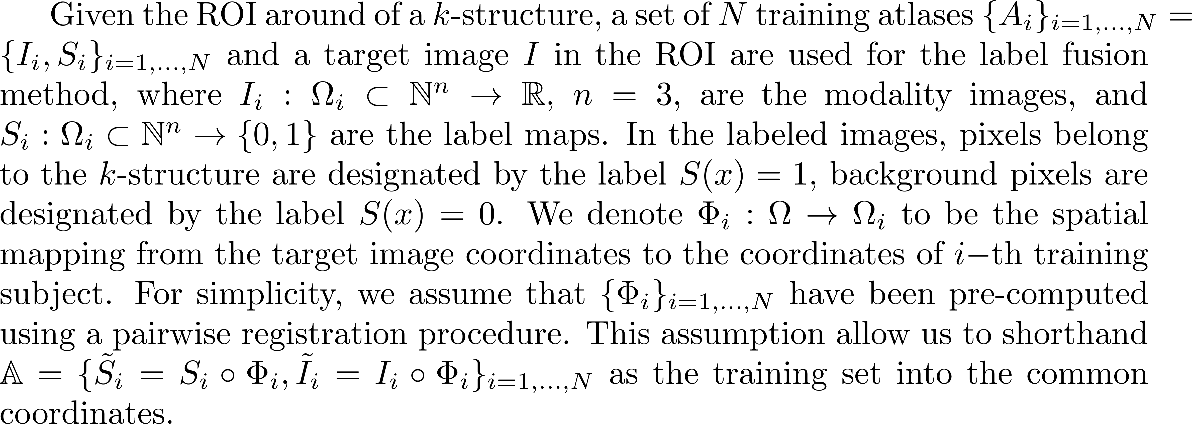
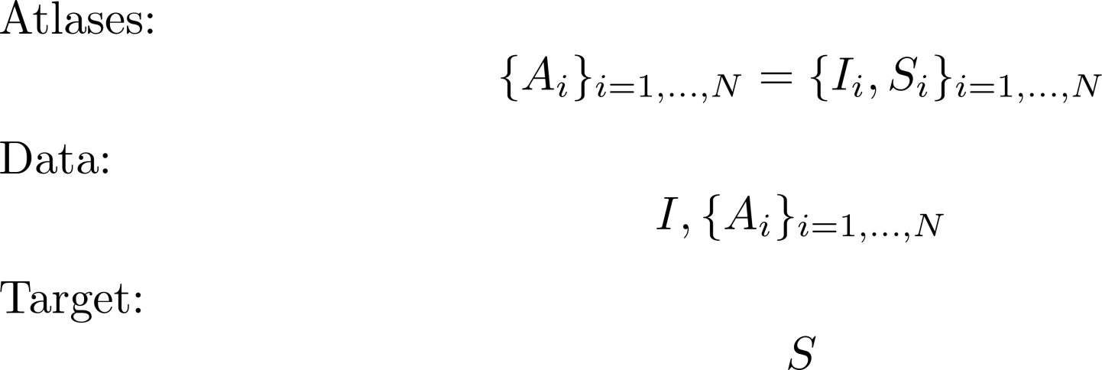
Label fusion method

Slide 11
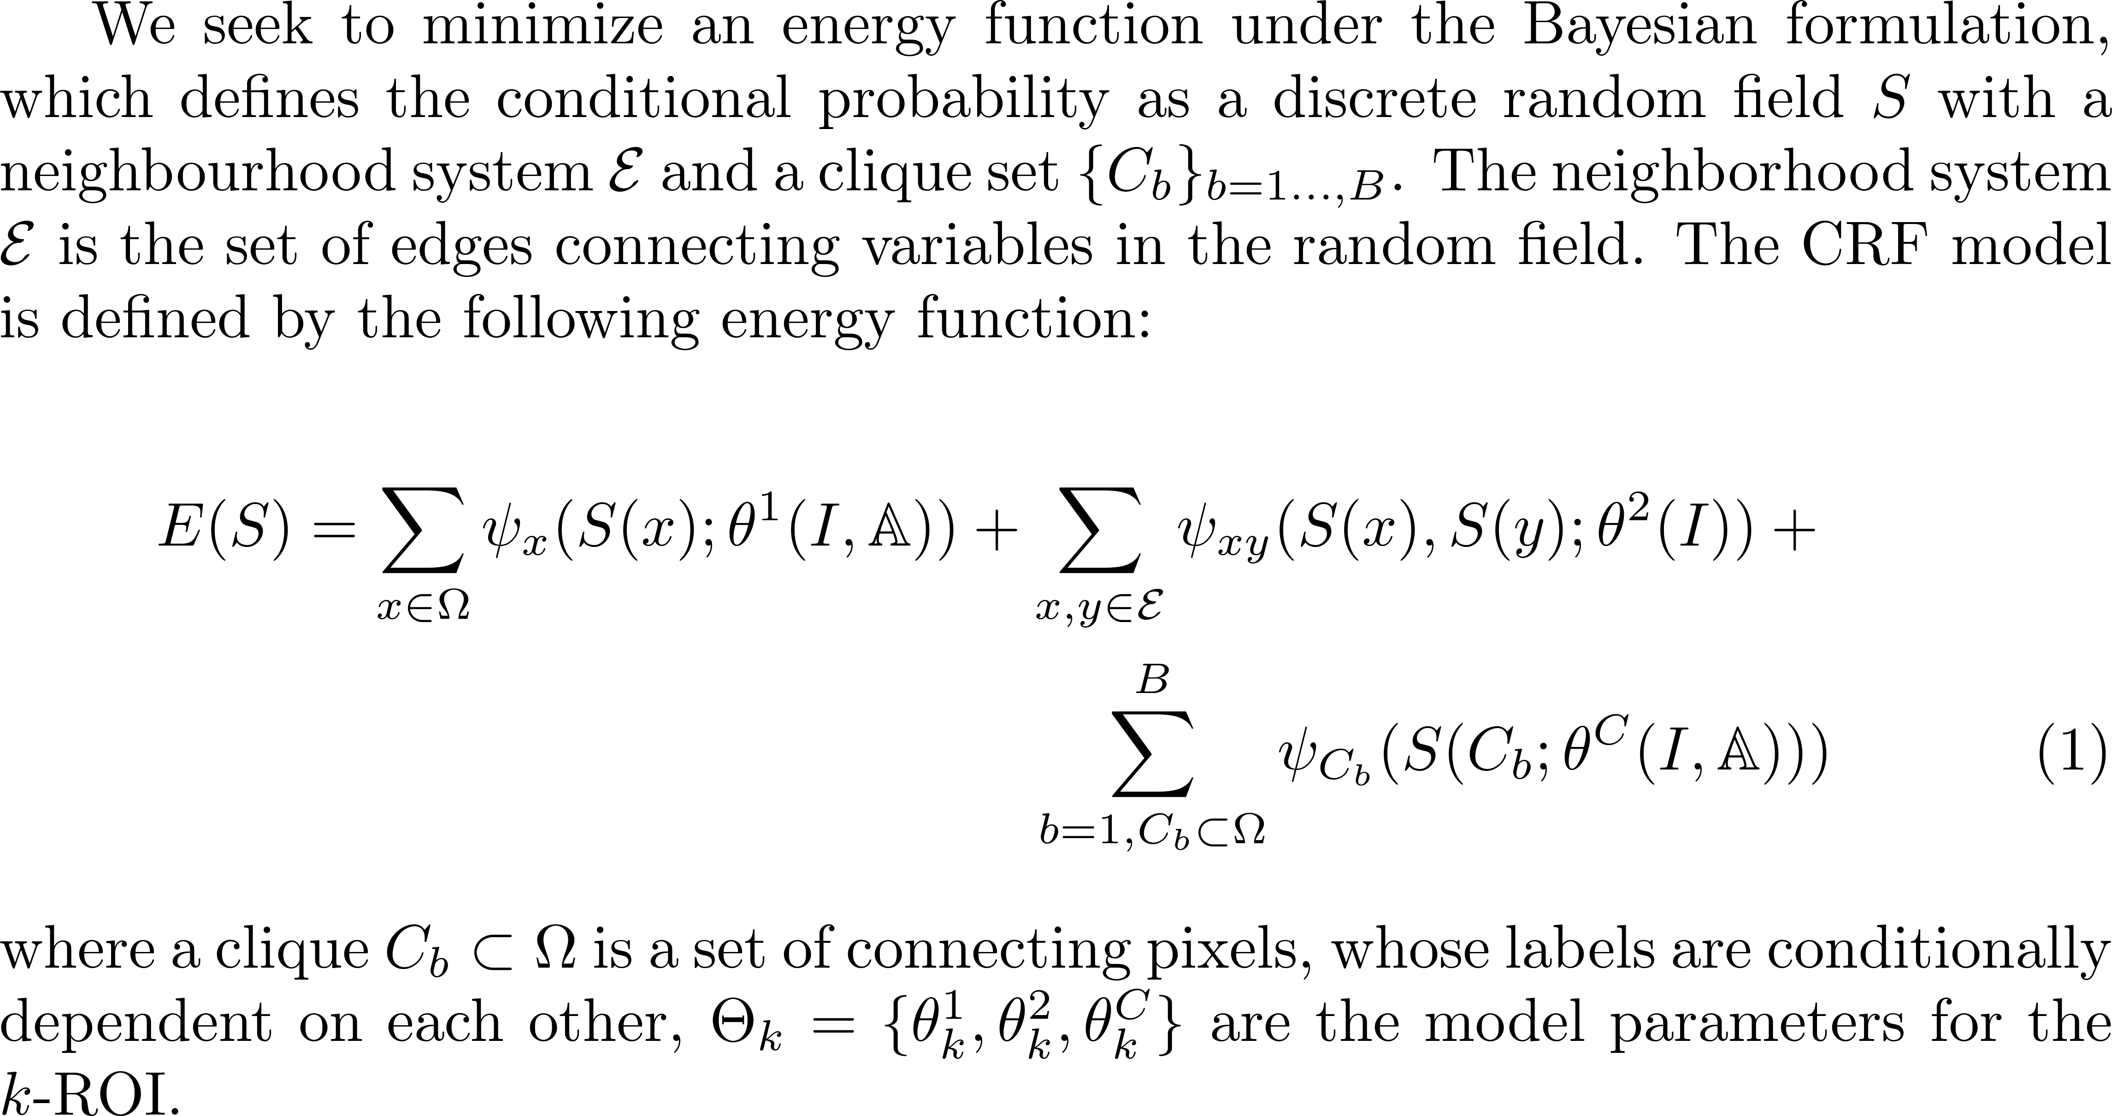
Label fusion method

Slide 12
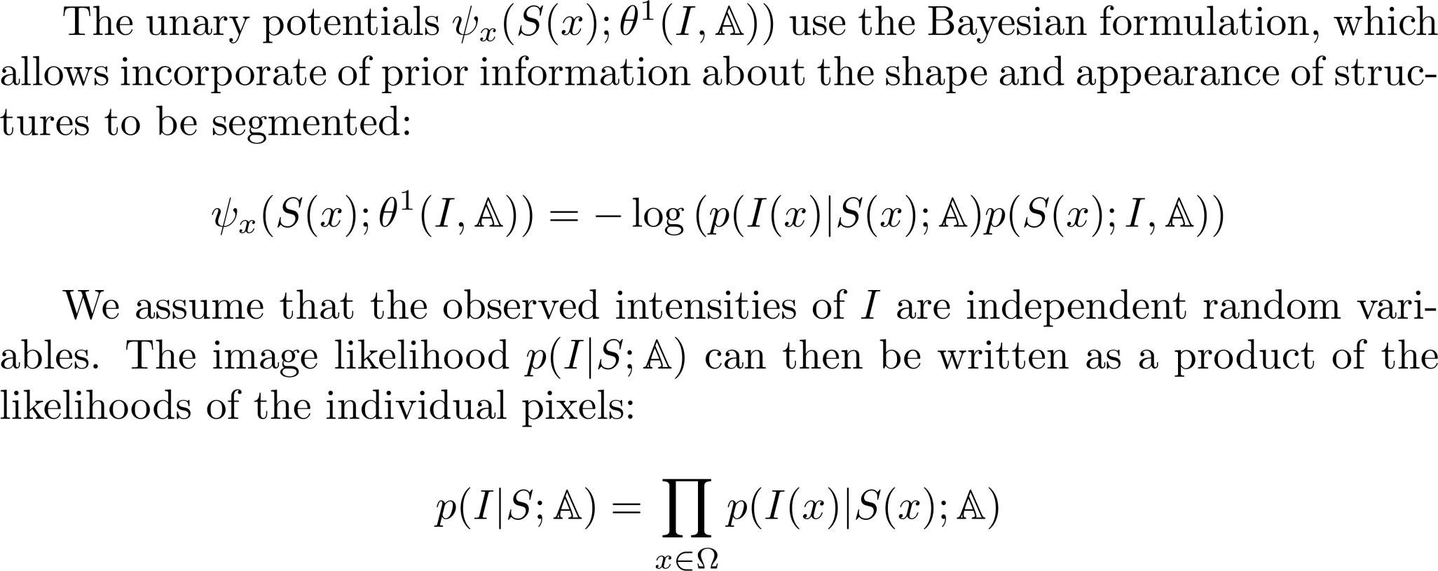
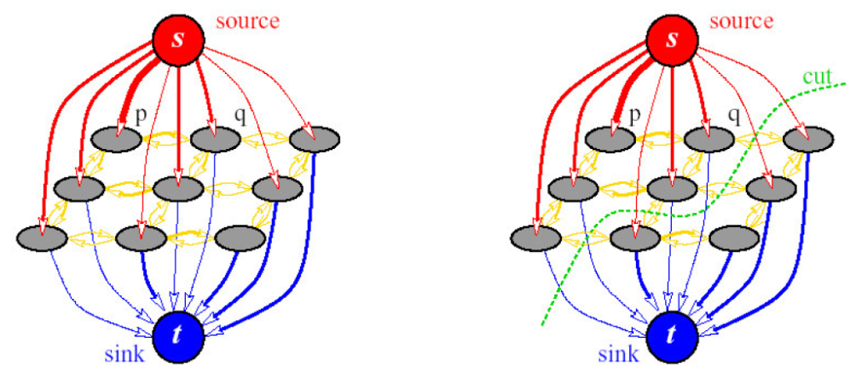
The unary potentials
s
x
t

Slide 13
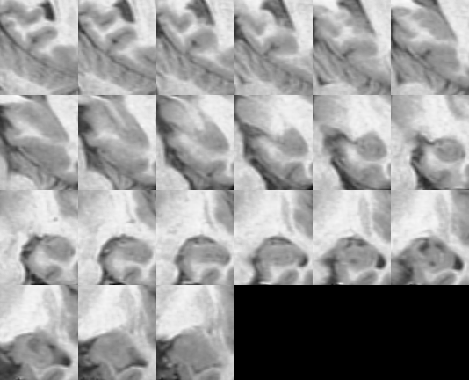
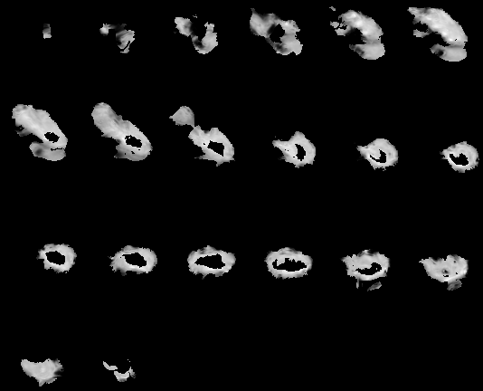
Image and Image likelihood

Slide 14
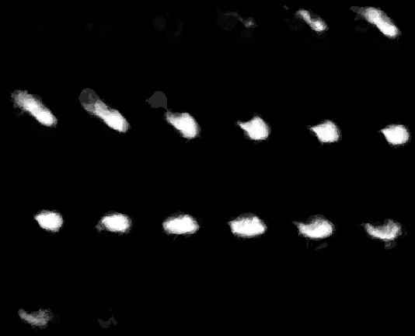
Image and label prior

Slide 15

Label prior & (label prior + image likelihood)

Slide 16
How can we introduce the global shape?

Slide 17
Spatial regularization
A smoothness term is added to the energy function, which is defined from a Finsler metric, into two elements.
The first part minimizes the segmentation surface by a Riemannian metric and the second one takes into account the orientation of the segmentation surface in the metric.

Slide 18
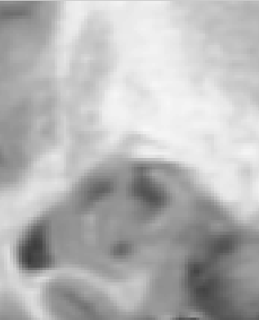
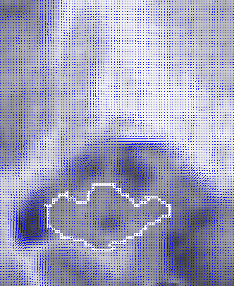
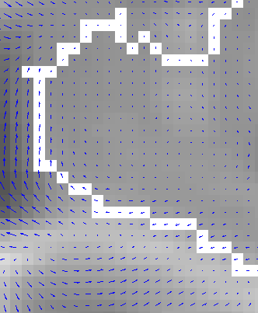
Spatial regularization
A smoothness term is added to the energy function, which is defined from a Finsler metric, into two elements.
The first part minimizes the segmentation surface by a Riemannian metric and the second one takes into account the orientation of the segmentation surface in the metric.

Slide 19
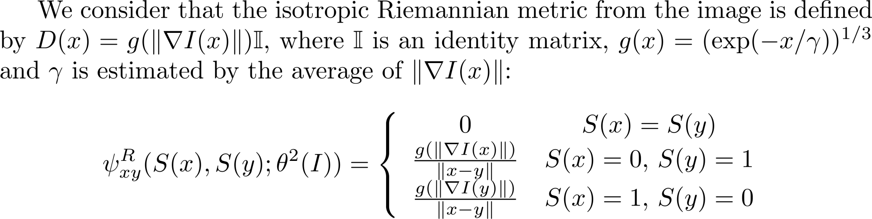


Spatial regularization (Riemannian metric)
s
x
y
t

Slide 20
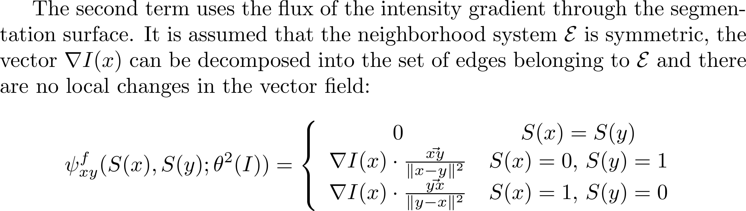







Spatial regularization
s
s
x₋₁
x
X₊₁
x₋₁
x
X₊₁
t
t

Slide 21
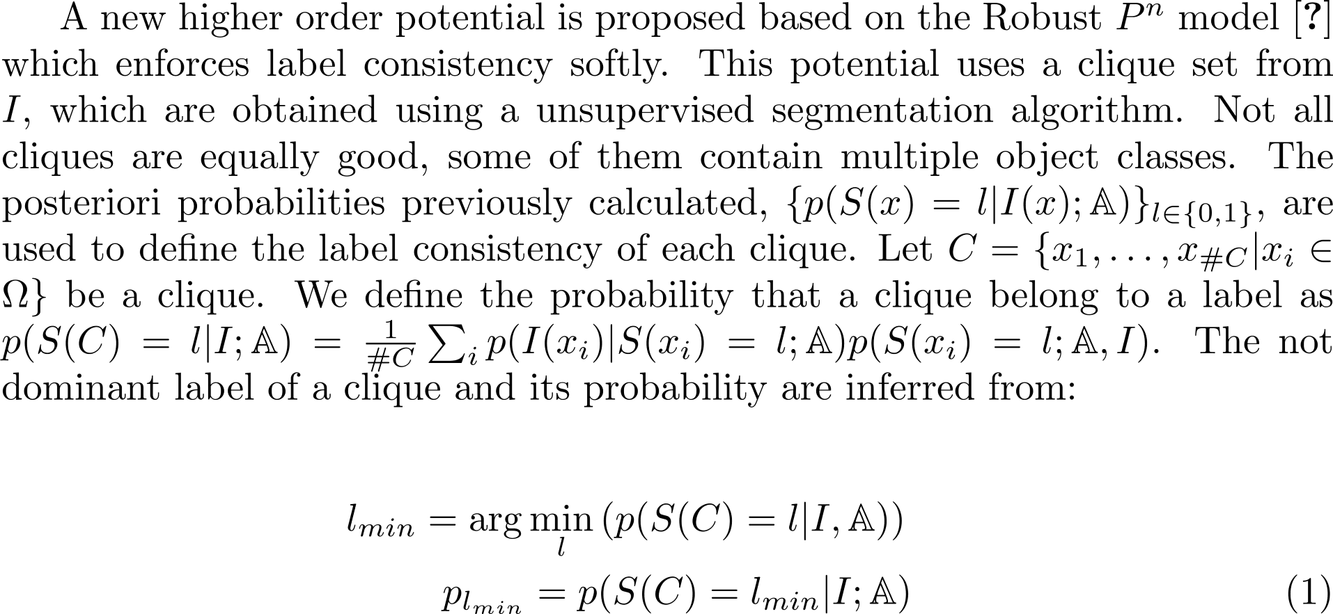
Higher Order Potentials

Slide 22
Example: higher order potentials

Slide 23
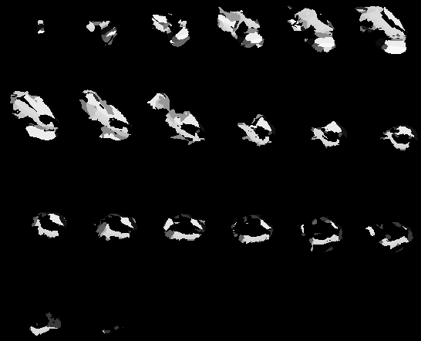
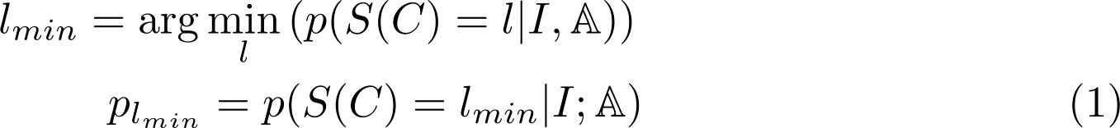
Higher Order Potentials

Slide 24
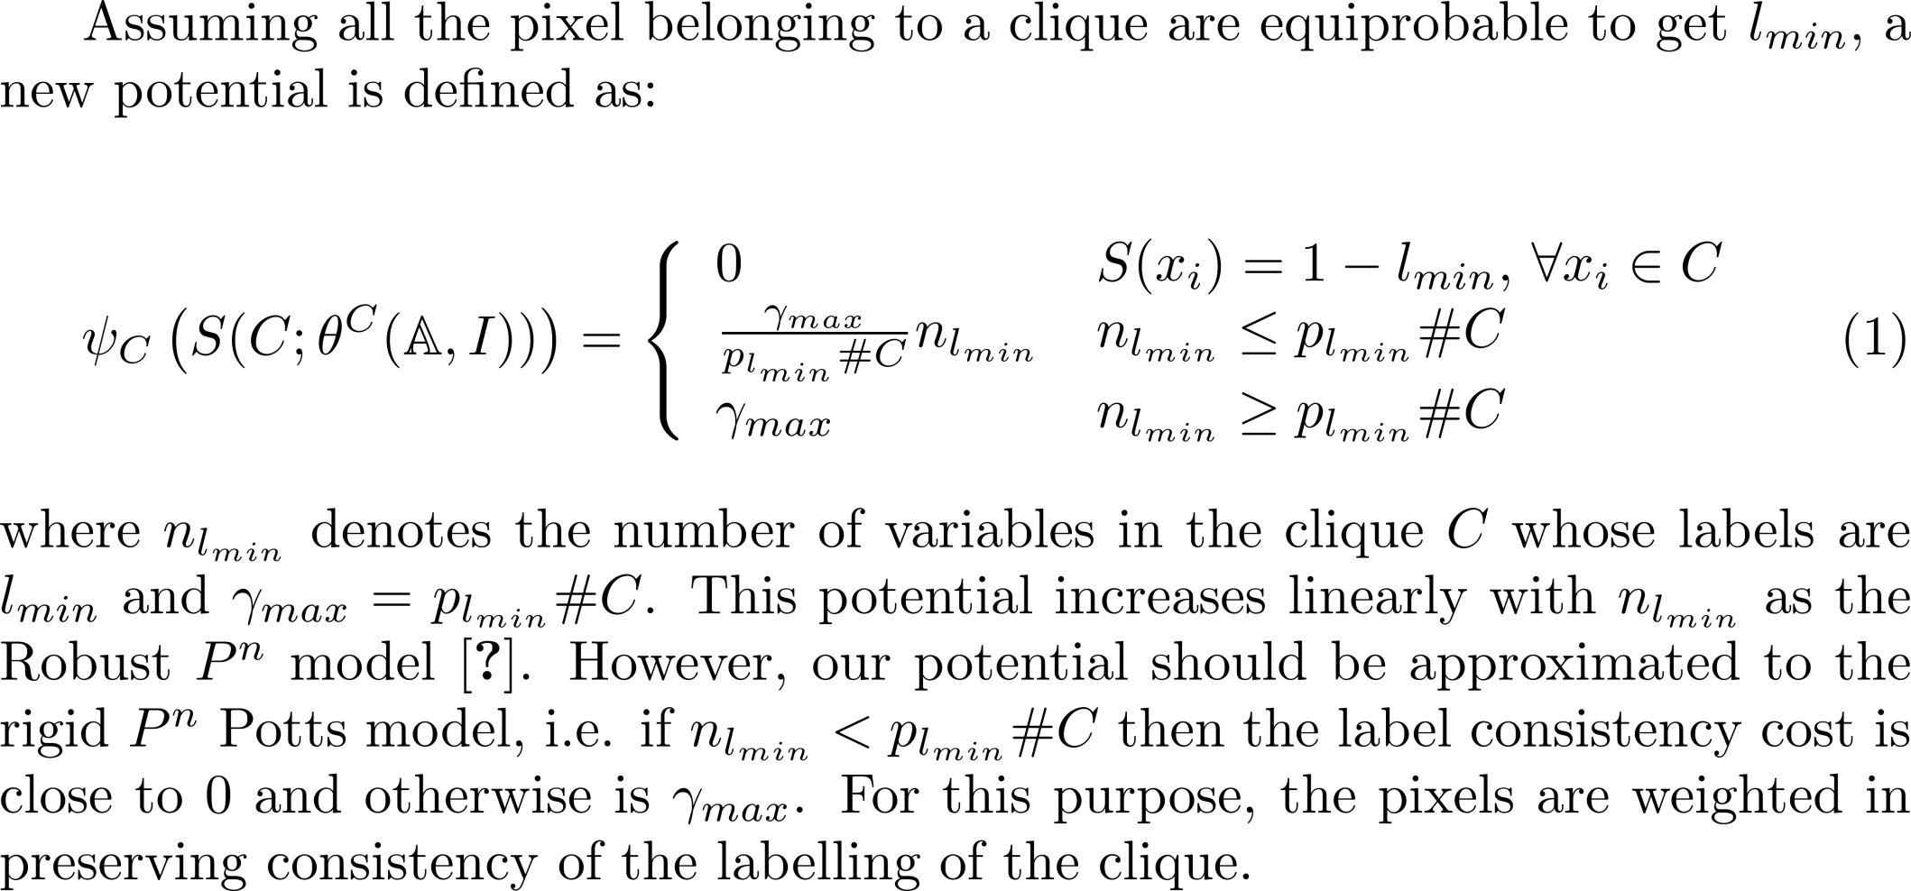
Higher Order Potentials

Slide 25
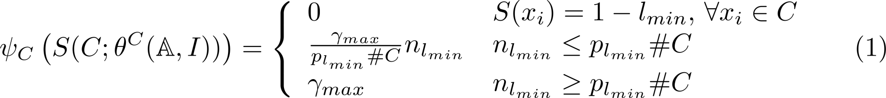

Higher Order Potentials
Robust P^{n}
γ_{max}
Ideal potential
P_{lmin} #C
n_{lmin}

Slide 26

Higher Order Potentials
$$ψ_{C}(S\left(C\right);θ_{C}\left(I,A\right))$$
Robust P^{n}
γ_{max}
Ideal potential
P_{lmin} #C
n_{lmin}

Slide 27
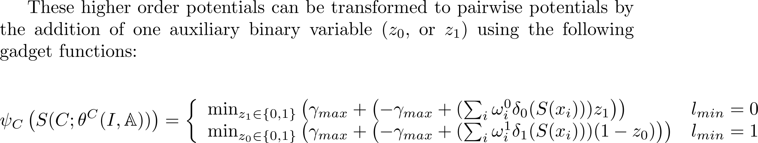







Higher Order Potentials
s
s
z₀
x₁
x₂
…
x_{#C}
x₁
x₂
…
x_{#C}
z₁
t
t

Slide 28
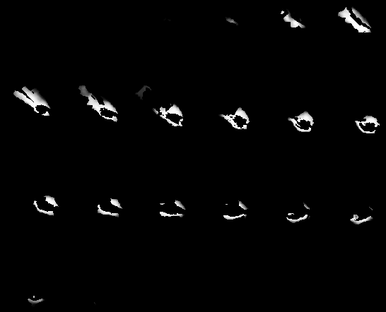
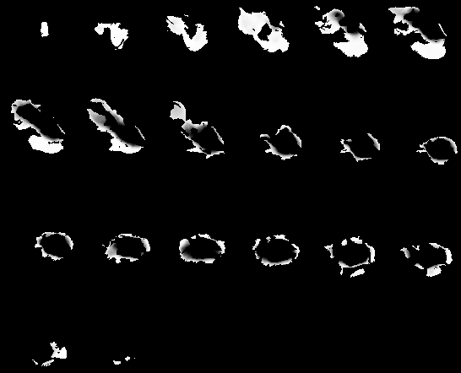
The weights (ω⁰_{i}, ω¹_{i})

Slide 29
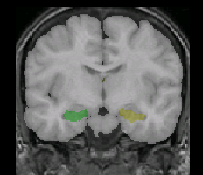
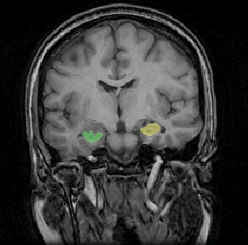
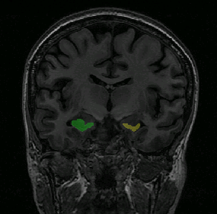
Experiments with Brain MR data
To evaluate the performance and the robustness of the different label fusion methods, we employ two available database of T1-weighted MR images: (i) 18 modified images from the Internet Brain Segmentation Repository (IBSR) and (ii) 50 images of epileptic patients and nonepileptic subjects with hippocampal outlines (HFH)

Slide 30
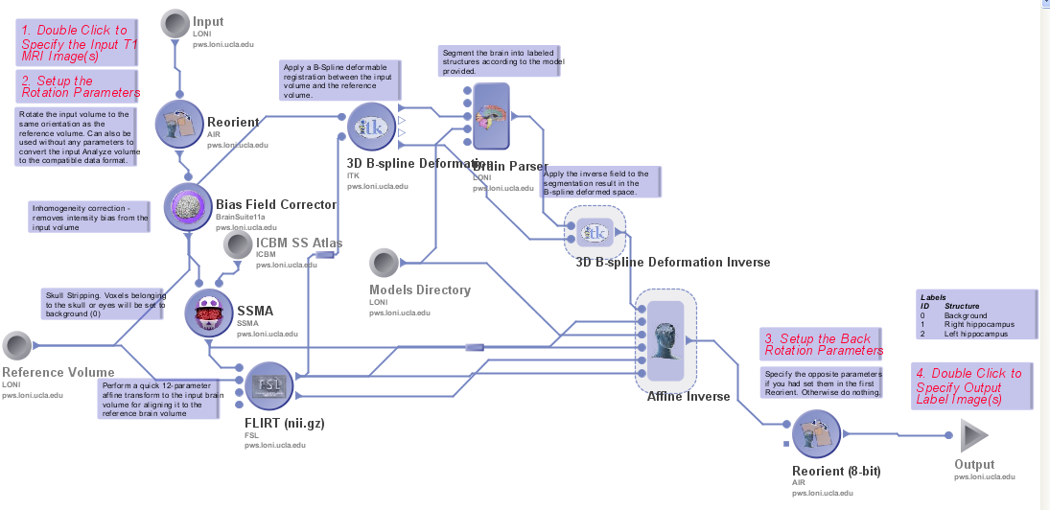
Workflow

Slide 31
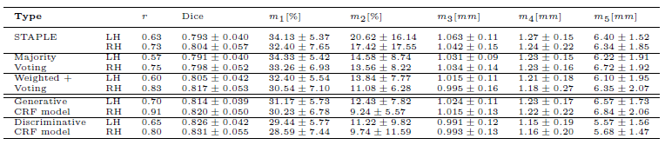
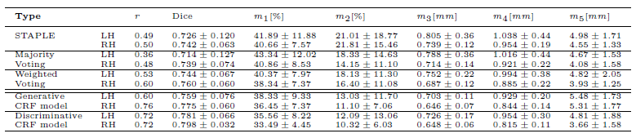
Medidas de calidad de la segmentación (1)
IBSR
HFH

Slide 32
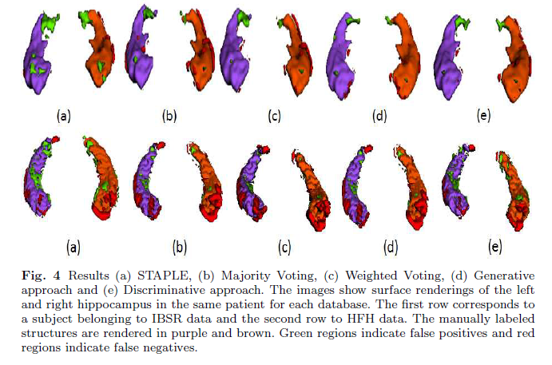
Medidas de calidad de la segmentación (2)

