Slide 1
What Energy Functions Can be Minimized Using
Graph Cuts?
Shai Bagon
Advanced Topics in Computer Vision
June 2010
Notes:
What do you make out of this title?? NOTHING!
So, Let’s start with a little example…

Slide 2



What is an Energy Function?
Image Segmentation:
For a given problem:
Useful Energy function:
Good solution → Low energy
Tractable → Can be minimized
suggested solution
E
a number
-20
237
Notes:
What we are going to do in this lecture is to peek inside this “black box” and ask:
“What kind of energy functions we can work with:
that have strong expressive poser
AND can be minimized”
We will explore in this talk FAMILIES of functions;
looking into their expressive power AND how to deal with them, i.e. how to minimize them

Slide 3



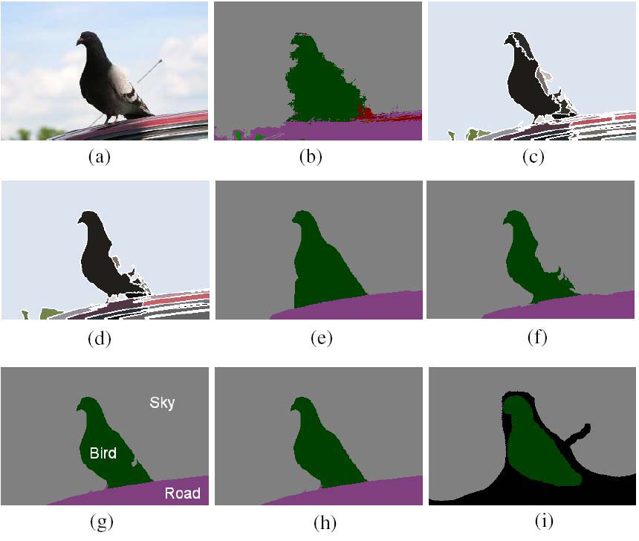
Families of Functions or Outline
F² submodular
Non submodular
F³
Beyond F³

Slide 4
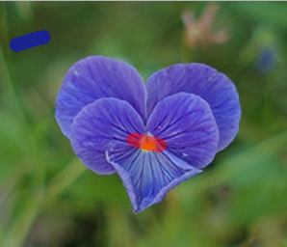
Foreground Selection
Let
  y_{i} – color of i^{th} pixel
  x_{i} ϵ {0,1} BG/FG labels (variables)
Given BG/FG scribbles:
  Pr(x_{i}|y_{i})=How likely each pixel to be FG/BG
  Pr(x_{m}|x_{n})=Adjacent pixels should have same label
F² energy:
E(x)=∑_{i}E_{i}(x_{i})+∑_{ij}E_{ij}(x_{i},x_{j})
y_{i}
x_{i}
x_{m}
x_{n}
Notes:
Making independent decision for each pixel does not get us too far …
We need stronger machinery → MRF!!!

Slide 5
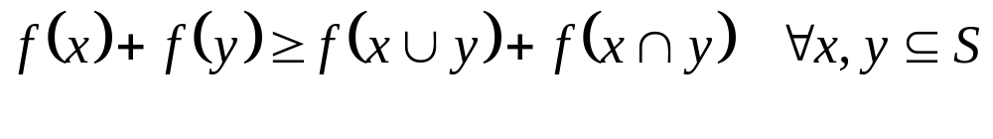
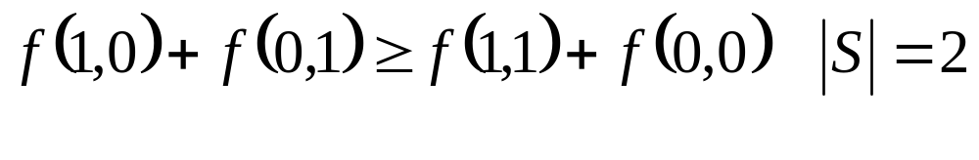
Submodular
Known concept from set-functions:
E(x) = ∑_{i} E_{i}(x_{i}) + ∑_{ij} E_{ij} (x_{i}, x_{j}), x_{i} ϵ {0,1}
What does it mean?
x_{j}
x_{i}
0
1
E_{ij}(x_{i},x_{j}):
0
A
B
B+C-A-D ≥ 0
1
C
D

Slide 6

F² submodular
How to
Minimize?
E(x) = ∑_{i} E_{i}(x_{i}) + ∑_{ij} E_{ij} (x_{i}, x_{j}), x_{i} ϵ {0,1}
Local “beliefs”:
Data term
Prior knowledge:
Smoothness term
Notes:
Discrete minimization techniques:
Belief propagation → Loopy belief propagation, more recent works Tree-Reweighed belief propagation – iterative algorithms for MAP estimation,
We want “single snap” solution!

Slide 7
Graph Partitioning
V
A weighted graph G=( V E w )
Special Nodes: s t
s-t cut:
Cost of a cut:
Nice property: 1:1 mapping
s-t cut ↔ {0,1}^{|V|-2}
E
w
s
S
⊂
V
,
T
⊂
V
,
s
∈
S
,
t
∈
T
S
∩
T
=
φ
,
S
∪
T
=
V
w_{ij}
t
=
∑
Cut
(
S
,
T
)
w_{ij}
i
∈
S
,
j
∈
T
Notes:
xi \in T ⬄ xi = 0
xi \in S ⬄ xi = 1

Slide 8
Graph Partitioning - Energy
Graph Partitioning
D-C
C-A
E(x) = ∑_{i} E_{i}(x_{i}) + ∑_{ij} E_{ij} (x_{i}, x_{j})
s
E_{j}(1)
B+C-A-D
i
j
E_{ij}(x_{i},x_{j})
E_{i}(0)
t
x_{j}
x_{i}
0
1
0
A
B
0
0
0
D-C
0
B+C-A-D
= A +
+
+
1
C
D
C-A
C-A
0
D-C
0
0
Notes:
Suppose Eij(0,0)=Eij(1,1) for all ij
xi \in T ⬄ xi = 0
xi \in S ⬄ xi = 1
The MOST IMPORTANT PART:
cut partition = labeling
Cut weight = energy of labeling
Take a look at the slide (top down):
Energy → Graph → partition=assignment → cut weight = energy of assignment
This is the key point of this lecture!!!!
State the obvious => MAP assignment <-> min-cut/max-flow in poly time!

Slide 9
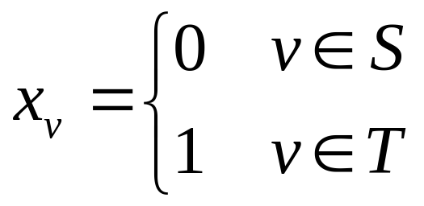
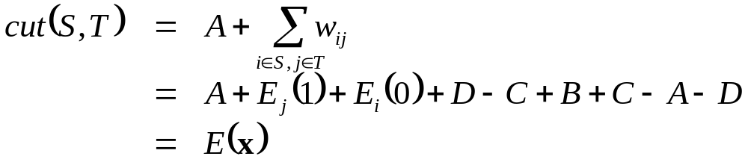
Graph Partitioning - Energy
Graph Partitioning
D-C
C-A
E(x) = ∑_{i} E_{i}(x_{i}) + ∑_{ij} E_{ij} (x_{i}, x_{j})
s
E_{j}(1)
st cut ⬄ binary assignment
cut cost ⬄ energy of assignment
min cut ⬄ Energy min.
B+C-A-D
i
j
E_{i}(0)
t
B=E_{ij}(0,1)
Notes:
Suppose Eij(0,0)=Eij(1,1) for all ij
xi \in T ⬄ xi = 0
xi \in S ⬄ xi = 1
The MOST IMPORTANT PART:
cut partition = labeling
Cut weight = energy of labeling
Take a look at the slide (top down):
Energy → Graph → partition=assignment → cut weight = energy of assignment
This is the key point of this lecture!!!!
State the obvious => MAP assignment <-> min-cut/max-flow in poly time!

Slide 10
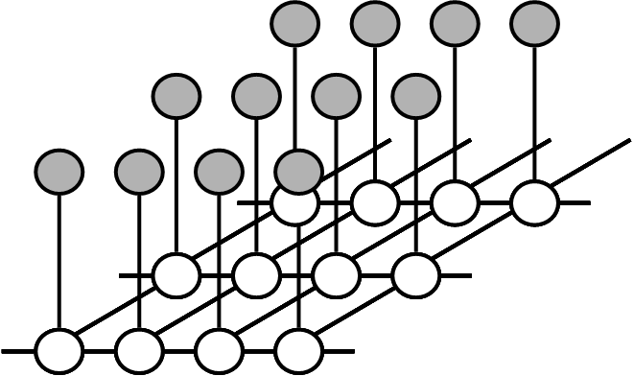
Recap
F² submodular:
E(x) = ∑_{i} E_{i}(x_{i}) + ∑_{ij} E_{ij} (x_{i}, x_{j})
E_{ij}(1,0)+E_{ij}(0,1)≥E_{ij}(0,0)+E_{ij}(1,1)
Mapping from energy to graph partition
Min Energy = computing min-cut
Global optimum in poly time
for submodular functions!

Slide 11

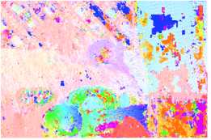


Next…
Multi-label F²
  E(x)=∑_{i} E_{i}(x_{i}) + ∑_{ij} E_{ij}(x_{i},x_{j}) s.t. x_{i} ϵ {1,…,L}
  Fusion moves: solving binary sub-problems
  Applications to stereo, stitching, segmentation…
Solve Binary problem: x_{i}=0 x_{i}=1
●
=
Current
labeling
suggested
labeling
Fusion
“Alpha expansion”

Slide 12
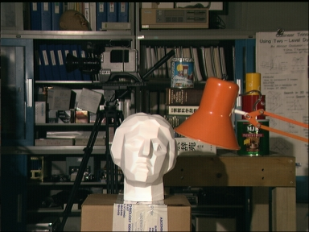
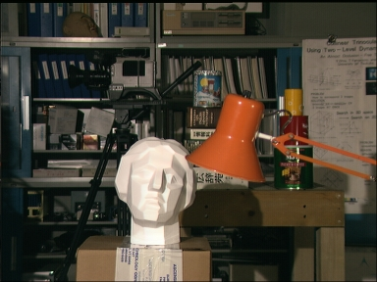


Stereo matching
see http://vision.middlebury.edu/stereo/
Input:
Pairwise MRF
[Boykov et al. ‘01]
Ground truth
slide by Carsten Rother, ICCV’09

Slide 13
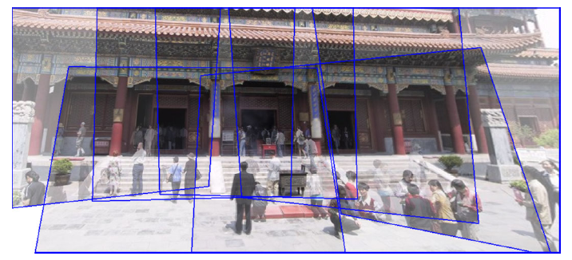
Panoramic stitching
slide by Carsten Rother, ICCV’09

Slide 14

Panoramic stitching
slide by Pushmeet Kohli, ICCV’09

Slide 15

AutoCollage
[Rother et. al. Siggraph ‘05 ]
http://research.microsoft.com/en-us/um/cambridge/projects/autocollage/

Slide 16
Next…
Multi-label F²
  E(x)=∑_{i} E_{i}(x_{i}) + ∑_{ij} E_{ij}(x_{i},x_{j}) s.t. x_{i} ϵ {1,…,L}
  Fusion moves: solving binary sub-problems
  Applications to stereo, stitching, segmentation…
Non-submodular
Beyond pair-wise interactions: F³
Notes:
If I were to give this talk 5 years ago…

Slide 17
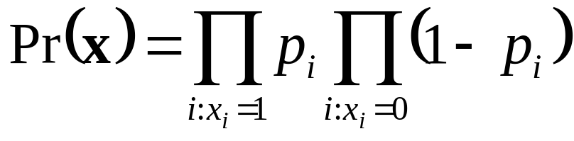
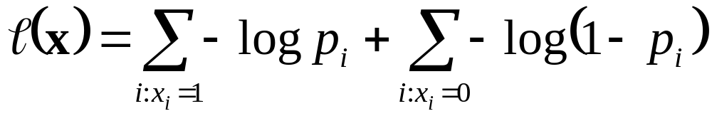
Merging Regions
input image
regions (Ncuts)
“edge” prob.
j
i
p_{i}
“weak” edge
p_{i} – prob. of boundary being edge
GOAL: Find labeling x_{i}ϵ{0,1} that max:
min:
“strong” edge
Taking -log

Slide 18
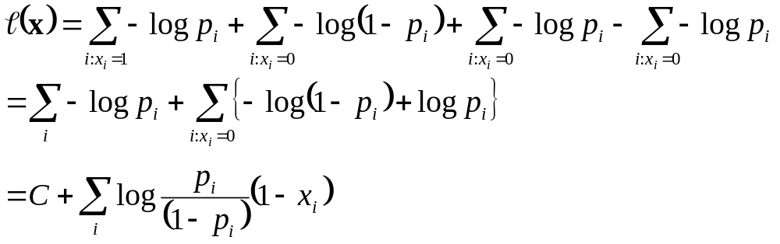
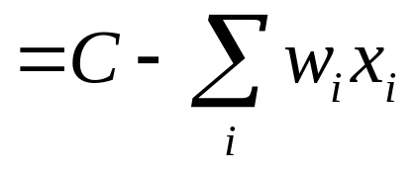
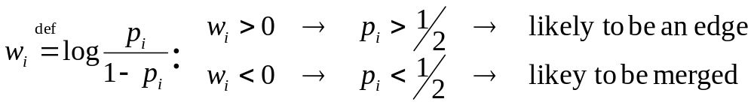
Merging Regions
Adding and subtracting the same number

Slide 19
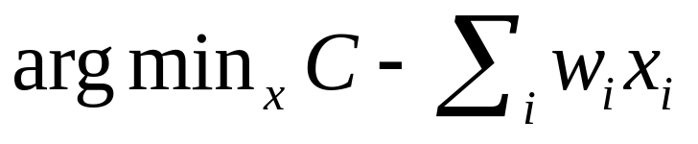
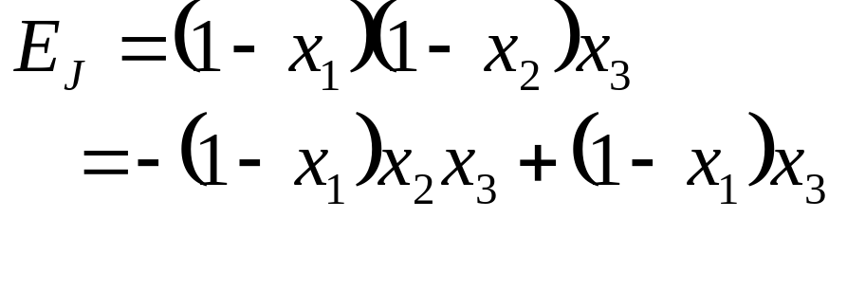
Merging Regions
Solving for edges:
Consistency constraints:
No “dangling” edge
J
x₁
x₂
x₃
E_{J}
x_{i}
0
0
0
0
w_{i}
1
1
1
0
No longer
pair-wise:
F³
0
1
1
0
0
0
1
λ

Slide 20
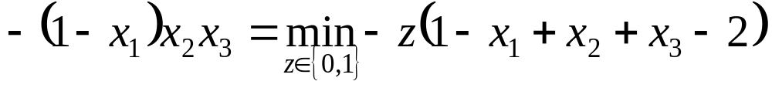
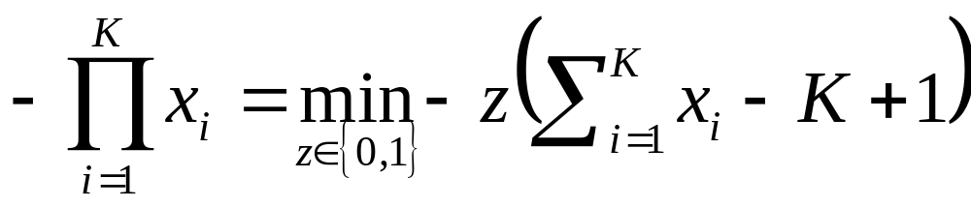
Minimization trick
Freedman D., Turek MW, Graph cuts with many pixel interactions:
theory and applications to shape modeling. Image Vision Computing 2010

Slide 21
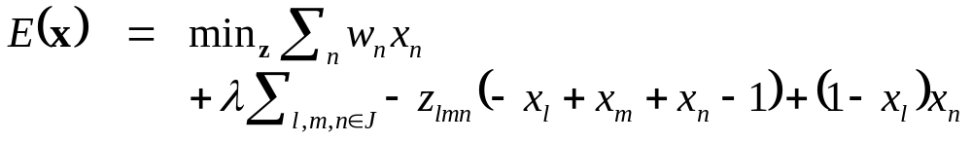
Merging Regions
The resulting energy:
+ Pair-wise
- Non submodular!

Slide 22
Quadratic Pseudo-Boolean Optimization
s
i
j
t
i
j
Kolmogorov V., Carsten R., Minimizing non-submodular functions with graph cuts – a review.
PAMI’07

Slide 23
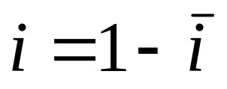
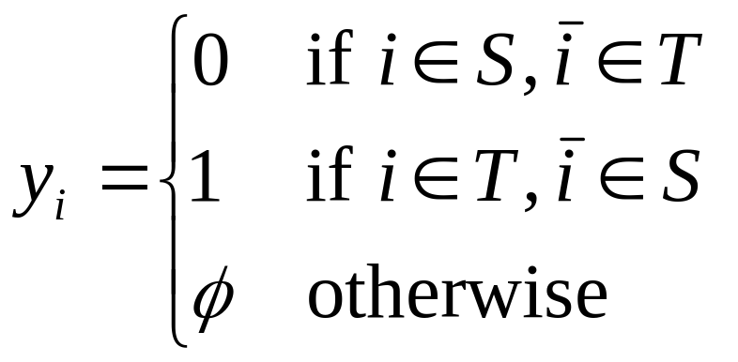
Quadratic Pseudo-Boolean Optimization
+ All edges with positive capacities
- No constraint
Labeling rule:
partial labeling
s
i
j
i
j
t

Slide 24
Quadratic Pseudo-Boolean Optimization
Properties of partial labeling y:
1. Let z=FUSE(y,x) →
E(z)≤E(x)
2. y is subset of optimal y*
y is complete:
1. E submodular
2. Exists flipping
(inference in trees)
s
i
j
i
j
t

Slide 25
QBPO - Probing
QPBO:
0 | ? | ? | ? | ? | ?
p
q
r
s
t
Probe Node p:
0 |  | 0 | 0 | ? | ?
0
1
0 |  | 0 | 1 | 0 | ?
p
q
r
s
t
p
q
r
s
t
What can we say about variables?
r -> is always 0
s -> is always equal to q
t -> is 0 when q = 1
slide by Pushmeet Kohli, ICCV’09

Slide 26
QBPO - Probing
Probe nodes in an order until energy unchanged
Simplified energy preserves global optimality and (sometimes) gives the global minimum
slide by Pushmeet Kohli, ICCV’09

Slide 27
Merging Regions
Result using QPBO-P:
input image
regions (Ncuts)
Result
Notes:
Some insights into qpbo:
- works when data term is dominant
- works when there are not too many supermodular terms

Slide 28
Recap
F³ and more
  Minimization trick
Non submodular
  QPBO approx. – partial labeling
Notes:
minimization trick – if energy is submodular the trick will generate submodular terms!

Slide 29
Beyond F³…
[Kohli et. al. CVPR ‘07, ‘08, PAMI ’08, IJCV ‘09]

Slide 30

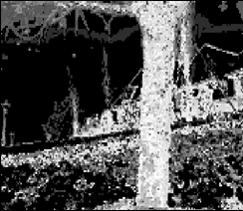

Image Segmentation
n = number of pixels
E: {0,1}^{n} → R
0 →fg, 1→bg
E(X) = ∑ c_{i} x_{i} + ∑ d_{ij} |x_{i}-x_{j}|
i
i,j
Image
Unary Cost
Segmentation
[Boykov and Jolly ‘ 01] [Blake et al. ‘04] [Rother et al.`04]

Slide 31






P^{n} Potts Potentials
Patch Dictionary (Tree)
{
0 if x_{i} = 0, i ϵ p
C_{max} otherwise
h(X_{p}) =
p
C_{max} ≥ 0
  [slide credits: Kohli]

Slide 32
P^{n} Potts Potentials
n = number of pixels
E: {0,1}^{n} → R
0 →fg, 1→bg
E(X) = ∑ c_{i} x_{i} + ∑ d_{ij} |x_{i}-x_{j}| + ∑ h_{p} (X_{p})
i
i,j
p
{
0 if x_{i} = 0, i ϵ p
C_{max} otherwise
h(X_{p}) =
p
  [slide credits: Kohli]

Slide 33

Image Segmentation
n = number of pixels
E: {0,1}^{n} → R
0 →fg, 1→bg
E(X) = ∑ c_{i} x_{i} + ∑ d_{ij} |x_{i}-x_{j}| + ∑ h_{p} (X_{p})
i
i,j
p
Image
Pairwise Segmentation
Final Segmentation
  [slide credits: Kohli]

Slide 34
Application:
Recognition and Segmentation
Image
One super-pixelization
another super-pixelization
Pairwise CRF only
[Shotton et al. ‘06]
P^{n} Potts
Unaries only
TextonBoost
[Shotton et al. ‘06]
  from [Kohli et al. ‘08]

Slide 35
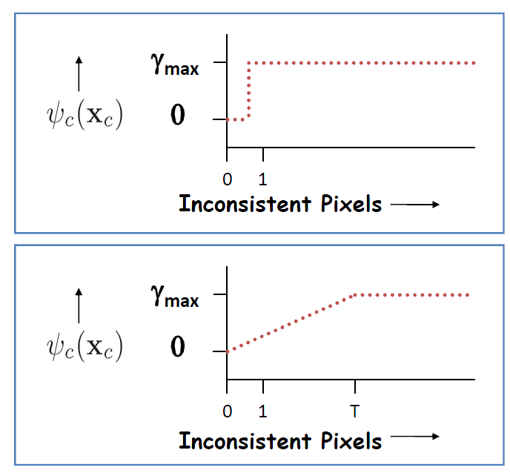
Robust(soft) P^{n} Potts model
{
0 if x_{i} = 0, i ϵ p
f(∑x_{p}) otherwise
h(x_{p}) =
p
p
P^{n} Potts
Robust P^{n} Potts
  from [Kohli et al. ‘08]

Slide 36
Application:
Recognition and Segmentation
Image
One super-pixelization
another super-pixelization
Pairwise CRF only
[Shotton et al. ‘06]
P^{n} Potts
robust P^{n} Potts
robust P^{n} Potts
(different f)
Unaries only
TextonBoost
[Shotton et al. ‘06]
  From [Kohli et al. ‘08]

Slide 37
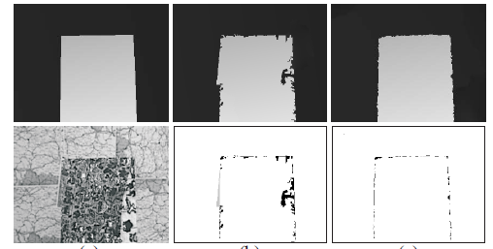
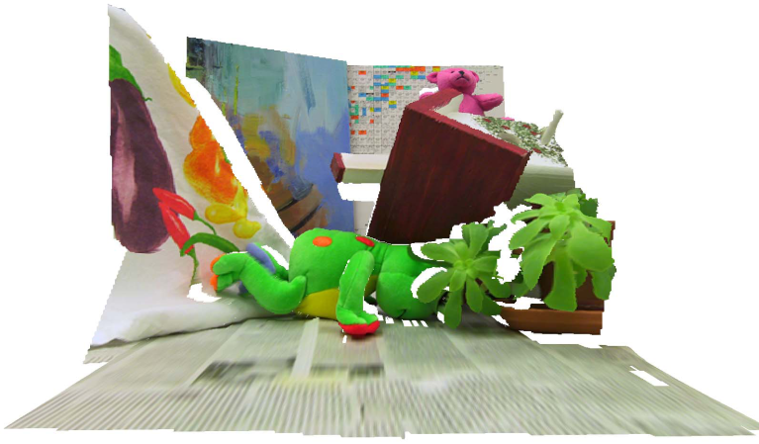
Same idea for surface-based stereo
[Bleyer ‘10]
One input image
Ground truth depth
Stereo with
hard-segmentation
Stereo with
robust P^{n} Potts
This approach gets best result on Middlebury Teddy image-pair:

Slide 38
How is it done…
Most general binary function:
H (X) = F ( ∑ x_{i} )
concave
H (X)
0
∑ x_{i}
The transformation is to a submodular pair-wise MRF, hence optimization globally optimal
  [slide credits: Kohli]

Slide 39
Higher order to Quadratic
Start with P^{n} Potts model:
{
0 if all x_{i} = 0
C₁ otherwise
x ϵ {0,1}^{n}
f(x) =
min f(x)
=
min C₁a + C₁ (1-a) ∑x_{i}
x
x,a ϵ {0,1}
Higher Order Function
Quadratic Submodular Function
∑x_{i} = 0
f(x) = 0
a=0
∑x_{i} > 0
f(x) = C₁
a=1
  [slide credits: Kohli]

Slide 40
Higher order to Quadratic
min f(x)
=
min C₁a + C₁ (1-a) ∑x_{i}
x
x,a ϵ {0,1}
Higher Order Function
Quadratic Submodular Function
C₁∑x_{i}
C₁
1
2
3
∑x_{i}
  [slide credits: Kohli]

Slide 41
Higher order to Quadratic
min f(x)
=
min C₁a + C₁ (1-a) ∑x_{i}
x
x,a ϵ {0,1}
Higher Order Submodular Function
Quadratic Submodular Function
C₁∑x_{i}
a=0
a=1
Lower envelope of concave functions is concave
C₁
1
2
3
∑x_{i}
  [slide credits: Kohli]

Slide 42
Summary
Submodular F²
F³ and beyond: minimization trick
Non submodular
  QPBO(P)
Beyond F³ – Robust HOP
Thank You!
s
i
j
i
j
f₂(x)
a=0
a=1
t
f₁(x)
∑x_{i}
Notes:
Problems that are known to be “easy”
- submodular
- inference in trees
Are indeed emerge as an ”easy” problems with graph-cut formulation

