Slide 1
HALL C OPTICS • PRELIMINARY
HMS angular optics:
conditioning and residual scan
6.667 GeV sample • term ladder through N = 210
Reports numerical stability and residual behavior only; no matrix-selection recommendation.
26 Aug 2026
Notes:
Purpose: give the collaboration a quick, plain-language view of the preliminary conditioning and residual scans. The deck deliberately stops short of recommending whether any matrix should be committed.
[Sources]
- /Users/christine/.codex/.chatgpt-projects/g-p-680be63e67b48191a251ae0adfb21ae2/work/hallc_spectrometer_angular_optics/HMS_6p667GeV/08_preliminary_conditioning/COLLABORATION_SUMMARY.md
- /Users/christine/.codex/.chatgpt-projects/g-p-680be63e67b48191a251ae0adfb21ae2/work/hallc_spectrometer_angular_optics/HMS_6p667GeV/08_preliminary_conditioning/PRELIMINARY_FINDINGS.md
[/Sources]

Slide 2
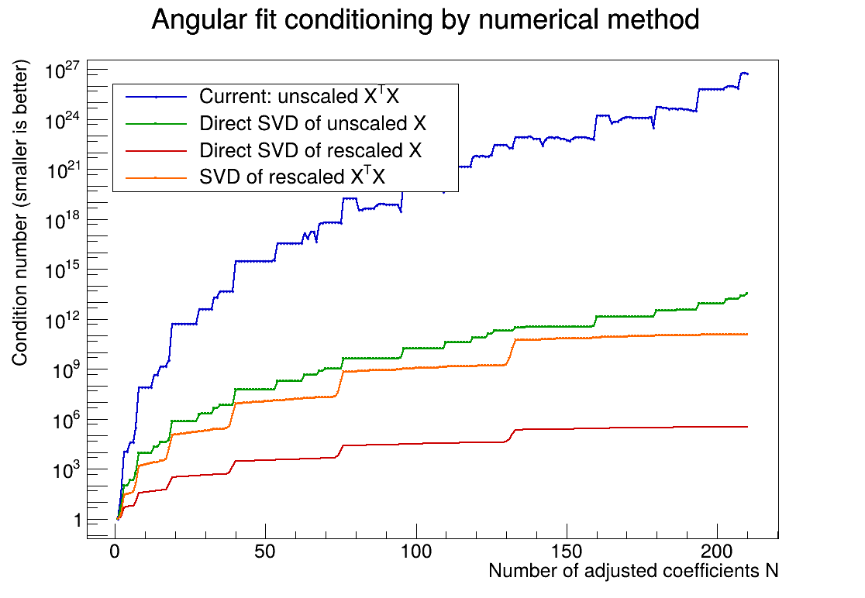
The unscaled XᵀX route is much less well-conditioned
AT N = 210
5.7 × 10²⁶
Condition number for the current unscaled XᵀX solve.
Rescaling the columns and solving X directly reduces this to about 3.5 × 10⁵.
A larger condition number means small numerical or data changes can be amplified more strongly.
PRELIMINARY • HMS 6.667 GeV
2
Notes:
How to read this slide: the condition number is a warning light for numerical sensitivity. XᵀX squares the spread already present in X, so the current route becomes much harder to solve accurately. Rescaling the columns and solving X directly changes the numerical representation, not the underlying fit model.
[Sources]
- /Users/christine/.codex/.chatgpt-projects/g-p-680be63e67b48191a251ae0adfb21ae2/work/hallc_spectrometer_angular_optics/HMS_6p667GeV/08_preliminary_conditioning/solver_comparison/condition_by_solve_method_vs_N.png
- /Users/christine/.codex/.chatgpt-projects/g-p-680be63e67b48191a251ae0adfb21ae2/work/hallc_spectrometer_angular_optics/HMS_6p667GeV/08_preliminary_conditioning/solver_comparison/angular_solver_comparison.tsv
[/Sources]

Slide 3
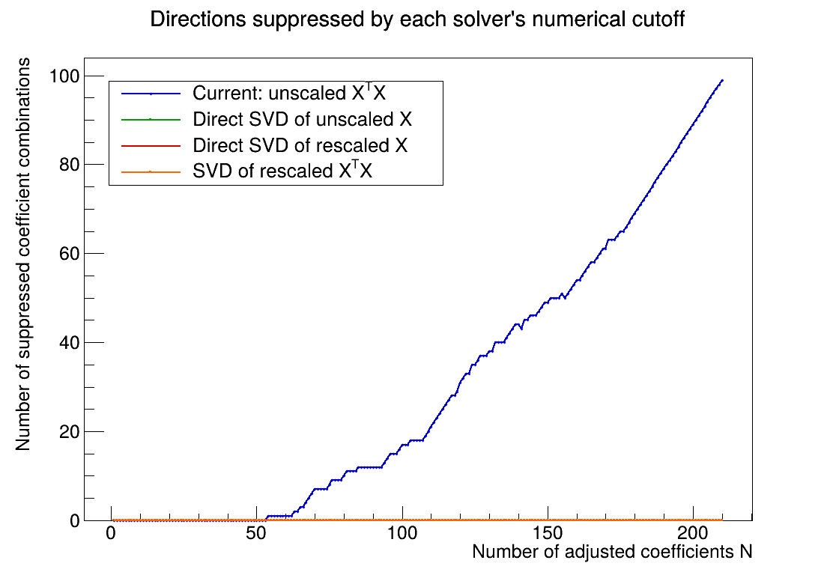
ROOT first drops one unresolved direction at N = 54
CURRENT XᵀX SOLVE
111 / 210
Independent directions retained at N = 210.
Truncation remains active after N = 54, but some later terms still add independent information until the retained rank reaches 111 by N = 176.
A truncated direction is a mixture of fitted coefficients; it does not mean one named coefficient is simply set to zero.
PRELIMINARY • HMS 6.667 GeV
3
Notes:
Plain-language interpretation: at N=54, the current normal-equation solve can no longer distinguish every independent combination of coefficients at ROOT's numerical cutoff. From then on at least one combination is dropped. Later terms can still add useful independent information, but the count of independently determined combinations stops growing at 111 by N=176.
[Sources]
- /Users/christine/.codex/.chatgpt-projects/g-p-680be63e67b48191a251ae0adfb21ae2/work/hallc_spectrometer_angular_optics/HMS_6p667GeV/08_preliminary_conditioning/solver_comparison/discarded_directions_by_solve_method_vs_N.png
- /Users/christine/.codex/.chatgpt-projects/g-p-680be63e67b48191a251ae0adfb21ae2/work/hallc_spectrometer_angular_optics/HMS_6p667GeV/08_preliminary_conditioning/term_ladder/angular_term_ladder.tsv
[/Sources]

Slide 4
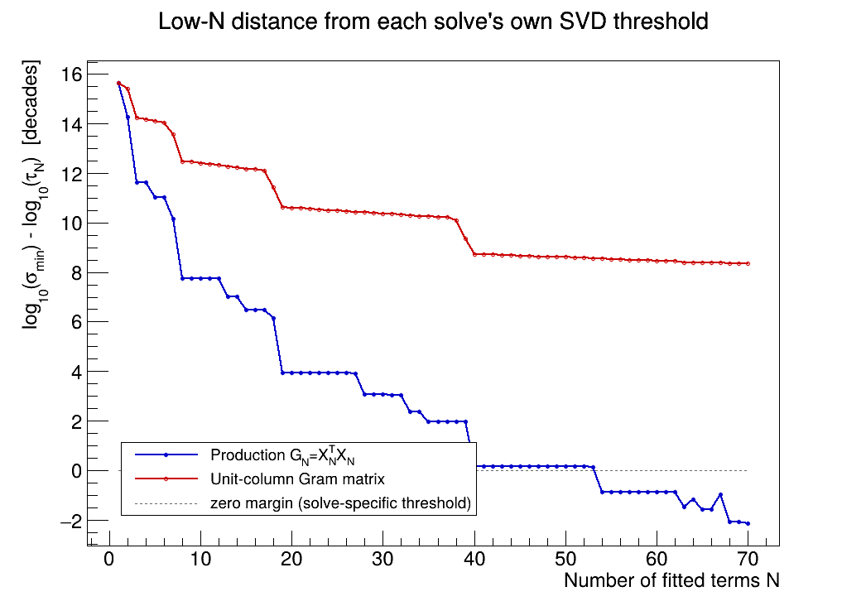
Each solve is compared with its own truncation cutoff
HOW TO READ ZERO
0
Zero means the smallest singular value has reached that solve’s truncation threshold.
Positive values are above the cutoff; negative values have crossed it.
This is a solve-by-solve distance from threshold, not one fixed horizontal threshold applied to every N.
PRELIMINARY • HMS 6.667 GeV
4
Notes:
The plotted quantity subtracts ROOT's solve-specific truncation threshold from the smallest numerical direction at each N. That is why one zero line is meaningful across the ladder even though the absolute cutoff changes with the solve.
[Sources]
- /Users/christine/.codex/.chatgpt-projects/g-p-680be63e67b48191a251ae0adfb21ae2/work/hallc_spectrometer_angular_optics/HMS_6p667GeV/08_preliminary_conditioning/term_ladder/truncation_margin_lowN.png
- /Users/christine/.codex/.chatgpt-projects/g-p-680be63e67b48191a251ae0adfb21ae2/work/hallc_spectrometer_angular_optics/HMS_6p667GeV/08_preliminary_conditioning/term_ladder/angular_term_ladder_summary.txt
[/Sources]

Slide 5
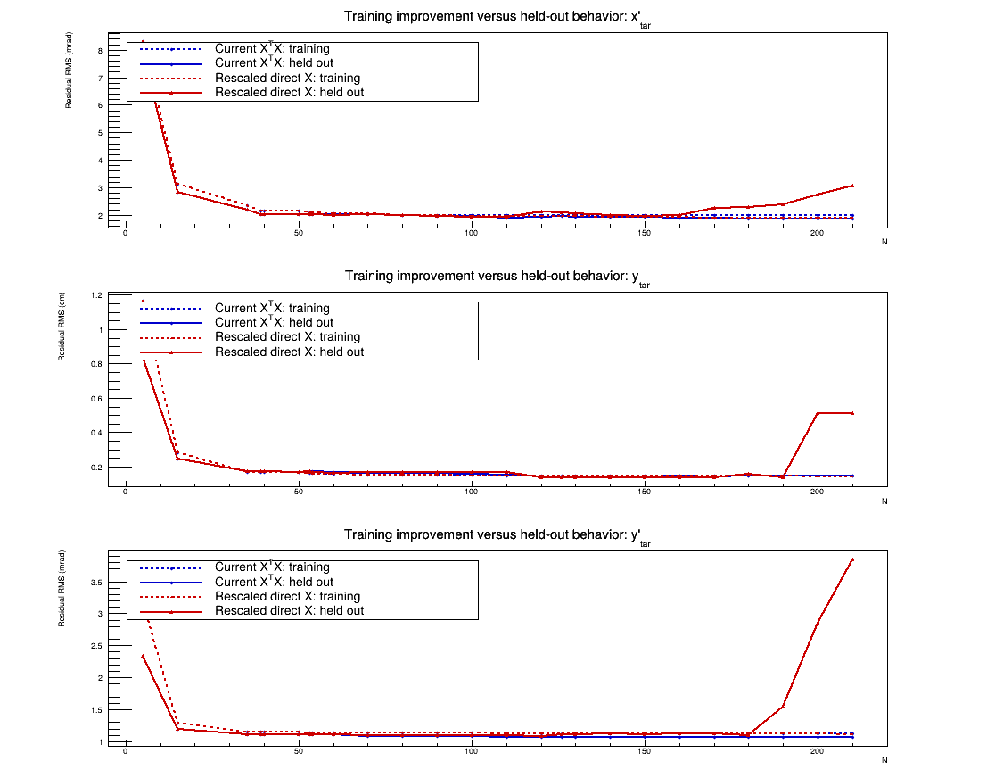
Held-out residuals reveal behavior that training residuals miss
TWO SAMPLES
166k / 279k
Selected training events and eligible held-out events.
Training residuals usually fall as N grows. Held-out residuals show where added flexibility stops carrying over to unused events.
Held-out events use the same runs and cuts, but were not selected for the fit.
PRELIMINARY • HMS 6.667 GeV
5
Notes:
Blue curves are events used in the fit; red curves are eligible events not selected for the fit. A falling training curve by itself cannot establish stability. The held-out curve is the more direct check for whether the added terms generalize to unused events.
[Sources]
- /Users/christine/.codex/.chatgpt-projects/g-p-680be63e67b48191a251ae0adfb21ae2/work/hallc_spectrometer_angular_optics/HMS_6p667GeV/08_preliminary_conditioning/solver_comparison/training_vs_heldout_residuals_by_N.png
- /Users/christine/.codex/.chatgpt-projects/g-p-680be63e67b48191a251ae0adfb21ae2/work/hallc_spectrometer_angular_optics/HMS_6p667GeV/08_preliminary_conditioning/per_foil_residual_ladder/angular_per_foil_residual_ladder.tsv
[/Sources]

Slide 6
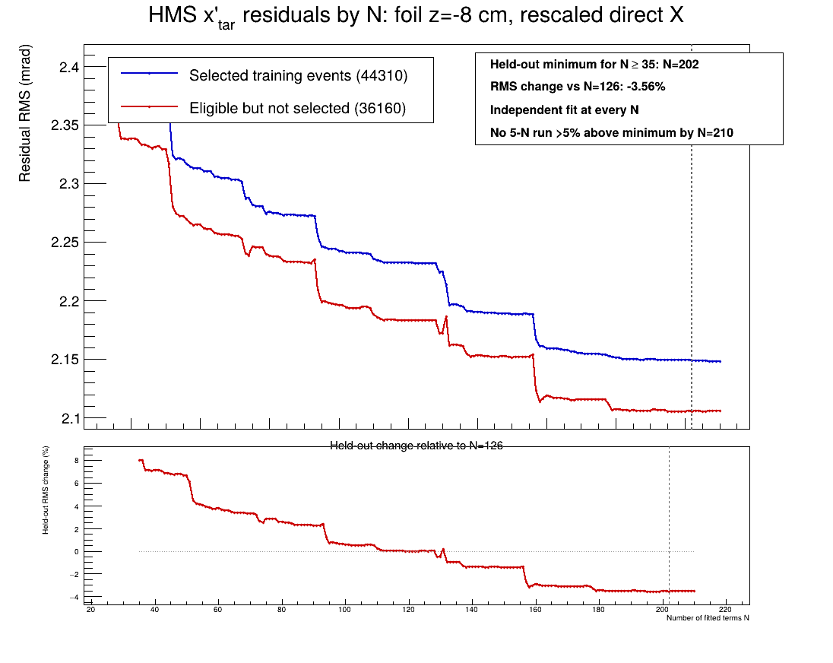
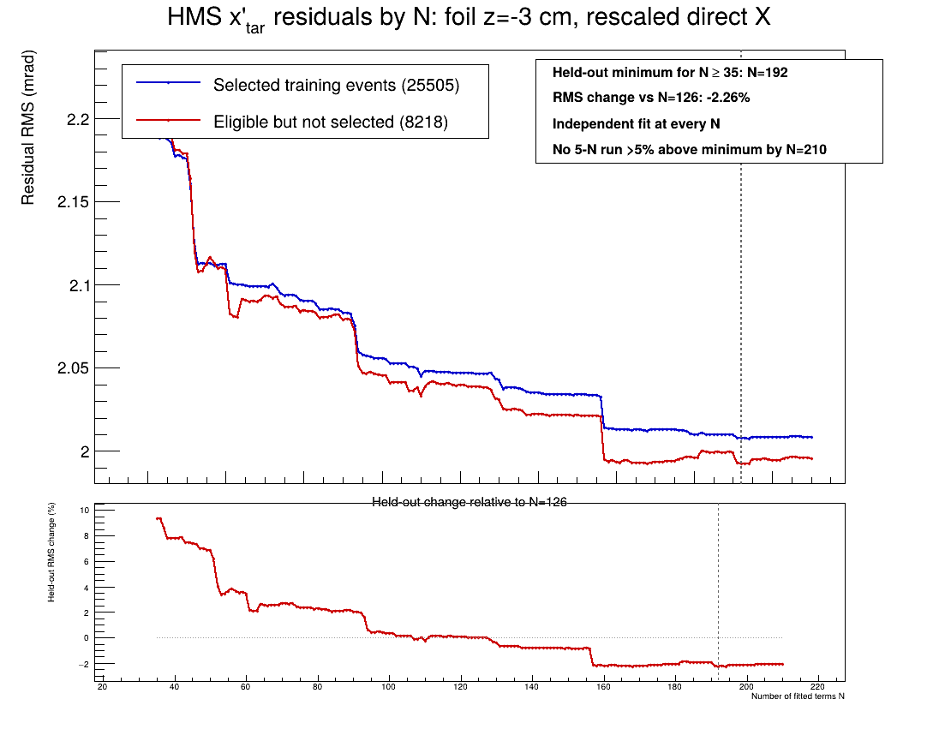
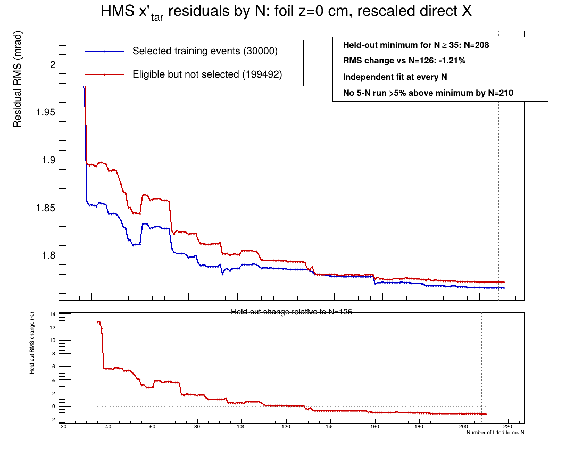
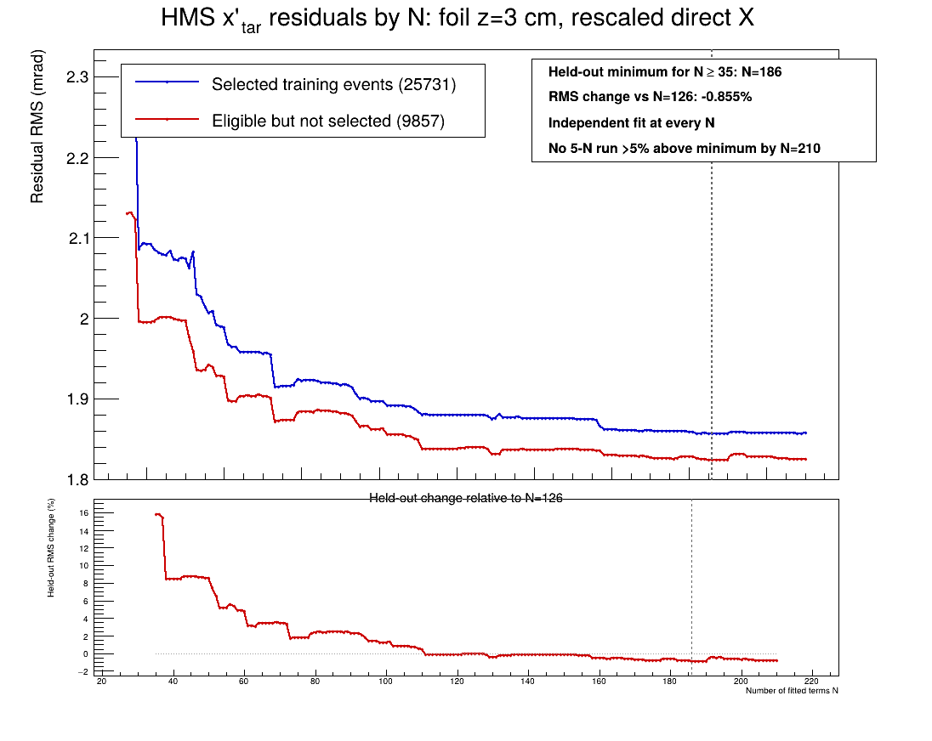
Most foil averages do not show the same sustained x′ rise
−8 cm
−3 cm
0 cm
+3 cm
PRELIMINARY • HMS 6.667 GeV
6
Notes:
Overview only: these four foil-averaged x-prime held-out curves do not satisfy the descriptive marker of five consecutive N values more than 5% above their N>=35 minimum by N=210. This marker is a summary aid, not a fit cutoff. Each foil average combines several settings, so a setting-level effect can be hidden.
[Sources]
- /Users/christine/.codex/.chatgpt-projects/g-p-680be63e67b48191a251ae0adfb21ae2/work/hallc_spectrometer_angular_optics/HMS_6p667GeV/08_preliminary_conditioning/per_foil_residual_ladder/rescaled_direct_X/foil_m8cm/xptar_residual_ladder.png
- /Users/christine/.codex/.chatgpt-projects/g-p-680be63e67b48191a251ae0adfb21ae2/work/hallc_spectrometer_angular_optics/HMS_6p667GeV/08_preliminary_conditioning/per_foil_residual_ladder/rescaled_direct_X/foil_m3cm/xptar_residual_ladder.png
- /Users/christine/.codex/.chatgpt-projects/g-p-680be63e67b48191a251ae0adfb21ae2/work/hallc_spectrometer_angular_optics/HMS_6p667GeV/08_preliminary_conditioning/per_foil_residual_ladder/rescaled_direct_X/foil_0cm/xptar_residual_ladder.png
- /Users/christine/.codex/.chatgpt-projects/g-p-680be63e67b48191a251ae0adfb21ae2/work/hallc_spectrometer_angular_optics/HMS_6p667GeV/08_preliminary_conditioning/per_foil_residual_ladder/rescaled_direct_X/foil_p3cm/xptar_residual_ladder.png
- /Users/christine/.codex/.chatgpt-projects/g-p-680be63e67b48191a251ae0adfb21ae2/work/hallc_spectrometer_angular_optics/HMS_6p667GeV/08_preliminary_conditioning/per_foil_residual_ladder/angular_per_foil_overfitting_onsets.tsv
[/Sources]

Slide 7
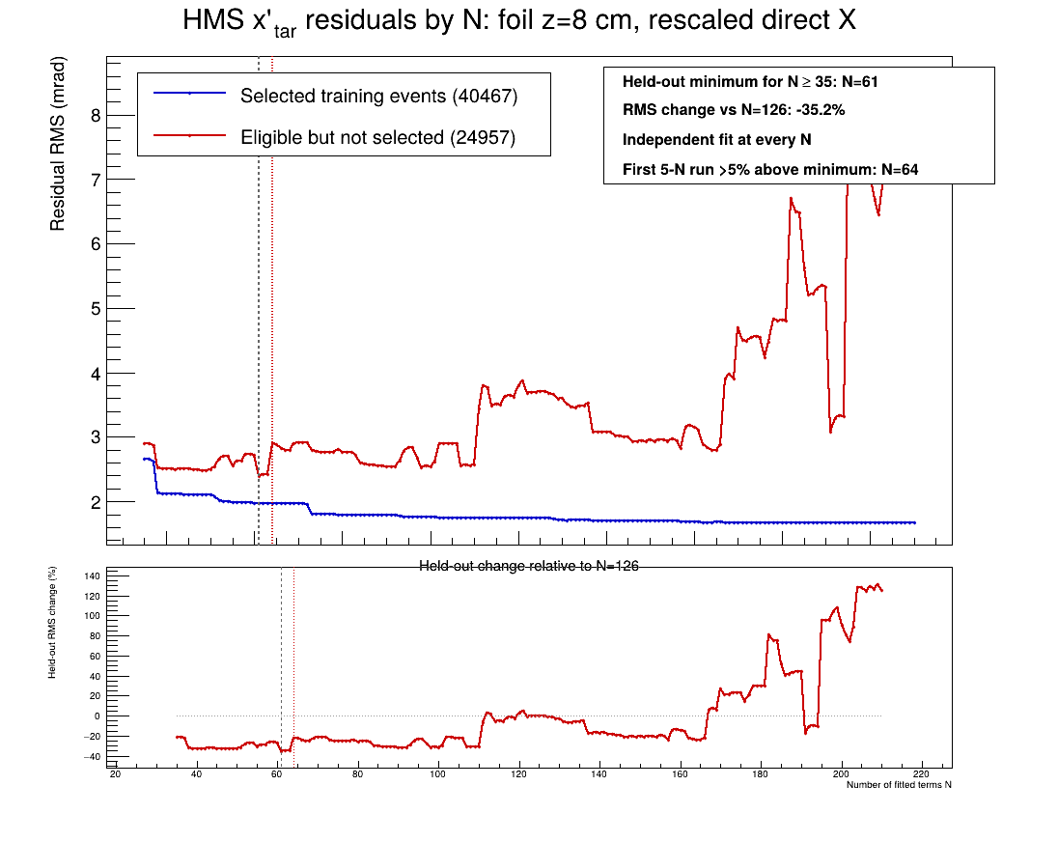
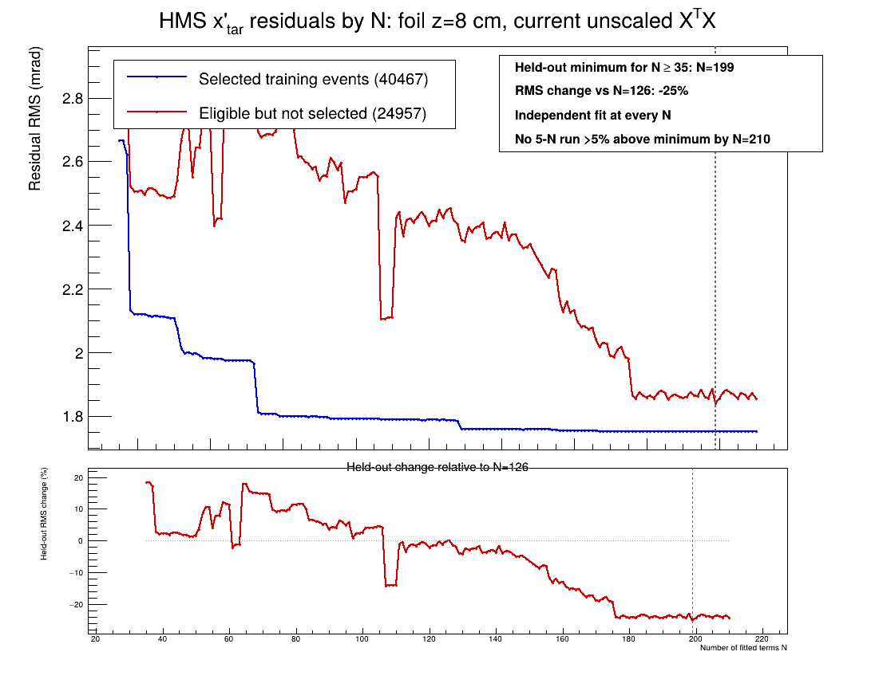
The +8 cm x′ curve separates the two solve routes
Rescaled direct X
Current unscaled XᵀX
Descriptive held-out marker: N = 64 for scaled direct X; no five-point marker by N = 210 for current XᵀX.
PRELIMINARY • HMS 6.667 GeV
7
Notes:
The +8 cm foil average is the clearest early x-prime held-out rise in the scaled direct-X ladder. The current XTX curve follows a different high-N path because the pseudoinverse is truncating numerical directions. The marker is descriptive and should not be read as a recommended cutoff.
[Sources]
- /Users/christine/.codex/.chatgpt-projects/g-p-680be63e67b48191a251ae0adfb21ae2/work/hallc_spectrometer_angular_optics/HMS_6p667GeV/08_preliminary_conditioning/per_foil_residual_ladder/rescaled_direct_X/foil_p8cm/xptar_residual_ladder.png
- /Users/christine/.codex/.chatgpt-projects/g-p-680be63e67b48191a251ae0adfb21ae2/work/hallc_spectrometer_angular_optics/HMS_6p667GeV/08_preliminary_conditioning/per_foil_residual_ladder/current_XTX/foil_p8cm/xptar_residual_ladder.png
- /Users/christine/.codex/.chatgpt-projects/g-p-680be63e67b48191a251ae0adfb21ae2/work/hallc_spectrometer_angular_optics/HMS_6p667GeV/08_preliminary_conditioning/per_foil_residual_ladder/angular_per_foil_overfitting_onsets.tsv
[/Sources]

Slide 8
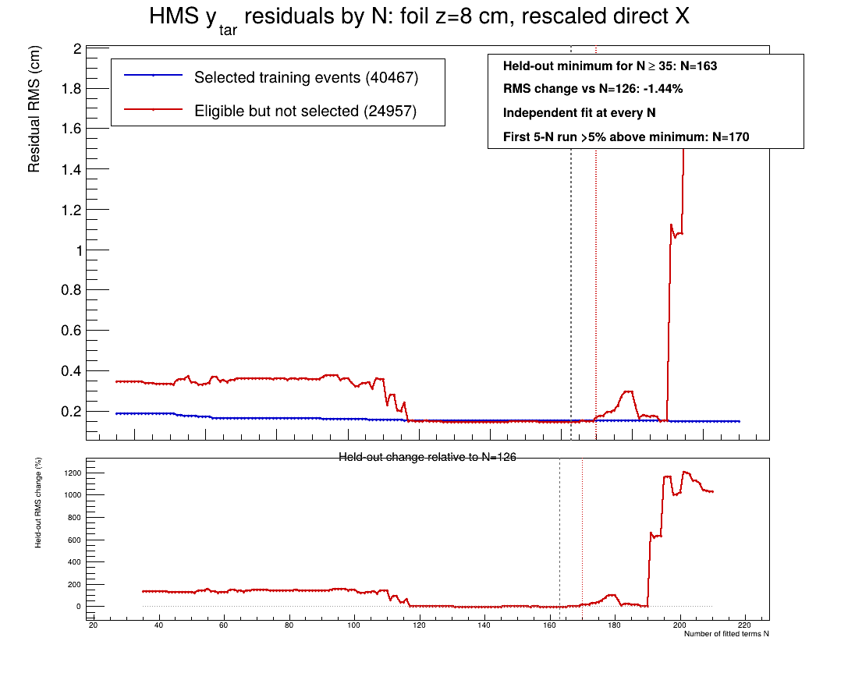
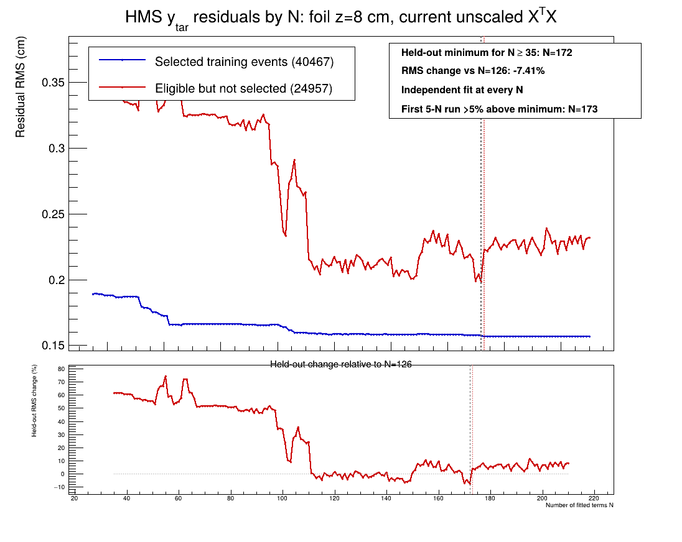
The +8 cm y residual turns upward late in both solves
Rescaled direct X
Current unscaled XᵀX
Descriptive held-out marker: N = 170 for scaled direct X and N = 173 for current XᵀX.
PRELIMINARY • HMS 6.667 GeV
8
Notes:
For the reconstructed target y coordinate at +8 cm, the sustained held-out rise is late and similar in onset for the two solve routes. The detailed curve shapes differ, so this is evidence of a shared late-N issue, not proof that the matrices are otherwise equivalent.
[Sources]
- /Users/christine/.codex/.chatgpt-projects/g-p-680be63e67b48191a251ae0adfb21ae2/work/hallc_spectrometer_angular_optics/HMS_6p667GeV/08_preliminary_conditioning/per_foil_residual_ladder/rescaled_direct_X/foil_p8cm/ytar_residual_ladder.png
- /Users/christine/.codex/.chatgpt-projects/g-p-680be63e67b48191a251ae0adfb21ae2/work/hallc_spectrometer_angular_optics/HMS_6p667GeV/08_preliminary_conditioning/per_foil_residual_ladder/current_XTX/foil_p8cm/ytar_residual_ladder.png
- /Users/christine/.codex/.chatgpt-projects/g-p-680be63e67b48191a251ae0adfb21ae2/work/hallc_spectrometer_angular_optics/HMS_6p667GeV/08_preliminary_conditioning/per_foil_residual_ladder/angular_per_foil_overfitting_onsets.tsv
[/Sources]

Slide 9
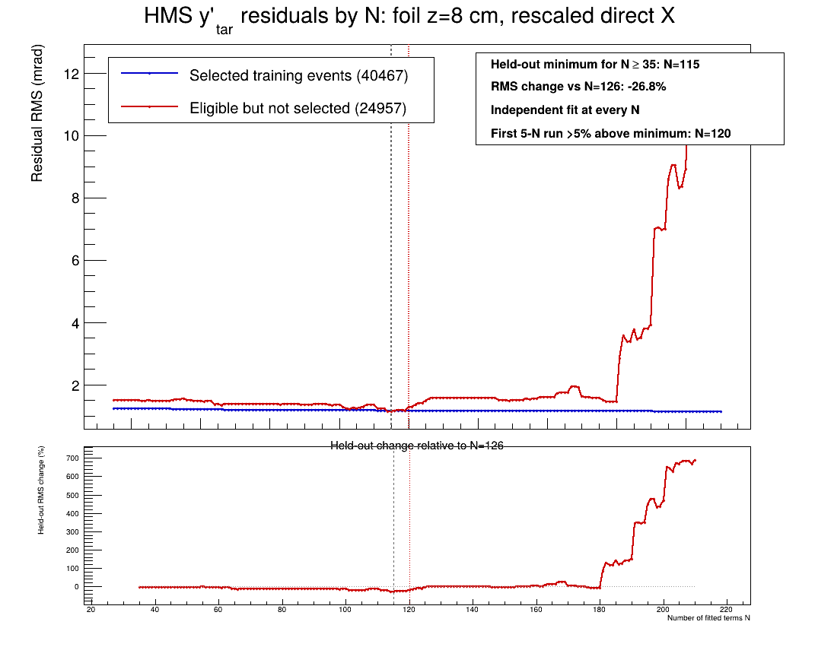
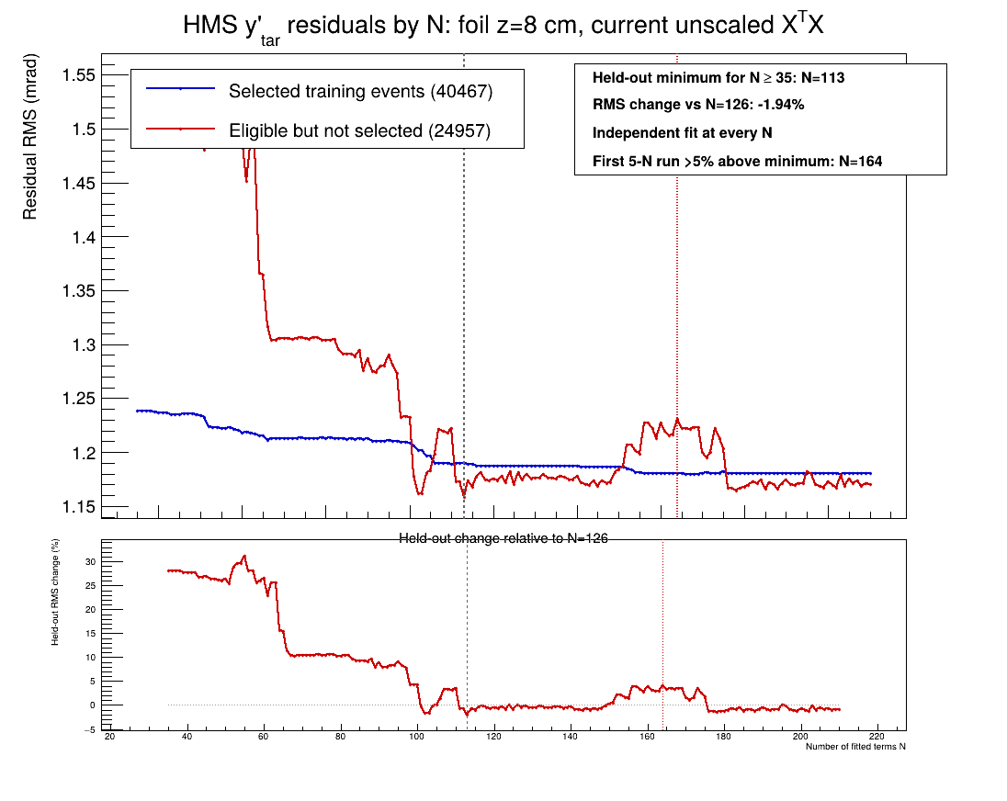
The +8 cm y′ onset is also solver-dependent
Rescaled direct X
Current unscaled XᵀX
Descriptive held-out marker: N = 120 for scaled direct X and N = 164 for current XᵀX.
PRELIMINARY • HMS 6.667 GeV
9
Notes:
For target y-prime at +8 cm, both held-out curves eventually rise, but the sustained rise begins earlier in the scaled direct-X solve. This comparison shows that the apparent stability range depends on the numerical solve, not only on the list of fitted terms.
[Sources]
- /Users/christine/.codex/.chatgpt-projects/g-p-680be63e67b48191a251ae0adfb21ae2/work/hallc_spectrometer_angular_optics/HMS_6p667GeV/08_preliminary_conditioning/per_foil_residual_ladder/rescaled_direct_X/foil_p8cm/yptar_residual_ladder.png
- /Users/christine/.codex/.chatgpt-projects/g-p-680be63e67b48191a251ae0adfb21ae2/work/hallc_spectrometer_angular_optics/HMS_6p667GeV/08_preliminary_conditioning/per_foil_residual_ladder/current_XTX/foil_p8cm/yptar_residual_ladder.png
- /Users/christine/.codex/.chatgpt-projects/g-p-680be63e67b48191a251ae0adfb21ae2/work/hallc_spectrometer_angular_optics/HMS_6p667GeV/08_preliminary_conditioning/per_foil_residual_ladder/angular_per_foil_overfitting_onsets.tsv
[/Sources]

Slide 10
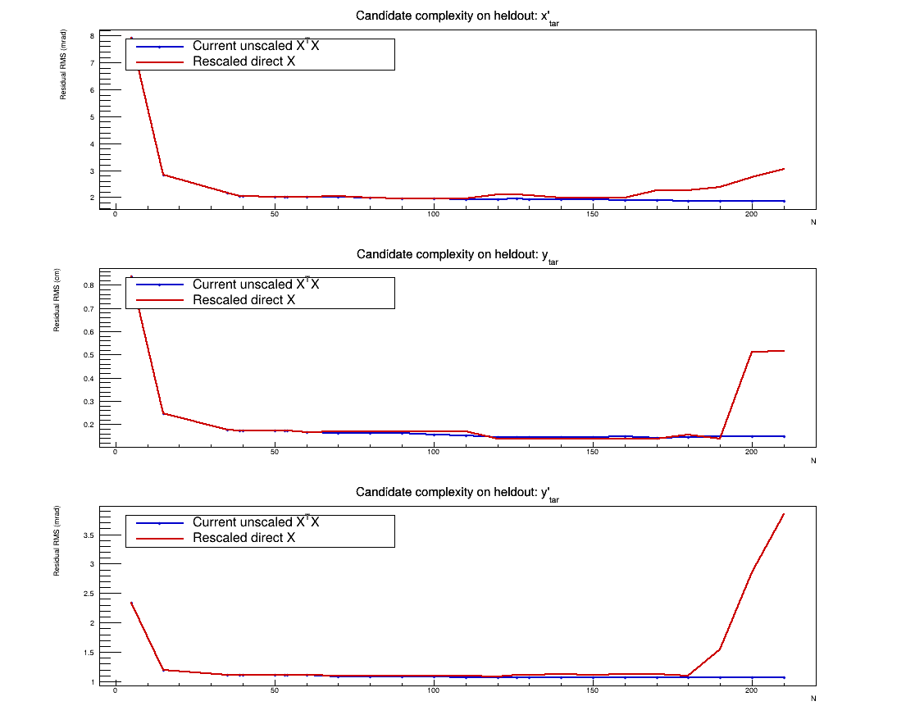
Held-out residuals depend on both solver and fitted order
OBSERVED PATTERN
N matters
The scaled full-order solve is numerically cleaner, but its held-out residuals are not uniformly better.
The lower-order point is a descriptive comparison, not a selection.
Full-sample averages are strongly influenced by the +8 cm subset and its setting mix.
PRELIMINARY • HMS 6.667 GeV
10
Notes:
This plot separates two questions: numerical conditioning and predictive behavior. A solve can be much better conditioned while still fitting high-order structure that does not transfer well to held-out events. The candidate comparison is included to expose that tradeoff, not to nominate a matrix.
[Sources]
- /Users/christine/.codex/.chatgpt-projects/g-p-680be63e67b48191a251ae0adfb21ae2/work/hallc_spectrometer_angular_optics/HMS_6p667GeV/08_preliminary_conditioning/solver_comparison/candidate_residuals_heldout.png
- /Users/christine/.codex/.chatgpt-projects/g-p-680be63e67b48191a251ae0adfb21ae2/work/hallc_spectrometer_angular_optics/HMS_6p667GeV/08_preliminary_conditioning/solver_comparison/angular_candidate_N_comparison.tsv
[/Sources]

Slide 11
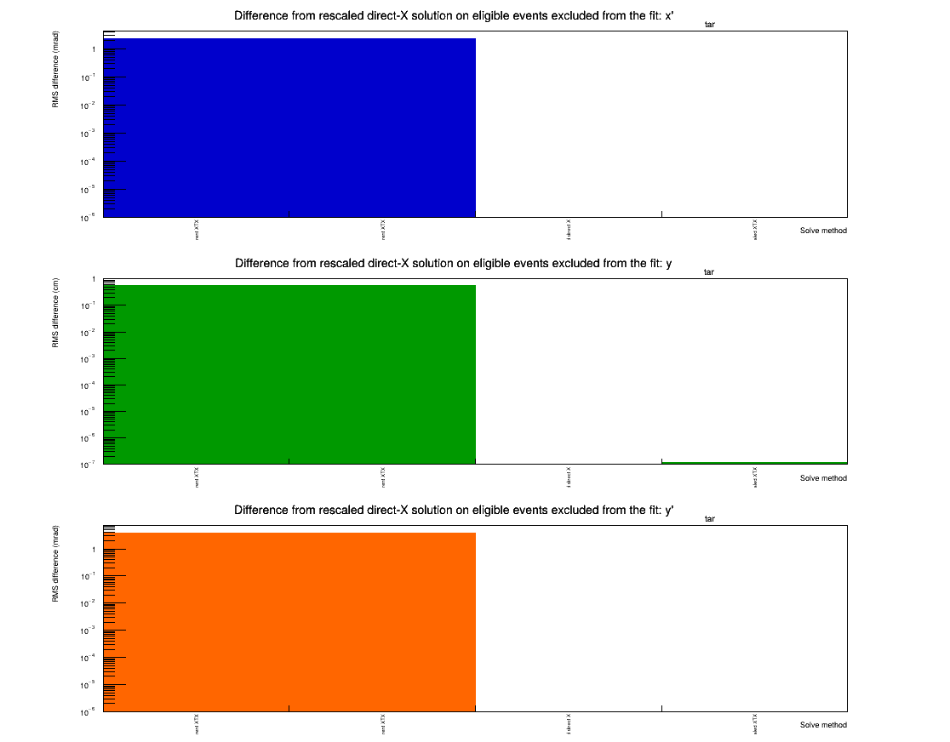
Most current-versus-scaled differences are small
CONSERVATIVE SUMMARY
Mostly close
For most held-out events, the matrix predictions are close. Rare events differ much more.
The late-N rise is concentrated in +8 cm data and may be setting-specific.
Next: inspect affected settings and replay-level vertex behavior. No commit decision is made here.
PRELIMINARY • HMS 6.667 GeV
11
Notes:
Bottom line for this preliminary scan: the current XTX solve begins truncating at N=54 and retains 111 independent directions at N=210; scaled direct X is much better conditioned; and high-N held-out behavior is not uniform across the data, with the +8 cm subset dominating the clearest rise. These are stability observations only. They do not establish which matrix should be committed.
[Sources]
- /Users/christine/.codex/.chatgpt-projects/g-p-680be63e67b48191a251ae0adfb21ae2/work/hallc_spectrometer_angular_optics/HMS_6p667GeV/08_preliminary_conditioning/solver_comparison/prediction_difference_from_rescaled_direct_X_heldout.png
- /Users/christine/.codex/.chatgpt-projects/g-p-680be63e67b48191a251ae0adfb21ae2/work/hallc_spectrometer_angular_optics/HMS_6p667GeV/08_preliminary_conditioning/solver_comparison/angular_solver_comparison_heldout.tsv
- /Users/christine/.codex/.chatgpt-projects/g-p-680be63e67b48191a251ae0adfb21ae2/work/hallc_spectrometer_angular_optics/HMS_6p667GeV/08_preliminary_conditioning/per_foil_residual_ladder/angular_per_foil_residual_ladder_summary.txt
[/Sources]

