Slide 1
Transformer
Input Sentence
Output Sentence
Encoder
Input
Sentence
Context
Decoder
Context
Output Sentence
Some
Sentence

Slide 2
Encoder
Input
Sentence
Context
Encoder Block
Encoder Block
Encoder Block
Encoder Block
Encoder Block
Encoder Block
Input
Sentence
Context
Multi-Head Attention
Layer
Position-wise Feed-Forward
Layer

Slide 3

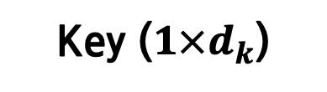

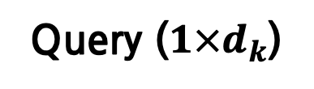
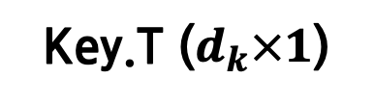
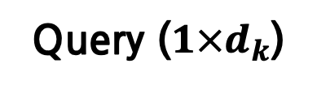
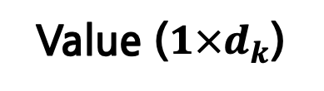
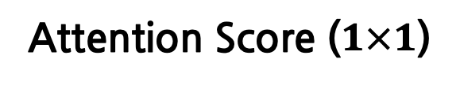
it
animal
animal
Query ($1×d_{k}$)
Key ($1×d_{k}$)
Value ($1×d_{k}$)
$$×$$
animal
$$=$$
it
Query ($1×d_{k}$)
Key.T ($d_{k}×1$)
Attention Score ($1×1$)

Slide 4
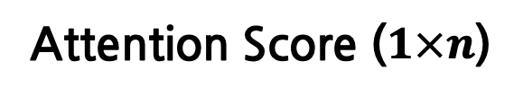
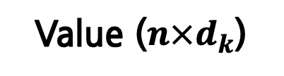

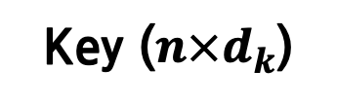

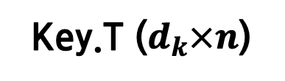
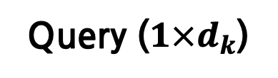
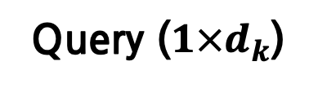
the
the
animal
animal
didn’t
didn’t
cross
cross
the
the
it
street
street
because
because
it
it
was
was
too
too
tired
tired
Query ($1×d_{k}$)
Key (${n×d}_{k}$)
Value (${n×d}_{k}$)
$$×$$
$$=$$
it
tired
too
was
it
because
street
cross
didn’t
the
animal
the
Query ($1×d_{k}$)
Key.T ($d_{k}×n$)
Attention Score ($1×n$)

Slide 5
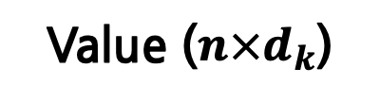


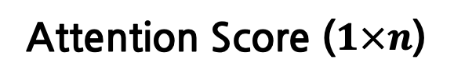
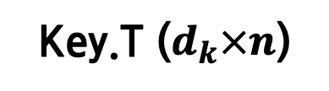

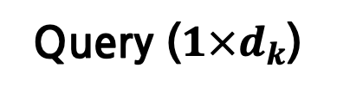
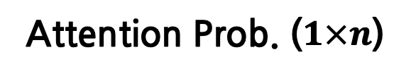
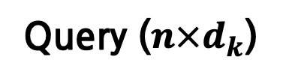
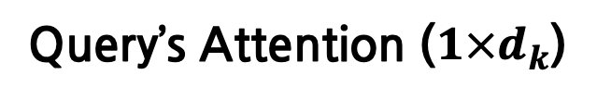
the
the
the
animal
animal
animal
didn’t
didn’t
didn’t
cross
cross
cross
the
the
the
street
street
street
because
because
because
it
it
it
was
was
was
too
too
too
tired
tired
tired
Query (${n×d}_{k}$)
Key (${n×d}_{k}$)
Value (${n×d}_{k}$)
$$×$$
$$=$$
it
tired
too
was
it
because
street
cross
didn’t
animal
tired
too
was
it
because
street
cross
didn’t
the
the
the
animal
the
Query ($1×d_{k}$)
Key.T ($d_{k}×n$)
Attention Score ($1×n$)
the
animal
didn’t
$$×$$
cross
$$=$$
Softmax
the
It
street
because
tired
it
too
was
it
because
street
cross
didn’t
the
animal
the
was
too
tired
Attention Prob. ($1×n$)
Value (${n×d}_{k}$)
Query’s Attention ($1×d_{k}$)

Slide 6

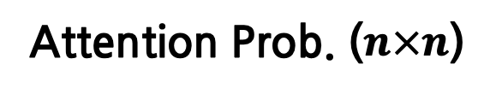
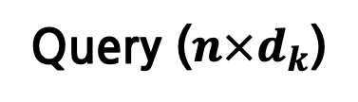
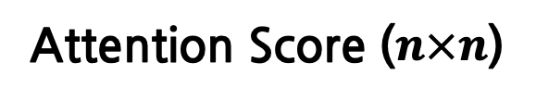
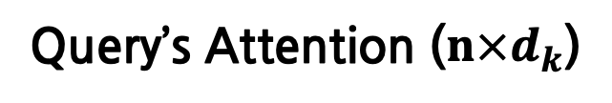

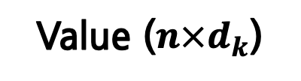

tired
too
was
it
because
street
cross
didn’t
the
animal
the
the
the
animal
animal
didn’t
didn’t
cross
$$×$$
$$=$$
cross
the
the
street
street
because
because
it
it
was
tired
was
too
was
it
because
street
cross
didn’t
the
animal
too
the
too
tired
tired
Query (${n×d}_{k}$)
Key.T ($d_{k}×n$)
Attention Score ($n×n$)
tired
too
was
it
because
street
cross
didn’t
the
animal
the
the
the
the
animal
animal
animal
didn’t
didn’t
didn’t
cross
$$×$$
cross
$$=$$
cross
Softmax
the
the
the
street
street
street
because
because
because
it
it
it
was
was
was
too
too
too
tired
tired
tired
Attention Prob. ($n×n$)
Value (${n×d}_{k}$)
Query’s Attention ($n×d_{k}$)

Slide 7
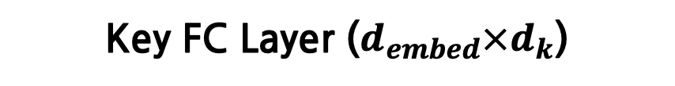
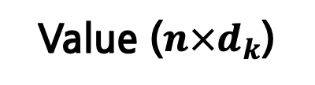


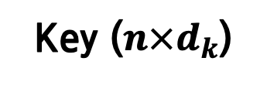
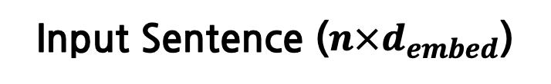
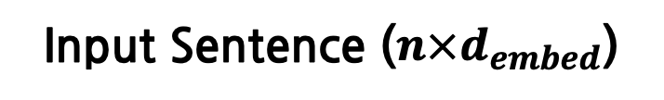
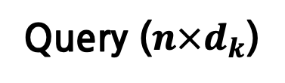
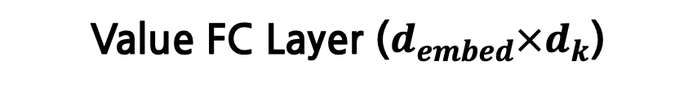
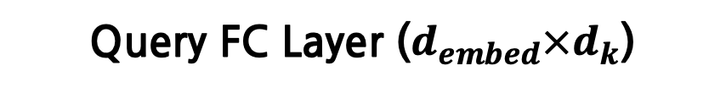
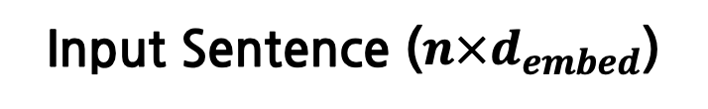
the
the
animal
animal
didn’t
didn’t
cross
$$×$$
$$=$$
cross
the
the
street
street
because
because
it
it
was
Query FC Layer ($d_{embed}×d_{k}$)
was
too
too
tired
tired
Input Sentence (${n×d}_{embed}$)
Query (${n×d}_{k}$)
the
the
animal
animal
didn’t
didn’t
cross
$$×$$
cross
the
$$=$$
the
street
street
because
because
it
it
was
Key FC Layer ($d_{embed}×d_{k}$)
was
too
too
tired
tired
Input Sentence (${n×d}_{embed}$)
Key (${n×d}_{k}$)
the
the
animal
animal
didn’t
didn’t
cross
$$×$$
cross
the
$$=$$
the
street
street
because
because
it
it
was
Value FC Layer ($d_{embed}×d_{k}$)
was
too
too
tired
tired
Input Sentence (${n×d}_{embed}$)
Value (${n×d}_{k}$)

Slide 8








$$h$$
$$d_{k}$$
$$d_{k}$$
$$d_{k}$$
$$d_{k}$$
$$d_{k}$$
$$d_{k}$$
$$d_{k}$$
$$d_{k}$$
Concat
$$d_{model}$$
$$=$$

Slide 9


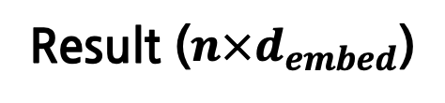
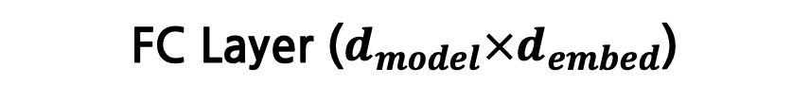
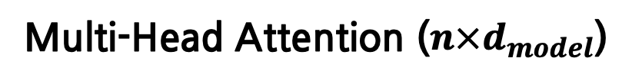
$$×$$
$$=$$
Multi-Head Attention ($n×d_{model}$)
Result ($n×d_{embed}$)
FC Layer ($d_{model}×d_{embed}$)

Slide 10
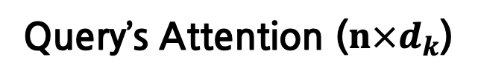
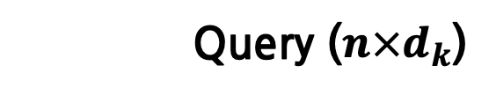
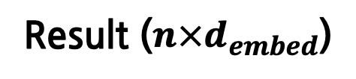
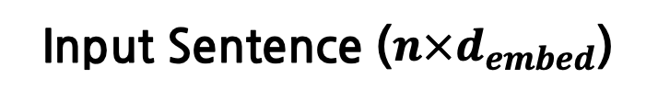
the
the
animal
animal
didn’t
didn’t
cross
Self-Attention
cross
the
the
street
street
because
because
it
it
was
was
too
too
tired
tired
Query (${n×d}_{k}$)
Query’s Attention ($n×d_{k}$)
the
the
animal
animal
didn’t
Multi-Head Attention
didn’t
cross
cross
the
the
street
street
because
because
it
it
was
was
too
too
tired
tired
Input Sentence (${n×d}_{embed}$)
Result ($n×d_{embed}$)

Slide 11
Encoder
Context
Decoder Block
Decoder Block
Decoder Block
Decoder Block
Decoder Block
Decoder Block
Ground Truth
Sentence
Predicted
Sentence
Context
Self-
Multi-Head Attention
Layer
Cross-
Multi-Head Attention
Layer
Position-wise Feed-Forward
Layer

Slide 12
RNN’s output
어머니
그동안
잘
지내셨어요?
<EOS>
RNN Cell
RNN Cell
RNN Cell
RNN Cell
RNN Cell
RNN’s output
<SOS>
어머니
그동안
잘
지내셨어요?
RNN’s output
어머니
그동안
잘
지내셨어요?
<EOS>
RNN Cell
RNN Cell
RNN Cell
RNN Cell
RNN Cell
Ground Truth
<SOS>
어머니
그동안
잘
지내셨어요?
RNN’s output
어머니
저녁은
좀
드셨어요?
<EOS>
RNN Cell
RNN Cell
RNN Cell
RNN Cell
RNN Cell
RNN’s output
<SOS>
어머니
저녁은
좀
드셨어요?

