Slide 1
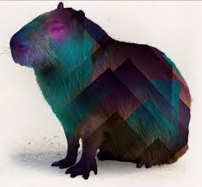
Capybara
Automation UI testing
Karime Salomon Z.

Slide 2
Welcome!!
What are you expecting from this course?
Do you have knowledge about capybara?

Slide 3
Objectives
What is capybara
How configure for an initial framework
Use different Web drivers
Implementation of UI test using capybara DSL
Headless execution

Slide 4
Plan
Requirements
Capybara with Cucumber
Web Drivers
DSL (Finders, clicking, navigation)
XPath, CSS and selectors
Tools
Best Practices
Headless implementation
Ruby
Ruby blocks
Classes
Modules
Regular expressions
Cucumber - BDT

Slide 5


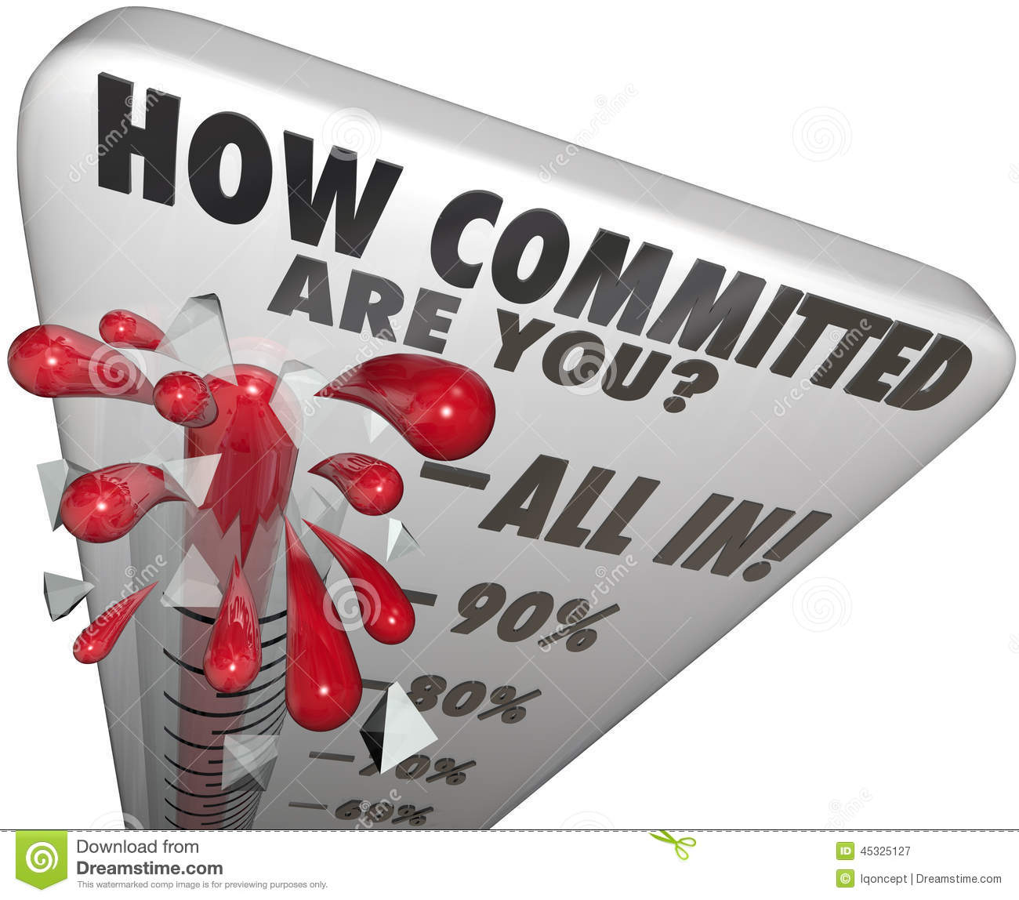
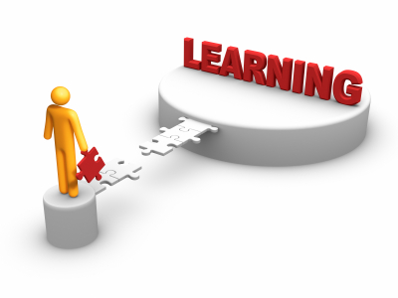

Rules

Slide 6
Why Capybara?
Capybara is a library written in the Ruby programming language, this library (gem) will help us to simulate in a easy and intuitive way how a user interacts with any application.
Capybara can talk with many different drivers which execute your tests through the same clean and simple interface. You can seamlessly choose between Selenium, Webkit or pure Ruby drivers.
Also capybara is ready to handled different asynchronous web components due to many synchronization features. Capybara automatically waits for your content to appear on the page, you never have to issue any manual sleeps.

Slide 7
Anatomy of Capybara
Capybara is built to be used on top of an underlying web-based driver. It offers a user-friendly DSL (Domain Specific Language) which is used to describe actions that are executed by the underlying web driver.
When the page is loaded using the DSL (and underlying web driver), Capybara will try to locate the relevant element in the DOM (Document Object Model) and execute the action, such as click button, link, etc.

Slide 8
Benefits
No setup necessary for Rails and Rack application. Works out of the box.
Intuitive API which mimics the language an actual user would use.
Switch the backend your tests run against from fast headless mode to an actual browser with no changes to your tests.
Powerful synchronization features mean you never have to manually wait for asynchronous processes to complete.

Slide 9
Constrains
No look and feel validation.
Depending on code structure (ids, classes, etc).
Need that QA is involved in every code changes to maintain new changes

Slide 10
Lets start with it….
Requirements :
Ruby – Dev Kit
Bundler
Gemfile :
gem ‘cucumber'
gem 'capybara'
No Bundler :
gem install cucumber
gem install capybara

Slide 11

Cucumber structure
cucumber --init

Slide 12
env.rb
Load libraries
Create initial configuration using “AfterConfiguration”
Global values
Capybara default configuration
Initial code

Slide 13
Load and find YML file
def load_app_config_file(filename)
config_file = find_config_file(filename)
config = YAML.load_file(config_file)
return config
end
def find_config_file(filename)
root = Pathname.pwd
while not root.root?
root.find do |path|
if path.file? and path.basename.to_s == filename
return path.to_s
end
end
root = root.parent
end
raise 'Configuration file ' #{filename}' not found!'
end

Slide 14
YML file
# capybara configuration
capybara:
default:
host: www.google.com
# how long to wait for asynchronous processing to finish
wait_time: 15
drivers:
- chrome

Slide 15
Capybara configurable options
Option | Value | Description | Default value
app_host | String/nil | The default host to use when giving a relative URL to visit, must be a valid | None. E.g http://www.example.com
run_server | Boolean | Whether to start a Rack server for the given Rack app | true
raise_server_errors | Boolean | Should errors raised in the server be raised in the tests? | true
default_selector | :css/:xpath | Methods which take a selector use the given type by default | :css
default_max_wait_time | Numeric | The maximum number of seconds to wait for asynchronous processes to finish | 2
ignore_hidden_elements | Boolean | Whether to ignore hidden elements on the page | true
save_path | String | Where to put pages saved through save_(page|screenshot), save_and_open_(page|screenshot) | Dir.pwd

Slide 16
Capybara configurable options
Option | Value | Description | Default value
default_driver | Symbol | The name of the driver to use by default. | :rack_test
javascript_driver | Symbol | The name of a driver to use for JavaScript enabled tests. | :selenium
register_driver | Method | Register a new driver for Capybara. | Capybara.register_driver :rack_test do |app| Capybara::RackTest::Driver.new(app) end
current_driver | Symbol | The name of the driver currently in use
configure | Method | Configure Capybara to suit your needs | Capybara.configure do |config| ###config values end

Slide 17
env.rb file
Initial libraries added :
begin require 'rspec/expectations'; rescue LoadError; require 'spec/expectations'; end
require 'capybara'
require 'capybara/dsl'
require 'capybara/cucumber'
require 'yaml'
require 'pathname'

Slide 18
env.rb file
Recognizing values from YML file:
AfterConfiguration do
#Load global configuration parameters
configuration = load_app_config_file('env.yml')
# configure capybara
config_capybara = configuration['capybara']
default_host = "#{config_capybara ['default']['host']} "
default_wait = config_capybara ['default']['wait_time'].to_i
drivers = config_capybara ['drivers']
………
end

Slide 19
env.rb file
Configuring initial parameters of capybara
AfterConfiguration do
……..
Capybara. configure do |config|
Capybara.default_driver = :selenium
Capybara.run_server = false
Capybara.app_host = default_host
Capybara.default_wait_time = default_wait
end
end

Slide 20
Practice
According the information described :
Create a new YML file using configuration of any application that you would like to test
Create your env.rb file to define initial parameter for your capybara test and also to create your global variables according information provided on YML file.
For this training session we will use a GitHub repository :
https://github.com/karimeSalomon/QETraining_Capybara.git
You should for this repository and create a Pull request once you have your practices ready.

Slide 21
Thanks!!!

