Slide 1
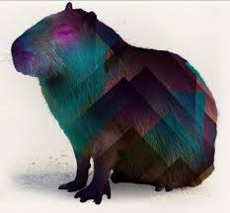
Capybara
Automation UI testing
Karime Salomon Z.

Slide 2
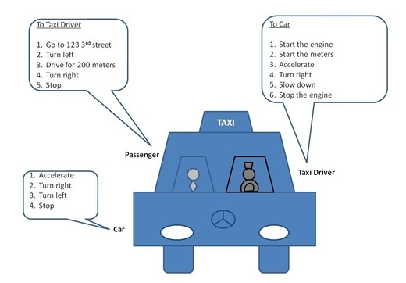
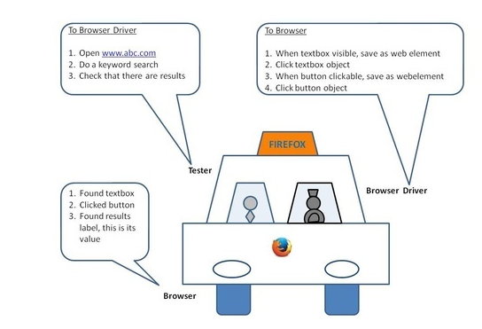
Web driver

Slide 3
Web driver - Selenium
Capybara supports Selenium 2.0 (Webdriver), not Selenium RC. In order to use Selenium, you'll need to install the selenium-webdriver gem, and add it to your Gemfile if you're using bundler. Provided Firefox is installed, everything is set up for you, and you should be able to start using Selenium right away.
Webdriver is the new version of selenium. It also works on multiple browsers. Its removed many drawbacks and issues in Selenium RC. It also supports Android and Iphone Testing. Architecture of WebDriver is totally different that the architecture of RC.
You can install it with:
gem install selenium-webdriver
Need to define in the configuration :
Capybara.javascript_driver = :selenium

Slide 4
Web driver - Webkit
The capybara-webkit driver is for true headless testing. It uses QtWebKit to start a rendering engine process. It can execute JavaScript as well. It is significantly faster than drivers like Selenium since it does not load an entire browser.
You can install it with:
gem install capybara-webkit
Need to define in the configuration :
Capybara.javascript_driver = :webkit

Slide 5
Web driver - Poltergeist
Poltergeist is another headless driver which integrates Capybara with PhantomJS. It is truly headless, so doesn't require Xvfb to run on your CI server.
It will also detect and report any Javascript errors that happen within the page.
Poltergeist is a driver for Capybara. It allows you to run your Capybara tests on a headless WebKit browser, provided by PhantomJS
You can install it with:
gem install poltergeist
Need to define in the configuration :
require 'capybara/poltergeist'
Capybara.javascript_driver = :poltergeist

Slide 6
Adding Web driver to config file
Our previous yml file have the configuration :
drivers:
- chrome
So into our file we need to convert it to a symbol in order to have
:chrome
drivers.each do |driver|
Capybara.register_driver :selenium do |app|
Capybara::Selenium::Driver.new(app, :browser => driver.to_sym)
end
end

Slide 7
Xpath
Consists of one or more chunks of text, delimited by any of a number of special characters, assembled in any of various formal ways. Each chunk, as well as the assemblage as a whole, is called an XPath expression.
Capybara allows selecting element using XPath.
Xpath makes it easy to find any element which does not have id and or name.

Slide 8
Xpath
Expression | Description
node-name | Select all nodes with the given name "nodename"
/ | Selection starts from the root node
// | Selection starts from the current node that match the selection
. | Selects the current node
.. | Selects the parent of the current node
@ | Selects attributes
student | Example: Selects all nodes with the name "student"
class/student | Example: Selects all student elements that are children of class
//student | Selects all student elements no matter where they are in the document

Slide 9
CSS or Xpath? How to configure
Both XPath and CSS expressions are supported, but Capybara does not try to automatically distinguish between them. The following statements are equivalent:
page.all(:css, 'a#person_123')
page.all(:xpath, '//a[@id="person_123"]')
If the type of selector is left out, Capybara uses Capybara.default_selector. It's set to :css by default:
page.all("a#person_123")
If we want to change the default valuee we have to :
Capybara.default_selector = :xpath
Then we can directly find some specific id for tag “a”:
page.all('//a[@id="person_123"]')

Slide 10
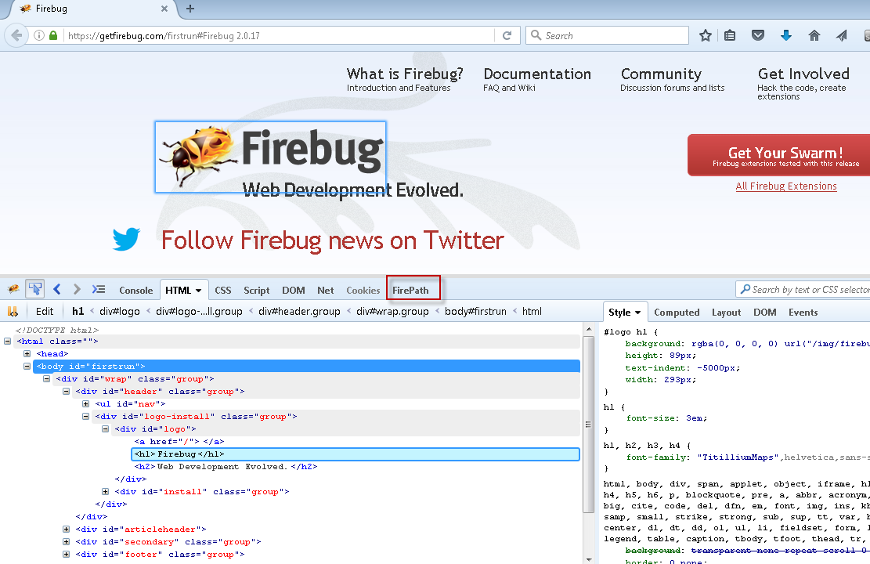
Tools
Firebug

Slide 11
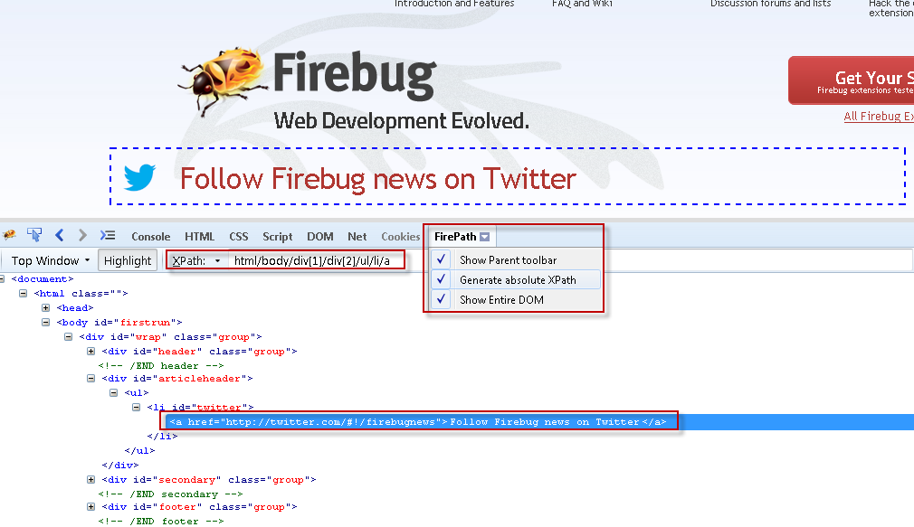
Tools
FirePath

Slide 12
Reviewing pre requisites to start
Gem installed
Capybara configuration options defined
Tools installed

Slide 13
Capybara DSL - Visit
Navigate to the given URL. The URL can either be a relative URL or an absolute URL The behaviour of either depends on the driver
Then, in code, you can call the url like so:
visit 'http://google.com'
Or, if you set the default app_host like so:
Capybara.app_host = 'http://google.com'
Then we can directly say :
visit('/')
And we will be able to open :
visit("http://google.com/")

Slide 14
Practice
Add libraries in env.rb
Add Capybara configuration. Which options need to be implemented to have a browser opened?
Add Feature files with 1 step to navigate to a page. E.g www.google.com
Once you run the feature file the page should be opened using the Capybara.host value.

Slide 15
Thanks!!!

