Slide 1
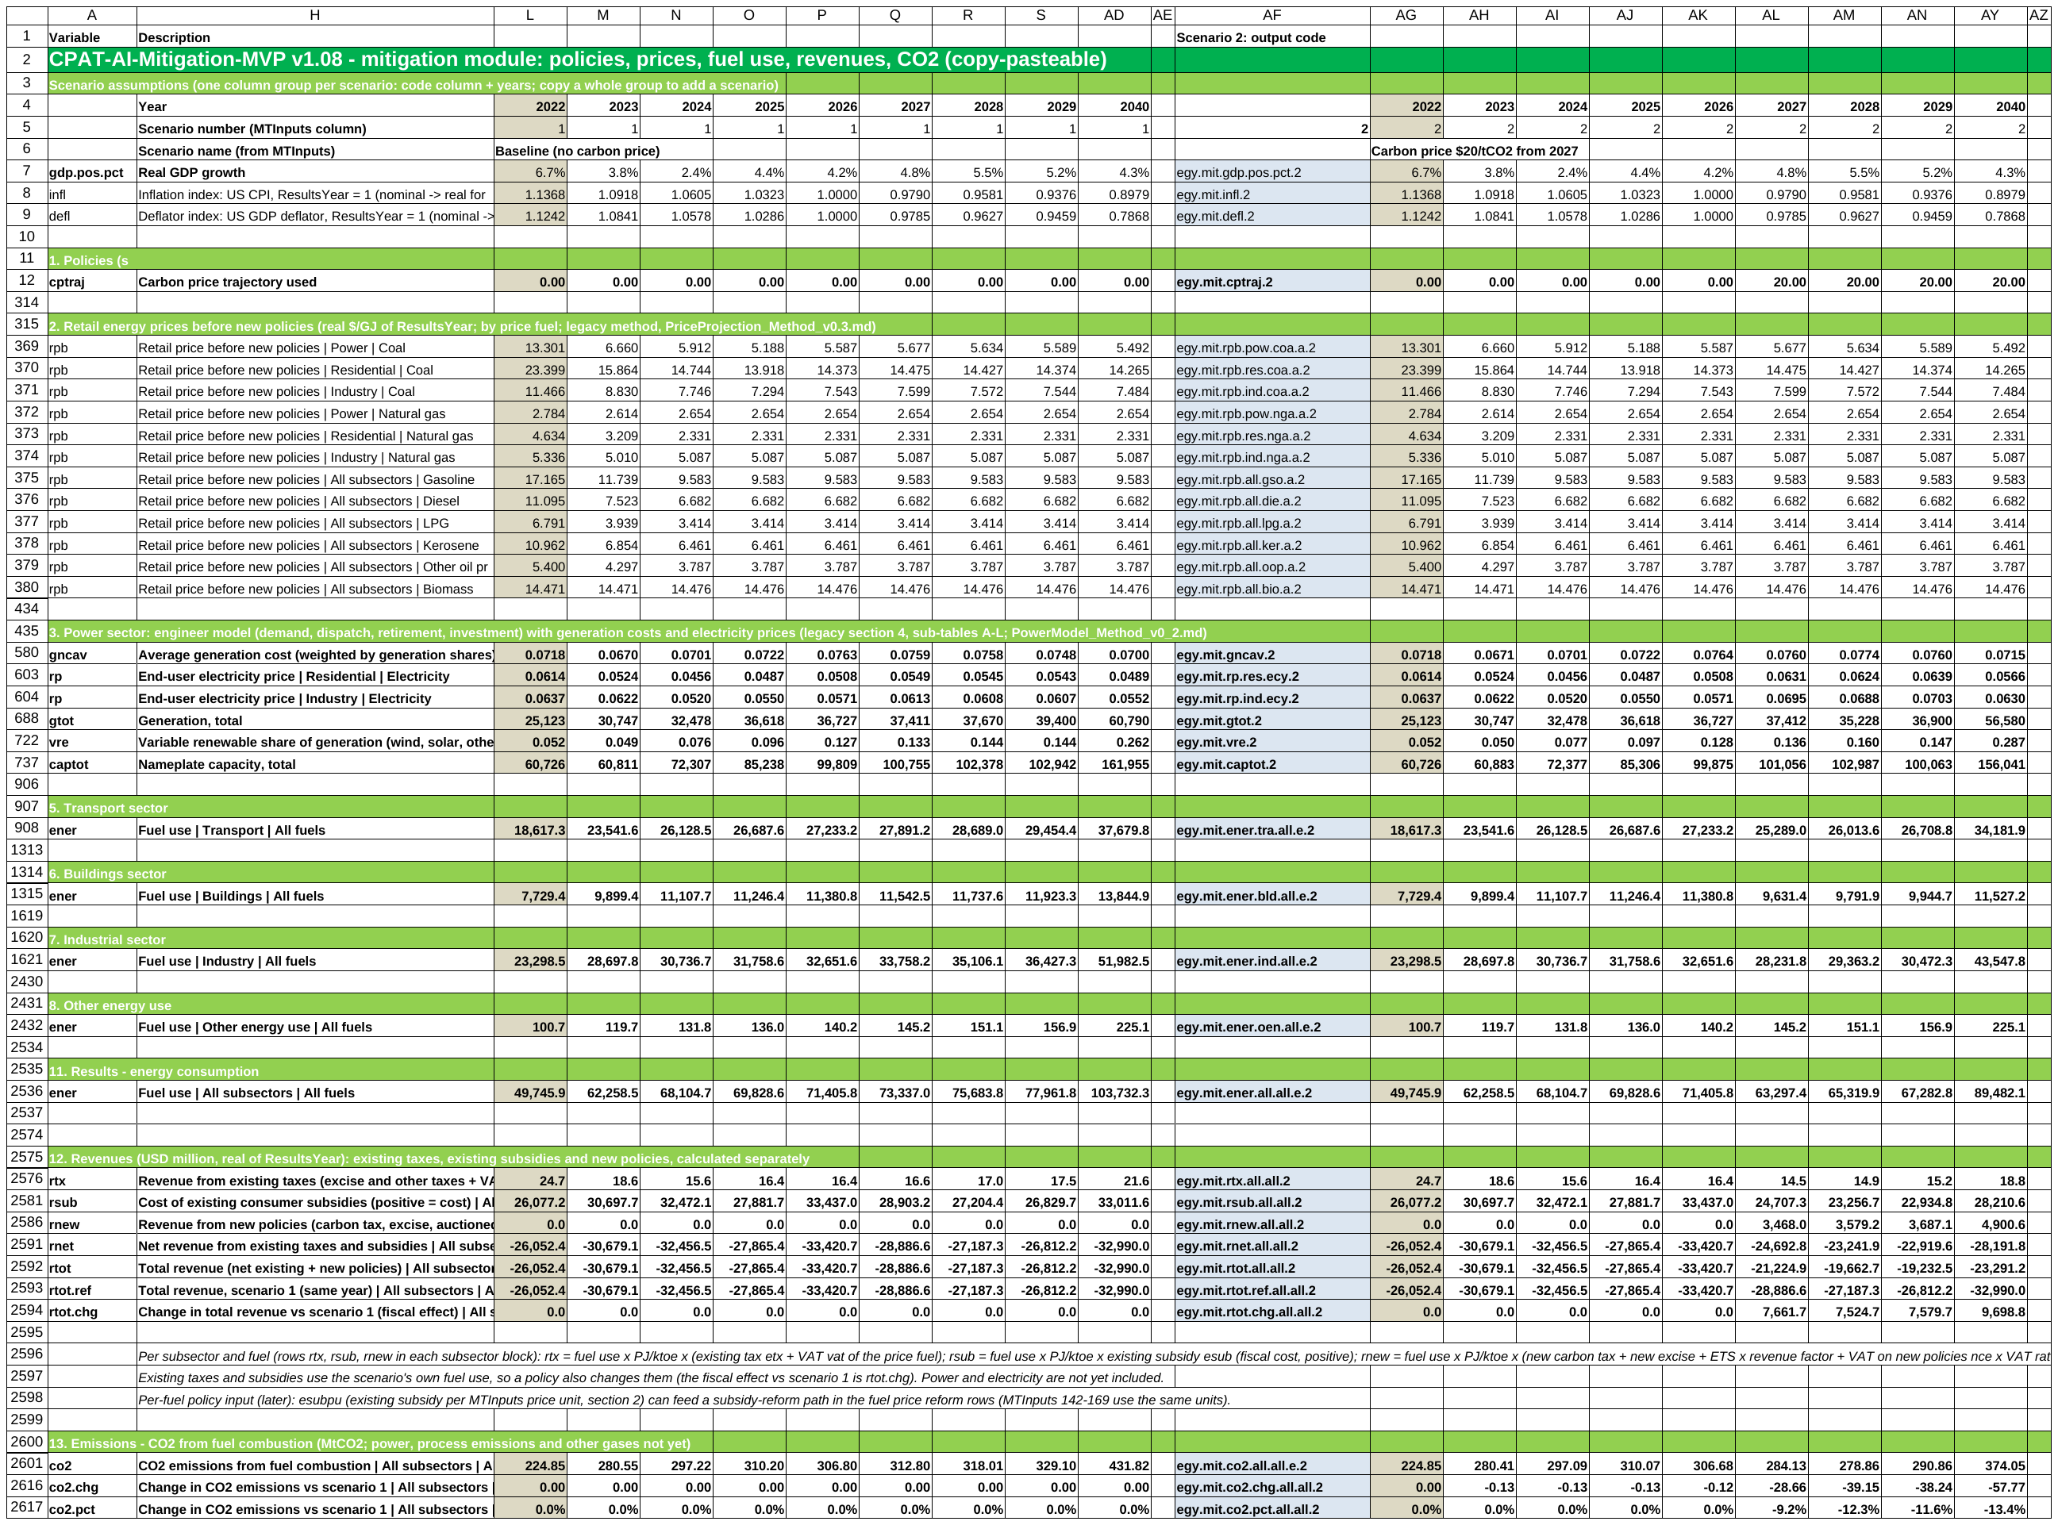
CPAT-AI-Mitigation-MVP
OVERVIEW + USER GUIDE
The CPAT mitigation module as a short, readable Excel workbook, generated and checked by AI.
Plain formulas
Scenarios side by side
Checked by Python
The Mitigation tab as it opens: everything rolled up
Version 1.08, October 2026 · Egypt data · prototype for discussion
Notes:
One workbook for the CPAT mitigation chain: policies, prices, power, fuel use, revenues and CO2. Generated and checked by AI; every value is recomputed independently.

Slide 2
One tab follows the CPAT mitigation chain
WHAT IT IS
1. Policies
2. Prices
3. Power
5-8. Fuel use
11-12. Energy, revenue
13. CO2
1
Policies
Carbon tax, ETS with a cap, feebates and fuel price reform, read from MTInputs.
IN THE WORKBOOK
Egypt data, 2022-2040
Any number of scenarios, run by one macro
Results and charts by output code
NOT YET
Other gases and local pollutants
Full numerical match with legacy CPAT
2
Prices and power
Retail prices by fuel; a power model with demand, dispatch, retirement and investment.
3
Fuel use and results
16 sectors × 8 fuels; fuel use, revenues and CO2 to 2040, in real 2026 USD.
Notes:
The section numbers follow legacy CPAT. Power demand has its own elasticities; sector policies act on fuels only (electricity appears as memo lines in the sector blocks).

Slide 3
Four problems with today's Excel, four fixes
WHAT CHANGES
TODAY IN CPAT
IN THE MVP
Hard to read: long formulas, many tabs
One tab, numbered sections; every formula at most 100 characters
Formulas differ from row to row
One formula per block: copy, drag or paste it anywhere in the block
New scenarios are slow to build
Copy a scenario block, or list scenarios in MTInputs and run one macro
Results are hard to verify
Every value recomputed in Python; legacy bugs found and listed
Notes:
Readability, copy-pasteable formulas, fast scenarios, and independent verification.

Slide 4
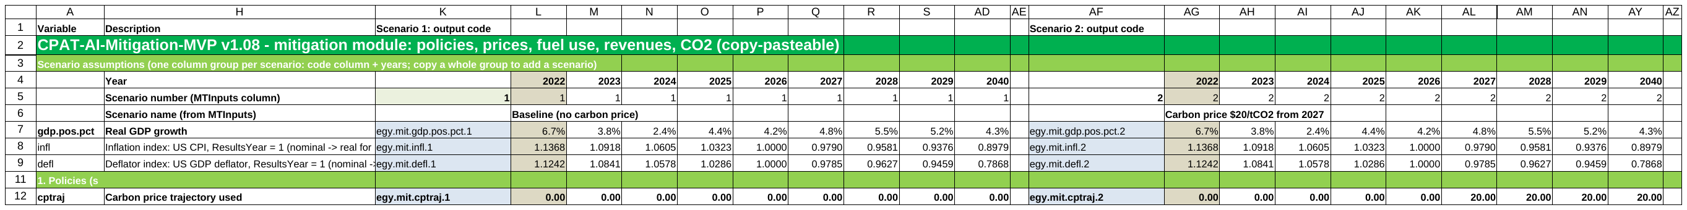
Years run across, scenarios sit side by side
USER GUIDE · LAYOUT
Each scenario is a block of columns: output codes, 2022 (beige), the years to 2040, a blank column.
1
Copy a settings column
In MTInputs, copy the last scenario column one to the right and edit it.
2
Copy a scenario block
In Mitigation, copy a whole block and paste it to the right.
3
Done
The scenario number goes up by one; the block reads its own MTInputs column.
Notes:
Row 5 holds the scenario number; every input row looks up its value in that MTInputs column.

Slide 5
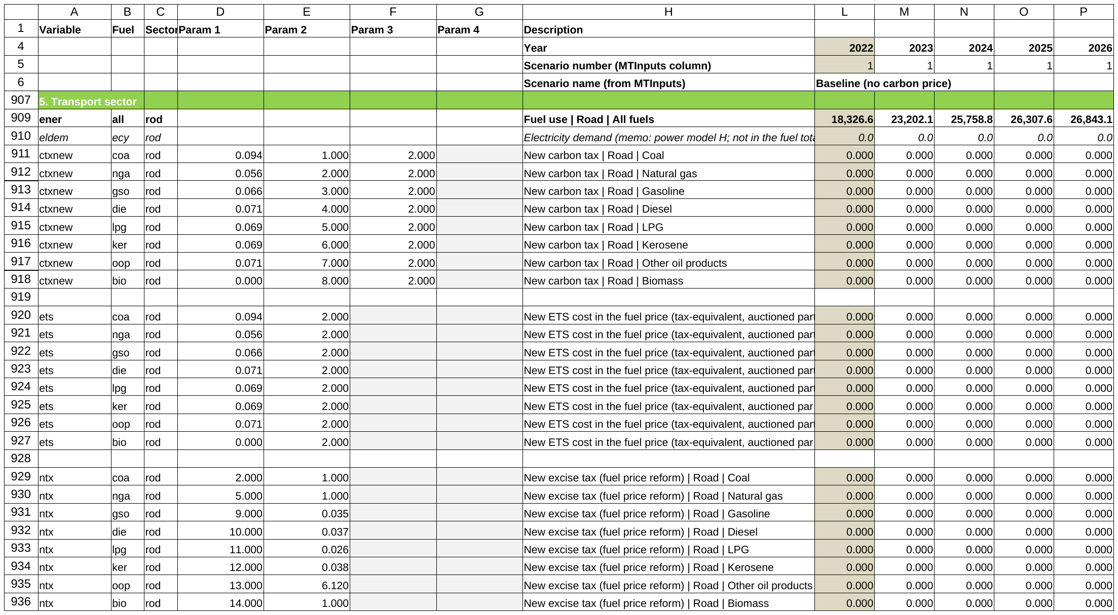
Row-specific numbers live on the left
USER GUIDE · ROWS
A
Columns B:C: fuel and sector
Every row is one fuel in one sector (here: road transport).
B
Columns D:G: that row's numbers
Emission factor, elasticities, positions: looked up once.
C
Year columns: one formula
The same formula in every row of a block.
Notes:
Columns B:G and I:K are grouped and rolled up on open: click + above the columns to show them. The italic memo line under each sector heading is its electricity demand from the power model.

Slide 6
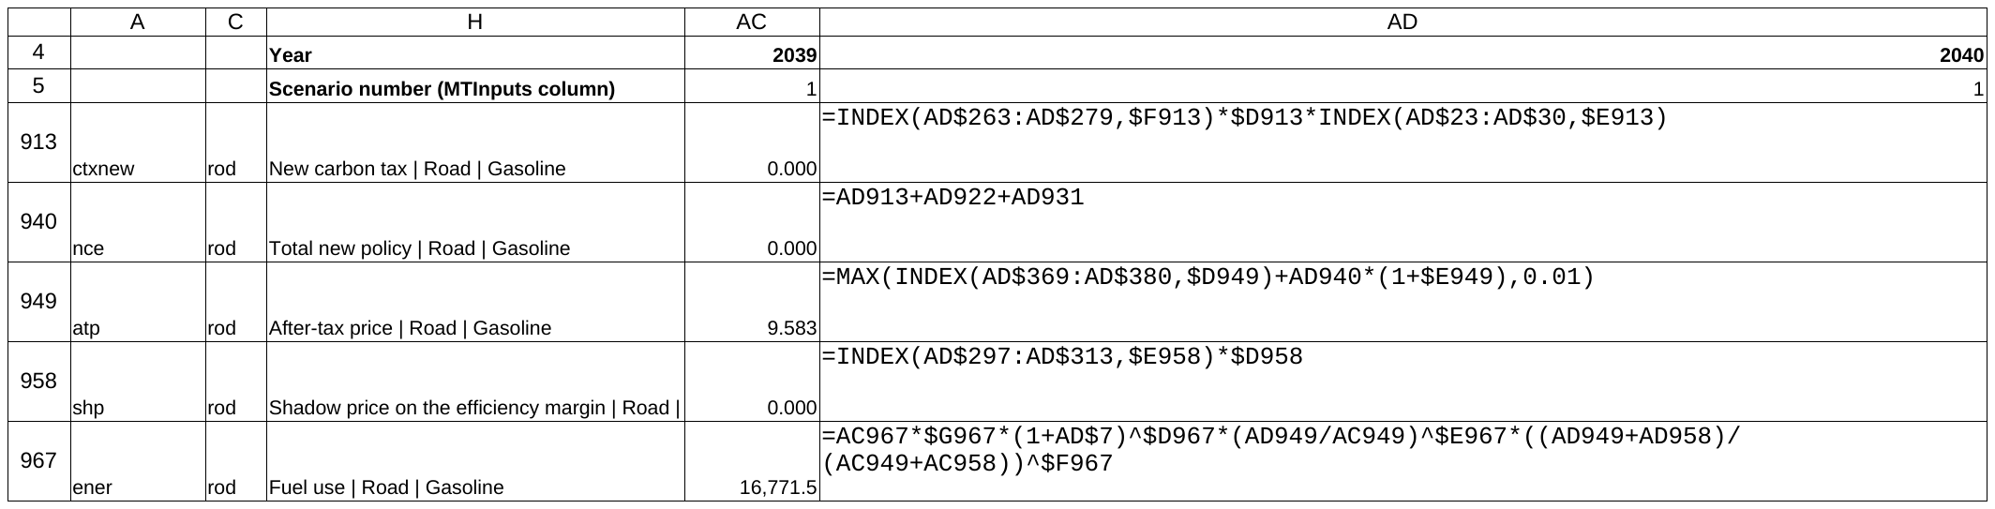
Short, plain formulas that work in any Excel
USER GUIDE · FORMULAS
At most 100 characters
All 111,245 formulas. Long ones are split into visible steps.
No LAMBDA needed
Every cell is plain Excel; LibreOffice recalculates it with zero errors.
LAMBDAs optional
Sheet Lambdas gives a named-function version of each row; same results.
Notes:
Formula text of the road gasoline rows, 2040 column: the same formula as every other year. Lookups use defined names for the data tables (e.g. WEOVal, PDomVal).

Slide 7
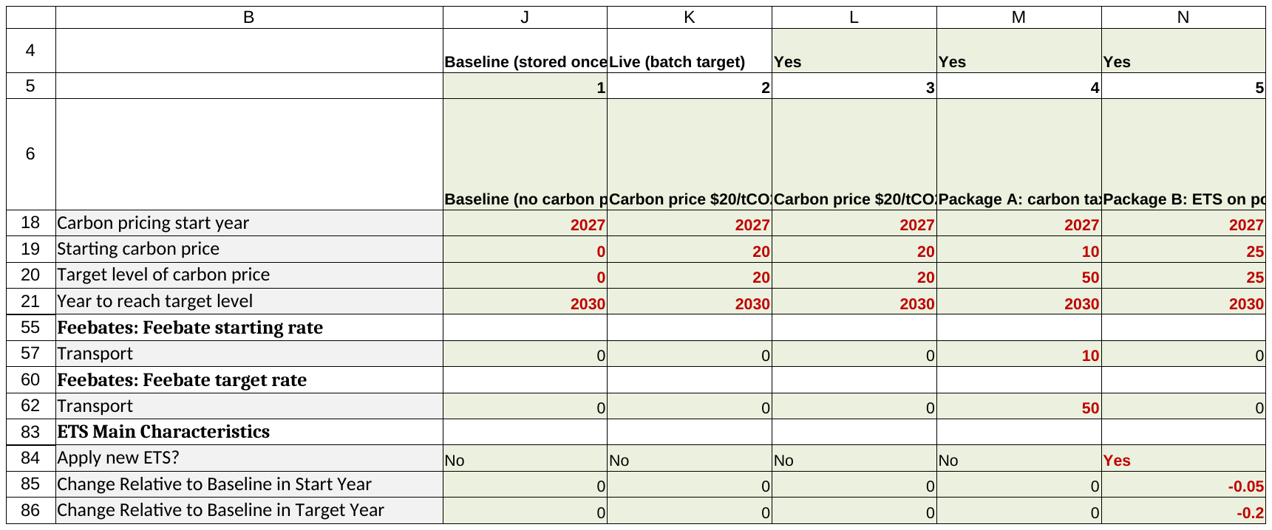
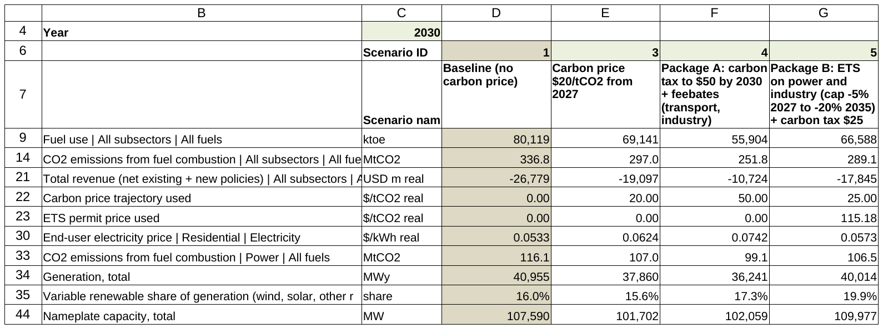
List scenarios, run one macro, compare
USER GUIDE · MANY SCENARIOS
Define in MTInputs
RunAllScenarios
StoredResults
ScenarioCompare
ScenarioCompare: levels in one year vs the baseline
MTInputs: one column per scenario, Run? = Yes
Notes:
The macro copies each definition into the live column, recalculates, runs the ETS goal seek where needed, and stores the results as values. CheckBatchRun tests the macros on first use in Excel.

Slide 8
Policies cut CO2; the ETS price meets its cap
RESULTS
Package B ETS price: 115 $/tCO2 in 2030 (goal seek, 17 iterations)
Notes:
Stored scenario results (StoredResults). Baseline = no carbon price; Package A = carbon tax to $50 + feebates; Package B = ETS on power and industry + carbon tax elsewhere.

Slide 9
A full power model, with ten legacy bugs fixed
POWER SECTOR
H. Demand
I. Dispatch
K. Capacity, retirement
L. Investment
G. Prices
SAME METHOD AS LEGACY
Reproduces 208 legacy rows of two runs (to 1e-13)
Ten bugs fixed; report in Word
IN THE WORKBOOK
Planned retirement by type (switch per type)
Electricity demand as memo lines by sector
Power CO2 counted in totals and the ETS
Notes:
Demand responds to last year's price; dispatch fills demand from capacity; investment follows a logit on levelised cost within scale-up limits. A carbon price raises the VRE share.

Slide 10
Every number is checked independently
QUALITY
0
error values when LibreOffice recalculates the shipped file
111,245
formulas, none longer than 100 characters
4,630
output codes unchanged against the previous version
12
scenario tests recomputed in Python
1
Independent recomputation
A Python script recomputes prices, fuel use, power, revenue and CO2 from the source data for every test scenario.
2
Macros tested
The batch macro runs in LibreOffice and matches the stored results; CheckBatchRun repeats the test in Excel.
3
Differences listed
Sheet LegacyDiff lists every difference with legacy CPAT and why.
4
Documented
Method notes, a Word documentation and a bug report for the power model.
Notes:
Check report check_report_v1.08.md: Overall PASS.

Slide 11
Open, run the check, then explore
GETTING STARTED
1
Open the .xlsm and enable macros
Run CheckBatchRun once (Alt+F8): sheet MacroCheck should say PASS.
NEXT
Review in Excel
Numerical check against legacy CPAT
Other gases and local pollutants
Planned-retirement data for Egypt
Stress test: add a fuel, a sector, a scenario
2
Change a scenario
Edit its MTInputs column; results update on Mitigation, MTOutputs and Charts.
3
Run many scenarios
Set Run? = Yes on the definitions and run RunAllScenarios; compare them.
4
Read more
ReadMe and LegacyDiff tabs; the Word documentation and method notes.
Notes:
Files: CPAT-AI-Mitigation-MVP-v1.08.xlsm, CPAT-AI-Mitigation-MVP_Documentation_v1.08.docx, PowerModel_BugsAndImprovements_v1_0.docx (working_version folder).

