Slide 1
FOLLOW-UP TO OUR MEETING · 20 OCTOBER 2026
The Macro-Fiscal-Energy-Scenario Tool
One country, one scenario: revenue, public investment, green investment needs and carbon pricing, through to growth, debt and debt risk to 2050
Stephen Stretton · World Bank · prototype v0.7 (MacFiscEnergyScenarioProto)

Slide 2
WHAT IT DOES
A scenario tool: set fiscal and energy policy, see the fiscal path
YOU SET
IT COMPUTES
YOU READ
Four main levers
Live, for 186 countries
One Dashboard, 2025-2050
• Revenue: increase in pp of GDP a year, up to a ceiling
• Public investment: increase in pp of GDP
• Climate investment programme: on or off (the budget need for net zero)
• Carbon pricing: tax, feebate, or the most effective politically feasible mix
• Green investment need and who pays (NMIM)
• Feasible carbon price and its revenue (PriceFeasibility)
• Growth and debt (DIGNAD-type macro model)
• Debt risk (LIC-DSF-lite, low and lower-middle income)
• Public debt; revenue and expenditure; balance
• GDP against no new measures
• Green investment need, budget need, green public investment
• Carbon price in force; debt sustainability
So: it answers 'what does this package do to the budget and debt?', in Excel, with no code.
Macro-Fiscal-Energy-Scenario Tool · 20 Oct 2026 · 2

Slide 3
HOW IT WORKS
Five models joined in one workbook, driven from the Dashboard
1 Data
2 Green investment
3 Carbon pricing
4 Macro
5 Debt
Dashboard
Tax & Macro-Fiscal Dashboard panel: 217 countries, fiscal, PIMA, debt, energy
DIGNAD-R live; GIMF / DIGNAD / DIGNAR-lite integrated run as cross-check
LIC-DSF-lite: five indicators against thresholds; risk rating
Debt, revenue, spending, GDP, green investment, carbon price, DSA
NMIM: net zero investment by sector, who pays (P1-P5), budget need 2025-50
PriceFeasibility: tax vs feebate under limits on tariffs, the poor, coal generators
Live, not pasted: change an investment assumption (e.g. the public share of viability-gap investment) and the budget need, the fiscal outlook and debt all recalculate. Every formula is checked against a Python copy of the equations.
So: the levers are few; the detail sits behind them for anyone who wants it.
Macro-Fiscal-Energy-Scenario Tool · 20 Oct 2026 · 3

Slide 4
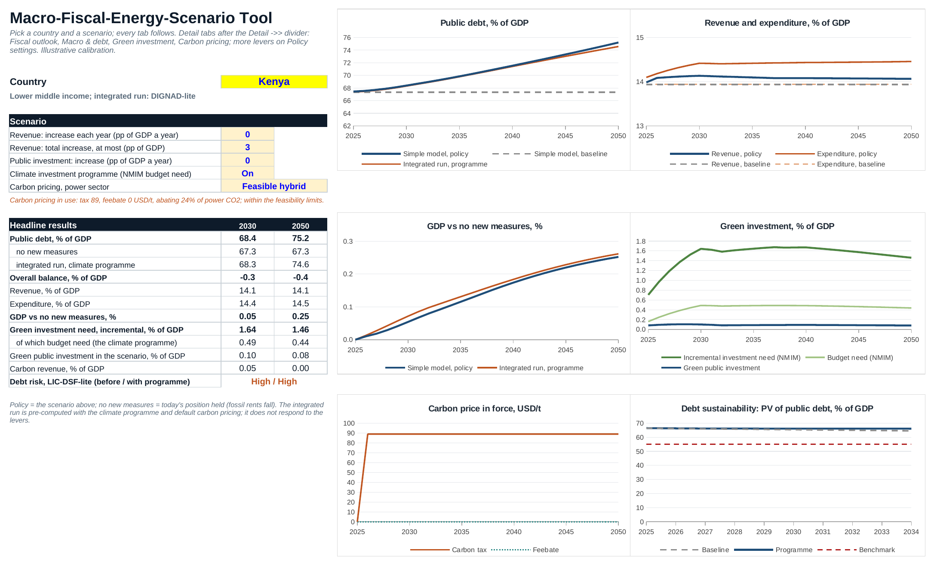
THE WORKBOOK
One core Dashboard; the indicators dashboard is a subcomponent
Tabs, left to right
• Dashboard: the only place you drive it
• Detail ->> Fiscal outlook · Macro & debt · Green investment · Carbon pricing · Policy settings · model sheets
• Not master ->> the Tax & Macro-Fiscal Dashboard's country profile (16 blocks, 217 countries), kept as a subcomponent; its master is maintained separately
• Data: the dashboard panel feeds every model's calibration
So: the dashboard is the data layer and a country profile; the scenario tool is what runs on top of it.
Macro-Fiscal-Energy-Scenario Tool · 20 Oct 2026 · 4

Slide 5
EXAMPLE · KENYA
What a package does to debt: an illustration
75%
128%
31%
89 USD/t
public debt in 2050 (% of GDP) with the climate programme and feasible carbon pricing; 67% with no new measures
if public investment also rises by 1.5pp of GDP, debt-financed
if revenue rises 0.5pp of GDP a year (to 3pp) to pay for it; GDP 3.2% higher by 2050
feasible power-sector carbon tax: abates 24% of power CO2, within all three limits
Kenya, 2030 | Value | Source in the tool
Incremental green investment need | 1.6% of GDP | Green investment (NMIM)
of which direct budget need | 0.5% of GDP | Green investment: P1 + public gap of P4
Debt risk (LIC-DSF-lite) | High, before and with the programme | Macro & debt
Illustrative calibration: the baseline holds today's position (no WEO projections yet) and several parameters are priors. For comparing packages, not as a forecast.
Macro-Fiscal-Energy-Scenario Tool · 20 Oct 2026 · 5

Slide 6
INTEGRATION
A natural fit with the FSA
TOOL TO FSA
FSA TO TOOL
R AND ENERGY RISKS
Scenario paths in
Sustainability out
Two good additions
• Revenue and expenditure paths, by item
• Primary balance, growth, interest
• Green investment and budget need by year
• Carbon revenue, and how it is used
• A proper baseline (where ours is a placeholder)
• Debt dynamics and fiscal space
• Replaces our simple debt module for all income groups
• One verdict, consistent with country work
• R tool: integrate it; the tool's data and model sheets map to a clear interface
• Energy fiscal risks: fossil revenue loss, utility liabilities (P2 tariff-backed investment), subsidies
• Most inputs already sit in the tool
So: the tool sets the policy scenario; the FSA judges its sustainability.
Macro-Fiscal-Energy-Scenario Tool · 20 Oct 2026 · 6

Slide 7
STATUS AND NEXT STEPS
Built and checked; next, the link to the FSA
BUILT
LIMITS TODAY
NEXT
Prototype v0.7
Illustrative
Proposed steps
• 186 countries; Excel, no code
• Formulas checked against Python to 1e-14
• Green investment matches NMIM exactly
• Docs and version notes in the repository
• Baseline holds today's ratios; no WEO path yet
• Macro calibration partly income-group defaults
• Carbon pricing: power sector only, several priors
• Agree the FSA interface: which variables, which years
• Integrate the R tool
• Add the energy fiscal risks module
• WEO baseline; one pilot country end to end
So: a short working session on the FSA interface would let us run one country through both.
Macro-Fiscal-Energy-Scenario Tool · 20 Oct 2026 · 7

