Slide 1
CPAT · FOR DISCUSSION · SEPTEMBER 2026
A new CPAT engine, and what we build on it
The problem, the coded and AI-Excel conversion, other products, and what to keep
AI-Excel
Coded: Python + Shiny
Other products
Stephen Stretton · World Bank
Notes:
Draws on Issues with CPAT and Options for Remediation (first presented April 2026), the Coded CPAT and other AI tools plan (September 2026) and the FY27 work plan.

Slide 2
Contents
Purpose: agree the plan for rebuilding CPAT's engine with AI, in code and in Excel, and decide which smaller products to keep alongside it.
PART 1 · SLIDES 3–5
PART 2 · SLIDES 6–12
PART 3 · SLIDES 13–19
PART 4 · SLIDES 20–21
The problem
Coded CPAT and AI-Excel
Other products
Keep, drop and conclude
Three problems
Two products compared
Overview (13)
What to keep and what to drop
Main coding issues
Purposes of AI-Excel
A · CPAT–SiSePuede (14)
Conclusion and next steps
Why a patch is not enough
Maintainability
B · Python platform (15)
Issues and resolutions
C · Dashboard and policy report (16–18)
Status and timeline
Where each form goes
D · Total Carbon Price into GHG accounting (19)
CPAT final summary · 2

Slide 3
PART 1 · THE PROBLEM
CPAT's mitigation module has three problems
Code quality
Empirical validation
Short-term usability
The module is large, slow, heavy and hard to maintain. No user can understand or validate 250,000+ spreadsheet cells.
The WB side has not published CPAT. The IMF publication relies mostly on an elasticity meta-analysis.
A few bugs, and hard to demonstrate: it can take ten minutes to load. This limits its use in country work.
CPAT final summary · 3

Slide 4
PART 1 · MAIN CODING ISSUES
Heavy, slow and hard to keep consistent
Heavy
The mitigation module is the largest part of CPAT.
Slow
Other modules depend on it, so they wait for it.
Hard to maintain
250,000+ cells are hard to understand and validate.
Hard to keep consistent
Excel, Python CPAT and documentation drift apart; a spreadsheet is hard to publish in a peer-reviewed journal.
Not fit for the new UI
Policy mixes need every sector and fuel combination handled properly: a fully consistent approach.
CPAT final summary · 4

Slide 5
PART 1 · WHY A PATCH IS NOT ENOUGH
Patching the old Excel will not be enough
The April option
What the engine must now do
A new engine tab in legacy CPAT
Policy mixes across every sector, fuel and policy
Lambda functions, arrays and simpler prices. Result: a more consistent engine, but CPAT not much faster or smaller.
A clean back end for the new WB–IMF interface
GHG accounting, with every figure traceable
So: rebuild the engine with AI, in code and in Excel, and keep them equal.
CPAT final summary · 5

Slide 6
PART 2 · TWO PRODUCTS, COMPARED
One set of equations, two forms
 | 1 · Coded (Python + Shiny) | 2 · AI-Excel
What it is | The core engine in Python, with an online Shiny interface | A cut-down CPAT in Excel, built from scratch with AI
First uses | Model comparison; full country work once complete; SiSePuede and pathways tool | GHG accounting; a clean back end for the new WB–IMF interface
Users | Modelers and teams who run code; web users via Shiny | Economists who work in Excel; IMF and WB CPAT teams
Strength | Scales, tests and links to other Python models | Familiar, transparent cell by cell, easy to audit
Limit | Not open to non-coders without Shiny | Harder to scale; LAMBDA needs a recent Excel
CPAT final summary · 6
Notes:
Both forms share one set of equations and are kept equivalent by script. Each is built component by component, together: distribution, mitigation basics, power, other mitigation and GDP, air pollution, transport.

Slide 7
PART 2 · THE CASE FOR AI-EXCEL
AI-Excel serves three purposes
1
2
3
Input to the WB–IMF process
GHG accounting and policy crediting
Cross-checking
An independent check on the coded engine and on legacy CPAT. Differences point to errors on either side.
Agreed with Dirk: a contributor to future development, not yet the full CPAT. A base for one maintainable model.
A transparent Excel tool for ex-ante DPF accounting and crediting, where each figure is traceable.
CPAT final summary · 7
Notes:
AI-Excel also lowers the risk of building a new user interface on an archaic back end. It is not meant to replace legacy CPAT yet; that is for later discussion.

Slide 8
PART 2 · MAINTAINABILITY
Scripts keep code, Excel and docs equal
Python engine
Excel CPAT
Extraction scripts
Generative files
AI-Excel
Legacy data and parameters
Pull data out, with a source trail
Build script + pseudocode
Documentation
Share generators, not context
Works with Claude or Copilot
Claude builds the Excel through a Python script. We save (a) that full script and (b) a readable pseudocode version that produces it.
Any AI coding tool can pick it up. Proprietary data stays ring-fenced outside the shared files.
CPAT final summary · 8
Notes:
Joint working with AI: rather than passing around long context, we keep small generative files and concise scripts. Anyone, with any AI tool, can regenerate the Excel, the code and the documentation from them.

Slide 9
PART 2 · ISSUES AND RESOLUTIONS
The main risks are known and manageable
Topic | Issue | Resolution
IMF ownership | The IMF may want to take control, and could build its own version. | Agree the WB side first, then bring the IMF in early. Their version may look like ours.
Compatibility | LAMBDA functions need recent Excel; older copies, e.g. in finance ministries, may fail. | Finance ministries are not the first audience. LAMBDAs can be turned back into direct formulae.
Functionality | Excel CPAT holds many ad hoc changes; the new model will not match them all at first. | Build a sound, maintainable base; extend it once code and AI-Excel are adequate.
Scope | Risk of two Excel models to maintain in the long run. | A contributor to the WB–IMF process, not yet the full CPAT. Long-term, keep one Excel.
Accessibility | Teams use different AI tools, and some data is proprietary. | Works with Claude or GitHub Copilot; proprietary data kept ring-fenced.
CPAT final summary · 9
Notes:
Ask the room: what other issues should we plan for? These points come from discussion with Dirk.

Slide 10
PART 2 · CURRENT STATUS · 28 SEPTEMBER
Five weeks spent; the proofs of concept are done
July · 2 weeks · done
September · 3 weeks · done
Pathways tool · in progress
Proofs of concept
Set-up
CPAT and SiSePuede
Coded CPAT prototype, proof of concept on prices
Requirements and scope
Assumptions reconciled; variables mapped
AI coding set-up
AI dashboard, with full data audit trail
AI-Excel form begun
Coded CPAT run in full on the SiSePuede side
Excise Diagnostic
Prices and policies partly brought in
Blocked by leave to 14 July and through August (leave without pay). Next: mitigation basics and the Excel MVP, from 5 October.
Source: FY27 work plan v1.1 · CPAT final summary · 10

Slide 11
PART 2 · MASTER TIMELINE²
Excel MVP¹ by 16 October; all modules by February
Model + AI-Excel
Shiny + code
Oct
Nov
Dec
Leave
Jan
Feb
Mar
Application
Other products
5
12
19
26
2
9
16
23
30
7
14
4
11
18
25
1
8
15
22
1
8
15
Mitigation basics + Excel MVP¹
MVP · 16 Oct
Code MVP + Shiny
Distribution
Power
Air pollution
Remainder of mitigation
Shiny prototype
GHG accounting
Transport
Policy crediting and FFI
Macro-fiscal dashboard updates
Policy reports
¹ MVP = minimum viable product: mitigation basics working, and matching, in code and AI-Excel. Hatched = leave.
² In parallel, not shown: CPAT–SiSePuede supervision (half a day a week to mid-Dec, a day a week in Jan); Python platform with Zoe (Feb, about half of each week); Energy GP finance model review (two weeks, late Jan–Feb, not yet slotted).
Week-of dates · CPAT final summary · 11
Notes:
Done so far (July and September, five weeks): prices proof of concept, AI dashboard and Excise Diagnostic proofs of concept, requirements and AI coding set-up, and the AI-Excel form begun. The week of 26 October is now leave, so distribution takes one week (2 November); all later dates are unchanged.

Slide 12
PART 2 · WHERE THE CODE AND THE EXCEL GO
The code feeds SiSePuede; the Excel feeds the WB–IMF process
CPAT–SiSePuede pathways tool · slide 14
Coded (Python)
Single Python platform with MFMod and FTT · slide 15
With a Shiny web interface
Model comparison and web users via Shiny
One engine
One set of equations, kept equal by script
WB–IMF CPAT process, as a contributor
AI-Excel
GHG accounting and policy crediting tool
A cut-down CPAT in Excel
Cross-check of the code and legacy CPAT
CPAT final summary · 12
Notes:
The transition to Part 3. The coded engine is the input to the CPAT–SiSePuede project and sits on the single Python platform. AI-Excel goes to the WB–IMF process, GHG accounting and cross-checking. Part 3 starts with the two places the code goes.

Slide 13
PART 3 · OTHER PRODUCTS
Small tasks, built on what already exists
Little change is proposed, as there is not time this FY: just tweaks to what is already there.
 | Product | Starting point (exists) | Tweak proposed | Slide
A | CPAT–SiSePuede | Coded CPAT runs in full on the SiSePuede side | Supervise the CPM team: prices, policies, air pollution | 16–18
B | Single Python platform | CPAT, MFMod-Python and FTT | One place to run them, with one user guide | 19
C | Dashboard and policy issue report | Excise Diagnostic; AI macro-fiscal dashboard | Add tax indicators; frame reports by issue | 16–18
D | Total Carbon Price into GHG accounting | Current Total Carbon Price | Link to the GHG accounting metric; standalone | 19
CPAT final summary · 13

Slide 14
PART 3 · A · CPAT–SISEPUEDE
Coded CPAT goes into the country pathways tool
With David Groves: CPAT, CPM (formerly SiSePuede), MANAGE and MINDSET combined into one country policy analysis tool.
Done · first phase, to July 2026
This year · supervising the CPM team
Assumptions and outputs reconciled
Finish prices, policies and the air pollution translation
Variables mapped and outputs compared
CPAT-LTS investment approach and policy interface
Coded CPAT runs in full on the SiSePuede side
Light touch: about half a day a week, a day a week in January
Prices and policies partly brought in
CPAT final summary · 14

Slide 15
PART 3 · B · SINGLE PYTHON PLATFORM
Make existing models easy to use, not develop them further
What
How
Not
CPAT, MFMod-Python and FTT, as they are today, on one common platform.
A shared set-up and one user guide. FTT made ready to run, with data aligned to CPAT countries.
No further model development, and no full merging of FTT or MFMod into CPAT.
CPAT final summary · 15

Slide 16
PART 3 · C · DASHBOARD AND POLICY ISSUE REPORT
Two prototypes become two products
Output 1
Prototype · done
Dashboard
Excise Diagnostic
Macro-fiscal indicators, now with excise and other tax indicators, and the Total Carbon Price
Country tax system: excises, subsidies, electricity pricing
Brought together
Prototype · done
Output 2
Macro-fiscal indicators
Policy issue report
AI dashboard with a full data audit trail
One issue in one country, e.g. feebates: the situation, best practice and reform
CPAT final summary · 16

Slide 17
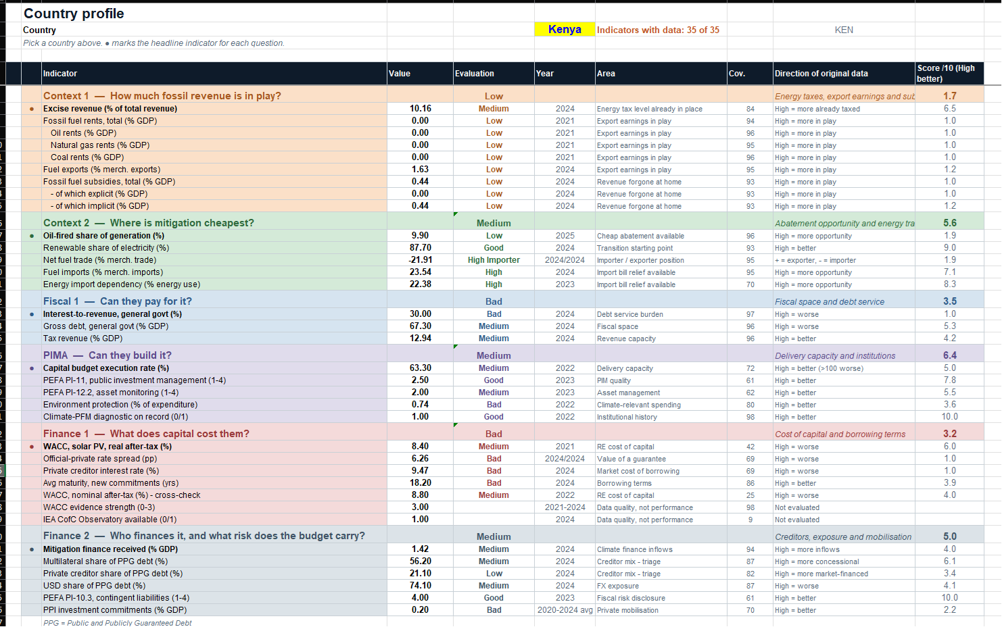
PART 3 · C · THE DASHBOARD INTERFACE IN DEVELOPMENT
The interface in development
A country profile
Kenya shown: 35 of 35 indicators with data
Grouped by question
Fossil revenue, mitigation cost, fiscal space, investment, cost of capital, finance
Scored and sourced
Each indicator rated, scored out of 10, with year and coverage
CPAT final summary · 17
Notes:
AI-built dashboard proof of concept, with a full data audit trail. The tax indicators from the Excise Diagnostic join this base.

Slide 18
PART 3 · C · POLICY ISSUE REPORT
One issue, one country, for example feebates
1
2
3
The situation
Best practice
Reform
Where the country stands on the issue, drawn from the dashboard and diagnostic.
The best policy design, and what other countries did and learned.
The opportunities for reform in that country, and how to get there.
CPAT final summary · 18
Notes:
The dashboard says what is there; the policy issue report says what to do next. Together they give a fast, sourced starting point for policy dialogue.

Slide 19
PART 3 · D · TOTAL CARBON PRICE INTO GHG ACCOUNTING
Bring the Total Carbon Price into GHG accounting
A standalone product
Linked to GHG accounting
Also in the dashboard
Delivered on its own, not as part of Coded CPAT.
Consistent with the GHG accounting metric.
Shown alongside the macro-fiscal and tax indicators.
CPAT final summary · 19

Slide 20
PART 4 · WHAT TO KEEP AND WHAT TO DROP
The plan is full to 20 March: anything added must replace something
KEEP · CORE
KEEP · SMALL
DROP OR DEFER
Coded CPAT and AI-Excel. Funded; the base for everything else
Python platform. Access only
Patching legacy Excel (new tab, Lambdas): superseded
Dashboard and policy report. Prototypes exist; funding to confirm
GHG accounting. A corporate requirement; no DPF tool exists
Validating legacy CPAT: separate note
Policy crediting and FFI. One week, on GHG accounting
Full CPAT replacement; merging FTT or MFMod: later
CPAT–SiSePuede. Funded; light-touch supervision
Total Carbon Price into GHG accounting. Not yet scheduled
April items not in FY27 plan: ETS pilot, downstream pricing, CPAT paper
Energy GP code help. Not on the timeline; needs a slot
Source: FY27 work plan v1.1 (28 Sept 2026) · CPAT final summary · 20
Notes:
For discussion. The work plan selects GHG accounting (3a) and marks policy crediting (3b) and the tax/fiscal dashboard (3c) as possibly dropped, at five weeks each. The master timeline gives them much less: one week for policy crediting and FFI, two weeks each for the dashboard and policy reports. The Energy GP coding help (3d, two weeks) is in the work plan but not on the master timeline, so it needs a slot or should go. The April items (ETS pilot, downstream industrial pricing, CPAT working paper) do not appear in the FY27 plan; confirm whether they are done, handed over or dropped.

Slide 21
CONCLUSION
One AI-built engine, two forms, a few small products
Fixes the module's problems
NEXT STEPS
A compact, traceable engine replaces 250,000+ cells and handles policy mixes.
Informal chats in the office before 16 October
Excel and coded MVP by 16 October
Each form has a home
Agree on the WB side, then bring the IMF in
Confirm GHG accounting and policy crediting requirements
Code into SiSePuede and the Python platform; AI-Excel into the WB–IMF process and GHG accounting.
Agree the keep-or-drop list
Choose a country project (to be defined)
Focus wins
Keep the core; other products are small tweaks or wait.
CPAT final summary · 21

