Slide 1
A new CPAT engine, and what we build on it
CPAT · FOR DISCUSSION · SEPTEMBER 2026
The problem, the coded and AI-Excel conversion, other products, and what to keep
AI-Excel
Coded: Python + Shiny
Other products
Notes:
Draws on Issues with CPAT and Options for Remediation (first presented April 2026), the Coded CPAT and other AI tools plan (September 2026) and the FY27 work plan.

Slide 2
Contents — Purpose: agree the plan for rebuilding CPAT's engine with AI, in code and in Excel, and decide which smaller products to keep alongside it.
PART 1 · SLIDES 3–5
The problem
Three problems
Main coding issues
Why a patch is not enough
PART 2 · SLIDES 6–12
Coded CPAT and AI-Excel
Two products compared
Purposes of AI-Excel
Maintainability
Issues and resolutions
Status and timeline
Where each form goes
PART 3 · SLIDES 13–19
Other products
Overview (13)
A · CPAT–SiSePuede (14)
B · Python platform (15)
C · Dashboard and policy report (16–18)
  D · Total Carbon Price into GHG accounting (19)
PART 4 · SLIDES 20–21
Keep, drop and conclude
What to keep and what to drop
Conclusion and next steps

Slide 3
PART 1 · THE PROBLEM — CPAT's mitigation module has three problems
Code quality
  The module is large, slow, heavy and hard to maintain. No user can understand or validate 250,000+ spreadsheet cells.
Empirical validation
  The WB side has not published CPAT. The IMF publication relies mostly on an elasticity meta-analysis.
Short-term usability
  A few bugs, and hard to demonstrate: it can take ten minutes to load. This limits its use in country work.

Slide 4
PART 1 · MAIN CODING ISSUES — Heavy, slow and hard to keep consistent
Heavy
Slow
Hard to maintain
Hard to keep consistent
Not fit for the new UI
  The mitigation module is the largest part of CPAT.
  Other modules depend on it, so they wait for it.
  250,000+ cells are hard to understand and validate.
  Excel, Python CPAT and documentation drift apart; a spreadsheet is hard to publish in a peer-reviewed journal.
  Policy mixes need every sector and fuel combination handled properly: a fully consistent approach.

Slide 5
PART 1 · WHY A PATCH IS NOT ENOUGH — Patching the old Excel will not be enough
  So: rebuild the engine with AI, in code and in Excel, and keep them equal.
The April option
A new engine tab in legacy CPAT
  Lambda functions, arrays and simpler prices. Result: a more consistent engine, but CPAT not much faster or smaller.
What the engine must now do
  Policy mixes across every sector, fuel and policy
  A clean back end for the new WB–IMF interface
  GHG accounting, with every figure traceable

Slide 6
PART 2 · TWO PRODUCTS, COMPARED — One set of equations, two forms
 | 1 · Coded (Python + Shiny) | 2 · AI-Excel
What it is | The core engine in Python, with an online Shiny interface | A cut-down CPAT in Excel, built from scratch with AI
First uses | Model comparison; full country work once complete; SiSePuede and pathways tool | GHG accounting; a clean back end for the new WB–IMF interface
Users | Modelers and teams who run code; web users via Shiny | Economists who work in Excel; IMF and WB CPAT teams
Strength | Scales, tests and links to other Python models | Familiar, transparent cell by cell, easy to audit
Limit | Not open to non-coders without Shiny | Harder to scale; LAMBDA needs a recent Excel
Notes:
Both forms share one set of equations and are kept equivalent by script. Each is built component by component, together: distribution, mitigation basics, power, other mitigation and GDP, air pollution, transport.

Slide 7
PART 2 · THE CASE FOR AI-EXCEL — AI-Excel serves three purposes
1
Input to the WB–IMF process
  Agreed with Dirk: a contributor to future development, not yet the full CPAT. A base for one maintainable model.
2
GHG accounting and policy crediting
  A transparent Excel tool for ex-ante DPF accounting and crediting, where each figure is traceable.
3
Cross-checking
  An independent check on the coded engine and on legacy CPAT. Differences point to errors on either side.
Notes:
AI-Excel also lowers the risk of building a new user interface on an archaic back end. It is not meant to replace legacy CPAT yet; that is for later discussion.

Slide 8
PART 2 · MAINTAINABILITY — Scripts keep code, Excel and docs equal
Excel CPAT
Legacy data and parameters
Share generators, not context
  Claude builds the Excel through a Python script. We save (a) that full script and (b) a readable pseudocode version that produces it.
Extraction scripts
Pull data out, with a source trail
Works with Claude or Copilot
  Any AI coding tool can pick it up. Proprietary data stays ring-fenced outside the shared files.
Generative files
Build script + pseudocode
Python engine
AI-Excel
Documentation
Notes:
Joint working with AI: rather than passing around long context, we keep small generative files and concise scripts. Anyone, with any AI tool, can regenerate the Excel, the code and the documentation from them.

Slide 9
PART 2 · ISSUES AND RESOLUTIONS — The main risks are known and manageable
Topic | Issue | Resolution
IMF ownership | The IMF may want to take control, and could build its own version. | Agree the WB side first, then bring the IMF in early. Their version may look like ours.
Compatibility | LAMBDA functions need recent Excel; older copies, e.g. in finance ministries, may fail. | Finance ministries are not the first audience. LAMBDAs can be turned back into direct formulae.
Functionality | Excel CPAT holds many ad hoc changes; the new model will not match them all at first. | Build a sound, maintainable base; extend it once code and AI-Excel are adequate.
Scope | Risk of two Excel models to maintain in the long run. | A contributor to the WB–IMF process, not yet the full CPAT. Long-term, keep one Excel.
Accessibility | Teams use different AI tools, and some data is proprietary. | Works with Claude or GitHub Copilot; proprietary data kept ring-fenced.
Notes:
Ask the room: what other issues should we plan for? These points come from discussion with Dirk.

Slide 10
PART 2 · CURRENT STATUS · 28 SEPTEMBER — Five weeks spent; the proofs of concept are done
  Blocked by leave to 14 July and through August (leave without pay). Next: mitigation basics and the Excel MVP, from 5 October.
July · 2 weeks · done
Proofs of concept
  Coded CPAT prototype, proof of concept on prices
AI dashboard, with full data audit trail
Excise Diagnostic
September · 3 weeks · done
Set-up
Requirements and scope
AI coding set-up
AI-Excel form begun
Pathways tool · in progress
CPAT and SiSePuede
Assumptions reconciled; variables mapped
  Coded CPAT run in full on the SiSePuede side
Prices and policies partly brought in
Source: Source: FY27 work plan v1.1

Slide 11
PART 2 · MASTER TIMELINE² — Excel MVP¹ by 16 October; all modules by February
Mitigation basics + Excel MVP¹
Code MVP + Shiny
Distribution
Power
Air pollution
Remainder of mitigation
Shiny prototype
GHG accounting
Transport
Policy crediting and FFI
Macro-fiscal dashboard updates
Policy reports
  ¹ MVP = minimum viable product: mitigation basics working, and matching, in code and AI-Excel. Hatched = leave.
  ² In parallel, not shown: CPAT–SiSePuede supervision (half a day a week to mid-Dec, a day a week in Jan); Python platform with Zoe (Feb, about half of each week); Energy GP finance model review (two weeks, late Jan–Feb, not yet slotted).
Model + AI-Excel
Application
Other products
Shiny + code
5
Oct
12
19
26
2
Nov
MVP · 16 Oct
9
16
23
30
7
Dec
14
Leave
4
Jan
11
18
25
1
Feb
8
15
22
1
Mar
8
15
Notes:
Done so far (July and September, five weeks): prices proof of concept, AI dashboard and Excise Diagnostic proofs of concept, requirements and AI coding set-up, and the AI-Excel form begun. The week of 26 October is now leave, so distribution takes one week (2 November); all later dates are unchanged.

Slide 12
PART 2 · WHERE THE CODE AND THE EXCEL GO — The code feeds SiSePuede; the Excel feeds the WB–IMF process
One engine
  One set of equations, kept equal by script
Coded (Python)
With a Shiny web interface
AI-Excel
A cut-down CPAT in Excel
CPAT–SiSePuede pathways tool · slide 14
  Single Python platform with MFMod and FTT · slide 15
Model comparison and web users via Shiny
WB–IMF CPAT process, as a contributor
GHG accounting and policy crediting tool
Cross-check of the code and legacy CPAT
Notes:
The transition to Part 3. The coded engine is the input to the CPAT–SiSePuede project and sits on the single Python platform. AI-Excel goes to the WB–IMF process, GHG accounting and cross-checking. Part 3 starts with the two places the code goes.

Slide 13
PART 3 · OTHER PRODUCTS — Small tasks, built on what already exists
 | Product | Starting point (exists) | Tweak proposed | Slide
A | CPAT–SiSePuede | Coded CPAT runs in full on the SiSePuede side | Supervise the CPM team: prices, policies, air pollution | 16–18
B | Single Python platform | CPAT, MFMod-Python and FTT | One place to run them, with one user guide | 19
C | Dashboard and policy issue report | Excise Diagnostic; AI macro-fiscal dashboard | Add tax indicators; frame reports by issue | 16–18
D | Total Carbon Price into GHG accounting | Current Total Carbon Price | Link to the GHG accounting metric; standalone | 19

Slide 14
PART 3 · A · CPAT–SISEPUEDE — Coded CPAT goes into the country pathways tool
  With David Groves: CPAT, CPM (formerly SiSePuede), MANAGE and MINDSET combined into one country policy analysis tool.
Done · first phase, to July 2026
Assumptions and outputs reconciled
Variables mapped and outputs compared
  Coded CPAT runs in full on the SiSePuede side
Prices and policies partly brought in
This year · supervising the CPM team
  Finish prices, policies and the air pollution translation
  CPAT-LTS investment approach and policy interface
  Light touch: about half a day a week, a day a week in January

Slide 15
PART 3 · B · SINGLE PYTHON PLATFORM — Make existing models easy to use, not develop them further
What
  CPAT, MFMod-Python and FTT, as they are today, on one common platform.
How
  A shared set-up and one user guide. FTT made ready to run, with data aligned to CPAT countries.
Not
  No further model development, and no full merging of FTT or MFMod into CPAT.

Slide 16
PART 3 · C · DASHBOARD AND POLICY ISSUE REPORT — Two prototypes become two products
Prototype · done
Excise Diagnostic
  Country tax system: excises, subsidies, electricity pricing
Prototype · done
Macro-fiscal indicators
  AI dashboard with a full data audit trail
Brought together
Output 1
Dashboard
  Macro-fiscal indicators, now with excise and other tax indicators, and the Total Carbon Price
Output 2
Policy issue report
  One issue in one country, e.g. feebates: the situation, best practice and reform

Slide 17
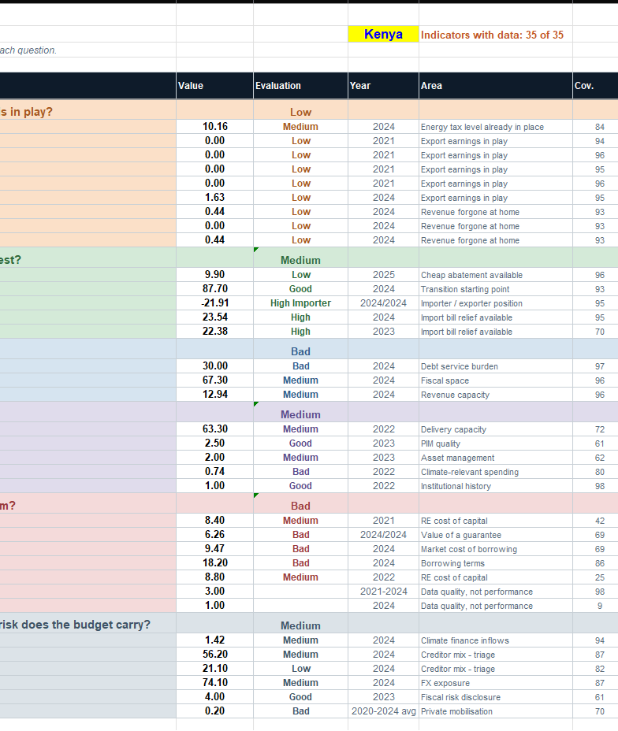
PART 3 · C · THE DASHBOARD INTERFACE IN DEVELOPMENT — The interface in development
A country profile
  Kenya shown: 35 of 35 indicators with data
Grouped by question
  Fossil revenue, mitigation cost, fiscal space, investment, cost of capital, finance
Scored and sourced
  Each indicator rated, scored out of 10, with year and coverage
Notes:
AI-built dashboard proof of concept, with a full data audit trail. The tax indicators from the Excise Diagnostic join this base.

Slide 18
PART 3 · C · POLICY ISSUE REPORT — One issue, one country, for example feebates
1
The situation
  Where the country stands on the issue, drawn from the dashboard and diagnostic.
2
Best practice
  The best policy design, and what other countries did and learned.
3
Reform
  The opportunities for reform in that country, and how to get there.
Notes:
The dashboard says what is there; the policy issue report says what to do next. Together they give a fast, sourced starting point for policy dialogue.

Slide 19
PART 3 · D · TOTAL CARBON PRICE INTO GHG ACCOUNTING — Bring the Total Carbon Price into GHG accounting
A standalone product
  Delivered on its own, not as part of Coded CPAT.
Linked to GHG accounting
  Consistent with the GHG accounting metric.
Also in the dashboard
  Shown alongside the macro-fiscal and tax indicators.

Slide 20
PART 4 · WHAT TO KEEP AND WHAT TO DROP — The plan is full to 20 March: anything added must replace something
KEEP · CORE
  Coded CPAT and AI-Excel. Funded; the base for everything else
  GHG accounting. A corporate requirement; no DPF tool exists
  CPAT–SiSePuede. Funded; light-touch supervision
KEEP · SMALL
Python platform. Access only
  Dashboard and policy report. Prototypes exist; funding to confirm
  Policy crediting and FFI. One week, on GHG accounting
  Total Carbon Price into GHG accounting. Not yet scheduled
  Energy GP code help. Not on the timeline; needs a slot
DROP OR DEFER
  Patching legacy Excel (new tab, Lambdas): superseded
Validating legacy CPAT: separate note
  Full CPAT replacement; merging FTT or MFMod: later
  April items not in FY27 plan: ETS pilot, downstream pricing, CPAT paper
Source: Source: FY27 work plan v1.1 (28 Sept 2026)
Notes:
For discussion. The work plan selects GHG accounting (3a) and marks policy crediting (3b) and the tax/fiscal dashboard (3c) as possibly dropped, at five weeks each. The master timeline gives them much less: one week for policy crediting and FFI, two weeks each for the dashboard and policy reports. The Energy GP coding help (3d, two weeks) is in the work plan but not on the master timeline, so it needs a slot or should go. The April items (ETS pilot, downstream industrial pricing, CPAT working paper) do not appear in the FY27 plan; confirm whether they are done, handed over or dropped.

Slide 21
CONCLUSION — One AI-built engine, two forms, a few small products
Fixes the module's problems
  A compact, traceable engine replaces 250,000+ cells and handles policy mixes.
Each form has a home
  Code into SiSePuede and the Python platform; AI-Excel into the WB–IMF process and GHG accounting.
Focus wins
  Keep the core; other products are small tweaks or wait.
NEXT STEPS
  Informal chats in the office before 16 October
Excel and coded MVP by 16 October
  Agree on the WB side, then bring the IMF in
  Confirm GHG accounting and policy crediting requirements
Agree the keep-or-drop list
Choose a country project (to be defined)

