Slide 1
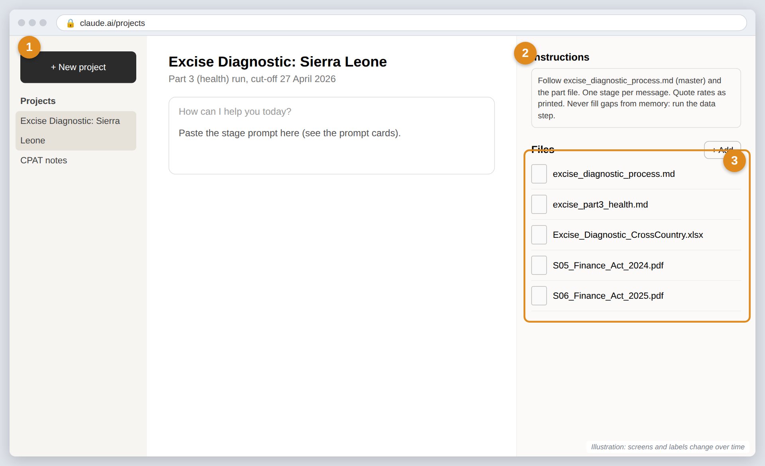
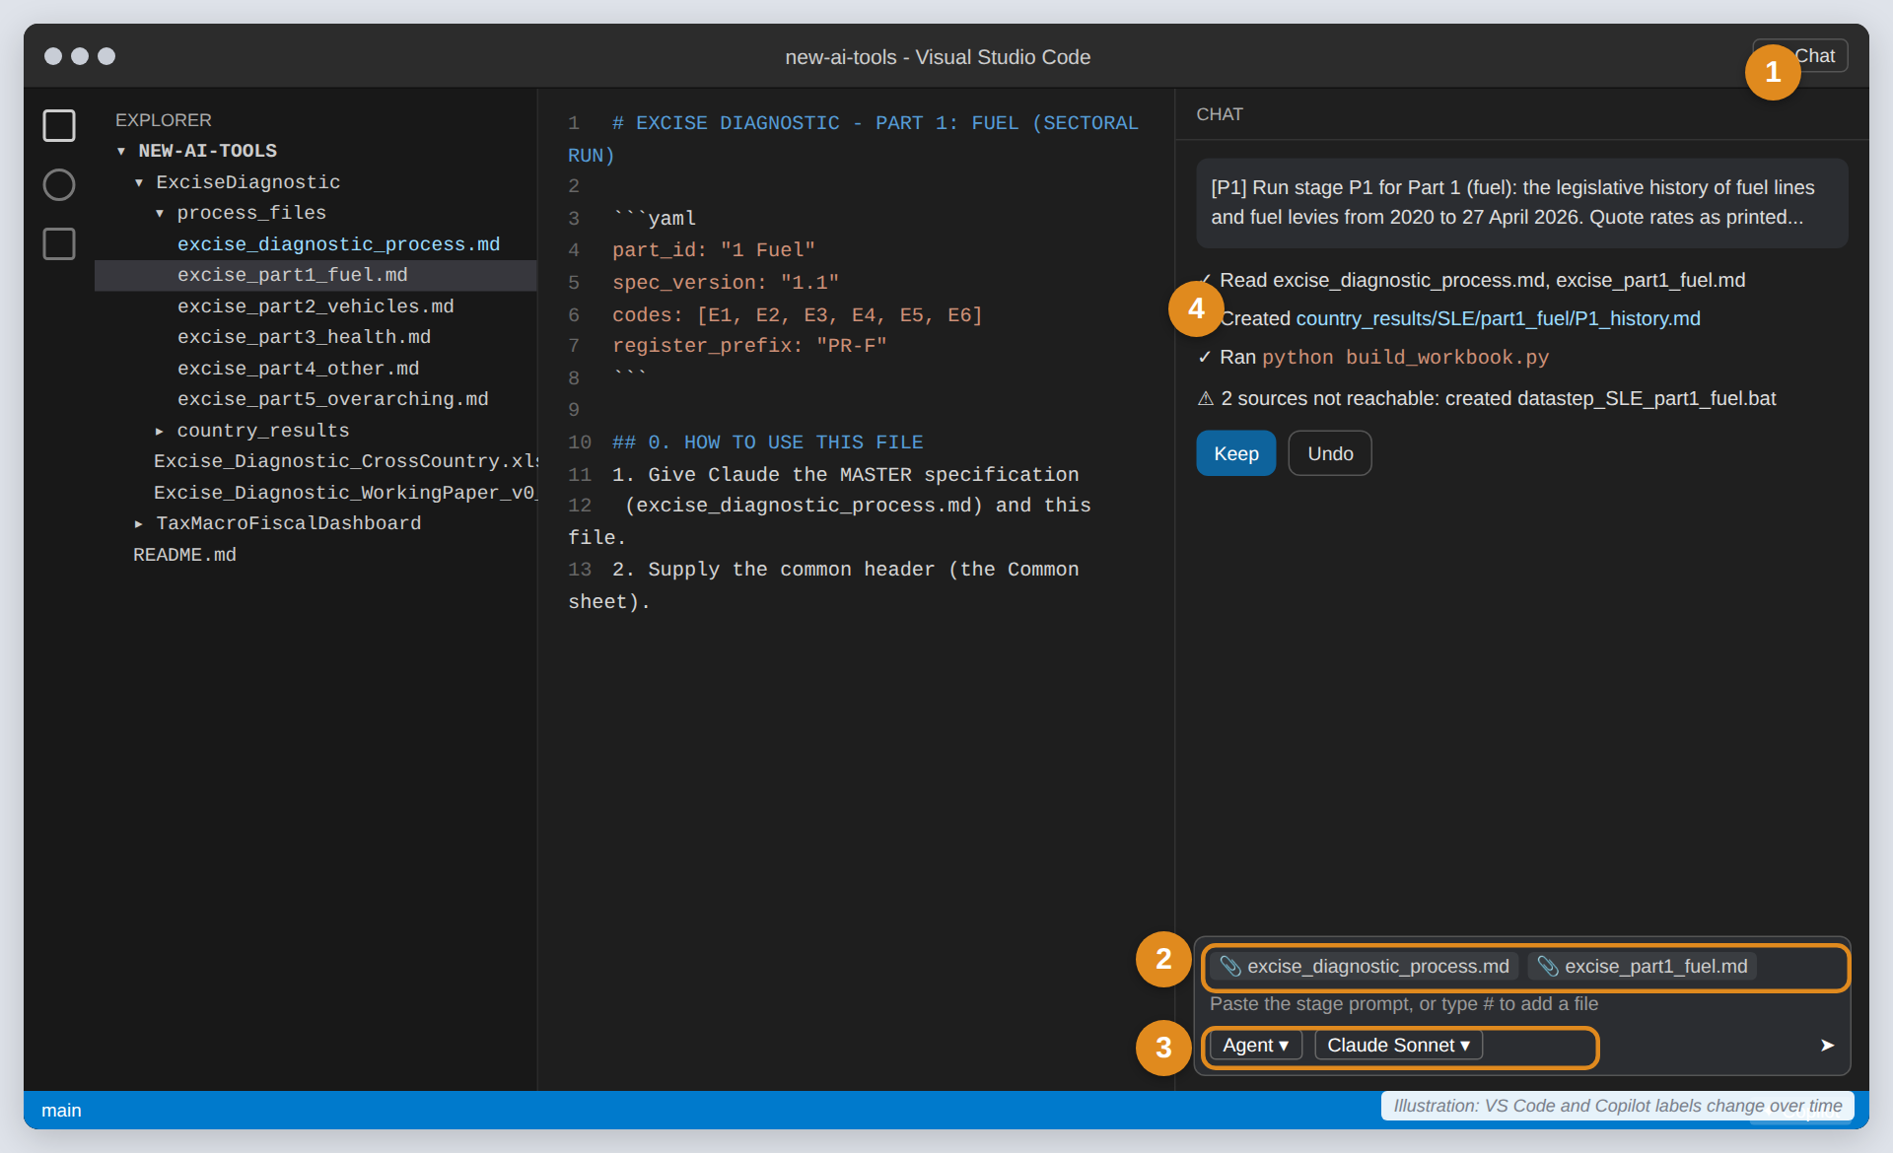
USER GUIDE
Running an Excise Diagnostic with AI
A beginner’s guide: (a) a full diagnostic, or (b) four sub-diagnostics plus aggregation, with Claude or GitHub Copilot
No coding needed
Step-by-step pictures
Report + Excel workbook
Draft, September 2026. Repository location used here is an example and will change.
Notes:
This guide assumes no prior experience with AI tools. It covers getting the files, setting up Claude or GitHub Copilot, running the diagnostic in one go or in five parts, and how the report and Excel workbook are produced.

Slide 2

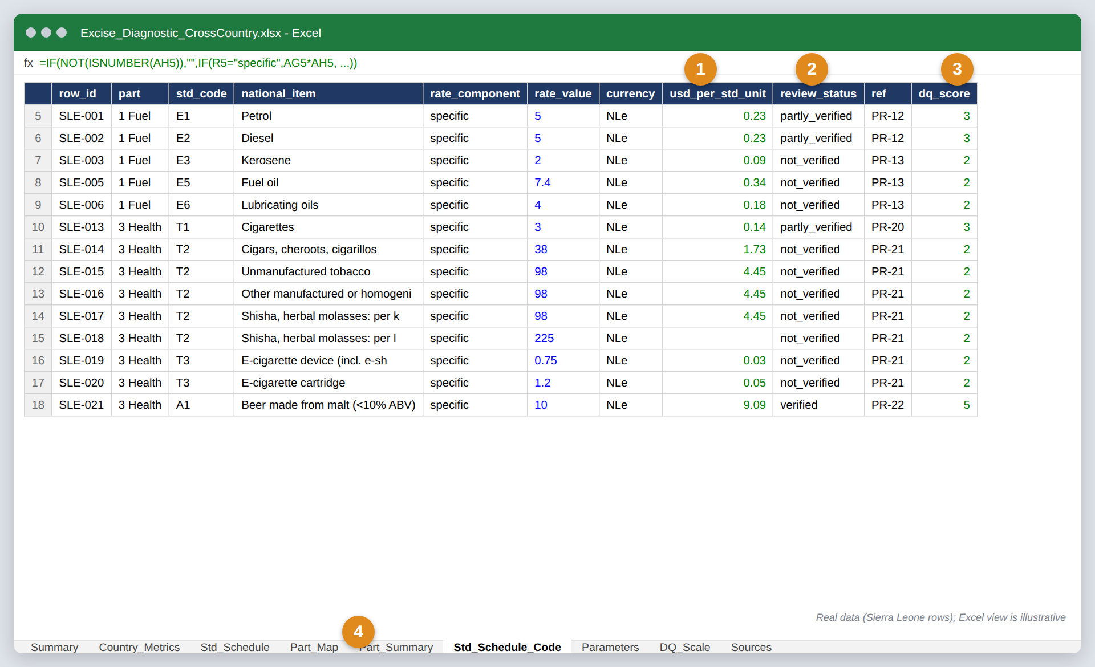
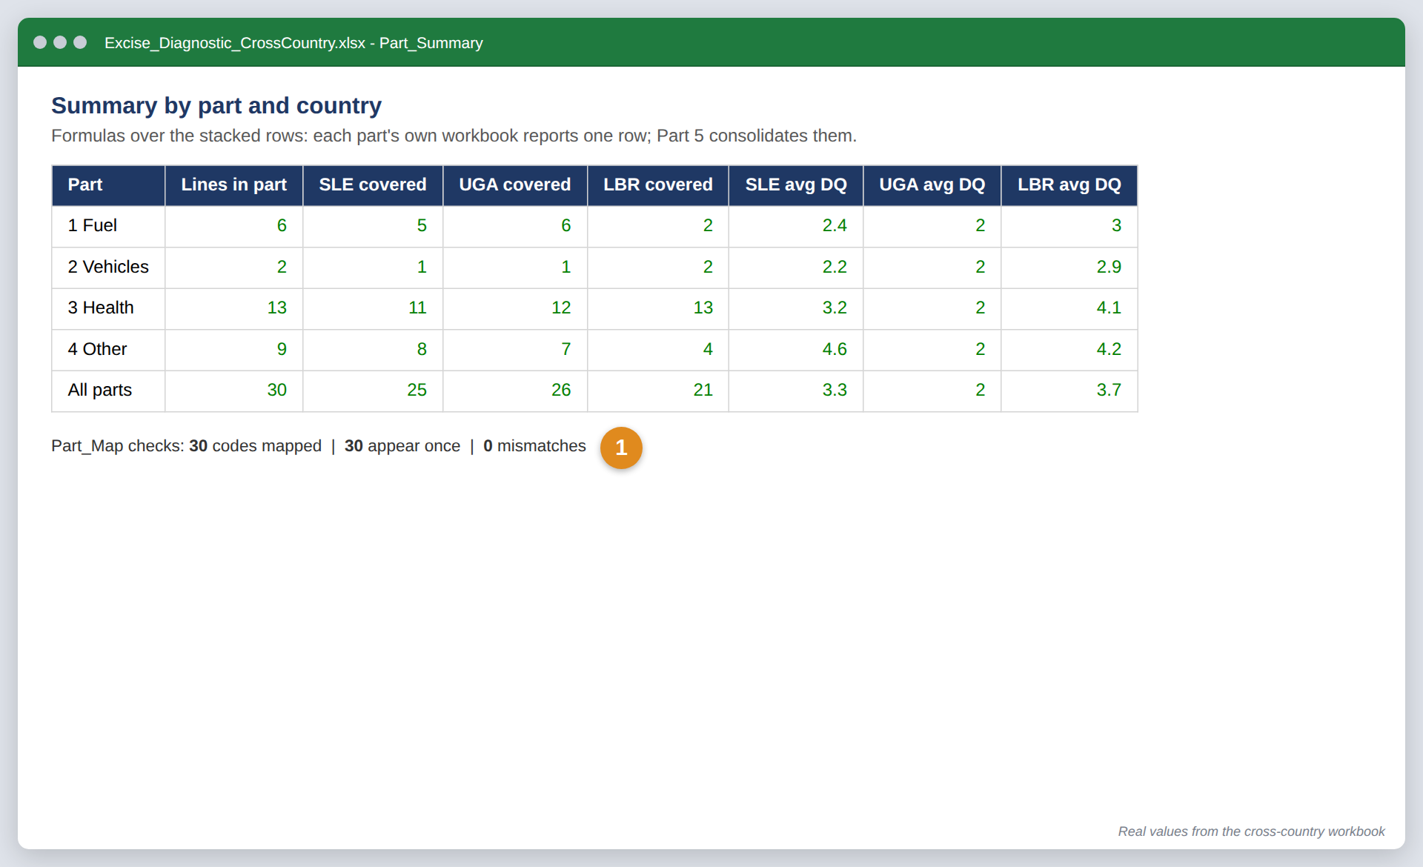
OVERVIEW
What you will produce, and two ways to get there
Every run produces two things
Two ways to run
a
Full diagnostic: one run
All 30 standard lines in one go, six stages (A1–A6). Give the AI the master file only.
Output: 1 report + 1 workbook
Best for: a first diagnostic or a short schedule.
An Excel workbook
Every rate as a row; US-dollar values and data-quality scores computed by formula.
b
Sectoral: four sub-diagnostics + aggregation
Part 1 Fuel · Part 2 Vehicles · Part 3 Health · Part 4 Other, in any order. Then Part 5 (overarching) runs last and combines them. Give the AI the master file plus one part file per run.
Output: 5 reports + 5 workbooks (4 part workbooks feed 1 master workbook)
Best for: long schedules, or when different people own different sectors.
A report
Word document: findings, schedules, sources and a peer-review register.
Excise Diagnostic with AI: user guide · Pictures are illustrations; real screens change over time
Notes:
Use the full run for a first diagnostic or a small schedule. Use the sectoral run when different people own different sectors, the schedule is large, or you want the fuel and vehicle parts for a joint paper.

Slide 3
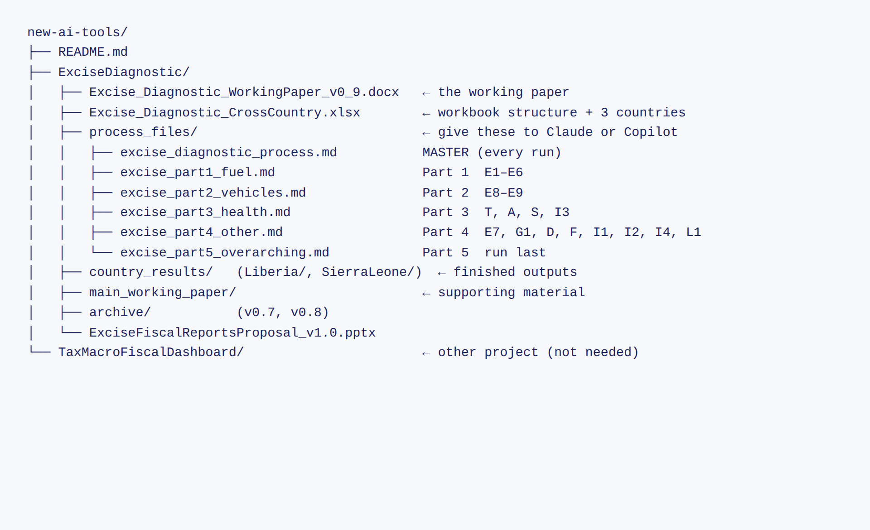
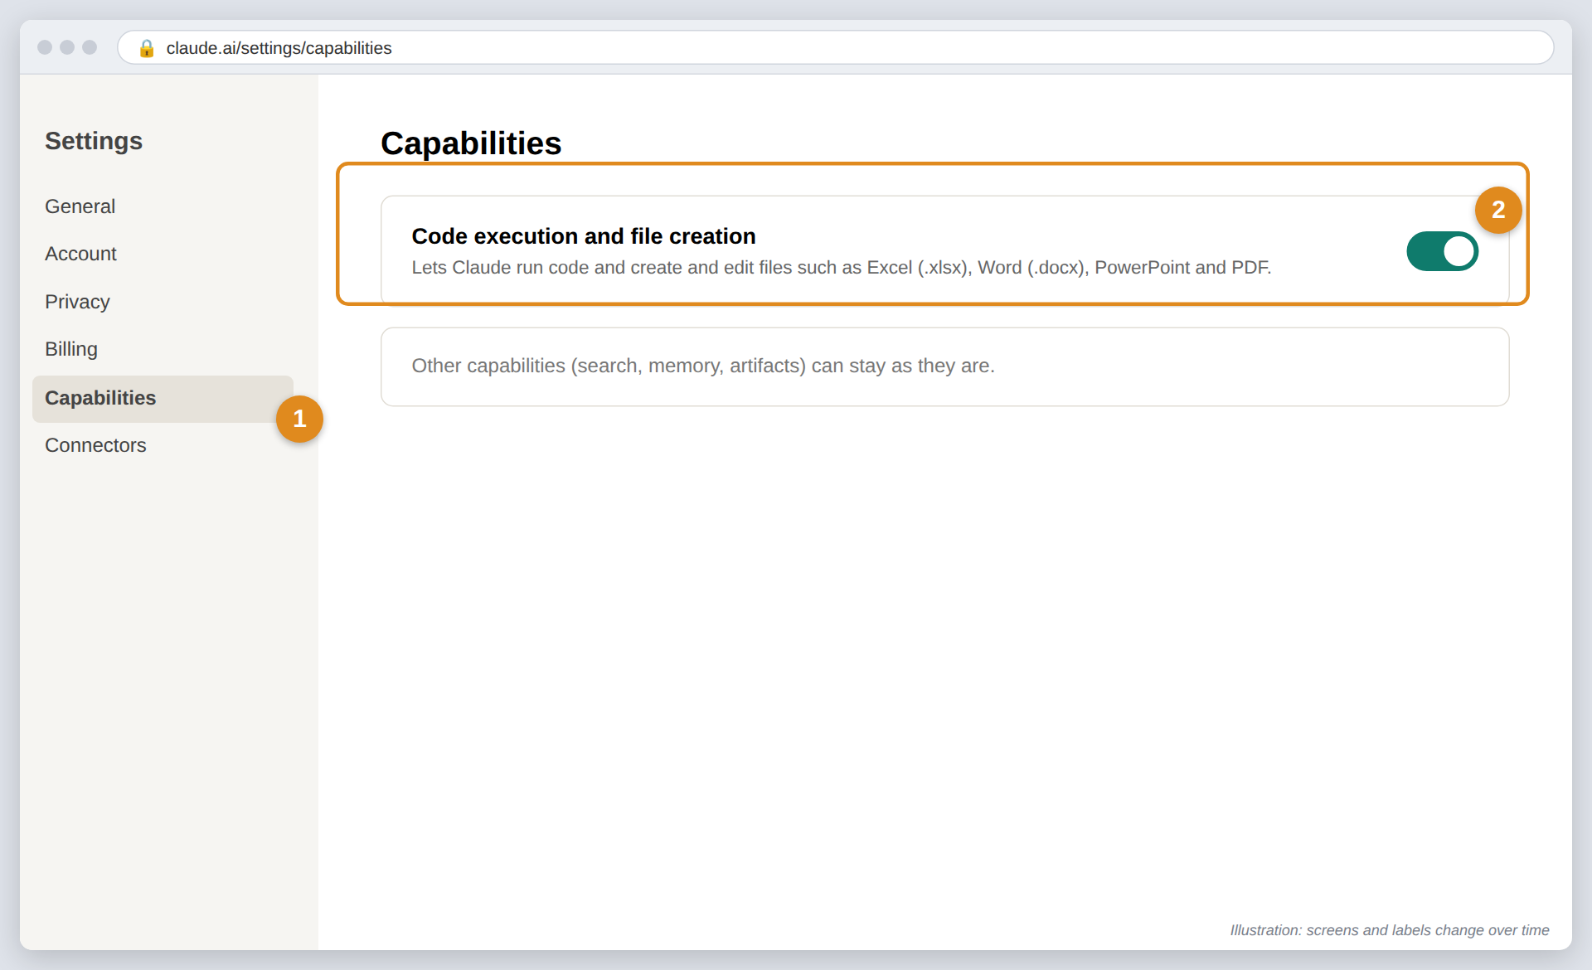
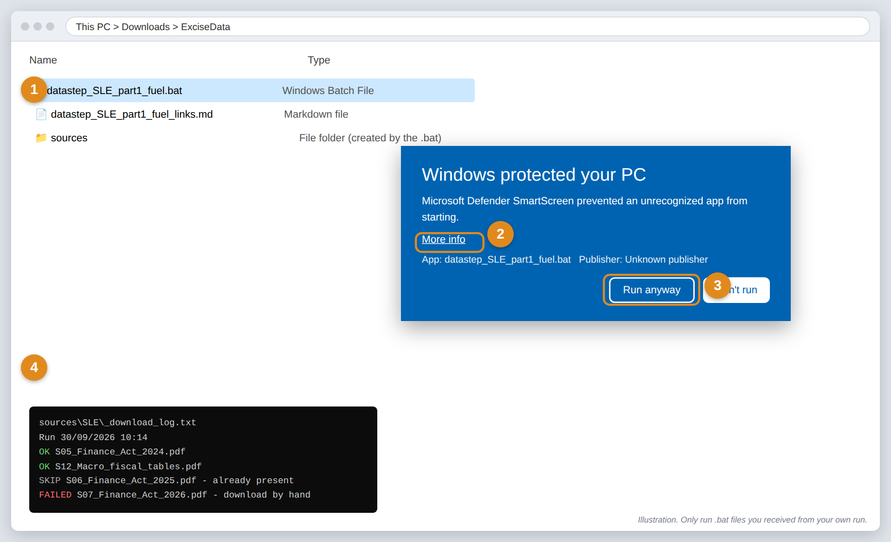
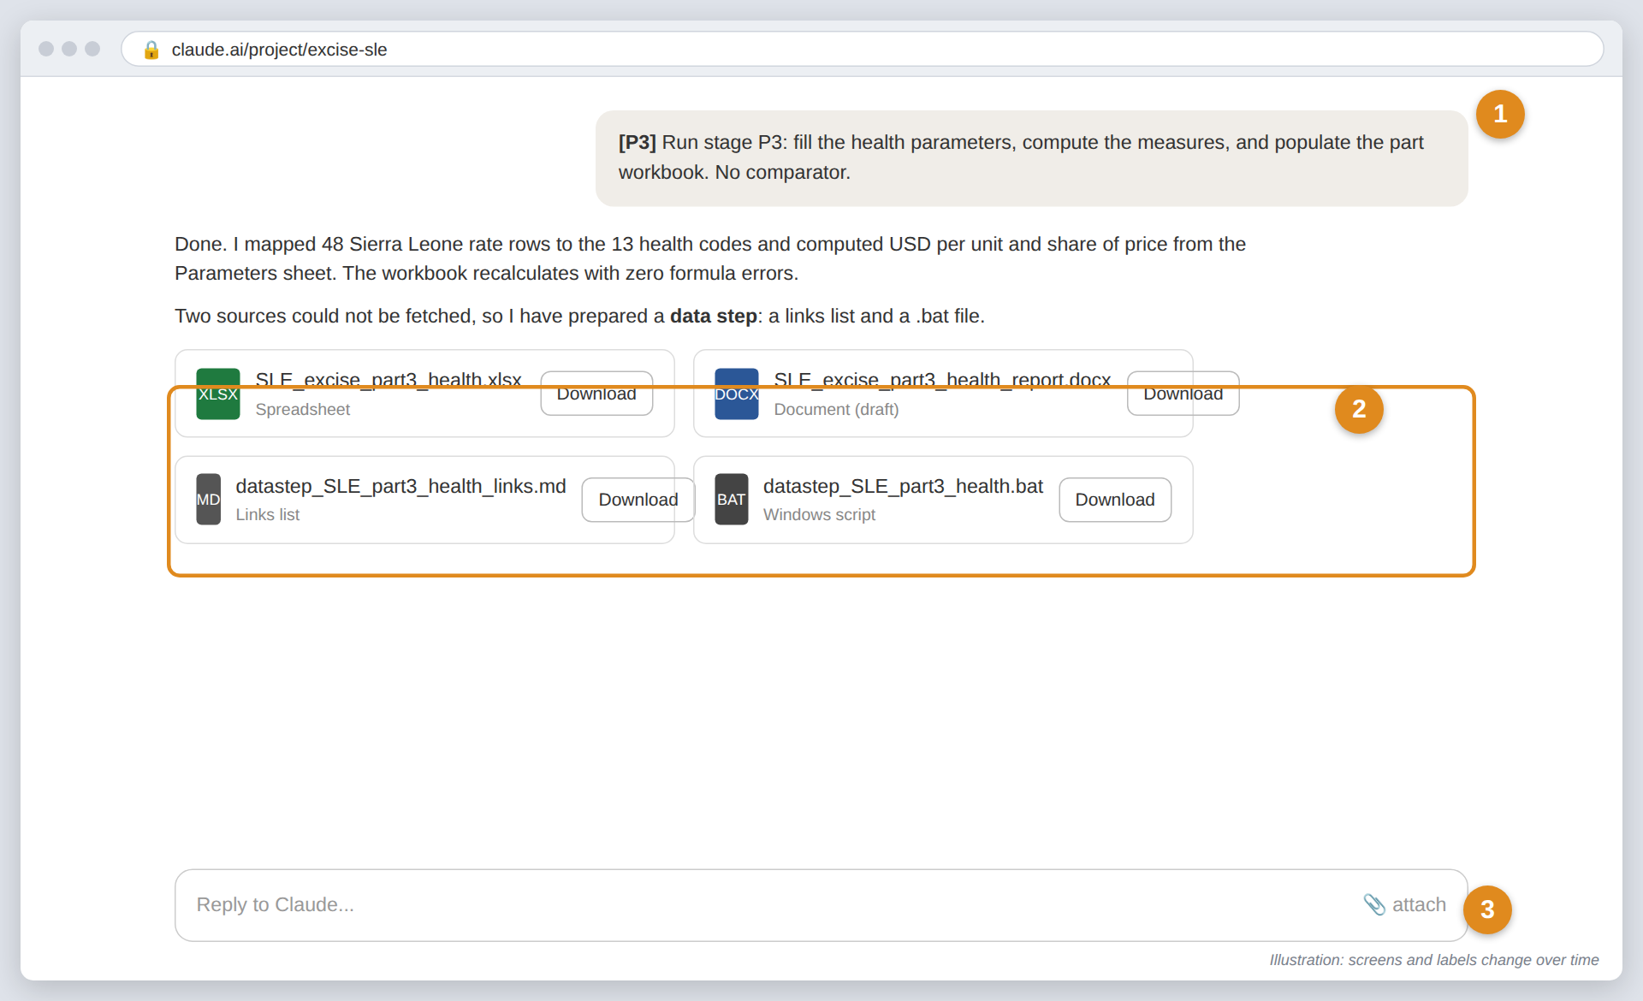
THE PATH
Your path in five steps
1
2
3
4
5
Get the files
Set up your AI tool
Gather sources
Run the stages
Check and share
Download the repository with the process files and workbook.
Claude (web) or GitHub Copilot (in VS Code). One-off.
Legal texts and data. If the AI cannot fetch them, it gives you a links list and a .bat file.
Paste one stage prompt at a time. Check each answer before the next.
Report (.docx) and workbook (.xlsx). Every line traced to a source.
Steps 1–2: do these once.
Steps 3–5: repeat for each country, and for each part in a sectoral run.
Excise Diagnostic with AI: user guide · Pictures are illustrations; real screens change over time
Notes:
Steps 1 and 2 are done once. Steps 3 to 5 repeat for each country, and for each part in a sectoral run.

Slide 4
STEP 1 · THE FILES
The repository: what is inside
Location will change
Example for now:
github.com/sjstretton/new-ai-tools
1
process_files/
The instructions. The master file goes to the AI in every run; add one part file for a sectoral run.
2
Excise_Diagnostic_CrossCountry.xlsx
The workbook structure every run fills in, with Sierra Leone, Uganda and Liberia as examples.
3
Working paper and country_results/
The method, a worked example, and finished outputs to copy from.
4
Not needed
TaxMacroFiscalDashboard/ and the .lnk shortcuts belong to other projects.
Excise Diagnostic with AI: user guide · Pictures are illustrations; real screens change over time
Notes:
The repository is public. You only need the ExciseDiagnostic folder. The master process file and the part files are plain text (Markdown), so they open in any editor.

Slide 5
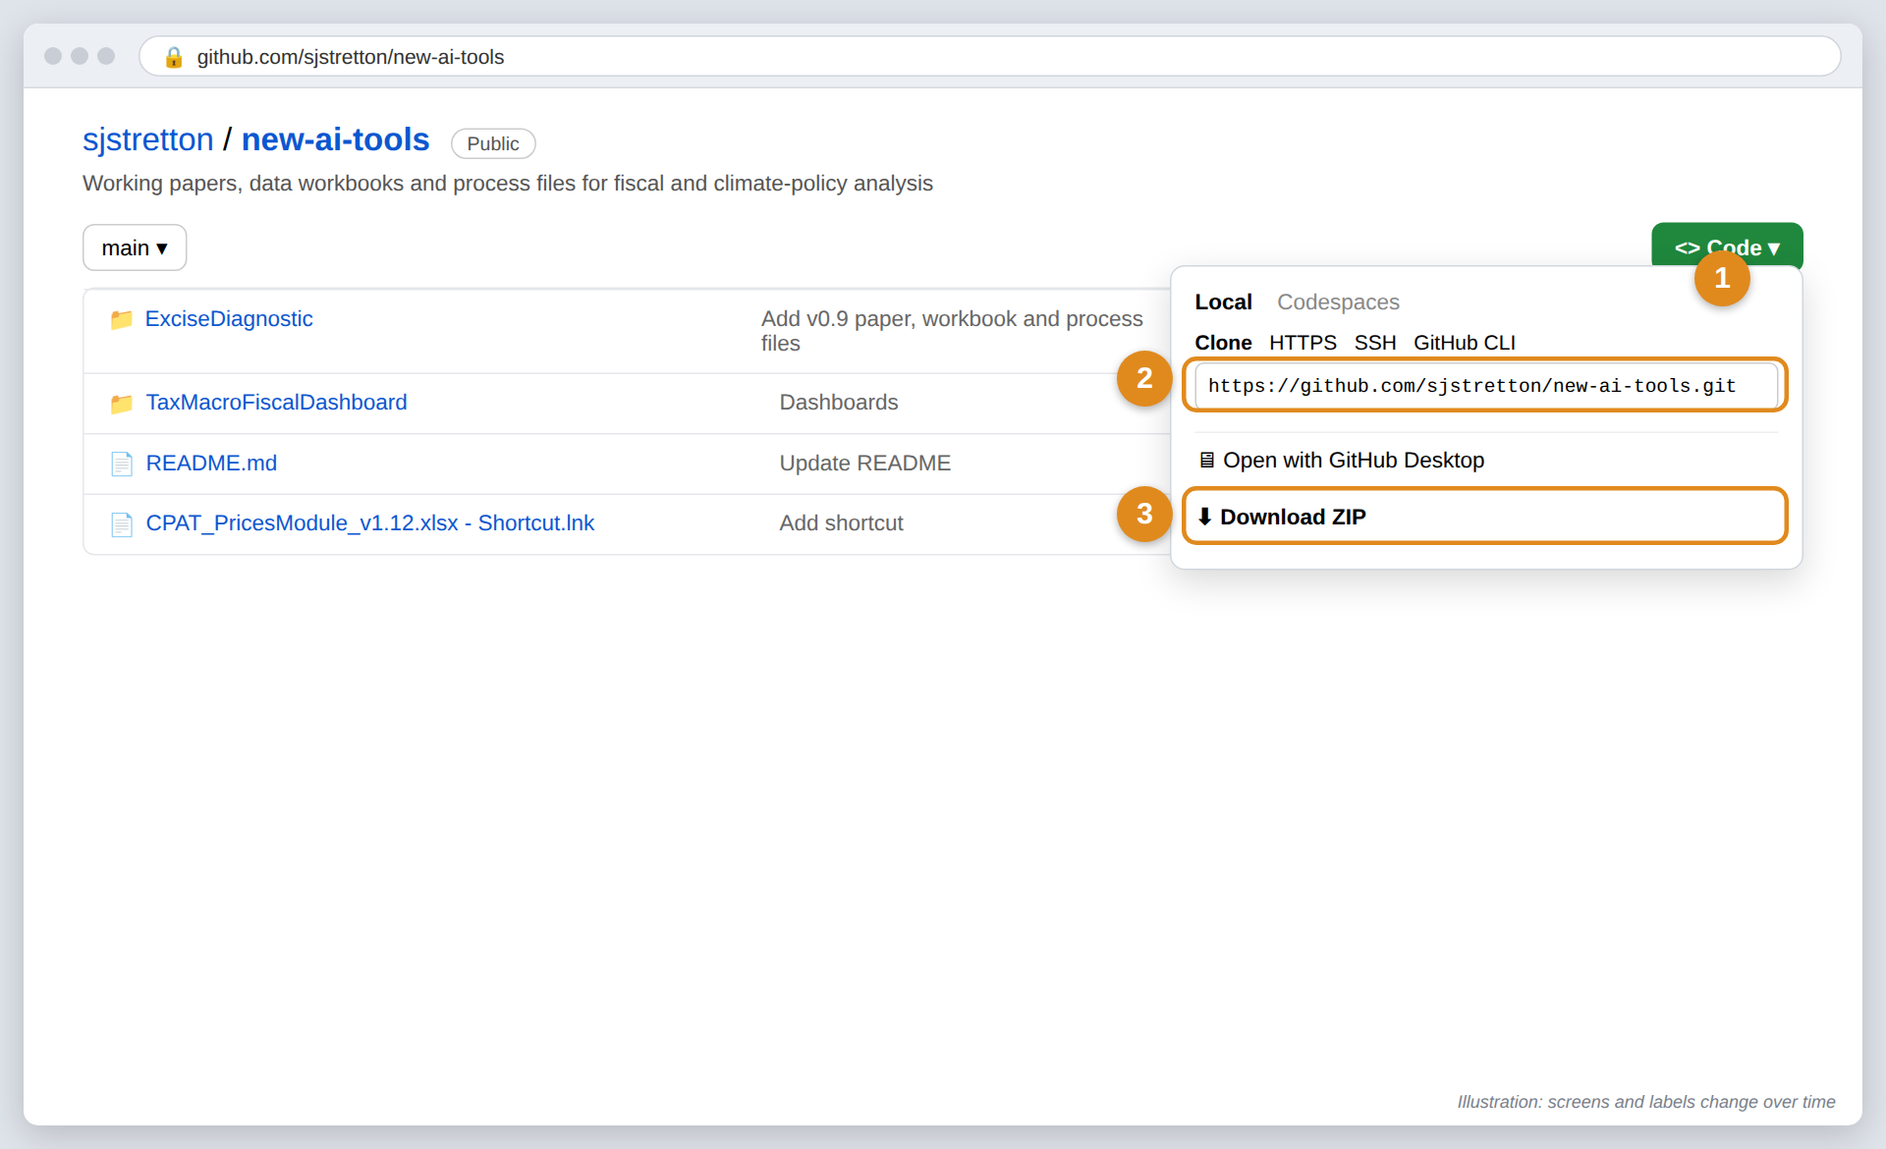
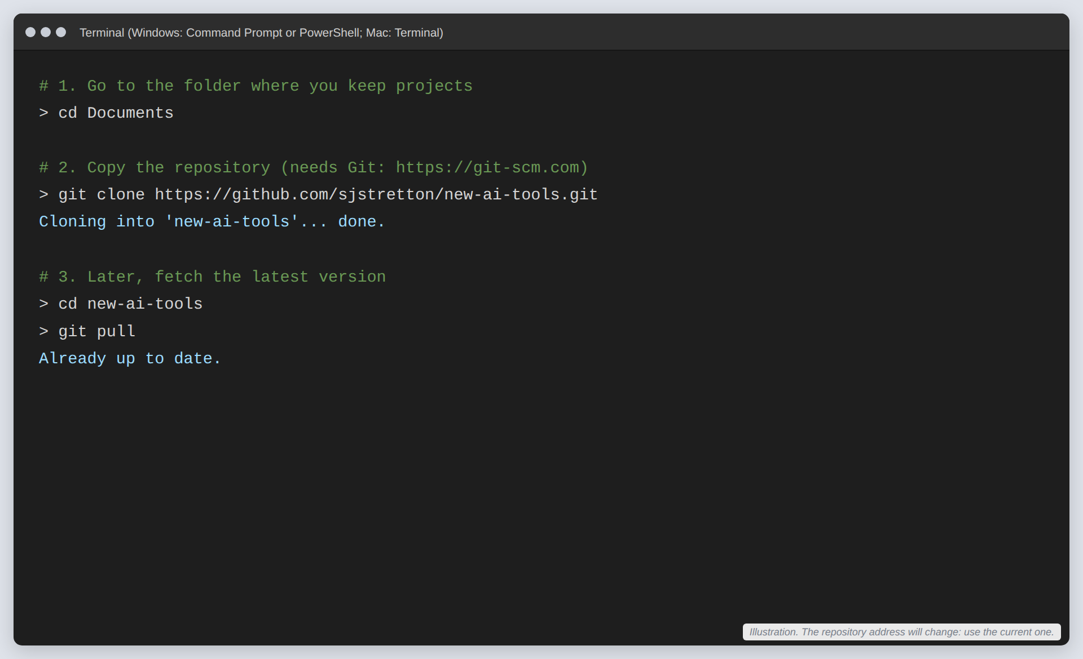
STEP 1 · THE FILES
Download the repository: three ways
2
With Git (keeps you up to date)
Install Git, then run git clone with the address. Later, git pull fetches changes.
1
Easiest: Download ZIP
Open the repository page → green Code button → Download ZIP. Right-click the file → Extract All.
3
With GitHub Desktop or VS Code
Code → Open with GitHub Desktop, or in VS Code: Clone Git Repository and paste the address.
Excise Diagnostic with AI: user guide · Pictures are illustrations; real screens change over time
Notes:
Download ZIP is enough for most users. Choose Git if you will update the files often or contribute changes back. The address will change when the repository moves; always use the current one.

Slide 6
STEP 2 · YOUR AI TOOL
Claude or GitHub Copilot?
 | Claude (claude.ai) | GitHub Copilot (in VS Code)
Best for | Economists who want a chat window; no installs | Users comfortable with a code editor; files stay in the repo folder
You need | A Claude account. Pro recommended for full runs; your organization may provide Team or Enterprise | A GitHub account, a Copilot plan with agent mode and Claude models, VS Code, Python
Files go in | A Claude Project (upload) | The repository folder on your computer
You give the spec by | Adding it to the project files | Attaching it in chat (# or drag), or a custom-instructions file
Outputs | Download buttons for .xlsx and .docx | Written straight into the folder
Cost (check current prices) | Free to try; Pro about USD 20 a month | Free tier is limited; Pro about USD 10 a month; or an organization seat
Claude
GitHub Copilot in VS Code
Excise Diagnostic with AI: user guide · Pictures are illustrations; real screens change over time
Notes:
Both routes use the same process files and produce the same outputs. Copilot can run Claude models, so the reasoning engine can be the same. The Bank's MAI platform can also run Claude, with limits. Prices change; check the vendors' plan pages.

Slide 7
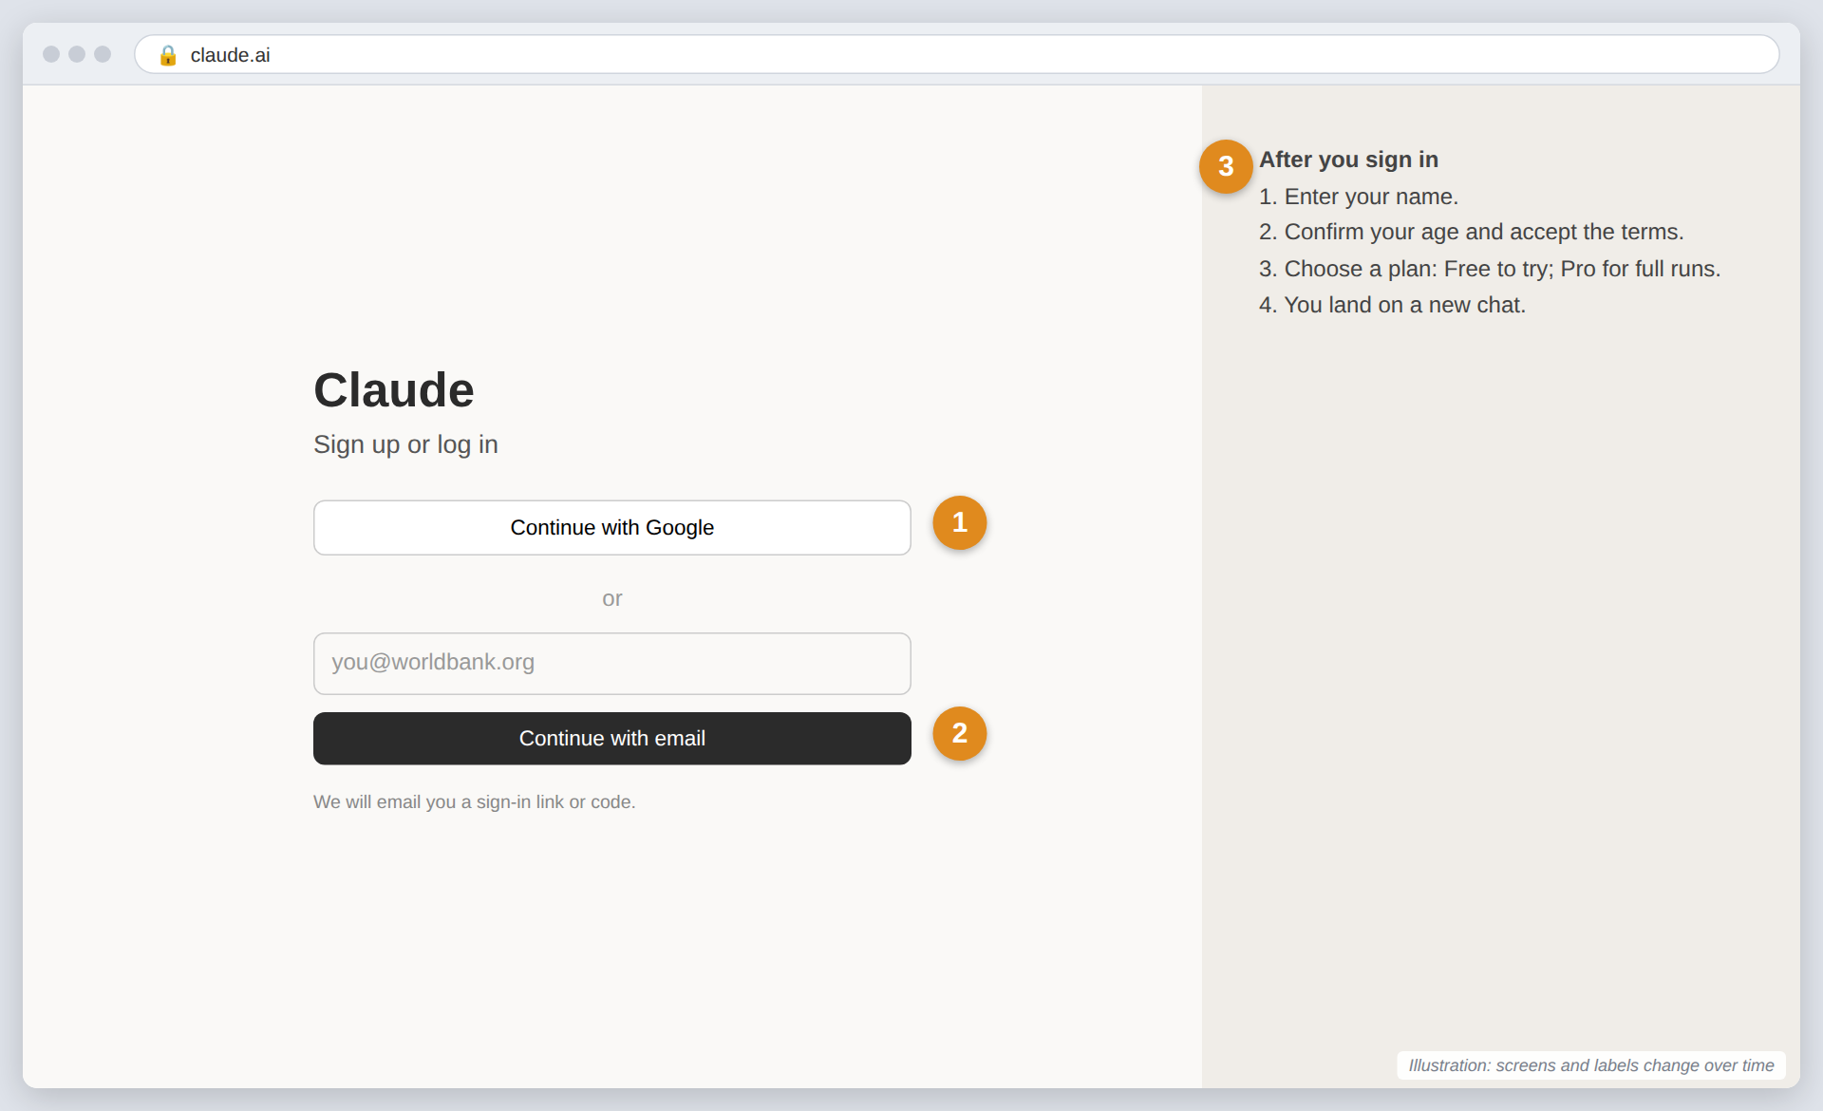
CLAUDE · STEP A
Create your Claude account
1
Go to claude.ai
In any browser, or install the Claude desktop app. Choose “Continue with Google”...
2
...or sign up with email
Type your email and enter the code or link Claude sends you. Use a work address if your organization requires it.
3
Finish the set-up
Add your name, accept the terms and choose a plan. Free works for a try-out; Pro is better for a full diagnostic.
Tip: one account is enough for every country and every part.
Excise Diagnostic with AI: user guide · Pictures are illustrations; real screens change over time
Notes:
If your organization provides Claude (Team or Enterprise, or the Bank's MAI platform), use that login instead of creating a personal account.

Slide 8
CLAUDE · STEP B
Turn on file creation (so Claude can build Excel and Word)
1
Open Settings → Capabilities
Click your name (bottom left) → Settings → Capabilities.
2
Switch on “Code execution and file creation”
This lets Claude write the .xlsx workbook and the .docx report, and run the checks.
3
Team or Enterprise?
An admin turns it on in Organization settings → Capabilities. Ask your IT contact.
Excise Diagnostic with AI: user guide · Pictures are illustrations; real screens change over time
Notes:
Without this setting Claude can still write the analysis, but cannot hand you finished Excel and Word files. Files up to 30 MB each can be uploaded and downloaded.

Slide 9
CLAUDE · STEP C
Create a project and add the files
1
Projects → + New project
Name it, e.g. “Excise Diagnostic: Sierra Leone – Part 3”. One project per country (or per part).
2
Paste the instructions
Use the text in the box below. It keeps every chat on the master process.
3
Add the files
Master process file, the part file (sectoral run), the workbook, and your legal texts.
Project instructions (copy):
Follow excise_diagnostic_process.md (master)
and the part file. One stage per message.
Quote rates as printed. Never fill gaps
from memory: run the data step instead.
Excise Diagnostic with AI: user guide · Pictures are illustrations; real screens change over time
Notes:
Project files are shared by every chat in the project. After each stage, upload the newest workbook to the project so the next chat starts from it.

Slide 10
CLAUDE · STEP D
Run each stage, then download the outputs
1
Paste one stage prompt
Copy it from the master or part file (section 9 or 10). Add new source files with the paperclip.
2
Check, then download
Read the answer. Click Download on the .xlsx and .docx cards. Save them in country_results/<country>/<part>.
3
Carry on
Reply with the next prompt. If the chat gets long, start a new chat in the same project and upload the latest workbook.
Excise Diagnostic with AI: user guide · Pictures are illustrations; real screens change over time
Notes:
Never skip the checking: the peer-review stage (A5 or P5) is mandatory, and every legal line must carry a source reference before the report is shared.

Slide 11
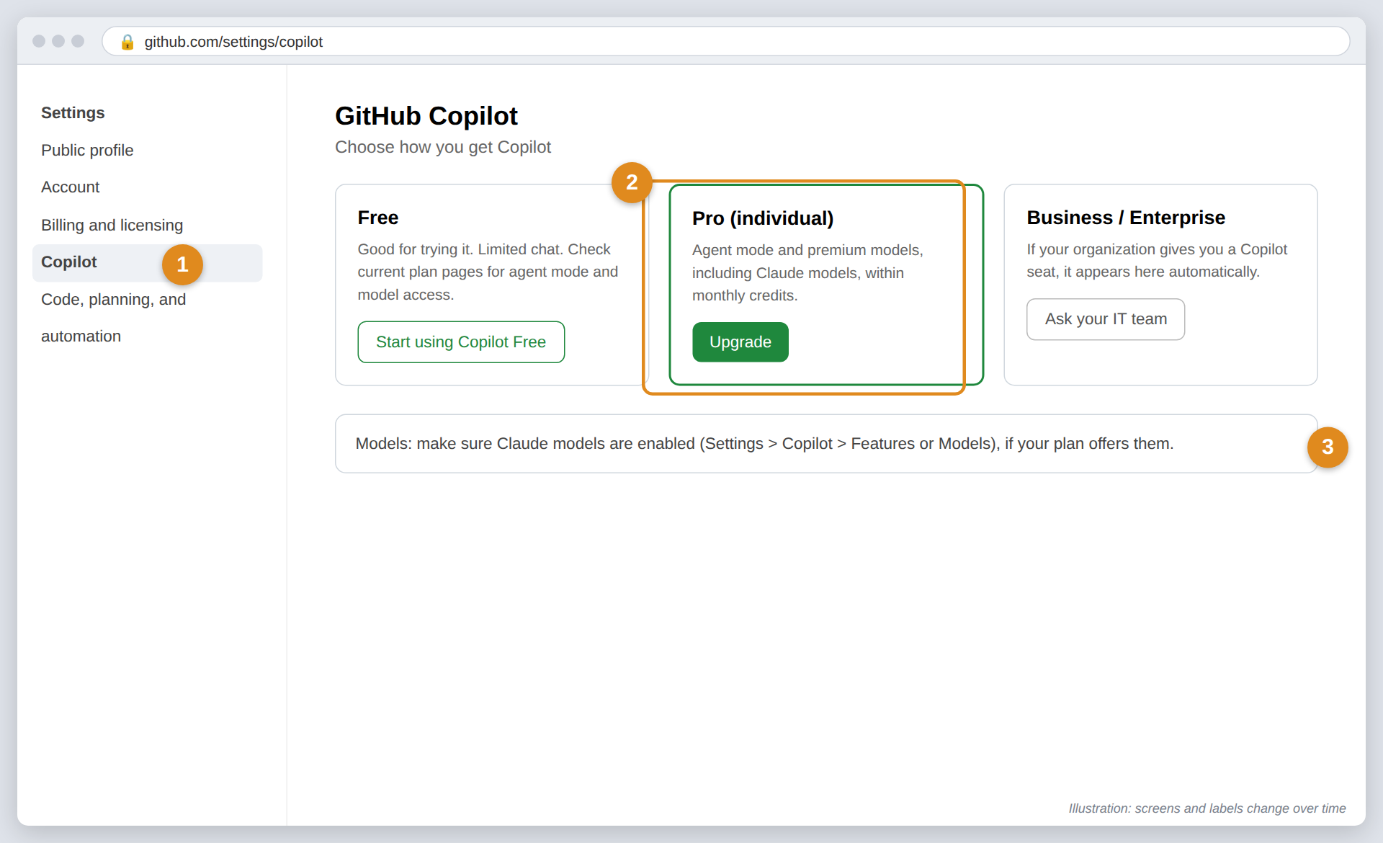
GITHUB COPILOT · STEP A
Create a GitHub account and get Copilot
1
Sign up at github.com
Username, email and password; confirm the code sent to your email. Free.
2
Settings → Copilot
Start Copilot Free to try, or a paid plan. Agent mode and Claude models need a plan that includes them; check GitHub’s plan page.
3
Organization seat?
If your organization licenses Copilot, it appears here. Make sure Claude models are enabled in the Copilot model settings.
Excise Diagnostic with AI: user guide · Pictures are illustrations; real screens change over time
Notes:
Plans and model availability change often. At the time of writing, GitHub lists Copilot Free, Pro and Pro+ for individuals, and Business and Enterprise for organizations.

Slide 12
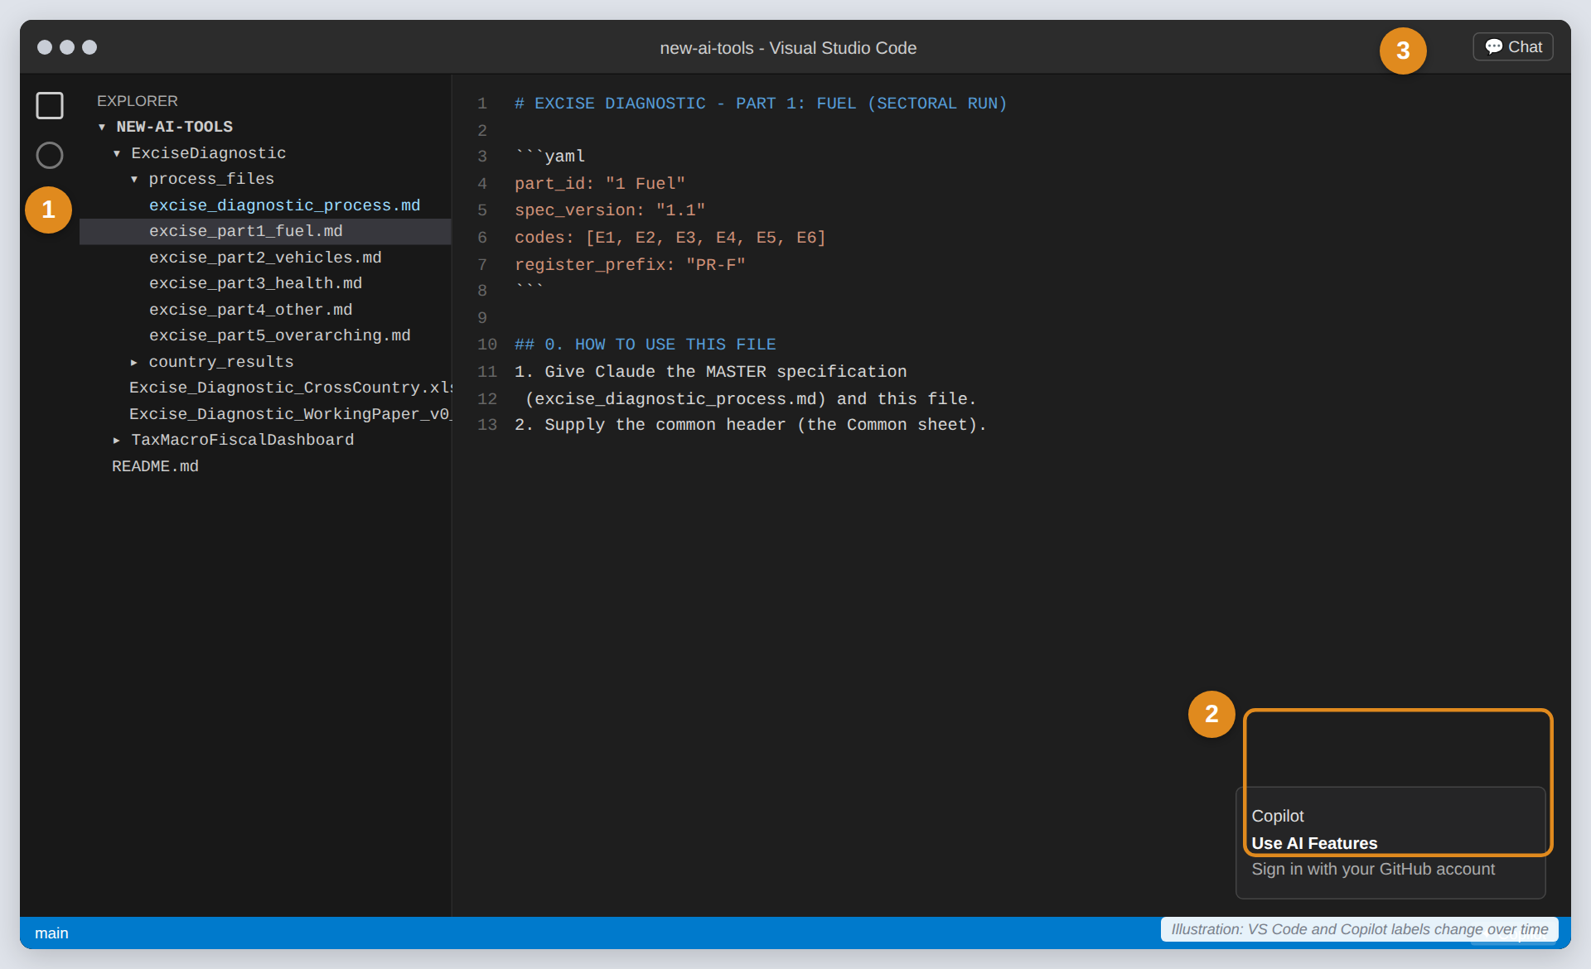
GITHUB COPILOT · STEP B
Install VS Code, open the repository, sign in
1
Install VS Code and Python
Free from code.visualstudio.com and python.org. Python lets Copilot build the Excel and Word files.
2
Open the folder and sign in
File → Open Folder → new-ai-tools. Click the Copilot icon in the status bar → Use AI Features → sign in with GitHub.
3
Open the Chat view
Chat icon at the top, or Ctrl+Alt+I (Windows) / Ctrl+Cmd+I (Mac).
Terminal (once):
pip install openpyxl python-docx
Excise Diagnostic with AI: user guide · Pictures are illustrations; real screens change over time
Notes:
After installing Python, run this once in the VS Code terminal: pip install openpyxl python-docx. Copilot can also do this for you when asked.

Slide 13
GITHUB COPILOT · STEP C
Agent mode, a Claude model, your files, the prompt
1
Choose Agent and a Claude model
Use the two drop-downs under the chat box. Agent mode can create and edit files.
2
Attach the process files
Drag them in, or type # and pick them: master + part file.
3
Paste the stage prompt
Copilot writes outputs into the folder. Review each change, then click Keep (or Undo).
.github/copilot-instructions.md (optional):
Follow ExciseDiagnostic/process_files/
excise_diagnostic_process.md (master).
One stage per message. Write outputs to
country_results/<ISO3>/<part>/.
Excise Diagnostic with AI: user guide · Pictures are illustrations; real screens change over time
Notes:
Optional: create .github/copilot-instructions.md in the repository with the same instructions used for the Claude project. Copilot then applies them to every chat.

Slide 14
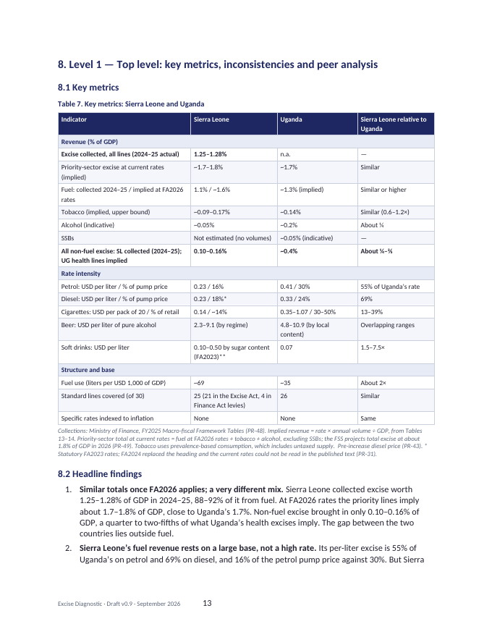
(A) FULL DIAGNOSTIC
One run, six stages: give the AI the master file only
A1
A2
A3
A4
A5
A6
History
Schedule
Standardize
Top level
Peer review
Assemble
Every law since 2020, rates as printed
Every line on five fields
30 standard lines; workbook rows
Framework, key metrics, findings
A source for every line
Final report + workbook
Example prompt for stage A1 (copy from section 10 of the master file):
Result
One report with Levels 1–4 and a register, like the Sierra Leone example (left: its Level 1 page), plus one workbook.
[A1] Using the excise diagnostic process specification
(master) and the legal texts provided, run stage A1 for
Sierra Leone, from 2020 to 27 April 2026. Output the
legislative history instrument by instrument, quoting
every rate as printed with its provision and effective
date. Mark unreadable tables "not legible". List
customs-tariff changes separately. List pending bills.
If you cannot fetch a source, run the data step: give
me the links list and the .bat file.
Excise Diagnostic with AI: user guide · Pictures are illustrations; real screens change over time
Notes:
Send one stage per message and check each answer before sending the next. The peer review (A5) is where earlier drafts caught their errors, so do not skip it.

Slide 15
(B) SUB-DIAGNOSTICS + AGGREGATION
Four parts in any order, then Part 5 combines them
Common header
Made by the first part you run: country, cut-off date, currency, exchange rate, GDP, list of laws. Every other part reuses it unchanged.
1
Part 1: Fuel E1–E6
excise_part1_fuel.md → report + workbook
5
Part 5: Overarching (always last)
Reads the four part workbooks. Writes the framework (total revenue, legal framework, indexation rule, records check) and stacks everything into one master workbook and full report.
2
Part 2: Vehicles E8–E9
excise_part2_vehicles.md → report + workbook
3
Part 3: Health Tobacco, alcohol, SSBs, sugar
excise_part3_health.md → report + workbook
4
Part 4: Other Plastics, gambling, cement...
excise_part4_other.md → report + workbook
Prompts in each part file (section 9 / 8)
Parts 1–4 | P0 header (first part only) | P1 history | P2 schedule | P3 measure + workbook | P4 findings | P5 peer review | P6 report
Part 5 | O1 checks | O2 framework | O3 aggregate | O4 review | O5 report + master workbook
Excise Diagnostic with AI: user guide · Pictures are illustrations; real screens change over time
Notes:
Parts 1 to 4 can run in parallel with different people. Part 5 stops if the four common headers differ, and asks which to keep. Gambling and plastics sit in Part 4; sugar sits in Part 3 with sugary drinks.

Slide 16
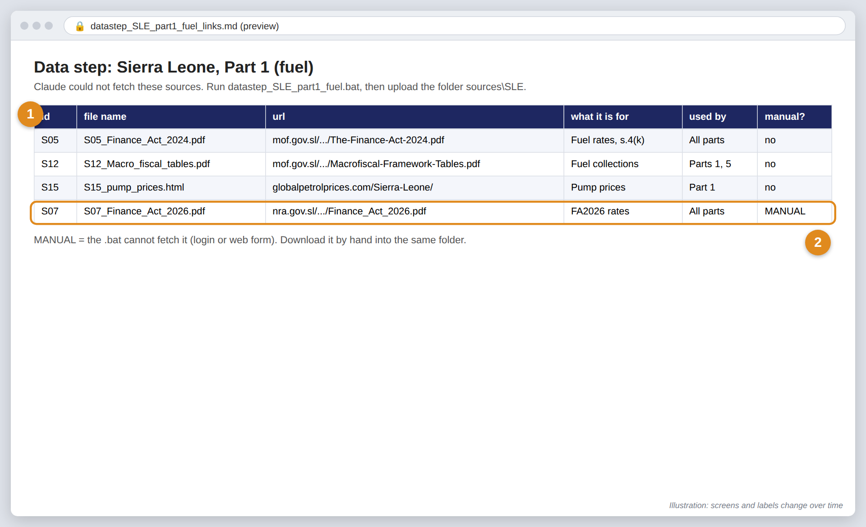
WHEN THE AI ASKS FOR DOWNLOADS
The data step: a links list and a .bat file
1
The AI stops and gives you two files
A links list (what each document is for) and a .bat script. Save both in one folder.
2
Double-click the .bat
If Windows warns you: More info → Run anyway (only for files from your own run).
3
Check the log, then upload
Download FAILED or MANUAL items by hand. Upload the sources folder and continue.
Excise Diagnostic with AI: user guide · Pictures are illustrations; real screens change over time
Notes:
This happens when a government site blocks automated access, a link loops, or a PDF table cannot be read. The .bat uses curl, which is built into Windows 10 and later, and skips files already downloaded. On Mac or Linux, ask for a .sh script instead.

Slide 17
HOW THE OUTPUTS ARE MADE
How the Excel workbook is produced
Stage | What lands in the workbook
A1–A2 | Every national rate, with its law and date
A3 | Std_Schedule_Code: one row per rate part; Parameters (exchange rate, GDP, prices); Std_Schedule (30 lines)
A4 | Country_Metrics: revenue, rate intensity, key questions
A5 | review_status + reference on every row → data-quality score (DQ_Scale)
Auto | Summary, Part_Map and Part_Summary update by formula
The AI fills the workbook with Python and recalculates it. Ship it only with zero formula errors.
Blue = typed inputs (rates, prices). Green = formulas (US$ per unit, data quality). Real Sierra Leone rows.
Excise Diagnostic with AI: user guide · Pictures are illustrations; real screens change over time
Notes:
Change the exchange rate on the Parameters sheet and every US-dollar column updates. The data-quality score comes from the peer-review status: 5 = checked against the law, 1 = placeholder.

Slide 18
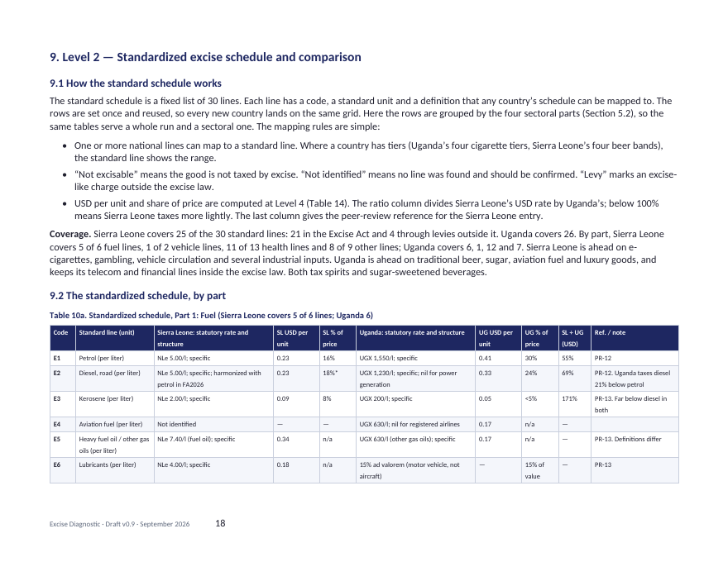
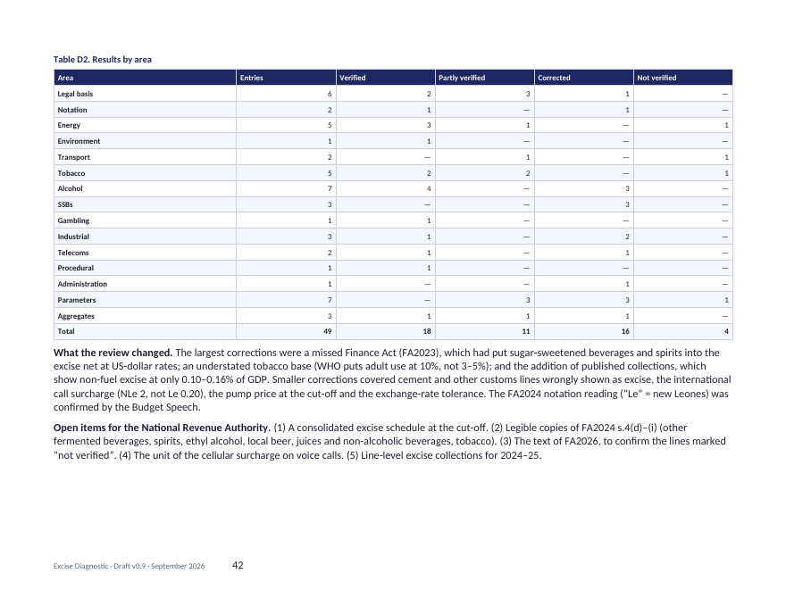
HOW THE OUTPUTS ARE MADE
How the report is produced: built bottom-up, read top-down
Level 1 Key metrics, findings, issues
A4
Level 2 Standardized schedule, by part
A3
built
Level 3 Country schedule, every line
A2
Level 2 table (by part)
Level 4 Raw data and legal history
Level 1 page
A1
Pages from the Sierra Leone example (working paper v0.9)
A5 peer review: every line gets a source reference (PR-nn) checked against the law, listed in a register annex. A6: Claude or Copilot assembles the Word report.
Peer-review register
Excise Diagnostic with AI: user guide · Pictures are illustrations; real screens change over time
Notes:
A minister reads Level 1. Each level can be checked against the one below it. Numbers are computed from the workbook, never typed into the text.

Slide 19
(B) AGGREGATION
How Part 5 turns four part workbooks into one
Part 1 Fuel.xlsx
O1 checks
Same common header? All 30 codes, once each? Unique PR ids? Zero formula errors?
Master workbook
rows stacked, never retyped; plus Part_Map, Part_Summary, Framework, merged Register
Part 2 Vehicles.xlsx
Part 3 Health.xlsx
Part_Summary: coverage and data quality by part (real values)
Part 4 Other.xlsx
+ the full report: framework first, then Levels 1–3 grouped by part, shared Level 4, one register
Output file | Made by | Contains
<ISO3>_excise_part1_fuel.xlsx (and parts 2–4) | Parts 1–4 | Only that part’s codes, plus Common and Register sheets
<ISO3>_excise_diagnostic.xlsx | Part 5 | All four stacked: the same structure as the cross-country workbook
<ISO3>_excise_diagnostic_report.docx | Part 5 | The full diagnostic report
Excise Diagnostic with AI: user guide · Pictures are illustrations; real screens change over time
Notes:
Part 5 never adds up numbers typed in the part reports. It stacks the part rows and recomputes totals by formula. To add the country to the cross-country workbook, append its Parameters row and schedule rows.

Slide 20
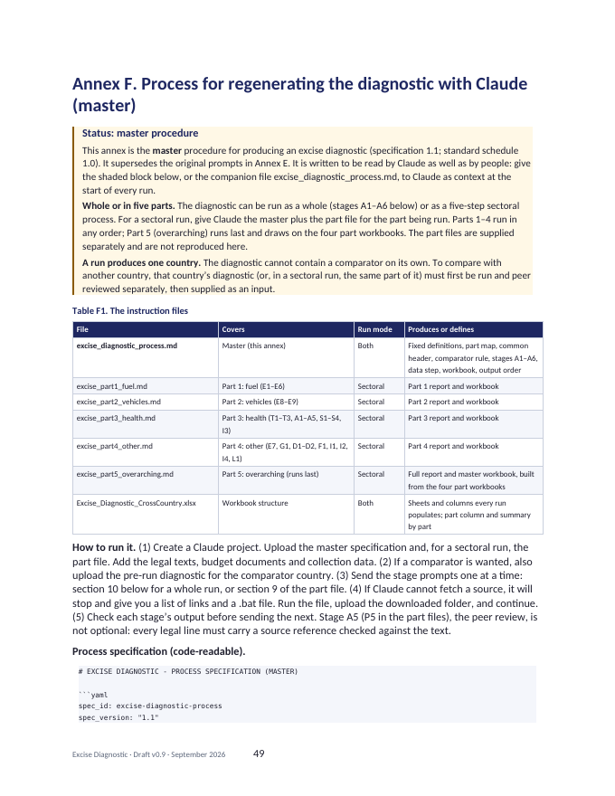
BEFORE YOU SHARE
Checklist and troubleshooting
Checklist
If this happens... | ...do this
“Usage limit reached” | Wait for the reset, start a new chat per stage, or move to a higher plan
The AI cannot open a website | Ask for the data step: links list + .bat
A table in a law is unreadable | It is marked “not legible”; get a clearer copy from the revenue authority
No download button (Claude) | Turn on “Code execution and file creation”
No Claude model (Copilot) | Check your plan and the Copilot model settings
Part 5 stops: headers differ | Choose which common header to keep, then re-run O1
Every legal line has a source reference (PR-nn)
Every “verified” line quotes the source
Workbook recalculates with zero formula errors
Part_Map: 30 codes, 0 mismatches
Collected and implied revenue both shown
Nothing filled from memory: gaps say “data gap”
Comparator only from a supplied, pre-run report
Full rules: Annex F of the working paper, and the master process file.
Part_Summary: check coverage and data quality
Excise Diagnostic with AI: user guide · Pictures are illustrations; real screens change over time
Notes:
The checklist mirrors the quality rules in section 7 of the master process file.

Slide 21
Quick reference
Files
(a) Full diagnostic
Tools
Repository (example; will change):
github.com/sjstretton/new-ai-tools
ExciseDiagnostic/process_files/
• excise_diagnostic_process.md (master)
• excise_part1..5_*.md (sectoral)
Workbook structure:
Excise_Diagnostic_CrossCountry.xlsx
Give: master file + legal texts
Prompts: A1 → A6 (master, section 10)
Get: 1 report + 1 workbook
(b) Sectoral
Give: master + one part file
Parts 1–4 any order: P0 → P6
Part 5 last: O1 → O5
Get: 5 reports + 5 workbooks
Claude: claude.ai → Settings → Capabilities → Code execution and file creation → Projects
Copilot: github.com → Copilot plan → VS Code → Chat → Agent + Claude model → attach files
Data step: links list + .bat → upload sources folder
Pictures in this guide are illustrations; real screens and plan names change over time.
Notes:
Keep this slide open while running the diagnostic.

