Slide 1
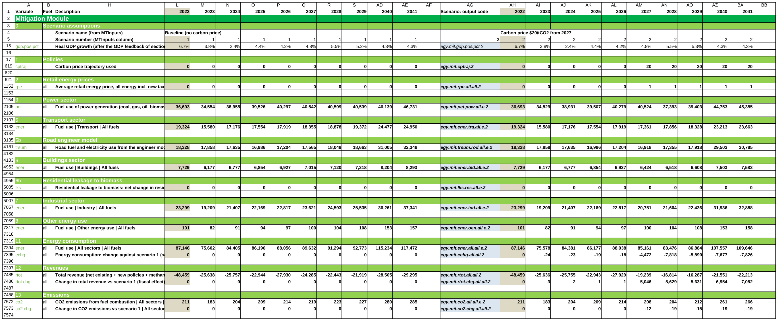
CPAT-AI-Mitigation-MVP
OVERVIEW + USER GUIDE
The CPAT mitigation and distribution modules as a readable Excel workbook, generated and checked by AI.
The Mitigation tab as it opens: every section rolled up
Plain formulas
Checked by Python
126 legacy bugs found
Version 6.3, October 2026 · Egypt data · prototype for discussion
Notes:
One workbook for the CPAT mitigation chain (policies, prices, power, fuel use, revenues, emissions, GDP) and the distribution module. Generated and checked by AI; every value is recomputed independently.

Slide 2
Two tabs follow the CPAT mitigation and distribution chain
WHAT IT IS
1. Policies
2. Prices
3. Power
5-8. Fuel use
11-13. Energy, revenue, CO2
14-18. GHGs, GDP, welfare
1
Policies and prices
Carbon tax, ETS with a cap, feebates, excises, subsidy phase-outs, producer subsidy reform, methane fee, regulations, existing carbon pricing.
IN THE WORKBOOK
Egypt data, 2022-2041; legacy data tabs paste in
Any number of scenarios, run by one macro
Distribution tab: one year, deciles across
The model in equations; every formula listed
NOT IN SCOPE
Air-pollution co-benefits module (dropped)
Transport externalities module (dropped)
2
Power and fuel use
The legacy power model with its engineer options; 16 sectors × 9 fuels; an optional engineer road model.
3
Results to 2041
Fuel use, revenue by policy, CO2, GHGs with methane, NDC comparison, GDP effects, welfare; distribution by decile.
Notes:
The section numbers follow legacy CPAT. Equations: Equations_v6_3.md; every workbook formula: Formulas_v6_3.md. Section 15 keeps the air-pollutant input table; the co-benefits and transport-externality modules were dropped by the user on 2026-10-20.

Slide 3
126 bugs found in legacy CPAT; 9 change today's results
LEGACY CPAT · FIXES NEEDED
ID | High-priority bug and its effect
L1 | Services electricity demand follows the industry multiple: the largest single power-demand error
L3 | Income factor applied twice: the GDP elasticity drifts, error growing to 2040
L13 | Other oil products priced at the 0.01 floor: their fuel use rises tenfold by 2030
L18 | Non-energy methane flat: a methane fee on farming and waste does nothing
L19 | CO2 from flaring booked as methane
L20 | Population 185 million in 2041 instead of 147 million (UN)
L24 | GDP effect added to growth every year: +0.5% compounds to about +10% of GDP
L53 | Actual capacity factors never used: the studies value always applies, the override bounds never act
L87 | Regulation scenarios (energy efficiency, feebates, fuel economy) have no effect: share fixed at 0
9
high: wrong results in standard runs
42
medium: some runs or countries, or a reported number
75
low: latent or reporting only
All are fixed or documented in the MVP; legacy CPAT still needs the fixes. Cell-level fix plans: CPAT_BugFix_Procedure_and_Register_v6_3.docx.
Notes:
Generated from the register (issues_register_v6_3.py, make_legacy_fixes_v6_3.py). The MVP never replicates a legacy bug; it replicates legacy issues and tracks them (NORMS section 0).

Slide 4
Four problems with today's Excel, four fixes
WHAT CHANGES
TODAY IN CPAT
IN THE MVP
Hard to read: long formulas, many tabs
Numbered sections, rolled up; every formula at most 100 characters
Formulas differ from row to row
One formula per block: copy, drag or paste it anywhere in the block
New scenarios are slow to build
Paste a scenario block, or list scenarios in MTInputs and run one macro
Results are hard to verify
Every value recomputed in Python; legacy bugs found, fixed and listed
Notes:
Readability, copy-pasteable formulas, fast scenarios, and independent verification.

Slide 5
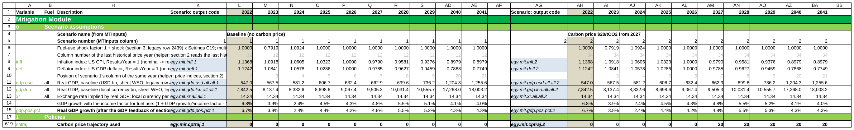
Years across, scenarios side by side, one formula per block
USER GUIDE · LAYOUT
Each scenario is a block of columns: output codes, 2022 (beige), the years to 2041, a blank column.
Paste a scenario
Paste a block of columns to the right: it numbers itself and runs the next MTInputs column.
One formula, at most 100 characters
The same formula in every row of a block; all 566,355 formulas are short.
LAMBDAs tested in a third group
Groups 1-2 hold plain formulas; group 3 reruns group 2 with the named LAMBDAs (Excel 365).
Notes:
Every section is rolled up to its summary row on open; columns B:G and I:K are grouped. Row 5 holds the scenario number (a formula); every input row looks up its value in that MTInputs column. The spacer column of each group compares it with the group on its right.

Slide 6
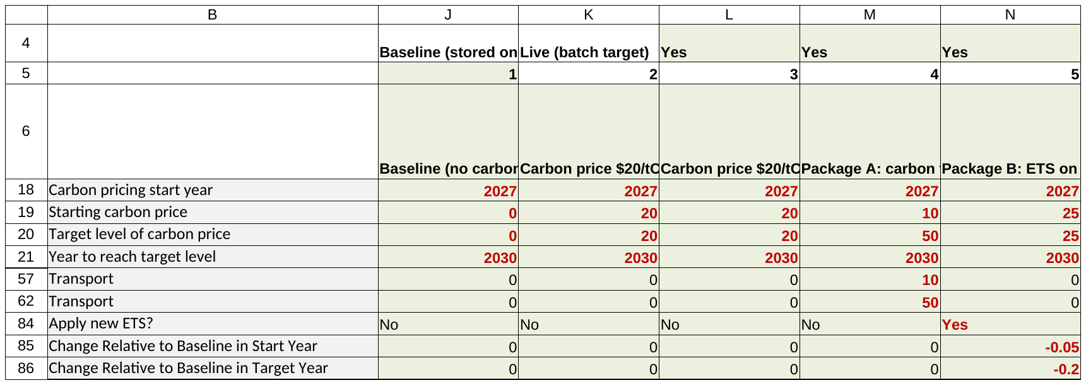
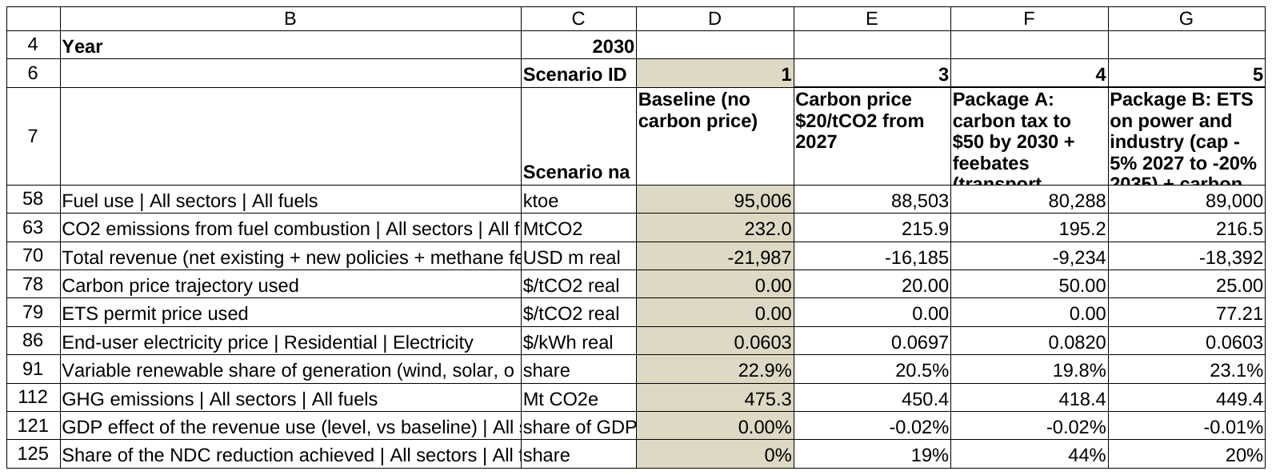
List scenarios, run one macro, compare
USER GUIDE · MANY SCENARIOS
Define in MTInputs
RunAllScenarios
StoredResults
ScenarioCompare
MTInputs: one column per scenario, Run? = Yes
ScenarioCompare: levels in one year vs the baseline
Notes:
The macro copies each definition into the live column, recalculates, runs the ETS goal seek where needed, and stores the results as values. CheckBatchRun tests the macros on first use in Excel.

Slide 7
Policies cut CO2; the ETS price of Package B is still an estimate
RESULTS
2030 vs baseline: $20 -7%, Package A -16%, Package B -7%. Package B ETS price 2030: 77 $/tCO2 (quick estimate).
Notes:
Stored scenario results (StoredResults). Baseline = no carbon price; Package A = carbon tax to $50 + feebates; Package B = ETS on power and industry + carbon tax elsewhere. Builds store a new ETS at its quick price estimate; the batch macro's goal seek on the cap is tested separately by the user (issue I30).

Slide 8
The legacy power model, its data from the legacy tabs
POWER SECTOR · THE MODEL
H. Demand
I. Dispatch
K. Capacity, retirement
L. Investment
G. Prices
SAME METHOD AS LEGACY
Power data computed from the legacy Power, CoC and GHGs tabs
Legacy bugs fixed: demand, capacity factors, hydro, WACC, sizing
IN THE RESULTS
Electricity demand as memo lines by sector
Power fuel use, revenue and CO2 in the totals
Notes:
Demand responds to last year's price; dispatch fills demand from capacity; investment follows a logit on levelised cost within scale-up limits, sized for next year's generation estimated from this year's growth (L67, no circular reference). The power data step on Inputs reproduces legacy Mitigation section 4 with L52-L56 fixed. A carbon price raises the VRE share.

Slide 9
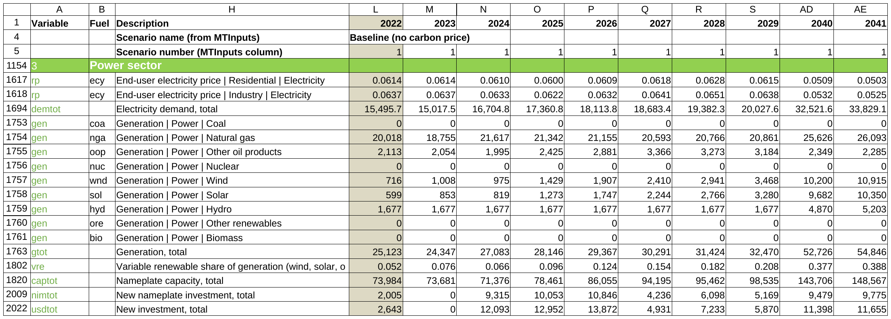
Every legacy power input can change by scenario
POWER SECTOR · OPTIONS
ENGINEER OPTIONS, AS LEGACY
Capacity factors, efficiency, WACC, lifetimes, scale-up and retirement
Gas capacity-factor cap; final deficit to gas
Long-term storage for high VRE shares
Manual capacity and investment
Coal implicit cost (GoalSeekCoal tab)
POWER POLICIES
PPAs for coal and gas; renewable subsidies
Electricity excise, revenue rebate, price floor
Section 3, baseline: generation, VRE share, capacity, investment, prices
Notes:
Power plan P1-P5 (v5.4, v5.6): every MTInputs power input is read in the scenario's own column; section 3 sub-table A0 applies them. Defaults keep Egypt's results. Legacy bugs fixed on the way: L107, L108, L114, L118.

Slide 10
Engineer road model as an option, 17 legacy bugs fixed
ROAD TRANSPORT
Ownership
Stock
Cost of ownership
EV choice
Fuel economy, distance
Fuel use
SAME METHOD AS LEGACY
Reproduces the cached legacy run (to 4e-14)
Fixes: ownership calibration two-sided, depreciation, buses; EV share of new cars 2035 21% -> 9%
IN THE WORKBOOK
Switch TrModel per scenario (default: elasticities, as Egypt)
Feebates, distance tax, EV subsidies, purchase taxes, charging subsidies
Bugs and decisions against legacy: Transport_vs_Legacy_v6_3.md; method: Transport_Method_v6_3.md.
Notes:
Legacy computes the engineer road model but the Egypt run uses the elasticity approach. The fixes cut the engineer baseline by about a third by 2035, mainly through the ownership calibration (L27). Further work on the engineer road model was dropped by the user (2026-10-20).

Slide 11
All greenhouse gases, compared with the NDC target
GHGS, NDC AND GDP
44%
of the NDC reduction achieved by Package A in 2030 (BAU target, -27%)
-12%
GHGs in 2030, Package A against the baseline
IN THE WORKBOOK
Methane by source; methane fee in revenue and in the fiscal space
Producer methane follows world demand, as legacy
NDC comparison: five NDC types, conditional or not
GDP effect of the revenue use, by use and by year
Notes:
Section 14 projects every gas from the GHGs inventory; 14c compares the selected NDC with the scenario (comparison only, no NDC goal seek). Section 16 turns revenue into fiscal space and a GDP effect with the legacy multipliers; the GDP effect enters growth once (legacy bug L24 fixed). The methane fee counts in the fiscal space on the scenario's own activity, as legacy.

Slide 12
Who pays, by decile, and how recycling changes it
DISTRIBUTION
THE LEGACY CHAIN, IN ONE TAB
Direct and indirect price effects (GTAP input-output)
Revenue recycling: tax cuts, investment, spending, transfers
ASPIRE and poverty-line transfers; compensation
Gini, Lorenz curves, urban and rural, top-20 sectors
CHECKED
Legacy distribution bugs fixed (D10-D31)
Equal to a Python reference (505 values)
Deciles across, one analysis year (MTInputs YearDistn); scenario groups as on the Mitigation tab.
Notes:
Distribution tab, scenario group 2. Gini change with recycling: -1.54%. Eleven charts on the tab. Method: Distribution_Method_v6_3.md.

Slide 13
Legacy's post-processing, rebuilt inside each scenario
RESULTS SECTIONS
ROWS IN EVERY SCENARIO BLOCK
2: average prices and price indices
11b, 13b, 14b: changes by fuel and sector; Kaya
12d, 12e: revenue by fuel and by policy, % of GDP
14c: NDC comparison
16, 16b: GDP effects; net energy imports
17: implicit carbon price, effective rate, coverage
18: social cost of carbon, damages avoided, welfare
EGYPT, CARBON PRICE $20 (SCENARIO 3)
Coverage of energy CO2, 2030: 99.8%
Implicit carbon price of fossil fuels, 2022: -193 $/tCO2
Net energy imports, 2030: -1.1 bn USD
Climate damages avoided, 2031: 2.0 bn USD (SCC 78 $/t)
Efficiency cost, 2031: -1.4 bn USD (negative = gain)
National welfare, 2031: 3.4 bn USD
Method: ResultsSections_Method_v6_3.md. Every new row is recomputed in Python in every scenario.
Notes:
Legacy's results area moved into the scenario sections, as memos or lettered sub-blocks, plus sections 17 and 18. Values from StoredResults (scenario 3 = the $20 carbon price of scenario 2). A negative implicit carbon price means fossil fuels are subsidised on balance.

Slide 14
Every number is checked independently
QUALITY
0
error values when LibreOffice recalculates the shipped file
566,355
formulas, none longer than 100 characters
13,396
output codes; 1908 of 13,052 changed against v6.1
126
legacy bugs found; none replicated in the MVP
1
Independent recomputation
Python recomputes prices, fuel use, power, revenue, emissions and distribution from the source data for the test scenarios.
2
Copy-paste and LAMBDAs tested
Scenario groups 1 and 2 are the same formulas; the LAMBDA group equals the plain group.
3
Differences listed
Tab 'Version Log, About, and Diff' lists every difference with legacy CPAT and why.
4
Documented
The model in equations, method notes, every formula, and the legacy bugs to fix.
Notes:
Quick check check_quick_report_v6.3.md: PASS. Full check check_report_v6.3.md: Overall (partial): FAIL**.

Slide 15
Open, run the check, then explore
GETTING STARTED
1
Open the .xlsm and enable macros
Run CheckBatchRun once (Alt+F8): MacroCheck should say PASS.
NEXT
Send bugs and fix plans to the CPAT team (U4)
Reconcile with legacy file 459 (U2)
Review in Excel 365 (I1; v6.3 opens without repair)
ETS goal seek: user test (I30)
DATA REQUESTS
GAINS emission-factor paths (I64)
Blank VAT cells in the price data (I65)
Proprietary tables, other countries (I13)
Historical GHGs 2018-2020 (I68)
2
Change a scenario
Edit its MTInputs column; results update on Mitigation, Distribution and MTOutputs.
3
Run many scenarios
Set Run? = Yes on the definitions and run RunAllScenarios; compare them.
4
Read more
Cover tab, QuickStart and equations; the bugs and issues register in Word.
Notes:
Files (mitigation_copypaste folder): CPAT-AI-Mitigation-MVP-v6.3.xlsm, QuickStart_v6_3.md, CPAT-AI-Mitigation-MVP_BugsIssuesUpgrades_v6.3.docx, CPAT_BugFix_Procedure_and_Register_v6_3.docx. Open items from issues_register_v6_3.py; I52 and I53 wait for features not planned.

