Slide 1
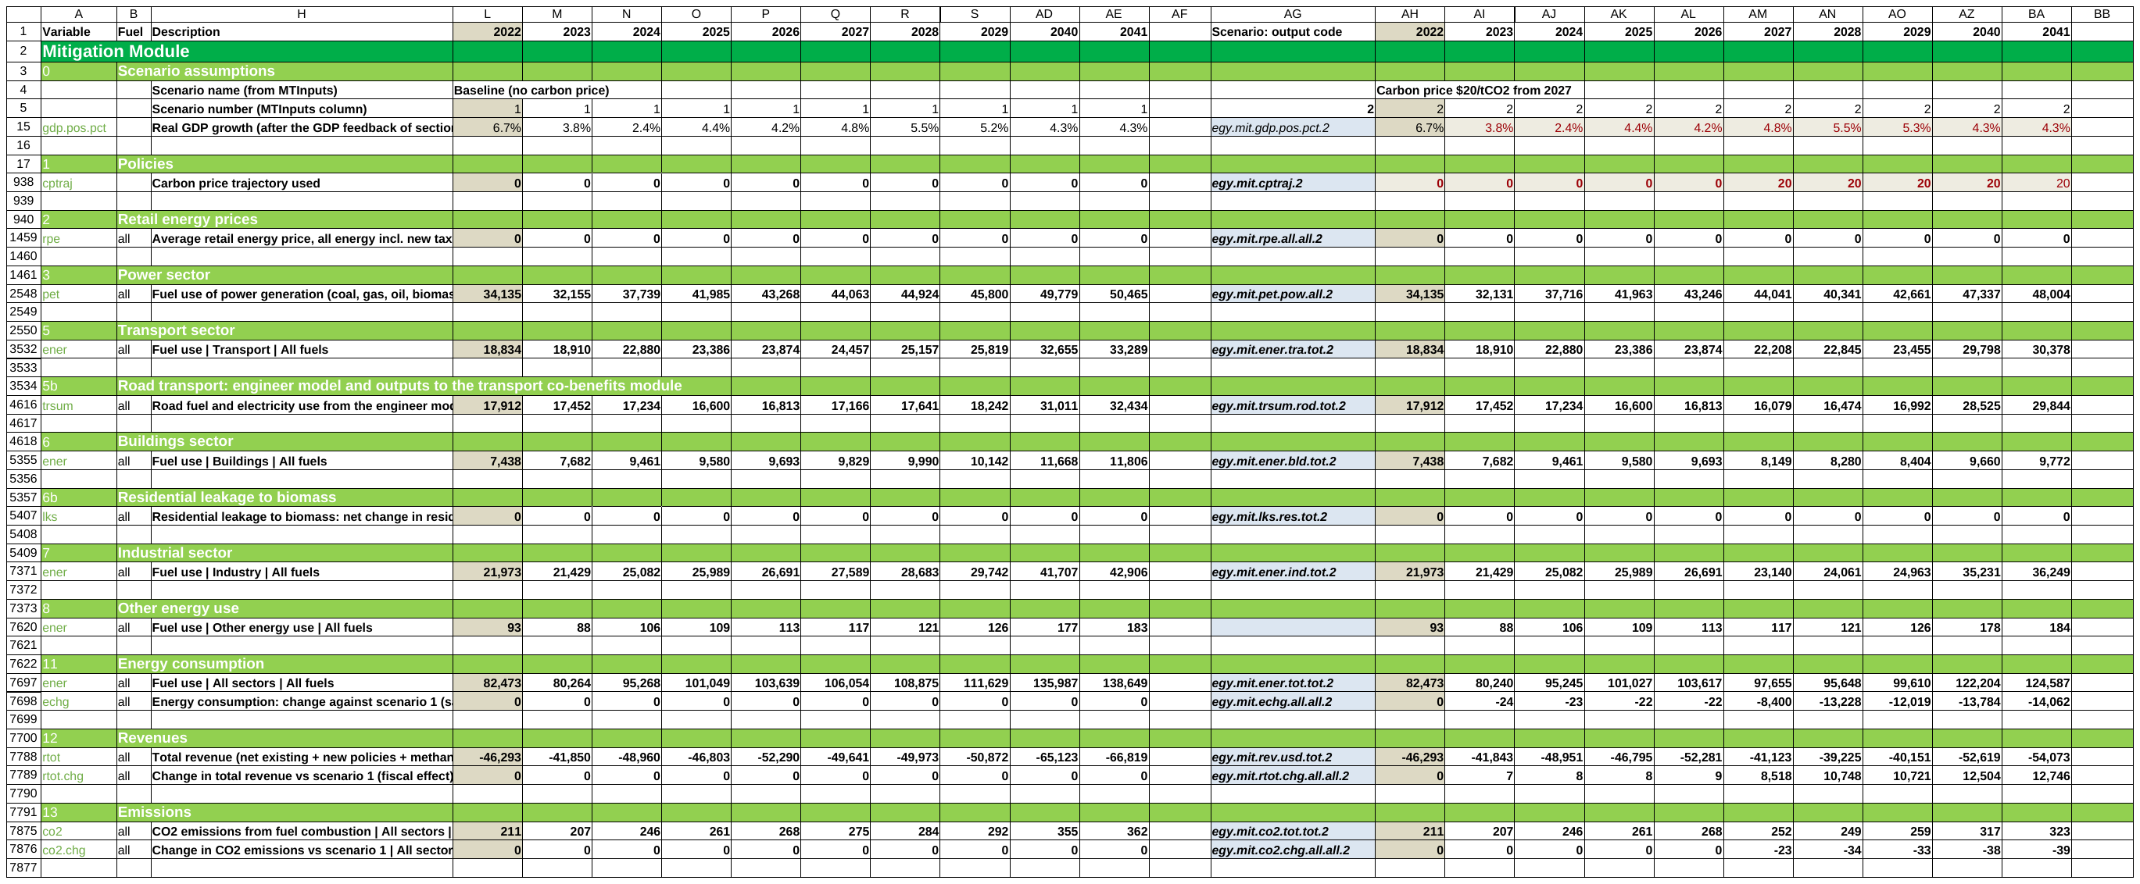
CPAT-AI-Mitigation-Prototype
OVERVIEW + USER GUIDE
The CPAT mitigation and distribution modules as a readable Excel workbook, generated and checked by AI.
The Mitigation tab as it opens: every section rolled up
Plain formulas
Checked by Python
163 legacy bugs found
Version 9.0, October 2026 · Egypt data · prototype for discussion
Notes:
One workbook for the CPAT mitigation chain (policies, prices, power, fuel use, revenues, emissions, GDP) and the distribution module. Generated and checked by AI; every value is recomputed independently.

Slide 2
Mitigation: substantial progress. Distribution: done.
WHERE WE ARE
MITIGATION
Prices, demand by 16 sectors and 8 fuels, power, road transport
Revenues, CO2, other GHGs, GDP effects, carbon rates
Checked against legacy CPAT and an independent Python recomputation
DISTRIBUTION
Household impacts as legacy, by decile
ASPIRE and poverty-line transfers, production-sector prices, charts
All 31 legacy distribution bugs fixed
SINCE v6.3
Ships with its values: opens without recalculating
Dashboard: Live or Stored results, key table, charts
9 data tabs linked to the data workbook
Codes on the CPAT code protocol (v7.2)
Every result checked again in a full check
163
legacy bugs found (132 mitigation, 31 distribution), none replicated
109
legacy issues (99 mitigation, 10 distribution), replicated and tracked
15,082
output codes, checked against an independent Python recomputation
Source: CPAT-AI repo, release 9.0 and the bug and issue register (Legacy_CPAT_Bugs_v9.0.docx).
Notes:
Around it: quick start, equations, method notes, every formula listed; the bug register with cell-by-cell fix plans for legacy CPAT; the Python model (Coded CPAT) shares the same codes. v7.2: every prototype code follows the CPAT code protocol (legacy variable names, no model letters, tot for totals, each code once); the v7.1 stems stay as aliases for one release.

Slide 3
Two tabs follow the CPAT mitigation and distribution chain
WHAT IT IS
1. Policies
2. Prices
3. Power
5-8. Fuel use
11-13. Energy, revenue, CO2
14-18. GHGs, GDP, welfare
1
Policies and prices
Carbon tax, ETS with a cap, feebates, excises, subsidy phase-outs, producer subsidy reform, methane fee, regulations, existing carbon pricing.
IN THE WORKBOOK
Egypt data, 2022-2041; legacy data tabs paste in
Any number of scenarios, run by one macro
Distribution tab: one year, deciles across
The model in equations; every formula listed
NOT IN SCOPE
Air-pollution co-benefits module (dropped)
Transport externalities module (dropped)
2
Power and fuel use
The legacy power model with its engineer options; 16 sectors × 9 fuels; an optional engineer road model.
3
Results to 2041
Fuel use, revenue by policy, CO2, GHGs with methane, NDC comparison, GDP effects, welfare; distribution by decile.
Notes:
The section numbers follow legacy CPAT. Equations: Equations.md; every workbook formula: Formulas.md. Section 15 keeps the air-pollutant input table; the co-benefits and transport-externality modules were dropped by the user on 2026-10-20.

Slide 4
163 bugs found in legacy CPAT; 9 change today's results
LEGACY CPAT · FIXES NEEDED
ID | High-priority bug and its effect
L1 | Services electricity demand follows the industry multiple: the largest single power-demand error
L3 | Income factor applied twice: the GDP elasticity drifts, error growing to 2040
L13 | Other oil products priced at the 0.01 floor: their fuel use rises tenfold by 2030
L18 | Non-energy methane flat: a methane fee on farming and waste does nothing
L19 | CO2 from flaring booked as methane
L20 | Population 185 million in 2041 instead of 147 million (UN)
L24 | GDP effect added to growth every year: +0.5% compounds to about +10% of GDP
L53 | Actual capacity factors never used: the studies value always applies, the override bounds never act
L87 | Regulation scenarios (energy efficiency, feebates, fuel economy) have no effect: share fixed at 0
9
mitigation, high: wrong results in standard runs
43
mitigation, medium: some runs or countries, or a reported number
80 + 31
mitigation low (latent or reporting) + distribution
132 mitigation and 31 distribution bugs, all fixed in the prototype; also 109 legacy issues (99 mitigation, 10 distribution), replicated and tracked. Fix plans: Legacy_CPAT_Bugs_v9.0.docx. Legacy CPAT 1.0pre_465: the CPAT team marked 63 fixed (52 confirmed, 9 with caveats, 2 not fixed).
Notes:
Generated from the register (issues_register.py, make_legacy_fixes.py). The prototype never replicates a legacy bug; it replicates legacy issues and tracks them (NORMS section 0).

Slide 5
Four problems with today's Excel, four fixes
WHAT CHANGES
TODAY IN CPAT
IN THE prototype
Hard to read: long formulas, many tabs
Numbered sections, rolled up; every formula at most 100 characters
Formulas differ from row to row
One formula per block: copy, drag or paste it anywhere in the block
New scenarios are slow to build
Paste a scenario block, or list scenarios in ScenarioDefinition and run one macro
Results are hard to verify
Every value recomputed in Python; legacy bugs found, fixed and listed
Notes:
Readability, copy-pasteable formulas, fast scenarios, and independent verification.

Slide 6

Years across, scenarios side by side, one formula per block
USER GUIDE · LAYOUT
Each scenario is a block of columns: output codes, 2022 (beige), the years to 2041, a blank column.
Paste a scenario
Paste a block of columns to the right: it numbers itself and runs the next ScenarioDefinition column.
One formula, at most 100 characters
The same formula in every row of a block; all 452,077 formulas are short.
LAMBDAs in the live scenario
Group 1 (baseline) holds plain formulas; group 2 (the live scenario) calls the named LAMBDAs.
Notes:
Every section is rolled up to its summary row on open; columns B:G and I:K are grouped. Row 5 holds the scenario number (a formula); every input row looks up its value in that ScenarioDefinition column. Two groups ship (v6.6); more by pasting group 2 to the right.

Slide 7

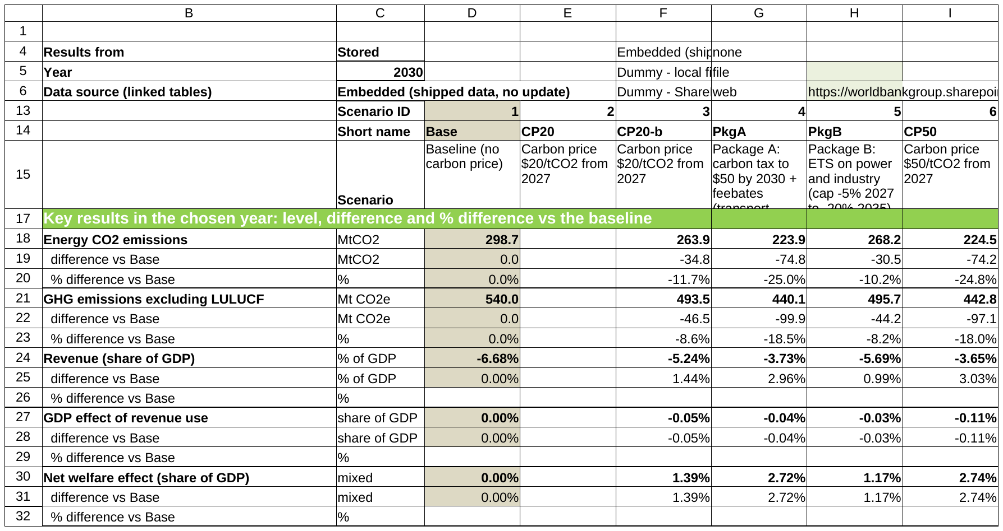
List scenarios, run one macro, compare
USER GUIDE · MANY SCENARIOS
Define in ScenarioDefinition
Run stored scenarios
StoredOutputs
ScenarioCompare
ScenarioDefinition: one column per scenario, short name, Run? = Yes
ScenarioCompare: key results vs the baseline (Live or Stored)
Notes:
The macro copies each definition into the live column, recalculates, runs the ETS goal seek where needed, and stores the results as values (StoredOutputs, sorted; every lookup by output code). The dashboard reads Live (LiveOutputs) or Stored results; charts show only scenarios with results.

Slide 8
Half the recalculation time of legacy, about half the file size
USER GUIDE · SPEED AND SIZE
5 s
recalculation after a change (legacy CPAT: about 10 s); opens with its values, no recalculation
10 MB
binary (.xlsb) today; 12-13 MB expected with all countries and the remaining modules (legacy CPAT: over 21 MB)
9
data tabs linked to the data workbook (local file or SharePoint)
1
Recalculate now / Recalculation on
Green buttons on ScenarioCompare: a timed full recalculation, or automatic calculation for interactive work.
2
Update data tables
Choose the data source on ScenarioCompare; each table is copied by column name; the status is on the Cover.
LINKED TABS
Balances · EnergyCons · Prices_dom · HHSurvey · IO_GTAP · HH_Elast · WEO · GDPRatios · UNPop
Notes:
Timings and sizes measured by the user in Excel 365 (2026-10-22): legacy about 10 s per recalculation, CPAT-AI about 5 s; CPAT-AI about 10 MB as .xlsb, legacy over 21 MB. Why: short formulas, one formula per block, two scenario groups shipped, values stored. v6.6: values stored, OFFSET and COUNTIFS replaced (formulas 568k -> 404k). v7.1: Balances, EnergyCons, Prices_dom, HHSurvey, IO_GTAP, HH_Elast (rows of the country); WEO, GDPRatios, UNPop (all rows). Data workbook: data/workbooks/CPAT_Data_dummy_python.xlsx (dummy values).

Slide 9
Policies cut CO2; the ETS price of Package B is still an estimate
RESULTS
2030 vs baseline: $20 -12%, Package A -25%, Package B -10%. Package B ETS price 2030: 78 $/tCO2 (quick estimate).
Notes:
Stored scenario results (StoredOutputs). Baseline = no carbon price; Package A = carbon tax to $50 + feebates; Package B = ETS on power and industry + carbon tax elsewhere. Builds store a new ETS at its quick price estimate; the batch macro's goal seek on the cap is tested separately by the user (issue I30).

Slide 10
The legacy power model, its data from the legacy tabs
POWER SECTOR · THE MODEL
H. Demand
I. Dispatch
K. Capacity, retirement
L. Investment
G. Prices
SAME METHOD AS LEGACY
Power data computed from the legacy Power, CoC and GHGs tabs
Legacy bugs fixed: demand, capacity factors, hydro, WACC, sizing
IN THE RESULTS
Electricity demand as memo lines by sector
Power fuel use, revenue and CO2 in the totals
Notes:
Demand responds to last year's price; dispatch fills demand from capacity; investment follows a logit on levelised cost within scale-up limits, sized for next year's generation estimated from this year's growth (L67, no circular reference). The power data step on Inputs reproduces legacy Mitigation section 4 with L52-L56 fixed. A carbon price raises the VRE share.

Slide 11

Every legacy power input can change by scenario
POWER SECTOR · OPTIONS
ENGINEER OPTIONS, AS LEGACY
Capacity factors, efficiency, WACC, lifetimes, scale-up and retirement
Gas capacity-factor cap; final deficit to gas
Long-term storage for high VRE shares
Manual capacity and investment
Coal implicit cost (GoalSeekCoal tab)
POWER POLICIES
PPAs for coal and gas; renewable subsidies
Electricity excise, revenue rebate, price floor
Section 3, baseline: generation, VRE share, capacity, investment, prices
Notes:
Power plan P1-P5 (v5.4, v5.6): every ScenarioDefinition power input is read in the scenario's own column; section 3 sub-table A0 applies them. Defaults keep Egypt's results. Legacy bugs fixed on the way: L107, L108, L114, L118.

Slide 12
Engineer road model as an option, 17 legacy bugs fixed
ROAD TRANSPORT
Ownership
Stock
Cost of ownership
EV choice
Fuel economy, distance
Fuel use
SAME METHOD AS LEGACY
Reproduces the cached legacy run (to 4e-14)
Fixes: ownership calibration two-sided, depreciation, buses; EV share of new cars 2035 18% -> 6%
IN THE WORKBOOK
Switch TrModel per scenario (default: elasticities, as Egypt)
Feebates, distance tax, EV subsidies, purchase taxes, charging subsidies
The road bugs: Legacy CPAT bugs, section 4.2 (Legacy_CPAT_Bugs_v9.0.docx); method: Methods, chapter Transport.
Notes:
Legacy computes the engineer road model but the Egypt run uses the elasticity approach. The fixes cut the engineer baseline by about a third by 2035, mainly through the ownership calibration (L27). Further work on the engineer road model was dropped by the user (2026-10-20).

Slide 13
All greenhouse gases, compared with the NDC target
GHGS, NDC AND GDP
69%
of the NDC reduction achieved by Package A in 2030 (BAU target, -27%)
-18%
GHGs in 2030, Package A against the baseline
IN THE WORKBOOK
Methane by source; methane fee in revenue and in the fiscal space
Producer methane follows world demand, as legacy
NDC comparison: five NDC types, conditional or not
GDP effect of the revenue use, by use and by year
Notes:
Section 14 projects every gas from the GHGs inventory; 14c compares the selected NDC with the scenario (comparison only, no NDC goal seek). Section 16 turns revenue into fiscal space and a GDP effect with the legacy multipliers; the GDP effect enters growth once (legacy bug L24 fixed). The methane fee counts in the fiscal space on the scenario's own activity, as legacy.

Slide 14
Who pays, by decile, and how recycling changes it
DISTRIBUTION
THE LEGACY CHAIN, IN ONE TAB
Direct and indirect price effects (GTAP input-output)
Revenue recycling: tax cuts, investment, spending, transfers
ASPIRE and poverty-line transfers; compensation
Gini, Lorenz curves, urban and rural, top-20 sectors
CHECKED
Legacy distribution bugs fixed (D10-D31)
Equal to a Python reference (505 values)
Deciles across, one analysis year (ScenarioDefinition YearDistn); scenario groups as on Mitigation.
Notes:
Distribution tab, scenario group 2. Gini change with recycling: -1.82%. Eleven charts on the tab. Method: Methods, chapter Distribution.

Slide 15
Legacy's post-processing, rebuilt inside each scenario
RESULTS SECTIONS
ROWS IN EVERY SCENARIO BLOCK
2: average prices and price indices
11b, 13b, 14b: changes by fuel and sector; Kaya
12d, 12e: revenue by fuel and by policy, % of GDP
14c: NDC comparison
16, 16b: GDP effects; net energy imports
17: implicit carbon price, effective rate, coverage
18: social cost of carbon, damages avoided, welfare
EGYPT, CARBON PRICE $20 (SCENARIO 3)
Coverage of energy CO2, 2030: 99.8%
Implicit carbon price of fossil fuels, 2022: -183 $/tCO2
Net energy imports, 2030: -2.8 bn USD
Climate damages avoided, 2031: 3.6 bn USD (SCC 78 $/t)
Efficiency cost, 2031: -5.1 bn USD (negative = gain)
National welfare, 2031: 10.6 bn USD
Method: Methods, chapter Macro and results. Every new row is recomputed in Python in every scenario.
Notes:
Legacy's results area moved into the scenario sections, as memos or lettered sub-blocks, plus sections 17 and 18. Values from StoredOutputs (scenario 3 = the $20 carbon price of scenario 2). A negative implicit carbon price means fossil fuels are subsidised on balance.

Slide 16
Every number is checked independently
QUALITY
0
error values when LibreOffice recalculates the shipped file
452,077
formulas, none longer than 100 characters
15,082
output codes; 3615 of 13,076 changed against the last release
163
legacy bugs found; none replicated in the prototype
1
Independent recomputation
Python recomputes prices, fuel use, power, revenue, emissions and distribution from the source data for the test scenarios.
2
Copy-paste and LAMBDAs tested
Pasted groups equal the stored results; the LAMBDA group equals the plain formulas of the last release.
3
Differences listed
Tab 'Version Log, About, and Diff' lists every difference with legacy CPAT and why.
4
Documented
The model in equations, method notes and every formula; one register of bugs and issues.
Notes:
Quick check check_quick_report_v9.0.md: PASS. Full check check_report_v9.0.md: Overall: PASS** (sections 0-13 in the full run; section 14 rerun).

Slide 17
Open, run the check, then explore
GETTING STARTED
1
Open the .xlsm and enable macros
Debug > Compile VBAProject once, then First-run test: PASS.
WHAT REMAINS
Review in Excel 365: timings, macros, links (I1)
Send bugs and fix plans to the CPAT team (U4)
Align codes: Excel, Python, master list
Link the other data tabs (GHGs, EF_GHG ...)
DATA REQUESTS
GAINS emission-factor paths (I64)
Blank VAT cells in the price data (I65)
Proprietary tables, other countries (I13)
Historical GHGs 2018-2020 (I68)
2
Change a scenario
Edit its ScenarioDefinition column, then click Recalculate now.
3
Run many scenarios
Run? = Yes on the definitions, click Run stored scenarios; read the dashboard.
4
Read more
Cover tab, QuickStart and equations; the bugs and issues register in Word.
Notes:
Files: CPAT-AI-Mitigation-Prototype-v9.0.xlsm (repository root), the Documentation, Legacy_CPAT_Bugs_v9.0.docx. Also open: the numerical check on the latest legacy file, 465 (U2); ETS goal seek user test (I30). Open items from issues_register.py; I52 and I53 wait for features not planned.

