Slide 1
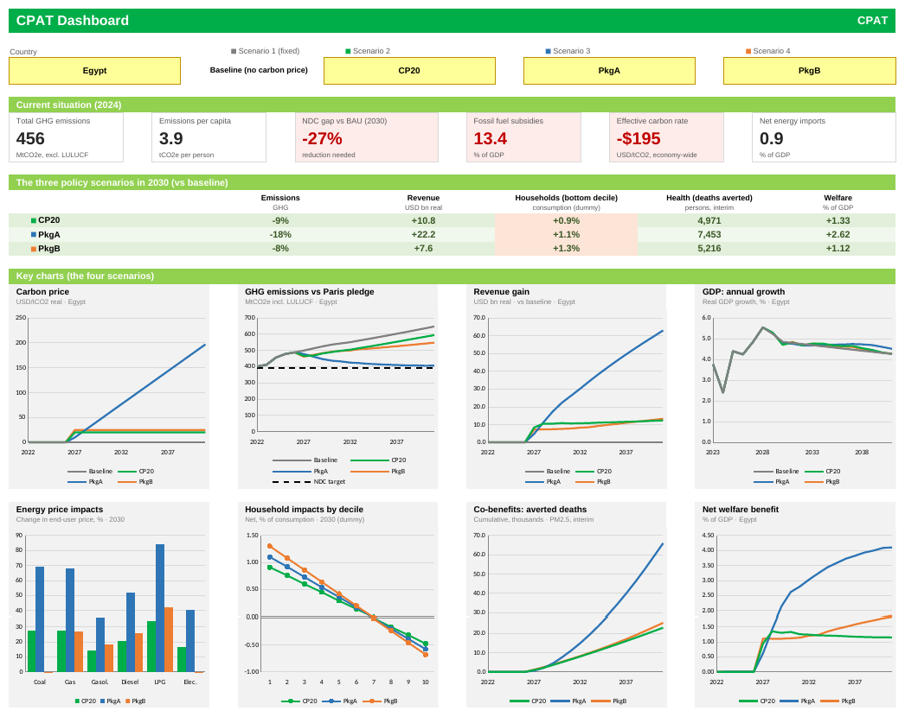
CPAT-AI: Introduction for IMF and WB Team
CPAT-AI · NOVEMBER 2026
The Dashboard: one country, four scenarios
WB CPAT Team

Slide 2
Why CPAT-AI, and what this deck covers
INTRODUCTION
PURPOSE OF CPAT-AI
CONTENTS
Readable: Climate-policy advice rests on CPAT's numbers: people must be able to read and check every one of them.
1
Terms used
3
Correct: Every bug of CPAT 1.0 fixed, with a cell plan to fix CPAT 1.0 itself; every issue kept as it is and tracked.
2
What it is
its forms and its status
4
3
Potential Improvements on CPAT 1.0
layout, formulas, scenarios, interface, data, proprietary data
5-13
Fast to run and to change: Many countries and scenarios at once; a new fuel, year or scenario is a paste, not a rebuild.
4
What we found, and our rules
bugs and issues; model and visual rules
14-15
5
Documentation
the website, bug definitions, cell plans
16
PURPOSE OF THIS DECK
One place to learn what CPAT-AI is and where it stands, where we hope to have improved upon CPAT 1.0, what we found, where it is documented, and how to use it, potentially develop it further and work together.
6
Use, develop, collaborate
the Master, the builders, two ways of working, GitHub
17-20
7
Next steps and conclusions
21-22

Slide 3
The words this deck uses, defined once
INTRODUCTION · TERMS USED
CPAT 1.0
The current World Bank-IMF CPAT workbook (file CPAT 1.0pre_465), the reference we compare with. The repository's codes call it legacy (the L codes).
CPAT-AI
The rebuild: human-readable Excel workbooks run from the Master, and their Python twin, Coded CPAT.
Master
The workbook that holds every macro: it activates CPAT-AI, loads the data, runs and stores many scenarios.
Unified CPAT
One workbook with mitigation and distribution inside, as CPAT 1.0 is, built by the Master.
Bug
CPAT 1.0 does not compute what it means to (a wrong row, a unit applied twice). CPAT-AI fixes it, never copies it.
Issue
CPAT 1.0 does what it means to, but the choice is open to question. CPAT-AI does the same and tracks it.
Major issue
An issue the CPAT team should decide first: five of data (MId), five of methodology (MIm).
Cell plan
For each bug: the cells of CPAT 1.0 to change, the formula now and the new formula.
Scenario group
One copy of the model's years for one scenario; four sit side by side, left to right.
LAMBDA
A named Excel 365 function (FUELUSE, ...) that a cell can call in place of a long direct formula.
Data edition
One complete data set in the CPAT 1.0 table layout: public and perturbed here, real ones private.
Sectoral models
The engineer models of power and road transport, beside the elasticity model, chosen by a switch.

Slide 4




CPAT rebuilt in readable forms; the core is done
1 · WHAT IT IS
The Master
Every macro in one place: activates CPAT-AI, loads the data, runs many countries × many scenarios, stores and compares the results.
STATUS
Mitigation
First full version (1.0) done, replicated in Python
Done
Unified CPAT
One workbook with mitigation and distribution inside, as CPAT 1.0, built by the Master; distribution reads mitigation directly.
Multi-scenario tool (MT)
First version done, inside the Master
Done
Unified CPAT
Mitigation and distribution in one workbook
WIP
Sectoral models
Engineer models of power and road transport beside the elasticity model, chosen by a switch; industry and residential kernels prototyped.
IMF-WB interface
Dashboard, Diagnostic and comparisons in place
Partly
Distribution
Still to discuss with World Bank experts
Prototype
Coded CPAT, the Python twin
Reads the same data and computes the same numbers, number for number.
Air pollution, transport co-benefits
To come, run from the Master like the rest
Next
Notes:
Sectoral models: Mitigation section 4 (power) and section 5 (road transport, engineer model), switch TrModel; kernels in other/standalone_initial_prototypes/. Unified CPAT: release 1.9.1, the Master's Build unified CPAT (plans/Unified_CPAT_plan.md). Distribution 0.6.0. IMF-WB interface: the NewMockupUI visioning file and the core graphs of a country report.

Slide 5








Eight improvements over CPAT 1.0
2 · BETTER THAN CPAT 1.0
Human readable
Consistency
LAMBDA or not
Copy-pastability
Every row named, labelled, with its unit and source; parameters in their own cells
The base year its own first column, then one formula per row for every later year
Direct cell formulas, as CPAT 1.0, or named LAMBDAs: chosen at activation
Columns copy across years, scenarios and fuels
Speed and size
Multiple scenarios
New interface
Data approach
Small files, shared formulas, binary working copies
Built into the Master: no separate Multiscenario Tool
Dashboard, Diagnostic, Scenario comparison: the IMF-WB interface, in part
CPAT 1.0 tables and layout, on a shared drive; one country at a time
Notes:
Every comparison is with CPAT 1.0 (file 1.0pre_465, the latest from the CPAT team). Each improvement has its own slide next.

Slide 6
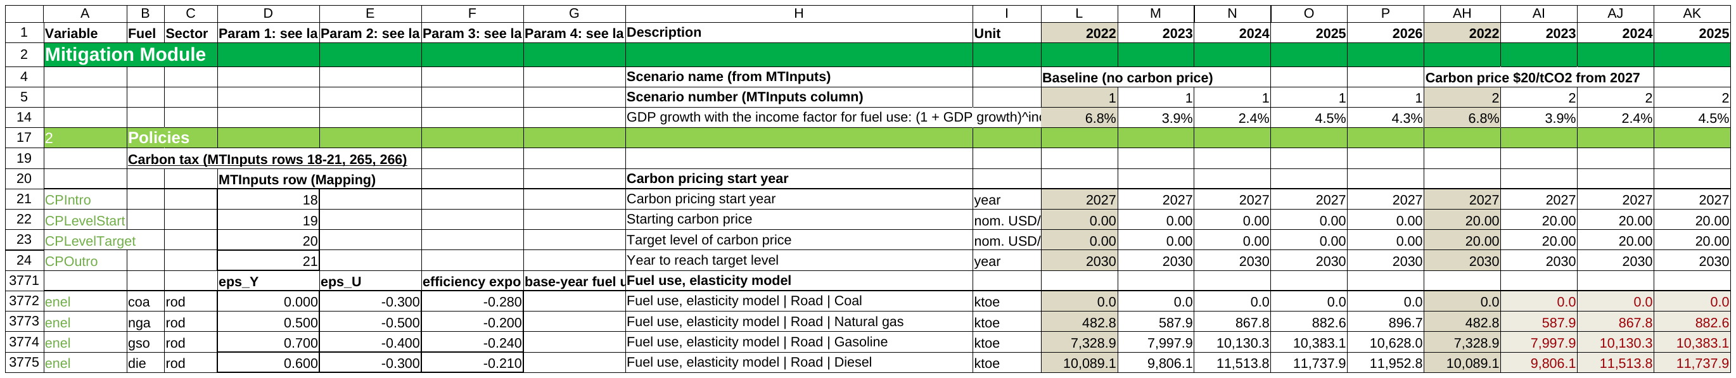
How the model sheet is set out: read it like a table
2 · HUMAN READABLE
1
Settings on the left
Columns D-G hold each row's parameters (elasticities, base-year data), named in the label row above them.
2
Macro variables on top
Rows 1-15: year, scenario name and number, deflators, GDP growth, read by every row below.
3
Drag right
The base year is the first column; from the next year on, one formula per row: drag any year right.
4
Scenarios left to right
Four scenario groups side by side (baseline, then the policies), the same rows, the same formulas.
More readable than CPAT 1.0 in many respects: every row has a variable code, a description, a unit and a source; inputs are read by name from tab Scenarios (the CPAT 1.0 MTInputs rows); parameters in cells of their own, not inside formulas.
Notes:
Screenshot: tab Mitigation as shipped (values), rows 1-24 and the road fuel-use block (rows 3771-3775); columns L-P are years 2022-2026 of group 1 (baseline), AH-AK the same years of group 2 (carbon price $20). Group 2 values in red are calculated by LAMBDAs.

Slide 7
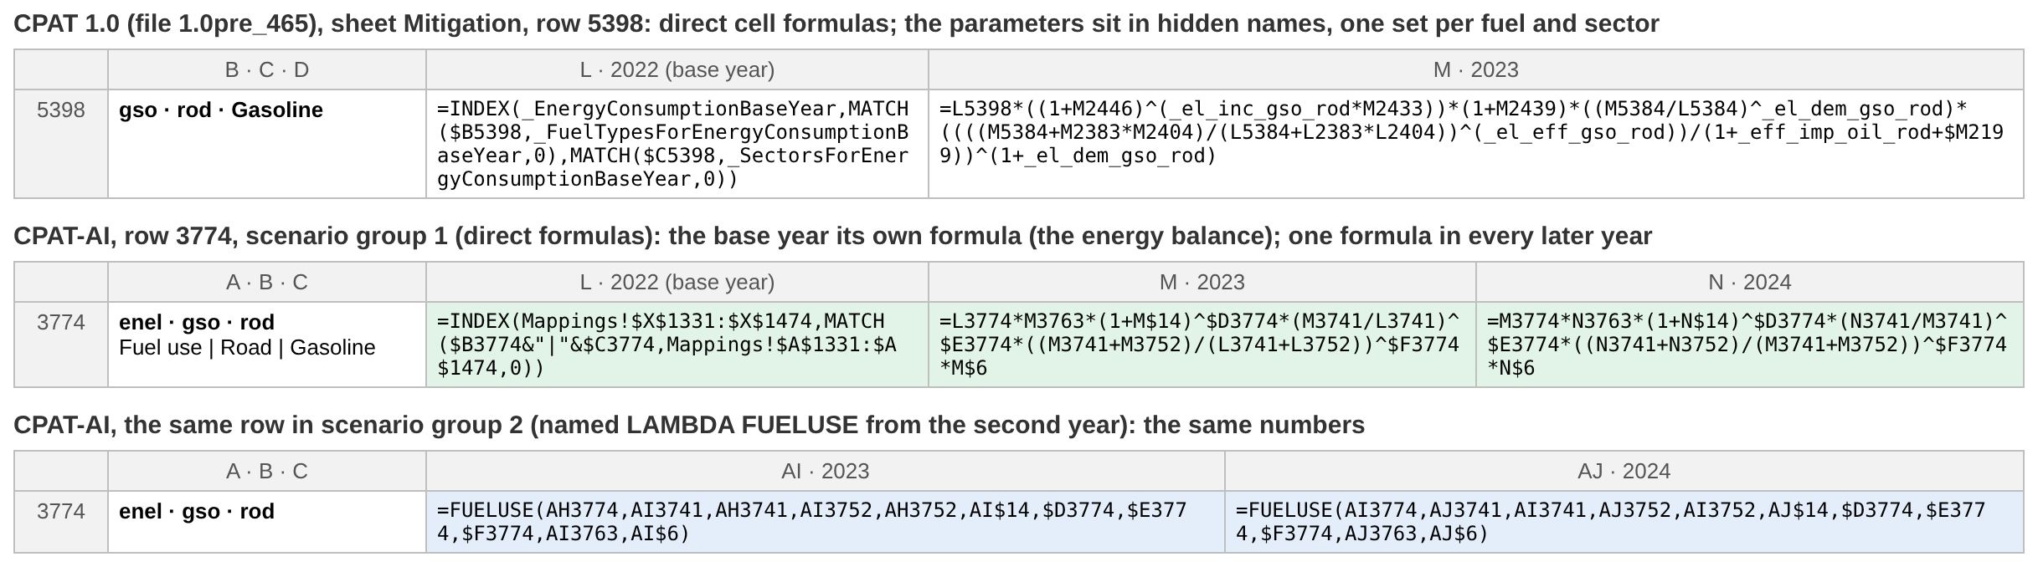
One row, CPAT 1.0 against CPAT-AI, LAMBDA or not
2 · CONSISTENCY AND LAMBDAS
1
Own first column, then one formula
The base year has its own formula (the data); every later year one formula, with an IF only where something changes later (the end of price history).
2
Direct formulas or LAMBDAs
CPAT 1.0 uses direct cell formulas only. CPAT-AI offers both, set at activation: Mix (baseline direct, scenarios with LAMBDAs such as FUELUSE), All direct, or All LAMBDA.
3
The same numbers either way
Coded CPAT replicates the workbook number for number; each release compares every output with the last one.
Notes:
Fuel use, road, gasoline: CPAT 1.0pre_465 (sheet Mitigation, row 5398) and CPAT-AI (row 3774), scenario group 1 (direct formulas) and group 2 (LAMBDA FUELUSE). LAMBDAs need Excel 365; direct formulas run anywhere, LibreOffice included. Master setting 'Formulas': Mix, All plain, All LAMBDA.

Slide 8
Copy a column and it works: across years, scenarios, fuels
2 · COPY-PASTABILITY
Group 1
BASE
Group 2
Dashboard scenario
Group 3
Dashboard scenario
Group 4
Dashboard scenario
1
Across the years
After the base year every row is one formula, so a fix in one cell is copied along the row. Activation copies 2035 out to 2041.
2
Across the scenarios
The four scenario groups hold the same formulas. Pasting a group's inputs gives that scenario's results (tested to 1e-13).
Years across, the same formulas in every scenario group: one row highlighted.
3
Across the fuels
A fuel is added in one place in the builder. Every lookup and total follows it (tested with a tenth fuel).
Against CPAT 1.0: each fuel and sector has its own formula, with its parameters in hidden names. Here a reviewer reads one cell and knows the whole row.

Slide 9
Fewer formulae, more ‘stored formulae’
2 · SPEED AND SIZE
Shared formulae are different from LAMBDAs. They are an internal calculation aspect of Excel that makes things go faster when a formula is ‘copy pasteable’. This makes the new Excel CPAT faster.
2 → 1
workbooks to run many scenarios
CPAT 1.0 needs the model and a separate Multiscenario Tool; CPAT-AI runs them from the Master
203k / 371k
formulas stored once
Shared formulas: a fill across the years is written once, not cell by cell
~50%
faster to open
Measured in Excel 365 when shared formulas came in (against the first CPAT-AI version)
.xlsb
binary working copies
The Master saves the activated workbooks as Excel binary: quick to open and save
Notes:
Sizes read from the files: data/Public01/legacy/CPAT 1.0pre_465_Public01.xlsb, the Multiscenario Tool 1.360 .xlsb, the CPAT-AI workbooks as shipped (.xlsx). The activated mitigation .xlsb with every year to 2041 is 14.2 MB. Opening time against CPAT 1.0 has not been timed side by side: a test in Excel 365.

Slide 10
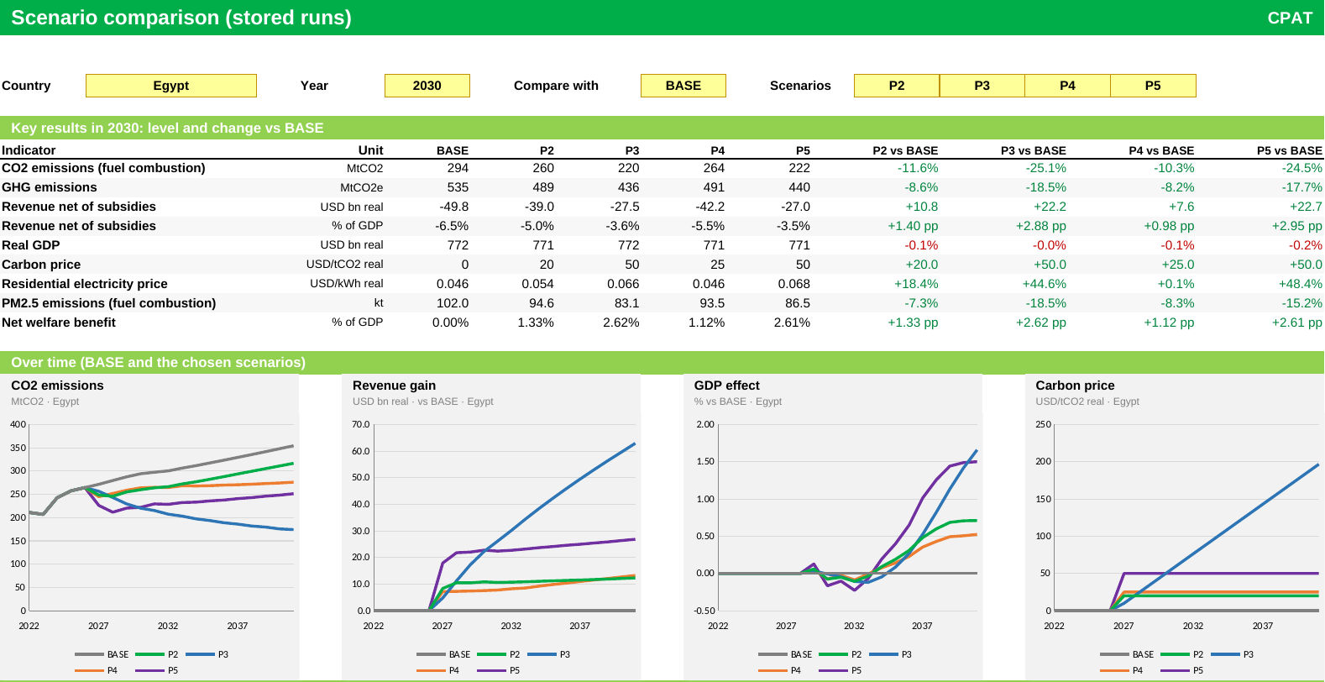
Many countries × many scenarios, every run stored
2 · MULTIPLE SCENARIOS
1
Four live scenarios
Side by side in the model, one group each, seen on the Dashboard.
2
Batch runs
The Master runs every listed country with every listed scenario, three at a time.
3
Every run kept
Stored as values in StoredResults; compared in Scenario comparison, OneCountry, ManyCountries.
4
Against CPAT 1.0
Replaces its separate Multiscenario Tool; ETS goal seek and Achieve NDCs kept.
The Master's Scenario comparison: stored runs side by side, levels and changes against BASE.

Slide 11
A dashboard first: the IMF-WB interface, partly in place
2 · NEW INTERFACE
1
Partly in place
The new IMF-WB interface: Dashboard (country, four scenarios, tiles, eight charts), country Diagnostic, Scenario comparison.
2
Built from approved mock-ups
One grid on every view: four chart panels a row, legends below, the data of each chart grouped underneath.
3
Inputs look like inputs
Lemon cells with bold text, as in CPAT 1.0; dummy data shaded pale orange until real data arrive.
Limitation: there is not currently a user-editable dashboard. Its tiles and charts are set by the builder; users choose the country and scenarios, not the layout.
Notes:
UI rules: excel_ai/core/UI_STYLE.md; mock-ups in core/plans/mockups/. The spec for the rest of the interface: the NewMockupUI visioning file and the 10 core graphs of a country report.

Slide 12
Data on a shared drive; CPAT holds one country at a time
2 · THE APPROACH TO DATA
All the data
Every country, real values, on the team's shared drive and in the private data repository
Update data
The Master picks the source (shared drive, data repository, local file, GitHub) and the rows: one country, or all
CPAT
Normally holds one country: small, quick, and no other country's proprietary data travel with it
HOW IT WORKS
EDITIONS IN USE
CPAT 1.0 formats and layout: The data tables keep the tabs, columns and cell addresses of CPAT 1.0, so its tables paste straight in.
Development editions, public: Public01 (the proprietary tables perturbed ±3%) and Public02 (randomized for every country), on GitHub.
Editions: Each data set is one folder of the same structure, a CSV per table with a manifest; Power Query fills the data tabs.
The real data: on the shared drive and in the private data repository; never on GitHub (next slide).
Many countries: For a run of many countries, Update data loads all their rows first; results are stored per country.
Excel and Python read the same edition: so a difference between them is a model difference, not a data one.
Notes:
CPAT 1.0 keeps every country's data inside the one workbook. Proprietary tables: Balances, EnergyCons, Prices_dom, IO_GTAP, HHSurvey, Tran_Scatter. Data sources of the Master: GitHub (Public01), a local file, the data repository, SharePoint (the shared drive). data/README.md.

Slide 13
No proprietary data (and no live CPAT with prop. data) in the repository
2 · PROPRIETARY DATA
THE SIX PROPRIETARY TABLES
THE RULES
Balances
energy balances (IEA)
1
No proprietary data on GitHub
The repository is public. It holds the six tables only perturbed (±3%, identities kept) or randomized, never real; the data tests fail on a real table.
EnergyCons
energy consumption, derived from the balances
2
Never upload a live CPAT
No CPAT 1.0 or CPAT-AI workbook loaded with real data goes into the repository. CPAT 1.0 is kept only as a shell, its six tabs empty.
Prices_dom
domestic fuel prices (IEA, Enerdata, country offices)
Tran_Scatter
road transport statistics (IRF World Road Statistics)
3
Working copies stay on your machine
active_workbooks/ is ignored by git, so an activated workbook with real data is never committed.
IO_GTAP
input-output tables (GTAP)
4
Real data live apart
On the team's shared drive and in the private data repository (edition Full01), loaded by the Master on your own machine.
HHSurvey
household surveys, for the distribution module
Notes:
Proprietary tables (data/catalog.csv): energy_balances (Balances), energy_consumption (EnergyCons), prices_domestic (Prices_dom), tran_scatter (Tran_Scatter), io_gtap (IO_GTAP), hh_survey (HHSurvey). Editions: data/editions.csv (Public01 public-perturbed, Public02 public-random, Full01 full-real, private). The legacy shell: data/legacy/CPAT 1.0pre_465_Shell.xlsb.

Slide 14
Bugs are fixed; issues are kept and tracked
3 · WHAT WE FOUND
232 bugs fixed in CPAT-AI, each with a cell plan
136 issues kept as CPAT 1.0 does them, and tracked
CPAT 1.0 does not compute what it means to. For example:
CPAT 1.0 does what it means to, but the choice is open. Major ones:
L24
The GDP effect is added to GDP growth every year, not once
MIm1
Fuel use grows with total GDP: population also gets the income elasticity
Flaring CO2 is counted as methane
MId2
Blank VAT cells in the IMF price data
L19
L87
Regulations never act: their share is 0 and the adjustments unused
L172
Margins in nominal dollars are added to real prices
L126
Power fuel prices average later years (the one the non-circularity rule changed)
Notes:
Counts from the register (core/BUGS.md, core/ISSUES.md): 232 bugs of CPAT 1.0 (code L), 25 bugs of CPAT-AI itself (M, all fixed), 20 documentation bugs (DOC); 10 major issues (MId, MIm), 126 other issues, 35 departures (LD), 14 upgrades (U). Of the bugs, the CPAT team had fixed 52 in file 465 (confirmed cell by cell).

Slide 15
Written rules for the model and for how it looks
3 · THE RULES WE ADOPTED
MODEL RULES
VISUAL RULES
Bugs and issues: Never copy a bug of CPAT 1.0; always keep its issues, and track them.
Lemon with bold black text: a cell you may type in, and nothing else
Own first column: The base year its own formula; one formula in every later year and scenario group; IFs only where needed.
Dark green: the title bar of every tab
By name, no hard-coding: Inputs read by their CPAT 1.0 names; no country typed in a formula; parameters in cells of their own.
Light green: section bands and table headers
Pale orange: dummy or assumed data
No circularity: No formula reads a later year; every range exact (rule below).
Blue band: a section another module reads
Never edit a release: Change the builder and release a new version; log every task.
One screen, one job: the answer on top, the detail below
The one exception where the method changes. The non-circularity rule made the fuel prices of the power model a trailing average (t-4 to t) instead of a centred one that reads later years. CPAT 1.0 (file 465) has made the same change for coal, gas and oil. There may be other places.
Same thing, same place: title row 2, choices rows 4-8, results below
Fixed chart colours: each fuel and scenario one colour, in every chart
No clutter: no help text on dashboards; Arial 10; zoom 80%
Notes:
Model rules: excel_ai/core/NORMS.md (section 0 bugs and issues; 3 formulas; circular references: no formula reads a later year, exact ranges, averages over one row; bug L126, fixed with caveats in 465). Visual rules: excel_ai/core/UI_STYLE.md.

Slide 16
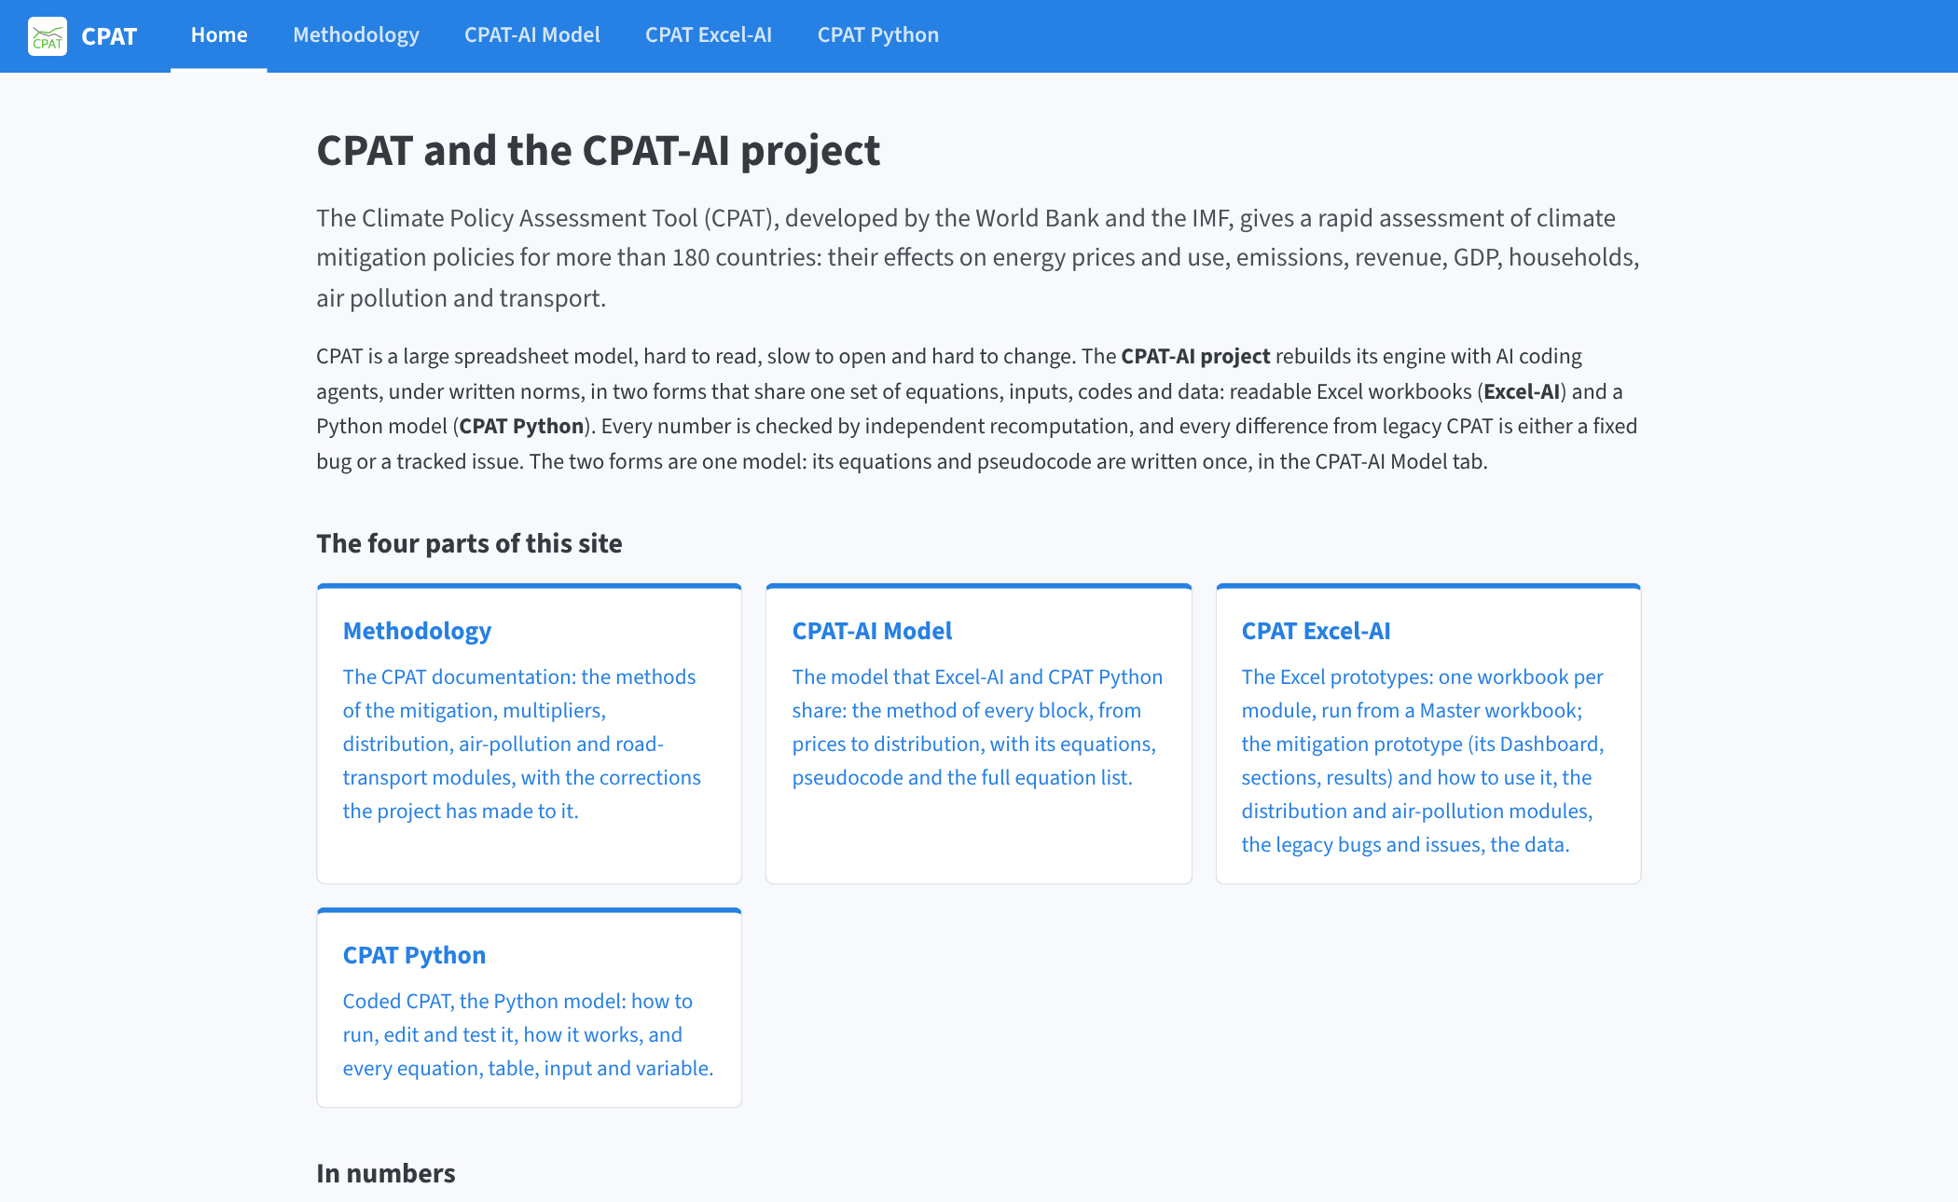
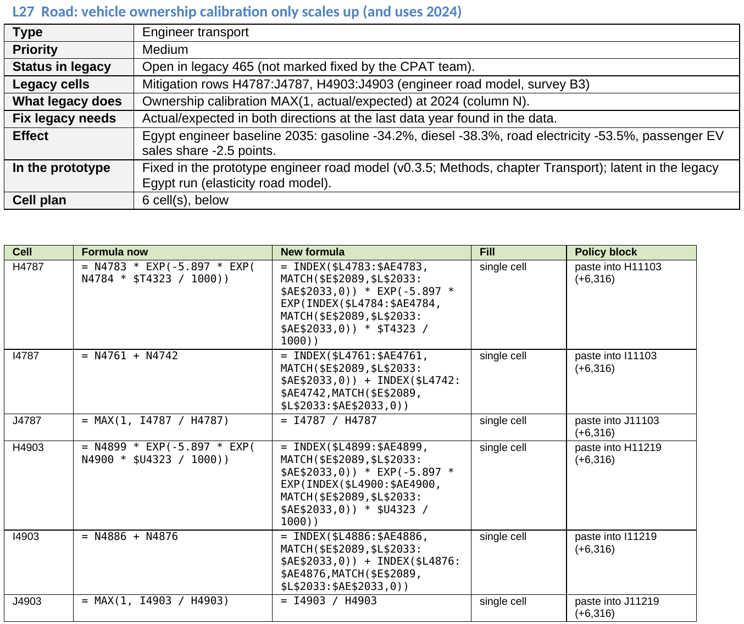
The method on the website; every bug with its cell plan
4 · DOCUMENTATION
The website, cpmodelai.github.io/cpat_ai
Methodology: the CPAT documentation, with the corrections made to it
CPAT-AI Model: every block: equations, pseudocode, Excel and Python
CPAT Excel-AI: the workbooks, the bugs and issues, the data, the slides
The bug book: each bug of CPAT 1.0 with what it does, the fix, its effect and the cell plan (cell, formula now, new formula). The tracker lists every bug and issue; BUGS.md and ISSUES.md come from the same register.
CPAT Python: run, edit and test the Python model
Notes:
Bug book: excel_ai/bugs_and_legacy/Legacy_CPAT_Bugs_v<n>.docx; tracker Tracking_Legacy_Bugs_v<n>.xlsx; QuickStart.docx at the root; the mitigation guide excel_ai/mitigation/docs/Documentation.md.

Slide 17
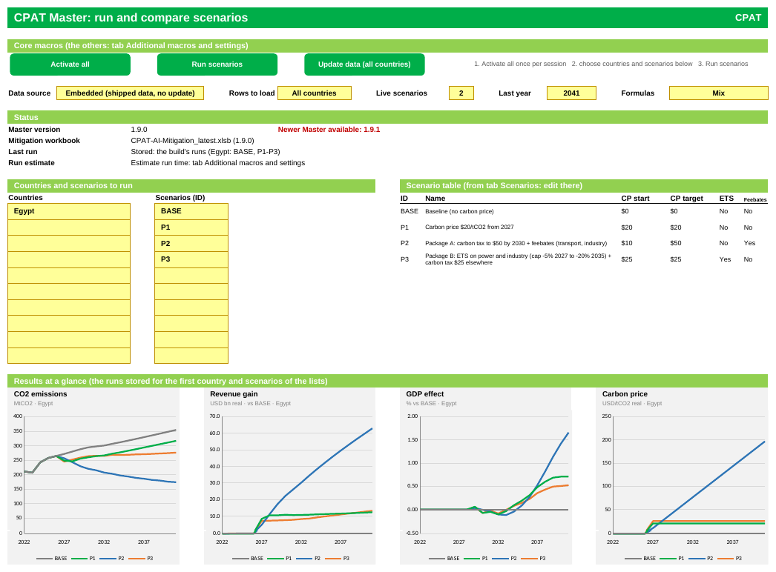
Open the Master, activate, choose, run, read
5 · HOW TO USE IT
1
Open the Master
excel_ai/master/CPAT-AI-MT_latest.xlsm in Excel 365 on Windows; click Enable Content.
2
Activate all
Saves your working copies in active_workbooks/ as .xlsb, filled to 2041; Build unified CPAT makes the one-workbook form.
3
Choose
Countries and scenario IDs (BASE, P1-P3, U1, ...) in the lemon lists; edit a scenario on tab Scenarios.
4
Update data, then Run scenarios
Load the data (one country, or all for a run of many), then run every country with every scenario.
5
Read the results
Live on the Dashboard; stored in Scenario comparison, OneCountry, ManyCountries; save to .csv.
Notes:
active_workbooks/ is yours and git-ignored. Every other macro is on the Master's tab Additional macros and settings, one button each.

Slide 18
Change the builder, check, release: the workbooks are generated
5 · DEVELOPING IT
1
Edit the builder
Python writes each workbook. In development the modules (mitigation, distribution, air pollution) are kept separate, each with its own builder and checks.
2
Run the checks
Every output compared with the last release; all countries; pasted scenarios; the Master; the Python tests.
3
Release
A new version in releases/; the Master joins the modules into the unified CPAT on the user's side.
WORKING ON IT
Python follows the fix: A bug of CPAT-AI is fixed in Excel and never put into Coded CPAT.
Log every task: Each finished task ends with an entry in excel_ai/core/CAVEATS.md; open work in TODO.md.
AI assistants: Any AI starts at AGENTS.md, which routes it to the rules (NORMS.md), TODO and CAVEATS.
Runs anywhere: The builders run on Linux and in the cloud (LibreOffice); the final review is in Excel 365.
Notes:
Builders: excel_ai/mitigation/build.py, distribution/build_distribution.py, master/build_master.py (and its VBA CPATMaster.bas); checks check_quick, check_allcountry, check_paste, check_master; core/tools/release.py.

Slide 19
In the cloud, or on a local copy of the repository
5 · TWO WAYS OF WORKING
Direct to the cloud e.g. Claude Code
On a local copy e.g. GitHub Copilot
How: A cloud session clones the repository from GitHub: nothing to install. You ask in plain words, from a browser or a phone.
How: Clone the repository to your machine with GitHub Desktop; sync before and after your work.
What it does: Edits the builders, runs them and the checks (Python, LibreOffice), and pushes a branch to GitHub.
What it does: Copilot works on your files in VS Code or the Copilot app; you review, commit and push.
Best for: Model and builder changes, checks, documentation, decks.
Best for: Running the Master in Excel 365, real data from the shared drive, the Excel review.
Limits: No Excel there: the macros and the Excel 365 review happen on your machine. Public data only, never real data.
Limits: Your machine's setup; keep real data and workbooks out of commits.
Both meet on GitHub and follow the same rules: any AI starts at AGENTS.md (NORMS, TODO, CAVEATS); work arrives on a branch and joins main when reviewed.
Notes:
Cloud sessions: claude.ai/code (Claude Code on the web) on the cpmodelai repositories; local: other/SetupGuide.docx (GitHub Desktop, CloneRepos.bat and SyncAllRepos.bat from repo-tools, the GitHub Copilot app).

Slide 20
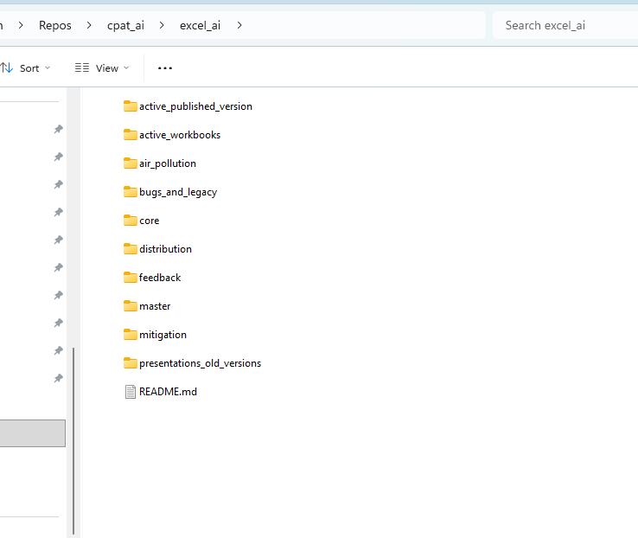
Structure of a Repository
5 · WAYS OF WORKING
Contains activated CPAT (gitignored, as built) and files for the modules

Slide 21
Join the CPAT team on GitHub, then ask the repository
5 · HOW TO COLLABORATE
WHAT YOU NEED (Local Option)
EXAMPLE QUERIES
1
A GitHub account, in the CPAT team
We have a CPAT team in the cpmodelai organisation on GitHub: ask to join it.
“Explain how the retail price of diesel is built up, with the cells.”
“Is this difference from CPAT 1.0 a bug or an issue? Register it.”
“Where does the distribution module get its price changes from?”
“Add a scenario with a $40 carbon price from 2028 and run it for Egypt.”
“What changed in the last release, and did the checks pass?”
2
Git and GitHub Desktop
Clone with CloneRepos.bat (repo-tools); SyncAllRepos.bat before and after your work.
3
Excel 365 on Windows
For the Master's macros; the real data from the shared drive, never committed.
4
An AI assistant (optional)
GitHub Copilot or Claude on your clone; it starts from AGENTS.md.
Not yet set up for Excel binaries on GitHub. Workbooks cannot be merged or compared line by line. Today the Python builders and the VBA text are what we share; the activated .xlsb stay on your machine. Agree who edits a workbook by hand.
WHAT YOU NEED (Claude-Code to Cloud)
1
A GitHub account, and a Claude account
Join the team (in cpmodelai) and get Claude (personal) set up. NEVER upload proprietary data to personal AI.
Notes:
Setup steps in detail: other/SetupGuide.docx. Git LFS or a convention for workbooks edited by hand is an open decision.

Slide 22
What comes next, and what could improve
6 · NEXT STEPS
NEXT
POSSIBLE IMPROVEMENTS
1
Discuss the existing modules with IMF and WB teams
Review the prototype's method and results, then bring it to a first full version.
Split policy settings from model settings
Today both sit on tab Scenarios, read from scenario 1 for some. Policy inputs per scenario; model settings in one table of their own.
2
Air pollution and transport co-benefits
The next modules; real averted deaths in place of the interim ones.
Then expand the policy settings
More policy levers, scenario by scenario, once they stand apart from the model settings.
3
The rest of the IMF-WB interface
The 10 core graphs of a country report.
A user-editable dashboard
Let users choose the tiles and charts, which the builder fixes today.
4
Working together on GitHub
Grow the CPAT team; agree how workbooks edited by hand are shared.

Slide 23
CPAT you can read, check and run fast
CONCLUSIONS
1
Readable
Named rows, settings on the left, macro variables on top, the base year first then one formula per row, LAMBDAs optional: more human readable than CPAT 1.0 in many respects.
2
Correct and documented
232 bugs fixed with cell plans, 136 issues kept and tracked; written rules; the method on the website; the same numbers in Python.
3
Working today
Mitigation, the multi-scenario Master and the unified CPAT are built; the IMF-WB interface is partly in place; distribution awaits expert review.
4
Open to collaborate
Data on the shared drive in CPAT 1.0's layout, one country at a time; the code on GitHub: join the CPAT team.
WB CPAT Team · github.com/cpmodelai/cpat_ai · cpmodelai.github.io/cpat_ai

