Slide 1
Magma Convection in Complex Reservoirs
as Source
of Geophysical Signals.
C. P. Montagna¹, A. Longo¹, M. Vassalli², P. Papale¹,
S. Giudice¹, G. Saccorotti¹
1. Istituto Nazionale di Geofisica e Vulcanologia, Pisa (Italy)
2. Geophysics group, University College Dublin, Dublin (Ireland)
Cities on Volcanoes 6 - Tenerife 2010

Slide 2
Rationale
Mass movements and associated stress changes in volcanic systems translate into variations of geophysical quantities commonly measured at the surface:
gravity field, geochemical parameters, rock deformation
Understanding signals at active volcanoes means gaining the capability to “look into” an active volcano
Physics of volcanoes
Volcanic hazard

Slide 3
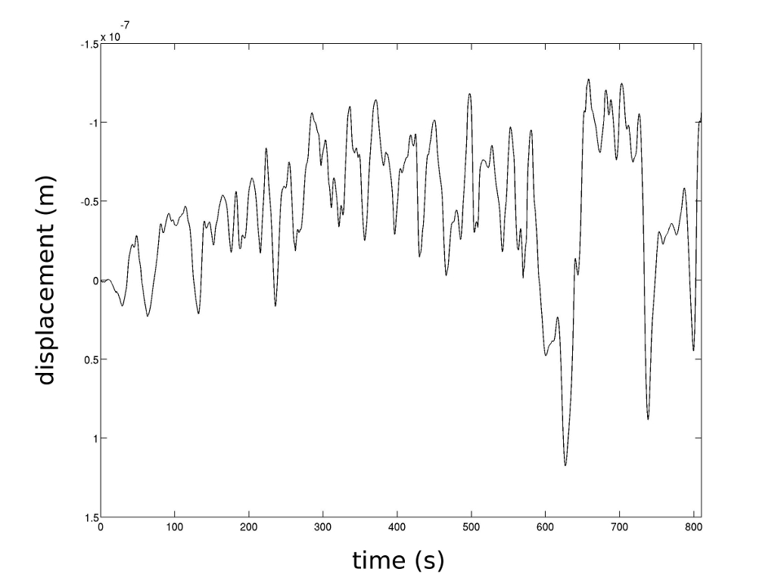
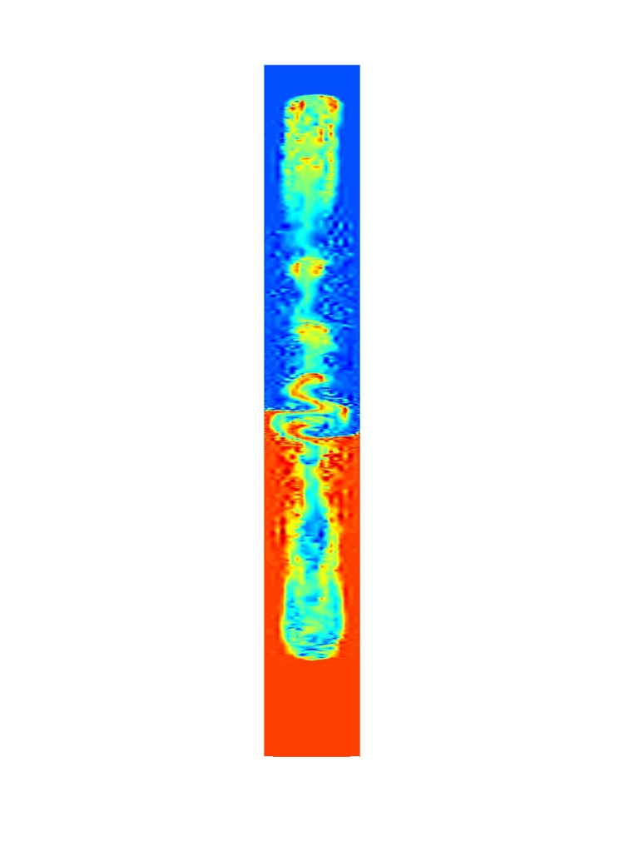
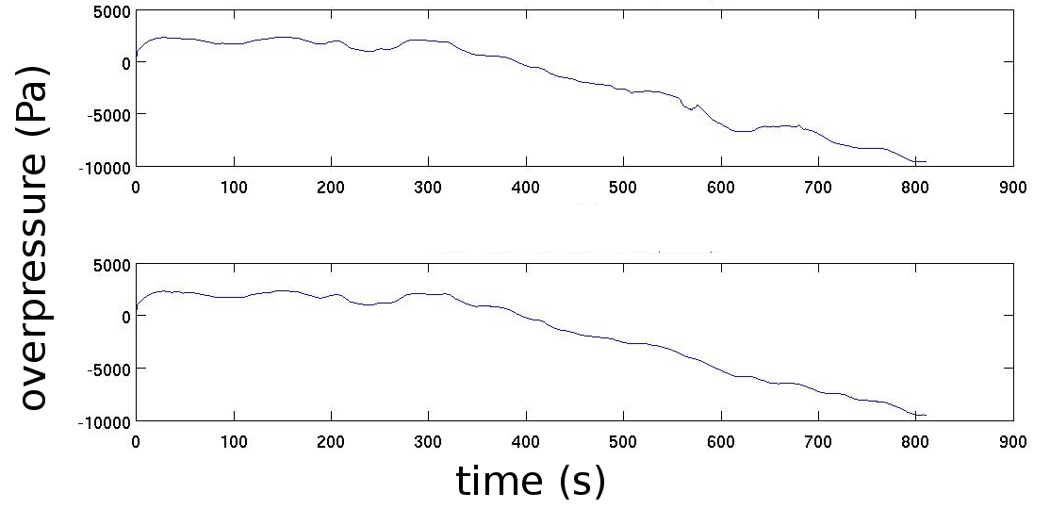
Method
pressure variations produced by magma motion at depth are used as the synthetic sources of ground displacement:
ground displacement
analytical Green function integration
in an homogeneous medium
elasto-dynamics code ELM
(O'Brien and Bean, 2004)
dike
system
pressure signal
fluid dynamical code GALES
(Longo et al. 2006)

Slide 4
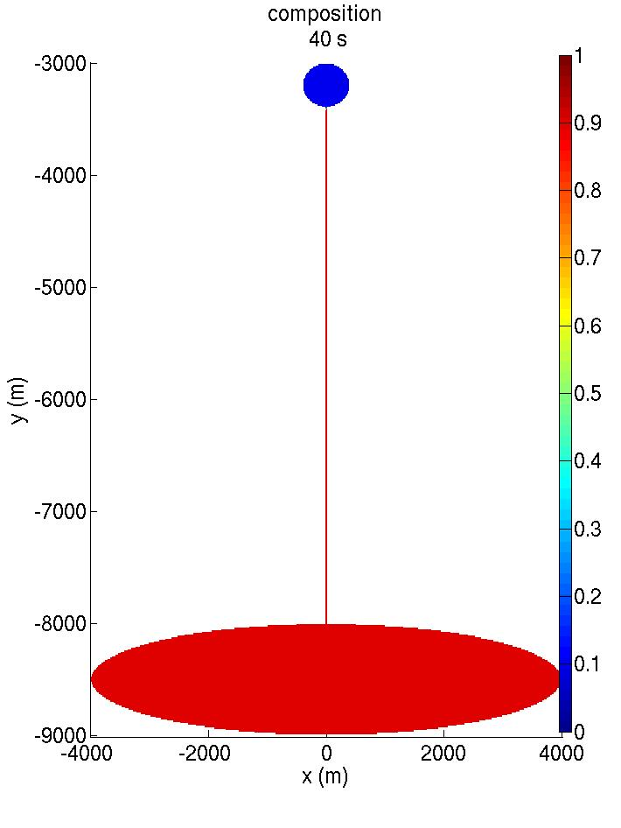
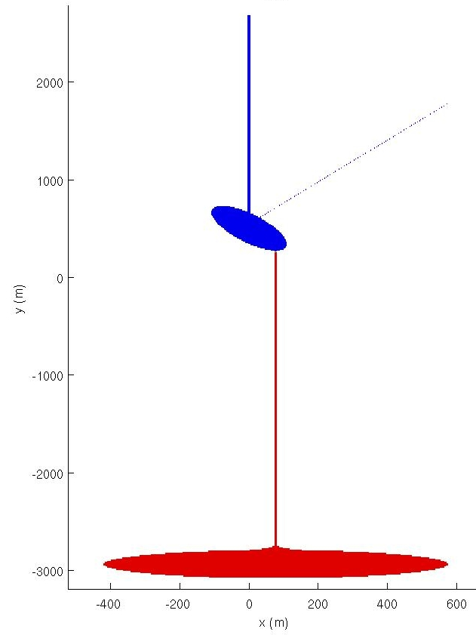
Simulated systems
Campi Flegrei
Etna
Shallow basalt
H₂O 1.5 wt%
CO₂ 0.5 wt%
Deep basalt
H₂O 3.5 wt%
CO₂ 2.0 wt%
p_{t o p} = 70 MPa (3 km)
Volatile poor phonolite
H₂O 2.5 wt%
CO₂ 0.3 wt%
p_{top} = 25 MPa (1 km)
5 gas vol%,
2270 kg/m³
10 gas vol%,
2230 kg/m³
Δρ = 40 kg/m³
Δρ = 550 kg/m³
10 gas vol%,
2250 kg/m³
Volatile rich shoshonite
H₂O 2 wt%
CO₂ 1 wt%
35 gas vol%,
1700 kg/m³
p_{b o t t o m} = 210 MPa (9 km)
p_{b o t t o m} = 120 MPa (6 km)
Exsolution law (Papale et al., 2006)
Viscosity (Giordano et al., 2008)

Slide 5
Campi Flegrei

Slide 6
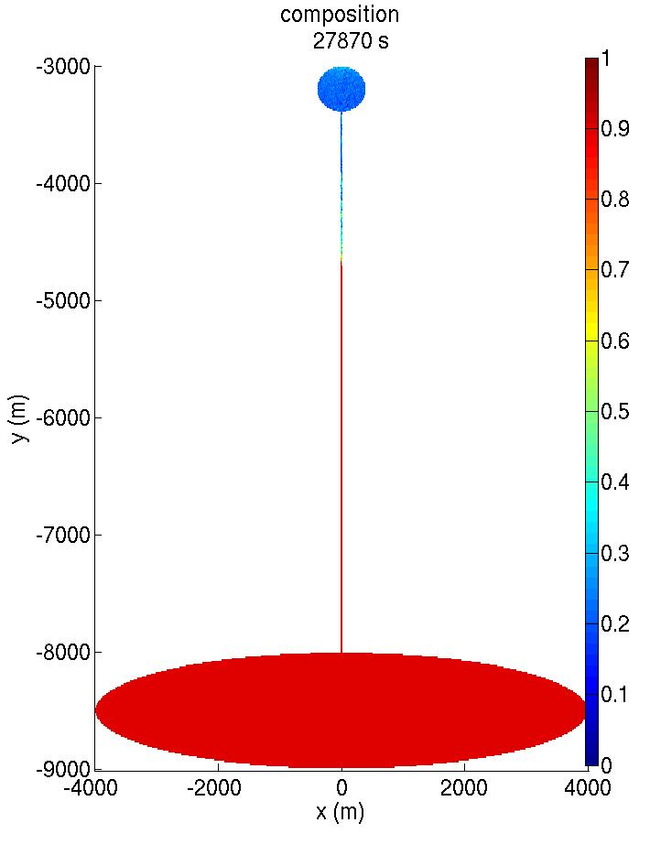
Campi Flegrei
Physical properties at t = 7h 45'
Upper chamber
v max ~1 m/s
~1 km
130 m/h
100 wt% -> ~70 wt% phonolite
density:
2240-2270 kg/m³ -> ~2190-2260 kg/m³
gas content:
6-5 vol% -> ~8-6 vol% gas
Relative mass changes
upper chamber -3 ·10⁻ ³
bottom chamber +3 ·10⁻ ⁵
v max ~ 0.1 m/s

Slide 7
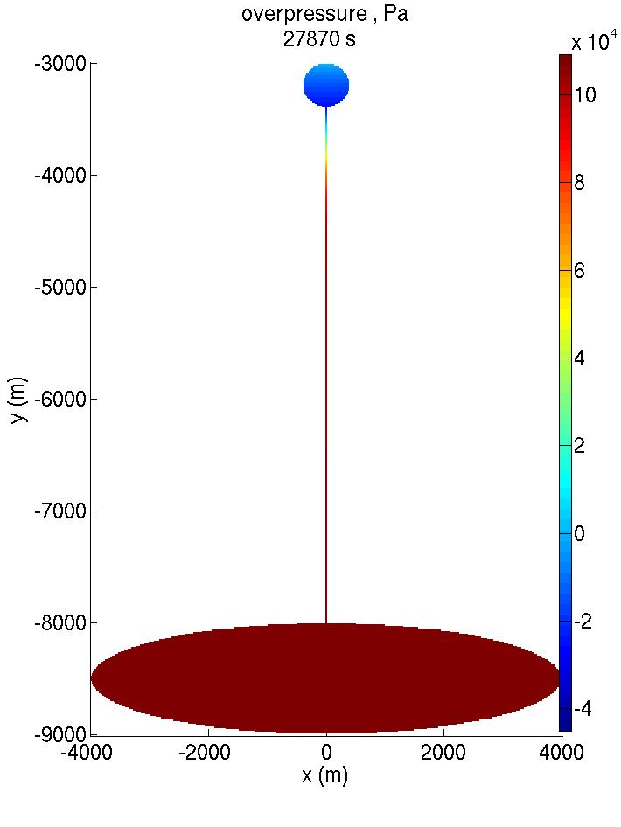
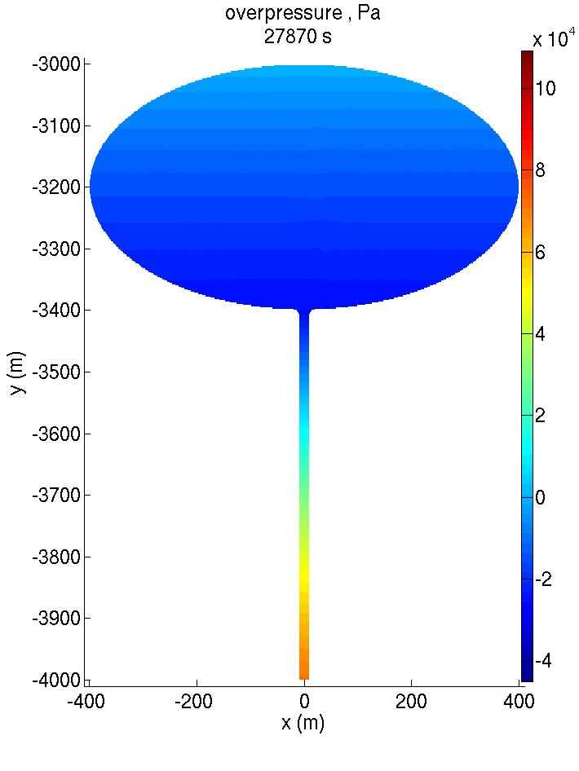
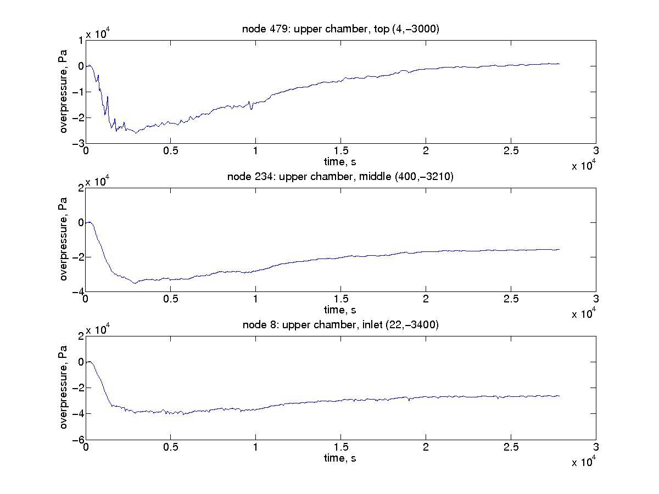
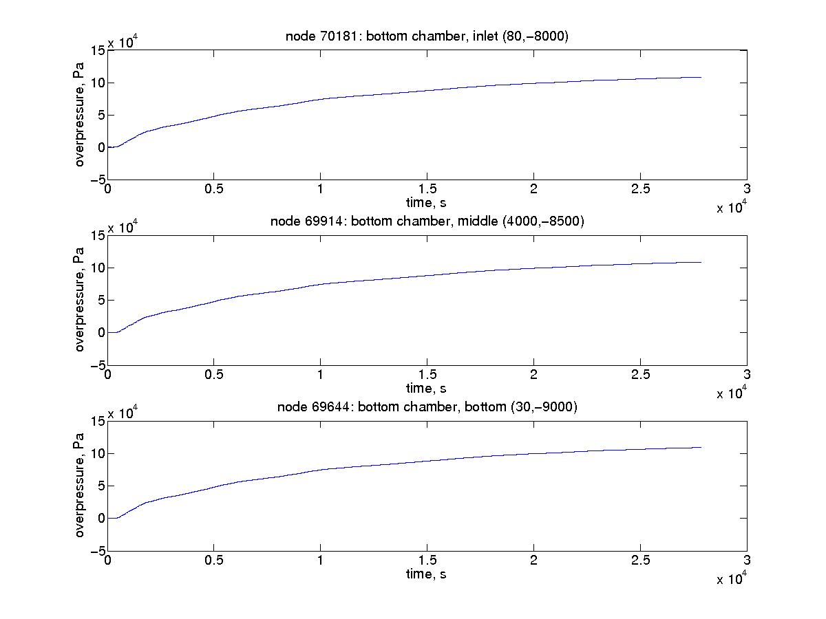
Campi Flegrei
Upper chamber
~ 8 hours
0 Pa
-2 · 10⁴ Pa
-3 · 10⁴ Pa
Lower chamber
+10⁵ Pa

Slide 8
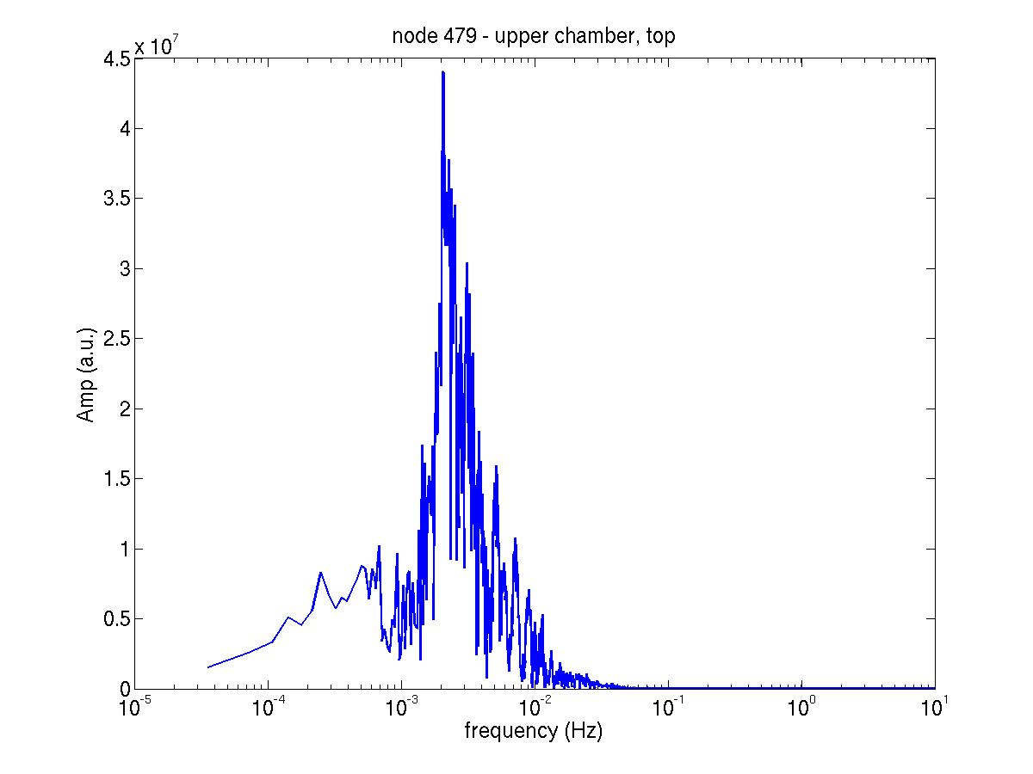
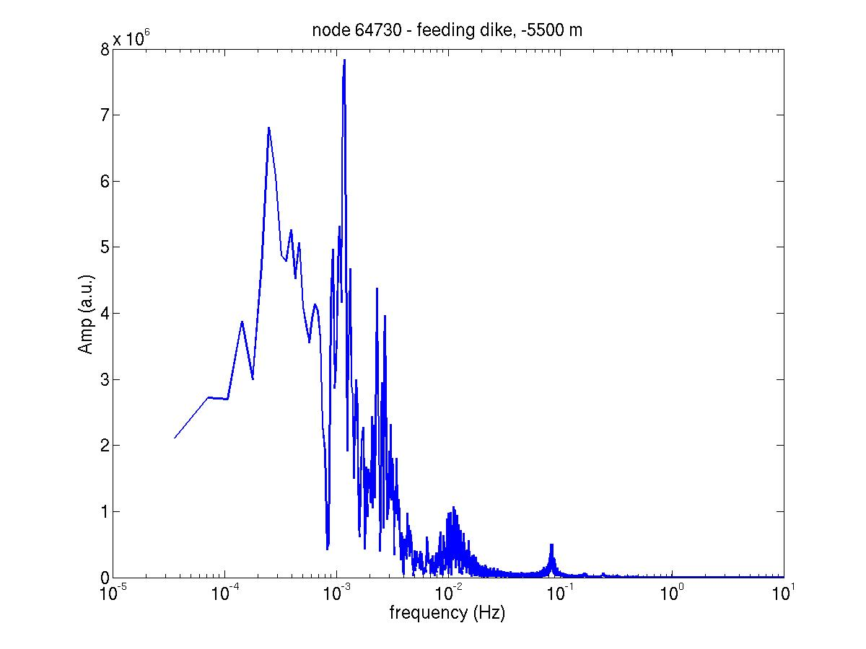
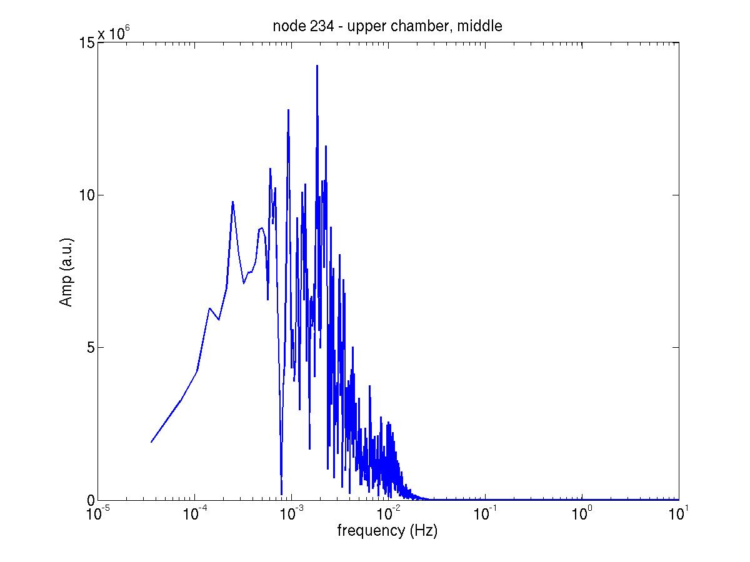
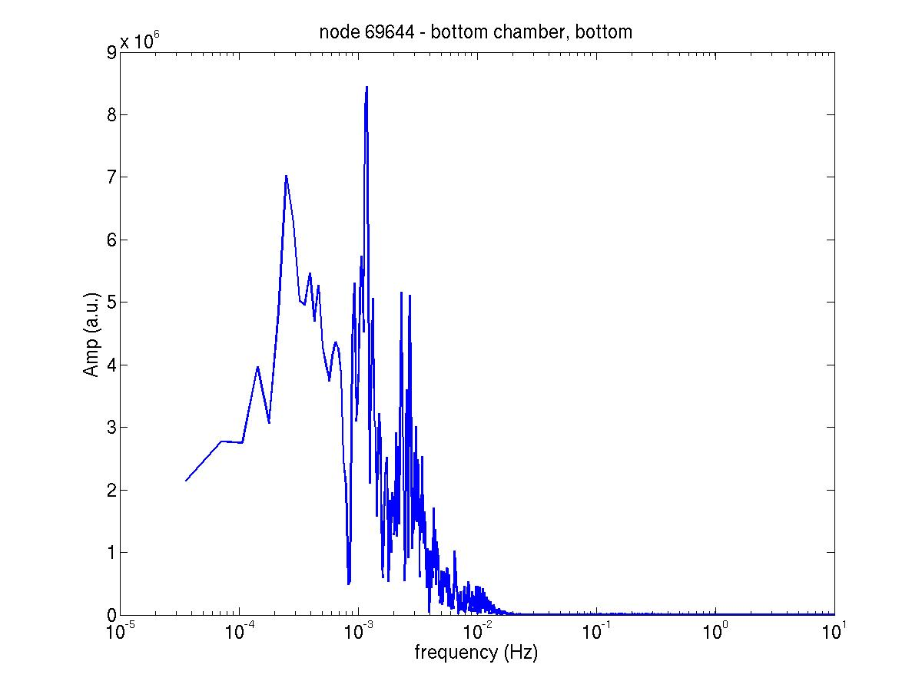
Campi Flegrei
Upper chamber top
Feeding dike
Peak:
0.002 Hz, 500 s
Peaks:
0.001 Hz, 1000 s
0.003 Hz, 330 s
0.01 Hz, 100 s
0.1 Hz, 10s
Upper chamber
middle
Bottom chamber

Slide 9
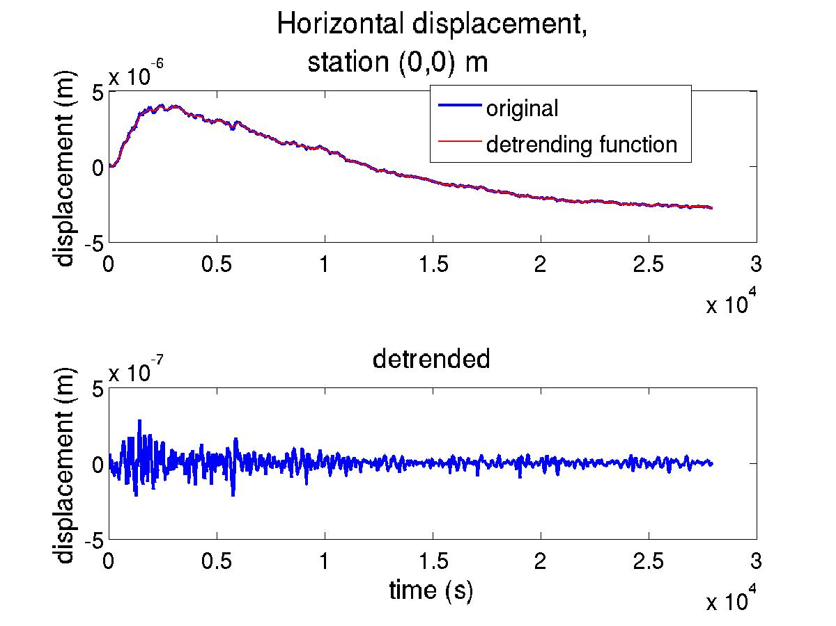
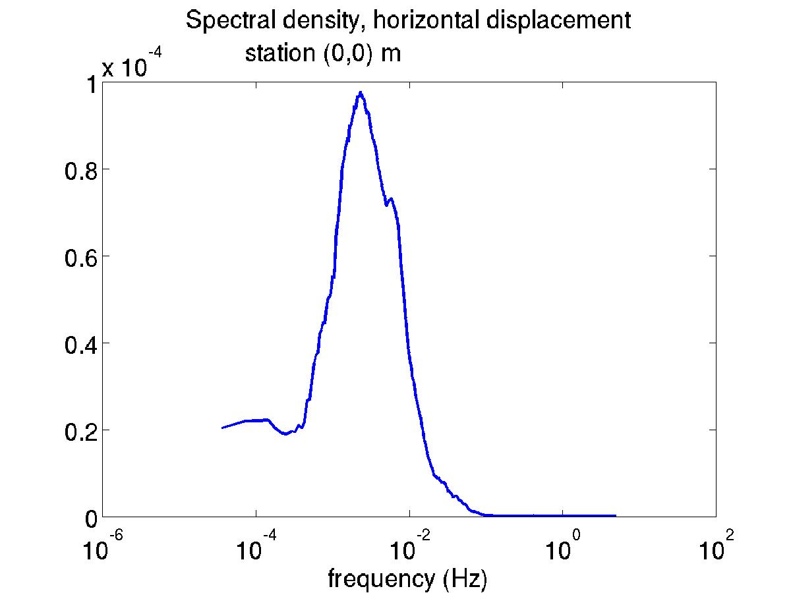
Campi Flegrei
rich in low frequencies

Slide 10
Etna

Slide 11
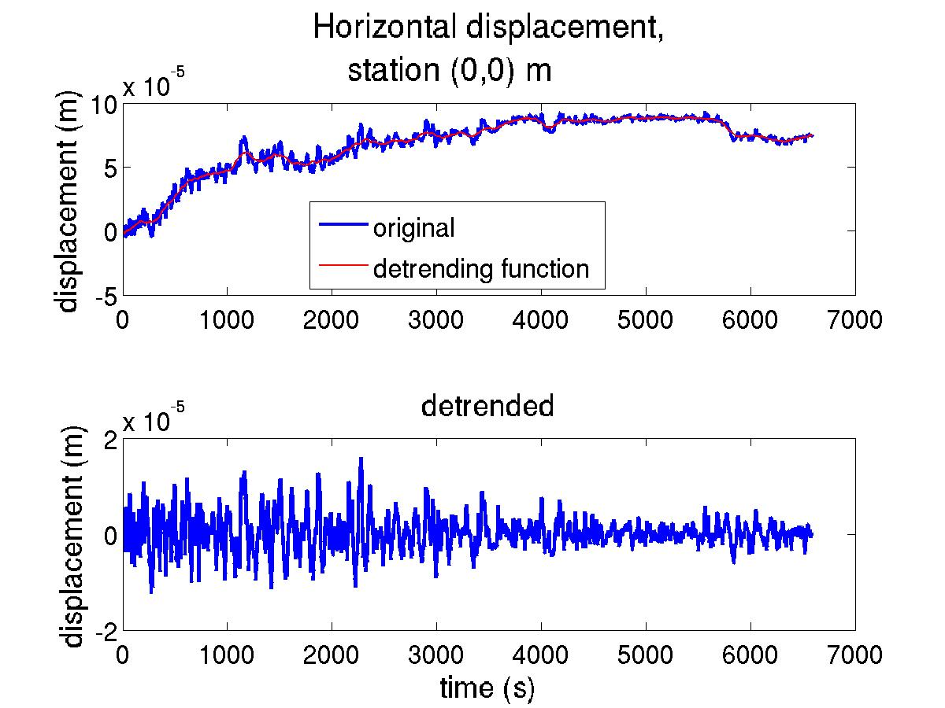
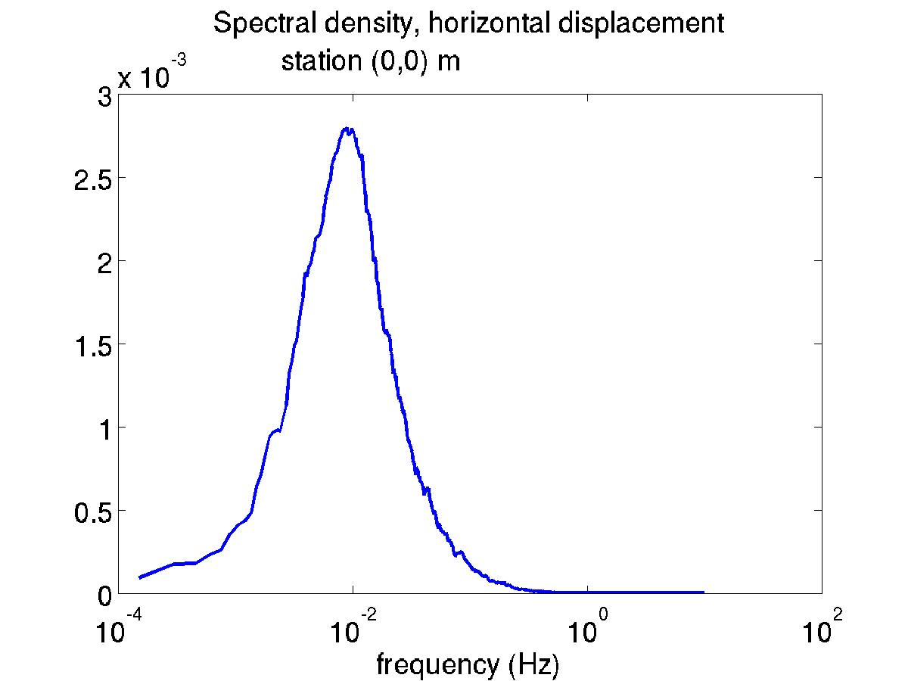
Etna
Low frequencies:
Green's function integration
Highest energy content
periods around 100 s

Slide 12
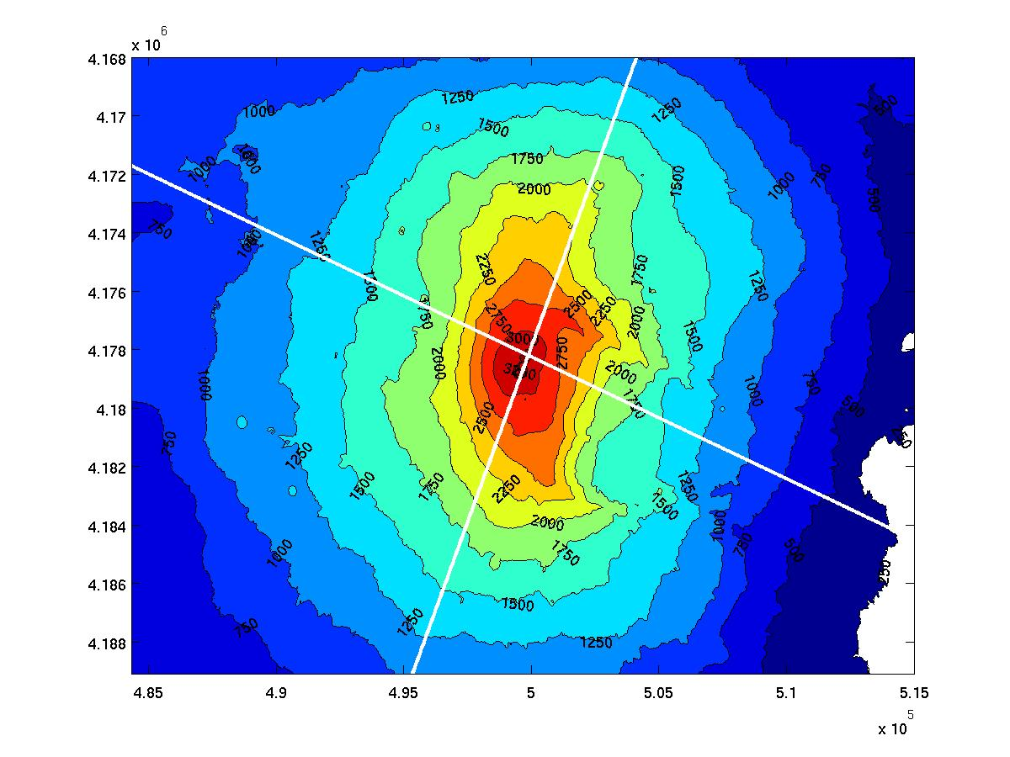
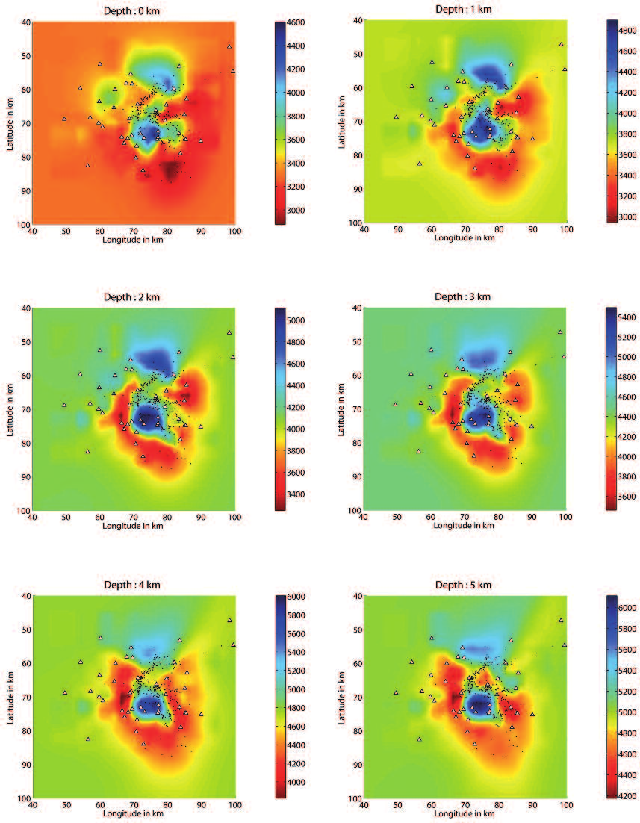
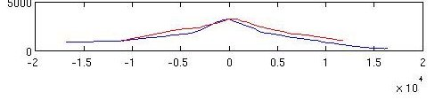
Etna
seismic frequency range:
ELM elastodynamics simulations
topography from DEM
realistic rock density profile
and elastic parameters
Valle del Bove
(m)

Slide 13
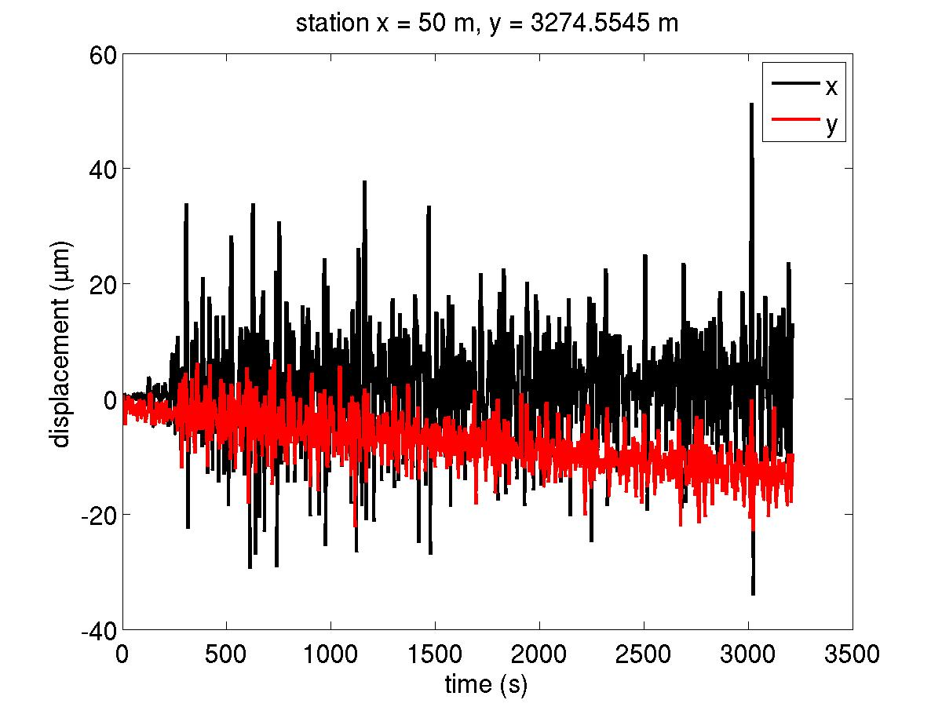
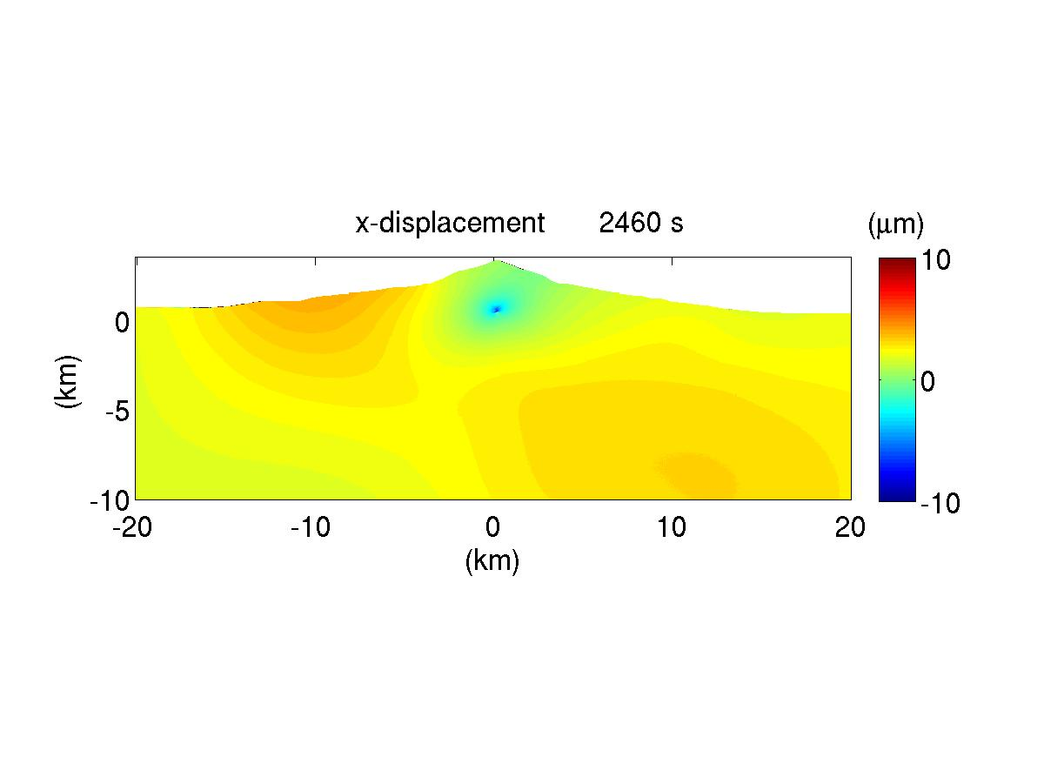
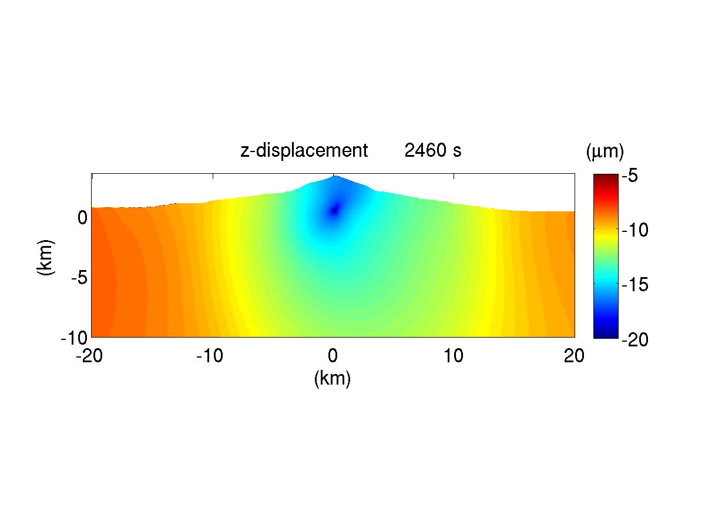
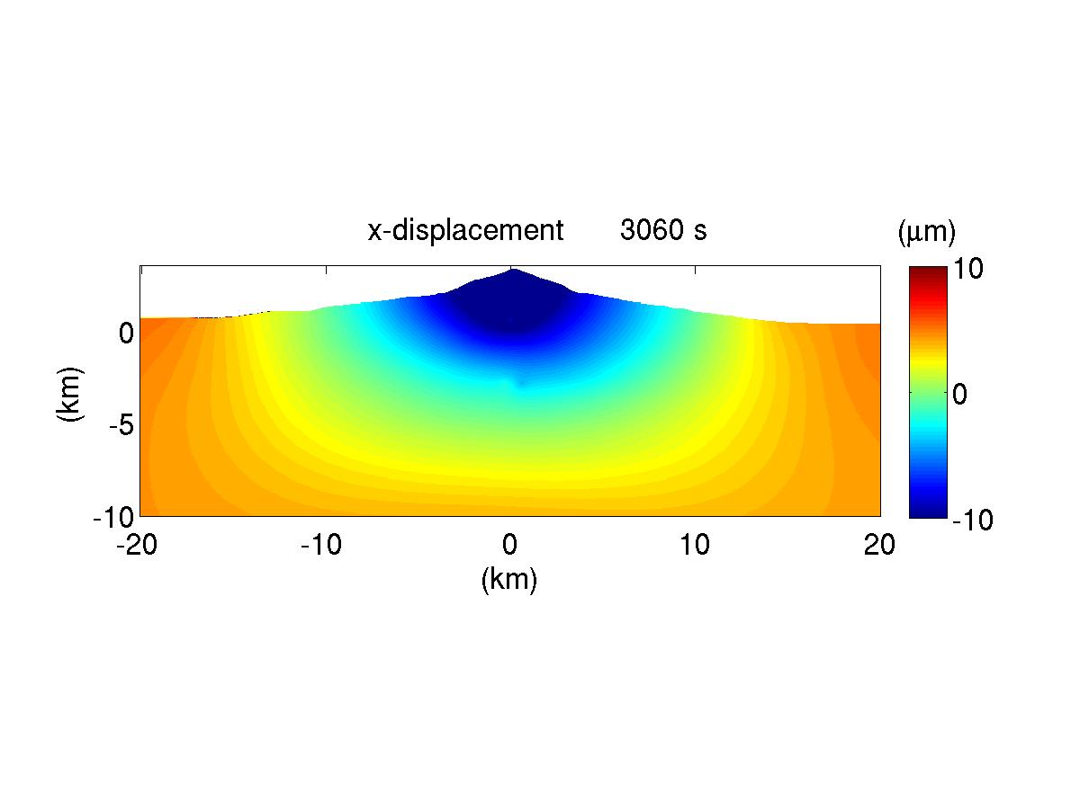
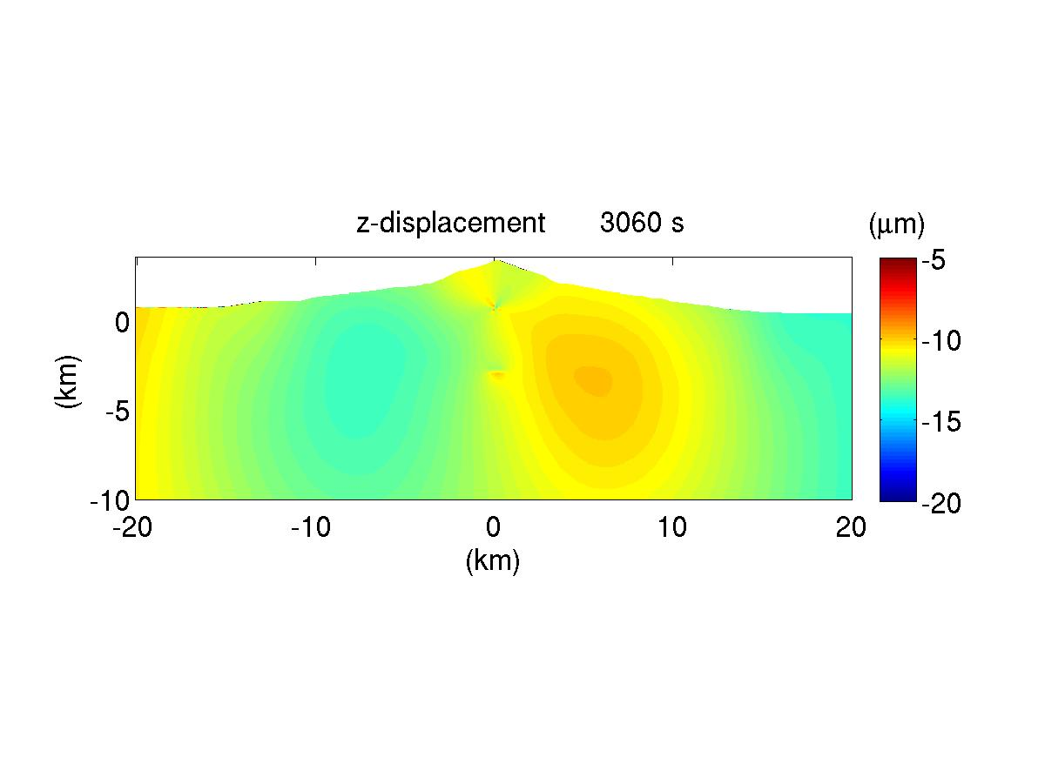
Etna
maximum seismic displacement:
~10 μm
patterns of rock displacements
deformed by heteorgeneities

Slide 14
Conclusions
new magma entering shallow chambers rapidly mixes up with the resident magma and looses its identity, over the time scale of hours
the evolution of pressure can be very complex, with regions of the magmatic system undergoing overall pressure decrease or increase
pressure oscillations emerge, having periods from tens of seconds to hours and amplitude decreasing with increasing oscillation frequency
ground oscillations with periods of tens to hundreds of seconds (ULP) emerge as diagnostic of magma convection and mixing in magmatic reservoirs
energy concentrates
at periods > 100s
→ ULP
CAMPI
FLEGREI
ETNA

