Slide 1
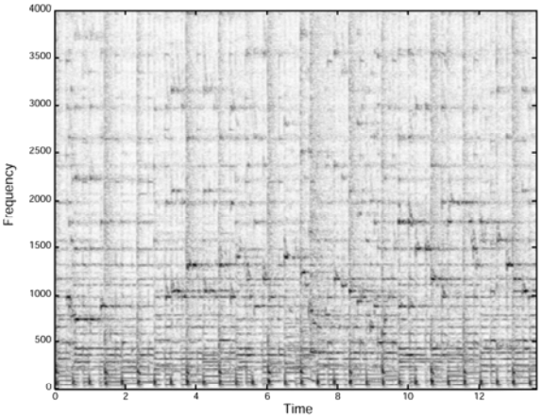
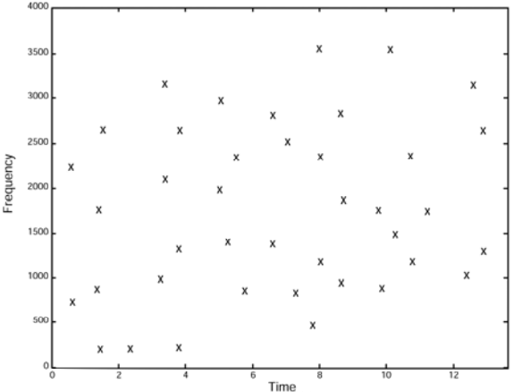
input data
high dimensional vector representation
1
0
1
1
0
0
0
1
0
0
0
0
1
1
0
1
C
.45
.68
.10
.92
sketched representation

Slide 2
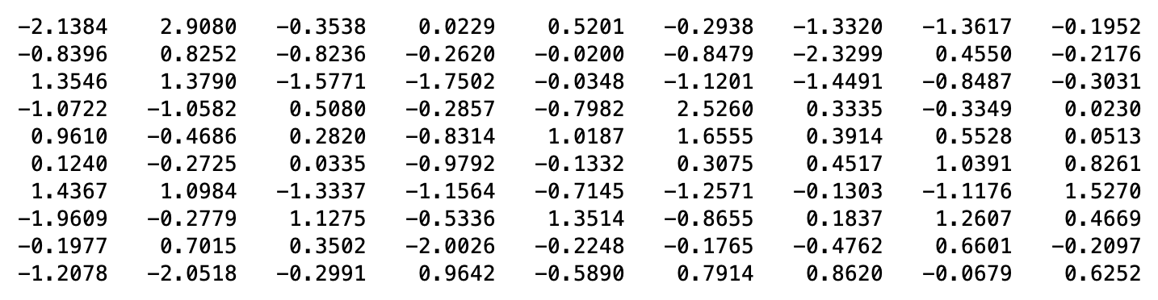

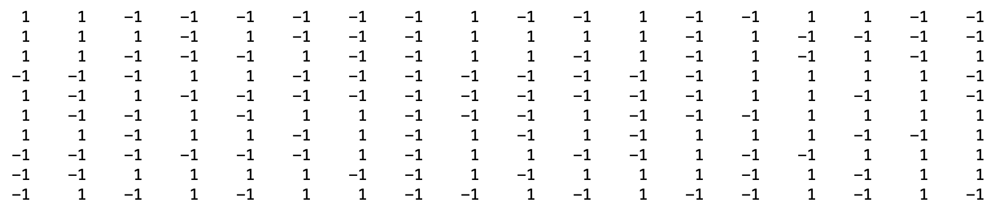


Slide 3
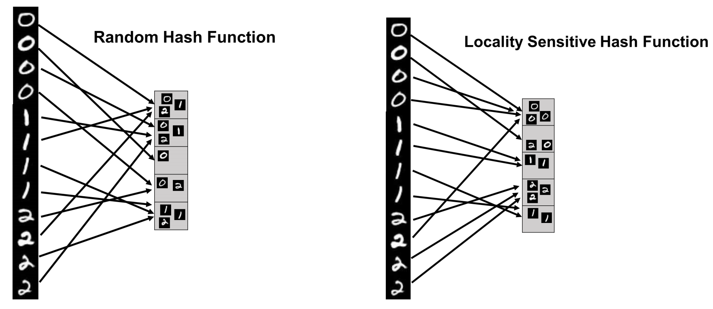

Slide 4
q
1
0
1
1
0
0
0
1
0
0
0
0
1
1
0
1
0
1
c(q)
.12
1
2
h(c(q))
m

Slide 5
r “bands”
q
c₁(q)
c₂(q)
c_{r}(q)
h(c₁(q), c₂(q),..., c_{r}(q))
1
2
m

Slide 6
T₁
r “bands”
c_{1,1}(q)
c_{1,2}(q)
c_{1,r}(q)
T₂
t tables
c_{2,1}(q)
c_{2,2}(q)
c_{2,r}(q)
...
...
...
...
c_{t,1}(q)
c_{t,2}(q)
c_{t,r}(q)
T_{t}

Slide 7
q₁
q₂
q₃
q₄
q₂
q₃
q₁
q₄
T

Slide 8
q₁
q₂
q₃
q₄
...
q₂
q₁
q₄
q₂
q₁
q₄
q₃
q₃
T₁
T_{t}

Slide 9
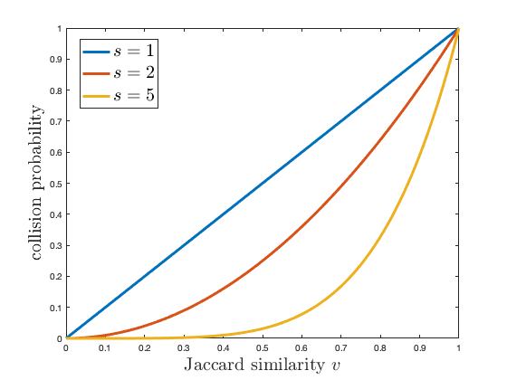

Slide 10
x
x
𝜃
𝜃
y
y
a
a
𝜃
𝜃
b
b

Slide 11
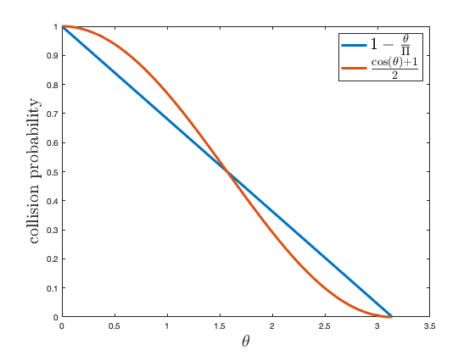

Slide 12
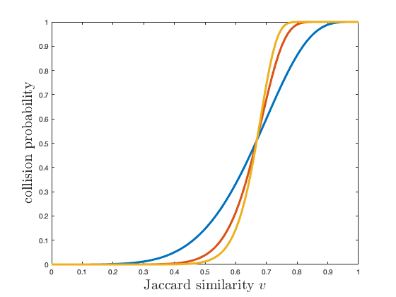

Slide 13
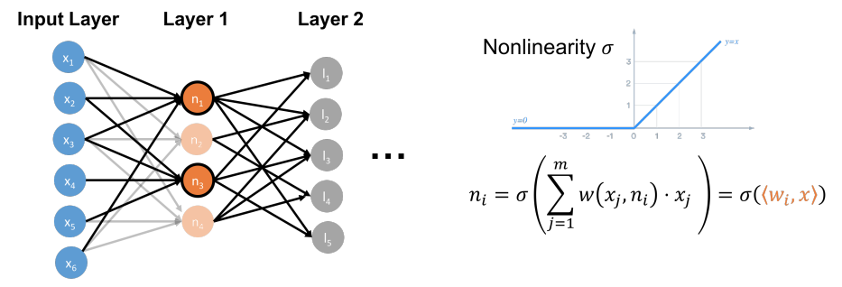

Slide 14
c
s_{i}
=
m
Π
d
q_{i}

Slide 15
O(log(1/𝛿)/ε²)
=
Π
C(x)
d
x

Slide 16
=
compute sign
Π
x

Slide 17
x
y
θ
g

Slide 18
x
y
θ
[1,0]
[0,1]

Slide 19
Uy
θ
Ux

Slide 20
x
y
θ
g

Slide 23
query

Slide 24
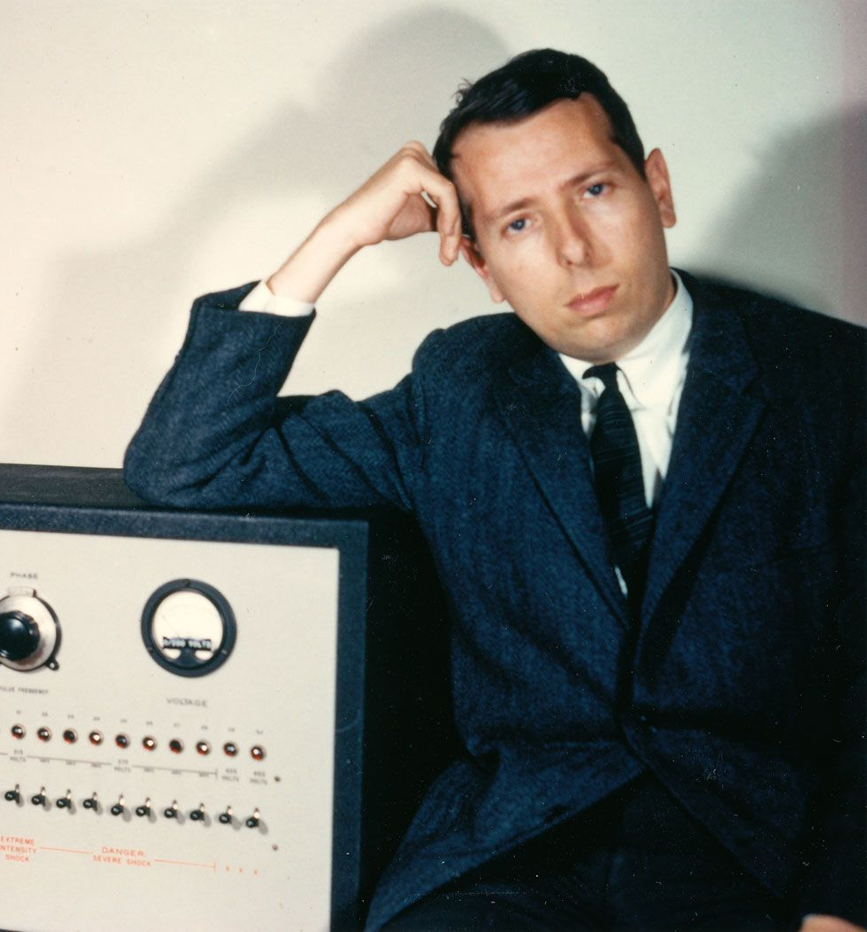
start
query

Slide 25
query

Slide 27
query

Slide 28
query

Slide 32

