Slide 1
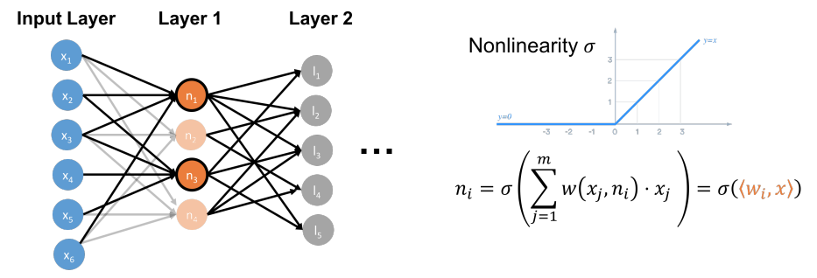

Slide 2
Gradient Descent
Adaptive Methods
Conjugate Gradient
Stochastic Methods
Frank Wolfe
Acceleration
Newton’s Methodç
Cutting Plane Methods
Mirror Descent
Derivative Free Optimization
Interior Point
...

Slide 5
f(x)
f(x)
f(x)
x
x
x
convex
non-convex
non-convex

Slide 6
Level sets of f(x)
v
-∇f(x)
-∇f(x)
x₂
-∇f(x)
x₁

Slide 7
Level sets of L(β)
v
-∇L(β)
β₂
-∇L(β)
β₁

Slide 8
Level sets of L(β)
v
L(β) = 10
L(β) = 9
β₂
β*
L(β) = 8
…
L(β) = 4
β₁

Slide 9
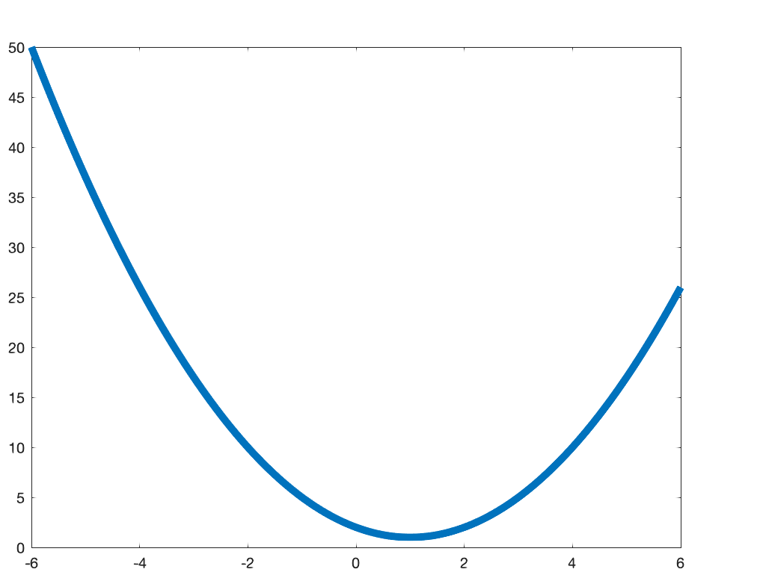
h = (1-𝜆)x + 𝜆y
f(y)
f(h)
f(x)
x
h
y

Slide 10
f(x+z)
f(x)
∇f(x)^{T}z
x
x+z

Slide 11
f(y)
f(x)
∇f(x)^{T}(y - x)
x
y

Slide 13
x
P_{S}(x)
f(y)
f(x)
h
y

