Slide 1
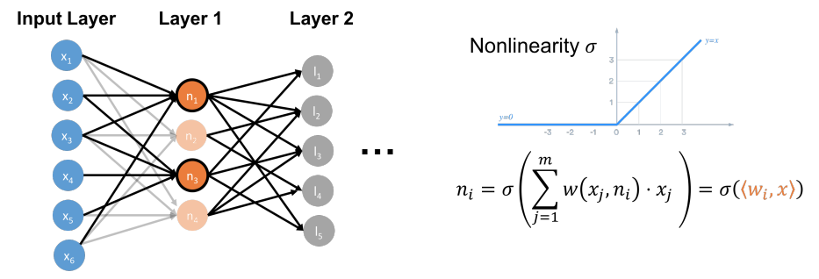

Slide 2
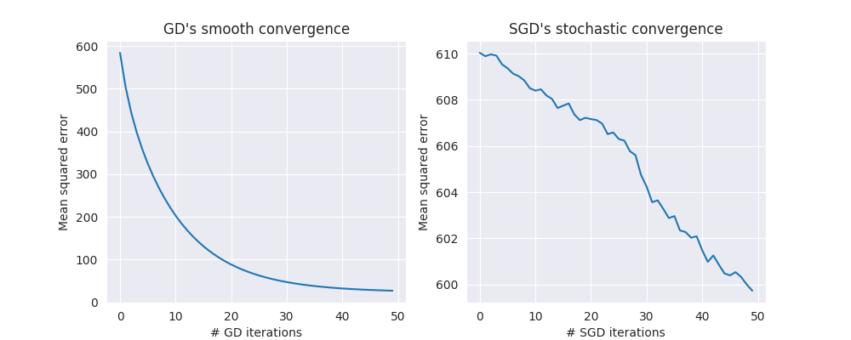
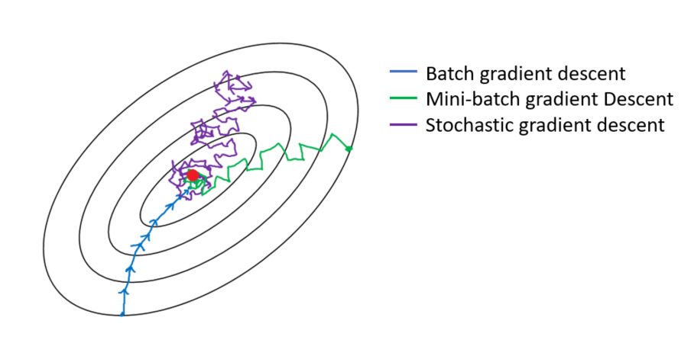

Slide 4
b

Slide 5
a₁
a₂
...
a_{d}
x
A
b

Slide 6
d
eigenvectors
eigenvalues
eigenvectors
λ₁
λ₂
d
H
=
V
Λ
V^{T}
λ_{d-1}
λ_{d}
v₁
v_{d}
v₂

Slide 7
f_{a}
f_{b}

