Slide 1
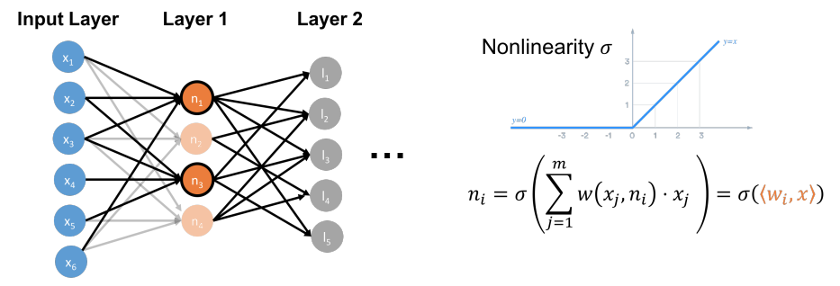

Slide 2
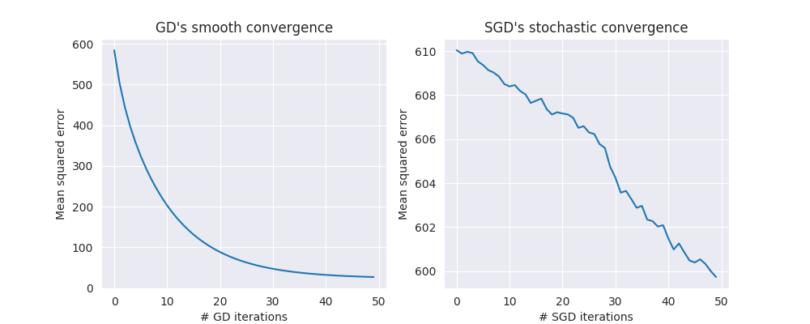
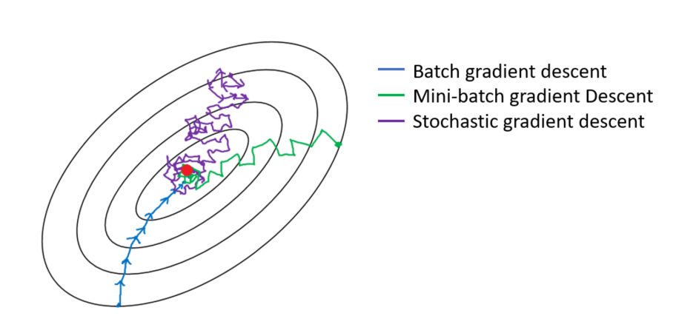

Slide 3
constraint set S
level sets of f(x)

Slide 4
b

Slide 5
a₁
a₂
...
a_{d}
x
A
b

Slide 6
d
eigenvectors
eigenvalues
eigenvectors
λ₁
λ₂
d
H
=
V
Λ
V^{T}
λ_{d-1}
λ_{d}
v₁
v_{d}
v₂

Slide 7
S
^{(1-𝛿)x*}
S^{𝛿}

Slide 8
^{y}
K
H

Slide 9
B(c_{R},R)
K
B(c_{r},r)

Slide 10
B(c_{R},R)
K
B(c_{r},r)

Slide 11
B(c_{R},R) = E₁
c_{R}
K
B(c_{r},r)
E₂

Slide 12
{x: ∥I(x-c)∥ < 𝛼}
{x: ∥D(x-c)∥ < 𝛼}
{x: ∥A(x-c)∥ < 𝛼}
c
c
c

Slide 13
S^{𝛿}

Slide 14
S₁
S₃
S^{𝛿}
S₂

Slide 15
S₁
c₁

Slide 16
∇f(c₁)
S₁
c₁

Slide 17
∇f(c₁)
S₁
c₁
H
S₂

Slide 18
Ax ≥ b
c

Slide 19

A.Y. Levin 1975
D.J. Newman 1975

